Slide 1
Unit 4
Memory and Basic Processor Interfaces
EL-GY 9463: Introduction to Hardware Design
ProfS. Sundeep Rangan, Siddharth Garg

Slide 2
Learning Objectives
Skill | You will be able to
Size memory for a data stream | Compute data rate, capacity and the number of memories, and choose registers, block memory or external memory
Compute memory addresses | Convert between word and byte addresses, split a global address into a local one, and lay out a register map
Identify bus master and slave | Say which party initiates a transaction, whichever way the data flows
Time a valid/ready handshake | Work out the cycle a transfer happens on, including when the receiver is busy
Analyze AXI4-Lite transactions | Time reads and writes across the AW, W, B, AR and R channels
Build an IP with AXI4-Lite registers | Write the Vitis HLS signature and s_axilite pragmas, and state the registers they produce
Determine the limiting resource | Compare the time spent moving data against the time spent computing
Each skill is assessed by problems in the LLM grader.

Slide 3
Outline
Random Access Memory and Memory-Mapped Registers
Processor Interfaces with AXI4-Lite
Implementing AXI4-Lite Interface in Vitis HLS

Slide 4

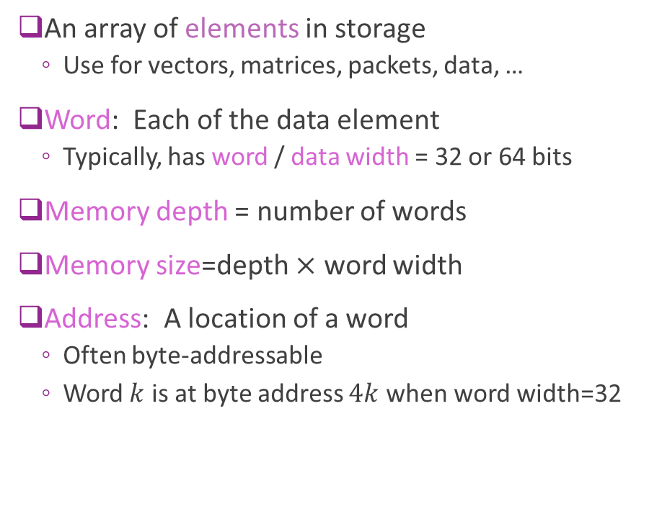


Addressable Memory
An array of elements in storage
  Use for vectors, matrices, packets, data, …
Word: Each data element
  Typically, has word / data width = 32 or 64 bits
Memory depth = number of words
Memory size=depth $×$ word width
Address: A location of a word
  Often byte-addressable
  Word $k$ is at byte address $4k$ when word width=32
Byte address
Data
0
Word 0
4
Word 1
8
Word 2
$$4(N−1)$$
Word $N−1$
Example 32-bit memory with $N$ depth

Slide 5
Byte vs. Word Addressing
Word address: counts words: 0, 1, 2, …
Byte address: counts bytes
  A 𝑊-bit word spans 𝑊/8 byte addresses
  Word 𝑘 starts at byte 4𝑘 (32-bit) or 8𝑘 (64-bit)
A byte address splits into two fields
  Low log₂(𝑊/8) bits: the byte within the word
  Remaining bits: the word index
Processor buses, including AXI, use byte addresses
  even when every access is a whole word
32-bit memory, byte-addressable
Word
Byte addresses
0
0
1
2
3
1
4
5
6
7
2
8
9
10
11
⋮
𝑘
4𝑘
4𝑘+1
4𝑘+2
4𝑘+3
A 32-bit byte address
word index
bits 31–2
byte
1–0
e.g. 0x14 → word 5, byte 0

Slide 6
Byte and Word Addresses
PRACTICE
A memory stores 64-bit words and is byte-addressable: byte address 0 is the first byte of word 0, and each word occupies consecutive byte addresses.
(a) What is the byte address of word 13? Give it in decimal and in hexadecimal.
(b) Which word contains byte address 0x5C, and at which byte offset within that word?
(c) The memory has a depth of 4096 words. How many address bits are needed with byte addressing? How many with word addressing?
64-bit words: 8 bytes each
0
0
1
2
3
4
5
6
7
1
8
9
10
11
12
13
14
15
⋮
Word 13 starts at byte ?
Also in the LLM grader: Unit 4 › Byte and word addresses

Slide 7
Byte and Word Addresses
SOLUTION
(a) 8 bytes per word, so word 13 starts at 13 × 8 = 104 = 0x68
(b) 0x5C = 92 = 8 × 11 + 4 → word 11, byte 4
word = addr >> 3 byte = addr & 0x7
(c) Word addressing: 4096 = 2¹² words → 12 bits
Byte addressing: 4096 × 8 = 2¹⁵ bytes → 15 bits
The extra 3 bits select the byte within the word
A byte address, 64-bit words
word index
bits 14–3
byte
2–0
Common error
Using 4 bytes per word, the 32-bit habit, gives 52, word 23 and 14 bits.
Also in the LLM grader: Unit 4 › Byte and word addresses

Slide 8
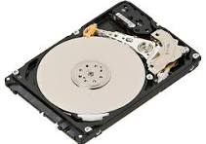
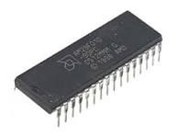
Sequential vs Random Access
Sequential Access
  Access time depends on position
  You must move through data in order
  Ex: Hard disks (seek + rotation)
  FIFO queues (logical sequential access)
Random access
  Any element can be accessed in constant time
  SRAM (on chip block memory, FPGA BRAM)
  DRAM (external memory)
  Register files (architecturally random access)

Slide 9
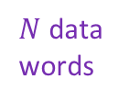
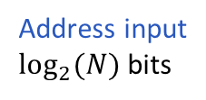

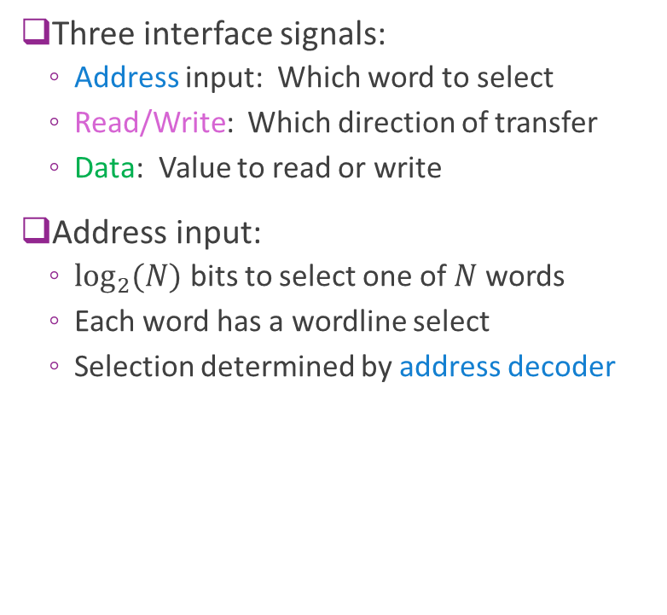


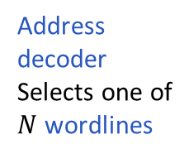
Typical RAM Architecture
Data
Bus
Three interface signals:
  Address input: Which word to select
  Read/Write: Which direction of transfer
  Data: Value to read or write
Address input:
  $\log_{2}{(N)}$ bits to select one of $N$ words
  Each word has a wordline select
  Selection determined by address decoder
$N$ data
words
R/W
$N$ wordlines
Address input
$\log_{2}{(N)}$bits
$$⋮$$
$$⋮$$
Address
decoder
Selects one of
$N$ wordlines

Slide 10
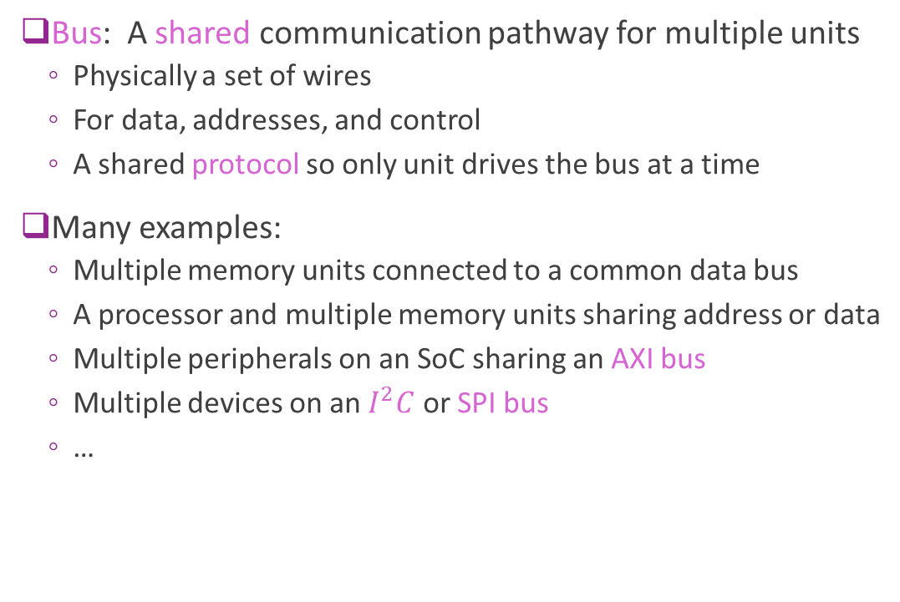
Bus
Bus: A shared communication pathway for multiple units
  Physically a set of wires
  For data, addresses, and control
  A shared protocol so only one unit drives the bus at a time
Many examples:
  Multiple memory units connected to a common data bus
  A processor and multiple memory units sharing address or data
  Multiple peripherals on an SoC sharing an AXI bus
  Multiple devices on an $I^{2}C$ or SPI bus
  …
Bus

Slide 11
Address Maps
Modules on a shared bus share one global address space
Each module gets a base address and a size
  Size a power of two; base aligned to the size
Local address: the offset within a module
  Global address = base + local address
  The module's decoder sees only the local address
Decoding a global address
  Upper bits select the module
  Lower bits are the local address
Example address map (not to scale)
0x0000_0000
DDR
1 GB
0x3FFF_FFFF
0x4000_0000
BRAM
8 KB
0x4000_1FFF
0x4001_0000
IP registers
4 KB
0x4001_0FFF
Global 0x4000_0104 → BRAM
local = 0x4000_0104 − 0x4000_0000 = 0x104
Vitis also says “global memory” for off-chip DDR, a different meaning.

Slide 12
Global and Local Addresses
PRACTICE
A processor bus uses 32-bit byte addresses. Three modules share it, each occupying a contiguous range of the global address space that starts at its base address.
(a) What global address does the processor use to access word 100 of Memory B?
(b) The processor reads global address 0x0000_2A0C. Which module responds? What is the local byte address, and which local word is it?
(c) What is the highest global address that belongs to Memory B? How many bits does Memory B need for its local byte address?
Module | Base address | Size
Memory A | 0x0000_0000 | 16 KB
Memory B | 0x0001_0000 | 64 KB
IP registers | 0x0002_0000 | 256 B
Both memories store 32-bit words.
1 KB = 1024 bytes.
Local address: offset from the module's base address
Global address = base + local address
Also in the LLM grader: Unit 4 › Global and local addresses

Slide 13
Global and Local Addresses
SOLUTION
(a) Word 100 → local byte 100 × 4 = 400 = 0x190
Global: 0x0001_0000 + 0x190 = 0x0001_0190
(b) Memory A spans 0x0000_0000–0x0000_3FFF (16 KB = 0x4000)
0x2A0C falls inside → Memory A, local byte 0x2A0C (10764)
Local word = 0x2A0C / 4 = 0xA83 = 2691
(c) 64 KB = 0x1_0000 bytes → B ends at 0x0001_FFFF
Local byte addresses 0x0000–0xFFFF → 16 bits
0x0000_0000
Memory A · 16 KB
0x2A0C is here
0x0000_3FFF
0x0001_0000
Memory B · 64 KB
word 100 at local 0x190
0x0001_FFFF
0x0002_0000
IP registers · 256 B
Also in the LLM grader: Unit 4 › Global and local addresses

Slide 14

High Impedance
Method to share a common bus
  One unit drives a value $V$ on the bus
  Other units go into a high-impedance state, denoted $Z$
  High impedance units are disconnected
  Bus value= $V$
Sometimes called Tri-State
  Each bit is 0, 1 or Z
Bus
A
B
C
A | B | C | Bus Value | Remarks
Z | 15 | Z | 15 | B drives bus
41 | Z | Z | 41 | A drives bus
Z | Z | Z | X | No driver- no reliable value
32 | 78 | Z | X | Collision of A, B – no reliable value Protocols will avoid this condition

Slide 15

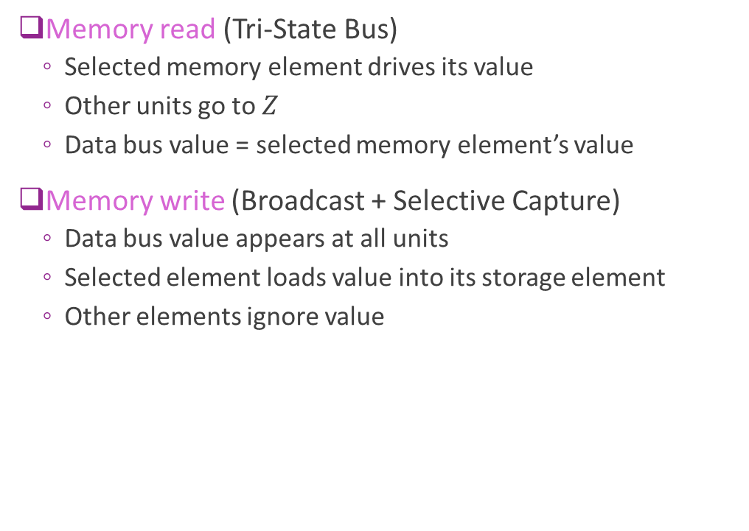
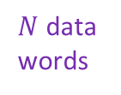

High Impedance on a Data Bus
$N$ data
words
Data
Bus
Memory read (Tri-State Bus)
  Selected memory element drives its value
  Other units go to $Z$
  Data bus value = selected memory element’s value
Memory write (Broadcast + Selective Capture)
  Data bus value appears at all units
  Selected element loads value into its storage element
  Other elements ignore value
R/W
$$⋮$$
$$⋮$$

Slide 16
External vs. Internal Memory
Processing
Hardware
External memory
Off-chip
High capacity (GBs)
But need I/O to process
Internal memory
On-chip
Low capacity (KB-MB)
Direct access to processing
Low latency

Slide 17
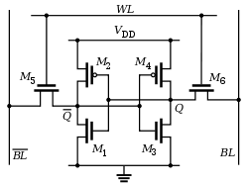
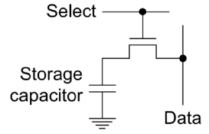
External vs. Internal Compared
Feature | Internal memory (SRAM) | External memory (DRAM)
Location | On-chip | Off-chip
Storage cell | 6-T cell (cross-coupled inverters) | Capacitor + access transistor
Density | Low | High
Capacity | Small (KB–MB) | Large (GB)
Speed | Very fast | Slower
Power | Higher static | Lower static, higher dynamic
Access | Direct by logic | Through a memory controller
Refresh | No | Yes
SRAM cell
DRAM cell

Slide 18
Example On-Chip Memory Sizes
Platform | On-chip memory | Typical size | Notes
Laptop CPU (Intel Core) | SRAM (L1/L2/L3) | 20–40 MB | L3 dominates; very fast
NVIDIA A100 GPU | SRAM (L2 cache) | ~40 MB | HBM2e (40–80 GB) is off-chip, on-package
Xilinx Virtex-7 FPGA | BRAM (36 Kb blocks) | 2–6 MB | Distributed across the fabric
Custom ASIC (5 mm², 16 nm) | SRAM | 5–10 MB | Depends on layout and redundancy
Lesson: internal memory is limited. Use it judiciously.
A 16 nm 6-T high-density bitcell is about 0.07 µm² (TSMC 128 Mb SRAM, ISSCC 2014), so 5 mm² of bitcells holds ≈ 70 Mbit — roughly 5–7 MB once decoders and sense amplifiers are counted.

Slide 19
Example: Video
A video processor stores 8 frames of raw video
  512 × 512 pixels, 3 color channels, 8 bits per channel
Memory capacity
  𝐵 = 512 × 512 × 3 × 8 bytes = 3·2²¹ bytes ≈ 6.3 MB
  A sizeable portion of memory, even on a large chip
Stored as 32-bit words
  𝑁 = 𝐵/4 = 3·2¹⁹ ≈ 1.57 M words
Address bits: the smallest K with 2^{K} ≥ the count
  Byte addressing: 2^{K} ≥ 3·2²¹ → K = 23
  Word addressing: 2^{K} ≥ 3·2¹⁹ → K = 21
512 × 512 × 3
one frame
8 frames
6.3 MB
23 bits
capacity
byte address

Slide 20

Registers vs. Block Memory
We have seen two storage types
Registers
  Typically implemented as flip-flops
  Useful for small, individual data pieces
  Control registers, intermediate calculations, …
Block memory
  Typically, DRAM or SRAM
  Ideal for large arrays
  Vectors or arrays
Registers
$$⋮$$
Block memory

Slide 21

Memory Mapped Registers
Registers can also be memory-mapped
  Connected to their own address decoder
  Determines which register to read/write
Common interface to processor
  Processor sees registers & block memory together
  One continuous address space
ADDR
bus
Register
address
decoder
Data
bus
Registers
Block mem
address
decoder
$$⋮$$
Block memory

Slide 22





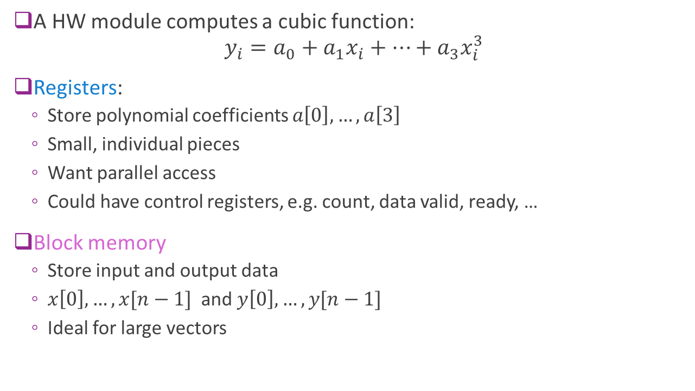







Example: The Cubic IP
Registers
$a[0]$
A HW module computes a cubic function:
$y_{i}=a_{0}+a_{1}x_{i}+⋯+a_{3}x_{i}^{3}$
Registers:
  Store polynomial coefficients $a\left[0\right],…,a\left[3\right]$
  Small, individual pieces
  Want parallel access
  Could have control registers, e.g. count, data valid, ready, …
Block memory
  Store input and output data
  $x\left[0\right],…,x[n−1]$ and $y\left[0\right], …, y[n−1]$
  Ideal for large vectors
$a[1]$
$a[2]$
$a[3]$
$x[0]$
$y[0]$
$x[1]$
$y[1]$
$$⋮$$
$$⋮$$
$x[n−1]$
$y[n−1]$
Block memory

Slide 23
Register Maps
Register map: where each field lives
  Offset from the IP's base, name, field bits, access
For now: no field spans two registers
  Each field fits inside one 32-bit register
  Tight packing comes later, with serialization
Unused upper bits are zero padding
  Read back as 0; ignored by the hardware
Example: a vector-scaling IP
Offset | Register | Field bits | Access
0x00 | CTRL | start [0], done [1] | R/W
0x04 | GAIN | 7:0 | R/W
0x08 | LEN | 9:0 | R/W
0x0C | SUM | 23:0 | R
The LEN register: 32 bits
zero padding
22 bits
LEN
10 bits
31
10
9
0

Slide 24
Register Map of the Cubic IP
PRACTICE
The cubic IP computes 𝑦[𝑖] = 𝑎₀ + 𝑎₁𝑥[𝑖] + 𝑎₂𝑥[𝑖]² + 𝑎₃𝑥[𝑖]³ over a vector of length 𝑛. Its registers hold:
start, done: 1 bit each, sharing CTRL (start = bit 0, done = bit 1)
a0–a3: 16-bit signed coefficients
n: 12-bit unsigned vector length
(a) Write the register map: offset, field(s) and zero-padding bits for each register.
(b) The IP is mapped at base 0x4000_0000. What global address does the processor write to set a2?
(c) The processor writes 𝑎₂ = −3. What 32-bit value reads back, in hex? What number does code get if it treats that as a signed 32-bit integer?
Layout rules
32-bit registers, one field each (CTRL holds both bits)
Fields in the low bits, zero padding above
Order from 0x00: CTRL, a0, a1, a2, a3, n
Offset | Register | Field bits | Padding
 | CTRL
 | a0
 | a1
 | a2
 | a3
 | n
Also in the LLM grader: Unit 4 › Register map

Slide 25
Register Map of the Cubic IP
SOLUTION
(a) See the table: registers sit 4 bytes apart
(b) 0x4000_0000 + 0x0C = 0x4000_000C
(c) −3 in 16-bit two's complement is 0xFFFD
Zero padding → reads back as 0x0000_FFFD
As a signed 32-bit integer: 65533, not −3
Offset | Register | Field bits | Padding
0x00 | CTRL | start [0], done [1] | 30
0x04 | a0 | 15:0 | 16
0x08 | a1 | 15:0 | 16
0x0C | a2 | 15:0 | 16
0x10 | a3 | 15:0 | 16
0x14 | n | 11:0 | 20
The a2 register after writing −3
Watch out: zero padding does not sign-extend.
Software must sign-extend a padded signed field itself.
0000 0000 0000 0000
bits 31–16: padding
1111 1111 1111 1101
bits 15–0: −3
Also in the LLM grader: Unit 4 › Register map

Slide 26
Outline
Random Access Memory and Memory-Mapped Registers
Processor Interfaces with AXI4-Lite
Implementing AXI4-Lite Interface in Vitis HLS

Slide 27
AXI4-Lite Protocol
ARM Extensible Interface family of protocols
  Others we will use in class are AXI4-Full and AXI4-Stream
Industry-standard, ubiquitously used
AXI4-Lite:
  Simple
  Ideal for programming registers
  Modular enables flexibility in delays and scheduling at both ends
  Typical throughput: 1 read / 1 write every 3-5 clock cycles

Slide 28
AXI4-Lite Use Case: Processor to Hardware IP
Control registers
Bus signals
Address, data
Control
Processor
E.g. ARM core
Hardware IP
Ex: FPGA module you have designed
Widely-used use case
Hardware IP has control registers
Need read / write access from an embedded processor

Slide 29
Master-Slave and Transactions
MASTER
SLAVE
Control registers
Bus signals
Address, data
Control
Processor
E.g. ARM core
Hardware IP
Ex: FPGA module you have designed
In AXI4-Lite:
Each read or write of a single word is a transaction
Master: The unit that initiates all transaction (typically the processor in this example)
Slave: The unit that responds to the transaction (typically the hardware IP)

Slide 30
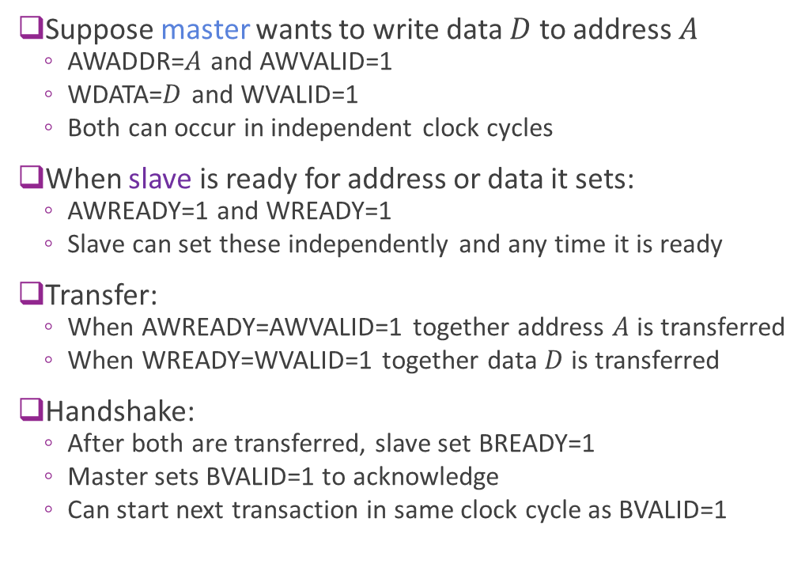
Review: AXI4-Lite Write Protocol
Suppose master wants to write data $D$ to address $A$
  AWADDR=$A$ and AWVALID=1
  WDATA=$D$ and WVALID=1
  Both can occur in independent clock cycles
When slave is ready for address or data it sets:
  AWREADY=1 and WREADY=1
  Slave can set these independently and any time it is ready
Transfer:
  When AWREADY=AWVALID=1 together address $A$ is transferred
  When WREADY=WVALID=1 together data $D$ is transferred
Write response (B channel):
  After both transfers, the slave sets BVALID=1 with the write response
  The master sets BREADY=1 to accept it; the response transfers when BVALID=BREADY=1
  Each channel is free for the next transaction once its own handshake completes
MASTER
SLAVE
AWADDR, AWVALID
AWREADY
WDATA, WVALID
WREADY
BVALID
BREADY

Slide 31
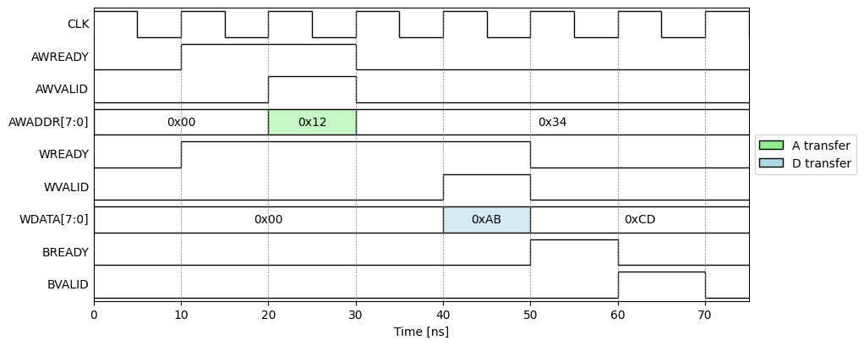
Example AXI4-Lite Write
Example with
Slave is ready before master
Address write before data write
But either order or together is fine
Transaction
4 cycles

Slide 32
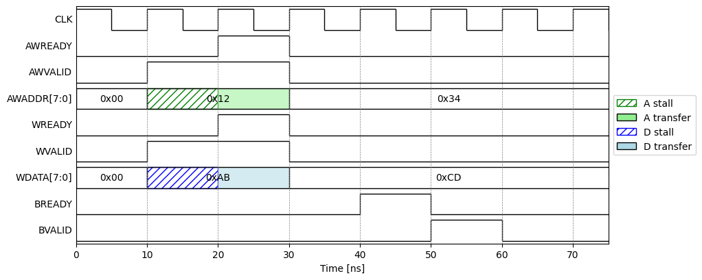
Example AXI4-Lite Write With Stall
Example:
Master sets valid
Slave is not ready
Transfer stalls
Provides flow control
  Ensures data waits until RX is ready
Transaction
4 cycles

Slide 33
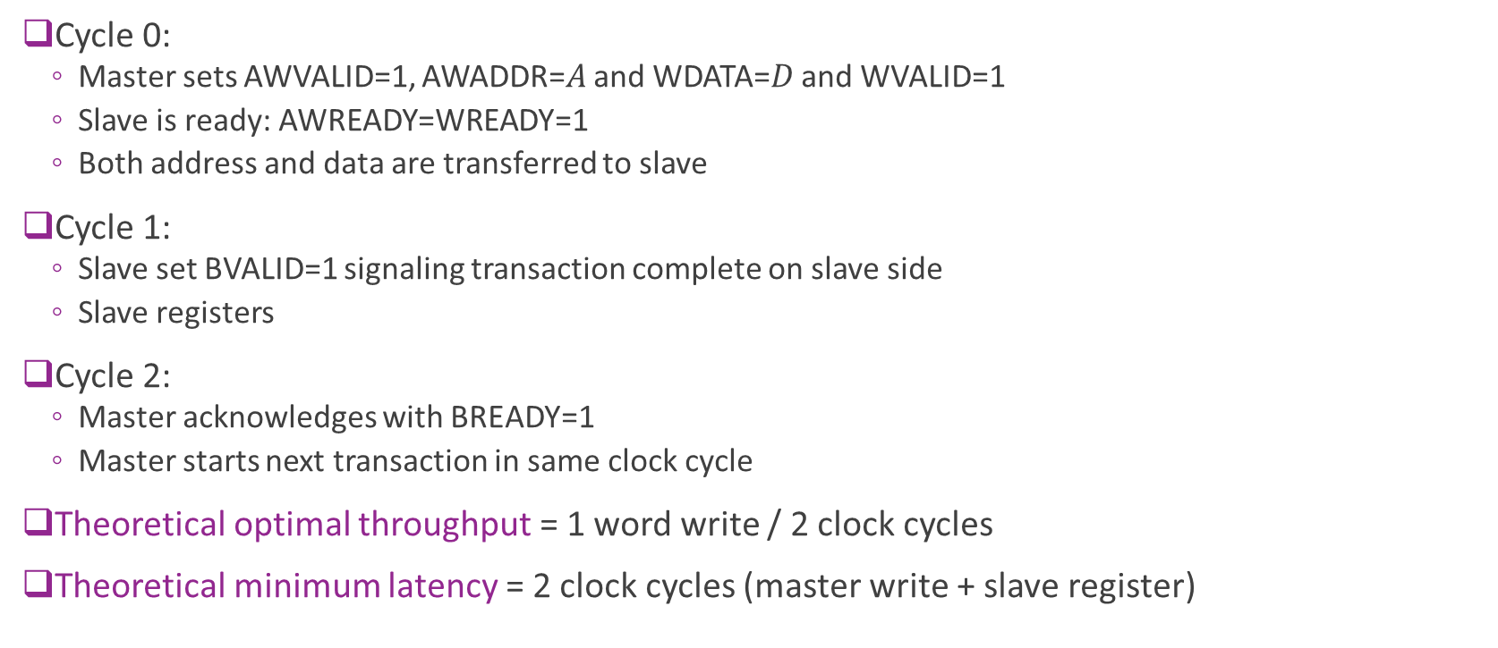
Theoretical Optimal Write Throughput
Cycle 0:
  Master sets AWVALID=1, AWADDR=$A$ and WDATA=$D$ and WVALID=1
  Slave is ready: AWREADY=WREADY=1
  Both address and data are transferred to slave
Cycle 1:
  Slave set BVALID=1 signaling transaction complete on slave side
  Slave registers
Cycle 2:
  Master acknowledges with BREADY=1
  Master starts next transaction in same clock cycle
Theoretical optimal throughput = 1 word write / 2 clock cycles
Theoretical minimum latency = 2 clock cycles (master write + slave register)

Slide 34
Practical AXI4-Lite Latency
Suppose:
  Master sets data and address on cycle 0
  Slave is ready
In most practical register systems:
  Slave takes 1-2 additional clock cycles for BREADY=1
Master takes at 1-2 additional clock cycles for BVALID=1 and next input
Practical throughput with AXI4-Lite: 1 word write per 3-5 clock cycles

Slide 35
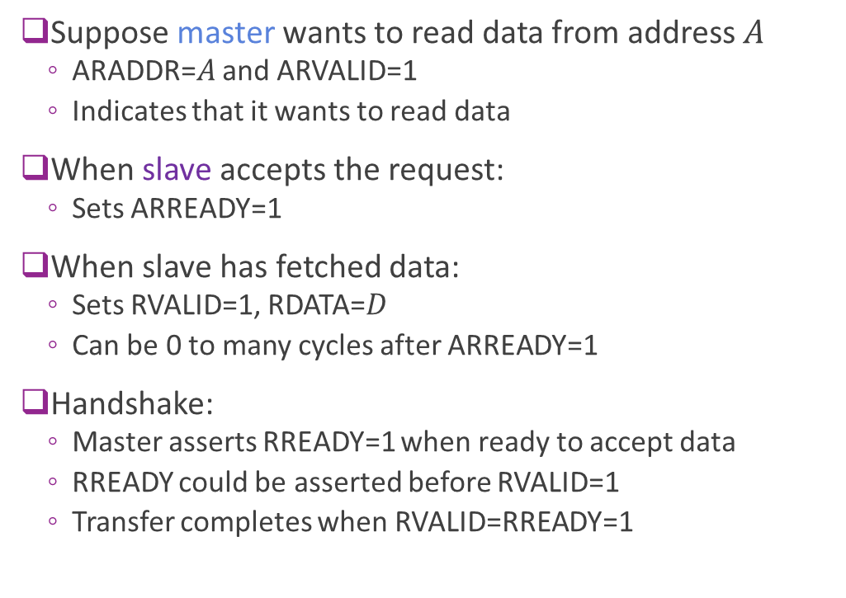
AXI4-Lite Read Protocol
Suppose master wants to read data from address $A$
  ARADDR=$A$ and ARVALID=1
  Indicates that it wants to read data
When slave accepts the request:
  Sets ARREADY=1
When slave has fetched data:
  Sets RVALID=1, RDATA=$D$
  Can be 0 to many cycles after ARREADY=1
Handshake:
  Master asserts RREADY=1 when ready to accept data
  RREADY could be asserted before RVALID=1
  Transfer completes when RVALID=RREADY=1
MASTER
SLAVE
ARADDR, ARVALID
ARREADY
RVALID, RDATA
RREADY
BVALID

Slide 36
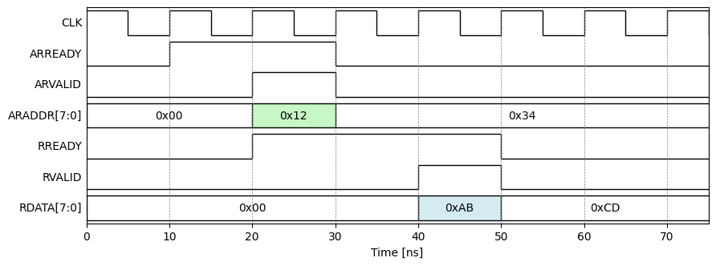
Example Read Timing
In this example:
Slave is initially ready
(ARREADY=1)
Slave immediately accepts
request
Master is immediately available for
Data valid with two cycle delay

Slide 37
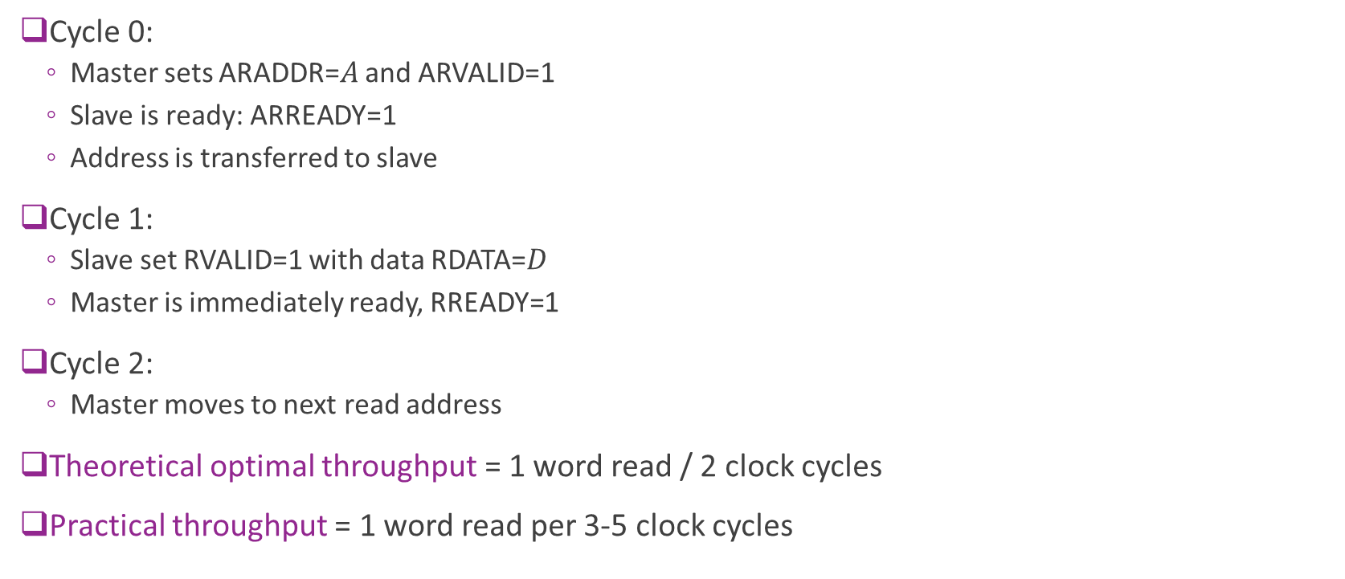
Theoretical Optimal Read Throughput
Cycle 0:
  Master sets ARADDR=$A$ and ARVALID=1
  Slave is ready: ARREADY=1
  Address is transferred to slave
Cycle 1:
  Slave set RVALID=1 with data RDATA=$D$
  Master is immediately ready, RREADY=1
Cycle 2:
  Master moves to next read address
Theoretical optimal throughput = 1 word read / 2 clock cycles
Practical throughput = 1 word read per 3-5 clock cycles

Slide 38
Outline
Random Access Memory and Memory-Mapped Registers
Processor Interfaces with AXI-Lite
Implementing AXI-Lite Interface in Vitis HLS

Slide 39



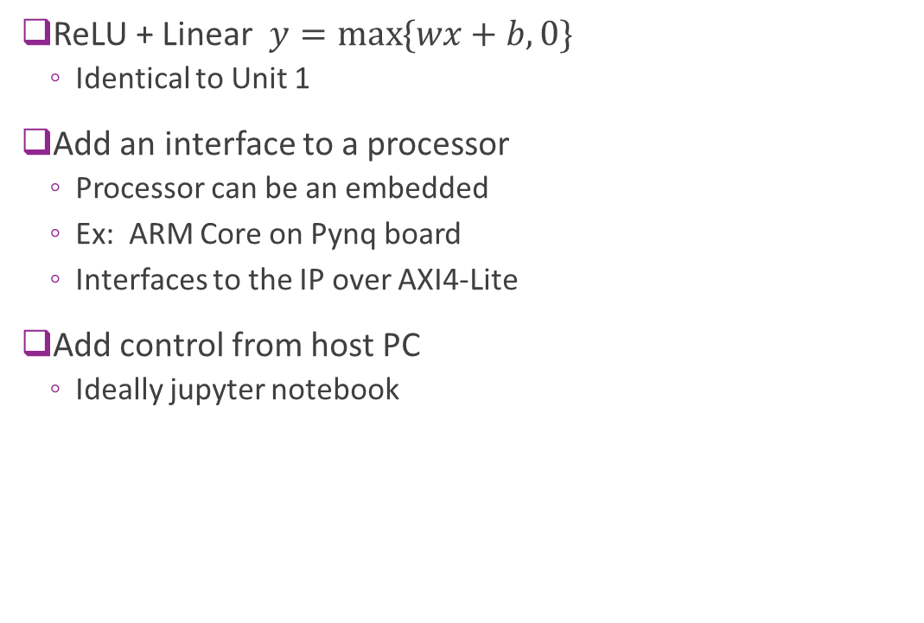



Example: Connecting a Simple IP
ReLU + Linear $y=\max{\{wx+b, 0\}}$
  Identical to Unit 1
Add an interface to a processor
  Processor can be an embedded
  Ex: ARM Core on Pynq board
  Interfaces to the IP over AXI4-Lite
Add control from host PC
  Ideally jupyter notebook
FPGA board
AXI4-Lite
$$w$$
$$b$$
$$x$$
$$y$$
Memory-
mapped
registers
Linear + ReLU
Hardware “IP”
Processor
system
(e.g., ARM)
Host PC

Slide 40
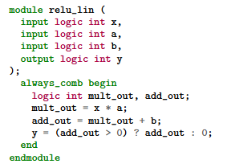


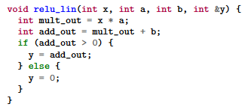
HLS vs. RTL
RTL: Register Transfer Language
  Use specialized languages (e.g., SystemVerilog)
  Manually schedule action in each clock cycle
  Interfaces designed from scratch
  High control, supports custom interfaces
  But time-consuming, difficult to maintain
HLS: High-Level Synthesis
  Write in general purpose languages (e.g., C++)
  Clock-level schedule determined automatically by compiler
  API support for common interfaces (e.g., AXI)
  Sacrifice some performance and flexibility
  But enables rapid development

Slide 41


HLS vs. RTL FPGA Design Flow
Human-written
RTL files
(e.g. SV)
Package
Traditional RTL Design Flow
  Designer directly writes RTL
  Tools simulate and synthesize
HLS Flow
  Designer write high-level language (e.g., C)
  Standard software compile-synthesis
  RTL files auto-generated
RTL Simulate
$$⋯$$
Human-written
C files
C
simulation
C Synthesis
Auto-generated
RTL files
RTL Simulation
Package

Slide 42
Bad vs. Good HLS Code Write
Bad: Treat HLS tool as a black box
Results in RTL code with poor performance
No way to evaluate if resulting design is good
Good: Have a mental model
Think what the RTL code should look like
What should happen on each clock cycle
What resources should be used
HLS
Tool
RTL
Tool
Mental RTL
model
HLS
Tool
RTL
Tool

Slide 43

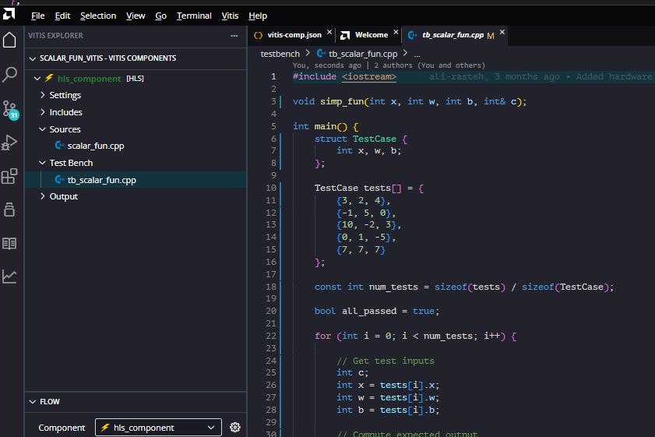
Vitis HLS
Developed by Xilinx (now AMD)
  Evolved from Vivado HLS
Supports C / C++
  Simple, common development
Some python support for testbenches
Ships with Vitis IDE
Native support for AXI protocols
  No need to build handshake from scratch

Slide 44
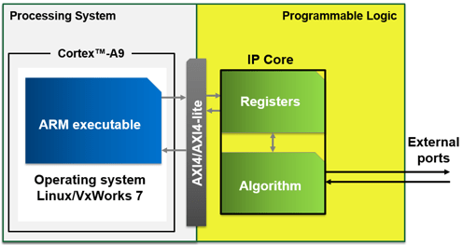
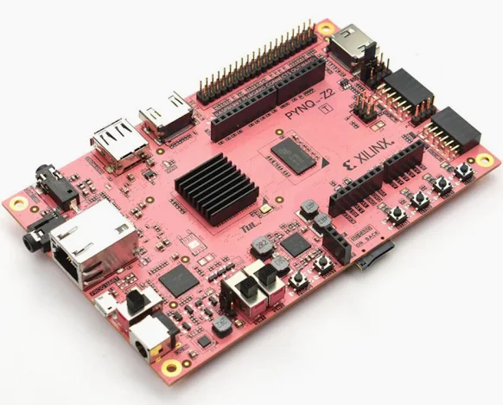
FPGA Board Components
We target a design on a real FPGA board
Boards have three components
Processing system (PS)
  A lightweight processor
  Often an ARM core
  E.g., ARM A9
Programmable logic (PL)
  The programmable fabric
  This is where your IP will reside
  Also contains the registers and internal memory
An AXI4 interface
Image from MathWorks page on embedded design

Slide 45





Target Architecture
Pynq Z2 board
We will rapidly build
Complete AXI4-Lite I/F
  Interface done automatically
  No need to code any handshaking
Control through host
  Simple python jupyter notebook
Deploy to a real FPGA!
AXI4-Lite
$$w$$
$$b$$
$$x$$
$$y$$
Memory-
mapped
registers
Linear + ReLU
Hardware “IP”
PS
Host PC
PL

Slide 46
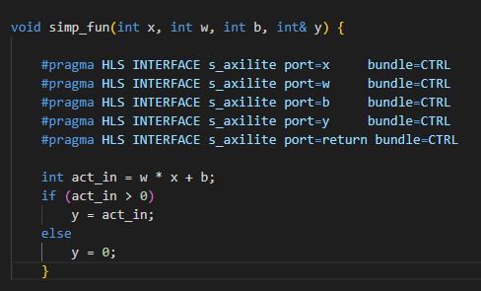
IP Source Code
IP Source Code is simple
Module declaration
Port descriptions
Main functional description

Slide 47
Module Declaration
Module declaration
  Defines inputs and outputs
  Standard C

Slide 48
Module Declaration
Port definitions
  Use pragma statements
  Do not change function
  But tell synthesizer how to map to hardware
  Indicates ports are axislite (AXI4-Lite slave)
  Share a common bundle
  (all on the same AXI4-Lite interface)
  Additional port=return
  (Provides start, stop, see later)

Slide 49
Module Declaration
Main function definition
  Plain C
  Do not specify the implementation
  Just the desired behavior
  Synthesizer may map to multiple clock cycles
  You do not have to do scheduling manually

Slide 50
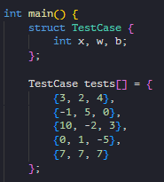
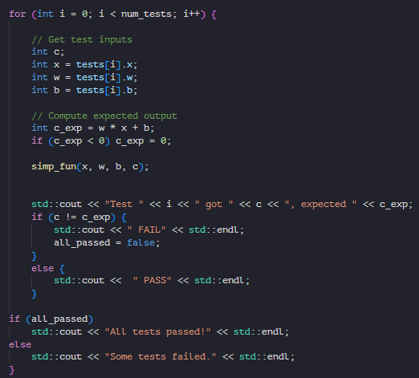
Vitis HLS Testbench
Testbench
  Program simulating another unit interacting with IP
  IP is the device-under-test (DUT)
In HLS:
  Testbench another C program
  Calls the DUT module like a C function
  Sequential behavior
  Testbench code can use any C / C++ functions
  Does not need to be “synthesizable”

Slide 51
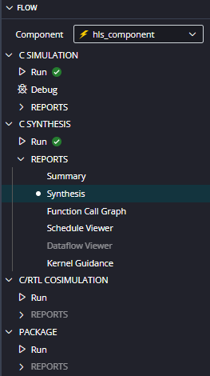
Vitis HLS Flow Described in Flow Panel
Tool follows expected steps for HLS flow
C
simulation
C Synthesis
Auto-generated
RTL files
RTL Simulation
Package

Slide 52
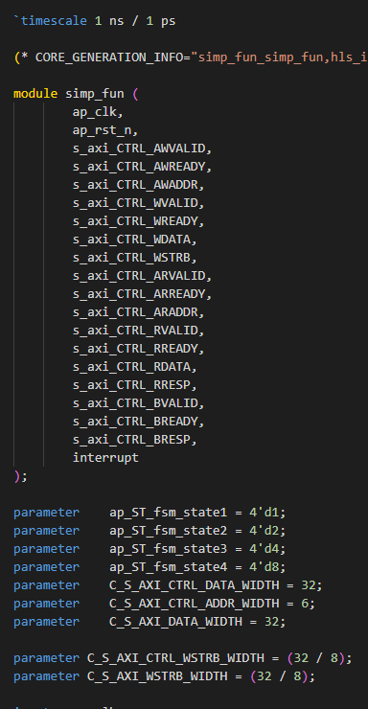
Synthesis Output
Resulting Verilog files are massive!
Main function in this case:
  simp_fun.v
  > 200 lines of Verilog
  Hard to read code
You saved a lot of time coding

Slide 53
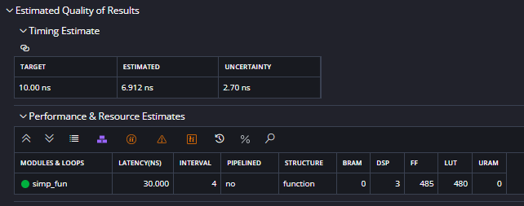
Synthesis Report
Generate a Report in Vitis Tool
  Later, we will write python to parse these
Timing estimate
  Timing of critical path
  Can verify that lower than clock period
Estimated latency
  In this case = 4 clock cylces
Estimate resources
  Amount of each FPGA resources used
  BRAM, DSP, …
  We will discuss these in detail later

Slide 54
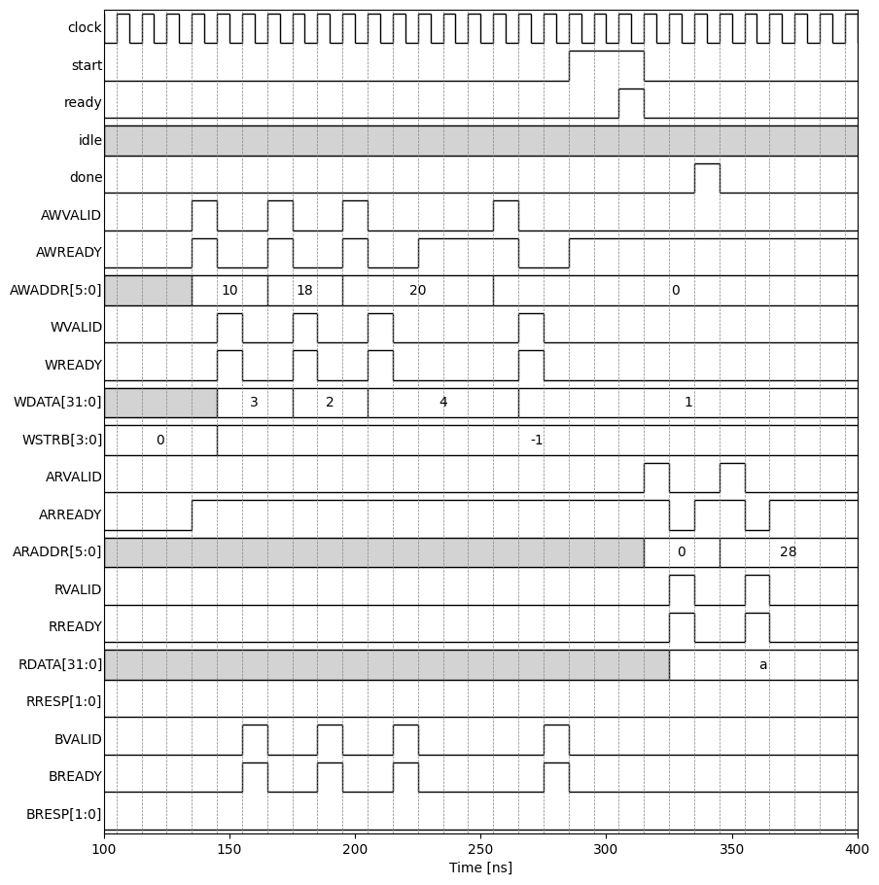
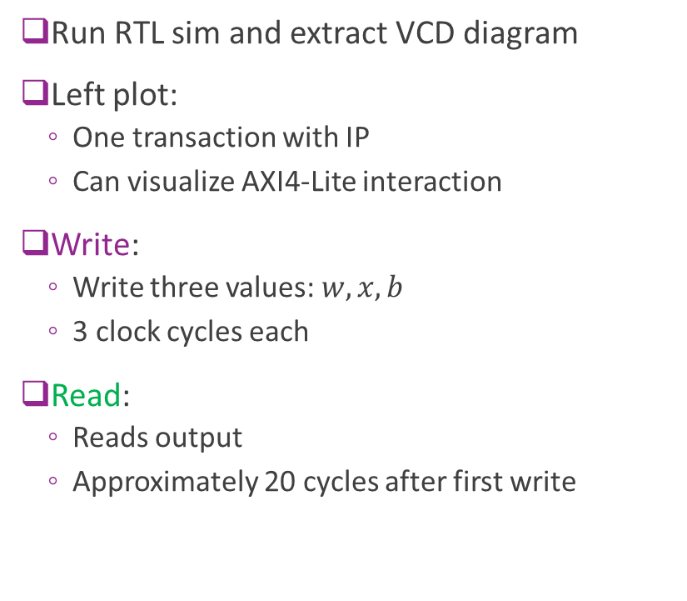
RTL Simulation
Run RTL sim and extract VCD diagram
Left plot:
  One transaction with IP
  Can visualize AXI4-Lite interaction
Write:
  Write three values: $w, x, b$
  3 clock cycles each
Read:
  Reads output
  Approximately 20 cycles after first write

Slide 55
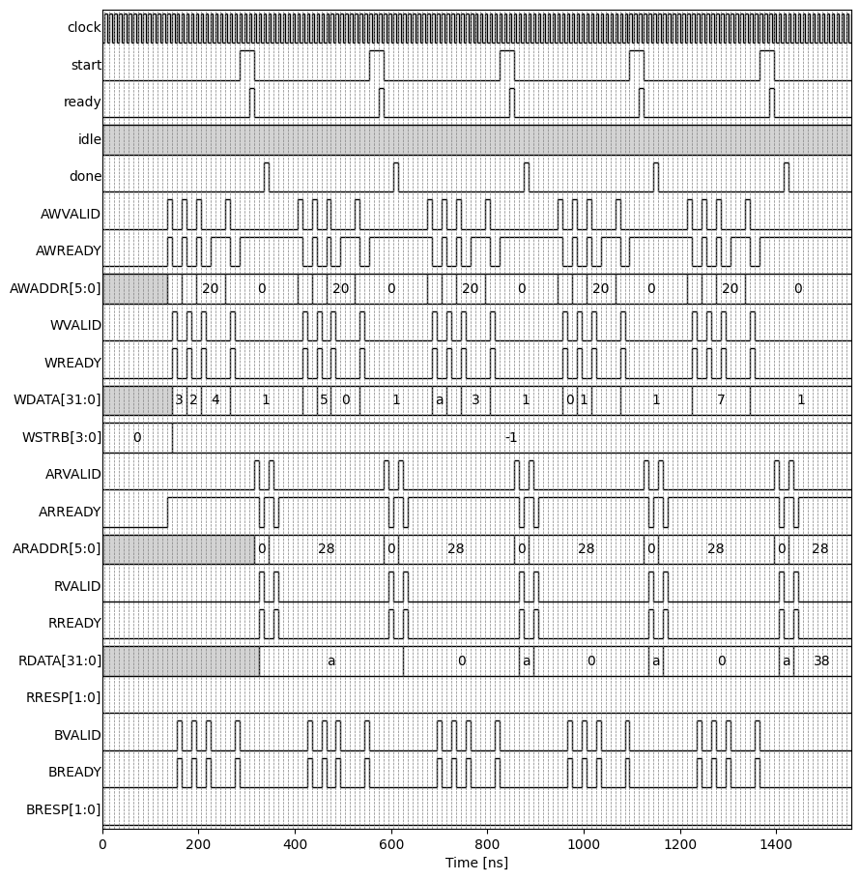
RTL Simulation over Multiple Interactions
Approximately 20 cycles for each input
We will be able to do this much faster
  Will use an AXI-Streaming interface
  Next lecture
AXI4-Lite is design for slowly varying items

Slide 56
Execution Model
Write phase
  PS writes input control registers
  PS “start” on the control register
  Transaction starts when “ready”
  IP asserts “done”
  PS reads outputs

Slide 57
Deploying on an FPGA Board
Will show this in class

