Slide 1
Unit 2
Memory and Basic Processor Interfaces
EL-GY 9463: Introduction to Hardware Design
ProfS. Sundeep Rangan, Siddharth Garg

Slide 2
Learning Objectives
Describe the basic components of random access memory
  Address and data bus, address decoder, storage
Identify which types of memory should be used for storage
  External vs. internal
  Registers vs. block memory
Describe and analyze timing for the AXI4-Lite protocol for reading and writing registers
Implement a simple IP with AXI4-Lite control registers using Vitis HLS
Synthesize and simulate the IP and analyze the timing diagrams
Deploy the IP on an FPGA board and interface with the IP via PYNQ

Slide 3
Outline
Random Access Memory and Memory-Mapped Registers
Processor Interfaces with AXI4-Lite
Implementing AXI4-Lite Interface in Vitis HLS

Slide 4

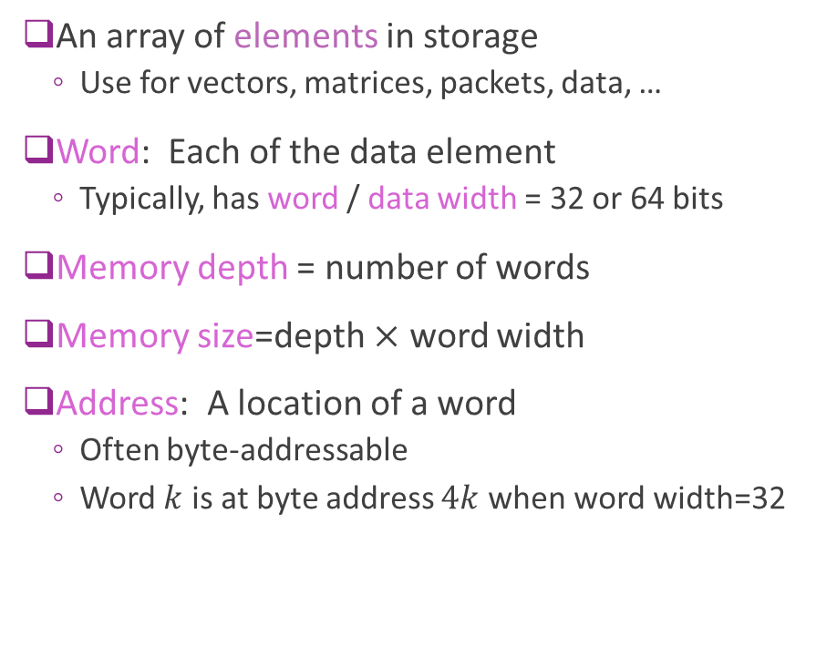


Addressable Memory
An array of elements in storage
  Use for vectors, matrices, packets, data, …
Word: Each of the data element
  Typically, has word / data width = 32 or 64 bits
Memory depth = number of words
Memory size=depth $×$ word width
Address: A location of a word
  Often byte-addressable
  Word $k$ is at byte address $4k$ when word width=32
Byte address
Data
0
Word 0
4
Word 1
8
Word 2
$$4(N−1)$$
Word $N−1$
Example 32-bit memory with $N$ depth

Slide 5
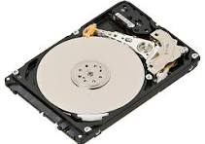
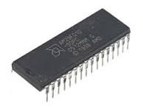
Sequential vs Random Access
Sequential Access
  Access time depends on position
  You must move through data in order
  Ex: Hard disks (seek + rotation)
  FIFO queues (logical sequential access)
Random access
  Any element can be accessed in constant time
  SRAM (on chip block memory, FPGA BRAM)
  DRAM (external memory)
  Register files (architecturally random access)

Slide 6
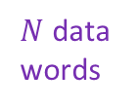
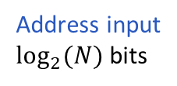

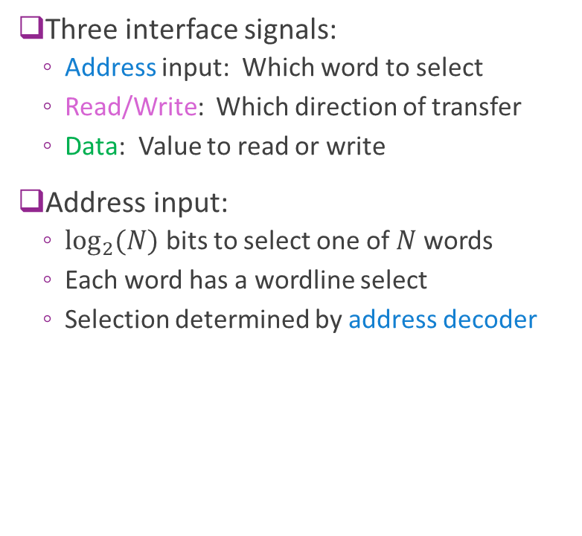


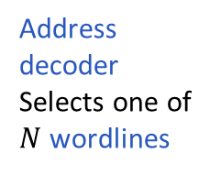
Typical RAM Architecture
Data
Bus
Three interface signals:
  Address input: Which word to select
  Read/Write: Which direction of transfer
  Data: Value to read or write
Address input:
  $\log_{2}{(N)}$ bits to select one of $N$ words
  Each word has a wordline select
  Selection determined by address decoder
$N$ data
words
R/W
$N$ wordlines
Address input
$\log_{2}{(N)}$bits
$$⋮$$
$$⋮$$
Address
decoder
Selects one of
$N$ wordlines

Slide 7
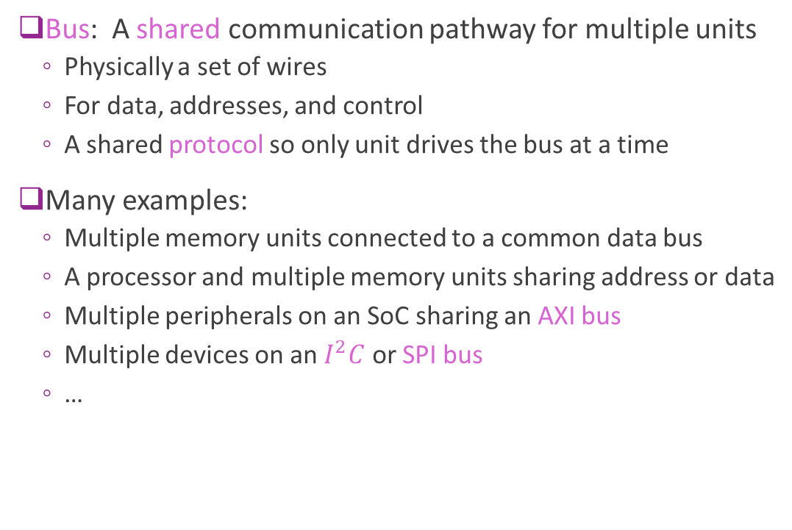
Bus
Bus: A shared communication pathway for multiple units
  Physically a set of wires
  For data, addresses, and control
  A shared protocol so only unit drives the bus at a time
Many examples:
  Multiple memory units connected to a common data bus
  A processor and multiple memory units sharing address or data
  Multiple peripherals on an SoC sharing an AXI bus
  Multiple devices on an $I^{2}C$ or SPI bus
  …
Bus

Slide 8

High Impedance
Method to share a common bus
  One unit drives a value $V$ on the bus
  Other units go into a high-impedance state, noted $Z$
  High impedance units are disconnected
  Bus value= $V$
Sometimes called Tri-State
  Each bit is 0, 1 or Z
Bus
A
B
C
A | B | C | Bus Value | Remarks
Z | 15 | Z | 15 | B drives bus
41 | Z | Z | 41 | A drives bus
Z | Z | Z | X | No driver- no reliable value
32 | 78 | Z | X | Collision of A, B – no reliable value Protocols will avoid this condition

Slide 9

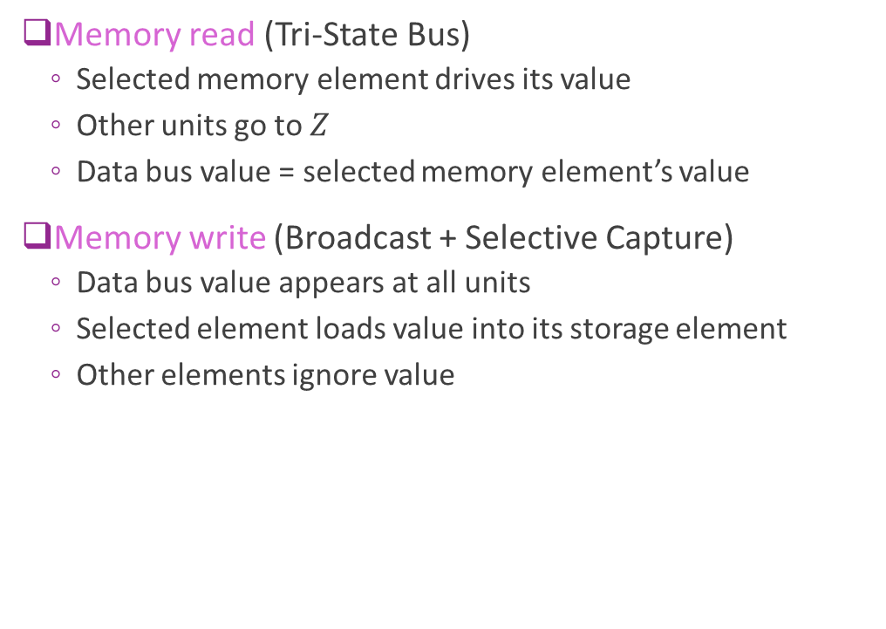
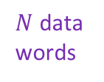

High Impedance on a Data Bus
$N$ data
words
Data
Bus
Memory read (Tri-State Bus)
  Selected memory element drives its value
  Other units go to $Z$
  Data bus value = selected memory element’s value
Memory write (Broadcast + Selective Capture)
  Data bus value appears at all units
  Selected element loads value into its storage element
  Other elements ignore value
R/W
$$⋮$$
$$⋮$$

Slide 10
External vs. Internal Memory
Processing
Hardware
External memory
Off-chip
High capacity (GBs)
But need I/O to process
Internal memory
On-chip
Low capacity (KB-MB)
Direct access to processing
Low latency

Slide 11
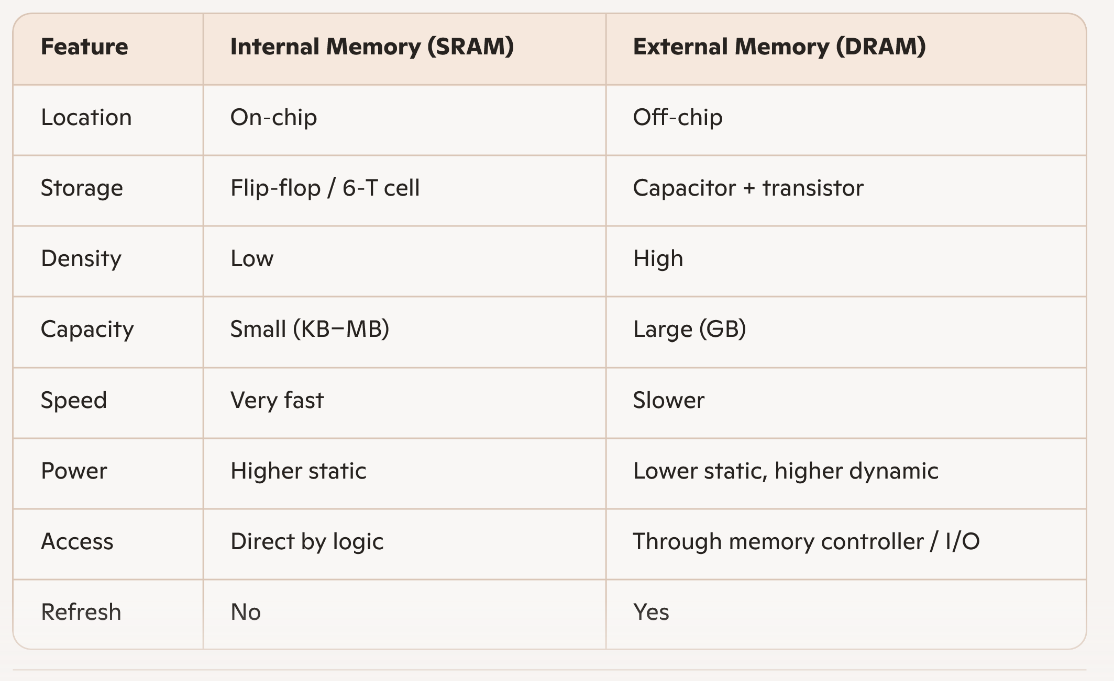
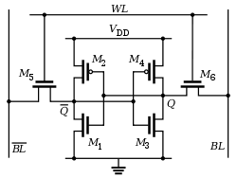
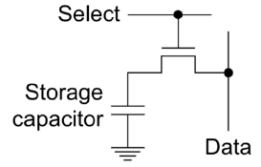
External vs. Internal Compared
SRAM cell
DRAM cell

Slide 12
Example Memory Internal Sizes
Platform | On-Chip Memory Type | Typical Size | Notes
Laptop CPU (Intel Core) | SRAM (L1/L2/L3) | 20–40 MB | L3 dominates; very fast
NVIDIA A100 GPU | SRAM (L2 cache) | ~40 MB | HBM2e (40–80 GB) is off-chip/on-package
Xilinx Virtex-7 FPGA | BRAM (36 Kb blocks) | 2–6 MB | Distributed across fabric
Custom ASIC (5 mm² @16nm) | SRAM | 5–10 MB | Depends on layout & redundancy
Lesson: Internal memory is limited! Use judiciously.

Slide 13
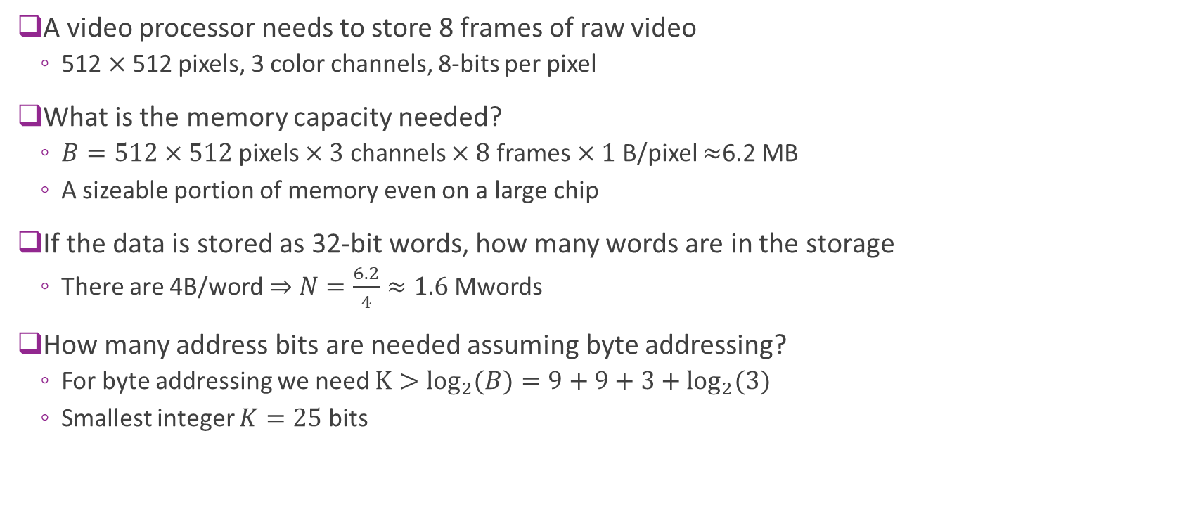
Example: Video
A video processor needs to store 8 frames of raw video
  512 $×$512 pixels, 3 color channels, 8-bits per pixel
What is the memory capacity needed?
  $B=512×512$pixels $×3$ channels $×8$ frames $×1$ B/pixel $≈$6.2 MB
  A sizeable portion of memory even on a large chip
If the data is stored as 32-bit words, how many words are in the storage
  There are 4B/word $⇒$ $N=\frac{6.2}{4}≈1.6$Mwords
How many address bits are needed assuming byte addressing?
  For byte addressing we need $K>\log_{2}{(B)}=9+9+3+\log_{2}{(3)}$
  Smallest integer $K=25$ bits

Slide 14

Registers vs. Block Memory
We have seen two storage types
Registers
  Typically implemented as flip-flops
  Useful for small, individual data pieces
  Control registers, intermediate calculations, …
Block memory
  Typically, DRAM or SRAM
  Ideal for large arrays
  Vectors or arrays
Registers
$$⋮$$
Block memory

Slide 15

Memory Mapped Registers
Registers can also be memory-mapped
  Connected to their own address decoder
  Determines which register to read/write
Common interface to processor
  Processor sees registers & block memory together
  One continuous address space
ADDR
bus
Register
address
decoder
Data
bus
Registers
Block mem
address
decoder
$$⋮$$
Block memory

Slide 16





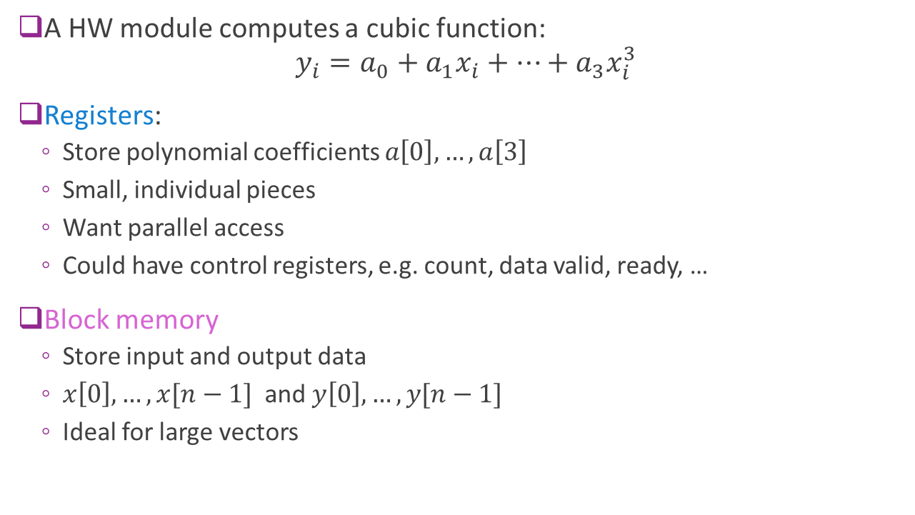







Example
Registers
$a[0]$
A HW module computes a cubic function:
$y_{i}=a_{0}+a_{1}x_{i}+⋯+a_{3}x_{i}^{3}$
Registers:
  Store polynomial coefficients $a\left[0\right],…,a\left[3\right]$
  Small, individual pieces
  Want parallel access
  Could have control registers, e.g. count, data valid, ready, …
Block memory
  Store input and output data
  $x\left[0\right],…,x[n−1]$ and $y\left[0\right], …, y[n−1]$
  Ideal for large vectors
$a[1]$
$a[2]$
$a[3]$
$x[0]$
$y[0]$
$x[1]$
$y[1]$
$$⋮$$
$$⋮$$
$x[n−1]$
$y[n−1]$
Block memory

Slide 17
Outline
Random Access Memory and Memory-Mapped Registers
Processor Interfaces with AXI-Lite
Implementing AXI-Lite Interface in Vitis

Slide 18
AXI4-Lite Protocol
ARM Extensible Interface family of protocols
  Others we will use in class are AXI4-Full and AXI4-Stream
Industry-standard, ubiquitously used
AXI4-Lite:
  Simple
  Ideal for programming registers
  Modular enables flexibility in delays and scheduling at both ends
  Typical throughput: 1 read / 1 write every 3-5 clock cycles

Slide 19
AXI4-Lite Use Case: Processor to Hardware IP
Control registers
Bus signals
Address, data
Control
Processor
E.g. ARM core
Hardware IP
Ex: FPGA module you have designed
Widely-used use case
Hardware IP has control registers
Need read / write access from an embedded processor

Slide 20
Master-Slave and Transactions
MASTER
SLAVE
Control registers
Bus signals
Address, data
Control
Processor
E.g. ARM core
Hardware IP
Ex: FPGA module you have designed
In AXI4-Lite:
Each read or write of a single word is a transaction
Master: The unit that initiates all transaction (typically the processor in this example)
Slave: The unit that responds to the transaction (typically the hardware IP)

Slide 21
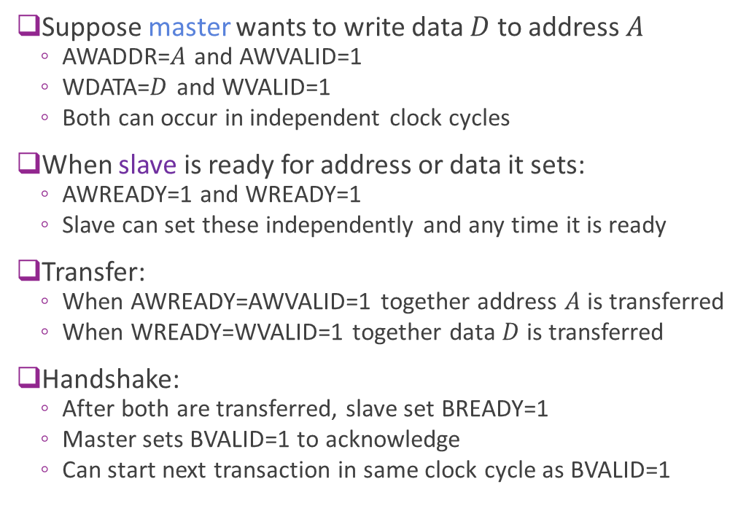
AXI4-Lite Write Protocol
Suppose master wants to write data $D$ to address $A$
  AWADDR=$A$ and AWVALID=1
  WDATA=$D$ and WVALID=1
  Both can occur in independent clock cycles
When slave is ready for address or data it sets:
  AWREADY=1 and WREADY=1
  Slave can set these independently and any time it is ready
Transfer:
  When AWREADY=AWVALID=1 together address $A$ is transferred
  When WREADY=WVALID=1 together data $D$ is transferred
Handshake:
  After both are transferred, slave set BREADY=1
  Master sets BVALID=1 to acknowledge
  Can start next transaction in same clock cycle as BVALID=1
MASTER
SLAVE
AWADDR, AWVALID
AWREADY
WDATA, WVALID
WREADY
BVALID
BREADY

Slide 22
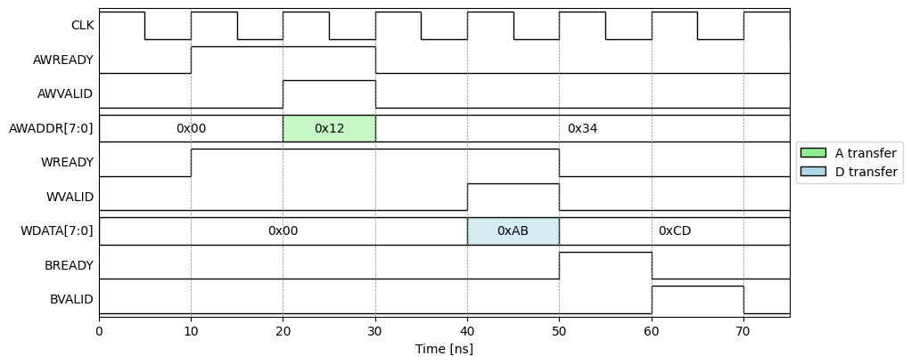
Example AXI4-Lite Write
Example with
Slave is ready before master
Address write before data write
But either order or together is fine
Transaction
4 cycles

Slide 23
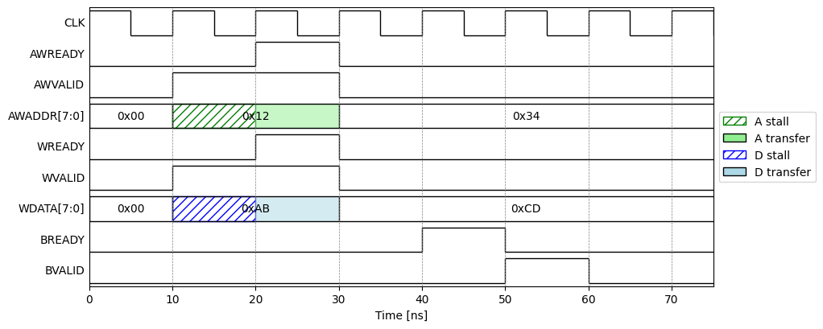
Example AXI4-Lite Write With Stall
Example:
Master sets valid
Slave is not ready
Transfer stalls
Provides flow control
  Ensures data waits until RX is ready
Transaction
4 cycles

Slide 24
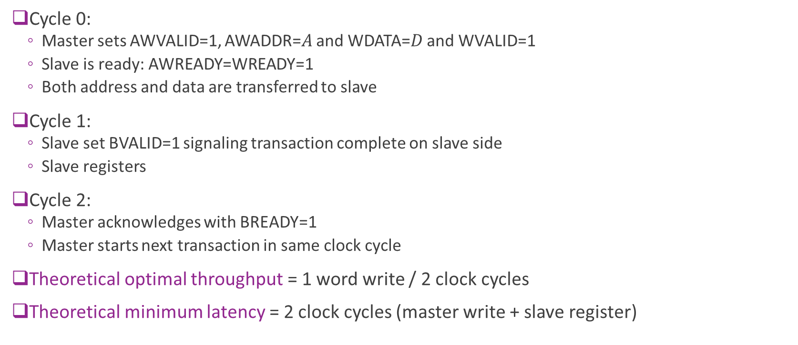
Theoretical Optimal Write Throughput
Cycle 0:
  Master sets AWVALID=1, AWADDR=$A$ and WDATA=$D$ and WVALID=1
  Slave is ready: AWREADY=WREADY=1
  Both address and data are transferred to slave
Cycle 1:
  Slave set BVALID=1 signaling transaction complete on slave side
  Slave registers
Cycle 2:
  Master acknowledges with BREADY=1
  Master starts next transaction in same clock cycle
Theoretical optimal throughput = 1 word write / 2 clock cycles
Theoretical minimum latency = 2 clock cycles (master write + slave register)

Slide 25
Practical AXI4-Lite Latency
Suppose:
  Master sets data and address on cycle 0
  Slave is ready
In most practical register systems:
  Slave takes 1-2 additional clock cycles for BREADY=1
Master takes at 1-2 additional clock cycles for BVALID=1 and next input
Practical throughput with AXI4-Lite: 1 word write per 3-5 clock cycles

Slide 26
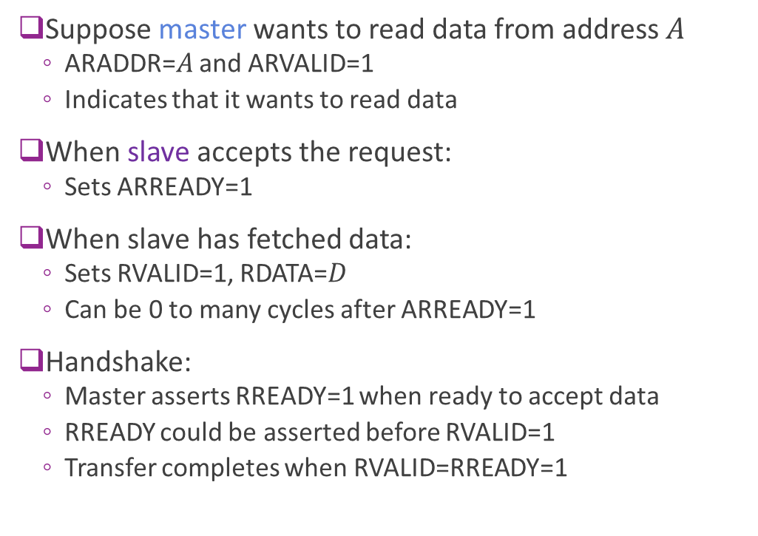
AXI4-Lite Read Protocol
Suppose master wants to read data from address $A$
  ARADDR=$A$ and ARVALID=1
  Indicates that it wants to read data
When slave accepts the request:
  Sets ARREADY=1
When slave has fetched data:
  Sets RVALID=1, RDATA=$D$
  Can be 0 to many cycles after ARREADY=1
Handshake:
  Master asserts RREADY=1 when ready to accept data
  RREADY could be asserted before RVALID=1
  Transfer completes when RVALID=RREADY=1
MASTER
SLAVE
ARADDR, ARVALID
ARREADY
RVALID, RDATA
RREADY
BVALID

Slide 27
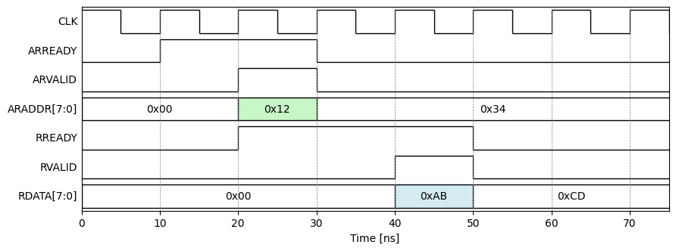
Example Read Timing
In this example:
Slave is initially ready
(ARREADY=1)
Slave immediately accepts
request
Master is immediately available for
Data valid with two cycle delay

Slide 28
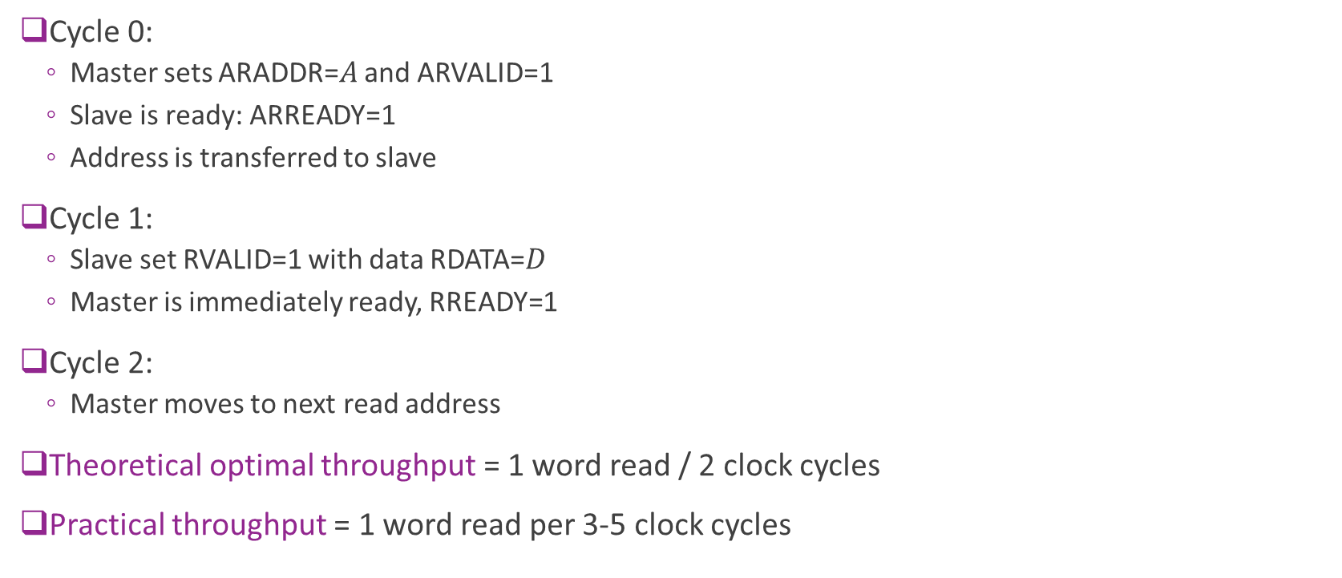
Theoretical Optimal Read Throughput
Cycle 0:
  Master sets ARADDR=$A$ and ARVALID=1
  Slave is ready: ARREADY=1
  Address is transferred to slave
Cycle 1:
  Slave set RVALID=1 with data RDATA=$D$
  Master is immediately ready, RREADY=1
Cycle 2:
  Master moves to next read address
Theoretical optimal throughput = 1 word read / 2 clock cycles
Practical throughput = 1 word read per 3-5 clock cycles

Slide 29
Outline
Random Access Memory and Memory-Mapped Registers
Processor Interfaces with AXI-Lite
Implementing AXI-Lite Interface in Vitis HLS

Slide 30



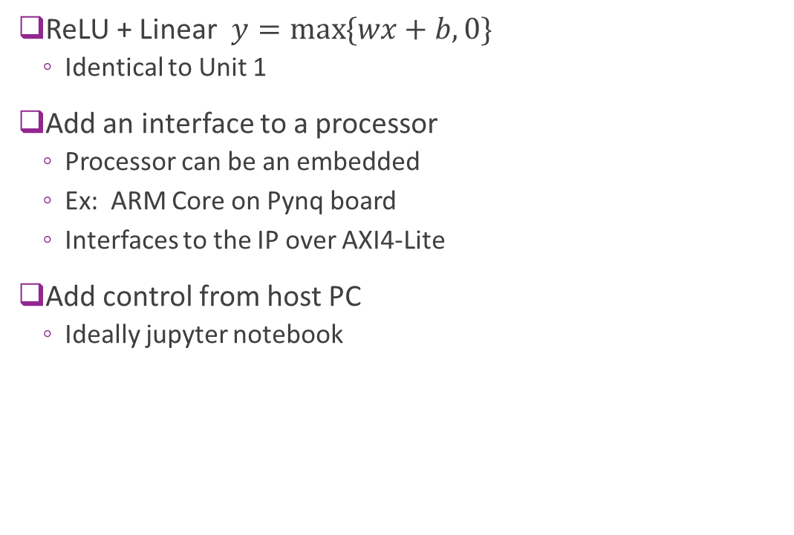



Example: Connecting a Simple IP
ReLU + Linear $y=\max{\{wx+b, 0\}}$
  Identical to Unit 1
Add an interface to a processor
  Processor can be an embedded
  Ex: ARM Core on Pynq board
  Interfaces to the IP over AXI4-Lite
Add control from host PC
  Ideally jupyter notebook
FPGA board
AXI4-Lite
$$w$$
$$b$$
$$x$$
$$y$$
Memory-
mapped
registers
Linear + ReLU
Hardware “IP”
Processor
system
(e.g., ARM)
Host PC

Slide 31
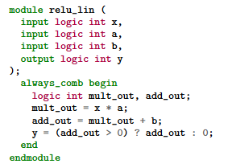


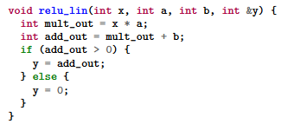
HLS vs. RTL
RTL: Register Transfer Language
  Use specialized languages (e.g., SystemVerilog)
  Manually schedule action in each clock cycle
  Interfaces designed from scratch
  High control, supports custom interfaces
  But time-consuming, difficult to maintain
HLS: High-Level Synthesis
  Write in general purpose languages (e.g., C++)
  Clock-level schedule determined automatically by compiler
  API support for common interfaces (e.g., AXI)
  Sacrifice some performance and flexibility
  But enables rapid development

Slide 32


HLS vs. RTL FPGA Design Flow
Human-written
RTL files
(e.g. SV)
Package
Traditional RTL Design Flow
  Designer directly writes RTL
  Tools simulate and synthesize
HLS Flow
  Designer write high-level language (e.g., C)
  Standard software compile-synthesis
  RTL files auto-generated
RTL Simulate
$$⋯$$
Human-written
C files
C
simulation
C Synthesis
Auto-generated
RTL files
RTL Simulation
Package

Slide 33
Bad vs. Good HLS Code Write
Bad: Treat HLS tool as a black box
Results in RTL code with poor performance
No way to evaluate if resulting design is good
Good: Have a mental model
Think what the RTL code should look like
What should happen on each clock cycle
What resources should be used
HLS
Tool
RTL
Tool
Mental RTL
model
HLS
Tool
RTL
Tool

Slide 34

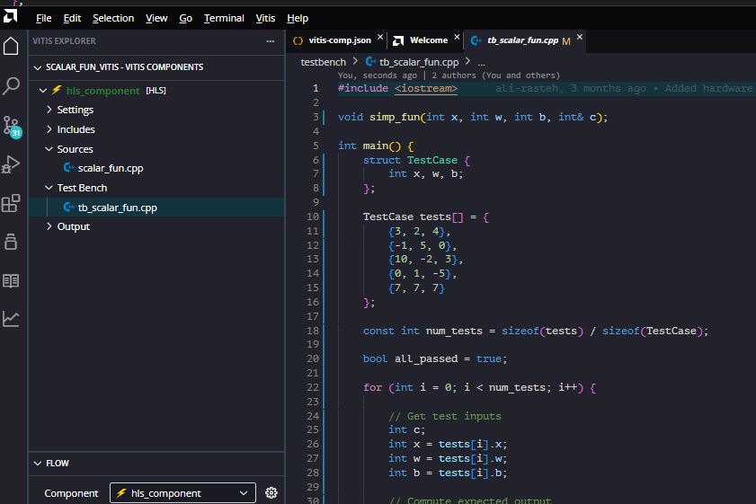
Vitis HLS
Developed by Xilinx (now AMD)
  Evolved from Vivado HLS
Supports C / C++
  Simple, common development
Some python support for testbenches
Ships with Vitis IDE
Native support for AXI protocols
  No need to build handshake from scratch

Slide 35
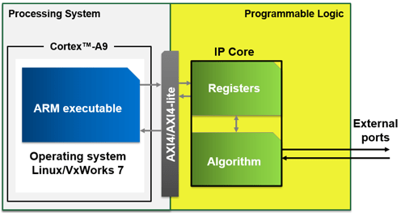
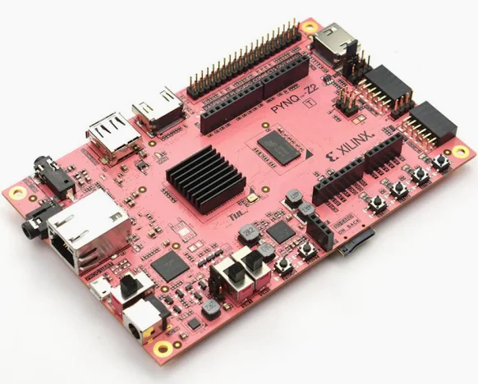
FPGA Board Components
We target a design on a real FPGA board
Boards have three components
Processing system (PS)
  A lightweight processor
  Often an ARM core
  E.g., ARM A9
Programmable logic (PL)
  The programmable fabric
  This is where your IP will reside
  Also contains the registers and internal memory
An AXI4 interface
Image from MathWorks page on embedded design

Slide 36





Target Architecture
Pynq Z2 board
We will rapidly build
Complete AXI4-Lite I/F
  Interface done automatically
  No need to code any handshaking
Control through host
  Simple python jupyter notebook
Deploy to a real FPGA!
AXI4-Lite
$$w$$
$$b$$
$$x$$
$$y$$
Memory-
mapped
registers
Linear + ReLU
Hardware “IP”
PS
Host PC
PL

Slide 37
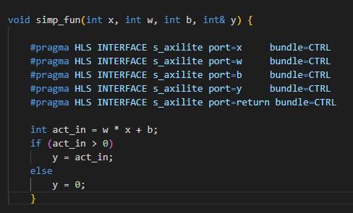
IP Source Code
IP Source Code is simple
Module declaration
Port descriptions
Main functional description

Slide 38
Module Declaration
Module declaration
  Defines inputs and outputs
  Standard C

Slide 39
Module Declaration
Port definitions
  Use pragma statements
  Do not change function
  But tell synthesizer how to map to hardware
  Indicates ports are axislite (AXI4-Lite slave)
  Share a common bundle
  (all on the same AXI4-Lite interface)
  Additional port=return
  (Provides start, stop, see later)

Slide 40
Module Declaration
Main function definition
  Plain C
  Do not specify the implementation
  Just the desired behavior
  Synthesizer may map to multiple clock cycles
  You do not have to do scheduling manually

Slide 41
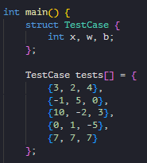
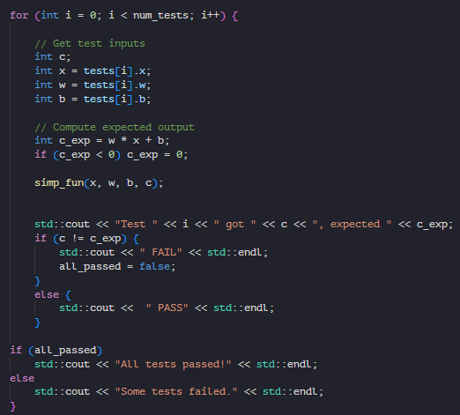
Vitis HLS Testbench
Testbench
  Program simulating another unit interacting with IP
  IP is the device-under-test (DUT)
In HLS:
  Testbench another C program
  Calls the DUT module like a C function
  Sequential behavior
  Testbench code can use any C / C++ functions
  Does not need to be “synthesizable”

Slide 42
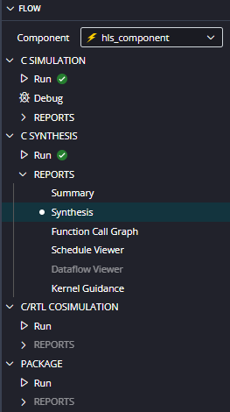
Vitis HLS Flow Described in Flow Panel
Tool follows expected steps for HLS flow
C
simulation
C Synthesis
Auto-generated
RTL files
RTL Simulation
Package

Slide 43
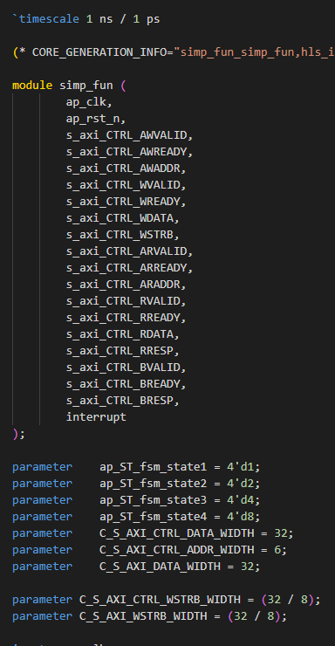
Synthesis Output
Resulting Verilog files are massive!
Main function in this case:
  simp_fun.v
  > 200 lines of Verilog
  Hard to read code
You saved a lot of time coding

Slide 44
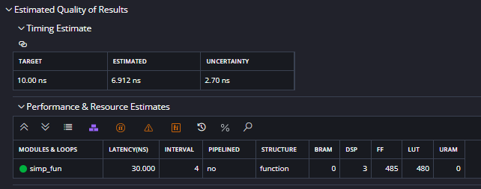
Synthesis Report
Generate a Report in Vitis Tool
  Later, we will write python to parse these
Timing estimate
  Timing of critical path
  Can verify that lower than clock period
Estimated latency
  In this case = 4 clock cylces
Estimate resources
  Amount of each FPGA resources used
  BRAM, DSP, …
  We will discuss these in detail later

Slide 45
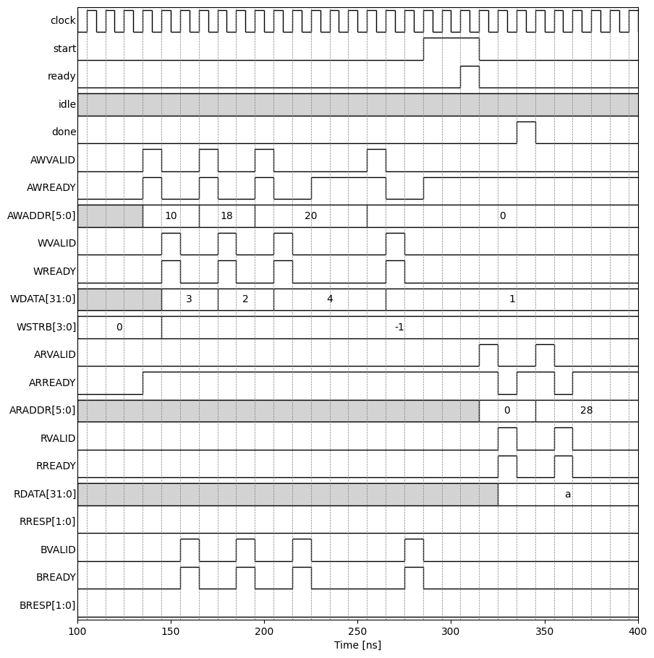
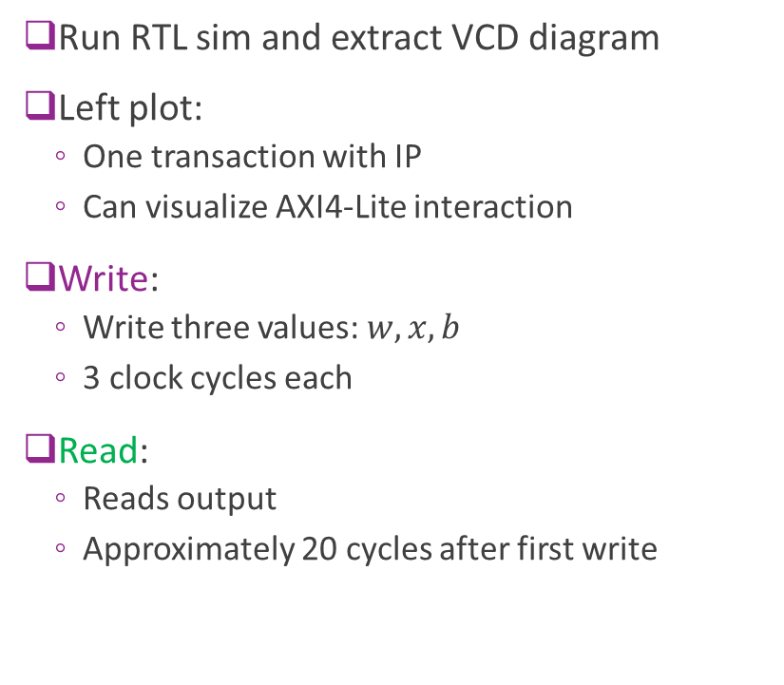
RTL Simulation
Run RTL sim and extract VCD diagram
Left plot:
  One transaction with IP
  Can visualize AXI4-Lite interaction
Write:
  Write three values: $w, x, b$
  3 clock cycles each
Read:
  Reads output
  Approximately 20 cycles after first write

Slide 46
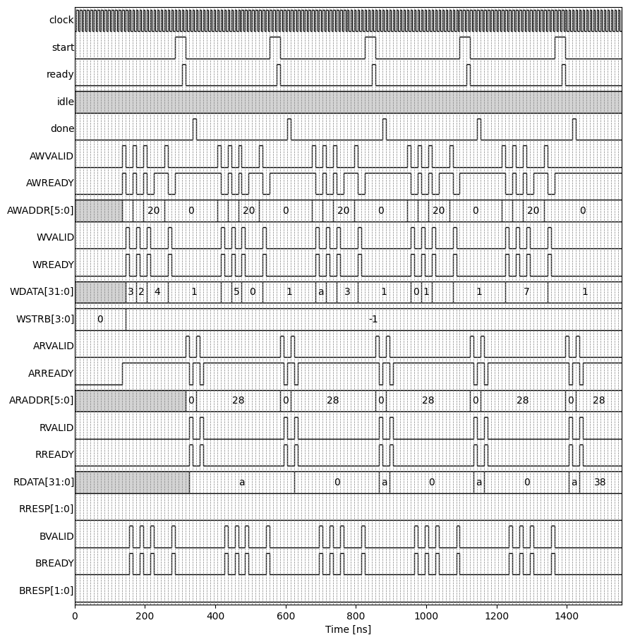
RTL Simulation over Multiple Interactions
Approximately 20 cycles for each input
We will be able to do this much faster
  Will use an AXI-Streaming interface
  Next lecture
AXI4-Lite is design for slowly varying items

Slide 47
Execution Model
Write phase
  PS writes input control registers
  PS “start” on the control register
  Transaction starts when “ready”
  IP asserts “done”
  PS reads outputs

Slide 48
Deploying on an FPGA Board
Will show this in class

