Slide 1
Unit 0
Course Introduction
ECE-GY 6463: Advanced Hardware Design
Prof. Sundeep Rangan, Siddharth Garg

Slide 2
Outline
Course Admin
What is Custom Hardware and What Can it Do?

Slide 3
Course Details
Instructor
  Sundeep Rangan, 370 Jay St, 9-th floor
Course assistant:
  Ruibin Chen,
Office Hours:
  Instructor: Tuesday, 2-3
Time and Location:
  Jacob’s Hall, 6 Metrotech Room 201
  Wednesdays 11-1:30

Slide 4
Learning Objectives
Identify tasks for hardware acceleration
Design, simulate, and evaluate designs for hardware accelerators
  Called Intellectual Property or IPs
  Use state-of-the-art tools
  High-level synthesis (HLS) and AI
Integrate IP into processor-based systems for real-world applications
Deploy and test systems on FPGA boards

Slide 5
Pre-Requisites
Anyone can learn hardware
No prior hardware experience is required!
No hard pre-requisites!
Just have
  Some software experience (e.g., C, python)
  Desire to learn
Many possible disciplines
  Robotics, wireless, scientific computation, cryptography, networking, …

Slide 6
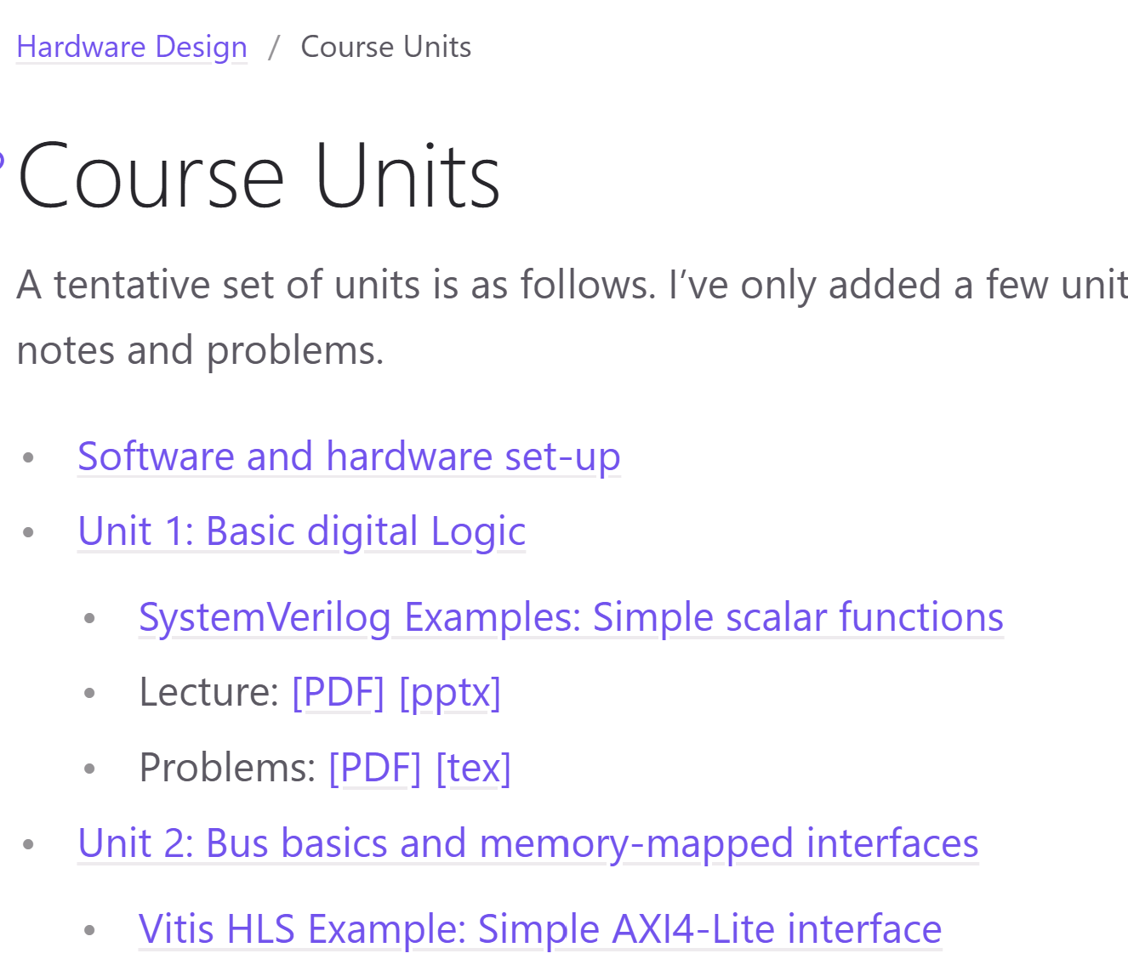
Course Webpage
All the material for the class is on GitHub
Demos:
  SystemVerilog
  Vitis HLS
  Python
Lecture notes
Problems, Lab assignnments
Repository is work in progress
  Re-sync periodically
https://sdrangan.github.io/hwdesign/docs

Slide 7
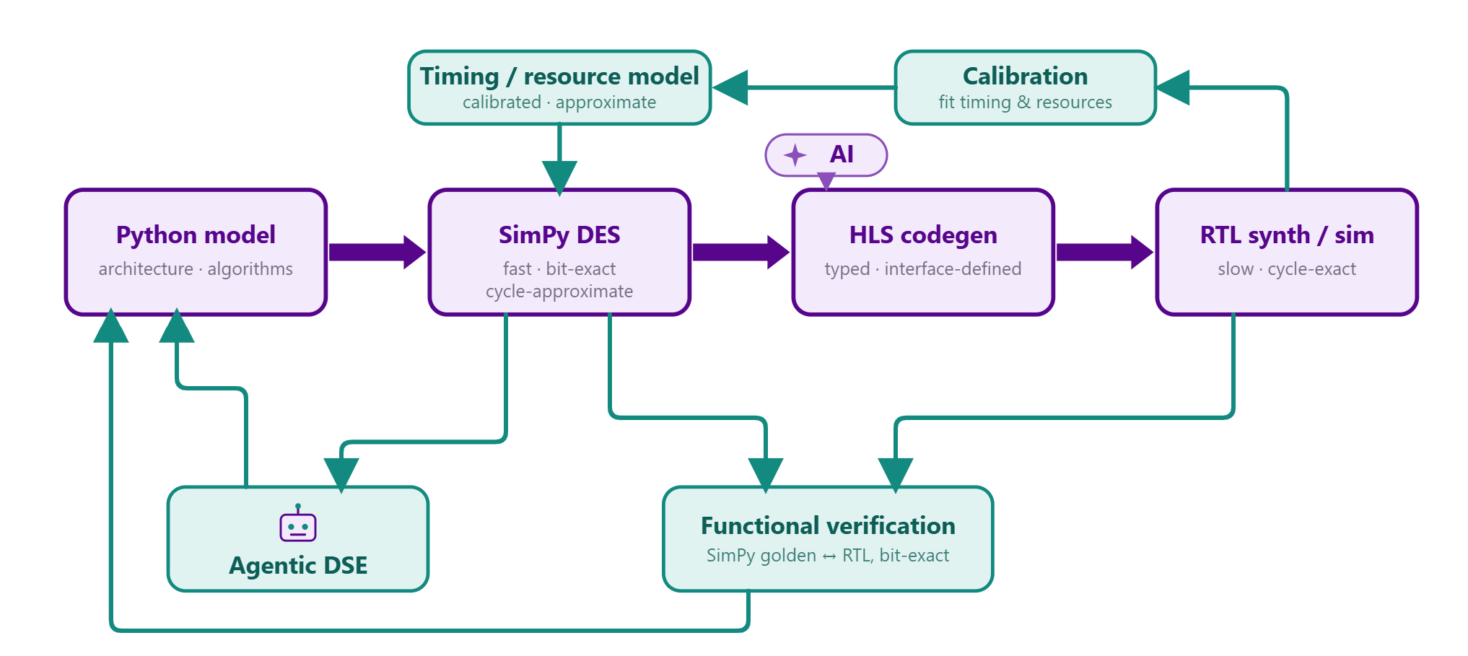
WaveFlow
Package for python-native circuit design
We will use this package for:
  Python-based AMD tool calls
  Python golden models
  Schemas and fixed point simulation
You can also use it for your project
https://sdrangan.github.io/waveflow/docs

Slide 8
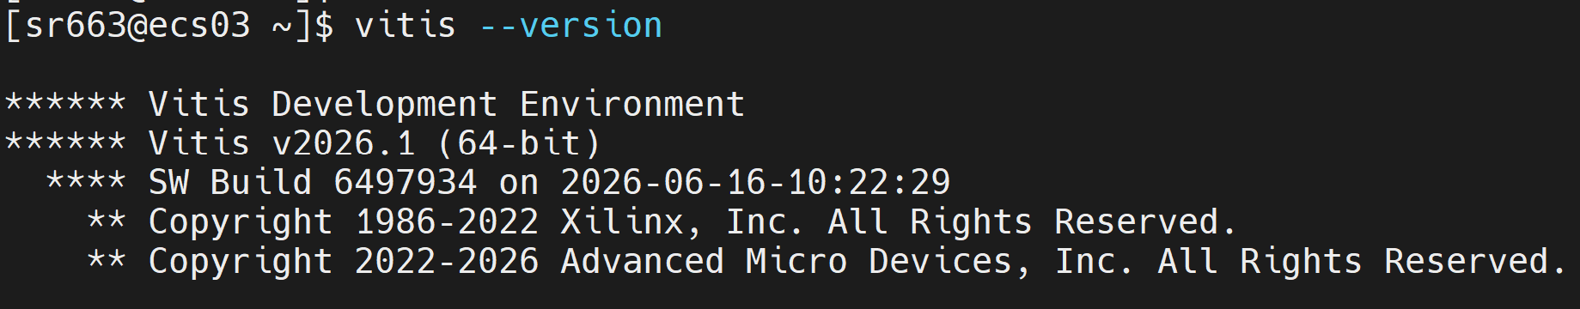
Software Set-Up: ECS Server
Main tools are Vitis and Vivado
  Basic software for digital design
You can run all demos and labs on NYU ECS servers
  No need for set-up on your local machine
Ideal for MacOS users
  Local set-up only supported on Windows and Linux
Instructor will provide your email to NYU IT
You will then be able to log into ecs03.poly.edu to ecs06.poly.edu
  SSH for command line
  Or FastX for a GUI-based system

Slide 9
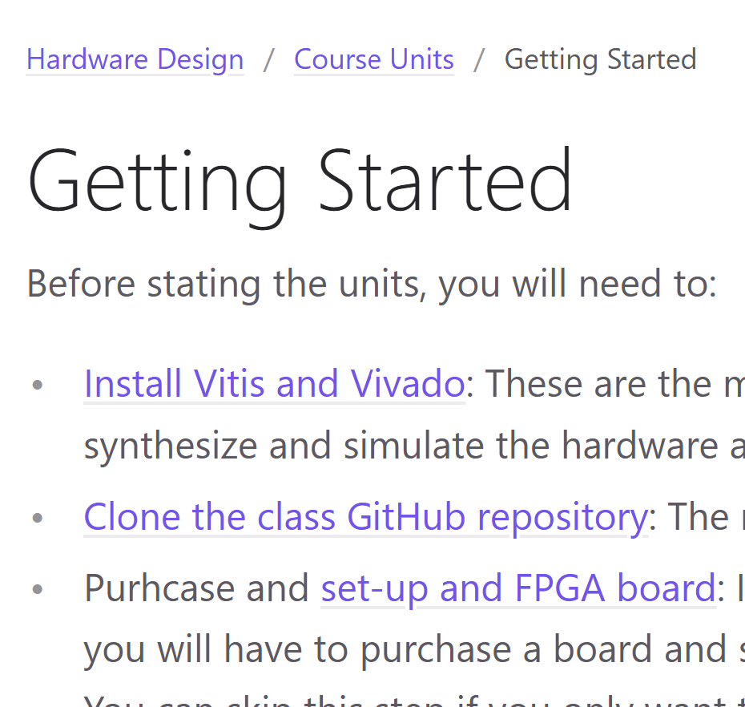
Software Set-Up: Local Machine
You can also install Vitis and Vivado on local machine
But only works for Windows and Linux
  Does not work for MacOS
Optional: Purchase an actual FPGA board
  See next slide
See installation instructions in class

Slide 10
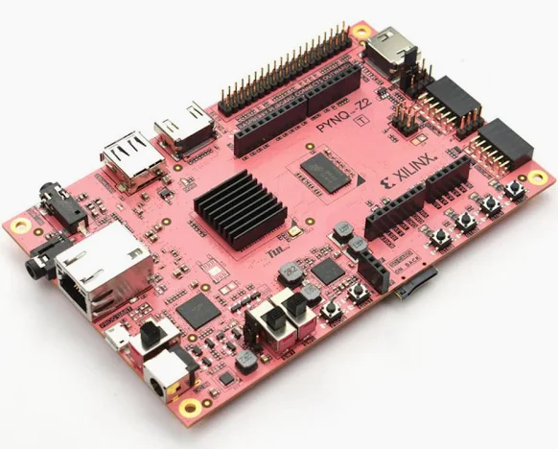
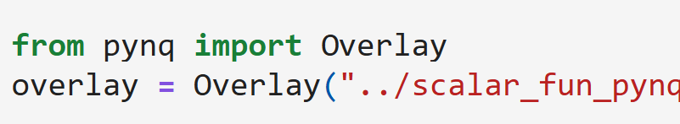
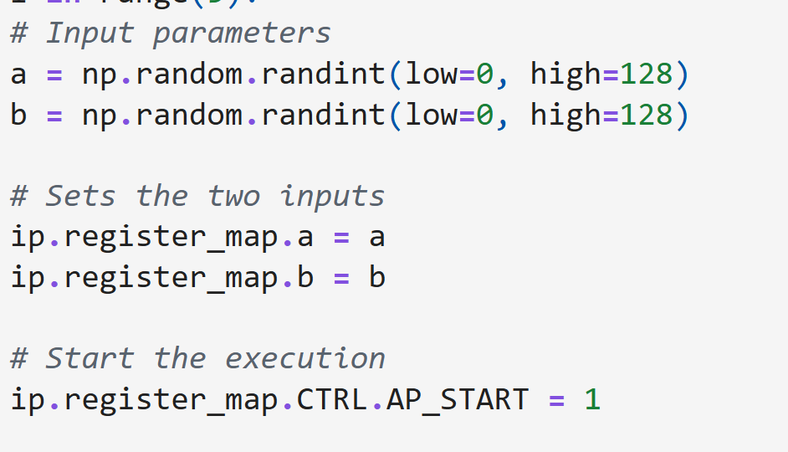
FPGA Boards
Projects and labs can be deployed on actual hardware
  Currently optional due to price
We suggest: Pynq-Z2 board
  $300
  USB connection to your laptop
  Pynq: Simple python interface
  Low-end, but ideal for teaching
Other boards may be available in lab
  Ex: RFSoC 4x2 for wireless communications

Slide 11
Tentative Grading
Points
  Homework + Labs: 25%
  Midterm: 25%
  Final: 25%
  Project: 25%
Labs will be mostly SystemVerilog and VitisHLS
  Approximately 4 Vitis HLS assignments
  Approximately 5 written assignments
Midterm and Final are in class
  Closed book, no electronic aids

Slide 12
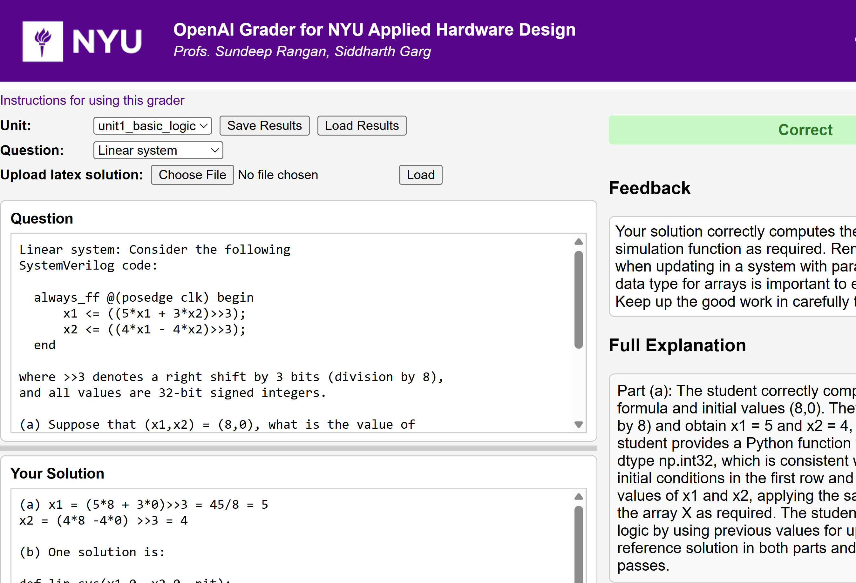
AI Autograder
An LLM-automated grader
Will use for:
  In class exercises
  For Gradescrope submissions
Provides
  Instant, detailed feedback
But
  May make mistakes
Still experimental
  Need your feedback

Slide 13
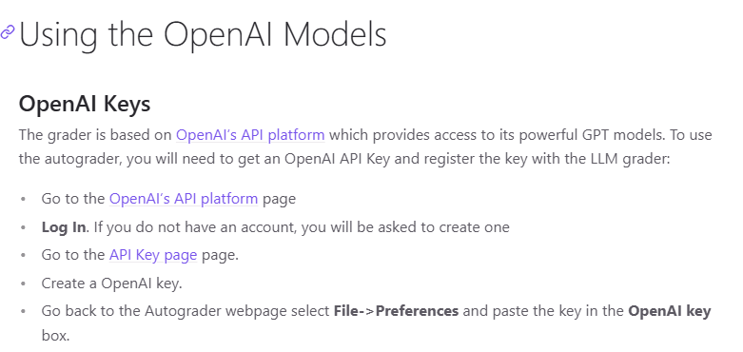
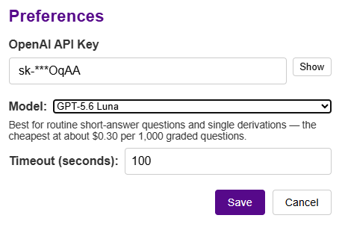
OpenAI API Keys
LLM Grader uses OpenAI models
You will need your own OpenAI API key
Follow instructions
Cost is minimal:
  For GPT-5.6 Luna, about $0.30 for 1000 questions
Note: Your OpenAI API key is kept privately
  Stored on your browser

Slide 14
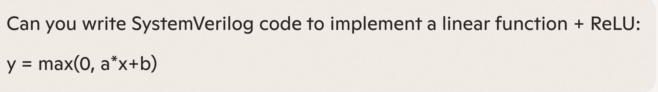
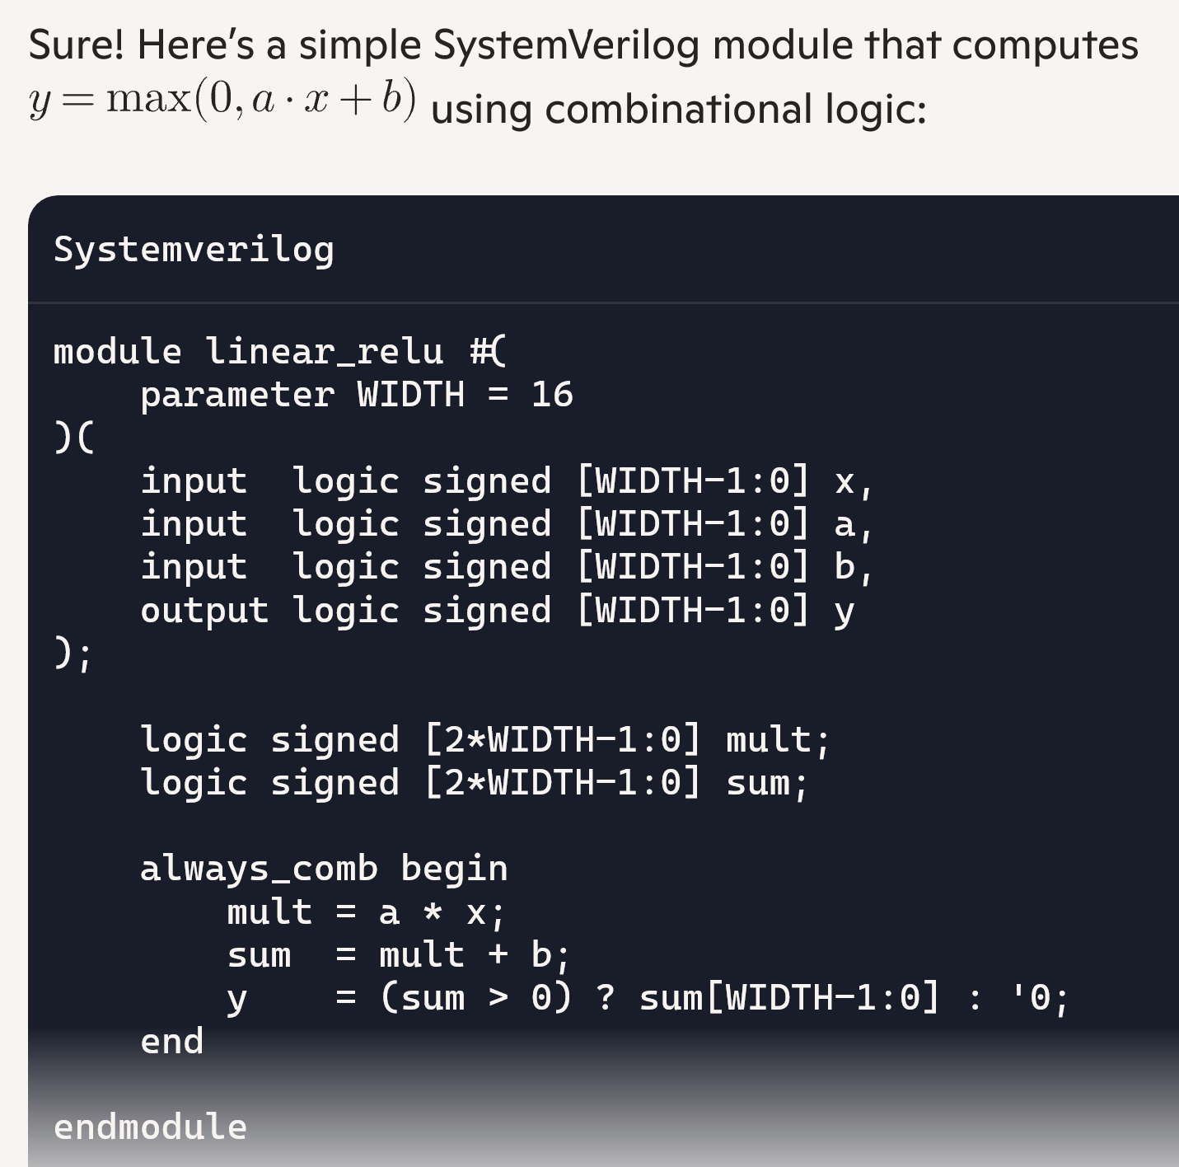

Using AI
It is encouraged!
  Use it for labs, problems, projects
But learn to use it well:
  It still makes mistakes.
  Learn to test the results
  Write clear, specific prompts
  Use it as a tutor
  Have it generate questions
  Explain results
On the midterm & final there are no aids!

Slide 15
Tentative Syllabus 1
Date | Lecture
9/2/2026 | Course Admin Unit 1: Data types and combinational logic
9/9/2026 | Unit 2: Sequential logic and finite state machines
9/16/2026 | Unit 3: Floating- and fixed-point arithmetic
9/23/2026 | Unit 4: Bus basics and memory-mapped interfaces
9/30/2026 | Unit 5: FIFO and streaming interfaces
10/7/2026 | Midterm review
10/14/2026 | Legislative Monday - no class
10/21/2026 | Midterm

Slide 16
Tentative Syllabus 2
Date | Lecture
10/28/2026 | Unit 6: Timing & critical path analysis
11/4/2026 | Unit 7: Pipelining and loop optimization
11/11/2026 | Unit 8: Shared memory architectures
11/18/2026 | Unit 9: Systolic arrays
11/25/2026 | Possible advanced topic
12/2/2026 | Final exam
12/9/2026 | Project presentations

Slide 17


Project
Build your own IP
You must provide:
  A clearly defined hardware IP block (RTL or HLS)
  A well‑specified interface and integration model with a host system
  A testbench and evaluation methodology
  Documentation that allows others to reproduce your result
Any topic of choice
  Computer vision, communications, computing, …
Work in groups of 2 to 4
  Individual projects require instructor permission
Hardware IP
or accelerator
Host system

Slide 18



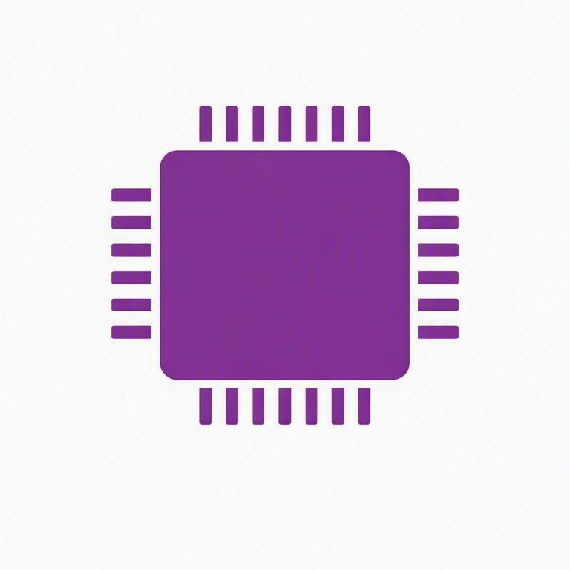
Use AI the Right Way!
AI works well only when…
Ideas and goals are precise
The design is planned
  Context before AI fills in the detail
Every output is verified
  AI makes mistakes — a design needs proof
  Know the expected result before you ask
Idea prompt
AI
Plan
AI
Design
Verify

Slide 19
Project Grading
See full rubric on project page on the GitHub pages
Submission on GitHub
  Create a repo for the project. You can start now!
  Submit only the repo URL.
IP definition and interface: Clear role, well-justified boundary between host and IP
IP design: Efficient design, correct, design choices
Verification and evaluation:
  Testbench that are comprehensive, test corner cases, evaluate performance
  Measure design options
Organization and documentation: Assume you are pitching to a prospective employer

Slide 20
Outline
Course Admin
What is Custom Hardware and What Can it Do?

Slide 21


Hardware vs. Software
Hardware
Any electronic circuit that performs some computation
Software
Instructions executed on hardware

Slide 22
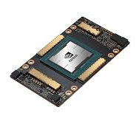
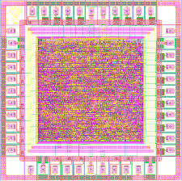
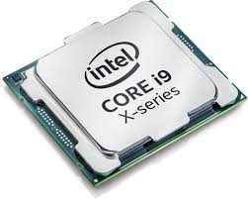
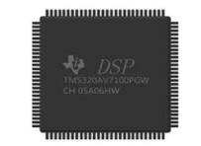
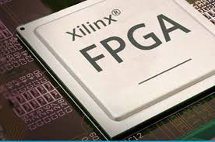
Hardware Comes in Many Forms
General purpose CPU
Intel, AMD, ARM
DSP
Texas Instruments,
Qualcomm
Hexagon
GPU
Nvidia
Intel Radeon
FPGA
Xilinx / AMD,
Intel / Altera
Custom ASIC
Qualcomm,
Apple,
Broadcomm

Slide 23
General Purpose vs. Custom
General purpose CPU
DSP
GPU
FPGA
Custom ASIC
General purpose,
Applies in many domains,
Re-programmed with software,
Performance via SW optimization, multi-cores
Domain specific,
HW optimized for specific task,
Can enable:
Higher performance,
Lower power / OP, size
Focus of this course

Slide 24

Accelerator or IP Model
Host system
Runs main application,
User interface,
May be embedded as well
(e.g., smartphone)
Embedded Processor
(DSP, ARM,…)
Configures HW,
Manages data transfer,
Performs some DSP
Hardware IP or accelerator
Compute intensive tasks
Domain specific
High-speed IO
Network interface,
Digital communication data
This class

Slide 25

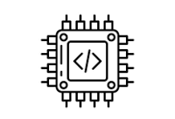


What HW Does Well: Parallelism
Custom hardware
Single thread processor
Step A
Step B
Step C
Step A
Step B
Step C
Throughput
$∝$ Clock frequency
$∝$ ${Power}^{2}$
Throughput
$∝$ Hardware instance
$∝Power$
HW parallelism can be fundamentally more efficient

Slide 26

What is HW is Bad at: Conditional Logic
Custom hardware
Single thread processor
Test $C$
If C:
Do A
else:
Do B
A
B
Conditional / intermittent logic: good
Use all resources to whatever is needed
Conditional / intermittent logic: poorly
Need logic for all paths
Paths not used are idle

Slide 27
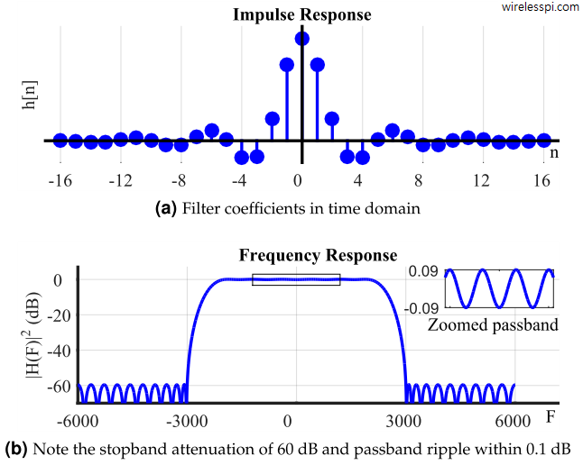
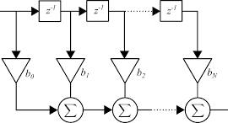
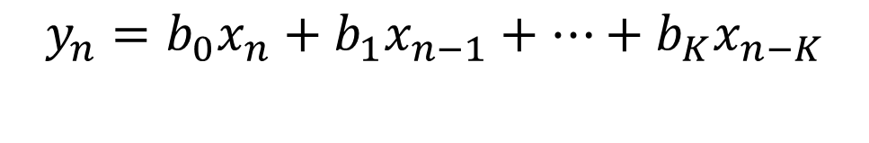

Example Accelerator: Filtering in DSP
$$y_{n}=b_{0}x_{n}+b_{1}x_{n−1}+…+b_{K}x_{n−K}$$
CPU / DSP:
Design taps
Intermittent,
delay insensitive
FPGA / ASIC accelerator
Run filter
High-speed, repeated, high-parallelism
$$b_{0},…, b_{K}$$

Slide 28
What is Custom Hardware Good At
Compute‑intensive kernels
  High arithmetic density, many operations per data
Structured, repetitive tasks
  Same operation repeated many times
  Regular data flow, memory access
Regular dataflow and memory patterns
  Tight control of timing, no OS jitter
High throughput with low energy
  Custom datapaths, optimized bit-widths, specialized memories
Examples: DSP, linear algebra, ML inference, crypto, compression

Slide 29
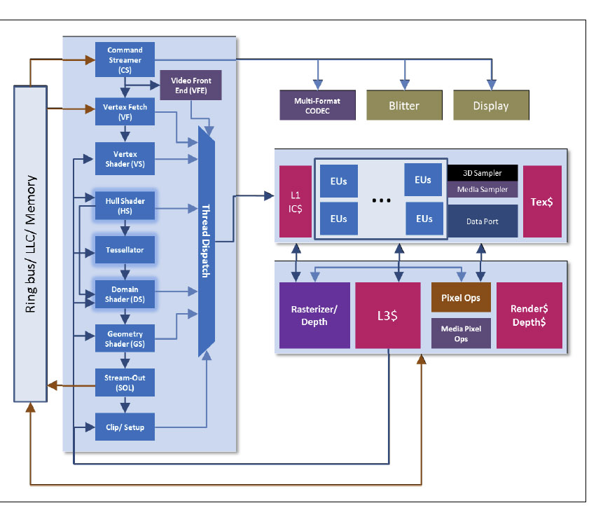
Example: Intel Quick Sync Media Processor
Intel specialized graphics units
  Programmable shaders for parallel math
  Fixed‑function blocks (rasterizer, tessellator, texture units)
  Media engines for video encode/decode (Quick Sync)
Integrated into Core‑i3 / i5 / i7 / i9 processors
  Physically part of the CPU die
  Shares memory hierarchy with CPU cores
  High‑speed on‑chip interfaces
Direct access to system memory
  High‑bandwidth internal fabric
  Connecting CPU, GPU, and media engines
  Low‑latency paths

Slide 30

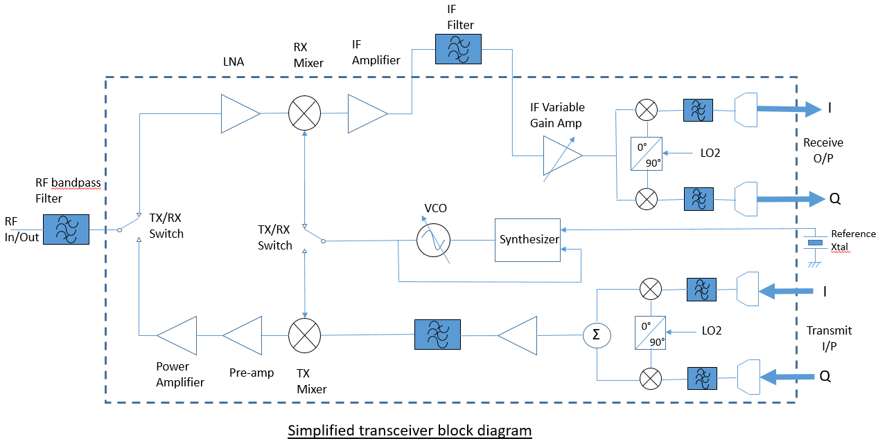
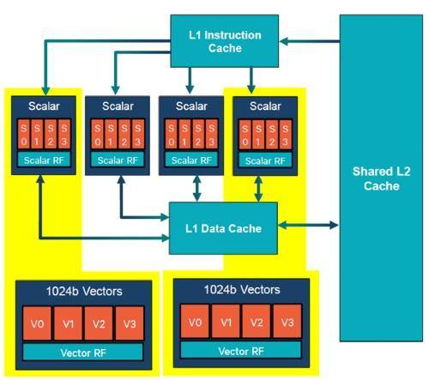
Example: 5G Modem Core
Gsamps / s
ARM Core
Upper layer SW,
Configuration,
Networking,
Packet processing
5G HW
Filtering,
Equalization,
Decoding,
…
RFIC
Antenna interface,
Radio frequency operations,
DACs / ADCs
Hexagon DSP
Control channels,
Infrequent, but complex,
data processing

Slide 31
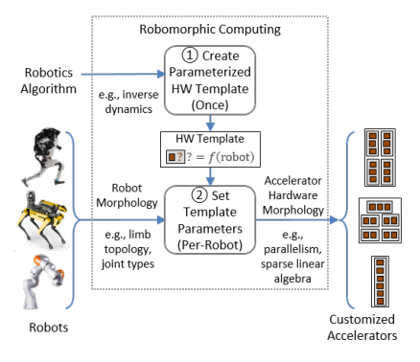
Example: Robomorphic Computing
Custom accelerator for robotic computation
Performs complex kinematic simulations for:
  Model predictive control
  Path planning
Key challenge:
  How do you describe robot morphology?
  Need a general structure applicable to many robots
  Many algorithms
Neuman, S. M., Plancher, B., Bourgeat, T., Tambe, T., Devadas, S., & Reddi, V. J. (2021, April). Robomorphic computing: a design methodology for domain-specific accelerators parameterized by robot morphology. In Proceedings of the 26th ACM International Conference on Architectural Support for Programming Languages and Operating Systems (pp. 674-686).

Slide 32
FPGA vs. ASIC
FPGA: Field‑Programmable Gate Array
  Reconfigurable hardware
  Great for prototyping and teaching: no fabrication needed
  Slower and less power‑efficient than ASICs
  Research, rapid development, low‑volume products, networking gear, some accelerators
ASIC: Application‑Specific Integrated Circuit
  Custom hardware chip designed for one purpose (e.g., video codec, 5G modem, ML accelerator)
  Much faster and more power‑efficient than FPGAs
  Cannot be changed after fabrication — the design is permanent
  Manufactured (“fabricated”) at a semiconductor foundry
  Ex: TSMC,
  Smartphones, GPUs, Automotive, …

Slide 33


Turnaround Time Contrasted
Seconds
Write code
Compile
Run
Software
Design
Simulate
Synthesize
Generate
Bitstream
Run
FPGA
Custom
ASIC
Design
Simulate
Synthesize
Layout
Fabrication
Package
Integrate
Run
Months

Slide 34
Three Conceptual Challenges for Hardware
Concurrency
  Hardware modules run in parallel
  Like multi-threaded programs
  Must consider resource contention, information passing, …
Long turnaround time
  Need reliable simulation and test before fabrication
  High level of rigor
Need for interface abstraction
  Hardware must work over broad range of problems
  But provide gains specific to domain

Slide 35



HW Design Is Getting Easier
Traditional view: HW is Hard
Rarely-used languages
Small, elite community
Complex tool chain
Long turnaround time
Need to design concurrent systems
New Tools
High-Level Synthesis
  Program in C/C++/Python
AI-assisted design
  LLMs are learning HW fast
Python-based tool flow
  FPGA Python APIs
  Python simulation, …

Slide 36
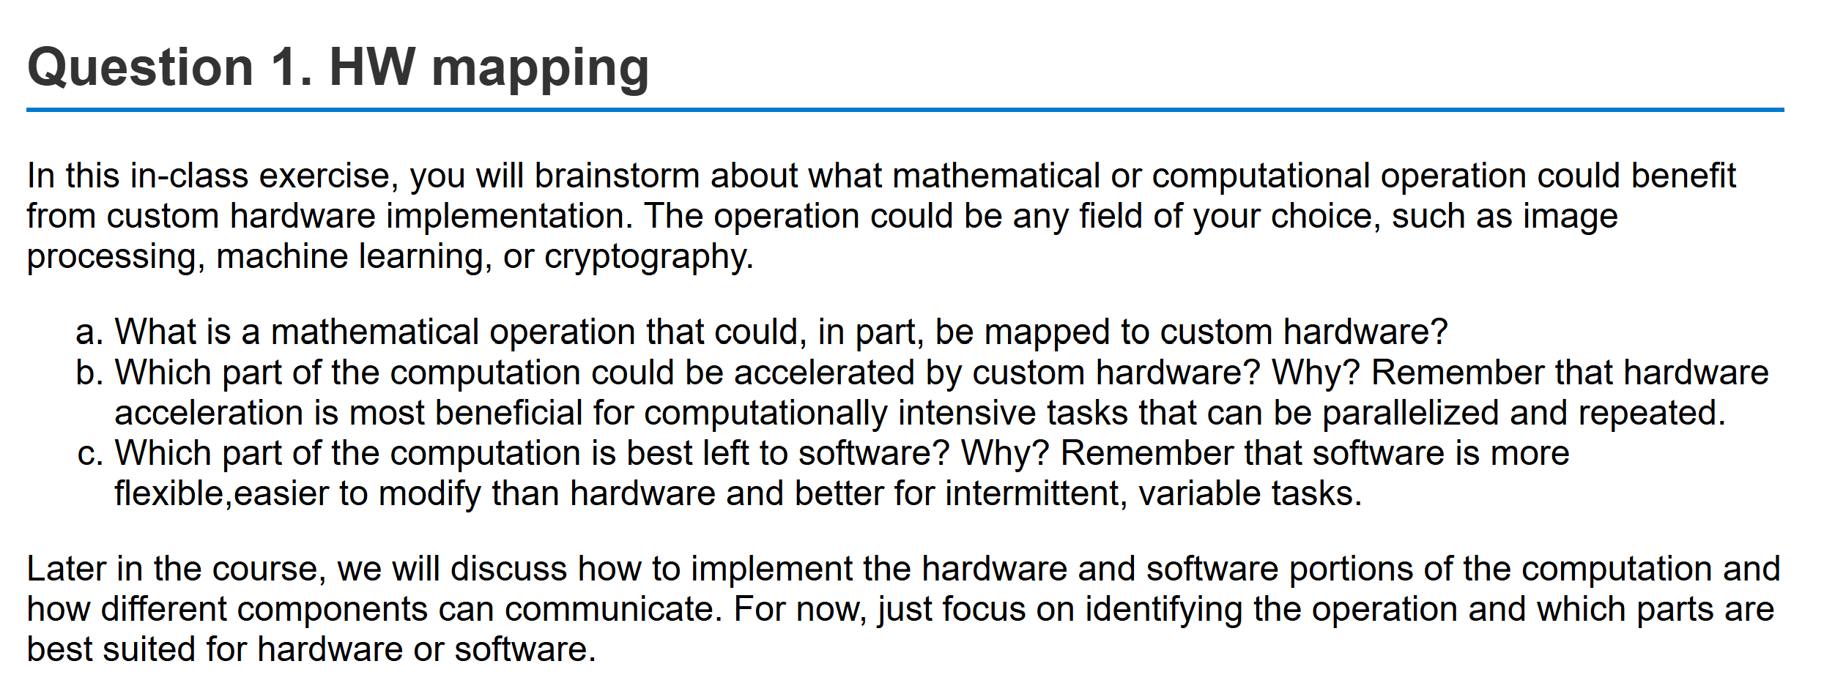
In-Class Exercise
Break into groups
Answer in llmgrader

Slide 37
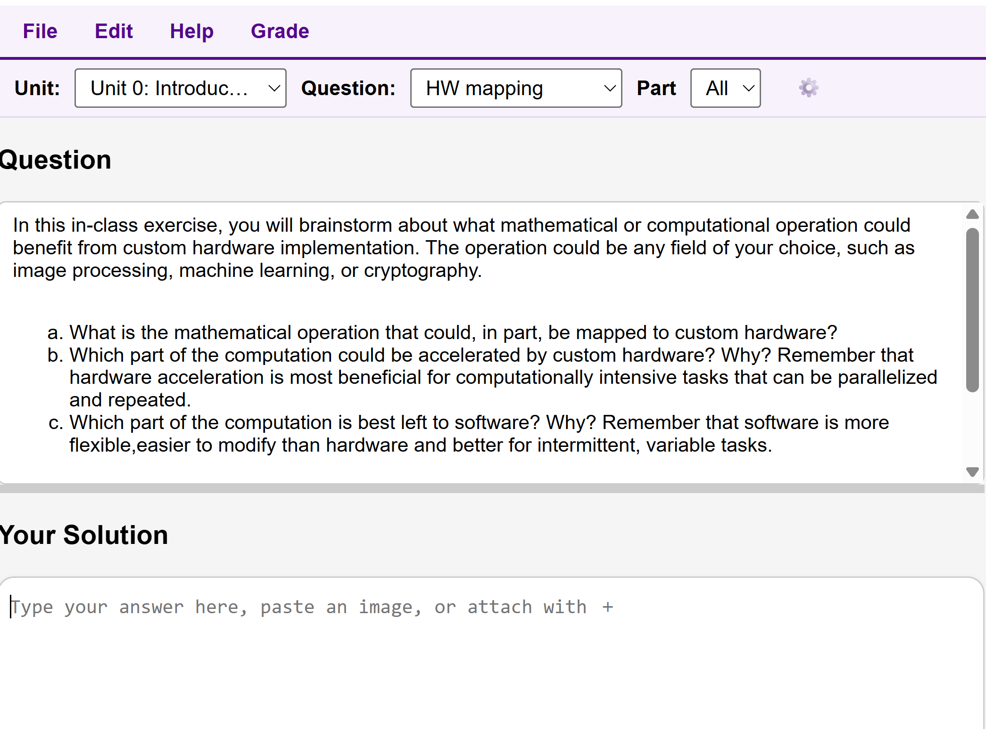
In-Class Exercise on LLM Grader
Break into groups
Go to: https://llmgrader-e6o7.onrender.com/
Select Unit 0
Select Question HW mapping
Iterate on your solution with your group

