Slide 1
Unit 7
Loop Optimization and Pipelining
ECE-GY 6463: Advanced Hardware Design
ProfS. Sundeep Rangan, Siddharth Garg

Slide 2
Learning Objectives
Manually pipeline simple sequential modules in System Verilog
Measure initiation interval, latency, and total latency
Control auto-pipelining in Vitis HLS
Extract resource and pipelining data from Vitis HLS synthesis reports
Unroll loops in Vitis HLS
Mitigate memory bottlenecks in unrolled loops with:
  Increased memory bit width
  Memory partitioning

Slide 3
Outline
Pipelining in SystemVerilog
Loop Pipelining in Vitis HLS
Loop Unrolling and Memory Constraints

Slide 4
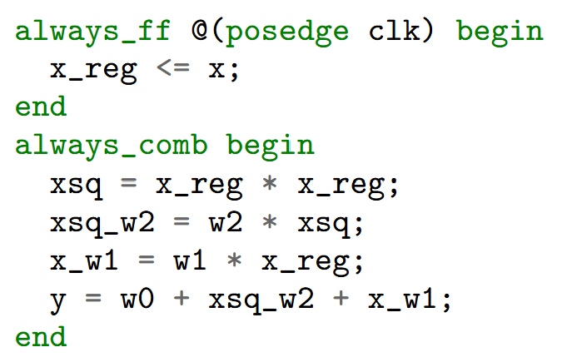
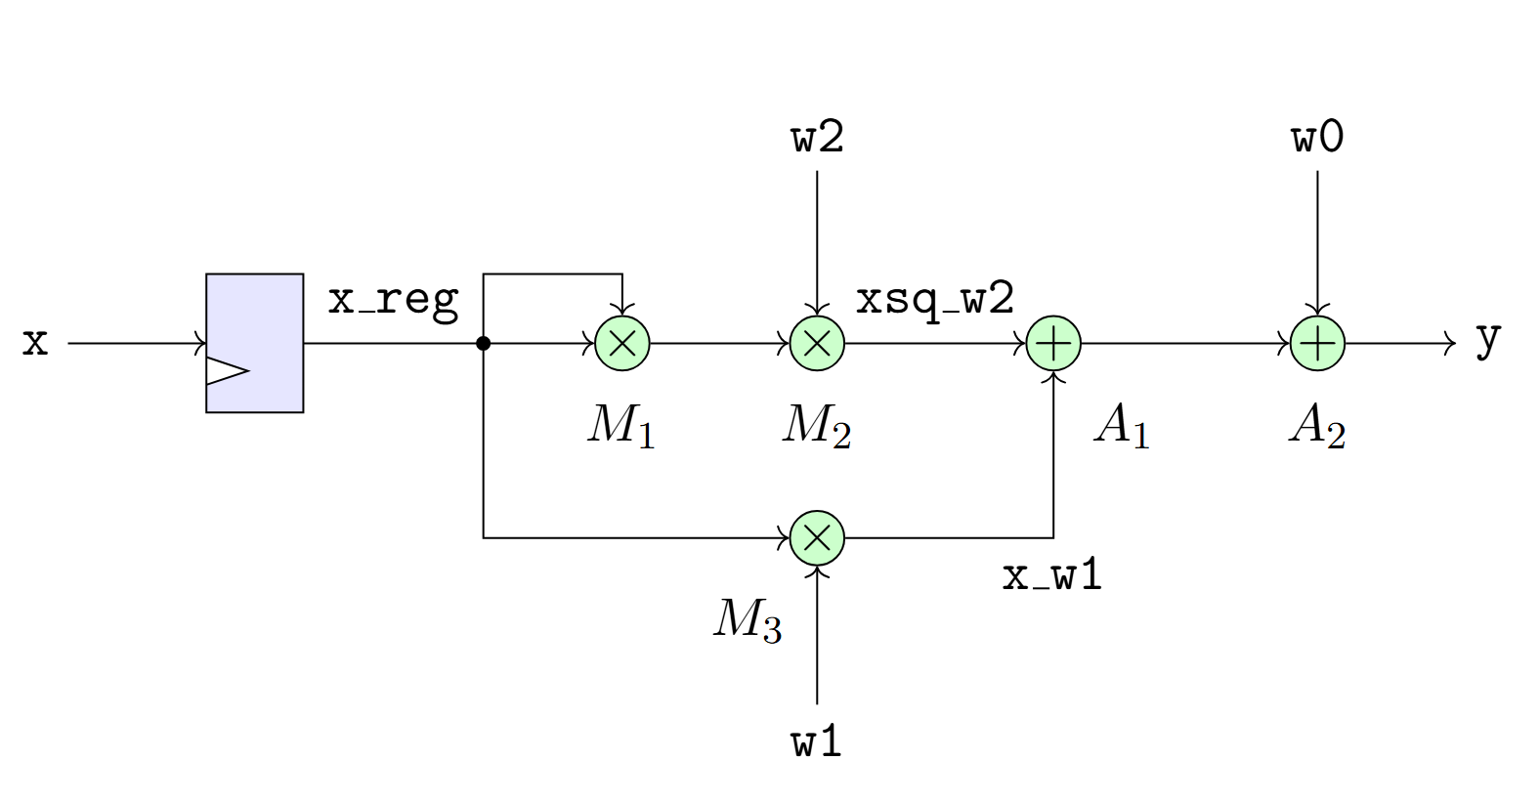

Quadratic Example
Consider a quadratic function: $y=w_{2}x^{2}+w_{1}x+w_{0}$ (from previous unit)
For simplicity, assume $w_{0},w_{1},w_{2}$ are fixed parameters
Single cycle implementation to the right
Marked multiplier units $M_{1},M_{2}, M_{3}$

Slide 5
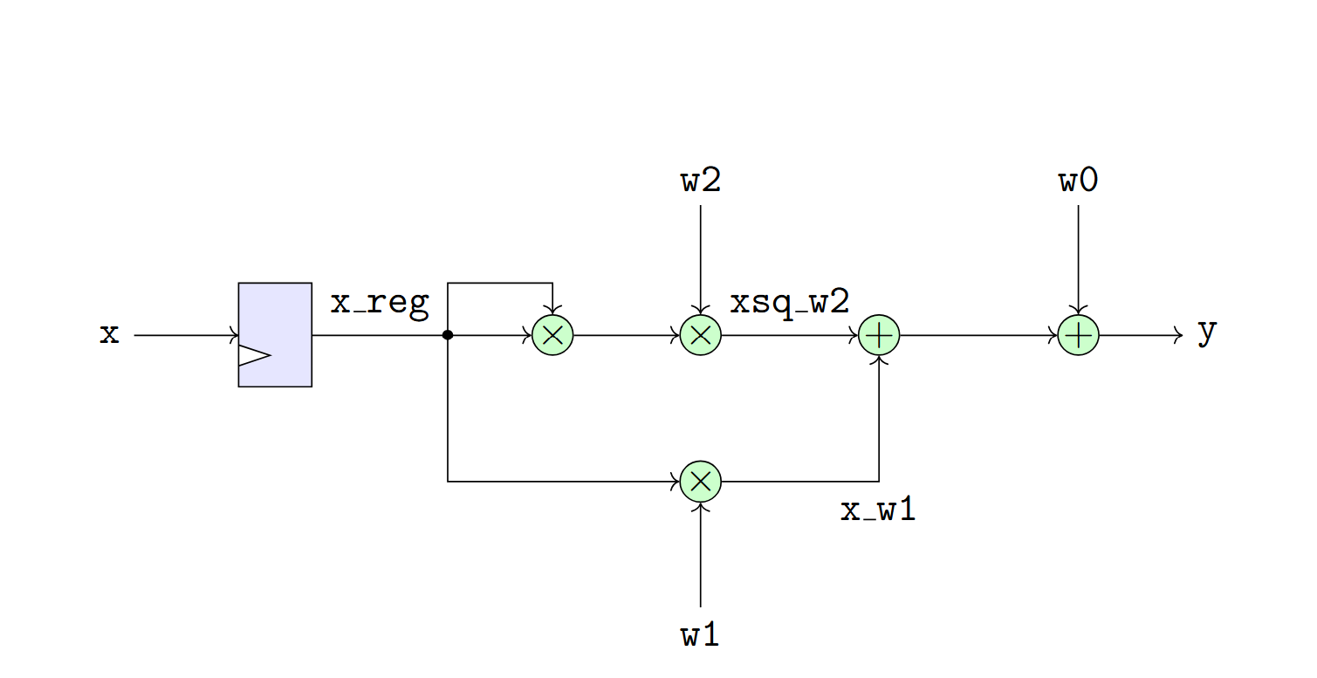
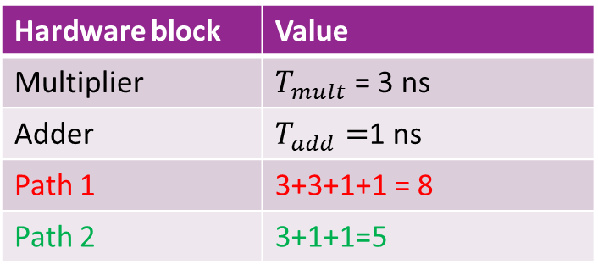
Finding the Critical Path
Hardware block | Value
Multiplier | $T_{mult}$ = 3 ns
Adder | $T_{add}=$1 ns
Path 1 | 3+3+1+1 = 8
Path 2 | 3+1+1=5
Consider implementation with times in table
Find critical path
  Not including clk-Q and setup time
Two paths:
Path 1: x, x_reg, xsq_w2, y
  2 mults, 2 adders = 8.5 ns
Path 2: x, x_reg, x_w1, y
  1 register, 1 mult, 2 adders = 5.5 ns
Path 1 is critical

Slide 6
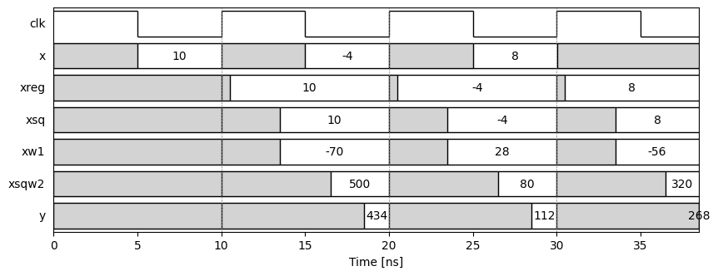

Timing Diagram
Timing diagram with $T_{clk}=10$ ns (100 MHz)

Slide 7
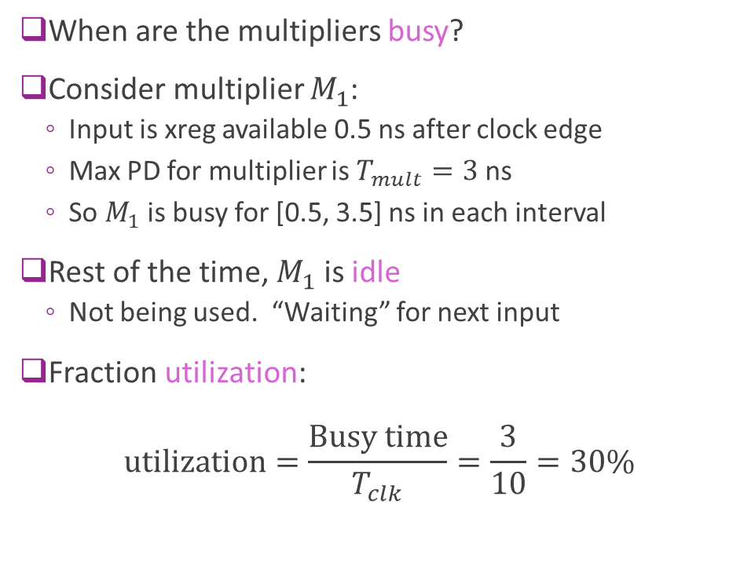
Multiplier Utilization
When are the multipliers busy?
Consider multiplier $M_{1}$:
  Input is xreg available 0.5 ns after clock edge
  Max PD for multiplier is $T_{mult}=3$ ns
  So $M_{1}$ is busy for [0.5, 3.5] ns in each interval
Rest of the time, $M_{1}$ is idle
  Not being used. “Waiting” for next input
Fraction utilization:
$\text{utilization}=\frac{\text{Busy} \text{time}}{T_{clk}}=\frac{3}{10}=30\%$

Slide 8
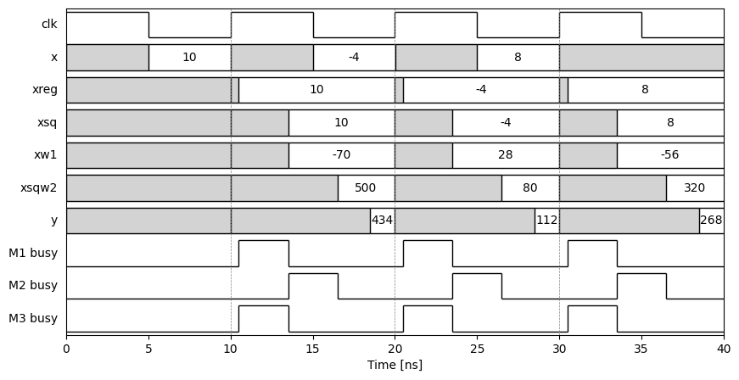


Plotting the Utilization
Each multiplier busy only once in clock period
$M_{1}, M_{3}$ busy
$M_{2}$ busy

Slide 9
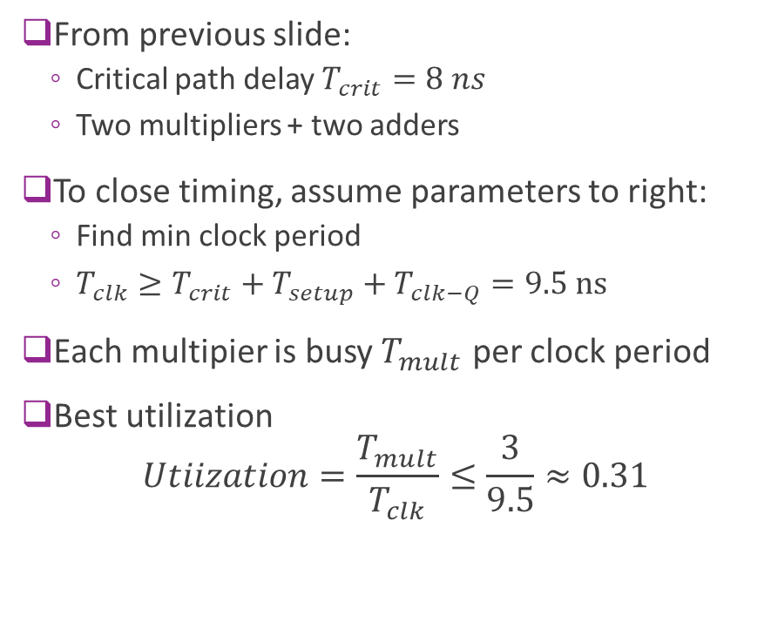
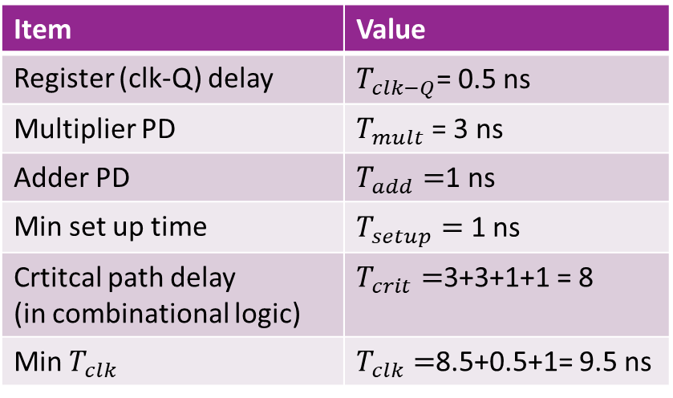
Best Utilization with Single Cycle Design
From previous slide:
  Critical path delay $T_{crit}=8 ns$
  Two multipliers + two adders
To close timing, assume parameters to right:
  Find min clock period
  $T_{clk}≥T_{crit}+T_{setup}+T_{clk−Q}=9.5 ns$
Each multipier is busy $T_{mult}$ per clock period
Best utilization
$Utiization=\frac{T_{mult}}{T_{clk}}≤\frac{3}{9.5}≈0.31$
Item | Value
Register (clk-Q) delay | $T_{clk−Q}$= 0.5 ns
Multiplier PD | $T_{mult}$ = 3 ns
Adder PD | $T_{add}=$1 ns
Min set up time | $T_{setup}=$ 1 ns
Crtitcal path delay (in combinational logic) | $T_{crit}=$3+3+1+1 = 8
Min $T_{clk}$ | $T_{clk}=$8.5+0.5+1= 9.5 ns

Slide 10
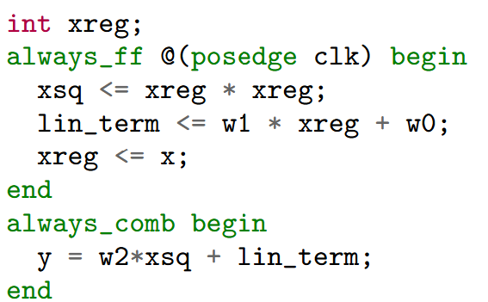
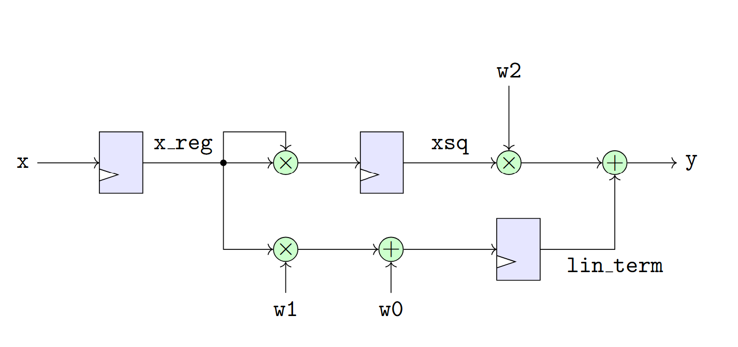
A Two Cycle Design
We can improve throughput by breaking computation over two cycles
Register two intermediate terms:
  xsq = xreg * xreg
  lin_term = w1*xreg + w0

Slide 11

Three Stages
Design is processed in three stages = 2 cycles
Stage 0
  Register input $x$ to xreg
Stage 1: Compute and register:
  xsq = xreg * xreg
  lin_term = w1*xreg + w0
Stage 2: Compute output
  y = w2*xsq + lin_term

Slide 12
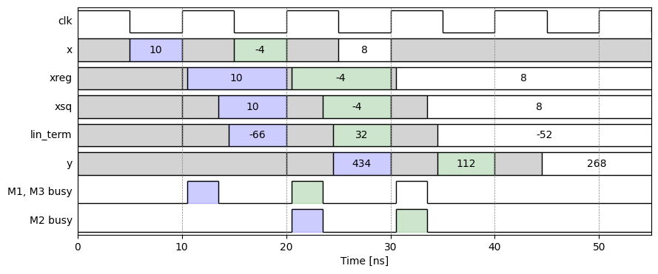
Pipelining Timing Diagram
Processing via a “pipeline”
Multipliers working simultaneously

Slide 13
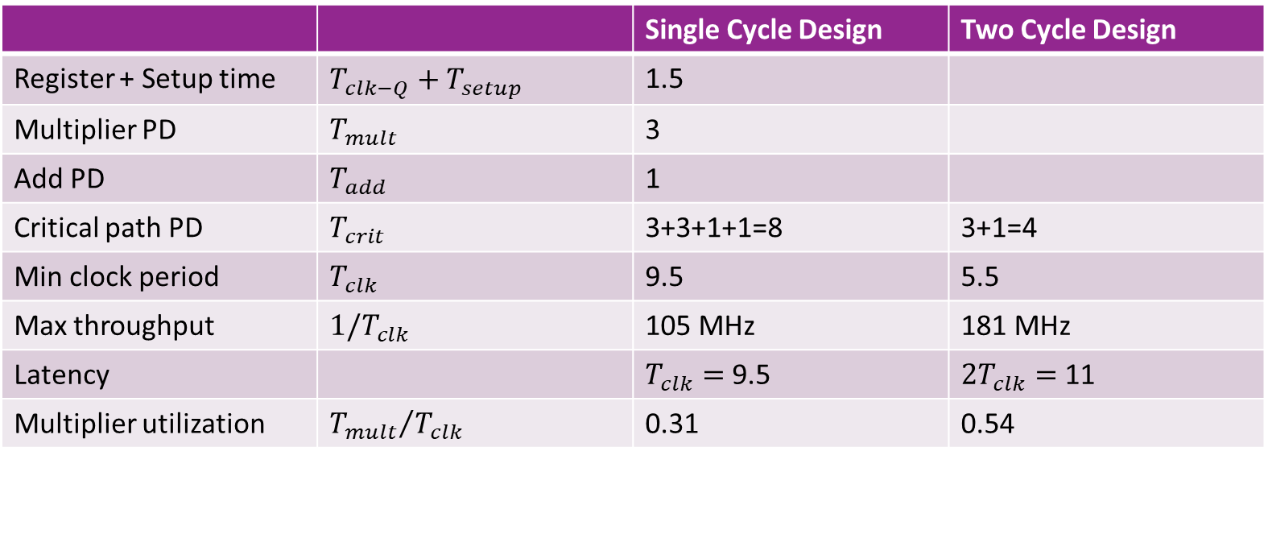
Comparison
 |  | Single Cycle Design | Two Cycle Design
Register + Setup time | $T_{clk−Q}+T_{setup}$ | 1.5
Multiplier PD | $T_{mult}$ | 3
Add PD | $T_{add}$ | 1
Critical path PD | $T_{crit}$ | 3+3+1+1=8 | 3+1=4
Min clock period | $T_{clk}$ | 9.5 | 5.5
Max throughput | $1/T_{clk}$ | 105 MHz | 181 MHz
Latency |  | $T_{clk}=$ 9.5 | $2T_{clk}=$ 11
Multiplier utilization | ${T_{mult}}/{T_{clk}}$ | 0.31 | 0.54
Pipelining: Higher throughput via better utilization

Slide 14
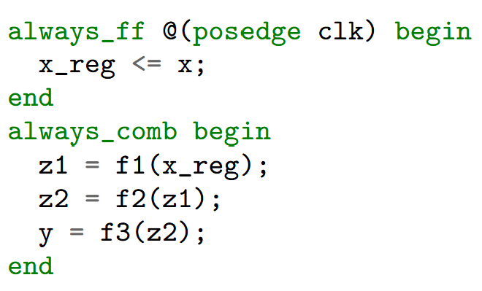
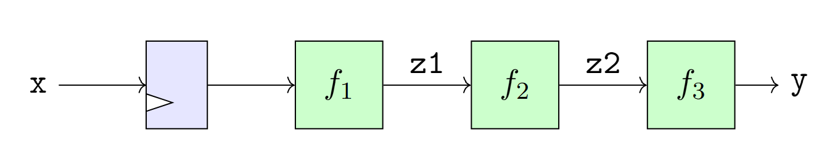
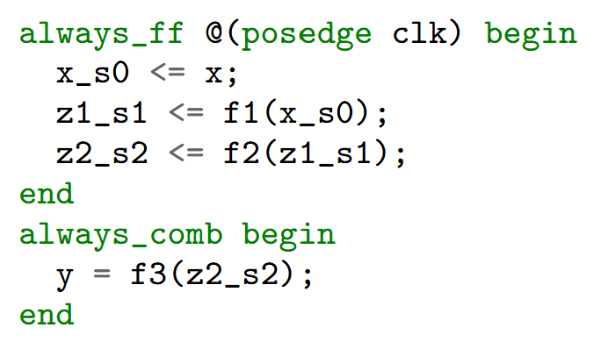
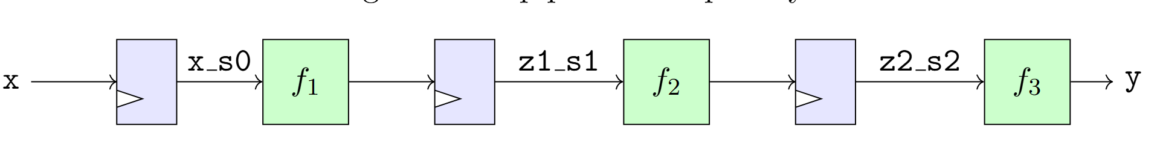
General Pipelining for a Series
Insert registers on each stage
Use suffixes s0, s1, s2 to indicate stage

Slide 15
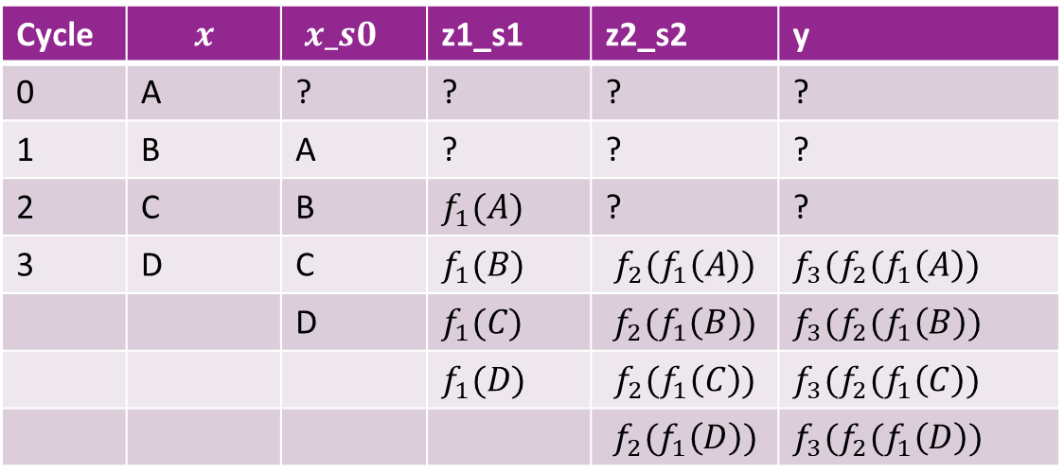
Cycle-by-Cycle Timing
Cycle | $$x$$ | $x_s0$ | z1_s1 | z2_s2 | y
0 | A | ? | ? | ? | ?
1 | B | A | ? | ? | ?
2 | C | B | $f_{1}(A)$ | ? | ?
3 | D | C | $f_{1}(B)$ | $$f_{2}(f_{1}\left(A\right))$$ | $f_{3}(f_{2}(f_{1}\left(A\right))$
 |  | D | $f_{1}(C)$ | $$f_{2}(f_{1}\left(B\right))$$ | $f_{3}(f_{2}(f_{1}\left(B\right))$
 |  |  | $f_{1}(D)$ | $$f_{2}(f_{1}\left(C\right))$$ | $f_{3}(f_{2}(f_{1}\left(C\right))$
 |  |  |  | $$f_{2}(f_{1}\left(D\right))$$ | $f_{3}(f_{2}(f_{1}\left(D\right))$

Slide 16
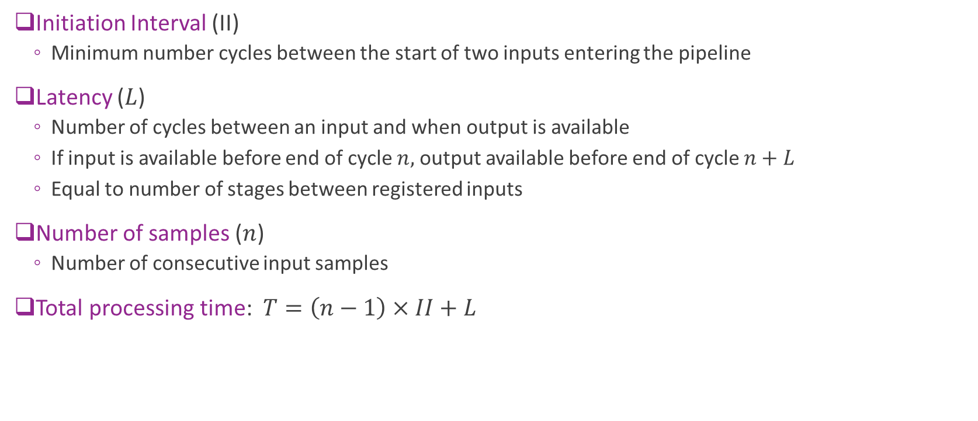
Timing Terminology
Initiation Interval (II)
  Minimum number cycles between the start of two inputs entering the pipeline
Latency ($L$)
  Number of cycles between an input and when output is available
  If input is available before end of cycle $n,$ output available before end of cycle $n+L$
  Equal to number of stages between registered inputs
Number of samples ($n$)
  Number of consecutive input samples
Total processing time: $T=\left(n−1\right)×II+L$

Slide 17
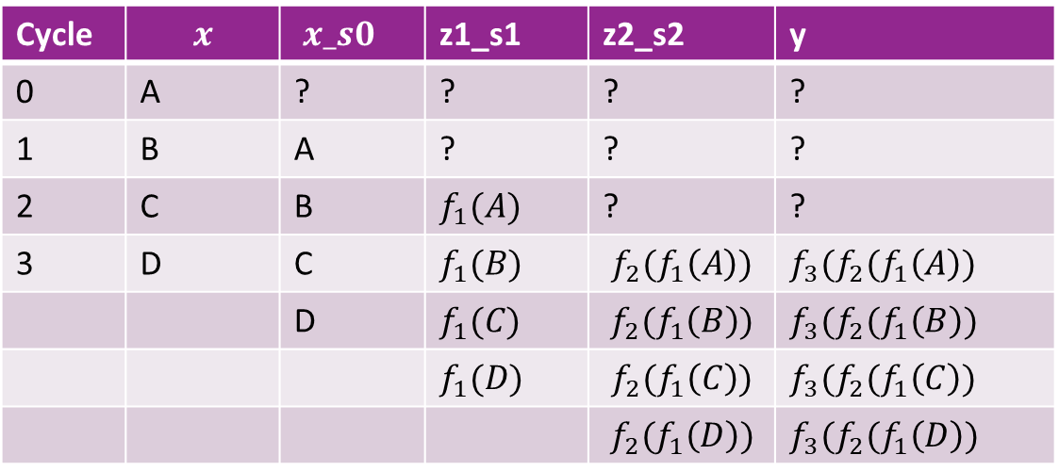


Timing Terminology Visualized
Cycle | $$x$$ | $x_s0$ | z1_s1 | z2_s2 | y
0 | A | ? | ? | ? | ?
1 | B | A | ? | ? | ?
2 | C | B | $f_{1}(A)$ | ? | ?
3 | D | C | $f_{1}(B)$ | $$f_{2}(f_{1}\left(A\right))$$ | $f_{3}(f_{2}(f_{1}\left(A\right))$
 |  | D | $f_{1}(C)$ | $$f_{2}(f_{1}\left(B\right))$$ | $f_{3}(f_{2}(f_{1}\left(B\right))$
 |  |  | $f_{1}(D)$ | $$f_{2}(f_{1}\left(C\right))$$ | $f_{3}(f_{2}(f_{1}\left(C\right))$
 |  |  |  | $$f_{2}(f_{1}\left(D\right))$$ | $f_{3}(f_{2}(f_{1}\left(D\right))$
$$II=1$$
$$L=3$$
Insert registers on each stage
Use suffixes s0, s1, s2 to indicate stage

Slide 18
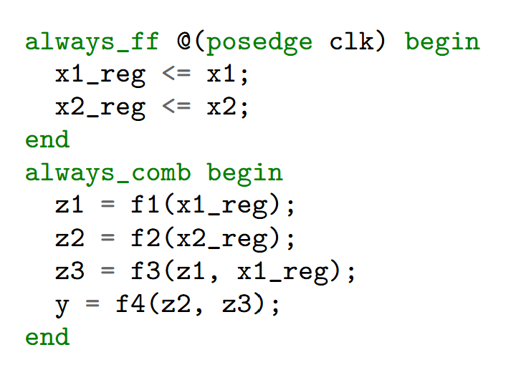
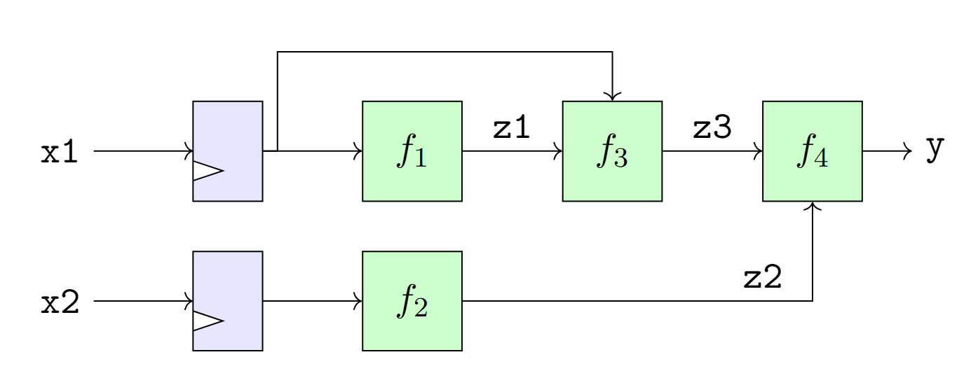
Pipelining with Multiple Paths
Now consider a more complex example with multiple paths
How do we pipeline this?

Slide 19
Multi-Path Pipelining: Identify Stages
First, we draw the stages
  Shown in the vertical lines
Stage 0: Inputs to registers
  This stage will exist in non-pipeline code
Stage 1, 2, …
  Will end where we will put registers
  Ensure that each stage can be computed in sufficient time
Output stage is combinational
Stage 0
Stage 1
Stage 2
Combinational

Slide 20
Multi-Path Pipelining: Register Locations
Place registers at stage crossing
Shown in blue circles
Note: Need register even when
  Signal is just a pass through
Stage 0
Stage 1
Stage 2
Combinational
Register locations

Slide 21
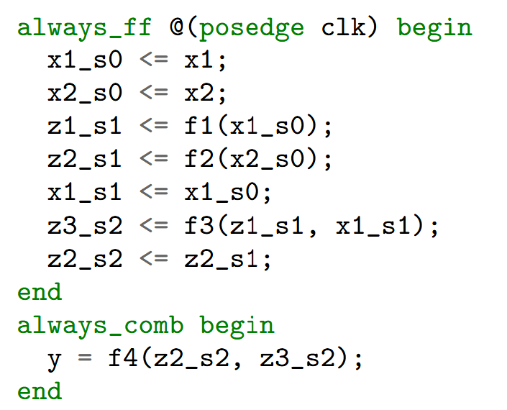
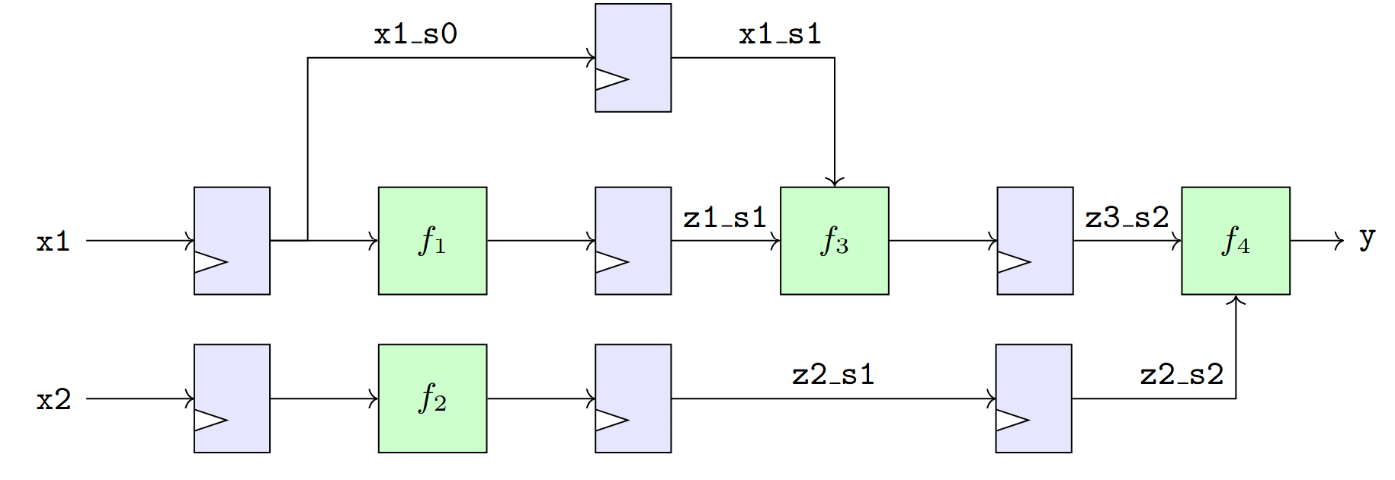
Final Pipelined Diagram and Code
Stage 0
Stage 1
Stage 2

Slide 22
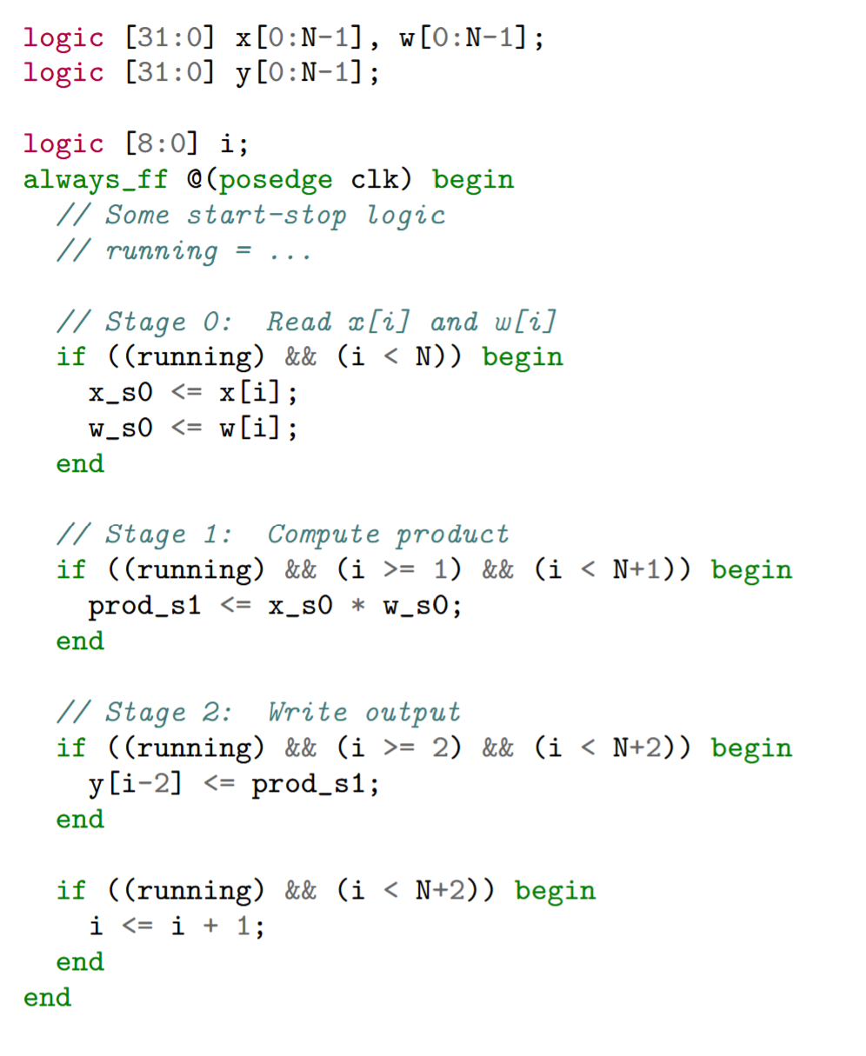
Memory Accesses
Memory reads and writes:
  Generally take at least on cycle delay
  Hardware provides an address
  Memory location fetched with an address decoder
Pipelining must account for this delay
Example to the right:
  Takes elementwise product
  Load, product, and store are on separate cycles
Note the pipeline flush
  Tail of the pipeline for stages 1,

Slide 23
Outline
Pipelining in SystemVerilog
Loop Pipelining in Vitis HLS
Loop Unrolling and Memory Constraints

Slide 24
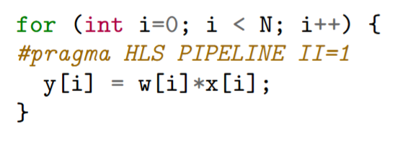
Why Use Vitis HLS?
Manual pipelining in System Verilog:
  Tedious
  Prone to mistakes
  Hard to optimize schedule
  Need to re-optimize on each technology
Vitis HLS C++
  Fully automated pipelining
  High-level description

Slide 25
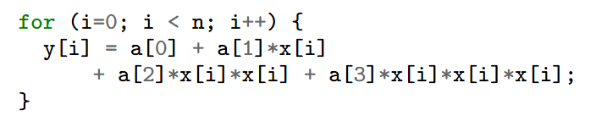
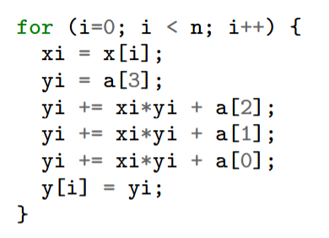
Polynomial Loop Example
Loop over cubic polynomial
Implemented with Horners method
  Bottom right
Each iteration involves
  One load from the array
  Three multiplications
  Three adds
  One store
We will implement in floating point FP32
  These are themselves pipelined
Would be hard to implement manually

Slide 26


Message Passing Protocol
Similar protocol to previous unit
Processing in blocks
Coefficients sent in a header
Followed by data
Transaction ID
  Used to ensure synchronization
  Robust to dropped packets
CmdHdr: Coefficients
num samples, trans ID
RespFtr: TransId
Vitis kernel
Testbench
or PS
SampDatIn: Values of $x[i]$
Perform polynomial evaluation
SampDataOut: Values $y[i]$
RespFtr: Error Code, num read

Slide 27
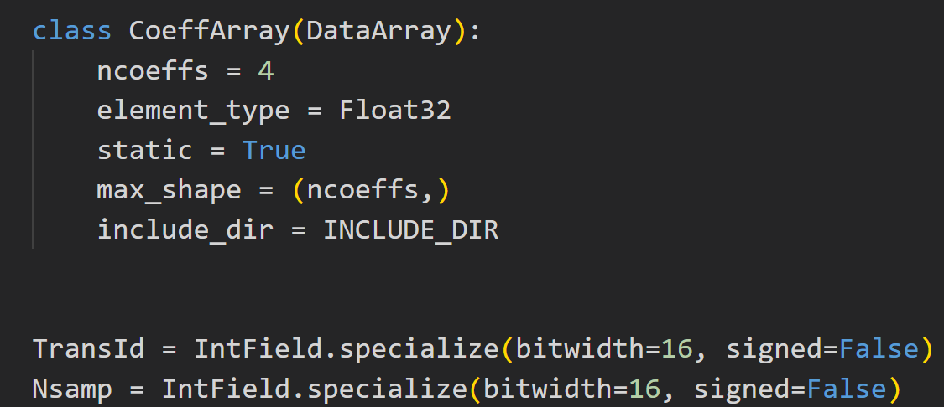
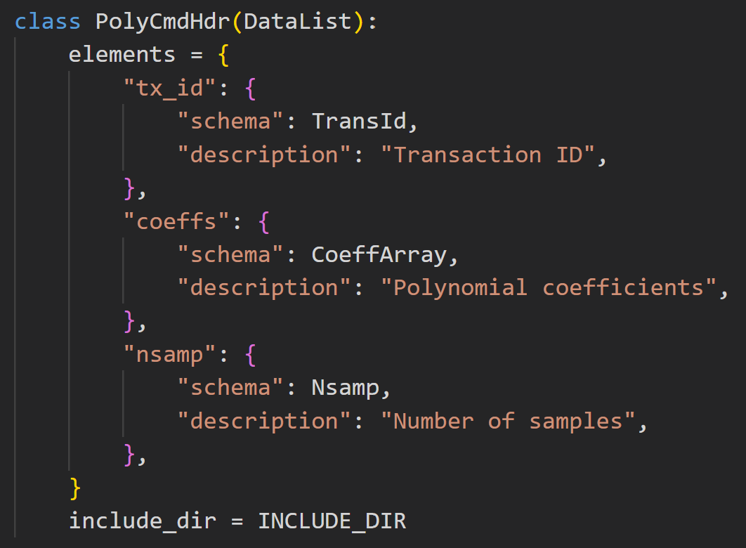
Define Data Structures
Use xilinxutils package
Define data structures in python

Slide 28
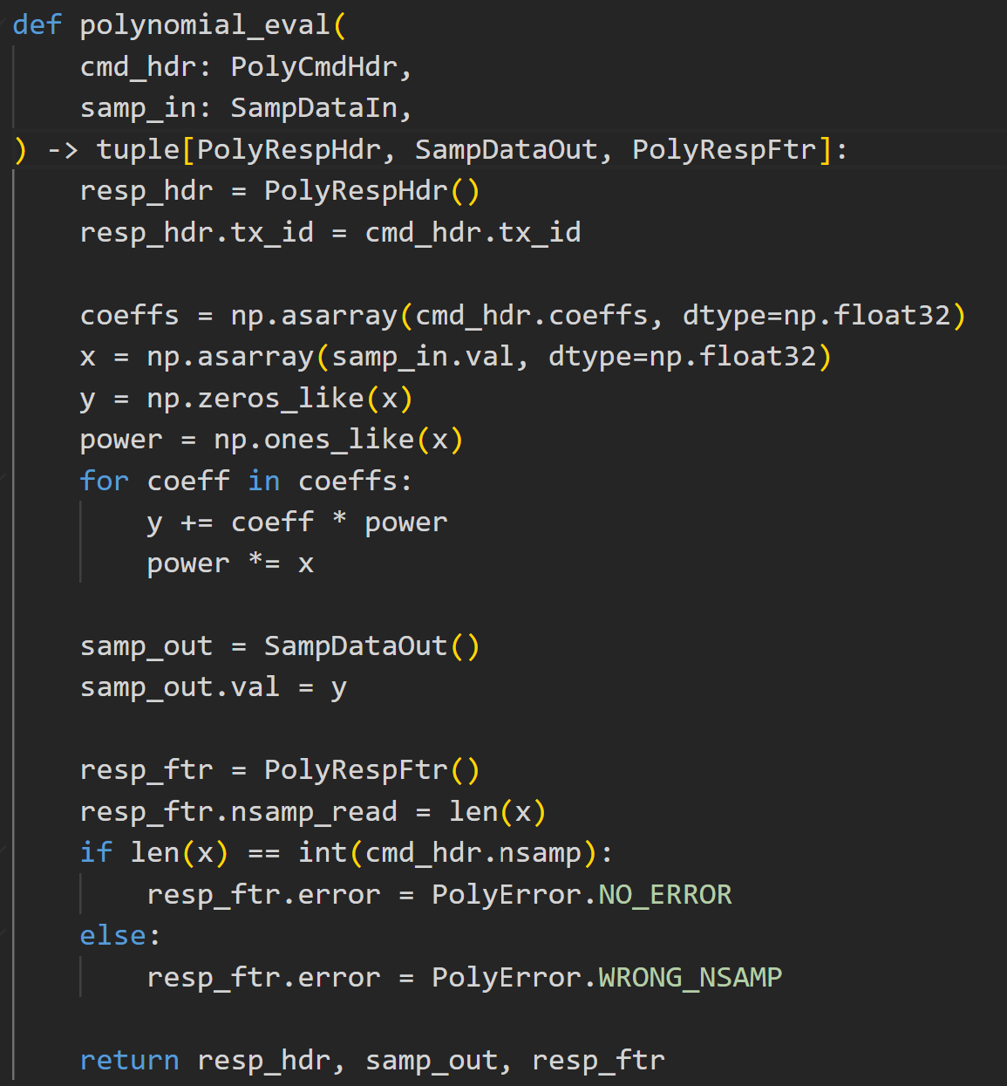
Create a Python Golden Model
Python Golden model
Simulates the same messages
Runs python polynomial evaluation

Slide 29
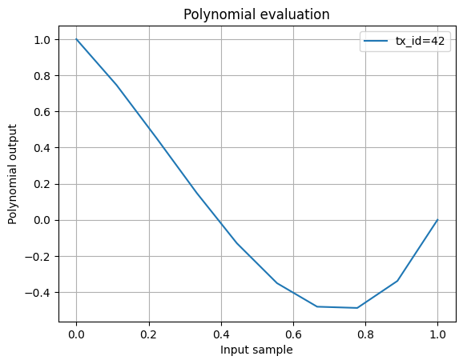
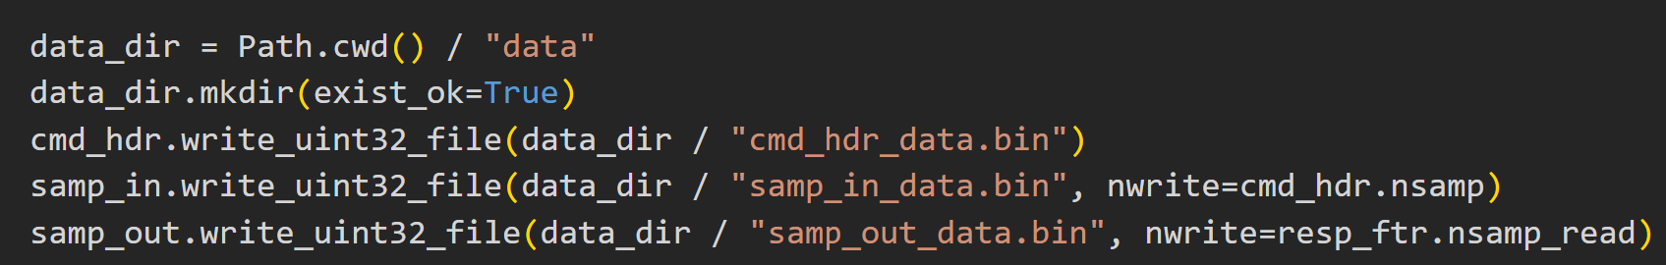
Running the Golden Model
Run the Golden model
Generate:
  Inputs
  Expected outputs

Slide 30
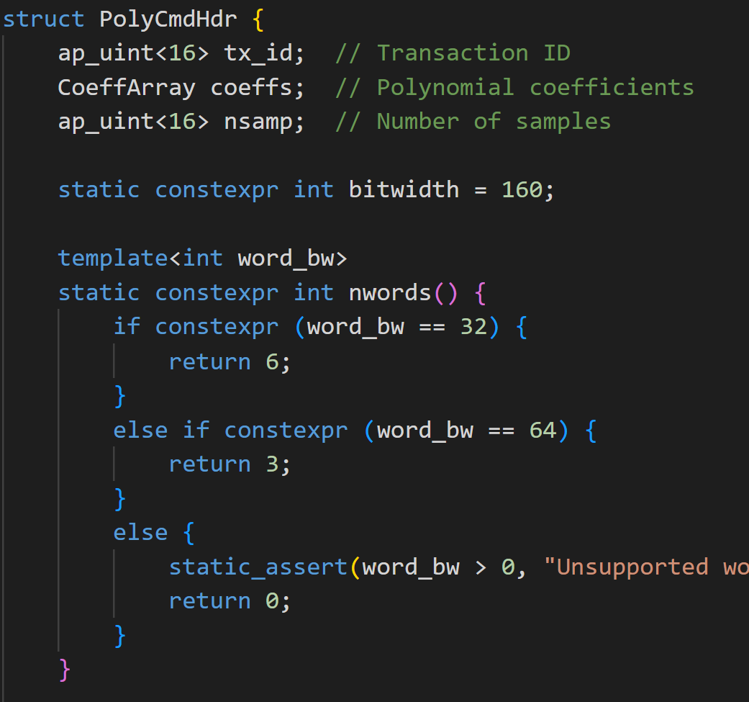
Auto-Generate the Header Files
For each class, we generate a header file
Header files include:
  Fields in the data structure
  Methods for serializing and deserializing

Slide 31
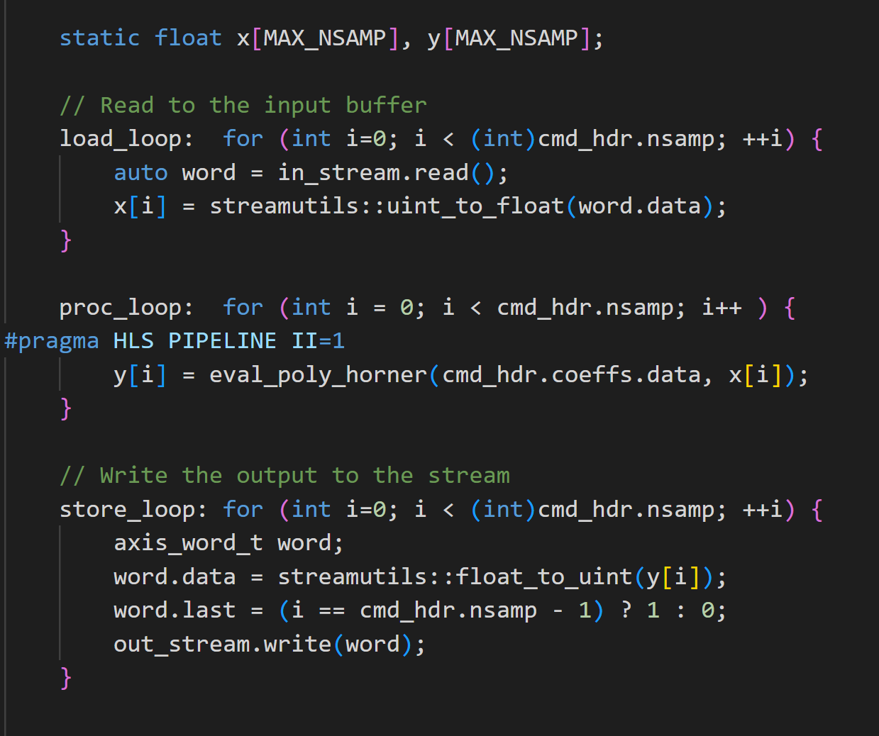
Vitis Kernel Implementation
Use array:
  Load to array, compute, write array to stream
  Computationally, adds an extra step
  But allows easy loop optimization analysis
Main loop is very simple
Note pragma HLS PIPELINE II=1
  Indicates to Vitis to try to pipeline this loop
  Try to find a schedule with II=1

Slide 32
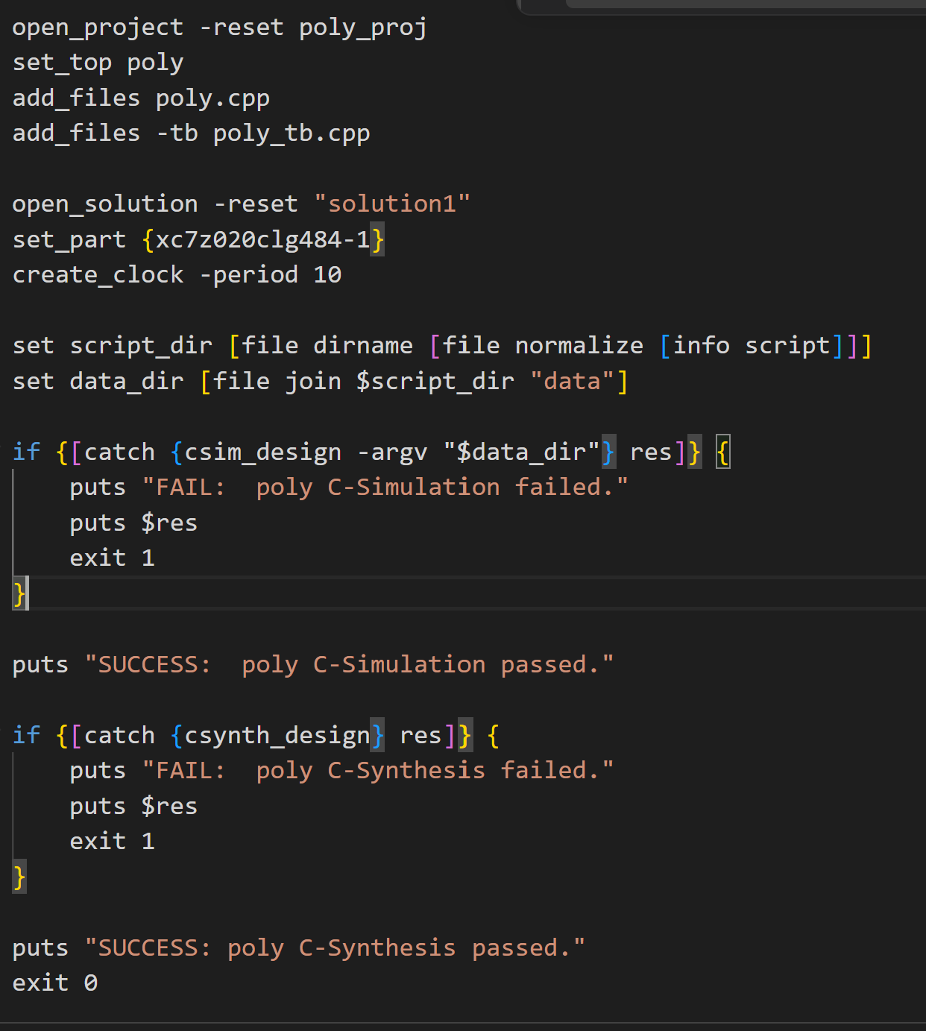
Running Vitis CS
Run C-simulation
  Performs functional validation
Run C-synthesis
  Performs pipelining
  Mapping of functions to resources
File to right: TCL script

Slide 33
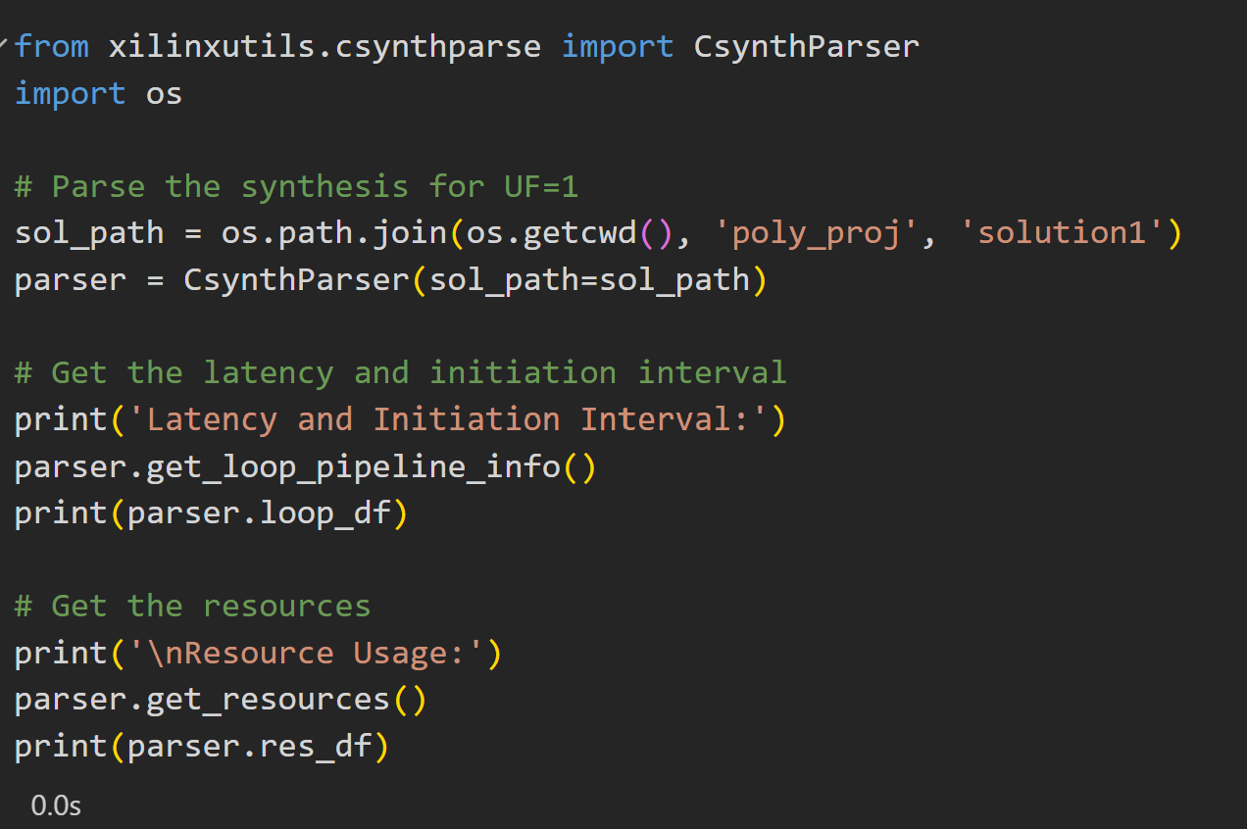
Parsing the Results
Vitis loop optimization results stored in XML file
Can parse results in xilinxutils CsynthParser
Allows easy automation

Slide 34
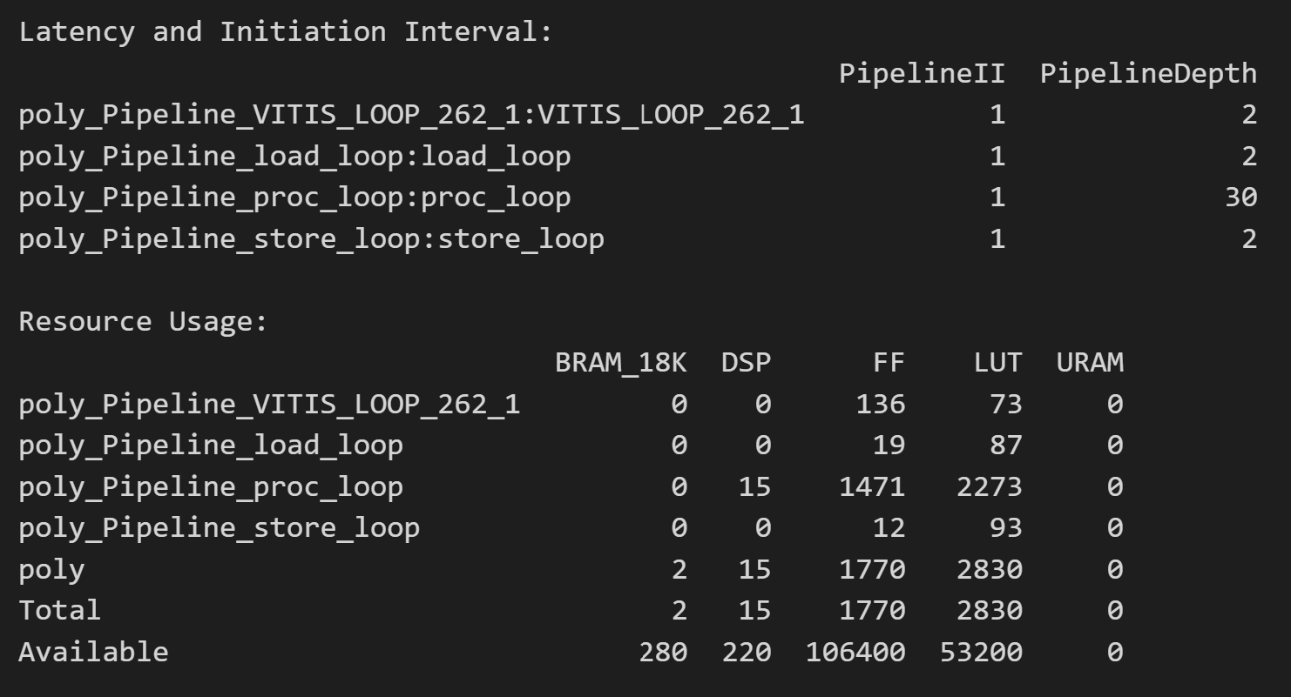
Pipelining Results
Main processing loop
  Obtains II=1
  High latency L=30
  Needed for many FP32 multiplies

Slide 35
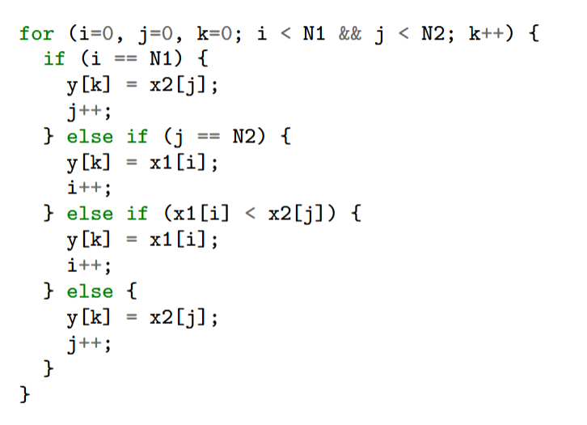

Loop Carry Dependency
Not all loops can be pipelined
Consider merge sort
  Given two sorted lists $x_{1}\left[i\right], x_{2}[j]$
  Find a merged sorted list $y[k]$
Algorithm:
  C code to the right
  Compare current $x_{1}[i]$ and $x_{2}[j]$
  Places smaller one on list
  Increments counter for the selected element

Slide 36
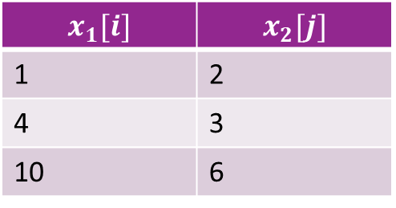
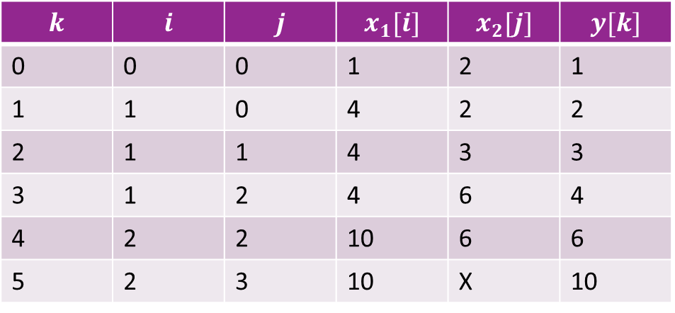
Merge Sort Example
$$k$$ | $$i$$ | $$j$$ | $$x_{1}[i]$$ | $$x_{2}[j]$$ | $$y[k]$$
0 | 0 | 0 | 1 | 2 | 1
1 | 1 | 0 | 4 | 2 | 2
2 | 1 | 1 | 4 | 3 | 3
3 | 1 | 2 | 4 | 6 | 4
4 | 2 | 2 | 10 | 6 | 6
5 | 2 | 3 | 10 | X | 10
$$x_{1}[i]$$ | $$x_{2}[j]$$
1 | 2
4 | 3
10 | 6

Slide 37
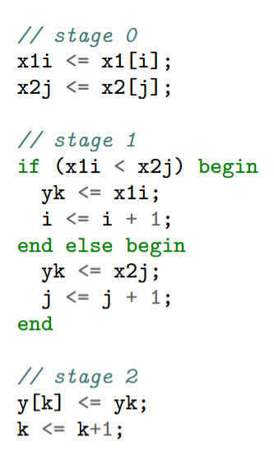
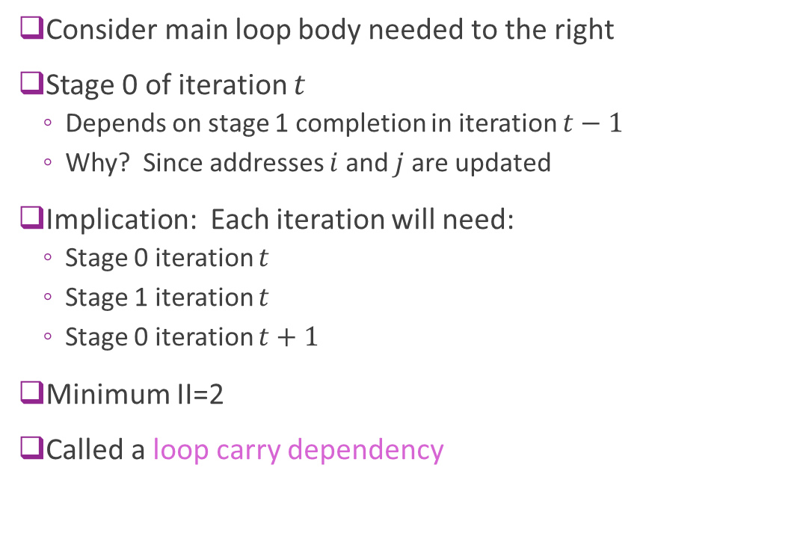
Pipelining Limit
Consider main loop body needed to the right
Stage 0 of iteration $t$
  Depends on stage 1 completion in iteration $t−1$
  Why? Since addresses $i$ and $j$ are updated
Implication: Each iteration will need:
  Stage 0 iteration $t$
  Stage 1 iteration $t$
  Stage 0 iteration $t+1$
Minimum II=2
Called a loop carry dependency

Slide 38
Outline
Pipelining in SystemVerilog
Loop Pipelining in Vitis HLS
Loop Unrolling and Memory Constraints

Slide 39
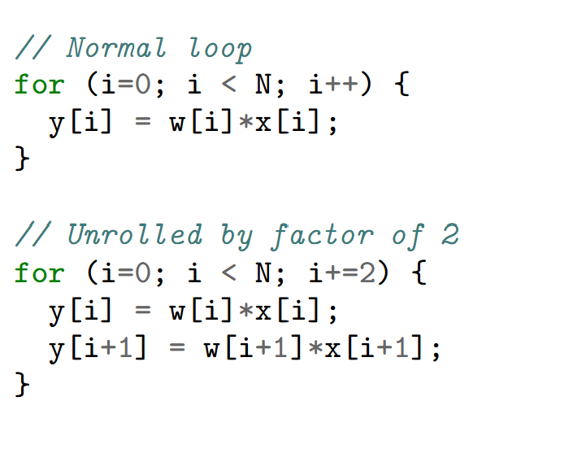
Loop Unrolling
Simple idea: Repeat processing in each cycle
Unroll by 2
  Need half the number of iterations
  But double the logic

Slide 40
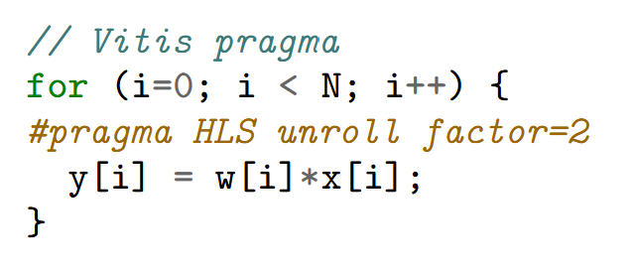
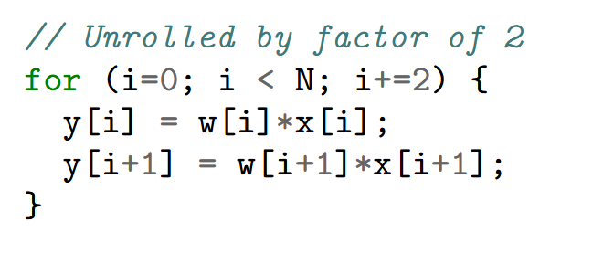

Loop Unrolling in Vitis
Can be done with a simple pragma
No need to manually unroll!
Handles cases when $N$ is not divisible by unroll factor
=

Slide 41
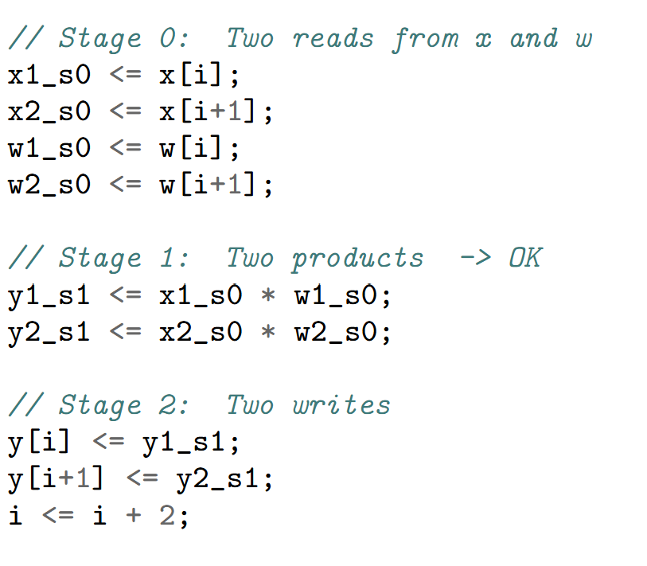

Memory Bottleneck
Memory bottleneck
  Loop unrolling is often limited by memory accesses
Consider vector multiply SV code
Stage 0 needs:
  Two reads from $x$ and two reads from $w$
Stage 2 needs:
  Two writes to $y$

Slide 42






Single Port Memory
Recall memory architecture from Unit 4
Basic memories are single port
There is a single address decoder
Can read / write one word in a cycle
$N$ data
words
Data
Bus
R/W
$N$ wordlines
Address input
$\log_{2}{(N)}$bits
$$⋮$$
$$⋮$$
Address
decoder
Selects one of
$N$ wordlines

Slide 43
Three Solutions
Solution 1: Use a true multi-port RAM
  Most general. Allows read and write from any combination of addresses
  Xilinx FGPA BRAMs are two port
  But most costly in hardware
Solution 2: Use a wider bitwidth
  Say 64 bits to read two 32 bit numbers
  Works only when the accesses are contiguous
Solution 3: Bank or partition memory
  Divide memory into partitions
  Each partition has its own decoder
  Works if accesses can be across different partitions

Slide 44


Mutli-Port RAMs
Allow arbitrary read / writes
  Except for read-write collisions to same address in same cycle
BRAM in FPGAs generally only support true two port
BMutli-port SRAMs in ASICs are expensive
Memory
Address
Decoder 1
Data1, Addr1
$$⋮$$
Data2, Addr2
Address
Decoder 2

Slide 45

Using Wider Bit widths
Narrow bit width design
Access only one word per cycle
Memory bottleneck
Wide bit width design
Only one R/W to each array
Can pipeline with II=1
But need accesses to be contiguous

