Slide 1
Unit 2
Sequential Logic and FSMs
ECE-GY 6463: Advanced Hardware Design
ProfS. Sundeep Rangan, Siddharth Garg

Slide 2
Learning Objectives
Define finite state machines and identify inputs, outputs, and states
Implement FSMs with sequential logic in SystemVerilog
Break and implement functions over multiple clock cycles
Write a testbench for the hardware modules
Simulate, and synthesize the SystemVerilog using Vivado tools

Slide 3
Outline
Registers, Clocks and Sequential Logic and Finite State Machines
Splitting Long Computations
Simulating and Synthesizing Simple Modules in Vivado

Slide 4
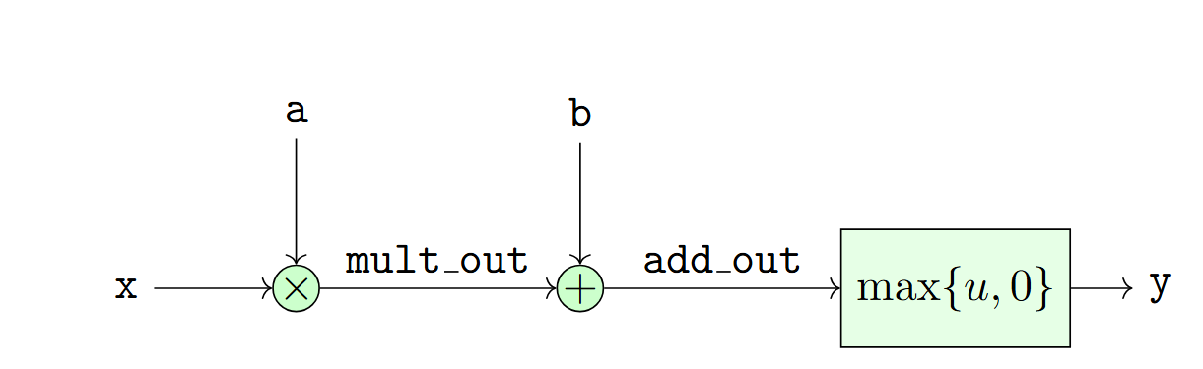
Limitations of Combinational Logic
No memory — cannot store past values
Output changes immediately with input changes (no control over timing)
Long combinational paths lead to large propagation delays
Hard to build large systems without controlled timing boundaries
Glitches and hazards can propagate freely
No notion of “steps” or “cycles” — everything is continuous

Slide 5
Synchronous (Sequential) Logic
Introduces state via flip‑flops or registers
Breaks long logic into clocked stages, improving performance
Provides predictable timing — changes only occur on clock edges
Makes large systems modular and easier to reason about
Eliminates most hazards/glitches from propagating across stages
Enables pipelining, finite‑state machines, and sequential algorithms
Allows clean interfaces between modules (valid/ready, handshakes, etc.)
Synchronous logic is the dominant paradigm for design

Slide 6
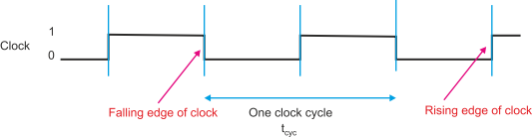

Clock Signal
Clock: An alternating binary signal
  Visualized as a square wave
Each period is called a clock cycle
  Typically, between two rising edges
Parameters:
  Clock period $T$
  Frequency $f=\frac{1}{T}$
Typical parameters:
  FPGA logic: 100 to 500 MHz
  ASIC: 500 MHz to 1 GHz

Slide 7
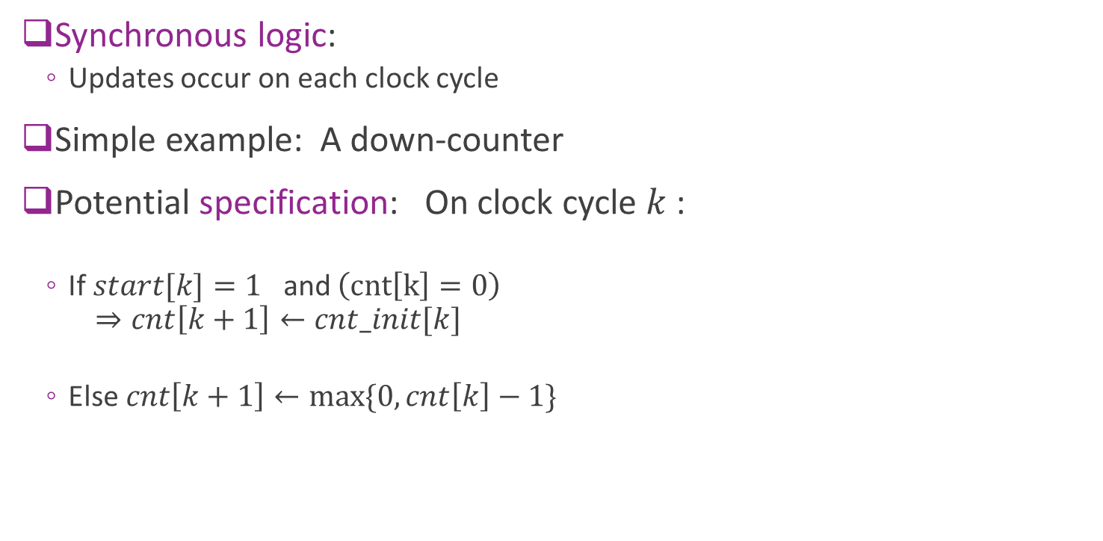
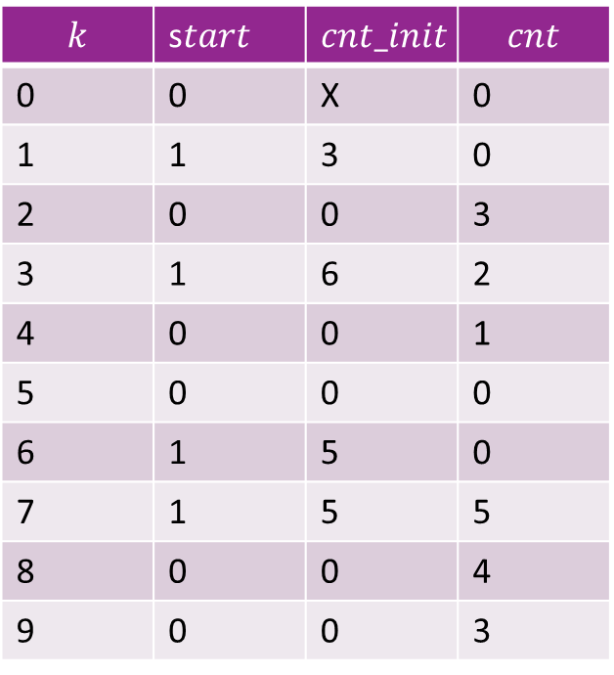
Synchronous Logic Example: Counter
Synchronous logic:
  Updates occur on each clock cycle
Simple example: A down-counter
Potential specification: On clock cycle $k$ :
  If $start[k]=1$ and $\left(cnt\left[k\right]=0\right)$
  $⇒cnt\left[k+1\right]←cnt_init[k]$
  Else $cnt\left[k+1\right]←\max{\{0, cnt\left[k\right]−1\}}$
$$k$$ | s$tart$ | $$cnt_init$$ | $$cnt$$
0 | 0 | X | 0
1 | 1 | 3 | 0
2 | 0 | 0 | 3
3 | 1 | 6 | 2
4 | 0 | 0 | 1
5 | 0 | 0 | 0
6 | 1 | 5 | 0
7 | 1 | 5 | 5
8 | 0 | 0 | 4
9 | 0 | 0 | 3

Slide 8
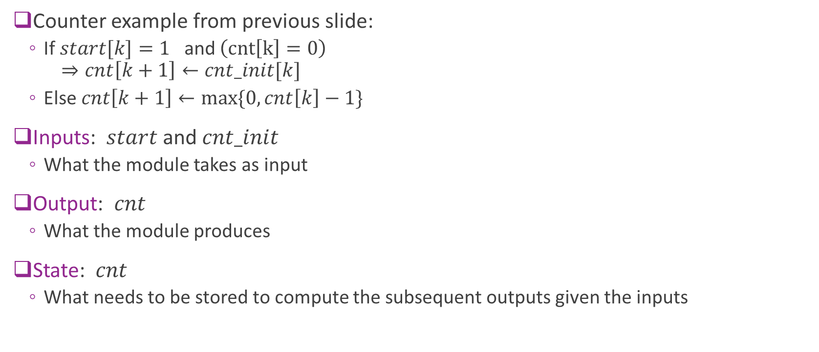
Key Components of a Module
Counter example from previous slide:
  If $start[k]=1$ and $\left(cnt\left[k\right]=0\right)$
  $⇒cnt\left[k+1\right]←cnt_init[k]$
  Else $cnt\left[k+1\right]←\max{\{0, cnt\left[k\right]−1\}}$
Inputs: $start$ and $cnt_init$
  What the module takes as input
Output: $cnt$
  What the module produces
State: $cnt$
  What needs to be stored to compute the subsequent outputs given the inputs

Slide 9
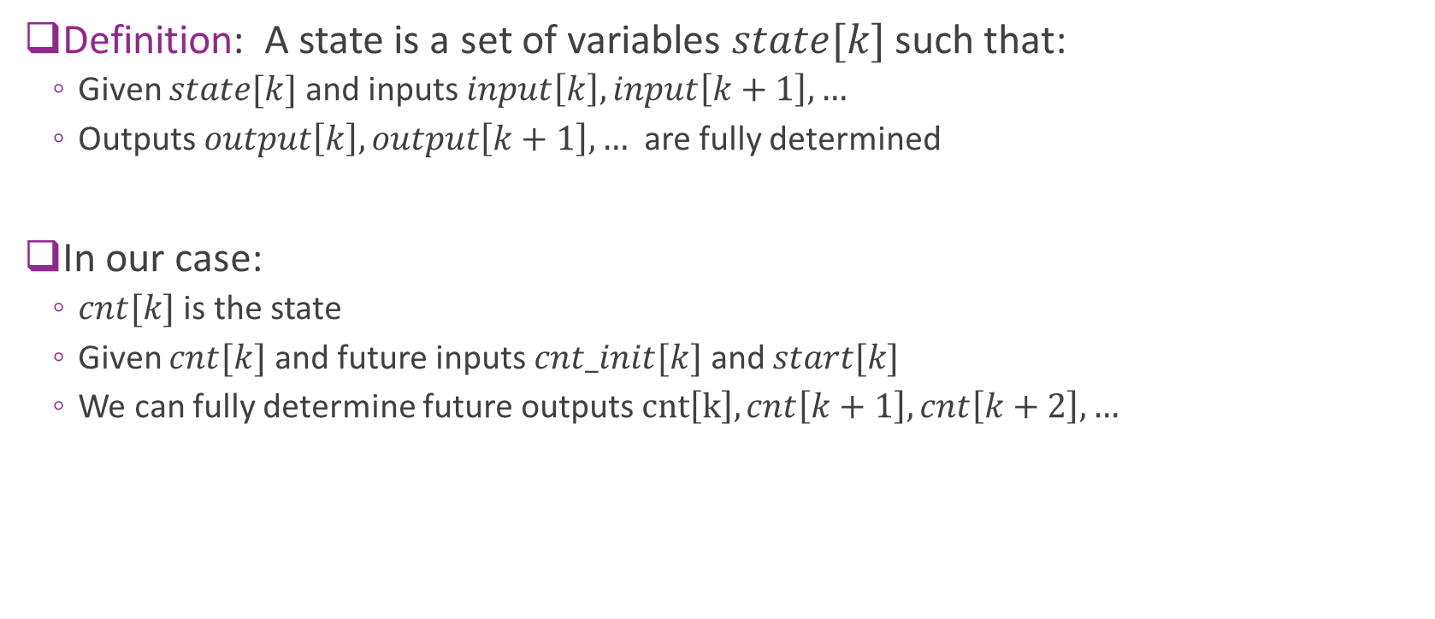
What is a State?
Definition: A state is a set of variables $state[k]$ such that:
  Given $state[k]$ and inputs $input\left[k\right], input\left[k+1\right], …$
  Outputs $output\left[k\right], output\left[k+1\right], …$ are fully determined
In our case:
  $cnt[k]$ is the state
  Given $cnt[k]$ and future inputs $cnt_init[k]$ and $start[k]$
  We can fully determine future outputs $cnt\left[k\right], cnt\left[k+1\right], cnt\left[k+2\right], …$

Slide 10





Synchronous Logic as an FSM
General finite state machine
Update function:
  $state\left[k+1\right]=F\left(state\left[k\right], input\left[k\right]\right)$
  Describes how the state evolves
Output function:
  $output\left[k\right]=G(state\left[k\right], input\left[k\right])$
Input$[k]$
State$[k]$
Update and output functions
O$utput[k]$
State$\left[k+1\right]=$state_next[k]

Slide 11



Building an FSM in Hardware
Input$[k]$
States are stored in registers
  Basic storage element
Update and output functions
  Implemented in combinational logic
  No storage
  Takes input and current state
  Produces next state and output
  Must finish within one clock cycle
Registers
(clocked)
Clock
O$utput[k]$
State$[k]$
Update and output functions
Combinational logic
(no clock)
State$\left[k+1\right]=$state_next[k]

Slide 12
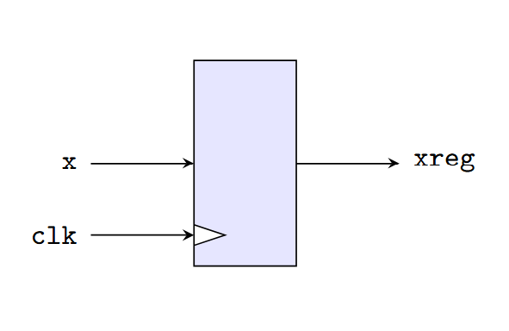
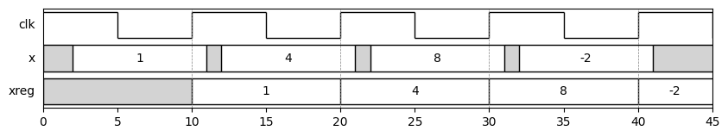
Register Physical Model
Basic storage element in synchronous logic
On each rising edge of clk:
  Assigns xreg to x
Value of xreg is maintained even if x changes
Example below: Input is “sampled” at rising edges

Slide 13
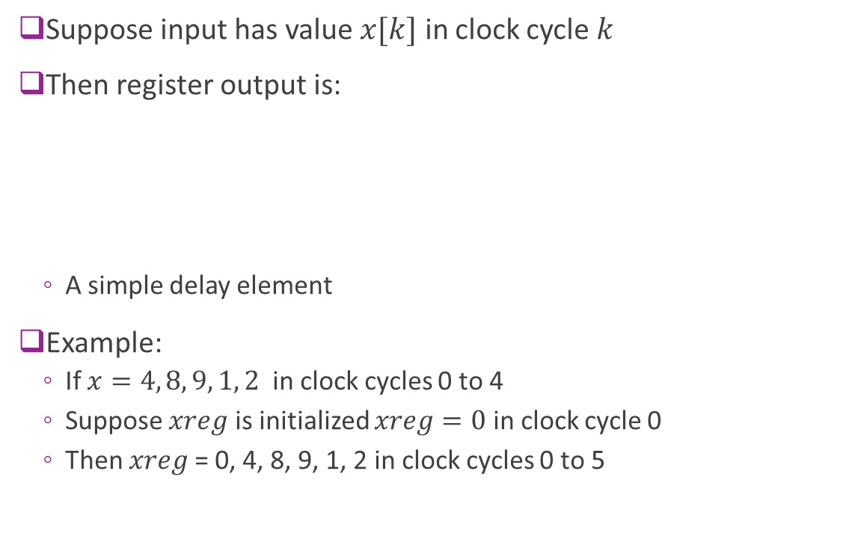
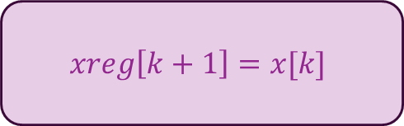
Register: Discrete-Time Model
Suppose input has value $x[k]$ in clock cycle $k$
Then register output is:
  A simple delay element
Example:
  If $x=4, 8, 9, 1, 2$ in clock cycles 0 to 4
  Suppose $xreg$ is initialized $xreg=0$ in clock cycle 0
  Then $xreg$= 0, 4, 8, 9, 1, 2 in clock cycles 0 to 5
$$xreg\left[k+1\right]=x[k]$$

Slide 14
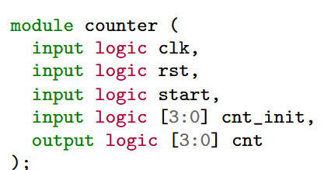
Writing the Counter in System Verilog
The counter is a module
The module definition describes:
  Inputs and outputs
  Must have a clock input
  Typically, also a reset
Does not need the internal state
  Unless it happens to be an output

Slide 15
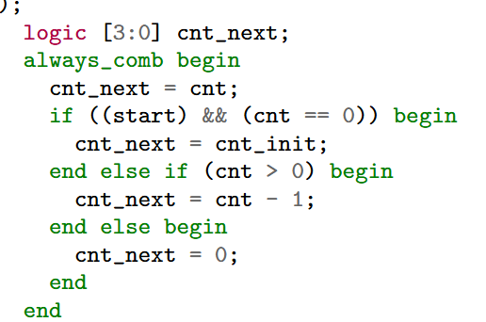
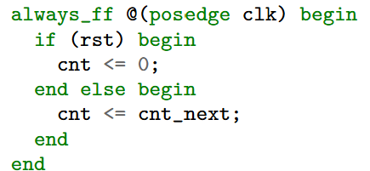
Counter Main Body
Combinational block (always_comb)
  Takes current state and input
  Describes next state and output
always_ff
  Registers values for next state

Slide 16
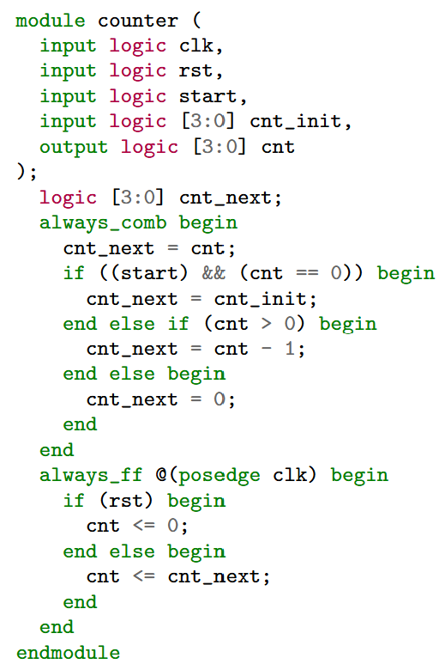
Putting it Together
We now have the FSM description
Three parts
Module declaration
  Inputs, outputs
Always_comb block
  Describes next state
Always_ff block
  Updates state from next_state

Slide 17
Blocking vs. Non-Blocking
Blocking assignment
  Use = in SV
  Performed sequentially
  Assigns temporary (i.e., non-state variables)
  Used in always_comb or always_ff block
Non-blocking assignment
  Use <= in SV
  Assigns registers / states
  Only in always_ff block
  Always update in parallel

Slide 18
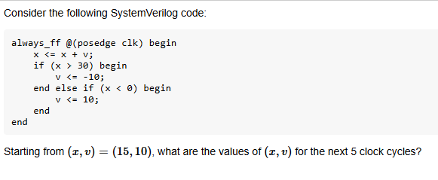
Example Problem

Slide 19
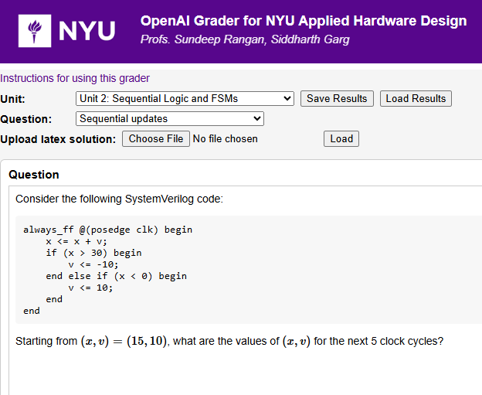
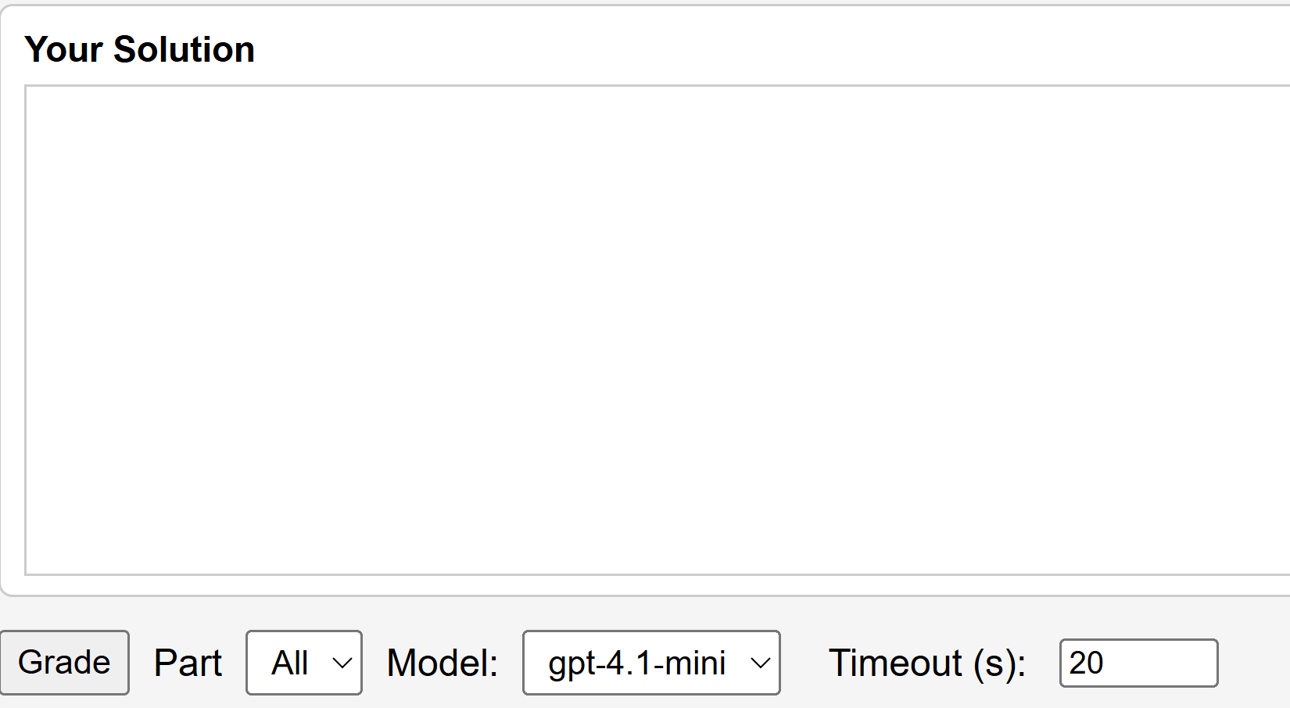
Try Answer on LLM Auto-Grader
Use AI to get instant feedback
Enter your answer
Hit Grade

Slide 20
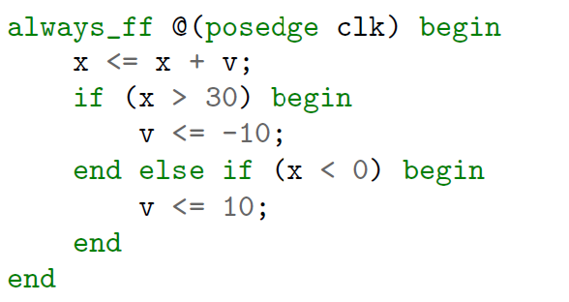


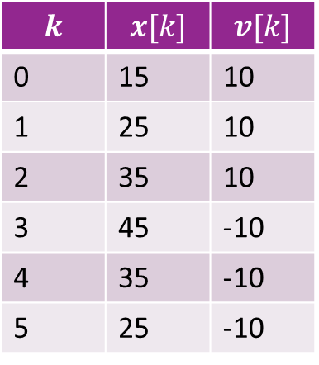
Solution: FSM Model
$$k$$ | $$x[k]$$ | $$v[k]$$
0 | 15 | 10
1 | 25 | 10
2 | 35 | 10
3 | 45 | -10
4 | 35 | -10
5 | 25 | -10
Write the FSM model
Remember: Updates in always_ff are in parallel
  Test $x>30$ is based on current cycle value, not next cycle
Equivalent FSM model
$x\left[k+1\right]=x\left[k\right]+v\left[k\right]$
if $x\left[k\right]>30$
$v\left[k+1\right]=−10$
else if ($x\left[k\right]<0)$
$v\left[k+1\right]=10$
$v\left[k+1\right]=v[k]$

Slide 21
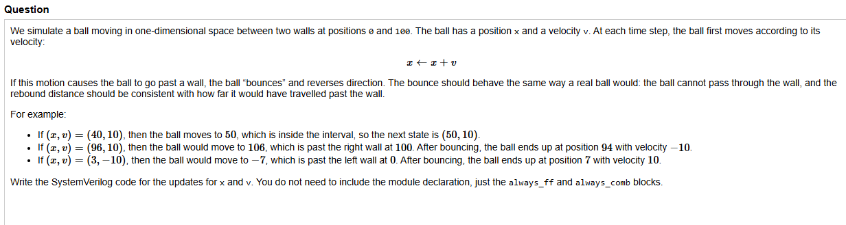
In-Class Exercise
Try answering on the auto-grader

Slide 22
Outline
Registers, Clocks and Sequential Logic and Finite State Machines
Splitting Long Computations
Simulating and Synthesizing Simple Modules in Vivado

Slide 23
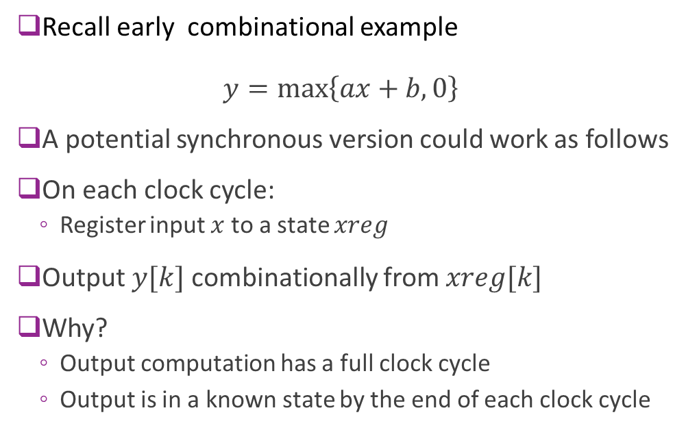
Synchronous Version of ReLU + Linear
Recall early combinational example
$y=\max\left\{ax+b, 0\right\}$
A potential synchronous version could work as follows
On each clock cycle:
  Register input $x$ to a state $xreg$
Output $y[k]$ combinationally from $xreg[k]$
Why?
  Output computation has a full clock cycle
  Output is in a known state by the end of each clock cycle

Slide 24
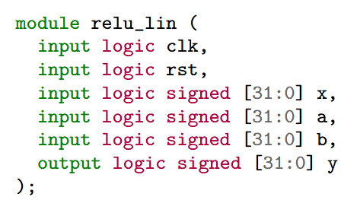
Synchronous Module Declaration
Making module synchronous is easy
First add two inputs to ports
  Clock signal
  Reset
Clock
Reset

Slide 25
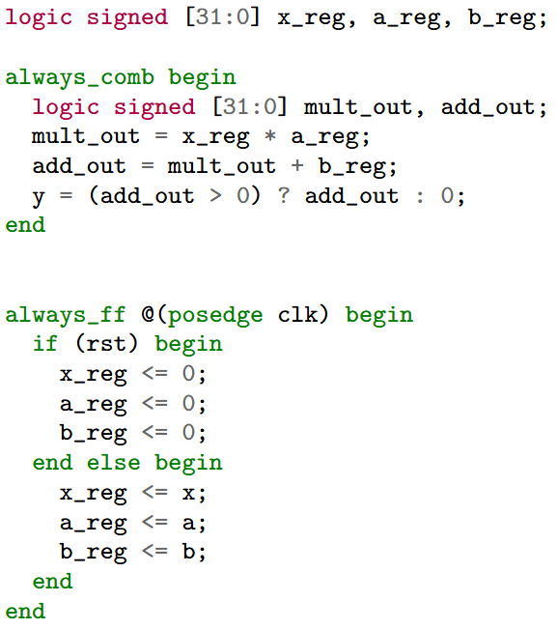
System Verilog Main Body
Synchronous logic has two parts
always_ff:
  Assigns register outputs
  All operations are in parallel (non-blocking)
  Our example: Saves inputs to registers
always_comb:
  Assigns signals via combinational logic
  Operations are sequential (blocking)
  Our example: Computes output from registered inputs

Slide 26
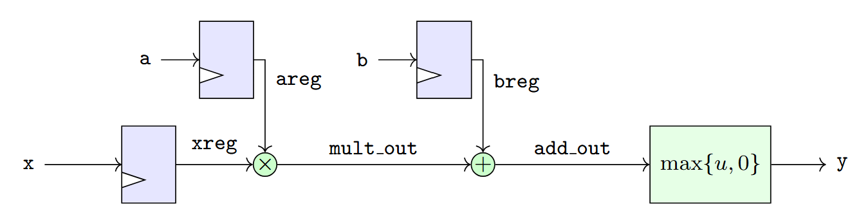
Synchronous Block Diagram
Inputs are registered
Output is combinational from input

Slide 27
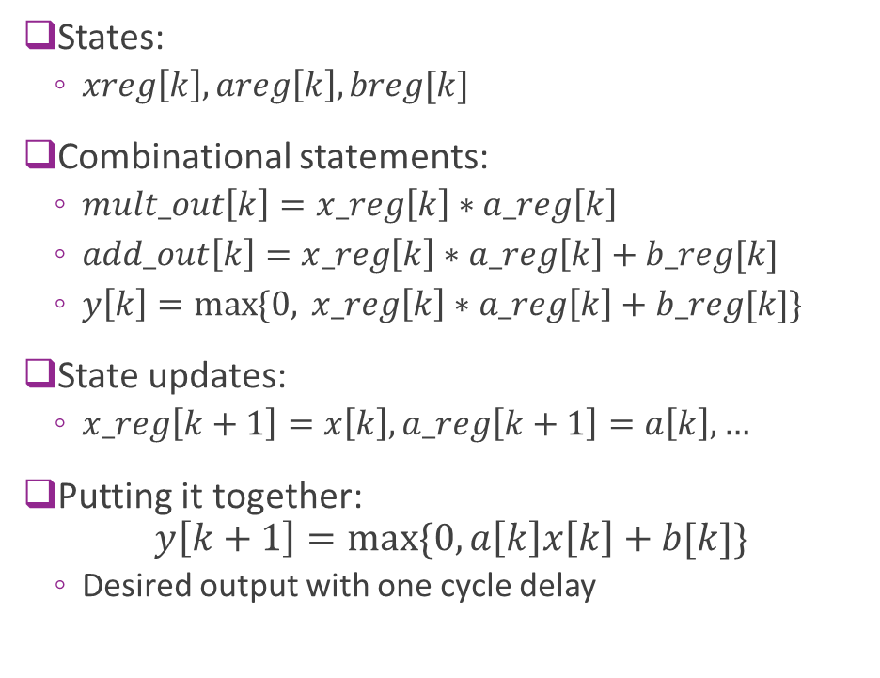
FSM Description
States:
  $xreg\left[k\right], areg\left[k\right], breg[k]$
Combinational statements:
  $mult_out\left[k\right]=x_reg\left[k\right]∗a_reg\left[k\right]$
  $add_out\left[k\right]=x_reg\left[k\right]∗a_reg\left[k\right]+b_reg[k]$
  $y\left[k\right]=\max{\{0, }x_reg\left[k\right]∗a_reg\left[k\right]+b_reg[k]\}$
State updates:
  $x_reg\left[k+1\right]=x\left[k\right], a_reg\left[k+1\right]=a\left[k\right], …$
Putting it together:
$y\left[k+1\right]=max⁡\{0, a\left[k\right]x\left[k\right]+b[k]\}$
  Desired output with one cycle delay

Slide 28
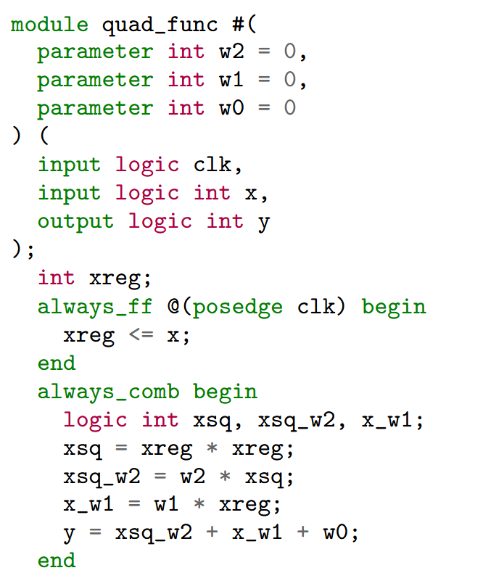
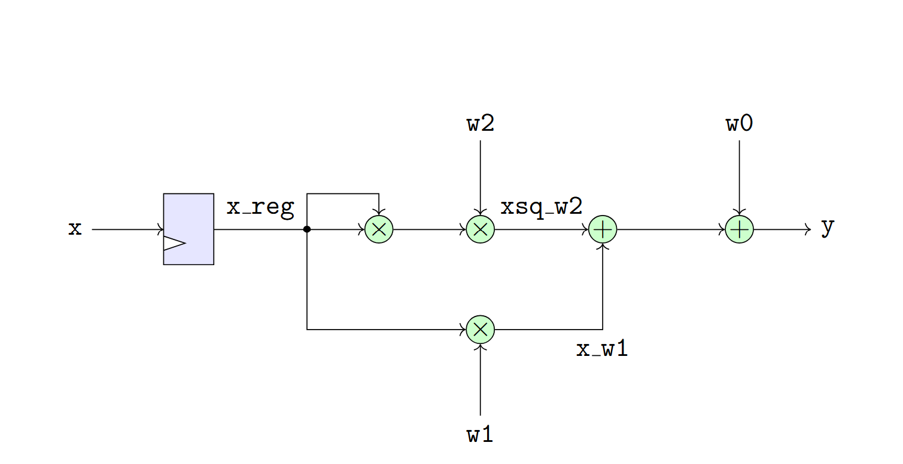

A More Complex Example
Consider a quadratic function: $y=w_{2}x^{2}+w_{1}x+w_{0}$
For simplicity, assume $w_{0},w_{1},w_{2}$ are fixed parameters
Single cycle implementation to the right

Slide 29
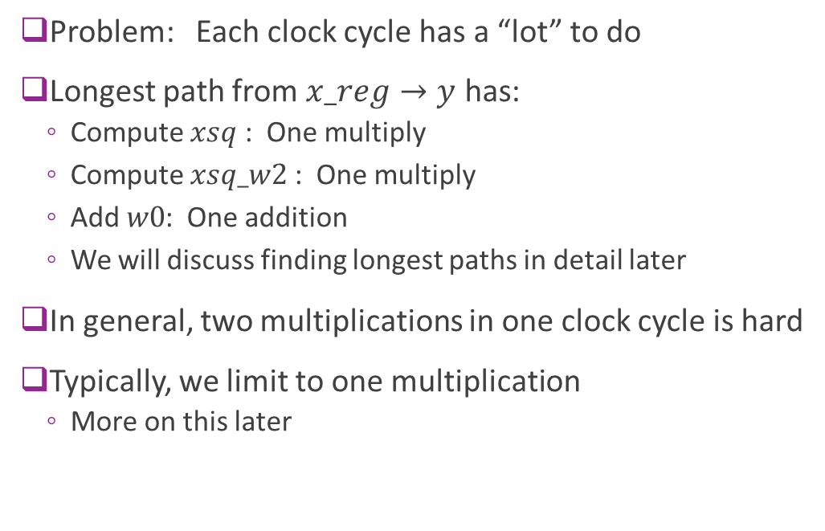
Problems with Single Cycle Implementation
Problem: Each clock cycle has a “lot” to do
Longest path from $x_reg→y$ has:
  Compute $xsq$ : One multiply
  Compute $xsq_w2$ : One multiply
  Add $w0$: One addition
  We will discuss finding longest paths in detail later
In general, two multiplications in one clock cycle is hard
Typically, we limit to one multiplication
  More on this later

Slide 30
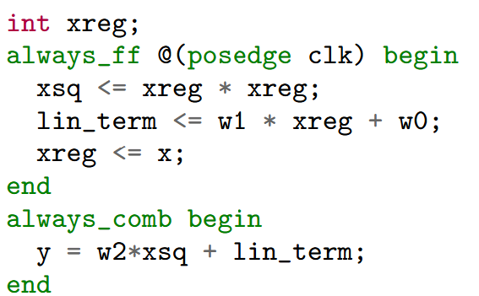
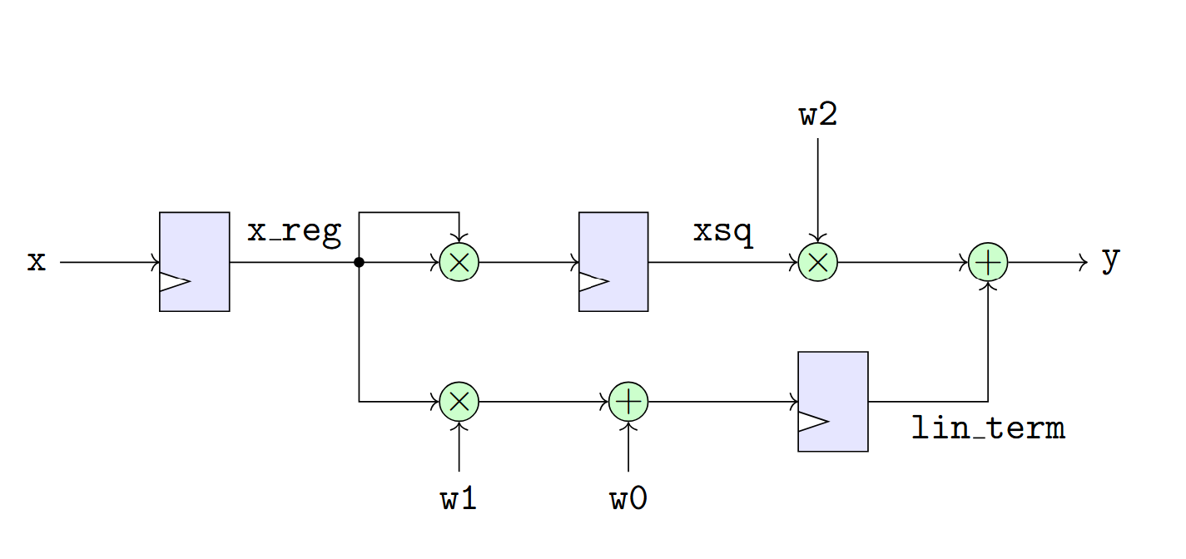
A Two Cycle Design
We can reduce the computation per cycle by breaking operation in two cycles
Register two intermediate terms:
  xsq = xreg * xreg
  lin_term = w1*xreg + w0

Slide 31
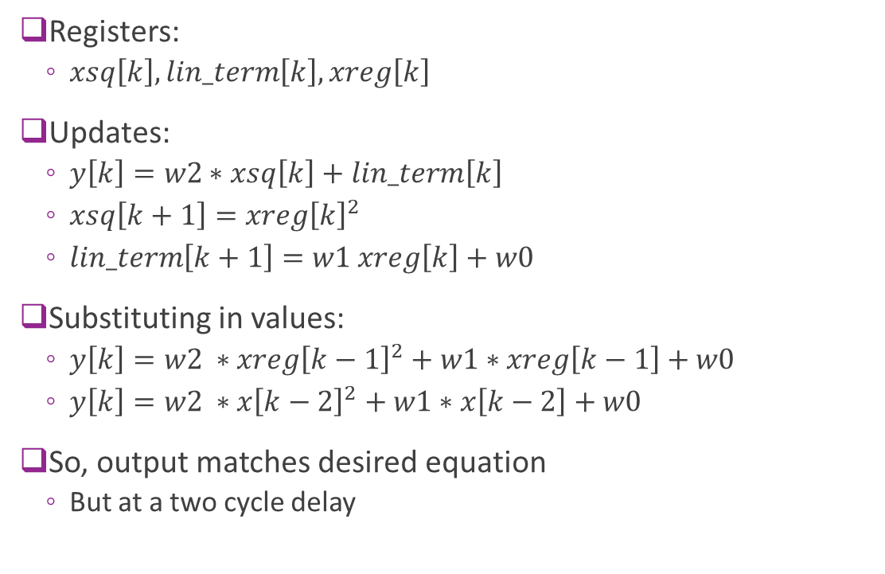
Analysis
Registers:
  $xsq\left[k\right], lin_term\left[k\right], xreg\left[k\right]$
Updates:
  $y\left[k\right]=w2∗xsq\left[k\right]+lin_term\left[k\right]$
  $xsq\left[k+1\right]=xreg{\left[k\right]}^{2}$
  $lin_term\left[k+1\right]=w1 xreg\left[k\right]+w0$
Substituting in values:
  $y\left[k\right]=w2 ∗xreg{\left[k−1\right]}^{2}+w1∗xreg\left[k−1\right]+w0$
  $y\left[k\right]=w2 ∗x{\left[k−2\right]}^{2}+w1∗x\left[k−2\right]+w0$
So, output matches desired equation
  But at a two cycle delay

Slide 32
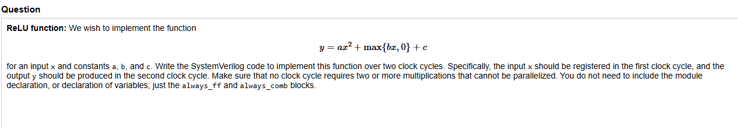
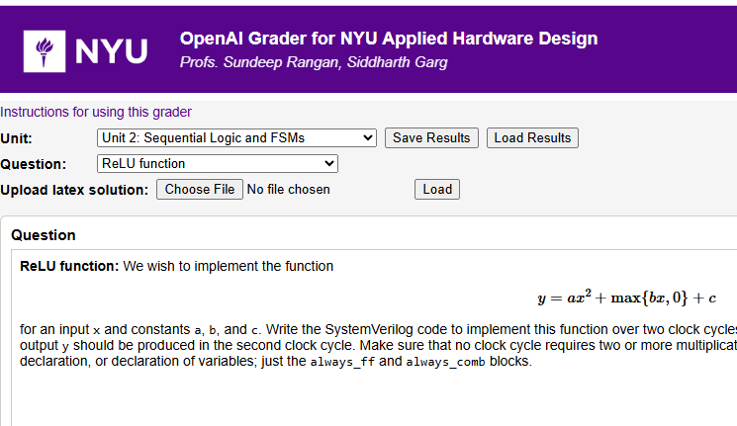

In Class Problem
Hint:
  Write the computation graph for $x→y$
  Add registers at input and intermediate variables

Slide 33
Outline
Registers, Clocks and Sequential Logic and Finite State Machines
Splitting Long Computations
Simulating and Synthesizing Simple Modules in Vivado

Slide 34
Building the Hardware Roadmap
Design
Design:
  Write a behavioral description (e.g., in SV)
  What should the module should do exactly?
Functional simulation
  Validate module does what it is supposed to do?
  Logical mapping from inputs to outputs
Synthesis
  Map the description into real hardware
  Gates, FPGA components, …
Next steps
  Place route, timing analysis, bitstreams, …
Functional simulation
This unit
Synthesis
Next steps
Later units…

Slide 35
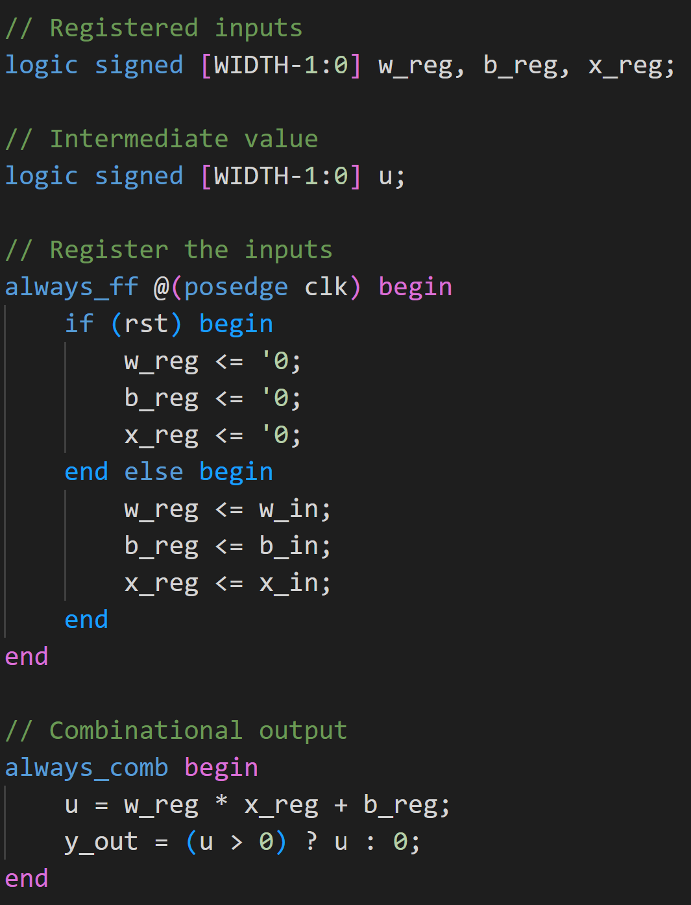
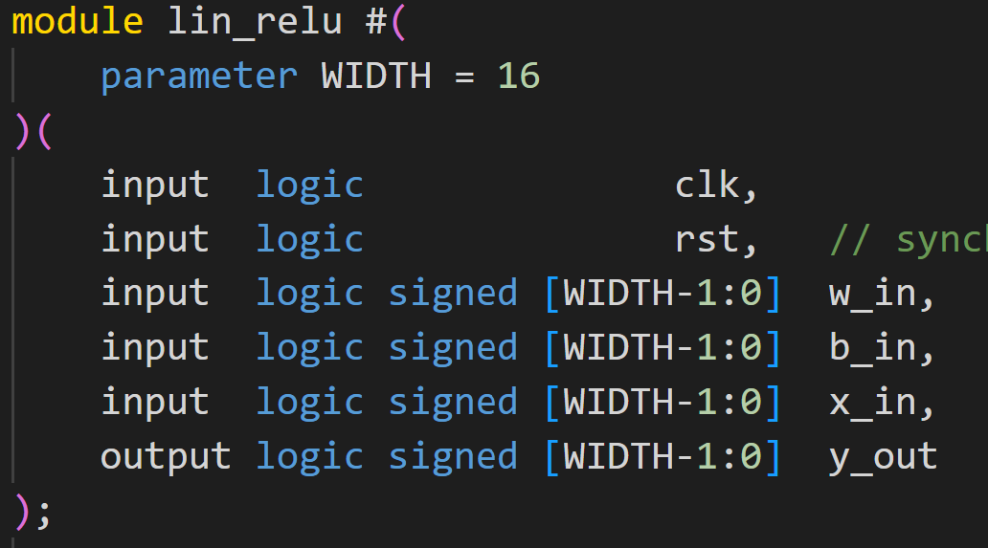
Linear+ReLU Example
All files in github repo:
hwdesign/demos/fsm
Define counter in file counter.sv

Slide 36
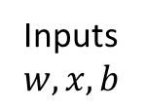
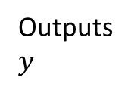
Next Step: Build a Testbench
Testbench
  A second SV module
  Connects to device under test
  (i.e, module we want to test)
  TB provides DUT inputs
  TB verifies DUT outputs are correct
Inputs
$w, x, b$
Outputs
$y$
Testbench
tb_lin_rely.sv
DUT
lin_relu.sv

Slide 37
Testbenches are not Synthesized
Testbenches are for simulation only
They will not be synthesized
Can include un-synthesizable constructs
  Print statements
  File read and write
  Complex data structures
Modern trend:
  Write TB in higher level language
  E.g., python
Inputs
$w, x, b$
Outputs
$y$
Testbench
tb_lin_rely.sv
DUT
lin_relu.sv

Slide 38
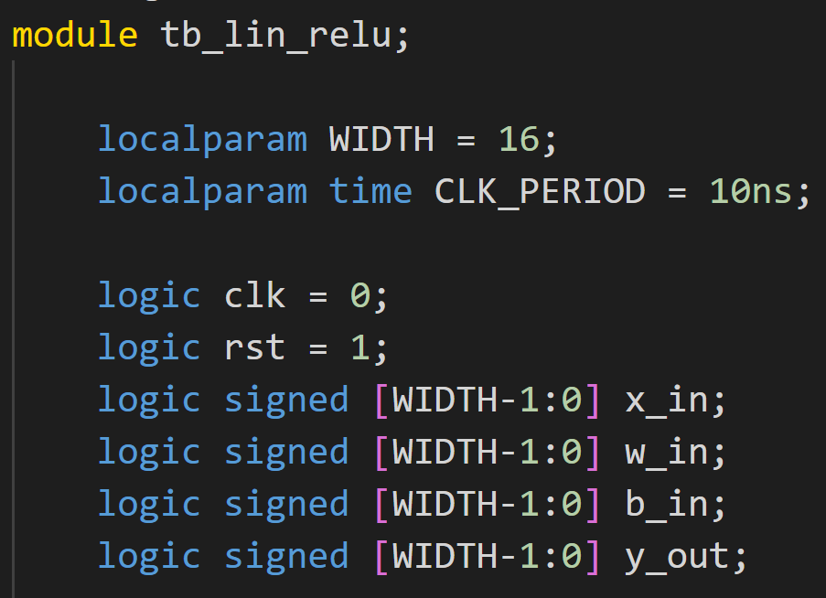
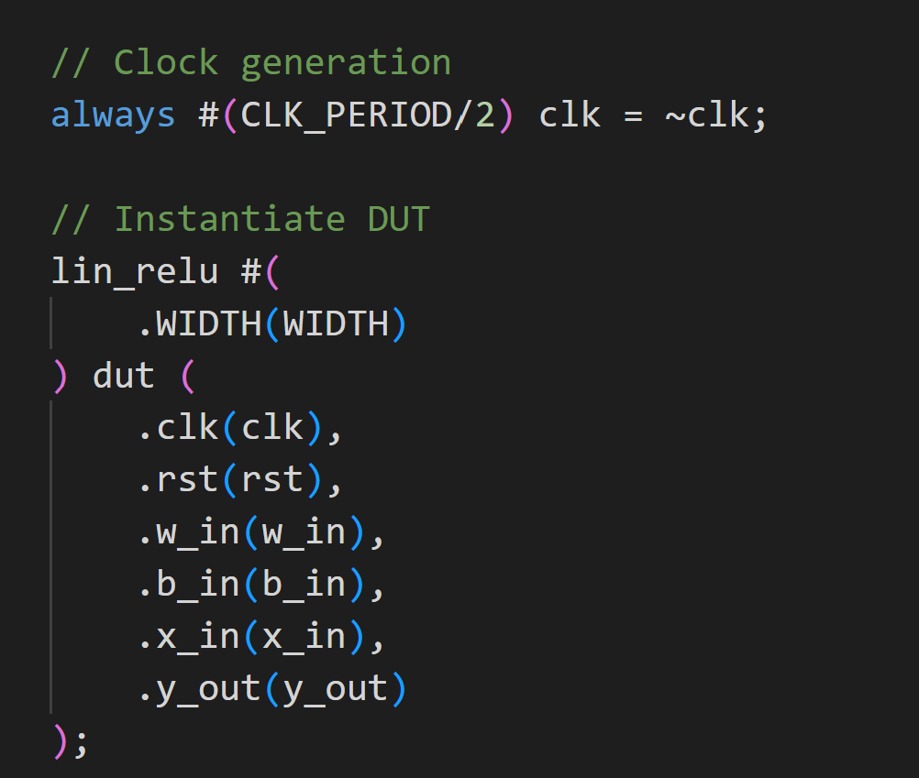
Testbench Declaration
Testbench: a module to test the module
  Will not be synthesized
  Can have un-synthesizable constructs
  Ex: Read / write from file
Create a clock
Instantiate an instance of module to test
  Called the DUT = device under test
  Connect DUT to testbench signals

Slide 39
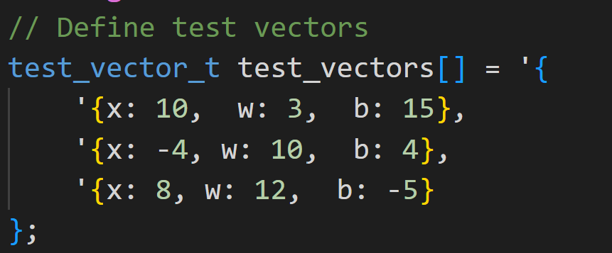
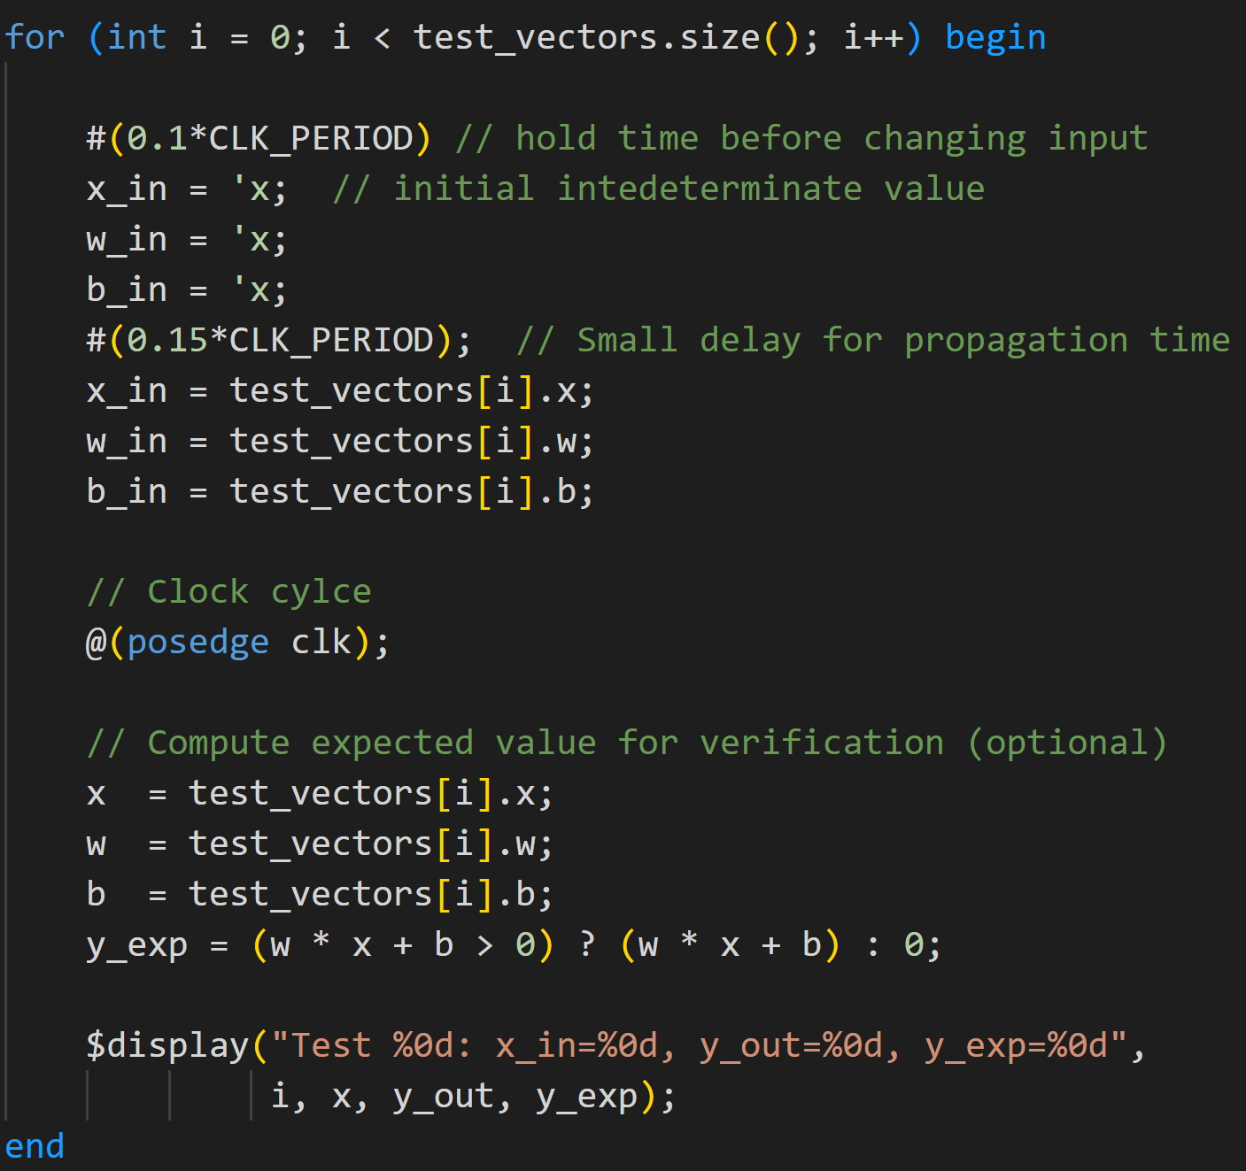
Test Vectors
Create a set of test inputs
Loop through inputs
Put one new input each clock cycle
Testbench uses an initial construct
  Enables sequential set of events

Slide 40
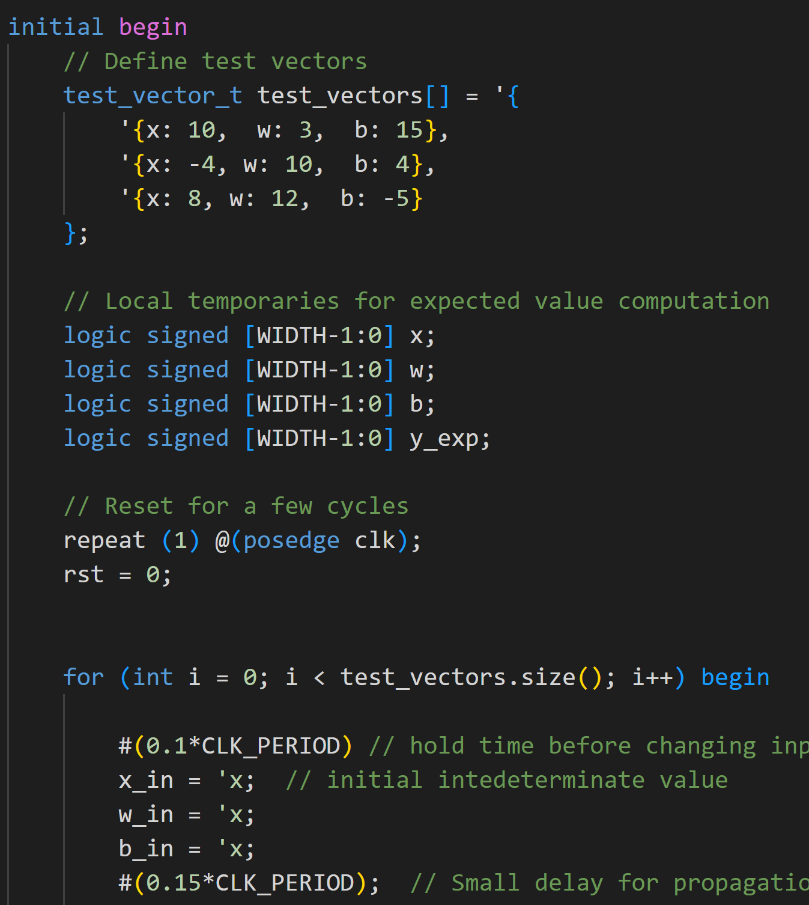
Initial Block
Runs once at time 0 of the simulation
  (or at its scheduled start time if delayed).
Statements inside run sequentially
  like a small program.
Not synthesizable for hardware
  Simulation‑only construct.
  Used for test benches
Concurrency:
  initial blocks and always blocks.

Slide 41
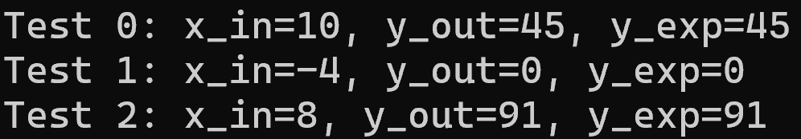
Test Results
Test results outputs
Match expected values

