Slide 1
Unit 5
FIFOs and Streaming Interfaces
ECE-GY 6463: Advanced Hardware Design
Profs. Sundeep Rangan, Siddharth Garg

Slide 2
Learning Objectives
Skill | You will be able to
Work out FIFO timing | Find the cycle each element is written, read and finished, and when a full FIFO stalls the producer
Size memory for a data stream | Compute a FIFO's element width and total size from its fields and its depth
Compare producer and consumer rates | Decide whether a consumer keeps up, when a stream finishes, and how burstiness sets the FIFO depth
Time a valid/ready handshake | Apply registered backpressure: when TREADY drops, and the cycle a stalled transfer completes
Describe AXI4-Stream | Find the cycles that carry a transfer, and where a packet framed by TLAST ends
Serialize and deserialize structured data | Pack a header into 32-bit words and write the code, moving fixed-point fields by their bit pattern
Each skill is assessed by problems in the LLM grader. The demos add what no problem tests yet: streaming kernels in Vitis HLS, and command-response messages with transaction IDs and error codes.

Slide 3
Outline
FIFOs
AXI4-Stream: Pure Streaming
Limitations of Pure Streaming with Vitis
AXI4-Stream: Packets and Serialization

Slide 4
Recap: The Cost of a Register Interface
22
cycles of bus traffic per call
5
cycles of actual computation
1
call at a time: nothing is queued
PROBLEM 1: HANDSHAKE OVERHEAD
PROBLEM 2: POLLING
Every value is its own AXI4-Lite transaction: address, data, response
About 3 cycles per register transfer
Guaranteed delivery and flow control, paid for per value
The processor starts the IP, then asks repeatedly whether it is done
The IP sits idle while the processor writes inputs and reads outputs
Neither side can work ahead of the other
This unit: put a FIFO between them, so each side runs at its own pace.
Figures measured in unit 4's scalar-function demo.

Slide 5
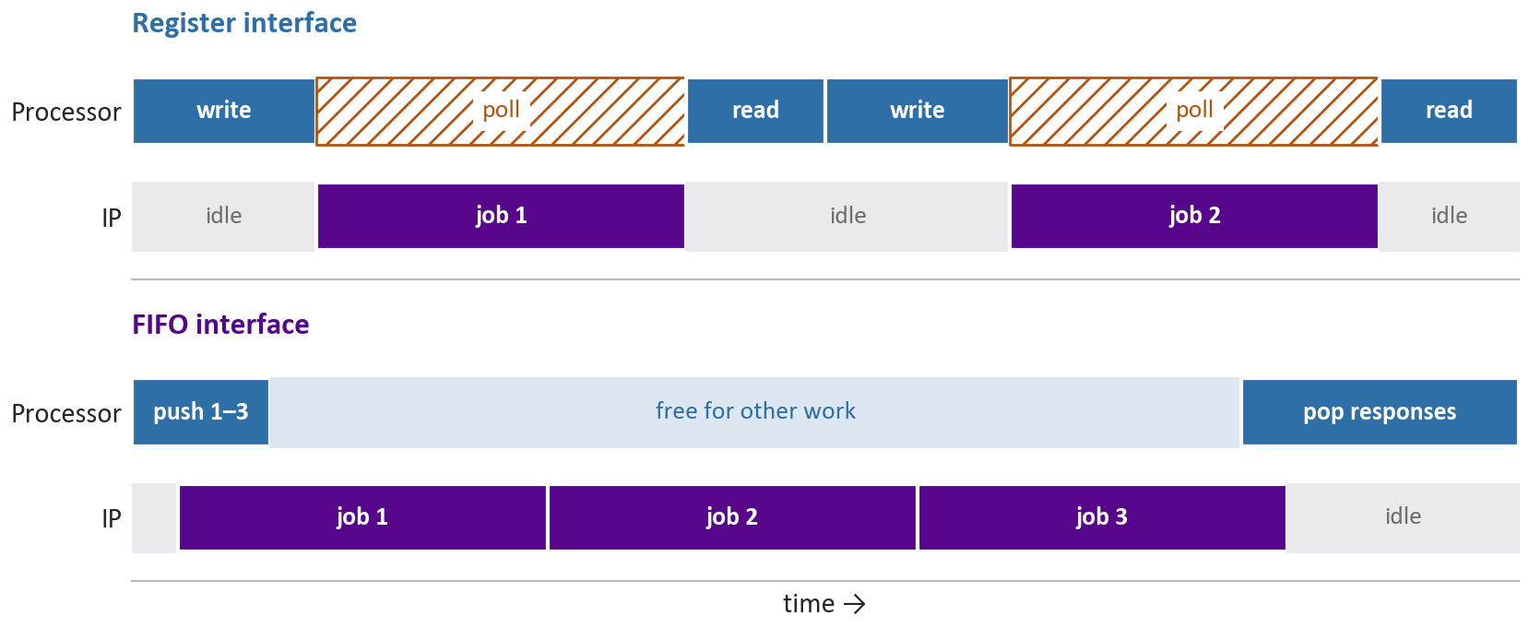
Where the Time Goes
A FIFO decouples the two sides in time: the processor queues work and leaves, and the IP runs job after job.

Slide 6
FIFO
FIFO (first-in, first-out): a hardware queue
Stores elements from a producer in order of arrival
Returns them to a consumer in the same order
Decouples producer and consumer timing
Each side runs at its own pace
Built-in flow control
The producer waits while the FIFO is full
The consumer waits while it is empty
Absorbs bursts of data, and enables streaming
Producer
Consumer

Slide 7
FIFO Terminology
Producer: the module that writes to the FIFO
Each write adds an element
Consumer: the module that reads from it
Each read removes an element
Element: one item stored in the FIFO
Element width: the size of each element, in bits or bytes
Depth: the maximum number of elements
Size = depth × element width
Producer
element width
depth
one element
Consumer

Slide 8
FIFO Order
The producer writes A, then B, then C
A is at the head: the oldest element
C is at the tail: the newest
The consumer reads from the head
It reads A, B, C: the order they were written
No reordering, and no addresses
Contrast the random-access memory of unit 4
Producer
C
← tail
B
A
← head
Consumer

Slide 9
Sizing FIFOs
PRACTICE
A FIFO buffer stores commands with three fields. Here ap_int<n> is an integer with n bits. Assume the fields are packed with no padding.
(a) What is the element width in bytes?
(b) If the FIFO has a depth of 32 elements, what is the total size of the FIFO in bytes?
struct Command {
ap_int<16> command_id;
ap_int<32> operand1;
ap_int<32> operand2;
};
Also in the LLM grader: Unit 5 › Sizing FIFOs

Slide 10
Sizing FIFOs
SOLUTION
(a) 16 + 32 + 32 = 80 bits = 2 + 4 + 4 bytes = 10 bytes
(b) 32 elements × 10 bytes = 320 bytes
Size = depth × element width
One element, no padding
id
2 B
operand1
4 B
operand2
4 B
Common errors
Leaving the width in bits: 80.
Padding command_id to 4 bytes: 12. The question rules that out.
Also in the LLM grader: Unit 5 › Sizing FIFOs

Slide 11
FIFO Timing
PRACTICE
A producer writes A, B and C into a FIFO at cycles 0, 1 and 6. An element can be read on the cycle after it is written.
After reading an element in cycle R, the consumer processes it in R+1, and can read the next one in R+2 at the earliest. It starts idle and reads as soon as it can.
At which cycle does the consumer read:
(a) A?
(b) B?
(c) C?
Work it cycle by cycle
Cycle | Producer | FIFO after | Consumer
0 | write A
1 | write B
2 | —
3 | —
4 | —
5 | —
6 | write C
7 | —
Also in the LLM grader: Unit 5 › FIFO timing

Slide 12
FIFO Timing
SOLUTION
(a) A is read at cycle 1, the first cycle after it is written
(b) B is in the FIFO from cycle 2, but the consumer is processing A: read at cycle 3
(c) The consumer is free from cycle 5, but C arrives at 6: read at cycle 7
Cycle | Producer | FIFO after | Consumer
0 | write A | [A] | idle
1 | write B | [B] | read A
2 | — | [B] | process A
3 | — | [ ] | read B
4 | — | [ ] | process B
5 | — | [ ] | idle
6 | write C | [C] | idle
7 | — | [ ] | read C
Two limits
An element waits for a busy consumer (B), or the consumer waits for an element (C).
Also in the LLM grader: Unit 5 › FIFO timing

Slide 13
FIFO Overflow
The producer has an element, but the FIFO is full
Blocking write
The FIFO deasserts READY; the producer waits and retries
The default for hardware interfaces, AXI4-Stream included
Also called a stall, backpressure or flow control
Drop
An element is discarded: the new one (tail drop), or one already queued
Common in network routers
Producer
G
full: wait
or drop
F
E
D
C
B
A
Consumer

Slide 14
FIFO Write Stall
PRACTICE
A producer has elements A, B, C and D, available for writing at the earliest in cycles 0, 1, 2 and 3.
The FIFO holds 2 elements. A write can occur only if the FIFO was not full after the previous cycle; otherwise the producer stalls and retries each cycle.
An element written in cycle N can be read, and removed, in N+1 at the earliest.
A read in cycle R is processed in R+1 and R+2; the next read is at R+3 at the earliest. The consumer starts idle.
For each element, give the cycle its write succeeds, and the last cycle of its processing:
(a) A (b) B (c) C (d) D
Work it cycle by cycle
For each cycle: what the producer does, what the FIFO holds at the end of it, and what the consumer does.
The FIFO state at the end of a cycle decides the next cycle's write.
Also in the LLM grader: Unit 5 › FIFO write stall

Slide 15
FIFO Write Stall
SOLUTION
Cycle | Producer | FIFO after | Consumer
0 | write A | [A] | idle
1 | write B | [B] | read A
2 | write C | [B, C] full | process A
3 | D stalls | [B, C] full | process A
4 | D stalls | [C] | read B
5 | write D | [C, D] full | process B
6 | — | [C, D] full | process B
7 | — | [D] | read C
8–9 | — | [D] | process C
10 | — | [ ] | read D
11–12 | — | [ ] | process D
Write succeeds · processing ends
(a) A: cycle 0 · cycle 3
(b) B: cycle 1 · cycle 6
(c) C: cycle 2 · cycle 9
(d) D: cycle 5 · cycle 12
Why not cycle 4 for D?
B is read in cycle 4, but the write decision uses the FIFO state after cycle 3, which is full. The slot freed in cycle 4 is usable in cycle 5.
Also in the LLM grader: Unit 5 › FIFO write stall

Slide 16
Producer and Consumer Rates
Producer rate λ: the average number of elements written per unit time
Per clock cycle, per second, … If the producer sends jobs, it is the workload
Consumer rate μ: the maximum number of reads per unit time
If each element must be processed, it is the consumer's throughput
With a varying cost per element: 1 / the average time per element
Load factor
ρ = λ / μ
Producer
λ
μ
Consumer
ρ compares the averages. Whether the FIFO stays small depends on ρ, and also on how bursty the arrivals are: next.

Slide 17
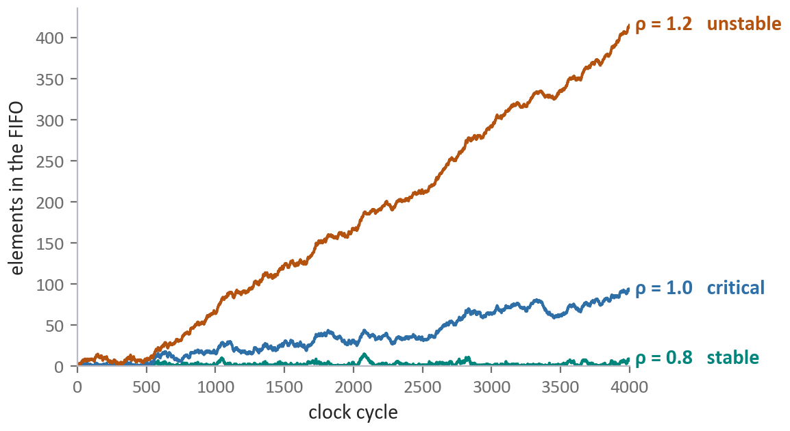
Load Factor and Stability
Load factor | In hardware | What the FIFO does
ρ < 1 stable | Under-utilized: headroom | Drains between bursts. Short-term stalls or drops are still possible
ρ = 1 critical | Fully utilized | No headroom. Only perfectly regular traffic keeps up; with any randomness the backlog keeps growing
ρ > 1 unstable | Over-subscribed | Grows without bound. With backpressure the producer falls ever further behind; without it, elements are dropped
Random arrivals and departures, same random seed, unbounded FIFO. Queueing theory names the three regimes.

Slide 18
Throughput and FIFO Depth
PRACTICE
A vision accelerator processes frames one at a time. Each frame takes 5 ms; on the 10% of frames with an object of interest it takes an extra 100 ms, 105 ms in all.
(a) What is the maximum frame rate the accelerator can sustain without its input FIFO growing without bound?
(b) Frames now arrive at 50 frames/s, one every 20 ms. Rank these patterns of expensive frames by how large the input FIFO typically needs to be, smallest first, and explain:
(i) Uniform: every 10th frame — 0, 10, 20, …
(ii) Bursty: runs of 10 — frames 0–9, then 100–109, then 200–209, …
(iii) Random: each frame independently, with probability 10%
Also in the LLM grader: Unit 5 › Accelerator throughput and FIFO depth

Slide 19
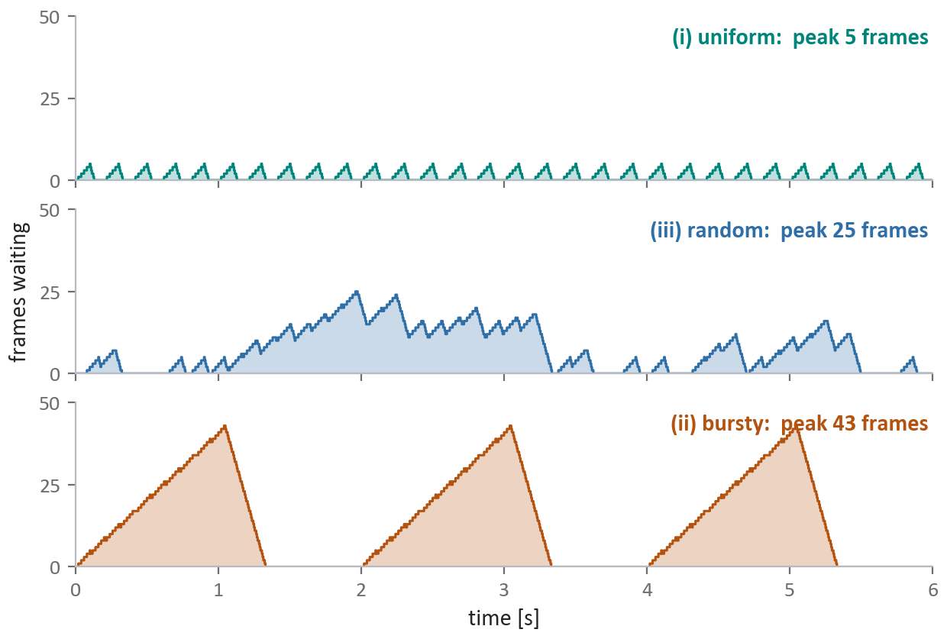
Throughput and FIFO Depth
SOLUTION
(a) Average time: 0.9 × 5 + 0.1 × 105 = 15 ms
Maximum rate: 1 / 15 ms ≈ 66.7 frames/s
(b) (i) uniform < (iii) random < (ii) bursty
The average load is the same in all three. What differs is how the expensive frames cluster, and a cluster builds a backlog the FIFO must hold while the accelerator falls behind.
Uniform: about 105 / 20 ≈ 5 frames arrive during one expensive frame, and drain before the next.
Bursty: 10 × 105 = 1050 ms, while about 52 frames arrive: a backlog of 40–50.
Simulated at 50 frames/s. The random pattern is one draw: its peak varies from run to run, and is unbounded in principle.
Also in the LLM grader: Unit 5 › Accelerator throughput and FIFO depth

Slide 20
Queueing Theory
Models arrivals and departures probabilistically
Used widely in networking research
  Determine probabilities of buffer overflow
  Optimal routing and drop policies
  Also used in network on chip
But requires mathematics
  Markov chains, probability
Take NYU’s networking theory class if interested

Slide 21
Outline
FIFOs
AXI4-Stream: Pure Streaming
Limitations of Pure Streaming with Vitis
AXI4-Stream: Packets and Serialization

Slide 22
Solution: Streaming FIFO Interface
Consider a PS sending jobs to accelerator
Use FIFOs for jobs and responses
Decouples for timing
  Transfer of data of the PS
  Processing of data in the HW
Enables efficient burst transfers
  Many elements can be transferred at once
  Reduces handshaking overhead
Both PS and HW run at their own pace
If some jobs need a lot of time
  Job FIFO buffers the jobs to process
Processing
System
Hardware
accelerator
Job FIFO
Processing
Engine
Response FIFO

Slide 23
AXI4-Stream
Industry standard streaming protocol
  Available as the interface to many Xilinx IP blocks
Pre-built in Vitis HLS
  All FIFO management is done for you
Part of the AXI4 family:
  AXI4-Lite: Covered last unit
  AXI4-Stream: This unit
  AXI4 (full, memory-mapped): later
Core signals: TDATA, TVALID and TREADY
Optional signals:
  TLAST, marking the end of a packet: later in this unit
  TKEEP, TSTRB, TID, TDEST, TUSER: not covered here
Processing
System
Hardware
accelerator
Command
AXI4-stream
Processing
Engine
Response
AXI4-stream

Slide 24
AXI4-Stream Terminology
TRANSMITTER
RECEIVER
FIFO
AXI4-Stream
Each AXI4-Stream is uni-directional
Transmitter is the producer / sender
  Could be PS sending jobs or HW accelerator returning responses
Receiver is the consumer
  Could be PS receiving response or HW accelerator receiving jobs
FIFO is typically realized on the receiver side
Called master and slave in older texts, and still in Vitis.

Slide 25
AXI4-Stream Protocol
TRANSMITTER
RECEIVER
Receiver asserts TREADY when it can accept data
  Typically, when FIFO has space
On any cycle it has data, the transmitter:
  Places data on TDATA
  Asserts TVALID
If TREADY=TVALID=1, there is a transfer
  Otherwise it holds TVALID and TDATA until TREADY=1
Receiver processes FIFO at its own pace
  Backpressure to transmitter via TREADY
At most one element transfers per cycle
TREADY
FIFO
TDATA
TVALID

Slide 26
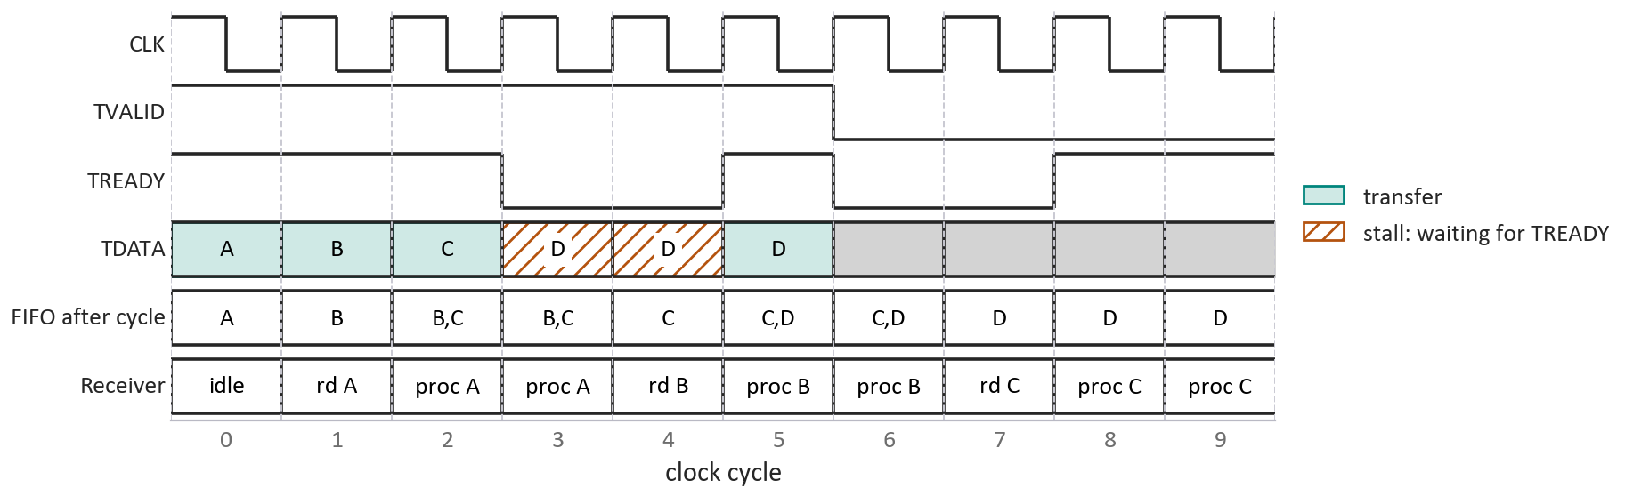
Example: Backpressure on AXI4-Stream
The FIFO write-stall problem, on the wires: A–D offered at cycles 0–3, FIFO depth 2
Registered TREADY: high in a cycle if the FIFO was not full after the previous one
D waits with TVALID held high until TREADY returns in cycle 5
TREADY high with TVALID low (cycles 8–9) is not a transfer: the receiver is ready, the transmitter has nothing to send.
Homework in the LLM grader: Unit 5 › AXI4-Stream timing, AXI4-Stream timing with stalls, Non-pipelined slave throughput

Slide 27

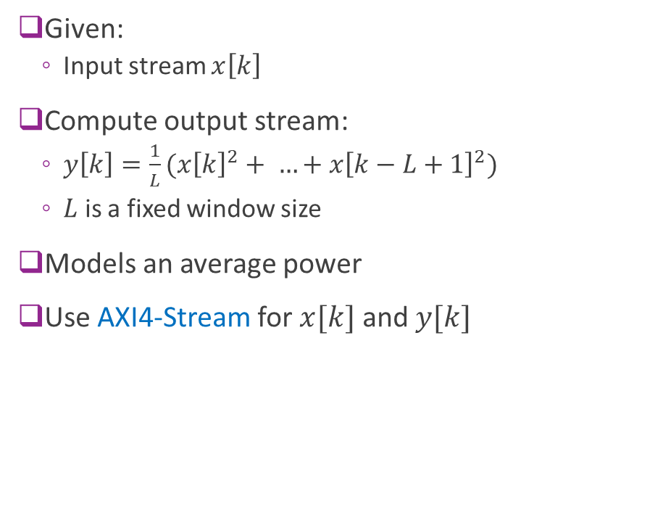

Example: Streaming Squared Average
Given:
  Input stream $x\left[k\right]$
Compute output stream:
  $y\left[k\right]=\frac{1}{L}(x{\left[k\right]}^{2}+ …+x{\left[k−L+1\right]}^{2})$
  $L$ is a fixed window size
Models an average power
Use AXI4-Stream for $x[k]$ and $y[k]$
Hardware
accelerator
$$x\left[k\right]$$
Input stream
Squared
average
AXI4-Stream
$$y\left[k\right]$$
Output stream

Slide 28
The Demo: a Streaming Filter
sdrangan.github.io/hwdesign — Demos › AXI4-Streaming
RUN THE WHOLE FLOW
WHAT TO WATCH FOR
cd demos/stream/avgfilt
python avgfilt_build.py --list-steps
python avgfilt_build.py --through verify_csim
python avgfilt_build.py
The kernel has no start or done: two axis ports and ap_ctrl_none
PIPELINE II=1: one sample in and one out every cycle
The C simulation still calls the kernel like a function, and exits on an empty stream
The timing diagram shows the handshake, the latency and the throughput
Measured in co-simulation: 200 samples out in 200 cycles, after a latency of 19 cycles, with no stalls.
That empty-stream exit is the first sign of the next section's limitation.

Slide 29
Outline
FIFOs
AXI4-Stream: Pure Streaming
Limitations of Pure Streaming with Vitis
AXI4-Stream: Packets and Serialization

Slide 30
Limitations of Pure Streaming
Problem 1: Many operations fundamentally operate in blocks
  Pure streaming interface does not natively have a block boundary
Problem 2: Hard to synchronize control and data
Problem 3: Vitis is not well-equipped to simulate continuous kernels
  Vitis has a fundamentally flawed execution model

Slide 31
Problem 1: Block-Based Operations
Many problems naturally work on blocks
Need to know boundaries
Ex: Image processing
  Each input is an image
  Images have a first and last element
  Scanned in some particular order (e.g. row-wise)
Ex 2: Matrix multiply
  Module needs two matrices
  Each has to be read in some order
Pure streaming is not natively good for these operations
Individual elements
Blocks of elements

Slide 32
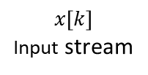
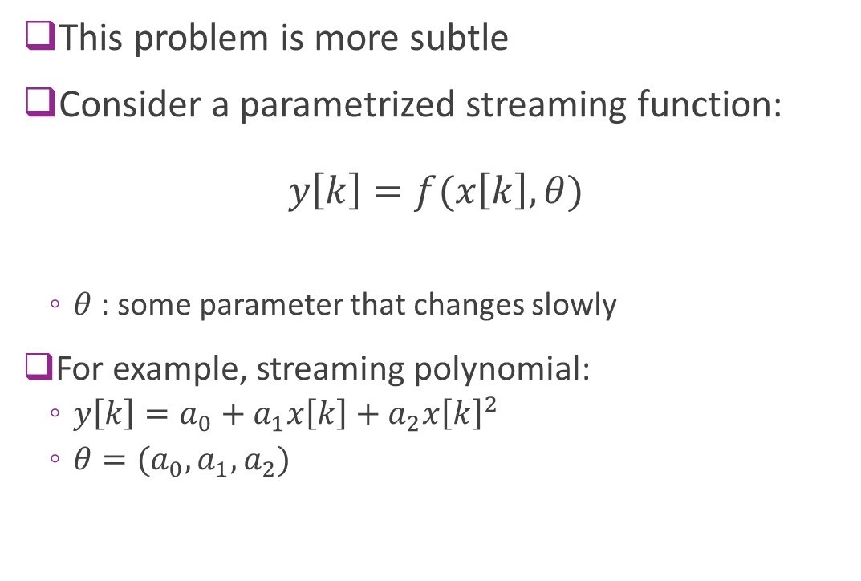

Problem 2: Control-Data Synchronization
This problem is more subtle
Consider a parametrized streaming function:
$y\left[k\right]=f(x\left[k\right], θ)$
  $θ$ : some parameter that changes slowly
For example, streaming polynomial:
  $y\left[k\right]=a_{0}+a_{1}x\left[k\right]+a_{2}x{\left[k\right]}^{2}$
  $θ=(a_{0}, a_{1}, a_{2})$
Hardware
accelerator
Control $θ$
$$x\left[k\right]$$
Input stream
Polynomial
Eval
$$y\left[k\right]$$
Output stream

Slide 33
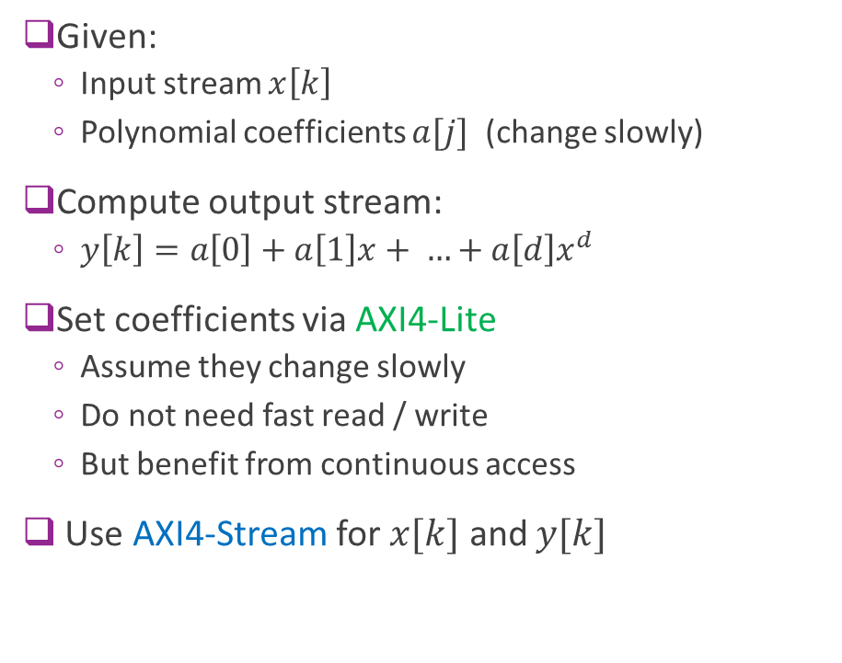

Solution: Mix AXI4-Lite and AXI4-Stream?
Given:
  Input stream $x\left[k\right]$
  Polynomial coefficients $a[j]$ (change slowly)
Compute output stream:
  $y\left[k\right]=a\left[0\right]+a\left[1\right]x+ …+a\left[d\right]x^{d}$
Set coefficients via AXI4-Lite
  Assume they change slowly
  Do not need fast read / write
  But benefit from continuous access
Use AXI4-Stream for $x[k]$ and $y[k]$
Hardware
accelerator
$$a[j]$$
Coefficients
AXI4-Lite
$$x\left[k\right]$$
Input stream
Polynomial
Eval
AXI4-Stream
$$y\left[k\right]$$
Output stream

Slide 34
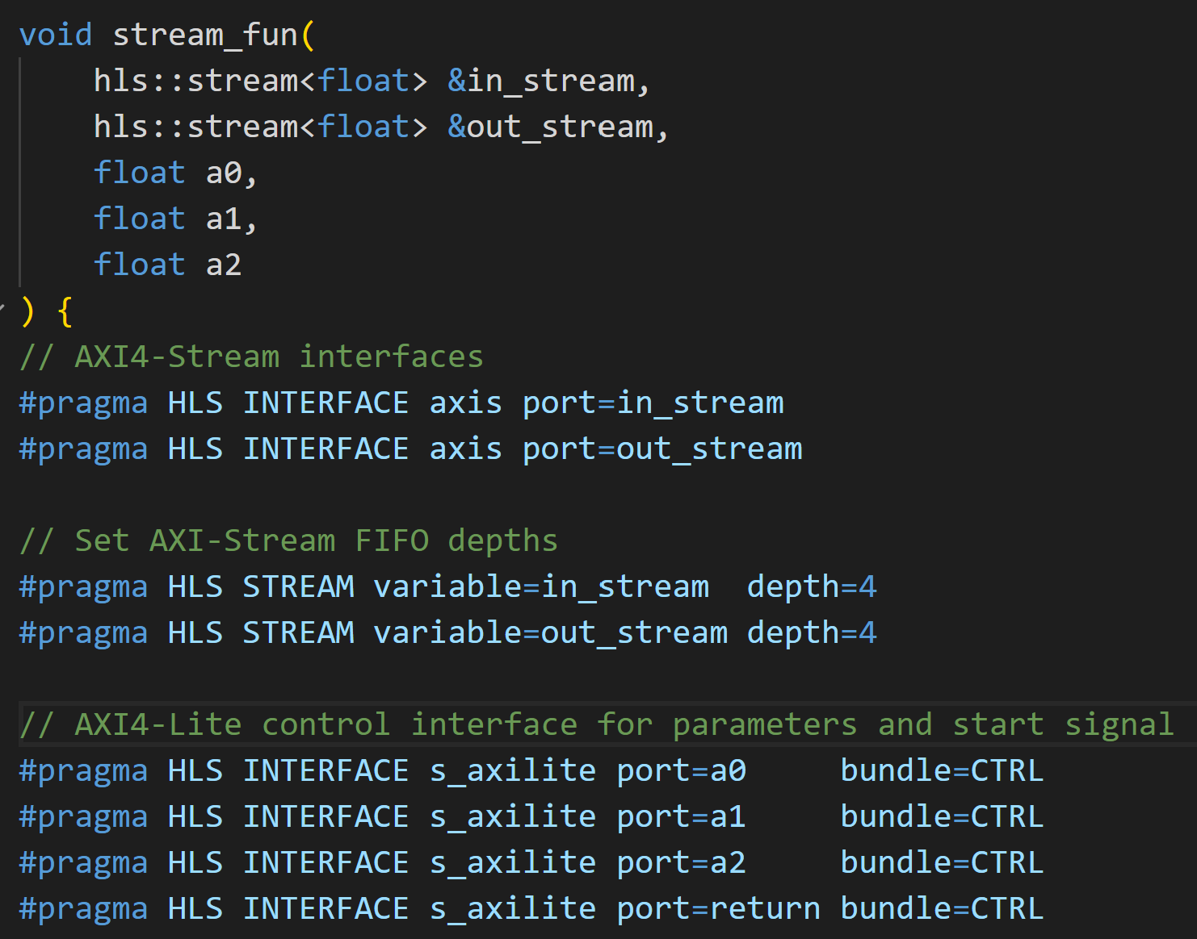
A Potential HLS Module Definition
Input and output streams
Coefficients
Declares that variables are AXI4-Stream
Does not state if transmitter or receiver.
Direction will be inferred
AXI4-Stream FIFO depth
Declares that coefficients are AXI4-Lite

Slide 35


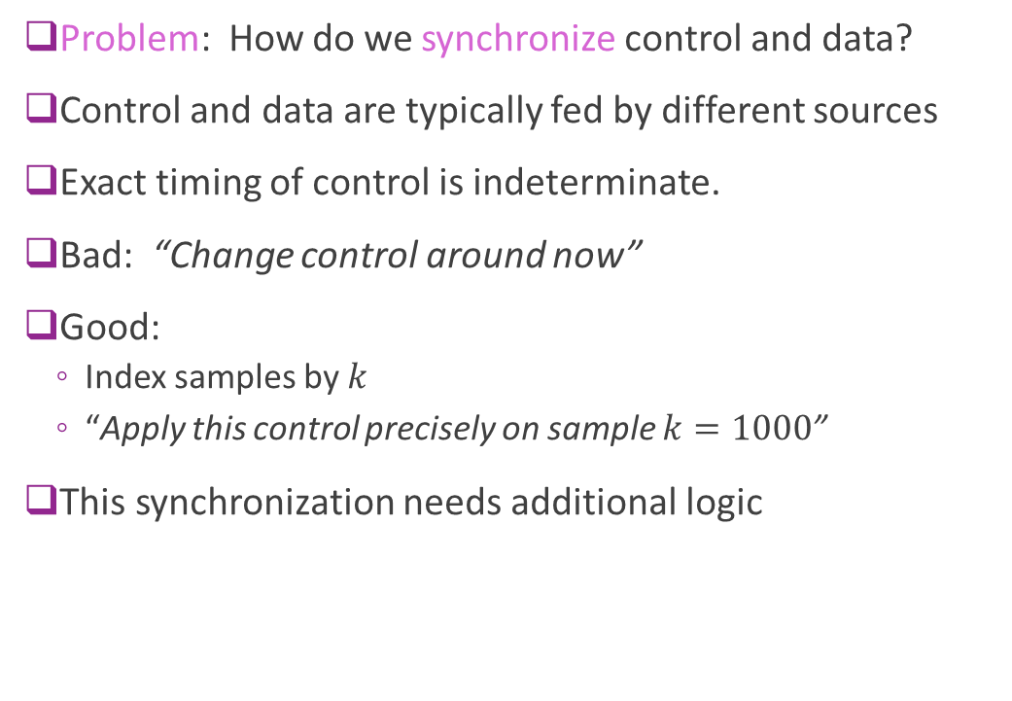
Problem Mixing AXI4-Lite and AXI4-Stream
Problem: How do we synchronize control and data?
Control and data are typically fed by different sources
Exact timing of control is indeterminate.
Bad: “Change control around now”
Good:
  Index samples by $k$
  “Apply this control precisely on sample $k=1000$”
This synchronization needs additional logic
Hardware
accelerator
$$a[j]$$
Coefficients
AXI4-Lite
$$x\left[k\right]$$
Input stream
Polynomial
Eval
AXI4-Stream
$$y\left[k\right]$$
Output stream

Slide 36
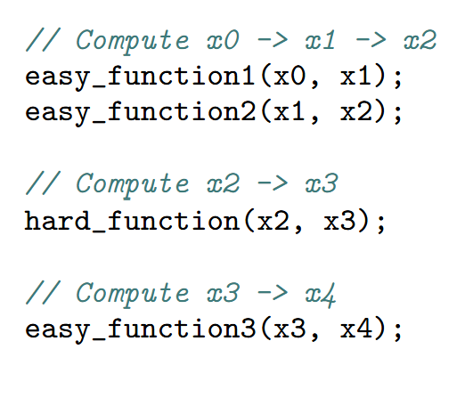


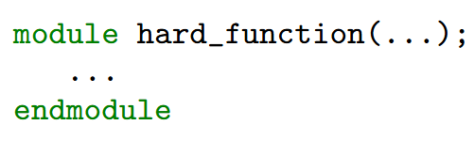
Problem 3: Vitis’ Flawed Execution Model
I need to
accelerate this step
Vitis generated RTL equivalent code
  Drop-in replacement for SW call
  Called with sequential manner
Software
developer

Slide 37
Vitis Execution Model Flaws
Item | Vitis Assumption | Proper hardware model
Execution paradigm | Module is “called” like a C function | Modules operate continuously and respond to events
Interface | C-like call | Hardware channels e.g., FIFOs and memory-mapped interfaces
Concurrent behavior | Obscured | Made explicit
Hardware is not software

Slide 38
Outline
FIFOs
AXI4-Stream: Pure Streaming
Limitations of Pure Streaming with Vitis
AXI4-Stream: Packets and Serialization

Slide 39
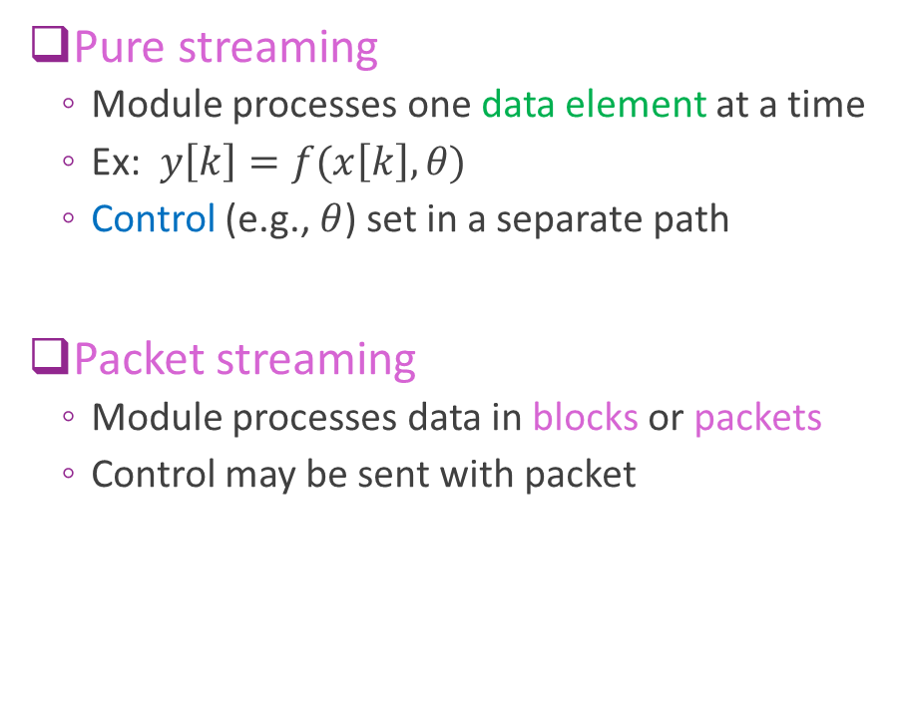
Pure vs. Packetized Streaming
Pure streaming
  Module processes one data element at a time
  Ex: $y\left[k\right]=f(x\left[k\right], θ)$
  Control (e.g., $θ$) set in a separate path
Packet streaming
  Module processes data in blocks or packets
  Control may be sent with packet
Control
Output data
Input data
HW module
Control
Data
HW module
Control
Data

Slide 40
AXI4-Stream Protocol with Packetization
TRANSMITTER
RECEIVER
Add a TLAST line
TLAST = 1 on the last transfer
Indicates the end of packet
Packets are transferred in bursts
  Begins with first TVALID = 1
  Ends with the transfer that has TLAST=1
Cycles in a burst are called beats
  Transfer beat (TVALID=TREADY=1)
  Idle beat (TVALID=0)
  Stall beat (TVALID=1, TREADY=0): data held
  Last beat (TVALID=TREADY=TLAST=1)
TREADY
FIFO
TDATA
TVALID
TLAST

Slide 41
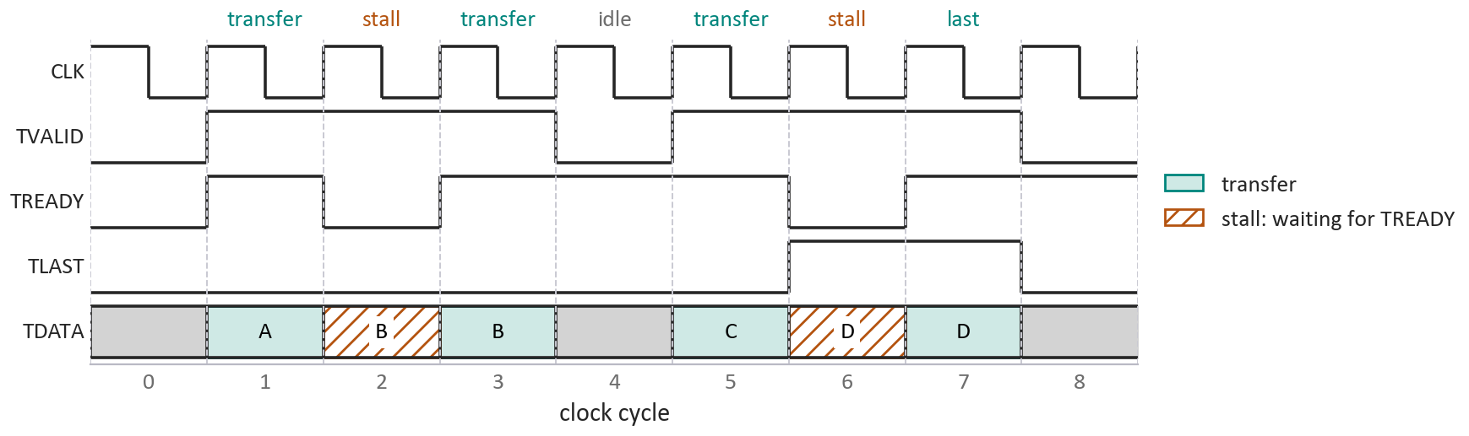
Example Burst Timing
A packet of four elements, A–D: 7 beats, 4 transfers
B and D stall: TREADY is low, and TDATA and TLAST are held
Cycle 4 is idle: TVALID drops inside the packet
The packet ends with the transfer that has TLAST = 1: cycle 7, not cycle 6 where TLAST first rises.

Slide 42
AXI4-Stream Burst with TLAST
PRACTICE
Cycle | TREADY | TVALID | TLAST
0 | 0 | 0 | 0
1 | 1 | 1 | 0
2 | 0 | 1 | 0
3 | 1 | 1 | 0
4 | 0 | 1 | 1
5 | 1 | 1 | 1
A transfer occurs on any cycle where TVALID = 1 and TREADY = 1.
(a) What is the first cycle of the burst, the first with TVALID = 1?
(b) On which cycle does the last transfer occur?
(c) How many elements were transferred in the burst?
Also in the LLM grader: Unit 5 › AXI4-Stream burst with TLAST

Slide 43
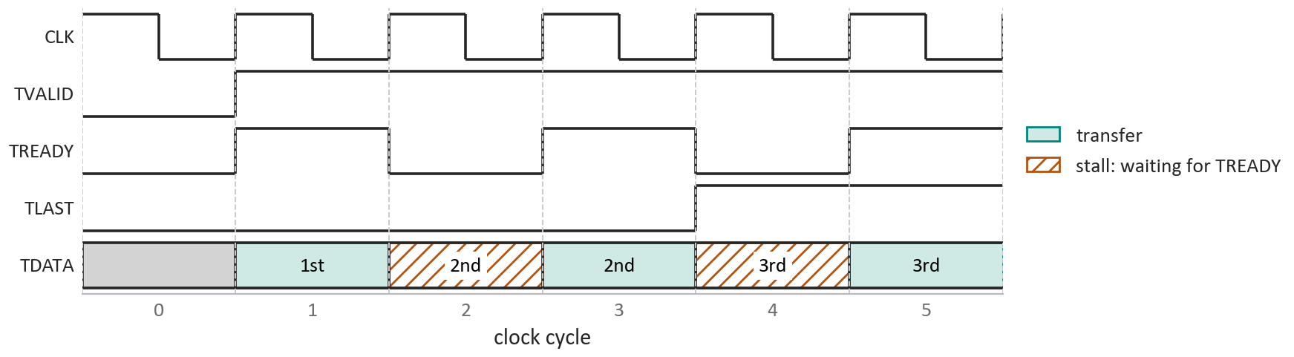
AXI4-Stream Burst with TLAST
SOLUTION
(a) Cycle 1: the first cycle with TVALID = 1
(b) Cycle 5. TLAST rises in cycle 4, but TREADY = 0 there, so the last element stalls
(c) 3 elements: transfers on cycles 1, 3 and 5. The burst is 5 beats, 2 of them stalls
Common errors
Counting a cycle with TVALID = 1 but TREADY = 0: 5 elements.
Ending the burst where TLAST first rises: cycle 4.
Also in the LLM grader: Unit 5 › AXI4-Stream burst with TLAST

Slide 44
Example: A Command-Response IP
Evaluate a cubic on a stream of samples
𝑦[𝑘] = 𝑐₀ + 𝑐₁𝑥[𝑘] + 𝑐₂𝑥[𝑘]² + 𝑐₃𝑥[𝑘]³
The coefficients arrive with the data, in a command
Each transaction can use a different polynomial
No separate AXI4-Lite path to keep in step
One transaction: a command in, a response out
TLAST ends each message, so the IP can tell a header from the samples that follow
in_stream
PolyCmdHdr
x[0] … x[nsamp−1]
poly IP
out_stream
PolyRespHdr
y[0] … y[nsamp−1]
PolyRespFtr
= TLAST

Slide 45
Command and Response Messages
Message | Field | Type | Holds
PolyCmdHdr | tx_id | uint16 | Transaction ID
 | coeffs | 4 × float32 | 𝑐₀ … 𝑐₃
 | nsamp | uint16 | Number of samples that follow
PolyRespHdr | tx_id | uint16 | Echo of the command's ID
PolyRespFtr | nsamp_read | uint16 | Samples actually read
 | error | 3-bit enum | What went wrong, if anything
Defined once, in Python
poly_schema.py describes each message as a waveflow data schema.
The C++ that packs and unpacks them is generated from it, so the kernel, the testbench and the model agree.
ONE TRANSACTION, WHERE EVERY | IS A TLAST
in_stream: PolyCmdHdr | x[0], x[1], …, x[nsamp−1] |
out_stream: PolyRespHdr | y[0], y[1], …, y[nsamp−1] | PolyRespFtr |

Slide 46
Robust Messages: IDs and Error Codes
Transaction IDs
Error codes, in the footer
Code | Error
0 | NO_ERROR
1 | TLAST_EARLY_CMD_HDR
2 | NO_TLAST_CMD_HDR
3 | TLAST_EARLY_SAMP_IN
4 | NO_TLAST_SAMP_IN
5 | WRONG_NSAMP
The command carries tx_id; the response header echoes it
The host matches each response to its command
A gap or a repeat in the IDs exposes a lost or duplicated message
Several commands can be in flight at once
Hardware cannot stop on bad input: the next command is already queued. It must report the error and resynchronize at the next TLAST.
The demo's hand-written kernel reports; its general kernel also recovers.

Slide 47
Serialization / Deserialization
Packets have arbitrary:
  Structure (often different fields)
  Arbitrary, sometimes variable, length
Hardware streams have specific bit widths
  Ex: 32, 64, 128, …
  Each stream element is a word
Serialization: Converts packets to array of stream words
Deserialization: Streams words to packets
Packet
uint32 words
uint32 words

Slide 48
Serialization / Deserialization Illustrated
TX Packet
AXI4-Stream
Deserialization
Serialization
Stream words
(e.g., ap_uint<32>)
Stream words
RX Packet

Slide 49
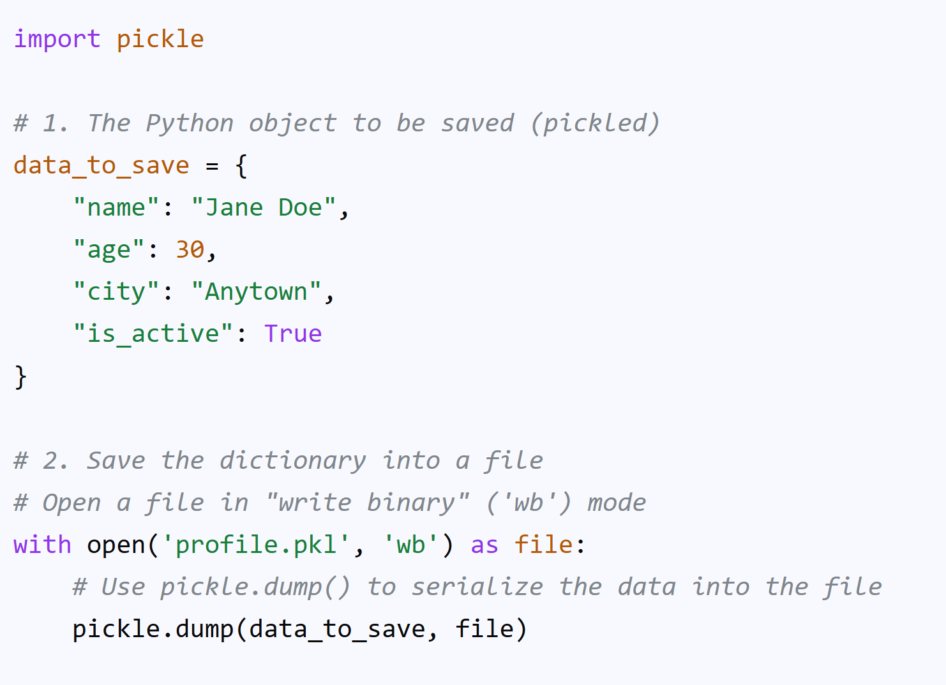
Serialization / Deserialization in Hardware
Python and C++ have widely-used serialization tools
Ex: Python pickle
  Can serialize an arbitrary class
  Serializes complex nested structures
Ex: Boost.serialization
  Similar package in C++
No standard library in hardware
Written by hand, or generated from a schema

Slide 50
Packing Fields into Words
A stream moves fixed-width words: 32 or 64 bits
Rule: no field crosses a word boundary
Pack small fields together; start a new word when the next will not fit
Set unused bits to zero
An integer field: assign its value to a bit range
w.range(15, 0) = nsamp_read;
A fixed-point field: copy its bits, not its value
w.range(11, 0) = a.range(11, 0); copies the bits
w.range(11, 0) = a; converts the value: 0.75 becomes 0
The demo's PolyRespFtr: two fields in one 32-bit word
zero
31–19
error
18–16
nsamp_read
15–0
Its PolyCmdHdr at 32 bits: six words
tx_id
w0
c0
w1
c1
w2
c2
w3
c3
w4
nsamp
w5
A float fills a word exactly. A 16-bit field leaves the upper half of its word zero, which a 64-bit stream packs more tightly.

Slide 51
Serializing a Command Header
PRACTICE
ap_uint<n> is an n-bit unsigned integer. ap_fixed<W,I> is a signed fixed-point value with W bits in all, I of them integer bits, the sign included.
(a) How many 32-bit words does one header need, if no field may be split across a word boundary?
(b) Complete the function below to serialize a header into 32-bit words. Use the minimum number of words.
class CmdHdr {
ap_uint<16> trans_id;
// Q1.11: 1 sign bit, 11 fractional bits;
// 1.0 corresponds to π radians
ap_fixed<12,1> yaw, pitch, roll;
ap_uint<16> nsamp;
};
void serialize(const CmdHdr &cmd_hdr,
ap_uint<32> words[/* ? */]) {
...
}
Also in the LLM grader: Unit 5 › Serializing a command header

Slide 52
Serializing a Command Header
SOLUTION
(a) 16 + 12 + 12 + 12 + 16 = 68 bits: more than two words. Three suffice: 3 words
void serialize(const CmdHdr &cmd_hdr,
ap_uint<32> words[3]) {
ap_uint<32> w0 = 0; // trans_id | yaw
w0.range(15, 0) = cmd_hdr.trans_id;
w0.range(27, 16) = cmd_hdr.yaw.range(11, 0);
words[0] = w0;
ap_uint<32> w1 = 0; // pitch | roll
w1.range(11, 0) = cmd_hdr.pitch.range(11, 0);
w1.range(23, 12) = cmd_hdr.roll.range(11, 0);
words[1] = w1;
ap_uint<32> w2 = 0; // nsamp
w2.range(15, 0) = cmd_hdr.nsamp;
words[2] = w2;
}
word 0
0
yaw 27–16
trans_id 15–0
word 1
0
roll 23–12
pitch 11–0
word 2
0
nsamp 15–0
The error that matters
w0.range(27, 16) = cmd_hdr.yaw; converts the value to an integer: yaw = −0.25 packs as 0, not 0xE00.
Also in the LLM grader: Unit 5 › Serializing a command header

Slide 53
Deserializing a Command Header
PRACTICE
The same CmdHdr has been serialized into three 32-bit words with the packing in the table.
Complete deserialize. It must assign every field, and each fixed-point field must get back exactly the value serialized, negative angles included.
class CmdHdr {
ap_uint<16> trans_id;
// Q1.11: 1 sign bit, 11 fractional bits;
// 1.0 corresponds to π radians
ap_fixed<12,1> yaw, pitch, roll;
ap_uint<16> nsamp;
};
Word | Bits | Field | Width
0 | 15:0 | trans_id | 16
0 | 27:16 | yaw | 12
1 | 11:0 | pitch | 12
1 | 23:12 | roll | 12
2 | 15:0 | nsamp | 16
void deserialize(CmdHdr &cmd_hdr,
ap_uint<32> words[3]) {
// Fill in your solution here
}
Also in the LLM grader: Unit 5 › Deserializing a command header

Slide 54
Deserializing a Command Header
SOLUTION
Assigning an integer to an ap_fixed is a numeric conversion, not a bit copy.
cmd_hdr.yaw = w0.range(27, 16); reads the 12 bits as an integer between −2048 and 2047, which wraps to 0 or −1 in the range [−1, 1).
Write the bits into the field with .range() instead. All 12 bits, the sign bit included, are copied, so no sign extension is needed.
void deserialize(CmdHdr &cmd_hdr,
ap_uint<32> words[3]) {
ap_uint<32> w0 = words[0];
ap_uint<32> w1 = words[1];
ap_uint<32> w2 = words[2];
// Word 0: trans_id | yaw
cmd_hdr.trans_id = w0.range(15, 0);
cmd_hdr.yaw.range(11, 0) = w0.range(27, 16);
// Word 1: pitch | roll
cmd_hdr.pitch.range(11, 0) = w1.range(11, 0);
cmd_hdr.roll.range(11, 0) = w1.range(23, 12);
// Word 2: nsamp
cmd_hdr.nsamp = w2.range(15, 0);
}
The same rule, both ways
Serialize: w.range(…) = f.range(11, 0);
Deserialize: f.range(11, 0) = w.range(…);
Also in the LLM grader: Unit 5 › Deserializing a command header

Slide 55
The Demo: a Command-Response IP
sdrangan.github.io/hwdesign — Demos › Command-Response FIFO Interface
RUN THE WHOLE FLOW
WHAT TO WATCH FOR
cd demos/stream/poly
python poly_build.py --list-steps
python poly_build.py --through verify_csim \
--kernel poly32 --force-step csim
python poly_build.py
The messages are written once, in poly_schema.py; the headers that pack them are generated
Three kernels, one function: poly32 and poly64 pack by hand, general uses the generated code
Every TLAST is checked, and a misplaced one is reported in the footer
The timing diagram decodes each message off the wires
Three transactions, checked field by field against the Python model. Output starts 34 cycles after the input, then comes out one sample per cycle.
Same stream interface as the filter; the messages are what is new.

Slide 56
Choosing an Interface
 | AXI4-Lite registers | AXI4-Stream, pure | AXI4-Stream, packets
Carries | A few control values | An endless sequence of samples | Commands and data, framed by TLAST
Rate | About 3 cycles per value | One value per cycle | One word per cycle
Control | Is the interface | A separate path, hard to keep in step | Travels with the data
Flow control | A handshake per transaction | TREADY backpressure into a FIFO | The same, plus IDs and error codes
Seen in | Unit 4, scalar function | Unit 5, streaming filter | Unit 5, polynomial IP
Registers to configure an IP; streams to feed it.

