Slide 1
Lab 1: Introduction to SDRs
Prof. Sundeep rangan

Slide 2
Learning Objectives
Describe a SDR vs. a traditional custom hardware device
Describe the roles of the SDR and host in TX and RX processing
Compare real-time and non-real time processing
Set up the ADALM-Pluto for non real-time processing in MATLAB
Set up different configurations (loopback, non-loopbacks, one or two hosts)
Transmit samples in a continuous loop
Capture and visualize a frame of samples

Slide 3
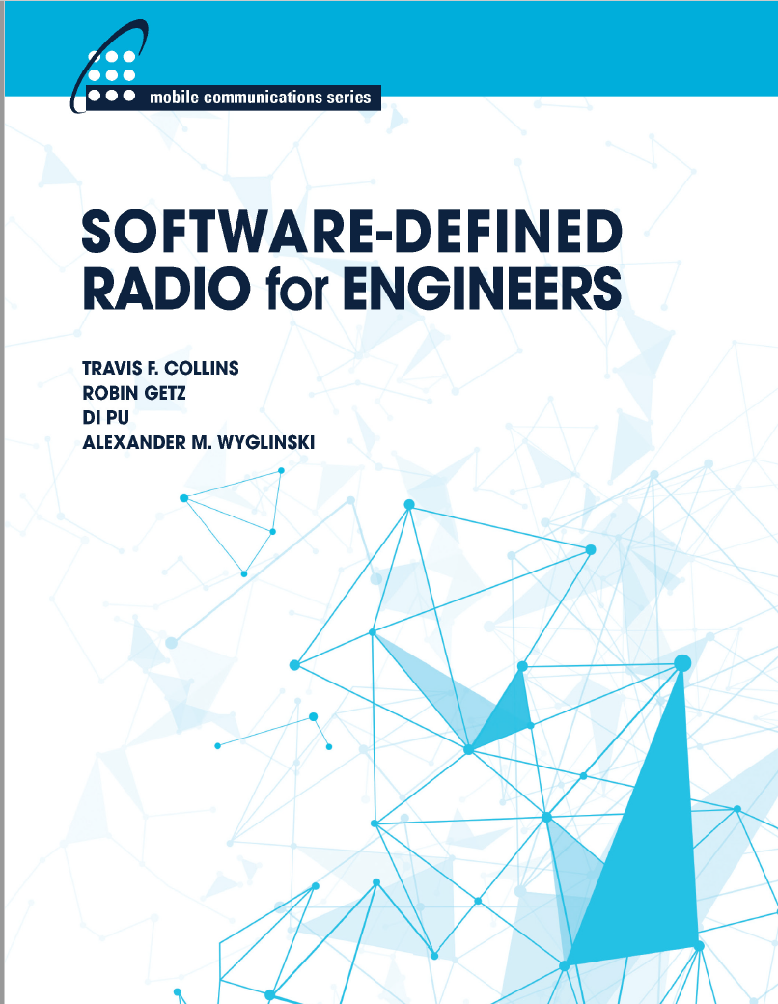
Excellent Reference
Free instruction book on SDRs
Analog website
MATLAB exercises
Based on ADALM-Pluto
But a little theoretical

Slide 4
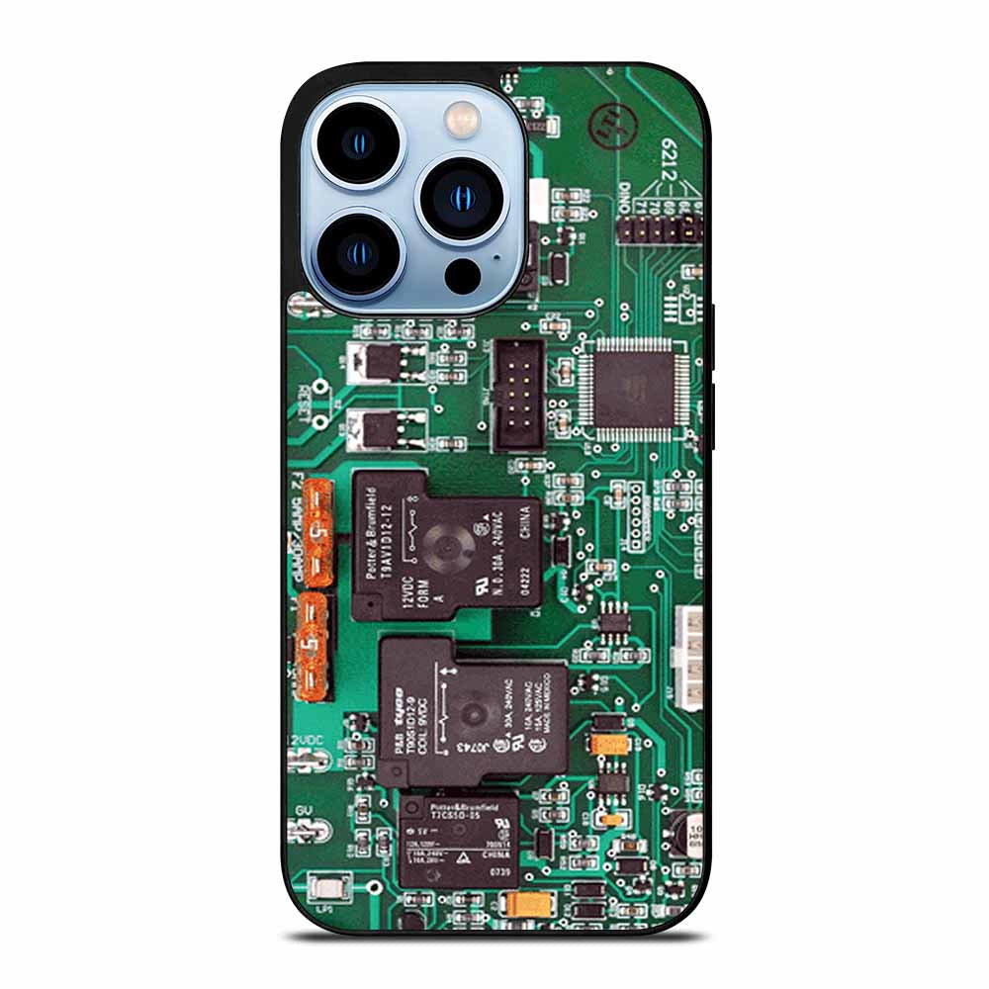
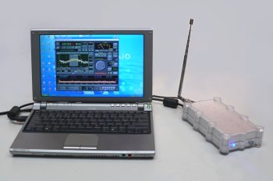
SDRs vs. Custom Hardware
Traditional custom communication hardware device
Ex: iPhone, Android, base stations (mostly)
Custom integrated circuits
Highly optimized
Power efficient, small form factor, high performance
Limited programmability of communications functions
Software defined radio
Implemented in programmable components (FPGA, ARM, Host PC)
Limited functionality / processing speed
Large form factor
Not (typically) for commercial use
Easy to change / program
Excellent for learning, simple

Slide 5
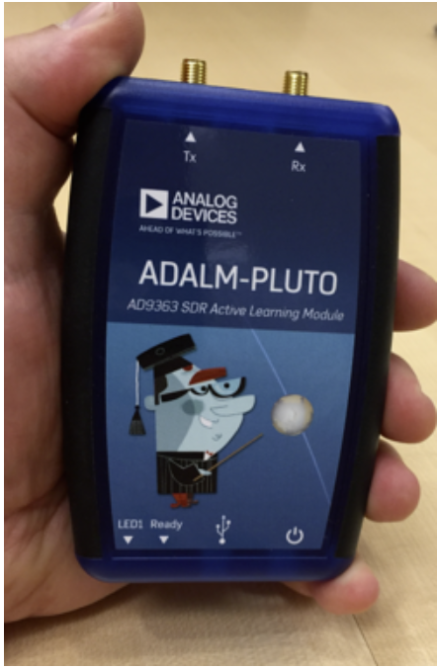
ADALM-Pluto
Simple, low-cost SDR
Lightweight
Can run on USB power
Sufficiently capable for basic experiments
WiFi and cellular emulation
NYU students will be provided one Pluto each
Work in pairs for most labs

Slide 6
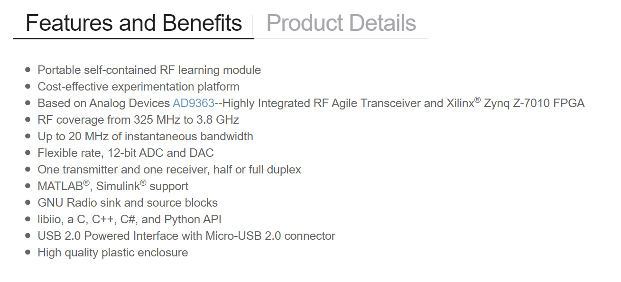
ADALM-Pluto Capabilities
From Analog devices webpage

Slide 7
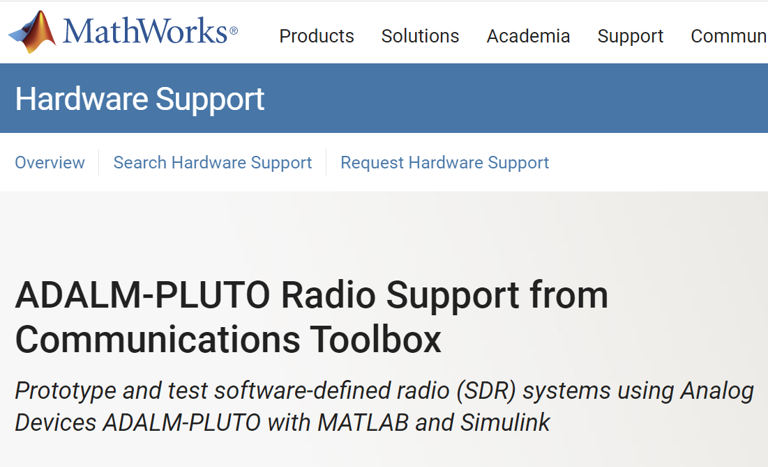
Getting Started
Purchase Pluto device
NYU students enrolled in class will get one device each to borrow for class
Install drivers on PC (Windows, Linux, or IOS)
Install MATLAB
All instructions available at MATLAB ADALM-Pluto webpage

Slide 8
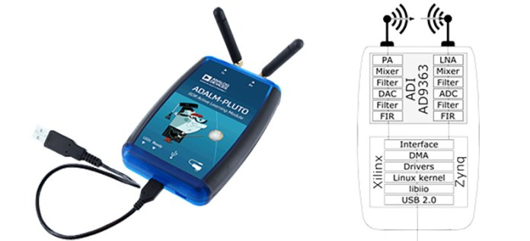


Inside the Pluto
Pluto
RF up-conversion & down-conversion
Filtering
ADCs and DACs
Interfaces with host via complex baseband samples
Host
Performs all baseband processing
This class we use MATLAB

Slide 9
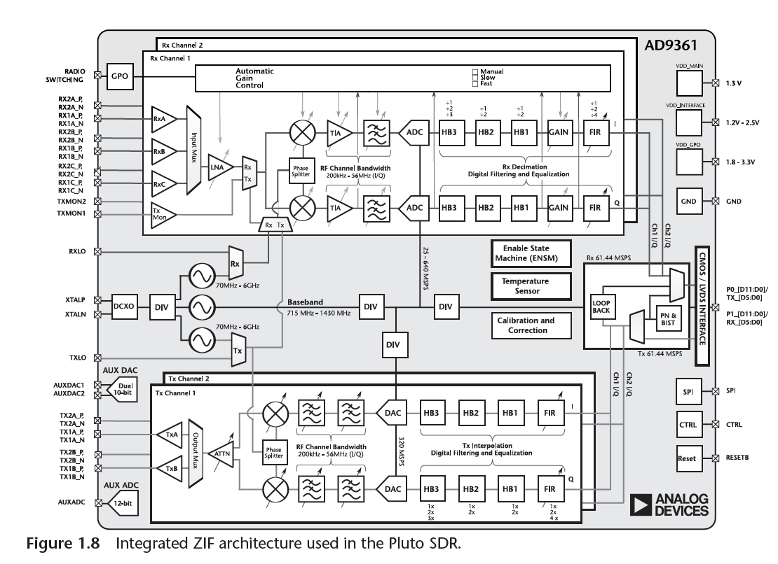
The 9361 Integrated Circuit
RX
Analog Devices AD9361 Wideband TXCR
Single integrated circuit
Receiver (RX):
Low noise amplifier (LNA)
Then tunable mixer, ADC, Filters
Transmitter (TX):
Filters, DAC, tunable mixer
Power amplifier (PA)
Digital I/Q
RF
TX

Slide 10

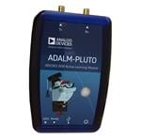

Non-Real Time Processing
This class: non-real time experiments
Simple and channel is realistic
But one-way, limited duration
Transmitter (TX)
Load circular buffer once
TX repeatedly sends same samples over and over again
Receiver (RX)
Capture one frame of samples
Load IQ samples into computer
Process offline
TX Buffer
TX
RX Buffer
RX

Slide 11
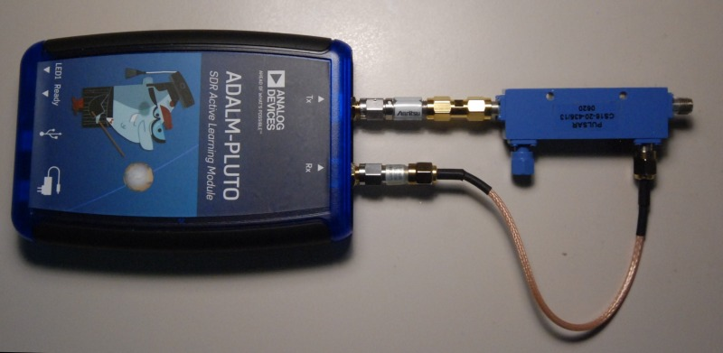
Configurations
Loopback
One Pluto, one host
Pluto performs TX and RX
Easy but fixed, uninteresting RF channels
Good for initial debugging
One host, two Plutos
Requires only one host
Channel limited by cable length
Two hosts, one Pluto each
Most flexibility in channels
But require two hosts
TX
RX

Slide 12


Lab Submissions
Use two Pluto devices
Single or two hosts
Work in pairs
At NYU, each student has one Pluto
TX
RX

Slide 13
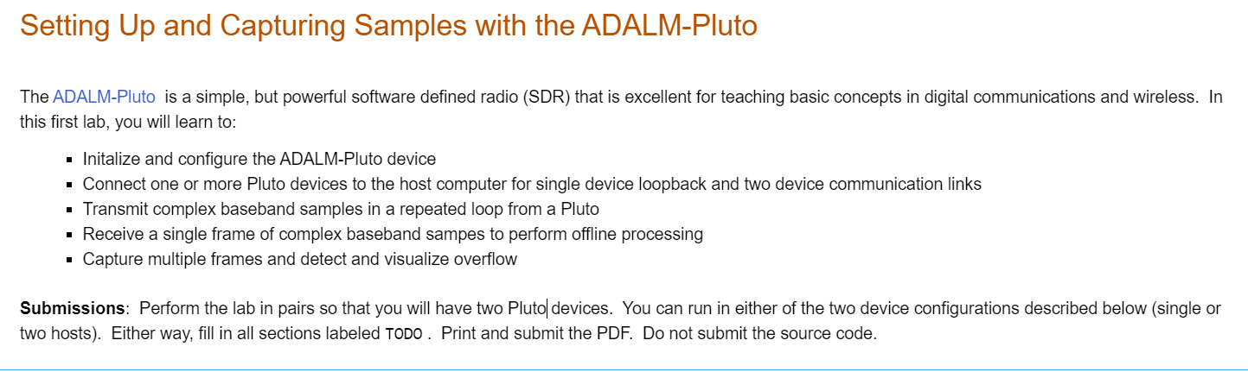
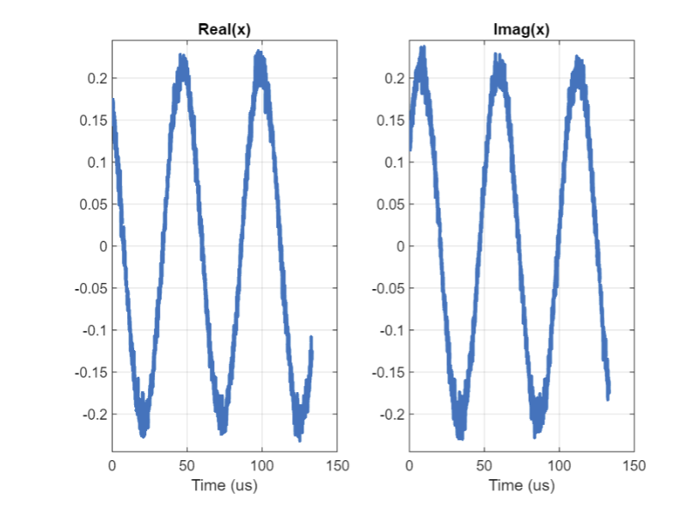
Lab 1: Capturing and Receiving Samples

