Slide 1
Lab 2: Frequency Estimation
Prof. Sundeep rangan

Slide 2
Learning Objectives
Send a complex exponential signal through the SDR
Estimate the complex gain and frequency of the RX complex exponential
Correlation method,
FFT method with oversampling
Gradient descent (advanced)
Estimate the carrier frequency offset

Slide 3
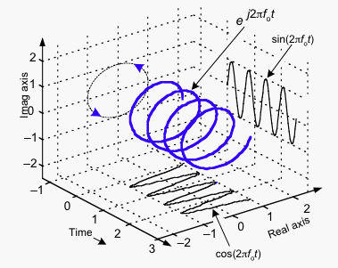
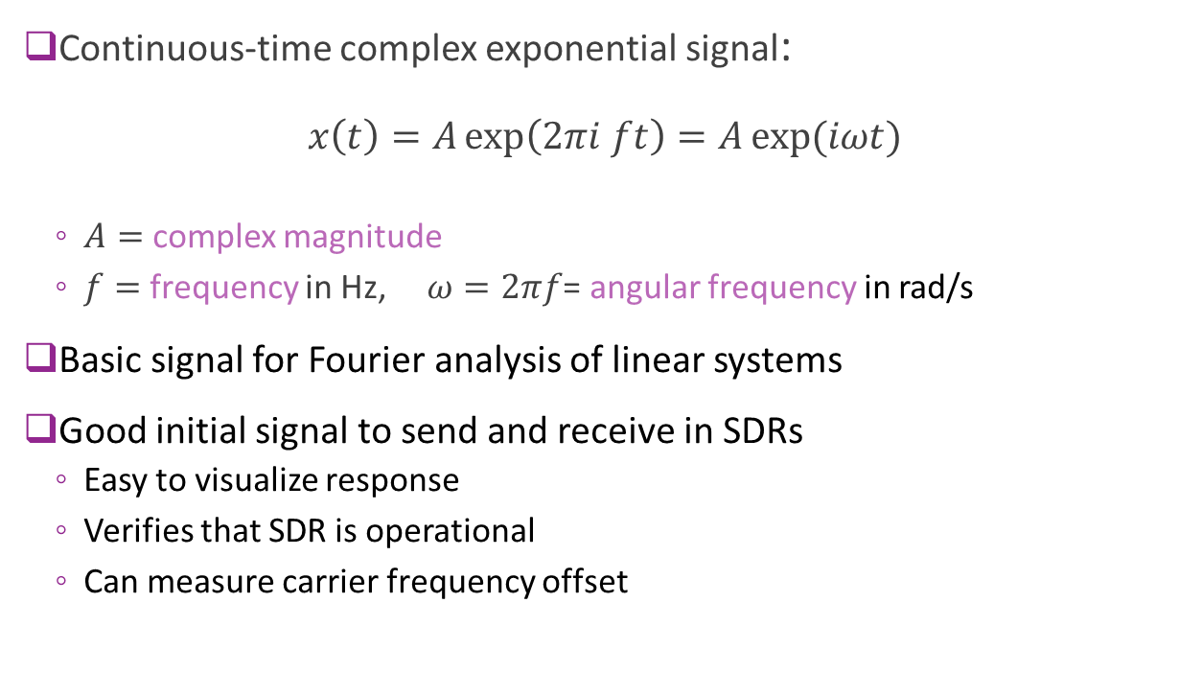
Complex Exponential
Continuous-time complex exponential signal: $x\left(t\right)=A\exp\left(2πi ft\right)=A\exp{(iωt)}$
$A=$ complex magnitude
$f=$ frequency in Hz, $ω=2πf$= angular frequency in rad/s
Basic signal for Fourier analysis of linear systems
Good initial signal to send and receive in SDRs
Easy to visualize response
Verifies that SDR is operational
Can measure carrier frequency offset

Slide 4
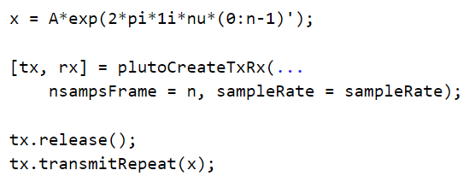
Transmitting a Complex Exponential
Create the signal
Create a TX object
Load the buffer
Will repeat continuously

Slide 5
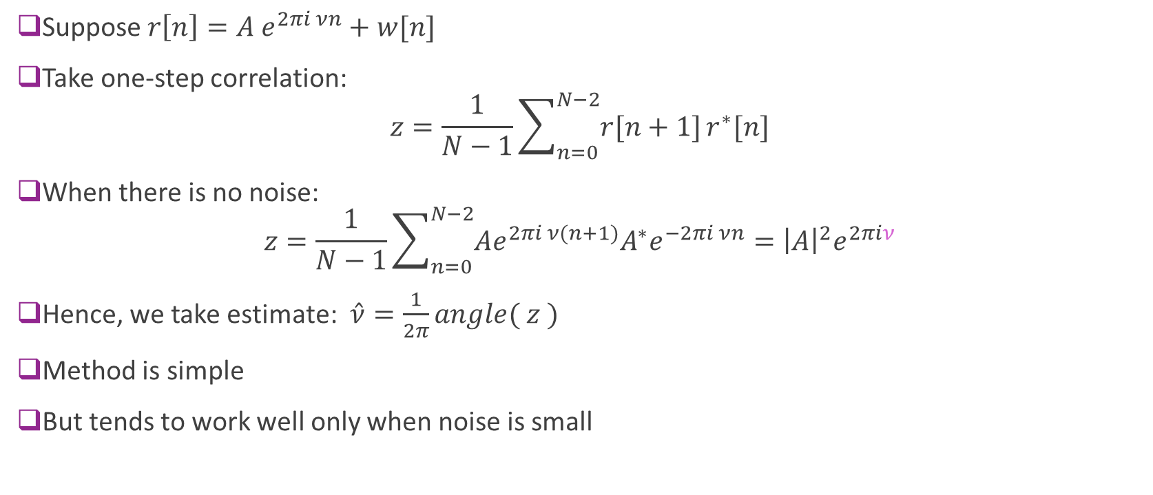
Estimating the Frequency Correlation Method
Suppose $r\left[n\right]=A e^{2πi νn}+w[n]$
Take one-step correlation: $z=\frac{1}{N−1}\sum_{n=0}^{N−2}{r[n+1]}r^{∗}[n]$
When there is no noise: $z=\frac{1}{N−1}\sum_{n=0}^{N−2}{Ae^{2πi ν(n+1)}A^{∗}e^{−2πi νn}}={\left|A\right|}^{2}e^{2πiν}$
Hence, we take estimate: $\hat{ν}=\frac{1}{2π}angle( z )$
Method is simple
But tends to work well only when noise is small

Slide 6
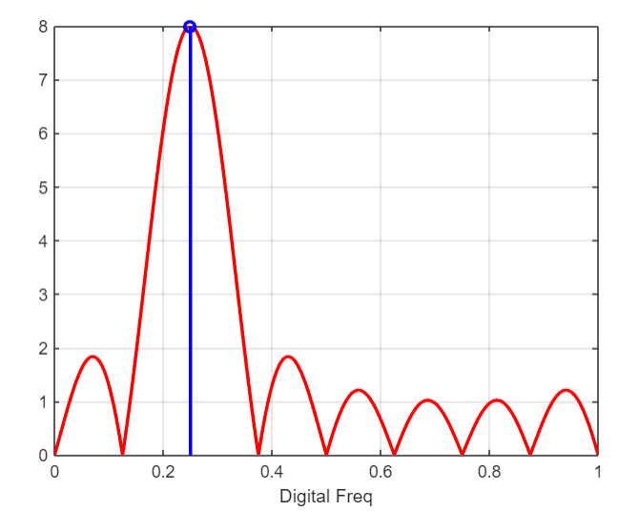

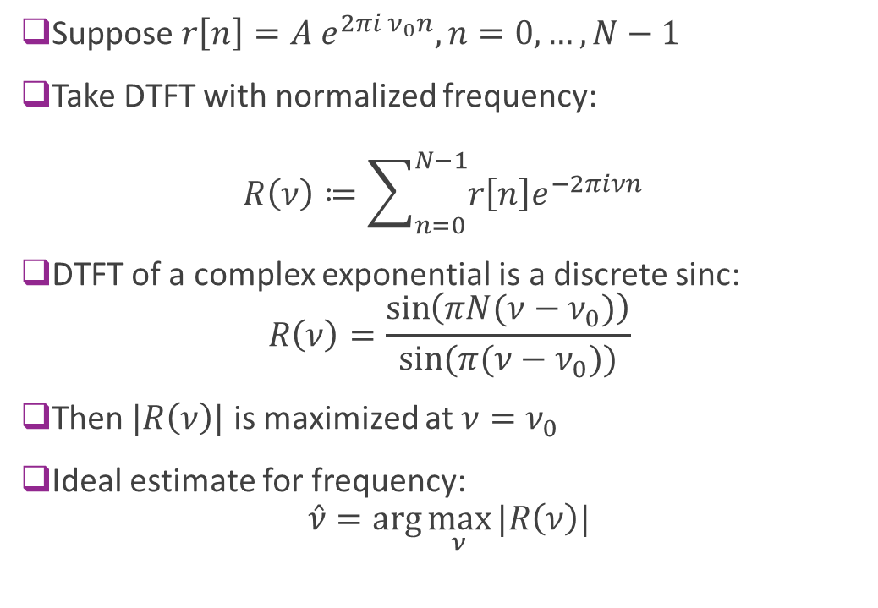
Estimating the Frequency with DTFT
Suppose $r\left[n\right]=A e^{2πi ν_{0}n}, n=0,…,N−1$
Take DTFT with normalized frequency: $R\left(ν\right)≔\sum_{n=0}^{N−1}{r\left[n\right]e^{−2πiνn}}$
DTFT of a complex exponential is a discrete sinc: $R\left(ν\right)=\frac{\sin\left(πN(ν−ν_{0})\right)}{sin⁡(π(ν−ν_{0}))}$
Then $|R\left(ν\right)|$ is maximized at $ν=ν_{0}$
Ideal estimate for frequency: $\hat{ν}=\arg{\max_{ν}{|R\left(ν\right)|}}$
$$ν_{0}$$

Slide 7
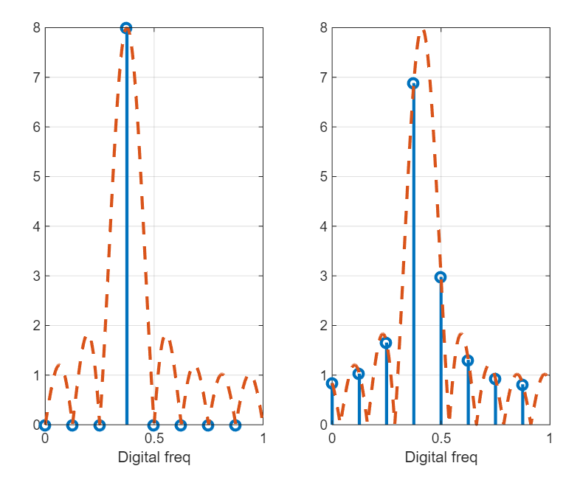
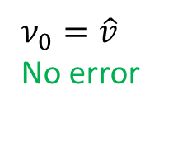
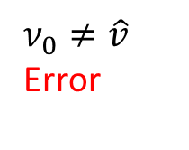
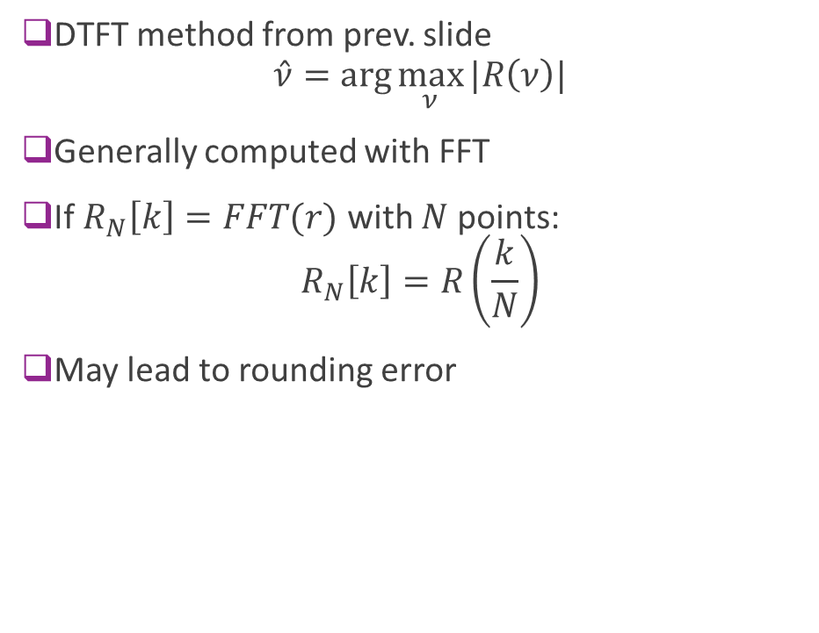


Estimating the Frequency with FFT
DTFT method from prev. slide $\hat{ν}=\arg{\max_{ν}{|R\left(ν\right)|}}$
Generally computed with FFT
If $R_{N}\left[k\right]=FFT(r)$ with $N$points: $R_{N}\left[k\right]=R\left(\frac{k}{N}\right)$
May lead to rounding error
$$\hat{ν}$$
$ν_{0}=\hat{v}$ No error
$ν_{0}≠\hat{v}$ Error
$$ν_{0}$$

Slide 8
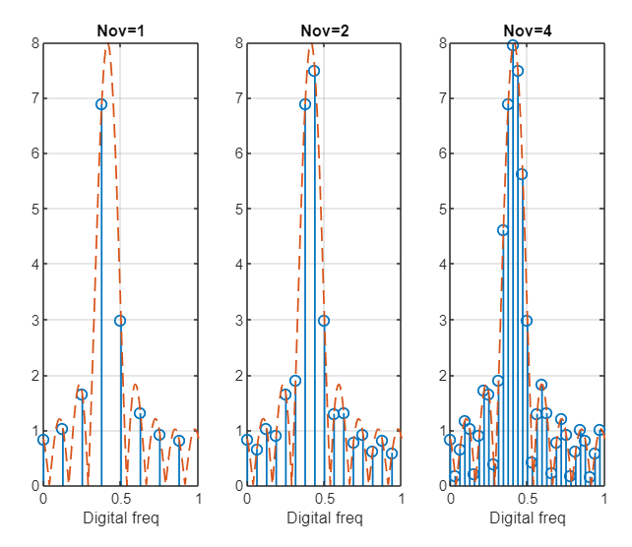
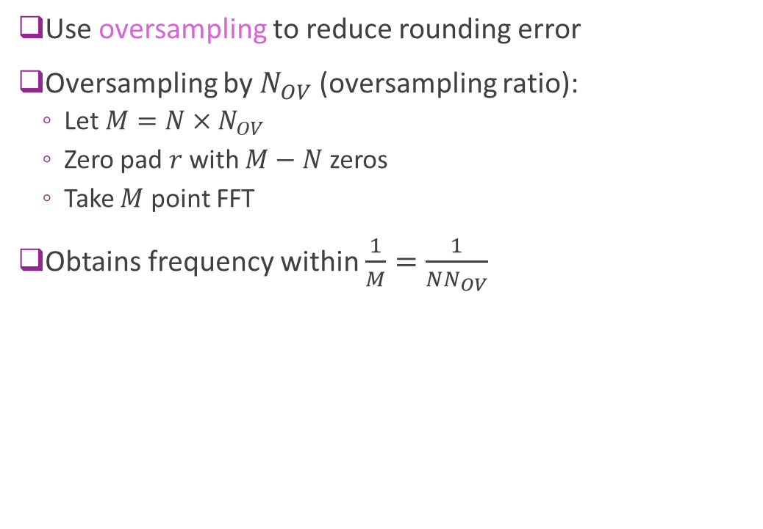
Using Oversampling
Use oversampling to reduce rounding error
Oversampling by $N_{OV}$ (oversampling ratio):
Let $M=N×N_{OV}$
Zero pad $r$ with $M−N$ zeros
Take $M$ point FFT
Obtains frequency within $\frac{1}{M}=\frac{1}{NN_{OV}}$
Lower frequency error

Slide 9




Carrier Frequency Offset
Recall: Mixer at TX and RX driven by a local oscillator (LO)
LO generally derived from a crystal with resonant frequency
LO frequencies may be slightly mismatched
Physical differences in crystal and temperatures
Causes a carrier frequency offset (CFO)
Lab: Use frequency estimation to estimate CFO
TX
RX
$$e^{jω_{0}t+θ_{0}}$$
$$e^{−jω_{1}t−θ_{1}}$$
LO 0
LO 1
CFO
$$ν_{TX}$$
$$ν_{RX}$$

Slide 10
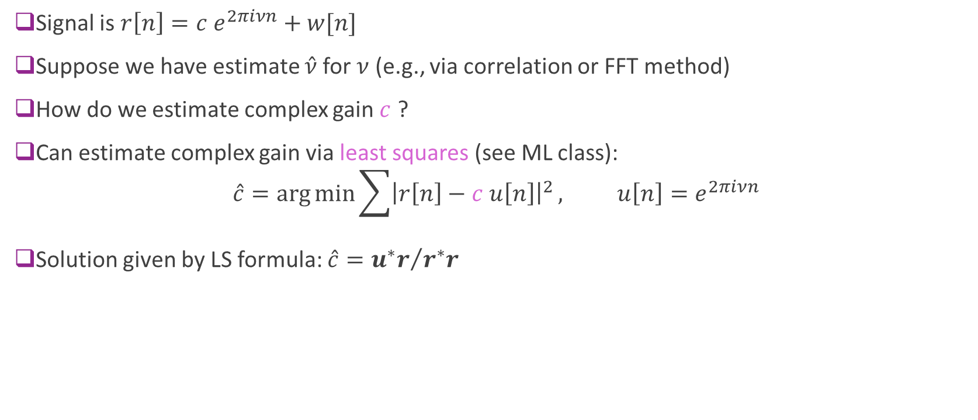
Estimating Gain with Least Squares
Signal is $r\left[n\right]=c e^{2πiνn}+w[n]$
Suppose we have estimate $\hat{ν}$for $ν$ (e.g., via correlation or FFT method)
How do we estimate complex gain $c$ ?
Can estimate complex gain via least squares (see ML class): $\hat{c}=\arg{\min{\sum{{\left|r\left[n\right]−c u\left[n\right]\right|}^{2}}}}, u\left[n\right]=e^{2πiνn}$
Solution given by LS formula: $\hat{c}={u^{∗}r}/{r^{∗}r}$

Slide 11
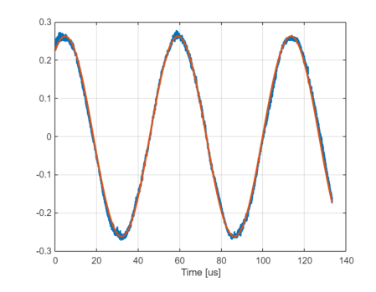
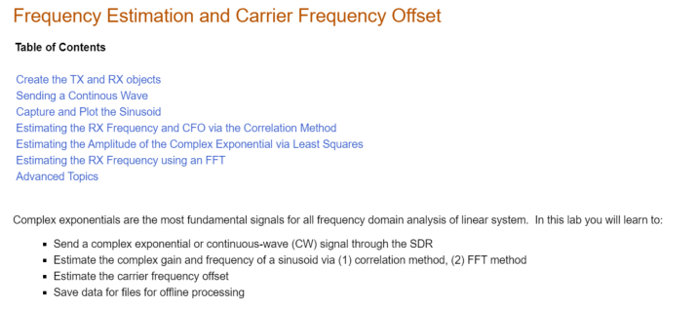
Lab 2
Lab 2 in the SDR lab github

