Slide 1
Course Introduction
ECE-GY 6023: Wireless Communications
Prof. Sundeep rangan

Slide 2
People and Time
Professor: Sundeep Rangan, srangan@nyu.edu
Office Hours: Wed 3-4pm
Course Assitant: None
But my PhD students may help
Class time: Tuesdays 6 to 8:30, 2 Metrotech Room 810
I will try to also broadcast on Zoom for those unable to attend
Attendance is optional
Lectures and problems
Online lectures from 2020 available on YouTube.
YouTube Wireless comm playlist
They are a bit out of date, but mostly OK

Slide 3
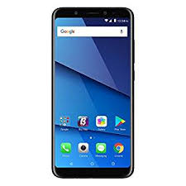
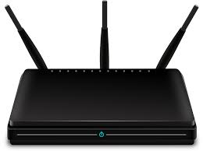
What is Wireless Communications?
Any communication of information via electromagnetic radio waves without a conductor
Wireless channel
Transmitter
Receiver

Slide 4
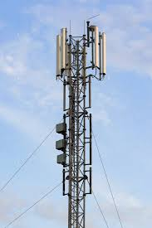
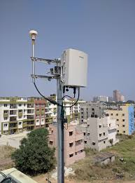
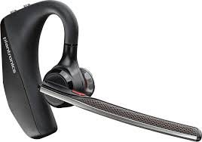
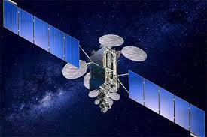
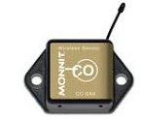
Wireless Communications Examples
Bluetooth devices
WiFi Access points
Smartphones
Cellular base stations
Satellite communications
Wireless sensors

Slide 5
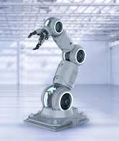
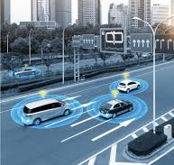

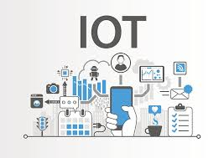

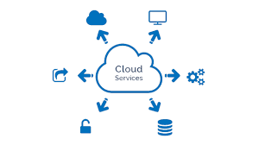
Many New Applications are Coming
Wireless connectivity can provide:
Portability and mobility
High data rates or low delay
Ubiquitous access to cloud services and data
Virtually every electronic device can benefit from wireless connectivity!

Slide 6
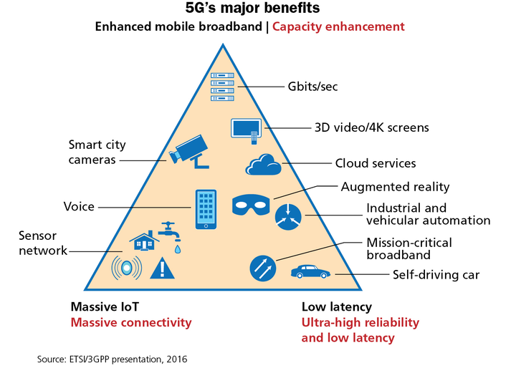
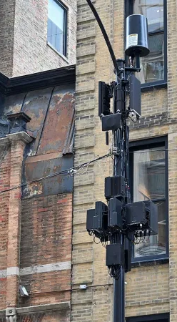
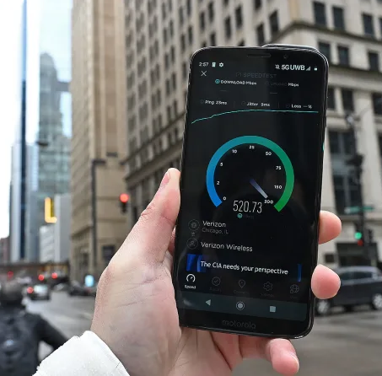
5G and Wireless Evolving Today
Photos from Sam Rutherford, Wind, Sleet, and Dead Zones: My Quest to Map Chicago's Spotty 5G
Trial results in VZ 5G Chicago network

Slide 7
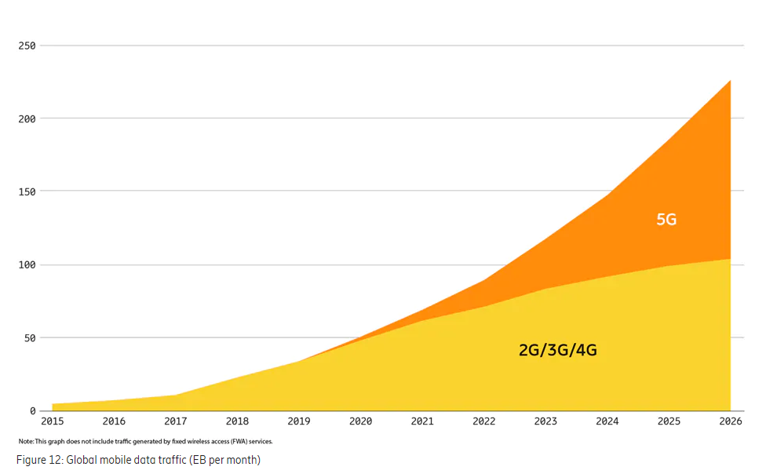
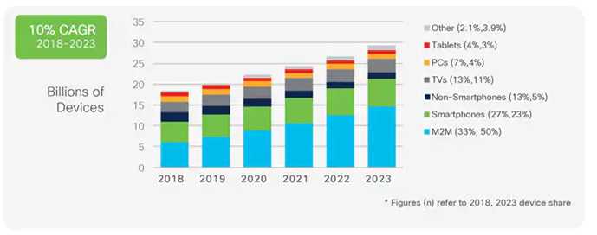
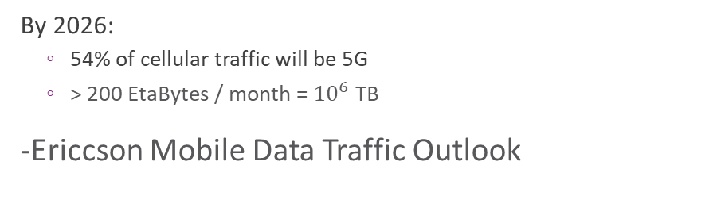
Wireless Continues to Grow
By 2023: >25 billion wirelessly connected devices –Cisco Annual Internet Report (2018–2023)
By 2026:
54% of cellular traffic will be 5G
> 200 EtaBytes / month = ${10}^{6}$ TB
-Ericcson Mobile Data Traffic Outlook

Slide 8


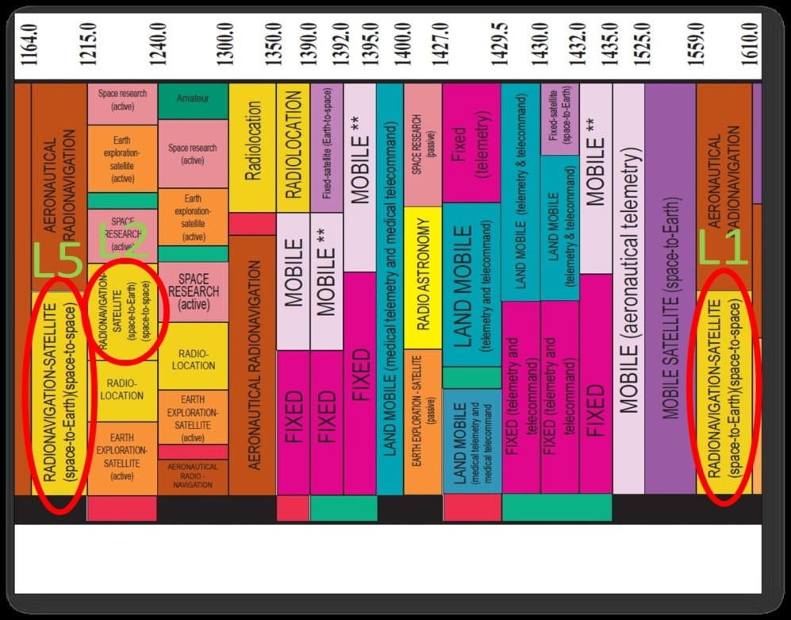
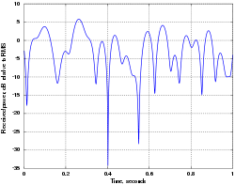
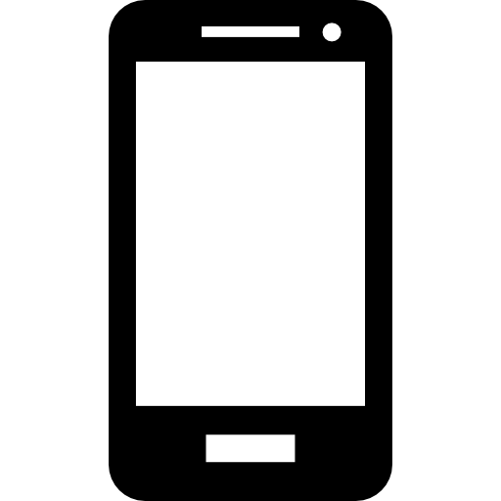
Key Challenges for Wireless
Interference and multiple users
Wireless signals radiate in all directions
Fading and propagation
Signals have limited range
Channel quality fluctuates in time with motion
Power consumption
Limited battery and processing
Limited spectrum
Licensed and unlicensed communications

Slide 9
Course Learning Objectives
Mathematically model and simulate wireless propagation
Antennas, EM waves
Multipath channels, statistical models, multi-antenna systems
Simulate and build simple wireless transceivers
Filtering, synchronization, equalization, coding, …
MAC and network layer protocols
Connect it all together for a simple end-to-end system
Analyze and optimize the system
Define and measure key performance metrics
Model impairments in the channel and devices
Describe and analyze commercial wireless systems in use today
4G, 5G cellular systems, WiFi, many others

Slide 10
Pre-Requisites
Graduate-level class intended for MS and PhD students in Electrical Engineering
Course may also be of interest to:
Working engineers in the field
Related areas: Robotics or vision
Graduate probability and digital communications
NYU students: ECE-GY 6013 Digital communications
Basics of modeling key components: mixing, synchronization, sampling, equalization, channel coding
Probability: Random variables and random processes
Programming:
Exercises are in MATLAB and Python
Any programming experience is probably suitable

Slide 11
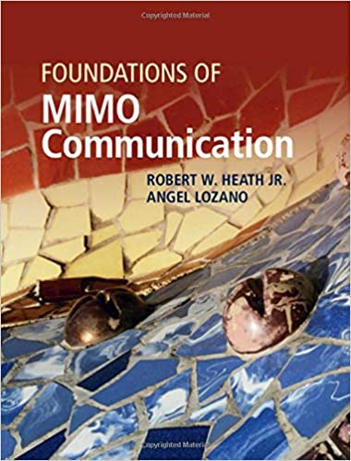
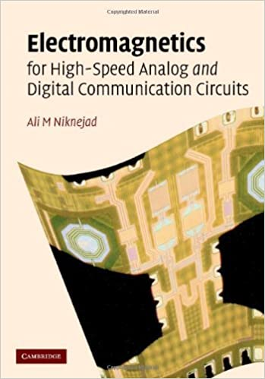
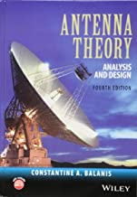
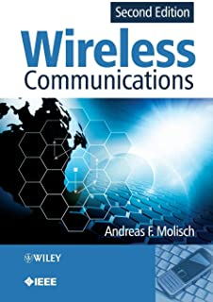
Supplementary Texts
Classic text on antennas
Encyclopedic reference for wireless
Up-to-date information theoretic perspective
EM from wireless comm perspective. Great material on high-speed RF
No required text, but there are many good references

Slide 12
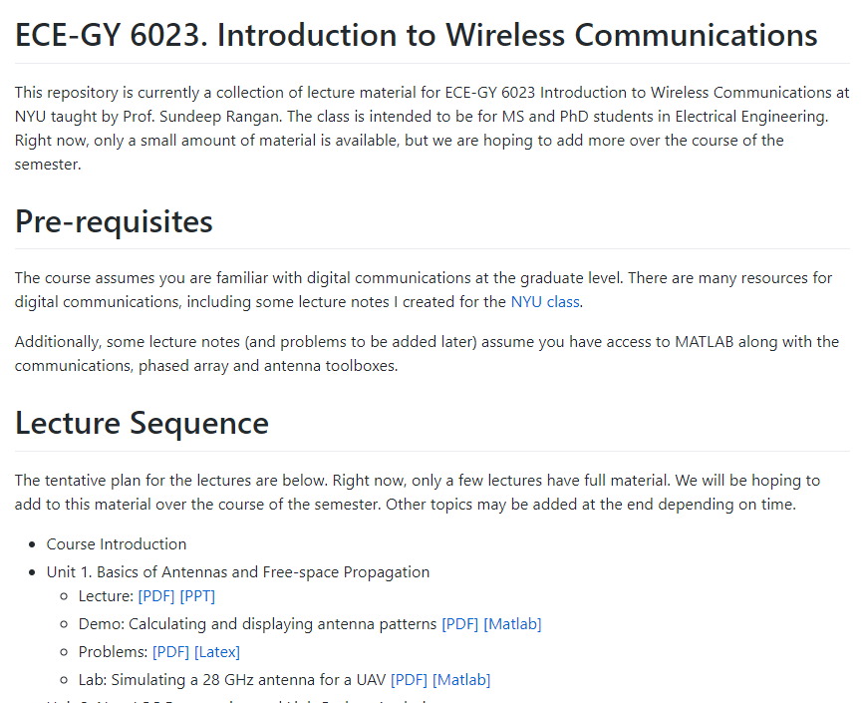
GitHub
All material can be found on GitHub: https://github.com/sdrangan/wirelesscomm
Lecture slides
Links to lecture videos
In-class MATLAB exercises
Problems and labs
Clone this repository
Pull to get latest material
Solutions to problems and labs:
Given to NYU students enrolled in class

Slide 13
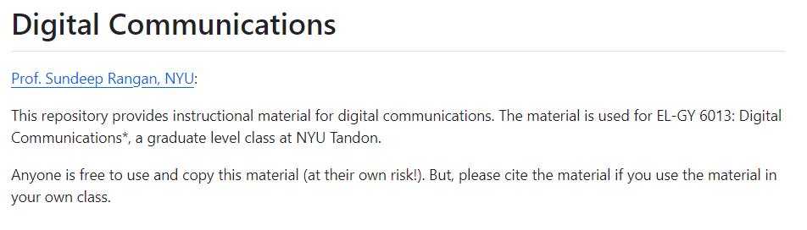
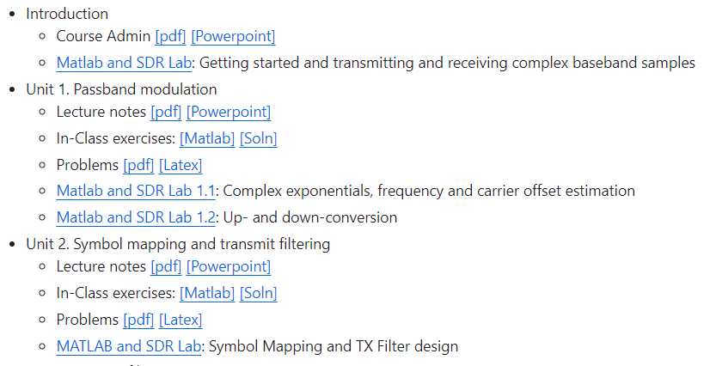
Digital Communications
Github site for digital communications: https://github.com/sdrangan/digitalcomm
This class (or equivalent) is a pre-req
Use this material for review if needed
Github site has:
Lecture slides
In-class MATLAB exercises
Problems and labs
But no videos

Slide 14
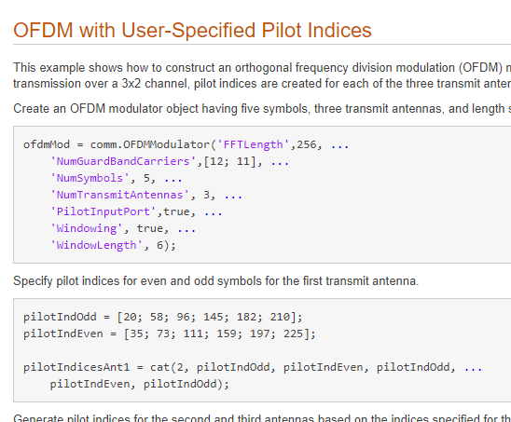
MATLAB
Most labs, demos and in-class exercises will be in MATLAB
Some parts may also use Python
Download the latest MATLAB
NYU students can get this for free:
https://www.mathworks.com/academia/tah-portal/new-york-university-618777.html
Make sure you get R2023B (Latest version)
Communications, Antenna and Phased Array Toolboxes
Very powerful set of tools for simulating wireless systems
Building blocks for all common parts
Antennas, phased arrays
Channels, modulators, demod, coding, decoding, …
Can integrate with Simulink
Can even export to HDL for synthesis

Slide 15
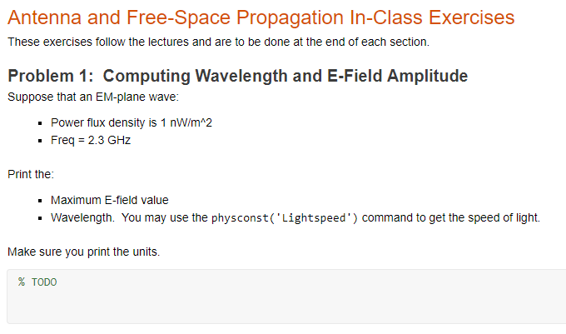
MATLAB Live Editor
Some course material MATLAB Live Editor
Will be used for in-class exercises, some labs
Similar to Python jupyter notebook
All code and text cells
Rich content and links
But you need to view them in MATLAB IDE
Cannot view in browser

Slide 16
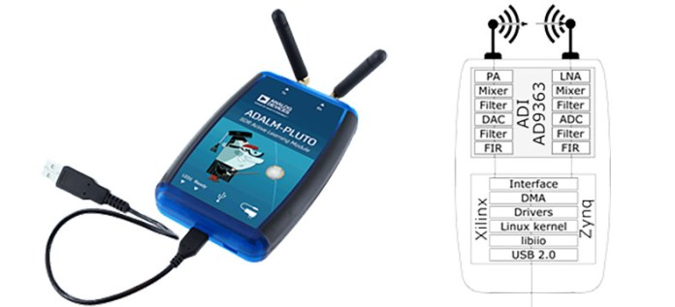


Software-Defined Radio (SDR) Labs
Based on ADALM-Pluto devices
Simple, but powerful
Low cost
Used in non-real-time mode
TX and RX signals over the air
Analyze offline in MATLAB
Continue labs from digital communications
Measure and analyze fading channels
Equalization
Coding
May add labs additional labs for MIMO
But needs other hardware

Slide 17
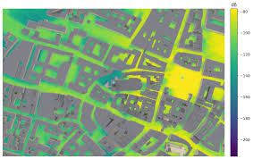
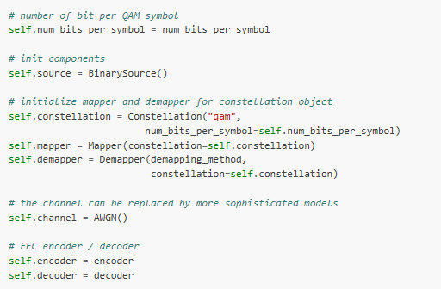
Nvidia Sionna
Sionna https://nvlabs.github.io/sionna/
Nvidia PHY layer simulation tool
Native integration in Tensorflow
Excellent for projects with ML
Full python based
Can be run in Google colab
Complete integration with ray tracing
Many comms functions
Basic antennas, channels, modulation, coding
Some 5G methods
Not as extensive as MATLAB’s Toolbox
I will move some labs to sionna

Slide 18
Grading
Grading:
25% Homework (including MATLAB exercises)
25% Midterm 1, 25% Midterm 2
25% Project
Exams: Midterms will be given remotely
Take home. Approximately one day to complete.
May use any material in the class or Internet
Just cannot talk to a friend

Slide 19
Project
Groups of two
Any topic of your interest in the area of wireless
Example:
802.11ad, LTE, 5G, …
Does not need to be original research.
Can be a solid implementation of something standard with a comprehensive evaluation.
Should involve some extensive simulation
You need a comprehensive simulation of at least one component
Better yet, some experimental component
Code will be graded for quality
Will give presentation in final lecture

Slide 20
Project Grading
Formulation
How well did you formulate the problem? Was it clear? What were you trying to achieve?
Approach and Design
Does your approach properly solve your problem? Is the design logical? Is the design robust?
Evaluation and Interpretation
How did you evaluate the approach? Were the metrics correct? What were the test assumptions?
Did you test against alternative approaches?
Implementation
Did the software work? Was it well-structured, commented. How modular is it?
Presentation
Were the ideas clear? Were all the details conveyed. Did you highlight the main points?
You can select a number of formats. Whatever makes sense. A github page
Bonus
Given for particularly hard / novel research

Slide 21
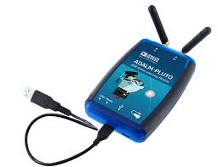
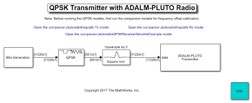
Many Resources for Your Projects
You will simulate an end-to-end system of your choice
Your project should comprehensively test at least one component
Ex: equalization, effect of phase noise, …
Many great resources:
MATLAB 5G toolbox
MATLAB HDL generator
Orbit testbed in Rutgers
ADAM Pluto
Nvidia Sionna

