Slide 1
Unit 4. Coding and Capacity on Fading Channels
Ece-gy 6023. Wireless communications
Prof. Sundeep rangan

Slide 2
Learning Objectives
Describe symbol mapping for QAM constellations
Implement symbol detection for faded symbols
Compute average BER and SER on AWGN and flat channels and compare
Identify if a system can be modeled as slow vs. fast and frequency-selective vs. flat fading
For slow and flat fading, compute outage probability and capacity under a fading model
For IID fading, compute the ergodic capacity
Create a TX and RX chain for flat and fading channels with given components
Symbol equalization, soft symbol detection, interleaving, channel decoder
Use MATLAB tools for common channel encoders and decoders
Convolutional, turbo codes and LDPC codes

Slide 3
Outline
Uncoded Modulation over Fading Channels
Capacity with Coding over Fading Channels: Outage Capacity
Capacity with Coding over Fading Channels: Ergodic Capacity
Review: Coding over an AWGN Channel
Coding over Fading Channels
Capacity with Bit-Interleaved Coded Modulation

Slide 4
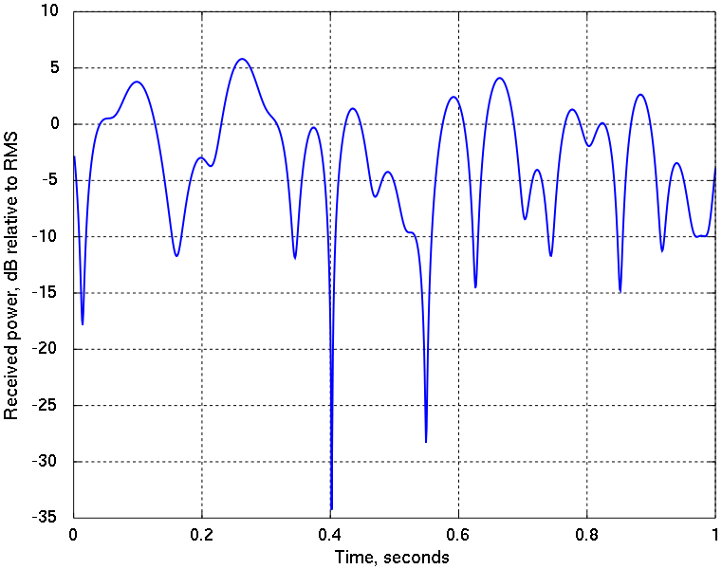
Uncoded Modulation
Symbol mapping
Symbol demodulation
TX filter
RX filter
TX bits
QAM symbols
RX QAM symbols
RX bits
Fading channel
This section: Uncoded modulation over fading channels
That is, communication with no channel encoding and decoding
We will show uncoded modulation works very poorly
Virtually all practical wireless systems use coding of some form

Slide 5
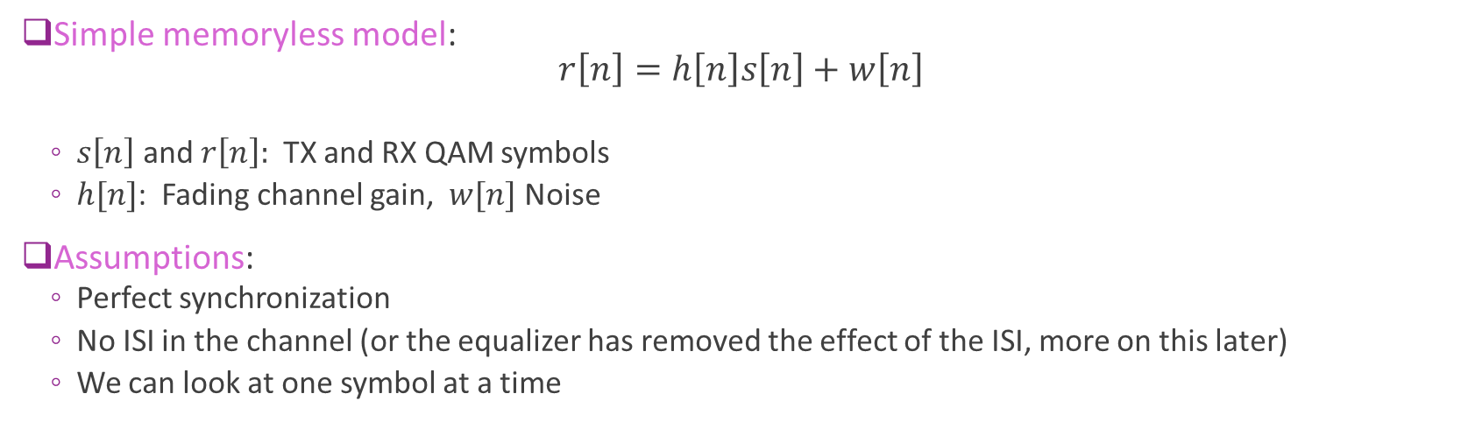
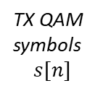
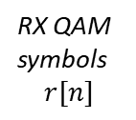
Mathematical Model
Fading channel
Symbol mapping
TX QAM symbols $$s[n]$$
RX QAM symbols $$r[n]$$
Symbol demodulation
TX bits
RX bits
Simple memoryless model: $r\left[n\right]=h\left[n\right]s\left[n\right]+w\left[n\right]$
$s\left[n\right]$ and $r\left[n\right]:$ TX and RX QAM symbols
$h[n]$: Fading channel gain, $w[n]$ Noise
Assumptions:
Perfect synchronization
No ISI in the channel (or the equalizer has removed the effect of the ISI, more on this later)
We can look at one symbol at a time

Slide 6

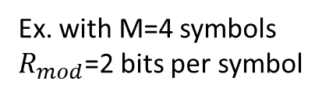
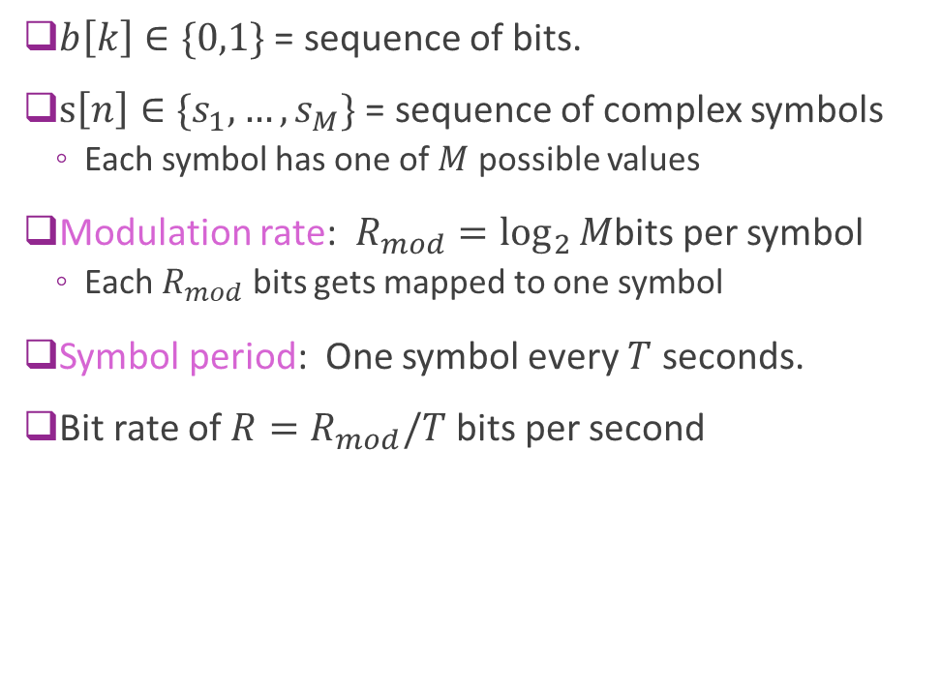



Review: Bit to Symbol Mapping
$b\left[k\right]∈\{0,1\}$ = sequence of bits.
$s\left[n\right]∈\{s_{1},…, s_{M}\}$ = sequence of complex symbols
Each symbol has one of $M$ possible values
Modulation rate: $R_{mod}=\log_{2}{M}$bits per symbol
Each $R_{mod}$ bits gets mapped to one symbol
Symbol period: One symbol every $T$ seconds.
Bit rate of $R=R_{mod}/T$ bits per second
$$b\left[0\right],b\left[1\right], b\left[2\right], b\left[3\right],b\left[4\right], b\left[5\right],…$$
$$s[0]$$
$$s[1]$$
$$s[2]$$
T
Ex. with M=4 symbols $R_{mod}$=2 bits per symbol

Slide 7
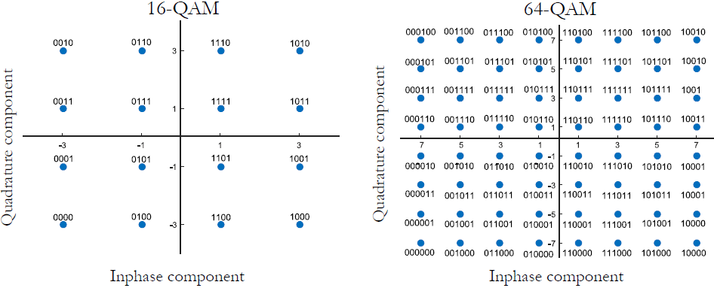
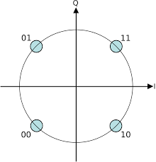




Review: QAM Modulation
$M−$QAM: Most common bit to symbol mapping in wireless system
$R/2$ bits mapped to $I$ and $R /2$ bits mapped to Q
Each dimension is mapped uniformly
QPSK
$R=2$ bits/sym
$R=4$ bits/sym
$R=6$ bits/sym

Slide 8
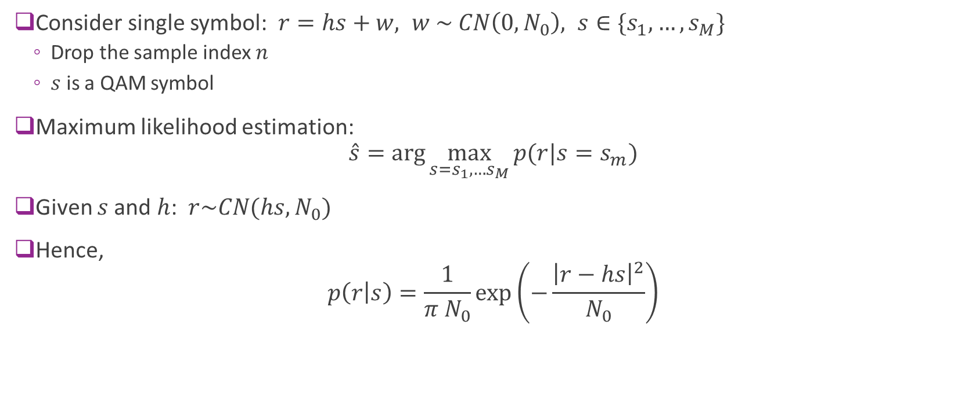
ML Estimation for Symbol Demodulation
Consider single symbol: $r=hs+w, w \sim CN\left(0,N_{0}\right), s∈\{s_{1},…, s_{M}\}$
Drop the sample index $n$
$s$ is a QAM symbol
Maximum likelihood estimation: $\hat{s}=\arg{\max_{{s=s}_{1},…s_{M}}{p(r|s=s_{m})}}$
Given $s$and $h$: $r\sim CN(hs, N_{0})$
Hence, $p\left(r | s\right)=\frac{1}{π N_{0}}\exp\left(−\frac{{\left|r−hs\right|}^{2}}{N_{0}}\right)$

Slide 9
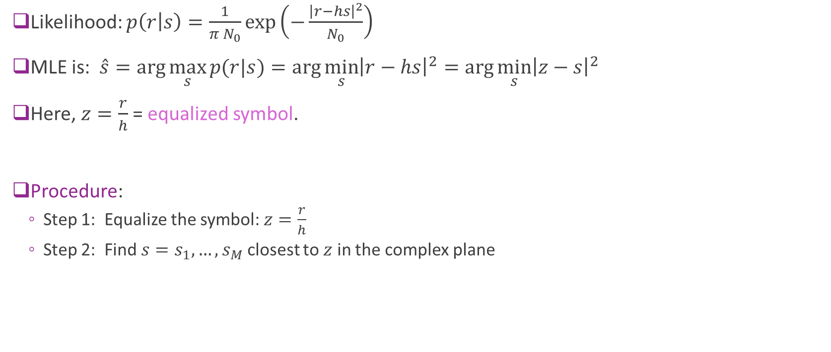
Equalization and Nearest Symbol Detection
Likelihood: $p\left(r | s\right)=\frac{1}{π N_{0}}\exp\left(−\frac{{\left|r−hs\right|}^{2}}{N_{0}}\right)$
MLE is: $\hat{s}=\arg{\max_{s}{p(r|s)}}=\arg{\min_{s}{{\left|r−hs\right|}^{2}}}=\arg{\min_{s}{{\left|z−s\right|}^{2}}}$
Here, $z=\frac{r}{h}$ = equalized symbol.
Procedure:
Step 1: Equalize the symbol: $z=\frac{r}{h}$
Step 2: Find $s=s_{1},…,s_{M}$ closest to $z$ in the complex plane

Slide 10

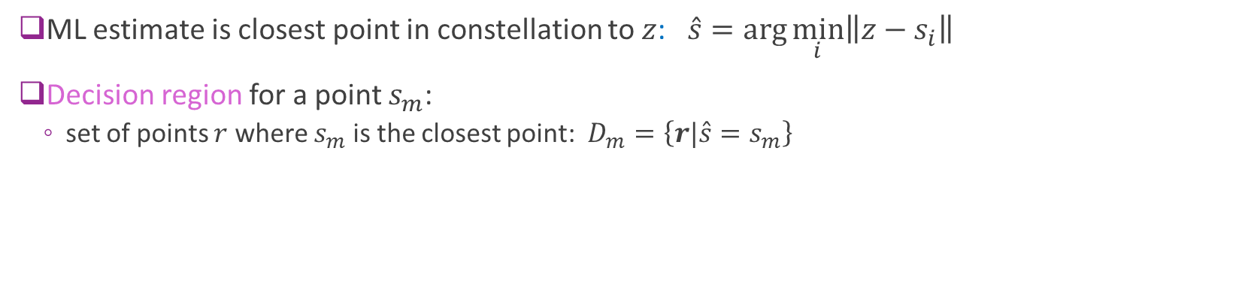
Decision Regions
s₂
s₁ (closest point)
Decision region for s₁
Example: Decision region in QPSK
$$z$$
s₃
s₄
ML estimate is closest point in constellation to $z$: $\hat{s}=\arg{\min_{i}\left\|z−s_{i}\right\|}$
Decision region for a point $s_{m}$:
set of points $r$ where $s_{m}$ is the closest point: $D_{m}=\left\{r|\hat{s}=s_{m}\right\}$

Slide 11
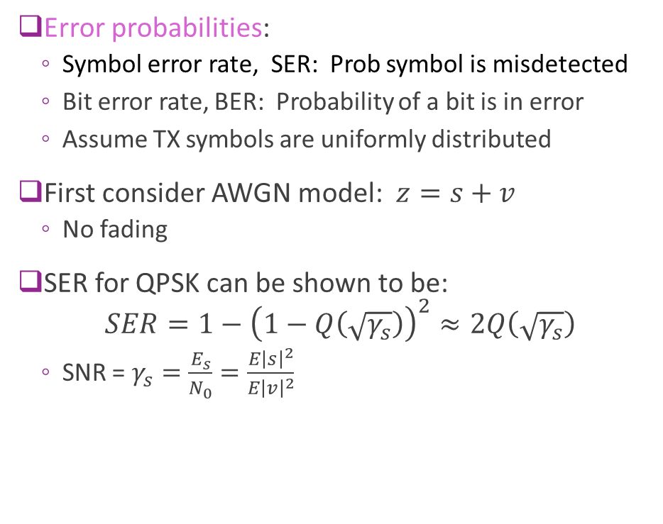
Error Probabilities on an AWGN Channel
Error probabilities:
Symbol error rate, SER: Prob symbol is misdetected
Bit error rate, BER: Probability of a bit is in error
Assume TX symbols are uniformly distributed
First consider AWGN model: $z=s+v$
No fading
SER for QPSK can be shown to be: $SER=1−{\left(1−Q\left(\sqrt{γ_{s}}\right)\right)}^{2}≈2Q\left(\sqrt{γ_{s}}\right)$
SNR = $γ_{s}=\frac{E_{s}}{N_{0}}=\frac{E{\left|s\right|}^{2}}{E{\left|v\right|}^{2}}$
z
No error
z in correct decision region
w
s_{m}
w
Error
z not in correct decision region
z
s_{m}

Slide 12
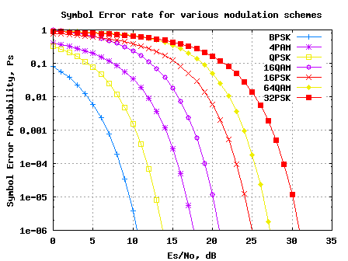
SER for AWGN Modulation
Error formula can be derived for most QAM mappings
See, e.g., Proakis
For an AWGN channel:
SER typically decays exponentially with SNR
Ex: for QPSK

Slide 13
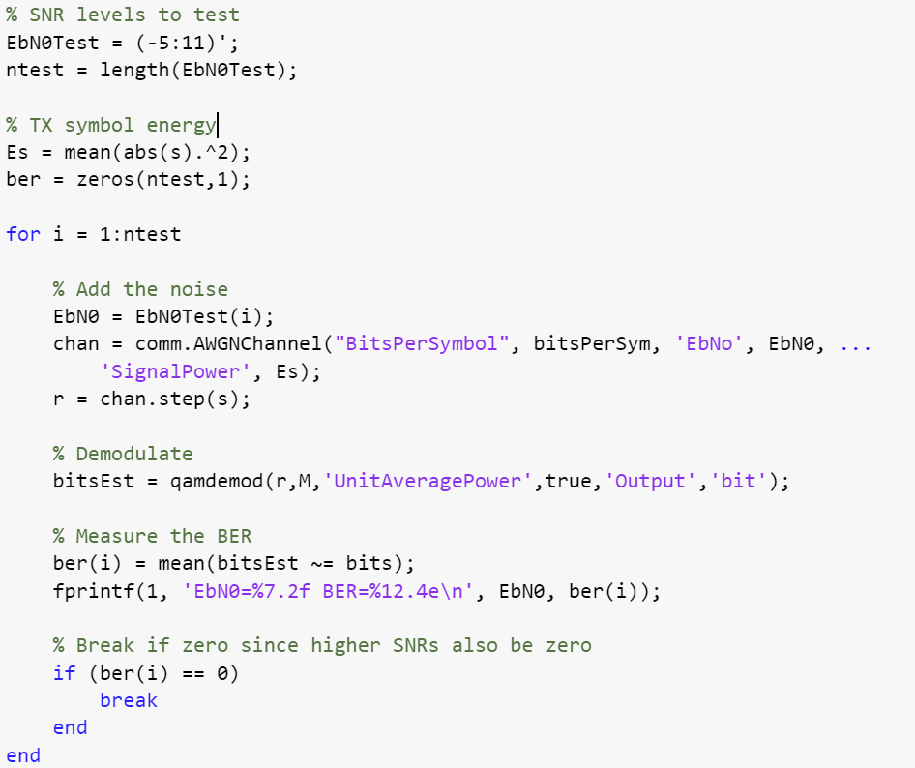
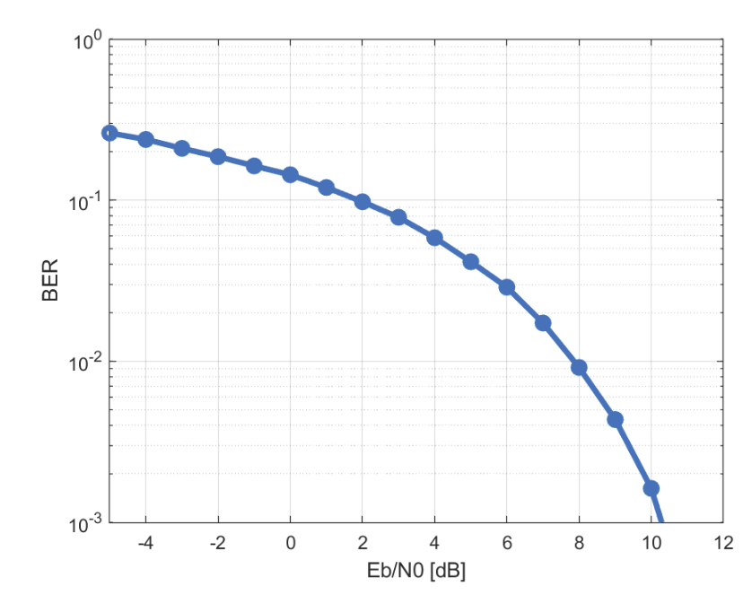
Ex: BER Simulation for 16-QAM
See demo
Easy to do in MATLAB

Slide 14
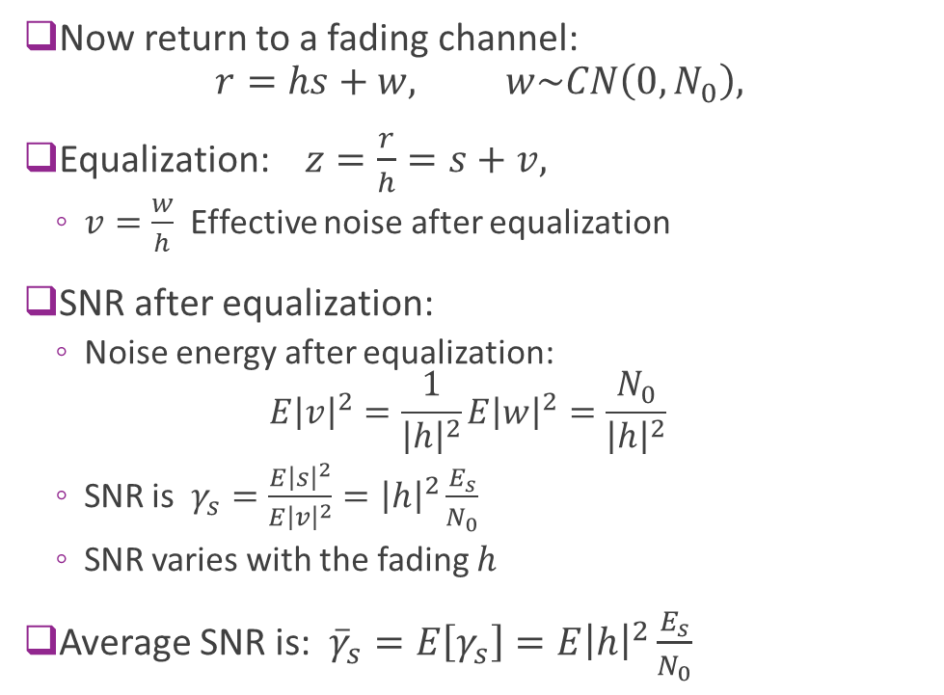
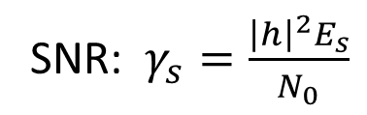
SNR on a Fading Channel
Now return to a fading channel: $r=hs+w, w\sim CN\left(0,N_{0}\right),$
Equalization: $z=\frac{r}{h}=s+v,$
$v=\frac{w}{h}$ Effective noise after equalization
SNR after equalization:
Noise energy after equalization: $E{\left|v\right|}^{2}=\frac{1}{{\left|h\right|}^{2}}E{\left|w\right|}^{2}=\frac{N_{0}}{{\left|h\right|}^{2}}$
SNR is $γ_{s}=\frac{E{\left|s\right|}^{2}}{E{\left|v\right|}^{2}}={\left|h\right|}^{2}\frac{E_{s}}{N_{0}}$
SNR varies with the fading $h$
Average SNR is: ${\overline{γ}}_{s}=E\left[γ_{s}\right]={E\left|h\right|}^{2}\frac{E_{s}}{N_{0}}$
SNR: $γ_{s}=\frac{{\left|h\right|}^{2}E_{s}}{N_{0}}$
High SNR
Low SNR

Slide 15
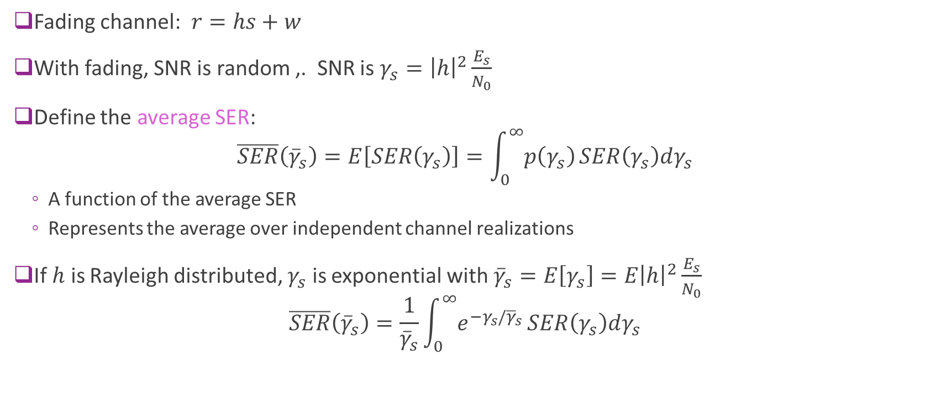
Average SER on a Fading Channel
Fading channel: $r=hs+w$
With fading, SNR is random ,. SNR is $γ_{s}={\left|h\right|}^{2}\frac{E_{s}}{N_{0}}$
Define the average SER: $\overline{SER}\left({\overline{γ}}_{s}\right)=E\left[SER\left(γ_{s}\right)\right]=\int_{0}^{∞}{p\left(γ_{s}\right)}SER\left(γ_{s}\right)dγ_{s}$
A function of the average SER
Represents the average over independent channel realizations
If $h$ is Rayleigh distributed, $γ_{s}$ is exponential with ${\overline{γ}}_{s}=E\left[γ_{s}\right]={E\left|h\right|}^{2}\frac{E_{s}}{N_{0}}$ $\overline{SER}\left({\overline{γ}}_{s}\right)=\frac{1}{{\overline{γ}}_{s}}\int_{0}^{∞}{e^{−γ_{s}/{\overline{γ}}_{s}}}SER\left(γ_{s}\right)dγ_{s}$

Slide 16
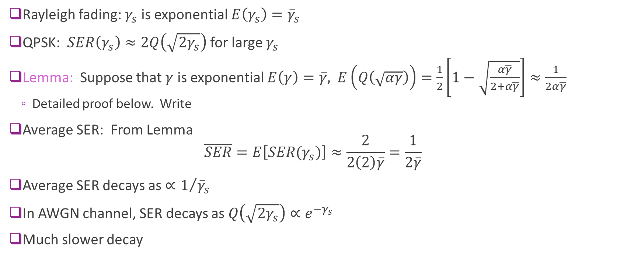
Example: SER on QPSK with Rayleigh Fading
Rayleigh fading: $γ_{s}$ is exponential $E\left(γ_{s}\right)={\overline{γ}}_{s}$
QPSK: $SER\left(γ_{s}\right)≈2Q\left(\sqrt{2γ_{s}}\right)$ for large $γ_{s}$
Lemma: Suppose that $γ$ is exponential $E\left(γ\right)=\overline{γ},$ $E\left(Q\left(\sqrt{αγ}\right)\right)=\frac{1}{2}\left[1−\sqrt{\frac{α\overline{γ}}{2+α\overline{γ}}}\right]≈\frac{1}{2α\overline{γ}}$
Detailed proof below. Write
Average SER: From Lemma $\overline{SER}=E\left[SER(γ_{s})\right]≈\frac{2}{2\left(2\right)\overline{γ}}=\frac{1}{2\overline{γ}}$
Average SER decays as ${∝1}/{{\overline{γ}}_{s}}$
In AWGN channel, SER decays as $Q\left(\sqrt{2γ_{s}}\right)∝e^{−γ_{s}}$
Much slower decay

Slide 17
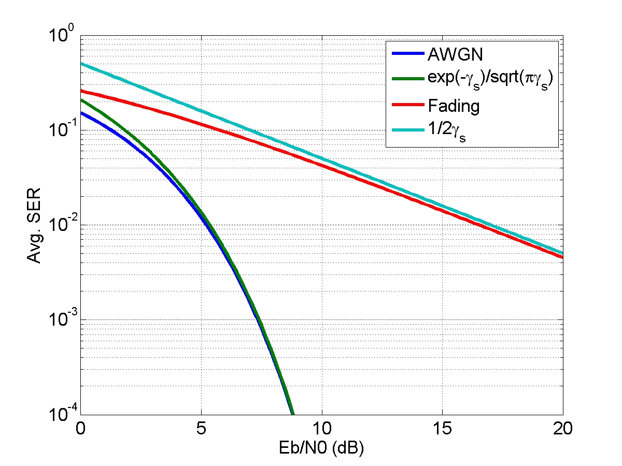
Comparison of Fading vs. AWGN
Error rate with fading is dramatically higher.
Ex. for QPSK:
No fading, SER decays exponentially
With fading, SER decays with inverse SNR
Similar relations for most other constellations
Need much higher SNR
SER with QPSK
No fading
Rayleigh fading

Slide 18
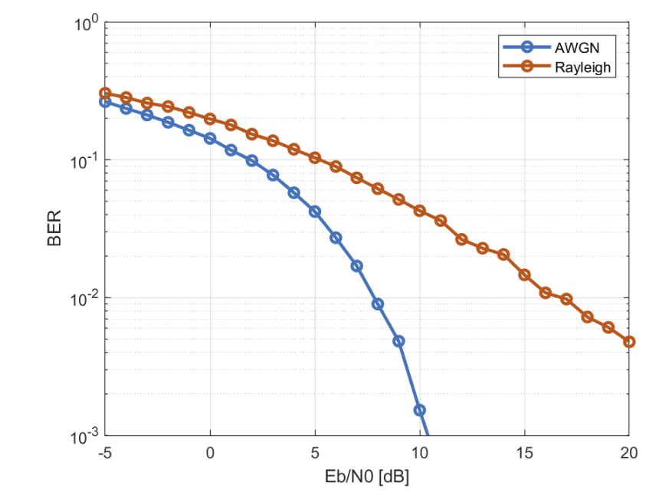
16-QAM Example
See demo
Large gap between AWGN and Rayleigh

Slide 19

Lemma for Average of Q function
Lemma: Suppose that $γ$ is exponential $E\left(γ\right)=\overline{γ}$. $E\left(Q\left(\sqrt{αγ}\right)\right)=\frac{1}{2}\left[1−\sqrt{\frac{α\overline{γ}}{2+α\overline{γ}}}\right]≈\frac{1}{2α\overline{γ}}$
Proof:
$E\left(Q\left(\sqrt{αγ}\right)\right)=\frac{1}{\overline{γ}}\int_{0}^{∞}{Q\left(\sqrt{αγ}\right)e^{−γ/{\overline{γ}}}dγ}$
$Q\left(\sqrt{αγ}\right)=\frac{1}{\sqrt{2π}}\int_{\sqrt{αγ}}^{∞}{e^{−{u^{2}}/2}du}$
Change order of integral

Slide 20
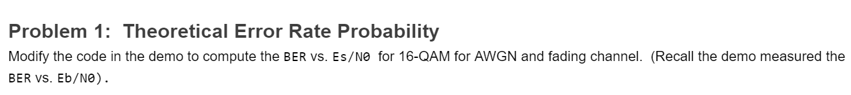
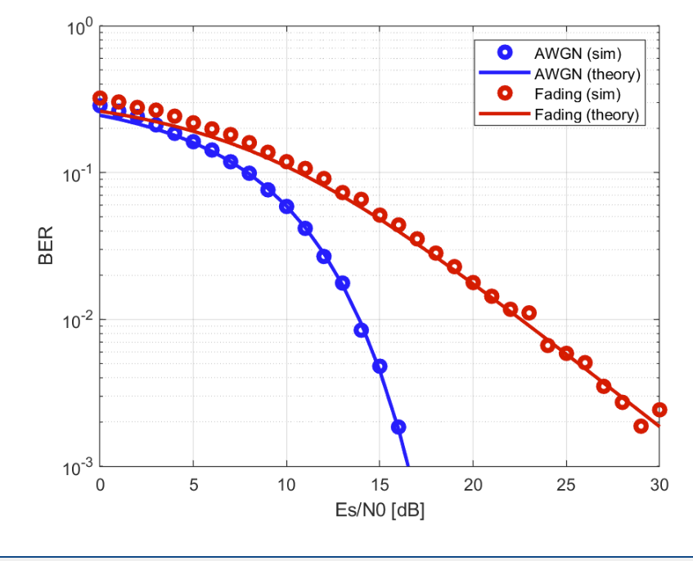
In-Class Exercise

Slide 21
Outline
Uncoded Modulation over Fading Channels
Capacity with Coding over Fading Channels: Outage Capacity
Capacity with Coding over Fading Channels: Ergodic Capacity
Review: Coding over an AWGN Channel
Coding over Fading Channels
Capacity with Bit-Interleaved Coded Modulation

Slide 22
Coding Over Fading Channels
Lesson from previous section:
With fading, uncoded modulation cannot provided sufficient reliability
Error rate decays slowly with SNR
Channel coding:
Send data in blocks
Block contains redundancy
If some parts fade, can still recover block
All commercial wireless systems use coding!

Slide 23
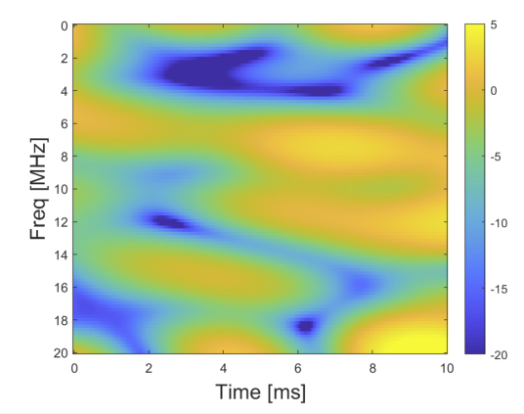
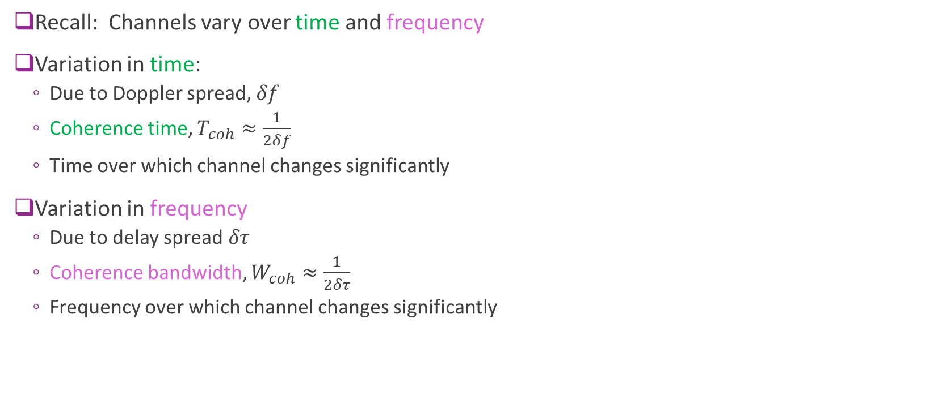
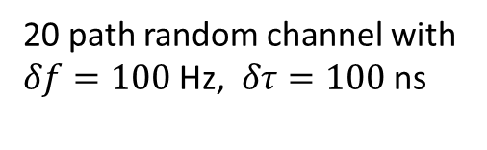
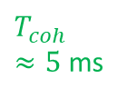

Time and Frequency Fading
SNR [dB]
Recall: Channels vary over time and frequency
Variation in time:
Due to Doppler spread, $δf$
Coherence time, $T_{coh}≈\frac{1}{2δf}$
Time over which channel changes significantly
Variation in frequency
Due to delay spread$δτ$
Coherence bandwidth, $W_{coh}≈\frac{1}{2δτ}$
Frequency over which channel changes significantly
$W_{coh}$ $≈5$ MHz
$T_{coh}$ $≈5$ ms
20 path random channel with $δf=100$ Hz, $δτ=100$ ns

Slide 24




Flat vs. Frequency-Selective Fading
Suppose we transmit a coding block
$T \text{in} \text{time}$ and $W$ in bandwidth
$T×W$ region in time and frequency
Flat fading: $W≪W_{coh}$
Channel does not vary in frequency over coding block
Frequency selective fading: $W≥W_{coh}$
Channel varies over frequency
Flat
$W_{coh}$
Frequency selective
$$W$$
$$T$$

Slide 25




Slow vs. Fast Fading
Suppose we transmit a coding block
$T \text{in} \text{time}$ and $W$ in bandwidth
$T×W$ region in time and frequency
Slow fading: $T≪T_{coh}$
Channel does not vary in time over coding block
Fast fading: $T≥T_{coh}$
Channel varies over frequency
Slow
Fast
$T_{coh}$
$$W$$
$$T$$

Slide 26

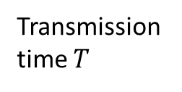

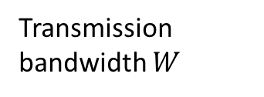


Summary: Four Regimes
Transmission bandwidth $W$
Slow, Frequency selective
Fast, Frequency selective
$$W_{coh}$$
Slow, Flat
Fast, Flat
Transmission time $T$
$$T_{coh}$$
Coding block
$$W$$
$$T$$

Slide 27
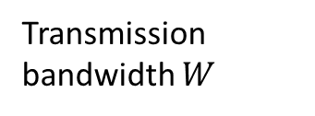
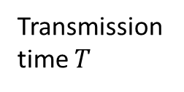


Regimes to Model Coding
To analyze fading, consider two extreme cases
Flat and slow fading over coding block:
Channel is flat and slow fading over coding block
All symbols see approximately same fading
IID fading in coding block:
Channel fades in time and/or frequency over block
Fast and/or frequency selective
Model as large number of independent fades
Transmission bandwidth $W$
Slow, Frequency selective
Fast, Frequency selective
$$W_{coh}$$
Slow, Flat
Fast, Flat
Transmission time $T$
$$T_{coh}$$

Slide 28
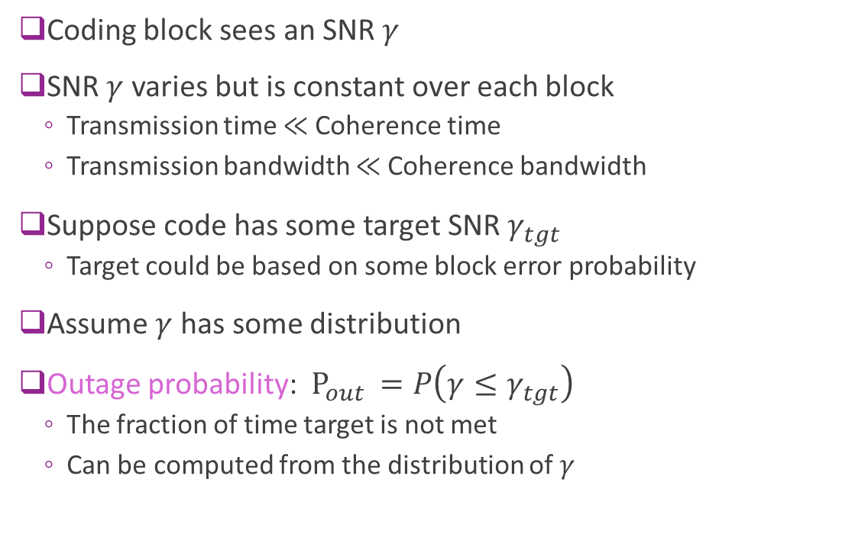
Analysis of Coding with Flat and Slow Fading
Coding block sees an SNR $γ$
SNR $γ$ varies but is constant over each block
Transmission time $≪$ Coherence time
Transmission bandwidth $≪$ Coherence bandwidth
Suppose code has some target SNR $γ_{tgt}$
Target could be based on some block error probability
Assume $γ$ has some distribution
Outage probability: $P_{out }=P\left(γ≤γ_{tgt}\right)$
The fraction of time target is not met
Can be computed from the distribution of $γ$
Coding block

Slide 29
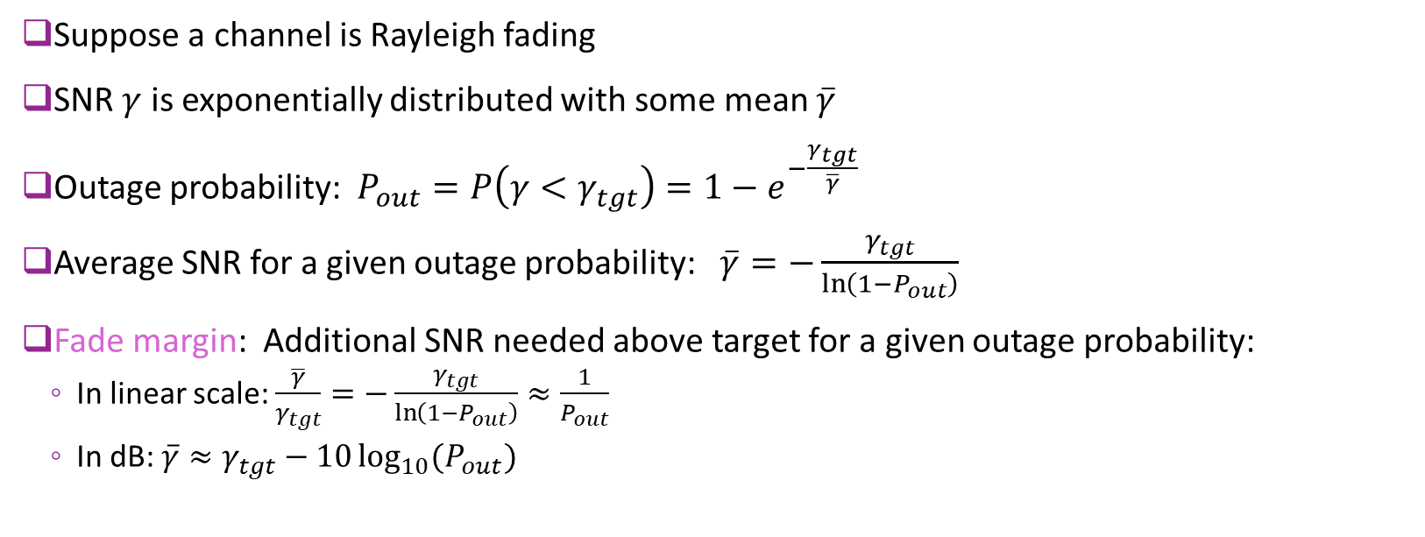
Outage Probability for Rayleigh Fading
Suppose a channel is Rayleigh fading
SNR $γ$ is exponentially distributed with some mean $\overline{γ}$
Outage probability: $P_{out}=P\left(γ<γ_{tgt}\right)=1−e^{−\frac{γ_{tgt}}{\overline{γ}}}$
Average SNR for a given outage probability: $\overline{γ}=−\frac{γ_{tgt}}{\ln\left(1−P_{out}\right)}$
Fade margin: Additional SNR needed above target for a given outage probability:
In linear scale: $\frac{\overline{γ}}{γ_{tgt}}=−\frac{γ_{tgt}}{\ln\left(1−P_{out}\right)}≈\frac{1}{P_{out}}$
In dB: $\overline{γ}≈γ_{tgt}−10\log_{10}{(P_{out})}$

Slide 30
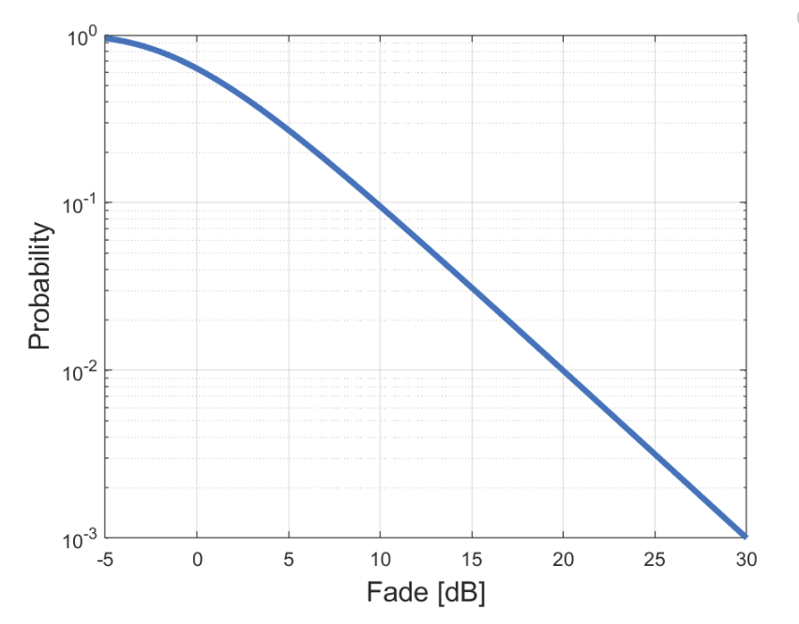
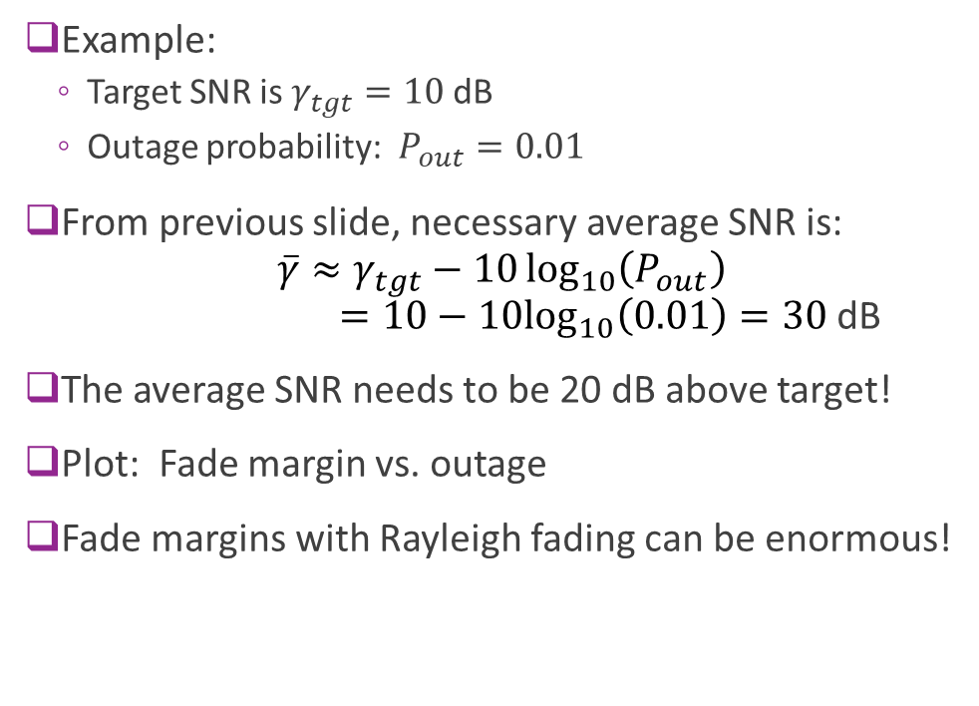

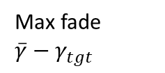
Fade Margin Example
Example:
Target SNR is $γ_{tgt}=10$ dB
Outage probability: $P_{out}=0.01$
From previous slide, necessary average SNR is: $\overline{γ}≈γ_{tgt}−10\log_{10}\left(P_{out}\right)$ $=10−10\log_{10}\left(0.01\right)=30$ dB
The average SNR needs to be 20 dB above target!
Plot: Fade margin vs. outage
Fade margins with Rayleigh fading can be enormous!
$$P_{out}$$
Fade=0
Max fade $\overline{γ}−γ_{tgt}$
20 dB fade margin

Slide 31
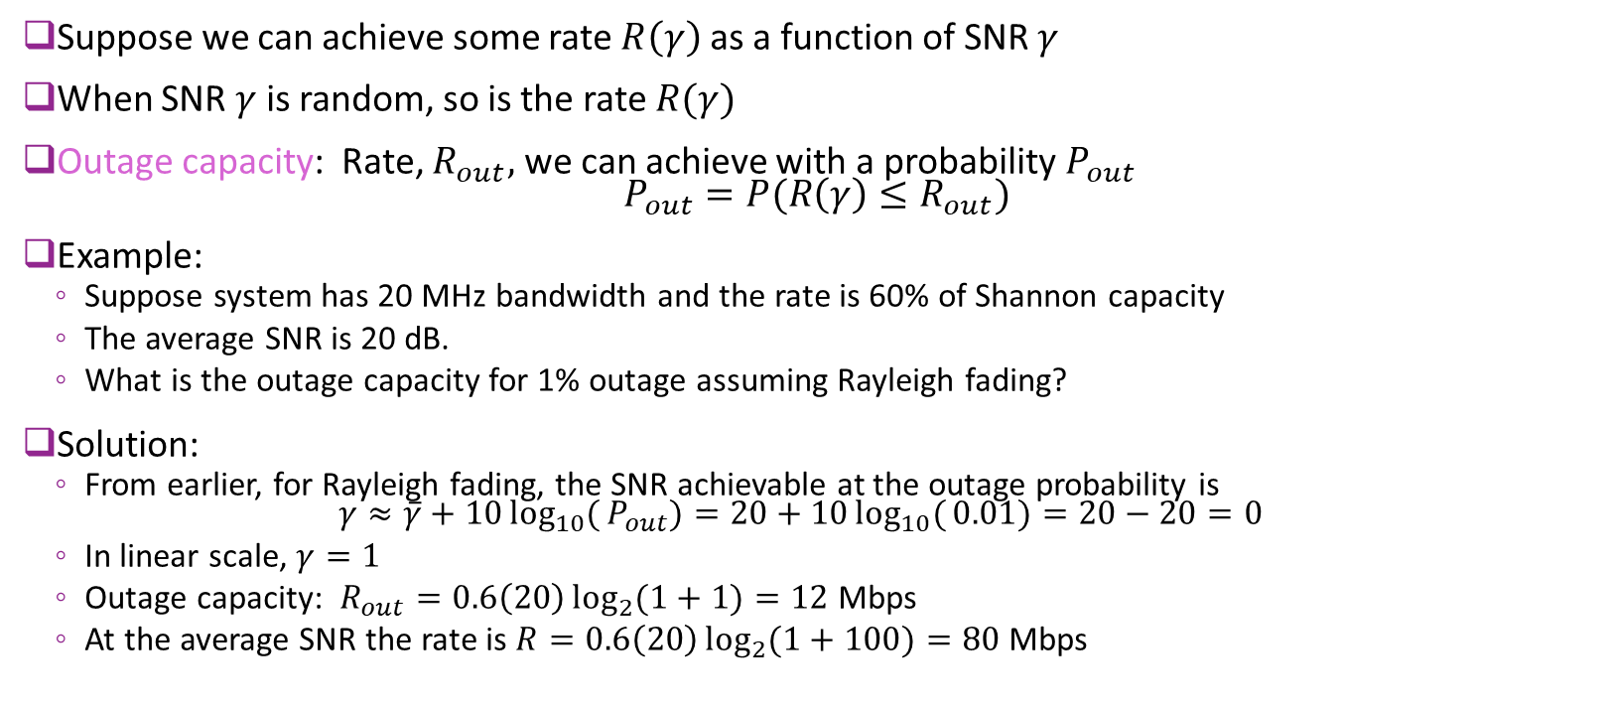
Outage Capacity
Suppose we can achieve some rate $R\left(γ\right)$ as a function of SNR $γ$
When SNR $γ$ is random, so is the rate $R(γ)$
Outage capacity: Rate, $R_{out},$ we can achieve with a probability $P_{out}$ $P_{out}=P(R\left(γ\right)≤R_{out})$
Example:
Suppose system has 20 MHz bandwidth and the rate is 60% of Shannon capacity
The average SNR is 20 dB.
What is the outage capacity for 1% outage assuming Rayleigh fading?
Solution:
From earlier, for Rayleigh fading, the SNR achievable at the outage probability is $γ≈\overline{γ}+10\log_{10}{(}P_{out})=20+10\log_{10}{(}0.01)=20−20=0$
In linear scale, $γ=1$
Outage capacity: $R_{out}=0.6\left(20\right)\log_{2}{(1+1)}=12$ Mbps
At the average SNR the rate is $R=0.6\left(20\right)\log_{2}{(1+100)}=80$ Mbps

Slide 32
System Implications for Outage
With flat and slow Rayleigh fading, need to add large fade margin
Channel coding does not mitigate fading
Fading causes all bits to fail
Still may be useful to use channel coding (e.g., for noise across the symbols)
Possible solutions?
If there is motion, perhaps we can retransmit later
Go to a lower rate (needs less SNR)
Just accept that some locations are in outage
Some of these solutions are discussed in the next unit

Slide 33
Outline
Uncoded Modulation over Fading Channels
Capacity with Coding over Fading Channels: Outage Capacity
Capacity with Coding over Fading Channels: Ergodic Capacity
Review: Coding over an AWGN Channel
Coding over Fading Channels
Capacity with Bit-Interleaved Coded Modulation

Slide 34
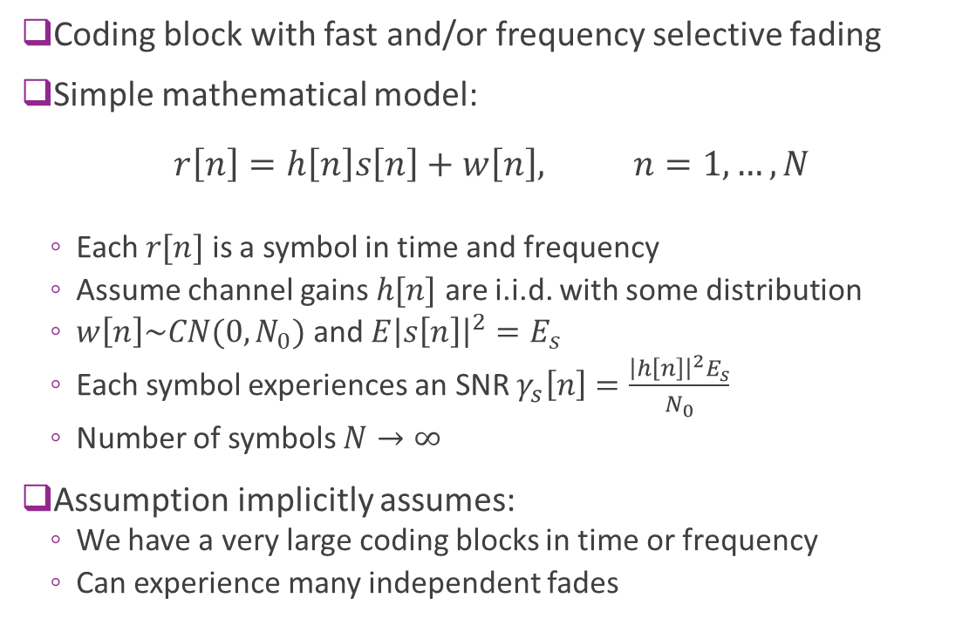
IID Fading Model
Coding block with fast and/or frequency selective fading
Simple mathematical model: $r\left[n\right]=h\left[n\right]s\left[n\right]+w\left[n\right], n=1,…,N$
Each $r[n]$ is a symbol in time and frequency
Assume channel gains $h[n]$ are i.i.d. with some distribution
$w\left[n\right]\sim CN(0,N_{0})$ and $E{\left|s\left[n\right]\right|}^{2}=E_{s}$
Each symbol experiences an SNR $γ_{s}\left[n\right]=\frac{{\left|h\left[n\right]\right|}^{2}E_{s}}{N_{0}}$
Number of symbols $N→∞$
Assumption implicitly assumes:
We have a very large coding blocks in time or frequency
Can experience many independent fades
Coding blocks with fast and/or frequency selective fading

Slide 35
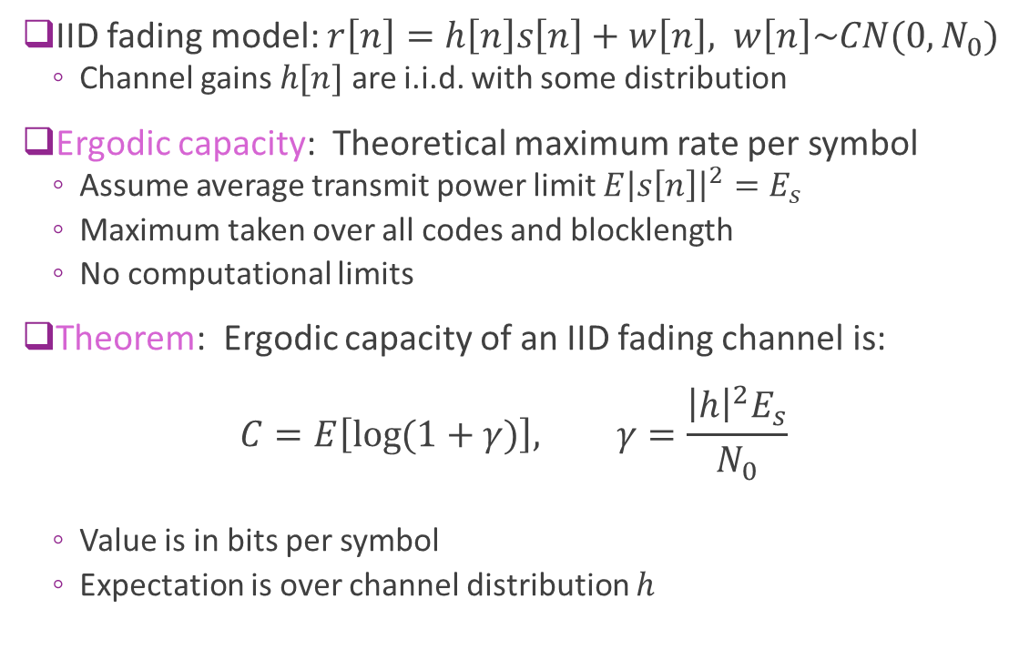
Ergodic Capacity
IID fading model: $r\left[n\right]=h\left[n\right]s\left[n\right]+w\left[n\right], w\left[n\right]\sim CN(0,N_{0})$
Channel gains $h[n]$ are i.i.d. with some distribution
Ergodic capacity: Theoretical maximum rate per symbol
Assume average transmit power limit $E{\left|s\left[n\right]\right|}^{2}=E_{s}$
Maximum taken over all codes and blocklength
No computational limits
Theorem: Ergodic capacity of an IID fading channel is: $C=E\left[\log{(1+γ)}\right], γ=\frac{{\left|h\right|}^{2}E_{s}}{N_{0}}$
Value is in bits per symbol
Expectation is over channel distribution $h$

Slide 36
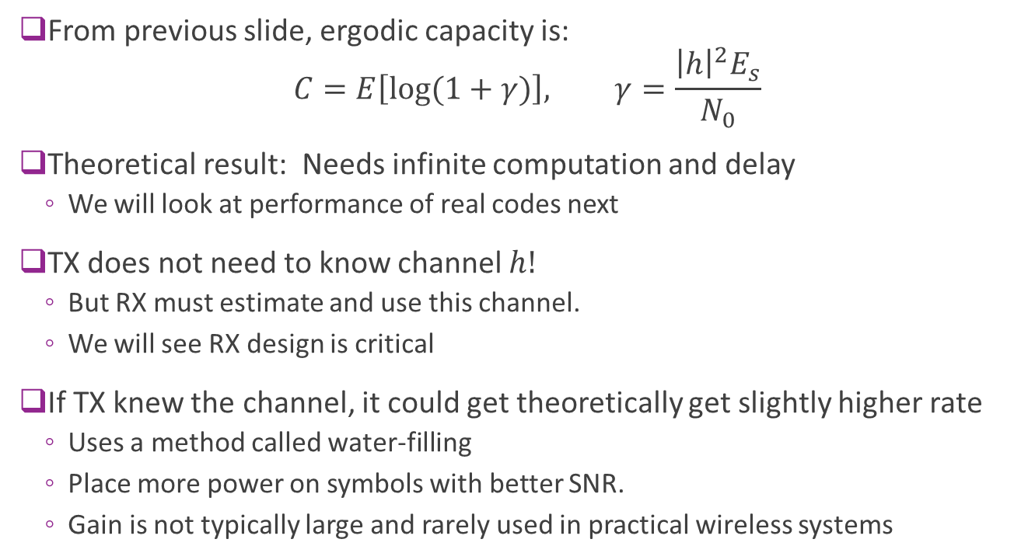
Shannon Ergodic Capacity Key Remarks
From previous slide, ergodic capacity is: $C=E\left[\log{(1+γ)}\right], γ=\frac{{\left|h\right|}^{2}E_{s}}{N_{0}}$
Theoretical result: Needs infinite computation and delay
We will look at performance of real codes next
TX does not need to know channel $h!$
But RX must estimate and use this channel.
We will see RX design is critical
If TX knew the channel, it could get theoretically get slightly higher rate
Uses a method called water-filling
Place more power on symbols with better SNR.
Gain is not typically large and rarely used in practical wireless systems

Slide 37
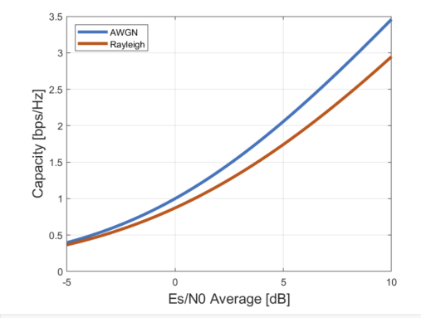
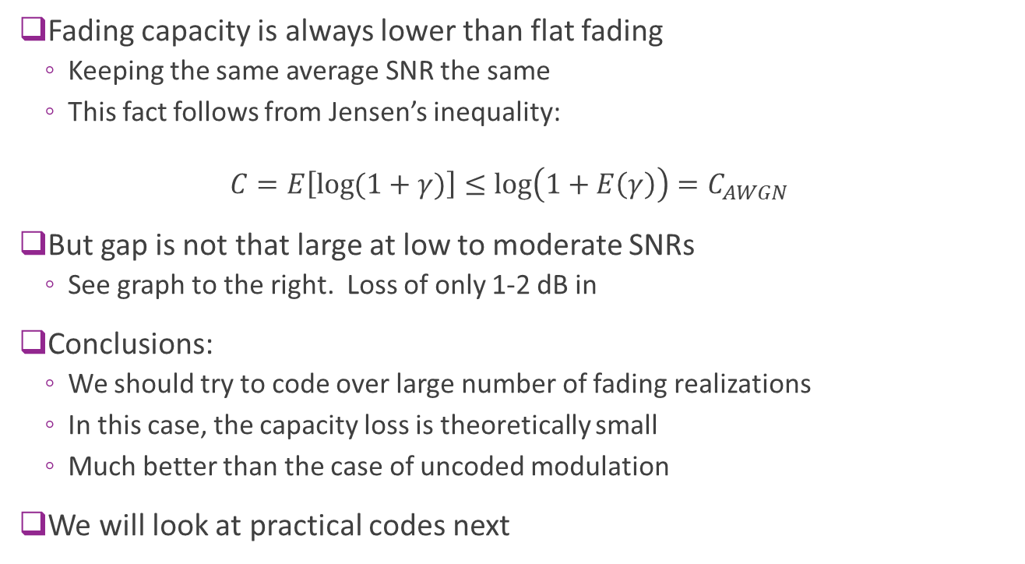
Comparing Ergodic and Flat Capacity
Fading capacity is always lower than flat fading
Keeping the same average SNR the same
This fact follows from Jensen’s inequality:
$$C=E\left[\log{(1+γ)}\right]≤\log\left(1+E\left(γ\right)\right)=C_{AWGN}$$
But gap is not that large at low to moderate SNRs
See graph to the right. Loss of only 1-2 dB in
Conclusions:
We should try to code over large number of fading realizations
In this case, the capacity loss is theoretically small
Much better than the case of uncoded modulation
We will look at practical codes next

Slide 38
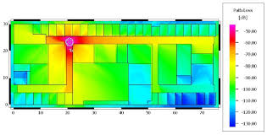
Small-Scale and Large-Scale Fading
Up to now we have considered variations due to small scale fading
Variations from constructive or destructive interference of multipath components
May or may not cause variations within a coding block
Ex: Variations within a few wavelength in one location in the office area
Most scenarios also have variations due to large scale fading:
Changes in distance-based path loss, shadowing, angles, …
Typically occur at slower time scales (100s of ms or more)
Rarely causes variation over a coding block (typically 10s of ms or less)
Ex: Moving within the office space to the right
Small scale region
Large scale region

Slide 39
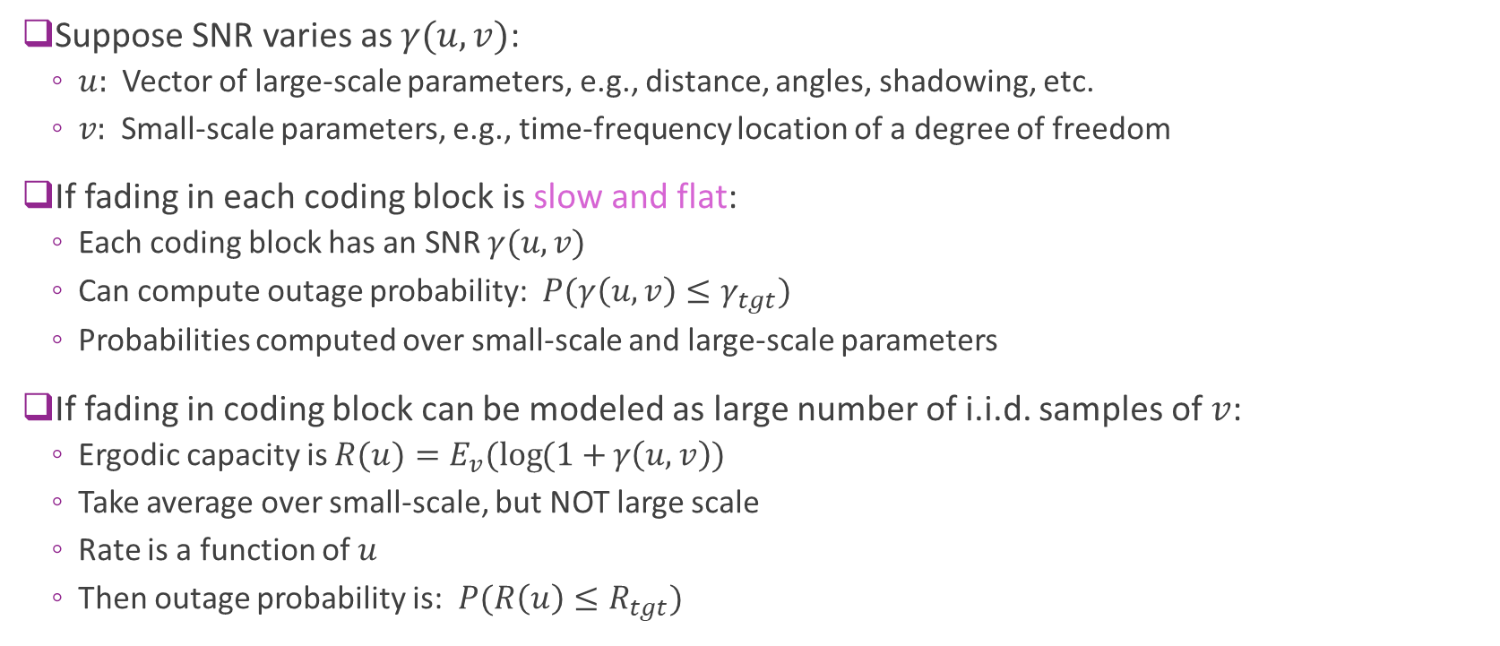
Analysis with Small- and Large-Scale Fading
Suppose SNR varies as $γ(u,v)$:
$u:$ Vector of large-scale parameters, e.g., distance, angles, shadowing, etc.
$v:$ Small-scale parameters, e.g., time-frequency location of a degree of freedom
If fading in each coding block is slow and flat:
Each coding block has an SNR $γ(u,v)$
Can compute outage probability: $P(γ\left(u,v\right)≤γ_{tgt})$
Probabilities computed over small-scale and large-scale parameters
If fading in coding block can be modeled as large number of i.i.d. samples of $v$:
Ergodic capacity is $R(u)=E_{v}(\log{(1+}γ\left(u,v\right))$
Take average over small-scale, but NOT large scale
Rate is a function of $u$
Then outage probability is: $P(R\left(u\right)≤R_{tgt})$

Slide 40


Example: Rate CDF Calculation
Large-scale model:
SNR due to large scale variations $\overline{γ}\left(d\right)=γ_{0}{\left(\frac{d_{0}}{d}\right)}^{2}$ [Simple model just for exercise]
$γ_{0}$= 10 dB and $d_{0}=$100 m
Distances vary $d$ uniformly in [50,200]m
Small scale model:
Variation within a location is Rayleigh
SNR at a particular time-freq DoF will be $γ=\overline{γ}\left(d\right)v$
$v$ can be modeled as exponential
Plotted:
SE under a constant model (slow and flat fading)
SE under IID fading at each distance $d$
See demo

Slide 41


In-Class Exercise
Indoor environment
Look at large scale and small-scale fading

Slide 42
Outline
Uncoded Modulation over Fading Channels
Capacity with Coding over Fading Channels: Outage Capacity
Capacity with Coding over Fading Channels: Ergodic Capacity
Review: Coding over an AWGN Channel
Coding over Fading Channels
Capacity with Bit-Interleaved Coded Modulation

Slide 43







Coded Communication on an AWGN Channel
Info bits $$b[k]$$
TX symbols $$s[n]$$
Channel with noise
RX symbols $$r[n]$$
Coded bits $c[k]$
Info bits $$\hat{b} [k]$$
LLR$[k]$
Channel coding
Symbol mapping
Soft symbol demodulation
Channel decoder
We first review channel coding on a flat channel: $r\left[n\right]=s\left[n\right]+w\left[n\right], w\left[n\right]\sim CN(0,N_{0})$
All details can be found in the digital communications class

Slide 44
Uncoded vs. Coded Modulation
Uncoded Modulation:
Modulate raw information bits
One symbol at a time.
Any symbol is in error, data packet is lost!
Coded modulation:
Transmit in blocks (also called frames)
Add extra parity bits to each block for reliability
Decode entire block together
Symbol mapping
Complex symbols
Info bits
Coding
Symbol mapping
Info bits block
Info
Parity
Block of symbols
Coded bit block

Slide 45

Key Parameters of Block Codes
Coding
k information bits
“message”
k info bits
n-k parity
“Bit Codeword” : n coded bits
An $(n,k)$ block code has:
$k$ = number of information bits (input block size)
$n$= number of coded bits (output block size)
$n−k$ = number of additional bits, typically parity
$Rcod$ = coding rate = $k/n$.
Typical values in wireless:
Block size: $k=100$ to 10000
Code rate: $\frac{1}{3}$ to $\frac{5}{6}$

Slide 46




Coded Communication on an AWGN Channel
Info bits $$b[k]$$
TX symbols $$s[n]$$
Channel with noise
RX symbols $$r[n]$$
Coded bits $c[k]$
Info bits $$\hat{b} [k]$$
$$LLR[k]$$
Channel coding
Symbol mapping
Soft symbol demodulation
Channel decoder
We first review channel coding on a flat channel: $r\left[n\right]=s\left[n\right]+w\left[n\right], w\left[n\right]\sim CN(0,N_{0})$

Slide 47






Soft Symbol Demodulation
$$w$$
$$c_{1},…,c_{K}$$
Symbol mapping
$$s$$
$$r=s+w$$
Soft demod
$${LLR}_{1},…,{LLR}_{K}$$
+
Set-up: Coded bits $(c_{1},…,c_{K})$ get mapped to symbol $s$
Receive $r=s+w, w\sim CN(0,N_{0})$
Uncoded systems use hard decision detection:
Estimate bits $({\hat{c}}_{1},…,{\hat{c}}_{K})$ from symbol $s$
Makes a discrete decision.
Coded systems generally use soft decision demodulation:
Output log likelihood ratios: $LLR_{k}=\ln{\frac{P(r|c_{k}=1)}{P(r|c_{k}=0)}}$
$LLR_{k}$ positive $⇒c_{k}=1$ more likely
$LLR_{k}$ negative $⇒c_{k}=0$ more likely

Slide 48





LLR for QPSK
TX symbol: $s=±A±iA, A=\sqrt{\frac{E_{s}}{2}}$
RX symbol: $r=s+w, w\sim CN(0,N_{0})$
LLR for bit $c_{0}$
$s_{I}=Re\left(s\right)=\left\{\begin{matrix}A & c_{0}=1 \\ −A & c_{0}=0\end{matrix}\right.$
$r_{I}=s_{I}+w_{I}, w_{I}\sim N(0,\frac{N_{0}}{2})$ [Each dim has $\frac{N_{0}}{2}]$
Likelihood: $p\left(r_{I} | s_{I}\right)=\frac{1}{\sqrt{πN_{0}}}\exp\left[−{\frac{1}{N_{0}}\left(r_{I}−s_{I}\right)}^{2}\right]$
$LLR_{0}=\ln{\frac{p\left(r_{I} | c_{0}=1\right)}{p\left(r_{I} | c_{0}=0\right)}}=\ln{\frac{p\left(r_{I} | s_{I}=A\right)}{p\left(r_{I} | s_{I}=−A\right)}}$
With some algebra: $LLR_{0}=\frac{4Ar_{I}}{N_{0}}=\frac{4}{N_{0}}\sqrt{\frac{E_{s}}{2}}r_{I}$
Mapping of bits $(c_{0},c_{1})$
$$s_{Q}=Im(s)$$
01
11
$$s_{I}=Re(s)$$
00
10

Slide 49






QPSK LLR Visualized
Mapping of bits $(c_{0},c_{1})$
$$LLR_{0}$$
$$r_{I}$$
$c_{0}=1$ more likely
$c_{0}=1$ more likely
LLR for $c_{0}$ is: $LLR_{0}=\frac{4}{N_{0}}\sqrt{\frac{E_{s}}{2}}r_{I}$
LLR for $c_{1}$ is: $LLR_{1}=\frac{4}{N_{0}}\sqrt{\frac{E_{s}}{2}}r_{Q}$

Slide 50




High Order Constellations
Higher order constellations (eg. 16- or 64-QAM)
Each constellation $r$is a point is a function of multiple bits.
Example: For 16-QAM
In phase dimension $r_{I}$ depends on bits $(c_{0},c_{1})$
Cannot compute LLR on an individual bit directly
Mapping of bits $(c_{1},c_{2},c_{3},c_{4})$
00
01
11
10
Two bits: $\left(c_{1},c_{2}\right)$
$r=s+n$

Slide 51







High Order Constellations
$s_{00}$
$$s_{10}$$
$$s_{11}$$
$s_{01}$
$r=s+n$
Two bits: $\left(c_{1},c_{2}\right)$
To create LLRs for individual bits use total probability rule: $p\left(r | c_{1}\right)=\frac{1}{2}\left(p\left(r | c_{1},c_{2}=0\right)+p\left(r | c_{1},c_{2}=1\right)\right)$
Resulting bitwise LLR: $LLR \text{for} c_{1}=\log{\frac{p\left(r | c_{1},c_{2}=1,0\right)+p\left(r | c_{1},c_{2}=1,1\right)}{p\left(r | c_{1},c_{2}=0,0\right)+p\left(r | c_{1},c_{2}=0,1\right)}}$

Slide 52


High Order Constellation Examples
2 bits / dim (16-QAM)
3 bits / dim (64-QAM)

Slide 53

Approximate Bitwise LLR
Exact LLR: $LLR_{k}=\log{\frac{P_{1}}{P_{0}}}, P_{1}=\sum_{s :bit k=1}{e^{−{\left(r−s\right)}^{2}/N_{0}}}\text{,} P_{0}=\sum_{s :bit k=0}{e^{−{\left(r−s\right)}^{2}/N_{0}}}$
Can be too computationally expensive
Approximate LLR. For $N_{0}$ small: $LLR_{k}≈\frac{1}{N_{0}}\left(D_{0}−D_{1}\right), D_{1}=\min_{s :bit k=1}{{\left(r−s\right)}^{2}}, D_{0}=\min_{s :bit k=0}{{\left(r−s\right)}^{2}}$
Typically, very close to exact LLR
Computationally simpler. Avoid exponentials and logarithms

Slide 54



Coded Communication on an AWGN Channel
Info bits $$b[k]$$
TX symbols $$s[n]$$
Channel with noise
Coded bits $c[k]$
RX symbols $$r[n]$$
Info bits $$\hat{b} [k]$$
LLR$[k]$
Channel coding
Symbol mapping
Soft symbol demodulation
Channel decoder
We first review channel coding on a flat channel: $r\left[n\right]=s\left[n\right]+w\left[n\right], w\left[n\right]\sim CN(0,N_{0})$

Slide 55






Maximum Likelihood Channel Decoding
TX symbols $$s$$
Channel with noise
RX symbols $$r$$
Info bits $$b$$
Coded bits $c$
Info bits $$\hat{b} [k]$$
Channel coding
LLR$[k]$
Channel decoder
Symbol mapping
Demod
Channel coding: Information block: $b=\left(b_{1},…,b_{K}\right)$ generates a codeword $c=(c_{1},…,c_{N})$
Receiver gets a vector $r=\left(r_{1},…,r_{L}\right),$ $L=$ number of complex modulation symbols
Channel decoder: Goal is to estimate $b$ (or equivalently $c$) from $r$.
Ideally will use maximum likelihood decoding: $\hat{c}=\arg{\max_{c}{\log{p(r|c)}}}$
Finds the codeword that is most likely given the receive vector

Slide 56





Decoding from LLRs
TX symbols $$s$$
RX symbols $$r$$
Info bits $$b$$
Coded bits $c$
LLRs $$z$$
Info bits $$\hat{b}$$
Channel coding
Symbol mapping
Demod
Channel decoder
LLRs sent to decoder: $z_{i}=\log{\frac{P\left(r | c_{i}=1\right)}{P\left(r | c_{i}=0\right)}}$
Decoder typically approximates: $\hat{c}=\arg{\max_{c}{\log{p(z|c)}}}$
The codeword most likely to produce the observed LLRs
Works on LLRs not RX symbols

Slide 57




Decoding from LLRs via Bitwise Approx
Bitwise independent approximation: Assume
$$p\left(z | c\right)≈\prod_{i=1}^{n}{p(z_{i}|c_{i})}$$
Ignore dependencies between coded bits
Under bitwise independent approximation, optimal decoder is: $\hat{c}=\arg{\max_{c}{p(z|c)}}=\arg{\max_{c}{\sum_{i=1}^{n}{c_{i}z_{i}}}}$
$z_{i}=\log{\frac{p\left(r | c_{i}=1\right)}{p\left(r | c_{i}=0\right)}}$ LLR for coded bit $i$
Proof in digital communications class
RX symbols $$r$$
Codeword $$\hat{c}$$
LLRs $$z$$
Demod
Channel decoder

Slide 58

Decoding Complexity
Channel decoding ideally selects codeword $\hat{c}=\arg{\max_{c}{\sum_{n=1}^{N}{c_{n}LLR_{n}}}}$
Brute force optimization is exponentially difficult:
Suppose the information block is $b=\left(b_{1},…,b_{K}\right)$
Each $b$ generates one codeword $c=(c_{1},…,c_{N})$
Optimization must, ideally, search over $2^{K}$ possible codewords $c$
Computationally impossible
Coding design requires searching over coding mechanisms with:
Computationally tractable decoding
But still have good performance

Slide 59
Quest for the Shannon Limit
Shannon capacity formula and random codes, 1948.
Determines the capacity, but no practical code to achieve it.
Hamming (7,4) code, 1950
Reed-Solomon codes based on polynomials over finite fields, 1960
Used in Voyager program, 1977. CD players, 1982.
Convolutional codes.
Viterbi algorithm, 1969. Widely used in cellular systems. (Viterbi later invents CDMA and founds Qualcomm)
Typically, within 3-4 dB of capacity
Turbo codes, Berrou, Glavieux, Thitimajshima, 1993.
Able to achieve capacity within a fraction of dB.
Adopted as standard in all 4G and 5G cellular systems by the late 1990s.
LDPC codes
Similar iterative technique as turbo codes. Re-discovered in 1996.
Used in 5G systems
See digital communications class for many examples

Slide 60



Convolutional Codes
Encode data through parallel binary (usu. FIR) filters
Example convolutional code:
Rate = ½ (two output bits ($c1[t], c2[t])$for each input bit $b[t]$.
Constraint length K=3 (size of shift register)
Additions are modulo two
Benefits:
Easy to implement, good performance
Can be decoded with Viterbi algorithm Iterative procedure similar to dynamic programming procedure
See digital comm class for more details
c₁[t]
b[t]
z⁻¹
z⁻¹
z⁻¹
c₂[t]
$$c_{1}\left[t\right]=b\left[t\right]+b\left[t−1\right]+b\left[t−2\right] \\ c_{2}\left[t\right]=b\left[t\right]+b[t−2]$$

Slide 61

Convolutional Code Performance
Convolutional codes performance:
> 5 dB better than uncoded BPSK at low BER
Only moderate constraint length (K=7) needed
Source: Proakis, “Digital communications”

Slide 62


Simulation in MATLAB
MATLAB has excellent tools
Conv encoder / decoder
LLR
See demo
Rate=1/2, QPSK, K=7 conv code

Slide 63

Turbo Codes
Turbo codes:
Concatenation of two convolutional codes Typically IIR and short (K=3)
Interleaver: Randomly permutes the input bits
Output
Input bit, and
Parity bits from each convolutional encoder
With no puncturing R=1/3
Discovered in 1993, ,
Berrou, Glavieux, Thitimajshima, 1993.
Able to achieve capacity within a fraction of dB.
Used in 3G and 4G standards

Slide 64


Turbo Code Iterative Decoding
Turbo decoder uses an iterative message passing
Decode each convolutional coder one at a time
Use posterior information of one code as prior for the other
Good performance in small number (usu. ~8) iterations
Typically use short codes (K=3).
Complexity similar to convolutional codes
Close to Shannon capacity
Much better than convolution codes
Source: Lin, Costello, “Error Control Coding”

Slide 65



LDPC Codes
LDPC Graph
Code defined by a bipartite graph
Connects $n$ coded bits and $n−k$parity bits
Data $k$ information bits
Also use a message passing decoder
Based on graphical models
Obtains excellent performance
Lower complexity than turbo decoder
Good for very high data rate applications
Used in 802.11ad and 5G New Radio
Coded bits
Parity check bits

Slide 66


In-Class Problem
Simulate the commercial 5G NR LDPC code
A rate 1/3 code
Much better performance than convolutional code

Slide 67
Outline
Uncoded Modulation over Fading Channels
Capacity with Coding over Fading Channels: Outage Capacity
Capacity with Coding over Fading Channels: Ergodic Capacity
Review: Coding over an AWGN Channel
Coding over Fading Channels
Capacity with Bit-Interleaved Coded Modulation

Slide 68



Coded Communication on a Fading Channel
Info bits $$b[k]$$
Channel encoder
Inter-leaver
Symbol mapping
Equal-ization
De-inter-leaver
Channel decoder
Info bits $$\hat{b} [k]$$
Fading channel
New block
New blocks
Now consider fading channel: $r\left[n\right]=h[n]s\left[n\right]+w\left[n\right], w\left[n\right]\sim CN(0,N_{0})$
To handle fading we need to introduce a few new blocks
Interleaving and de-interleaving
Equalization

Slide 69






Symbol Equalization via Inversion
Received noisy symbol: $r=hs+w, w\sim CN\left(0,N_{0}\right)$
Symbol equalization:
Estimate $s$ from $r$
Also obtain a noise estimate (needed for LLR)
Channel inversion:
Symbol estimate $\hat{s}=\frac{r}{h}=s+v, v=\frac{w}{h}$
Noise estimate: $E{\left|v\right|}^{2}=\frac{1}{{\left|h\right|}^{2}}E{\left|w\right|}^{2}=\frac{N_{0}}{{\left|h\right|}^{2}}$
$$w$$
$$s$$
$$h$$
$$r$$
Symbol Equalization
$$\hat{s}$$
+

Slide 70

MMSE Symbol Equalization
Received noisy symbol: $r=hs+w, w\sim CN\left(0,N_{0}\right)$
MMSE estimation:
Use linear estimate $\hat{s}=αr$
Select $α$ to minimize $E{\left|s−\hat{s}\right|}^{2}=E{\left|s−αr\right|}^{2}$
Resulting estimate (shown with simple algebra):
Estimate: $\hat{s}=αr, α=\frac{E_{s}h^{∗}}{{\left|h\right|}^{2}E_{s}+N_{0}}$
Noise variance: $E{\left|s−\hat{s}\right|}^{2}=\frac{E_{s}N_{0}}{{\left|h\right|}^{2}E_{s}+N_{0}}$
Provides lower noise estimate than channel inversion
$$w$$
$$s$$
$$h$$
$$r$$
Symbol Equalization
$$\hat{s}$$
+

Slide 71

Interleaving and De-Interleaving
Problem: Fading is correlated in time
Will result in many consecutive faded bits
Many codes perform poorly if errors are together
Interleaver
Shuffles the bits before symbol mapping
De-interleaving is performed on LLRs
Randomizes locations of errors
Removes time correlations
Many interleavers used in practice
Random interleaver (with some seed at TX and RX)
Row-column interleavers…
Inter-leaver
De-Interleaving

Slide 72


Simulation
Simulation:
Convolutional code, rate $\frac{1}{2}$ with QPSK
Constraint length $K=7$
Plotted is block error rate (BLER) vs. $\frac{E_{b}}{N_{0}}$
Gap between AWGN and fading:
Approximately 3 dB at BLER = ${10}^{−2}$
Much smaller gap than uncoded modulation

Slide 73



Scaling the LLRs in MATLAB
Noise variance after equalization: $σ_{n}^{2}=\frac{E_{s}N_{0}}{{\left|h_{n}\right|}^{2}E_{s}+N_{0}}$
Changes with channel gain
Difference symbols have different $σ_{n}^{2}$
Recall that for approximate LLR: $LLR∝\frac{1}{σ_{n}^{2}}$
MATLAB:
Compute LLRs with noise variance = 1
Then scale with noise variance
Built-in scaling doesn’t appear to work
Manual noise scaling: Works
MATLAB built-in scaling: Does not work!

Slide 74


Simulating in MATLAB
Transmitter and Channel Fading
Channel Noise and Receiver

Slide 75


Summary
Fading: Causes variations in SNR
Uncoded modulation:
Dramatically increases error rate
Must add significant fade margin
Coding with flat and slow fading
All symbols are faded together
Fade margin still necessary
Coding with fast or frequency-selective fading
Can greatly mitigate fading
Recover faded bits with redundancy
But needs to encoded over many independent fades
Transmit over many coherence or bandwidth

Slide 76
Outline
Uncoded Modulation over Fading Channels
Capacity with Coding over Fading Channels: Outage Capacity
Capacity with Coding over Fading Channels: Ergodic Capacity
Review: Coding over an AWGN Channel
Coding over Fading Channels
Capacity with Bit-Interleaved Coded Modulation

Slide 77




Practical Fading Channel Capacity
Info bits $$b[k]$$
Coded bits $$c[k]$$
Bitwise LLRs $$z[k]$$
Channel encoder
Inter-leaver
Symbol mapping
Equal-ization
De-inter-leaver
Channel decoder
Fading channel
Previously, we computed ergodic capacity $C=E[\log_{2}{(1+γ)}]$
But achieving this capacity requires:
Gaussian signaling while practical systems use M-QAM
Ideal decoding while practical systems use bitwise LLRs
Bitwise Interleaved Coded Modulation
An estimate of the capacity under constraints of using bitwise LLRs

Slide 78



Bitwise Channel
Info bits $$b[k]$$
Channel encoder
Inter-leaver
Symbol mapping
Equal-ization
De-inter-leaver
Channel decoder
Fading channel
Info bits $$b[k]$$
Coded bits $$c[k]$$
Bitwise LLRs $$z[k]$$
Channel encoder
Bitwise channel
Channel decoder
Noise and channel gain

Slide 79



BICM Theorem
Consider channel from coded bits to LLRs
Theoretical capacity = $I\left(c;z\right)$
Information bits / coded bit $∈[0,1]$
Theorem: Mutual information is bounded below: $$I\left(c;z\right)≥1−E[BCE\left(c,z\right)]$$
Binary cross entropy: $BCE\left(c,z\right)=\log\left(1+e^{−z}\right)−cz$
Bound is exact when:
$z_{k}=\log{\frac{P\left(r_{k} | c_{k}=1\right)}{P(r_{k}|c_{k}=0)}}$ for some received data $r_{k}$
$z_{k}$ are independent given $c$
Coded bits $${(c}_{1},…,c_{K})$$
Bitwise LLRs $$\left(z_{1},…,z_{K}\right)$$
Channel encoder
Bitwise channel
Channel decoder
Noise and channel gain

Slide 80


BICM Capacity
Model $r=hs+w$
$s=$ QAM symbol
AWGN $h=1$
Fading: $h$ i.i.d. complex Normal
Loss is ~2 dB with optimal MCS choice

