Slide 1
Unit 5. Adaptive Modulation and Coding
Ece-gy 6023. Wireless communications
Prof. Sundeep rangan

Slide 2
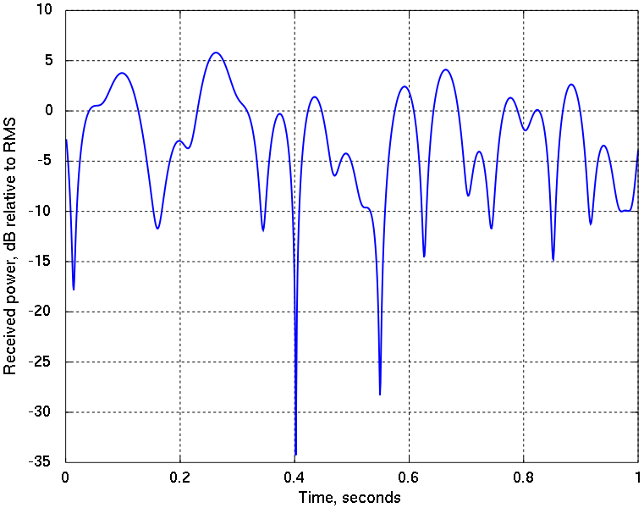
Questions
Fading causes variations in SNR
Large scale and small-scale variations
TX must adapt the MCS
Basic questions:
How does the TX select the MCS?
How does it send the selected MCS to the RX?
What happens if it selects the MCS incorrectly?
High rate
Low rate

Slide 3
Learning Objectives
Describe ARQ protocol in 802.11 WiFi systems
Implement and simulate a simple trial-and-error MCS selection system
Describe the key components in scheduling in 5G NR
Data and control channels, timeline
Compute delays and packet ordering with errors in a multiple ARQ processes
Describe the CSI-RS channel
Implement and simulate simple CSI measurements from the CSI-RS measurements
Describe and analyze Hybrid ARQ
Implement and simulate multi-process HARQ process over a fading channel

Slide 4
Outline
MCS Selection and ARQ in 802.11 Wireless LAN
MCS Selection, Scheduling and ARQ in 5G NR
CSI Feedback and Link Adaptation in 5G NR
Hybrid ARQ

Slide 5
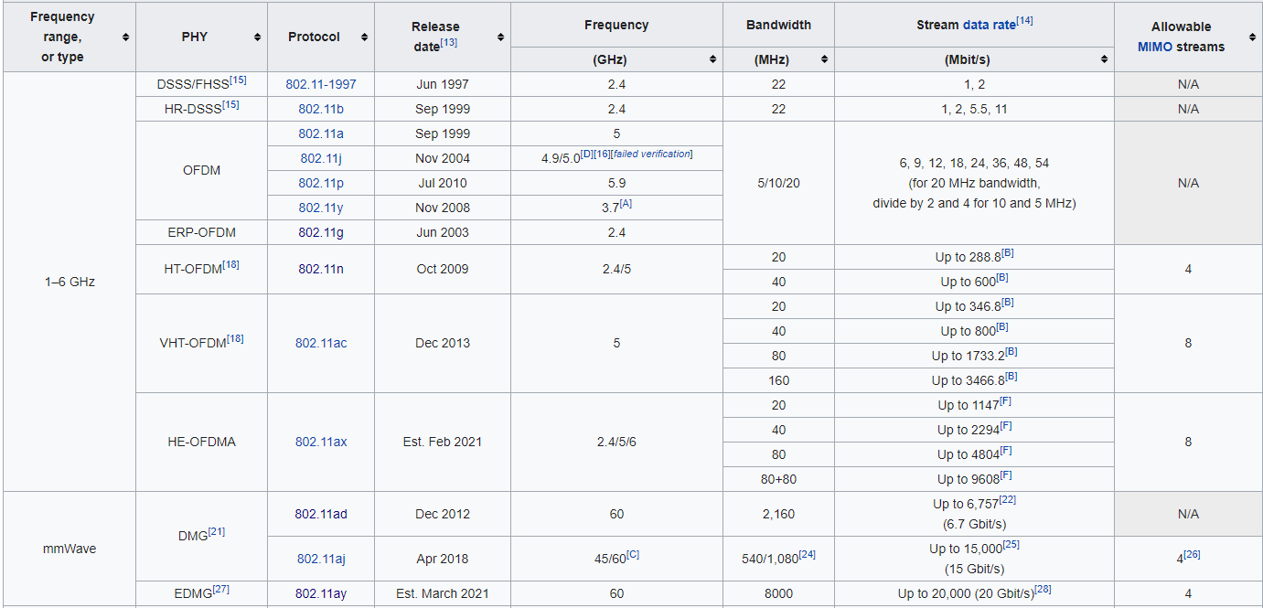
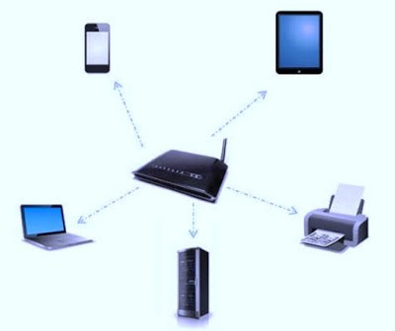
802.11 Family of Wireless LAN Standards
Full details on Wikipedia

Slide 6
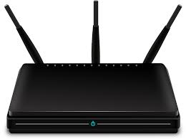

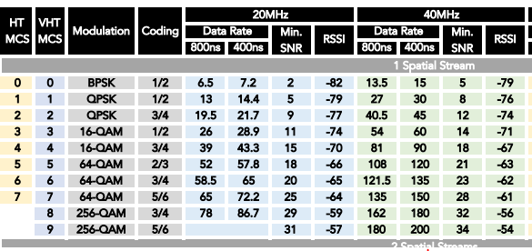
MCS Selection in 802.11
MCS Options in 802.11n (HT) and 802.11ac (VHT)
Each packet is transmitted in some MCS
Ex: 802.11n (see full table on Wikipedia)
Eight possible MCS options
Up to four possible spatial streams (More on this in MIMO)
Trade off SNR requirement with data rate

Slide 7
Sending the MCS Selection
MCS selection
Training
Signal
Data
FCS
Fixed MCS
Variable MCS
Training field: To detect presence of packet, synchronize RX and train equalizer
Signal field: Packet format including MCS and PDU length
Data: User data plus MAC information such as address info
FCS: Frame check sum to detect if data is received correctly

Slide 8
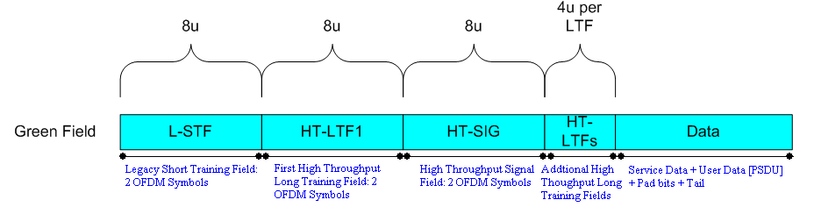
Example Details in 802.11n
From http://rfmw.em.keysight.com/wireless/helpfiles/n7617/Content/Main/MIMO_OFDM_Signal_Structure.htm
Packet components:
L-STF and HT-LTF1: Training fields for synchronization and equalization training
HT-SIG: Encodes the MCS and PDU length
Data: The PDU encoded at the MCS

Slide 9
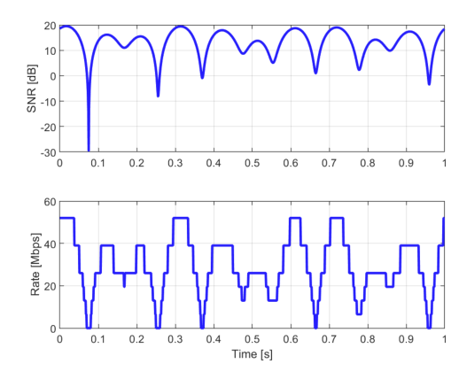
Example: MCS Selection on a Fading Channel
Simple simulation:
3 path channel
Doppler spread 10 Hz
Narrowband fading
Avg SNR = 15 dB
Time is divided into 1ms time slots
At each time slot:
Select MCS based on SNR
Observe discrete rate options
See demo

Slide 10
Packet Errors
Packets may experience errors
MCS may not be selected correctly
Questions:
How does the TX select the MCS optimally?
How does the RX detect the errors?
What can the TX do?
Packet passes
SNR target
Packet fails

Slide 11
Detecting Errors with CRCs
Transmitted packet
Received packet
P = Payload
(Up to 1000s of bits)
CRC=f(P)
Typ. 16 to 32 bits
P = Payload’
CRC’
Checks if CRC’ = f(P’)
How does the receiver know that a data packet received successfully?
Each packet contains a CRC (cyclic redundancy check)
CRC = f(payload)
Receiver checks if CRC=f(payload) for decoded packet
If CRC fails, receiver knows there is an error
If CRC passes, very high probability that packet is correct
Chance that CRC passes for a random packet is 2^{-n}, n = num bits in CRC

Slide 12
Auto-Repeat Request (ARQ)
Attempt 1
Attempt 2
Attempt 3
Data
NAK
Data
NAK
Data
ACK
Fade level
Can overcome errors with multiple attempts
RX success is checked with a CRC on packet
RX then replies with ACK (success) or NACK (fail)
TX resends on NAK.
Continues until passes

Slide 13
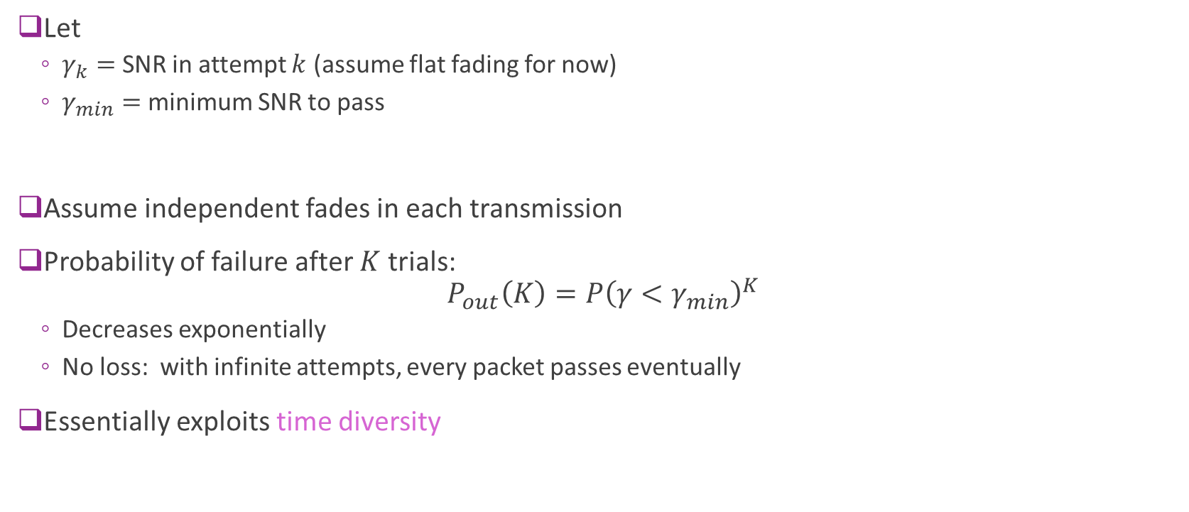
Error Probability with ARQ
Let
$γ_{k}=$ SNR in attempt $k$ (assume flat fading for now)
$γ_{min}=$ minimum SNR to pass
Assume independent fades in each transmission
Probability of failure after $K$ trials: $P_{out}\left(K\right)=P{\left(γ<γ_{min}\right)}^{K}$
Decreases exponentially
No loss: with infinite attempts, every packet passes eventually
Essentially exploits time diversity

Slide 14
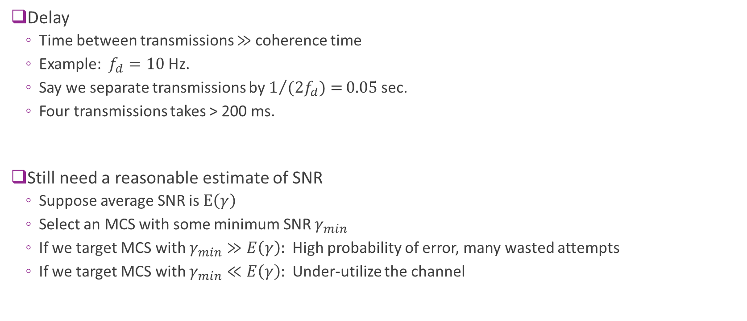
Problems with ARQ
Delay
Time between transmissions $≫$ coherence time
Example: $f_{d}=10$ Hz.
Say we separate transmissions by $1/{(2f_{d})=}0.05$sec.
Four transmissions takes > 200 ms.
Still need a reasonable estimate of SNR
Suppose average SNR is $E\left(γ\right)$
Select an MCS with some minimum SNR $γ_{min}$
If we target MCS with $γ_{min}≫E\left(γ\right):$ High probability of error, many wasted attempts
If we target MCS with $γ_{min}≪E\left(γ\right):$ Under-utilize the channel

Slide 15
Trial and Error Rate Adaptation
Min SNR for attempted MCS
Dec MCS
Dec MCS
Inc MCS
Drop MCS
Channel SNR
NAK
NAK
NAK
ACK
ACK
How do we set MCS in absence of channel state information?
Typically use simple “trial and error” method:
No ACK => Try lower rate for retransmission
ACK => Occasionally try higher rate.
“Probe” to see if channel has improved
Does not require any channel quality feedback.
Widely used in 802.11 transmitters

Slide 16
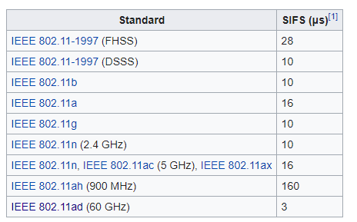

Decoding Time in 802.11
In 802.11 systems, ACK is sent very rapidly
ACK sent within Short Interframe Space
Typically, around 10 us
Very challenging engineering effort
Start decoding the packet while it is being received
Cannot interleave across OFDM symbols
$≤$SIFS time
RX packet
ACK
Conv decoding

Slide 17
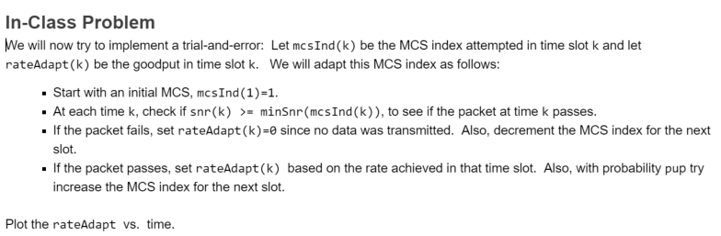
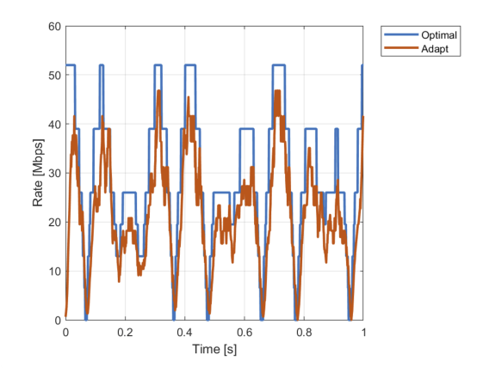
In-Class Problem

Slide 18
Outline
MCS Selection and ARQ in 802.11 Wireless LAN
MCS Selection, Scheduling and ARQ in 5G NR
CSI Feedback and Link Adaptation in 5G NR
Hybrid ARQ

Slide 19


Scheduling in Cellular OFDM Systems
Transmissions are scheduled by the base station
Each assignment from the base station contains:
A UE identity
Direction (uplink or downlink)
Time and frequency resources for data
MCS for the data
Time and frequency resources for the ACK
Other formatting information
Scheduling with OFDM enables:
Very flexible resource allocation among multiple users
Rapid adaptation to channel conditions and traffic requirements
Used in 4G LTE and 5G NR
Data
Assignment
ACK
Frequency
UE1
UE2
Time

Slide 20
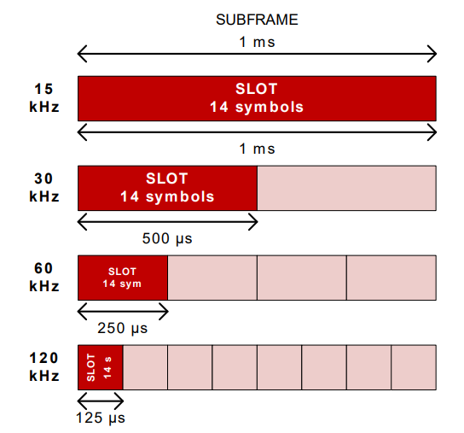
Resource Blocks in 5G NR
Assignments are in units of resource blocks
One slot in time = 14 OFDM symbols (normal mode)
12 sub-carriers in frequency
Each assignment has one or more RBs in a slot
Slot time depends on sub-carrier spacing
12 subcarriers
1 slot = 14 OFDM symbols

Slide 21
Key Channels in 5G NR Data
Downlink: gNB to UE
PDSCH: Physical downlink shared channel
DL data
PDCCH: Physical downlink control channel:
Assignments for both the uplink and downlink
Schedules resources on PDSCH and PUSCH
Uplink: UE to gNB
PUSCH: Physical uplink shared channel
UL data
May also contain UL ACKs
PUCCH: Physical uplink control channel:
Scheduling requests
UL ACKs (if PUSCH is not available)

Slide 22
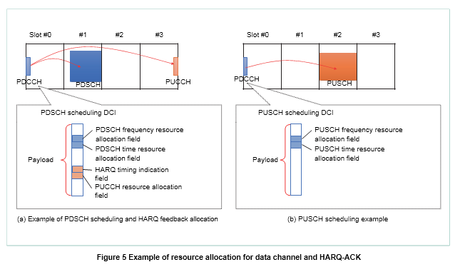
PDCCH Scheduling
UL and DL grants sent on PDCCH
DCI: Downlink control information
Many different DCI formats
All DCI contain
Time allocation: Slot number
Frequency allocation: Set of RBs
MCS
ARQ location (DL grant only)
Many other formatting details…

Slide 23
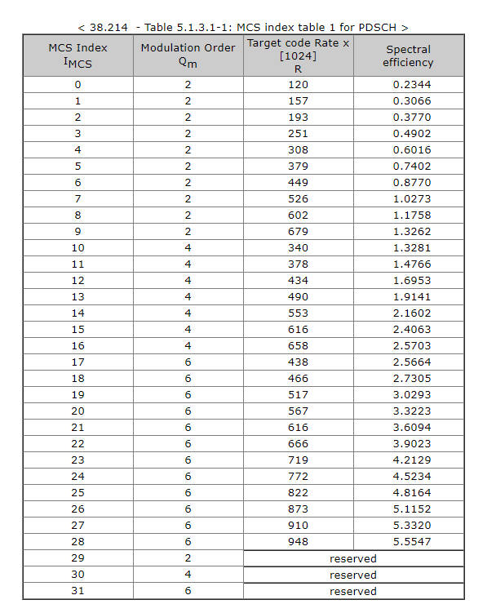
5G NR MCS Options
Transport block (TB):
Transmission associated with one assignment
Occurs in one or more RBs in a slot
Each TB is transmitted with some MCS
Modulation and coding scheme
Currently there are 28 options
Set by the base station depending on SNR

Slide 24

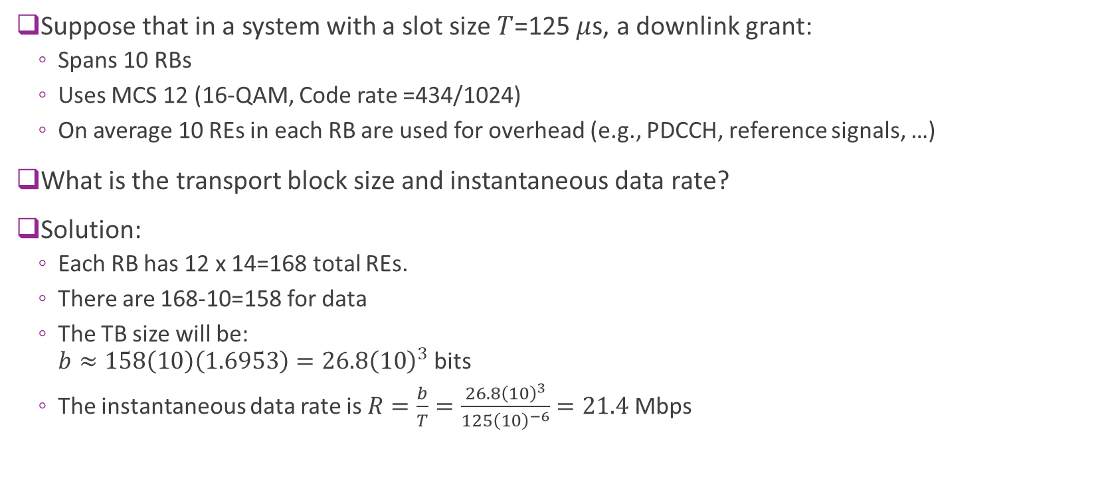
Example: Computing TB Size
Suppose that in a system with a slot size $T$=125 $μ$s, a downlink grant:
Spans 10 RBs
Uses MCS 12 (16-QAM, Code rate =434/1024)
On average 10 REs in each RB are used for overhead (e.g., PDCCH, reference signals, …)
What is the transport block size and instantaneous data rate?
Solution:
Each RB has 12 x 14=168 total REs.
There are 168-10=158 for data
The TB size will be: $b≈158\left(10\right)\left(1.6953\right)=26.8{\left(10\right)}^{3}$ bits
The instantaneous data rate is $R=\frac{b}{T}=\frac{26.8{\left(10\right)}^{3}}{125{\left(10\right)}^{−6}}=21.4$Mbps

Slide 25
Downlink Scheduling Timeline
Initial TX
Next TX or Re-TX
ACK/NACK on PUCCH
DL data
PDCCH assignment
PDSCH data
Scheduling decision
Decode attempt
Decode attempt
DL data
ACKs for downlink data transmitted on PUCCH
Physical uplink control channel
Can also be transmitted on the uplink data channel if it is available

Slide 26
Uplink Scheduling Timeline
New or Re-TX
SR on PUCCH
UL grant on PDCCH
Data on PUSCH
UL grant on PDCCH
Data on PUSCH
UL data
Decode attempt &
re-schedule
Decode attempt &
re-schedule
Scheduling decision
In uplink, UE must inform gNB it has data to be transmitted
Can use scheduling request (SR) or buffer status report (BSR)
No explicit ACK needs to be transmitted
gNB can grant the re-transmission or not
UL data

Slide 27
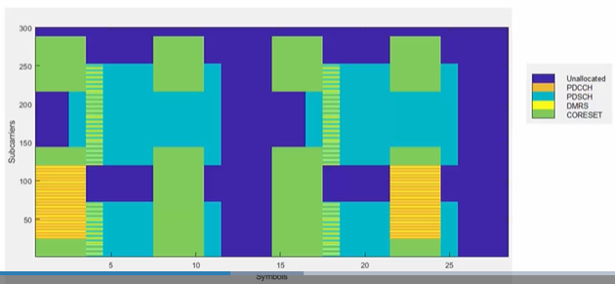
PDCCH Channel Configuration
5G NR provides very flexible allocation of resources to the PDCCH
Allocated to control resource sets (CORESETs)
CORESETs provide possible locations of the PDCCH assignments
UEs search CORESETs for PDCCH allocated to it
Configurability can tradeoff delay, overhead, …
See MATLAB excellent 5G Toolbox video, PDCCH mapping to Coreset, for all the details

Slide 28
Multiple HARQ Processes
Transmissions involves several delays:
Transmission & decode of data
Transmission & decode of ACK
Decision for scheduling
To enable continuous transmissions:
Use multiple HARQ processes in parallel
5G NR supports up to 16
HARQ process scheduling
HARQ processes indicated in DCI
Can be in any order
Very flexible
HARQ Process
1
2
3
4
1
2
ACK decode & schedule time
Decode time

Slide 29
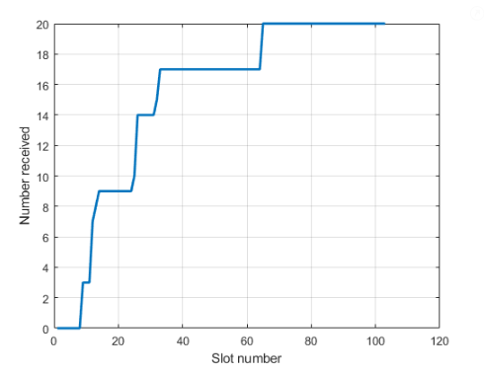
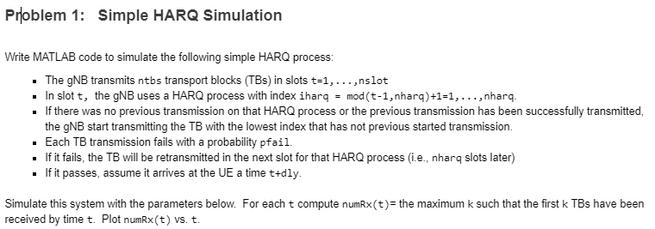
In-Class Exercise

Slide 30
Outline
MCS Selection and ARQ in 802.11 Wireless LAN
MCS Selection, Scheduling and ARQ in 5G NR
CSI Feedback and Link Adaptation in 5G NR
Hybrid ARQ

Slide 31
CQI Feedback
Periodic CQI reports (typ. ~100 per sec)
Data with rate based on CSI
Trial and error rate adaptation is inexact
Fading can result in many wasted attempts
Ideally, TX needs to needs to know the channel quality information (CQI)
In cellular systems, CQI is often performed via feedback
CQI is measured at the UE
Fed back to the base station in a CQI report

Slide 32
CSI Feedback in NR DL
gNB
UE
gNB sends periodic CSI RS:
CSI reference signals
Typically, 1 CSI-RS per 5 to 10ms
UE measures CSI from the CSI-RS
Sends back report to the gNB
gNB can correctly select MCS
CSI RS
Measures CSI
CSI Report
Selects MCS
Assignment w/ MCS
Data

Slide 33
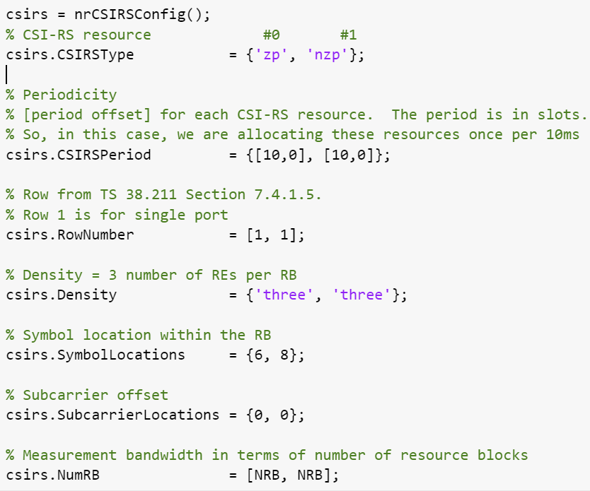
CSI-RS Configuration in MATLAB
Ex to the right:
One zero power (ZP) CSI-RS: Can measure noise
One non-zero power (NZP): Can measure signal strength
Configurable structure
Periodicity
Density
Position in RB
Trades off CSI estimation accuracy and overhead

Slide 34
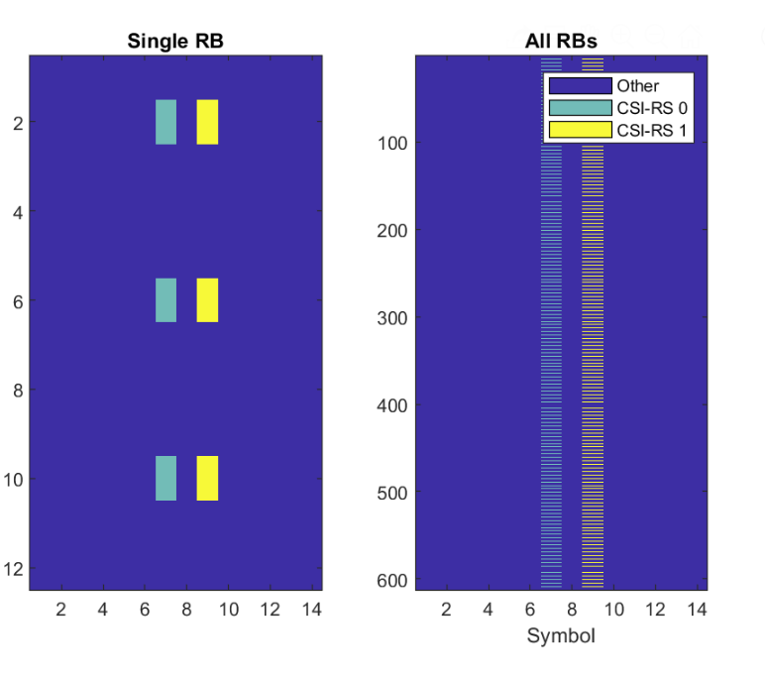
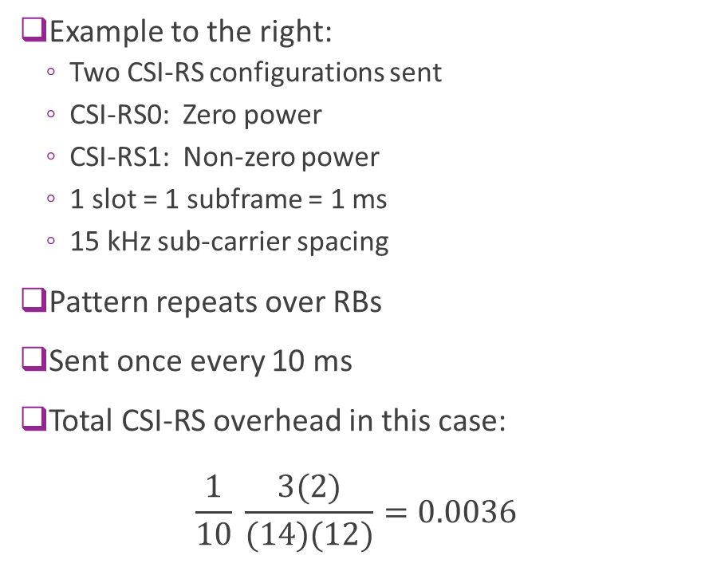
Visualizing the CSI-RS Configuration
Example to the right:
Two CSI-RS configurations sent
CSI-RS0: Zero power
CSI-RS1: Non-zero power
1 slot = 1 subframe = 1 ms
15 kHz sub-carrier spacing
Pattern repeats over RBs
Sent once every 10 ms
Total CSI-RS overhead in this case: $\frac{1}{10} \frac{3(2)}{(14)(12)}=0.0036$
1 ms

Slide 35
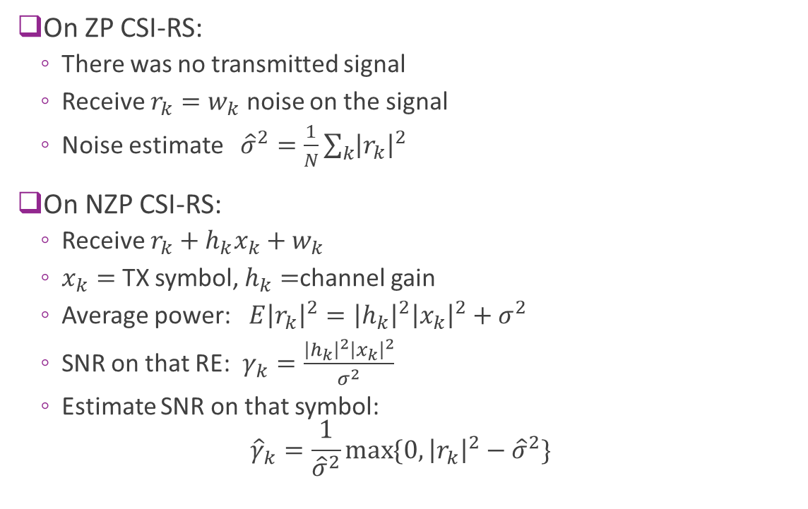
Estimating the CSI using ZP and NZP
On ZP CSI-RS:
There was no transmitted signal
Receive $r_{k}=w_{k}$ noise on the signal
Noise estimate ${\hat{σ}}^{2}=\frac{1}{N}\sum_{k}{{\left|r_{k}\right|}^{2}}$
On NZP CSI-RS:
Receive $r_{k}+h_{k}x_{k}+w_{k}$
$x_{k}=$ TX symbol, $h_{k}=$channel gain
Average power:$E{\left|r_{k}\right|}^{2}={\left|h_{k}\right|}^{2}{\left|x_{k}\right|}^{2}+σ^{2}$
SNR on that RE: $γ_{k}=\frac{{\left|h_{k}\right|}^{2}{\left|x_{k}\right|}^{2}}{σ^{2}}$
Estimate SNR on that symbol: ${\hat{γ}}_{k}=\frac{1}{{\hat{σ}}^{2}}\max{\{0,}{\left|r_{k}\right|}^{2}−{\hat{σ}}^{2}\}$

Slide 36
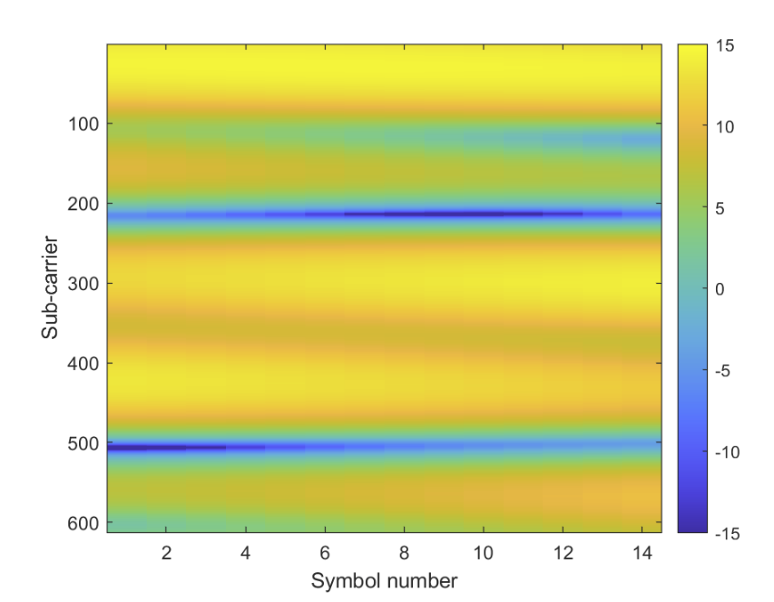
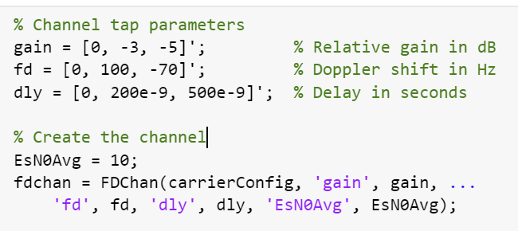

Example Simulation
Three path channel, average SNR = 10 dB
Simulated in frequency-domain
Significant frequency selective fading
Bandwidth $W>\frac{1}{2δ}$
But coherence time $>$ 1ms.
SNR [dB] per RE

Slide 37
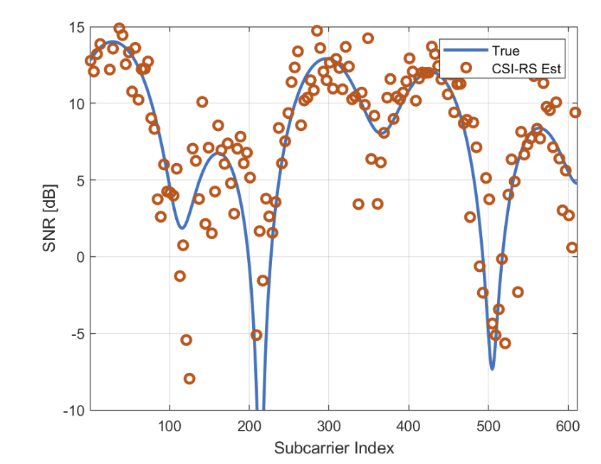
Example Estimate
Plotted:
True channel on symbol for the CSI-RS
Red: Estimates on the CSI-RS sub-carriers
Individual CSI-RS estimates are noisy
But averaged values can be accurate

Slide 38
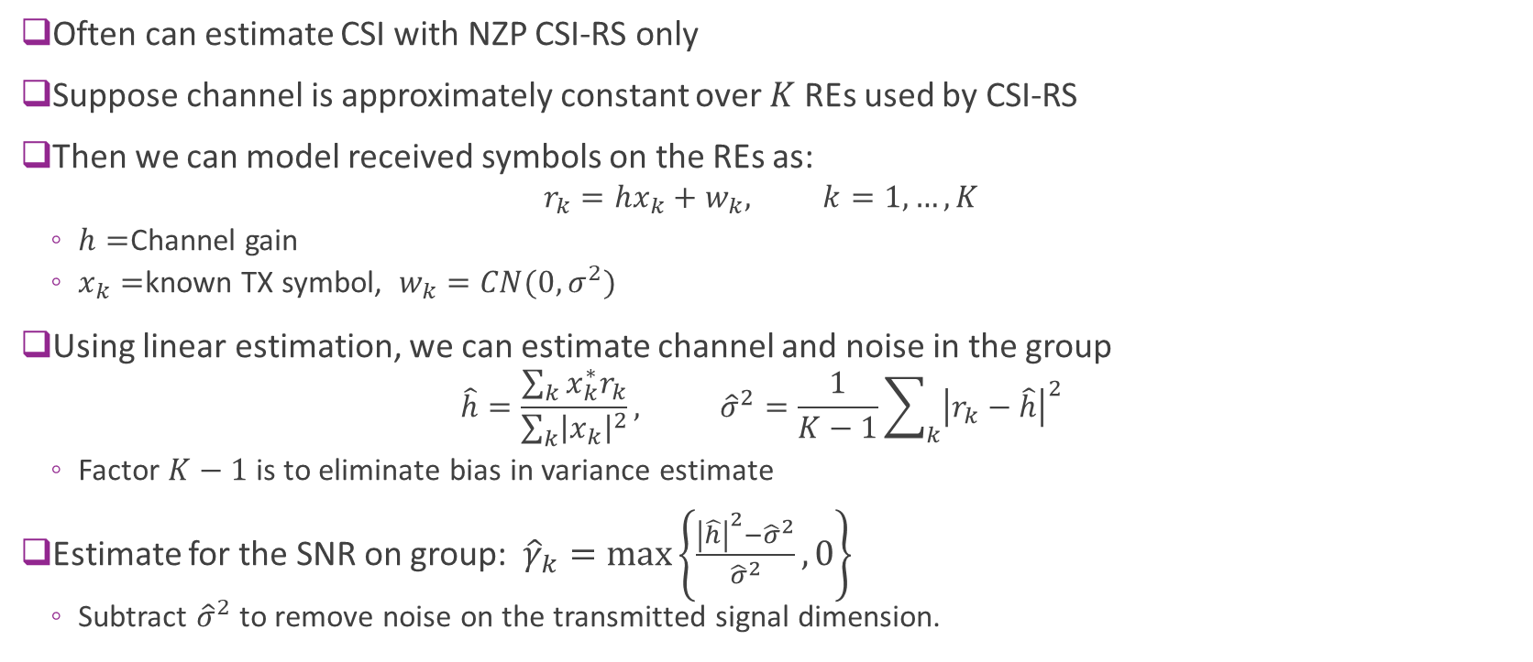
Estimate the CSI with NZP CSI-RS Only
Often can estimate CSI with NZP CSI-RS only
Suppose channel is approximately constant over $K$ REs used by CSI-RS
Then we can model received symbols on the REs as:
$$r_{k}=hx_{k}+w_{k}, k=1,…,K$$
$h=$Channel gain
$x_{k}=$known TX symbol, $w_{k}=CN(0,σ^{2})$
Using linear estimation, we can estimate channel and noise in the group
$$\hat{h}=\frac{\sum_{k}{x_{k}^{∗}r_{k}}}{\sum_{k}{{\left|x_{k}\right|}^{2}}}, {\hat{σ}}^{2}=\frac{1}{K−1}\sum_{k}{{\left|r_{k}−\hat{h}\right|}^{2}}$$
Factor $K−1$ is to eliminate bias in variance estimate
Estimate for the SNR on group: ${\hat{γ}}_{k}=\max\left\{\frac{{\left|\hat{h}\right|}^{2}−{\hat{σ}}^{2}}{{\hat{σ}}^{2}},0\right\}$
Subtract ${\hat{σ}}^{2}$ to remove noise on the transmitted signal dimension.

Slide 39
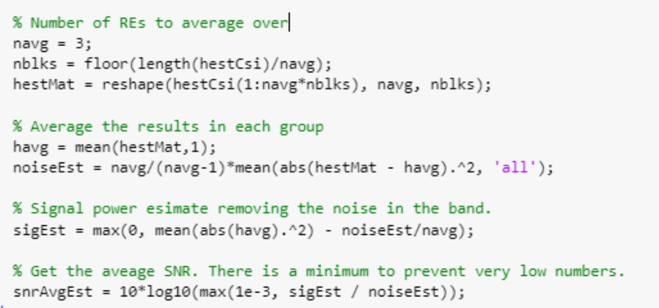
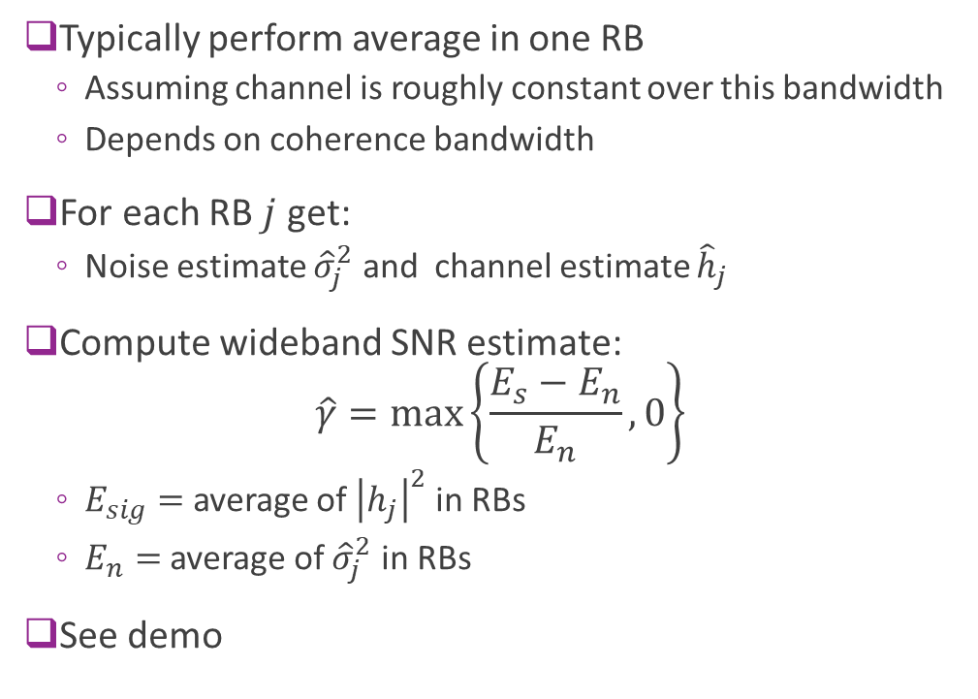
Implementation in MATLAB
Typically perform average in one RB
Assuming channel is roughly constant over this bandwidth
Depends on coherence bandwidth
For each RB $j$ get:
Noise estimate ${\hat{σ}}_{j}^{2}$ and channel estimate ${\hat{h}}_{j}$
Compute wideband SNR estimate: $\hat{γ}=\max\left\{\frac{E_{s}−E_{n}}{E_{n}},0\right\}$
$E_{sig}=$ average of ${\left|h_{j}\right|}^{2}$ in RBs
$E_{n}=$average of ${\hat{σ}}_{j}^{2}$ in RBs
See demo

Slide 40
Uplink Power Control
Reference signals (PUCCH, SRS, …)
Power amplifier (PA)
Measure SNR
Gain control
Fast power control
Uplink is power controlled (more on this later)
Keep transmit RX power at a target
Save UE battery, reduces interference
Minimizes dynamic range and near-far effect in multi-user systems
Cannot use RX SNR as a measure of channel quality

Slide 41


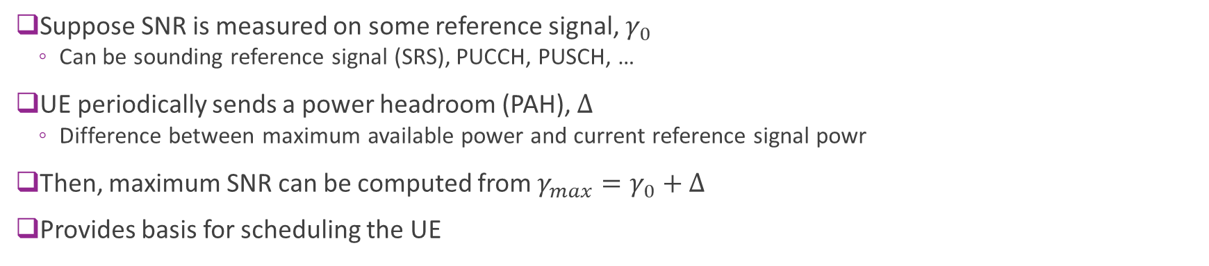


Uplink CSI
Max TX power
Max RX power
PA headroom $Δ$
$Δ$
Max SNR $γ_{max}$
Ref signal TX power
Ref SNR $γ_{0}$
Ref signal RX power
Thermal noise
Suppose SNR is measured on some reference signal, $γ_{0}$
Can be sounding reference signal (SRS), PUCCH, PUSCH, …
UE periodically sends a power headroom (PAH), $Δ$
Difference between maximum available power and current reference signal powr
Then, maximum SNR can be computed from $γ_{max}=γ_{0}+Δ$
Provides basis for scheduling the UE

Slide 42
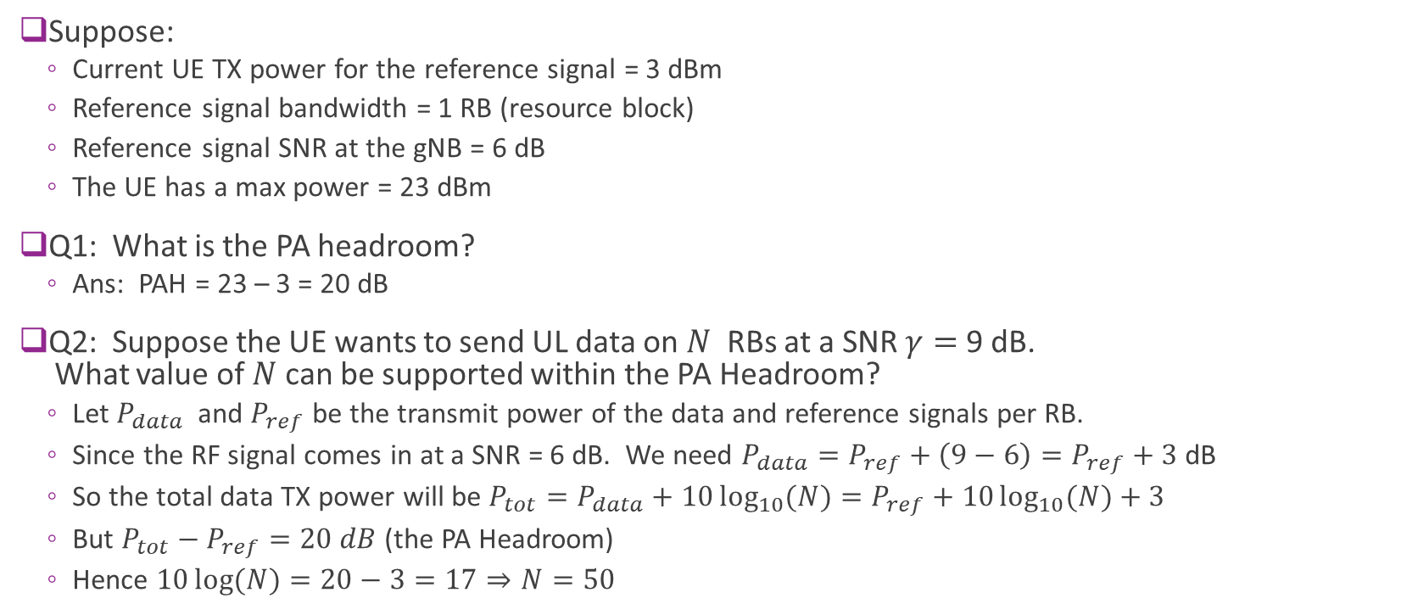
Example: PA Headroom
Suppose:
Current UE TX power for the reference signal = 3 dBm
Reference signal bandwidth = 1 RB (resource block)
Reference signal SNR at the gNB = 6 dB
The UE has a max power = 23 dBm
Q1: What is the PA headroom?
Ans: PAH = 23 – 3 = 20 dB
Q2: Suppose the UE wants to send UL data on $N$ RBs at a SNR $γ=$ 9 dB. What value of $N$ can be supported within the PA Headroom?
Let $P_{data}$ and $P_{ref}$ be the transmit power of the data and reference signals per RB.
Since the RF signal comes in at a SNR = 6 dB. We need $P_{data}=P_{ref}+\left(9−6\right)=P_{ref}+3$ dB
So the total data TX power will be $P_{tot}=P_{data}+10\log_{10}{(N)}=P_{ref}+10\log_{10}{(N)}+3$
But $P_{tot}−P_{ref}=20 dB$ (the PA Headroom)
Hence $10\log{(N)}=20−3=17⇒N=50$

Slide 43
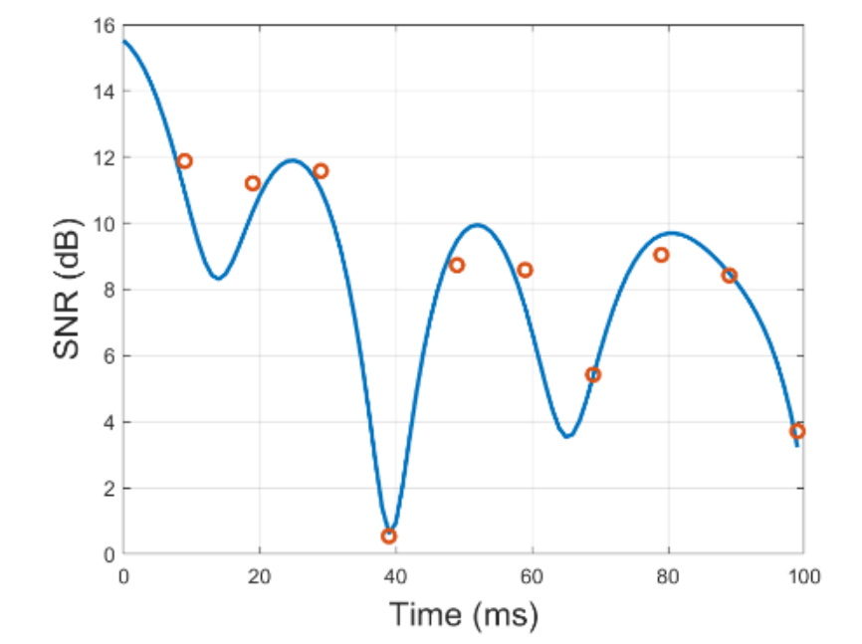
Errors in CSI
In general, there will be errors in the CSI at the TX
The RX does not measure the CSI exactly
Time delay between:
The CSI measurement report and TX based on the CSI

Slide 44
Further Topics
The 5G NR standard provides many powerful features for CSI reporting
Flexible configuration of the CSI-RS and CSI reporting
Rich CSI reporting: wideband, per sub-band, multiple layers, …
Optimizing the use of the CSI-RS is a complex and interesting design problem
Channel quality estimation algorithms
Tradeoffs in overhead and accuracy
Channel quality tracking and prediction
Particularly challenging when we get to multi-antenna systems

Slide 45
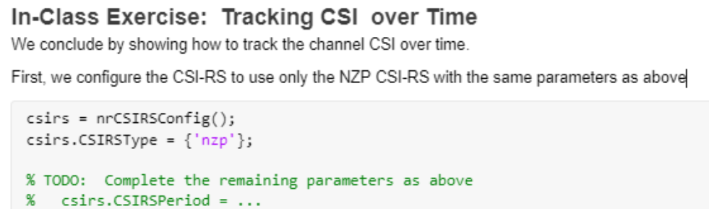
In Class Exercise: CSI Tracking

Slide 46
Outline
MCS Selection and ARQ in 802.11 Wireless LAN
MCS Selection, Scheduling and ARQ in 5G NR
CSI Feedback and Link Adaptation in 5G NR
Hybrid ARQ

Slide 47
Hybrid ARQ
Standard ARQ wastes transmissions on losses
No data sent in each failed transmission
Hybrid ARQ concept:
On each failure, store received symbols
Combine new symbols with old until successfully decoded
“Failed” transmissions are not wasted
Two methods:
Chase combining
Incremental redundancy

Slide 48
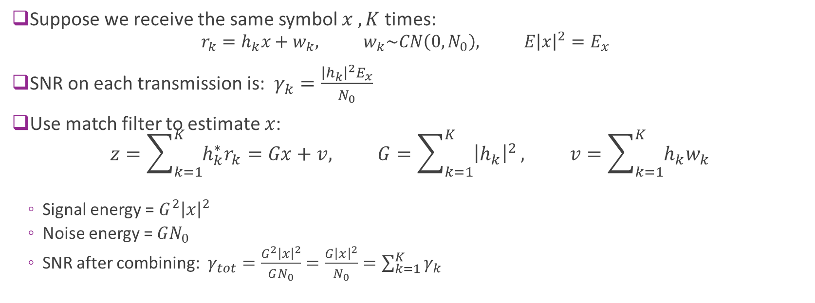
Combing Multiple Symbols
Suppose we receive the same symbol $x , K$ times:
$$r_{k}=h_{k}x+w_{k}, w_{k}\sim CN\left(0,N_{0}\right), E{\left|x\right|}^{2}=E_{x}$$
SNR on each transmission is: $γ_{k}=\frac{{\left|h_{k}\right|}^{2}E_{x}}{N_{0}}$
Use match filter to estimate $x$: $z=\sum_{k=1}^{K}{h_{k}^{∗}r_{k}}=Gx+v, G=\sum_{k=1}^{K}{{\left|h_{k}\right|}^{2}}, v=\sum_{k=1}^{K}{h_{k}w_{k}}$
Signal energy = $G^{2}{\left|x\right|}^{2}$
Noise energy = $GN_{0}$
SNR after combining: $γ_{tot}=\frac{G^{2}{\left|x\right|}^{2}}{GN_{0}}=\frac{G{\left|x\right|}^{2}}{N_{0}}=\sum_{k=1}^{K}{γ_{k}}$
SNR with combining is the sum of the individual SNRs

Slide 49


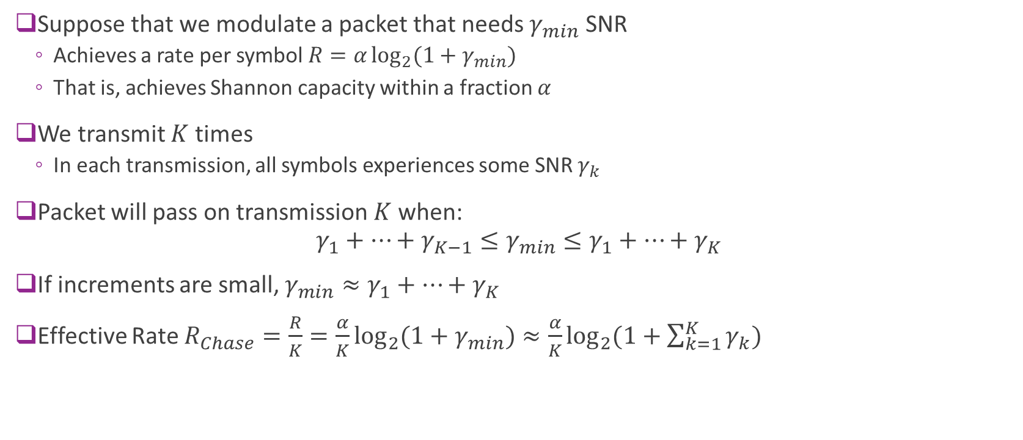



Chase Combining and SNR Accumulation
Suppose that we modulate a packet that needs $γ_{min}$ SNR
Achieves a rate per symbol $R=α\log_{2}{(1+γ_{min})}$
That is, achieves Shannon capacity within a fraction $α$
We transmit $K$ times
In each transmission, all symbols experiences some SNR $γ_{k}$
Packet will pass on transmission $K$when: $γ_{1}+⋯+γ_{K−1}≤γ_{min}≤γ_{1}+⋯+γ_{K}$
If increments are small, $γ_{min}≈γ_{1}+⋯+γ_{K}$
Effective Rate $R_{Chase}=\frac{R}{K}=\frac{α}{K}\log_{2}{(1+γ_{min})}≈\frac{α}{K}\log_{2}{(1+\sum_{k=1}^{K}{γ_{k}})}$
Accumulated SNR
$$γ_{3}$$
$$γ_{min}$$
$$γ_{2}$$
$$γ_{1}$$
$$0$$

Slide 50

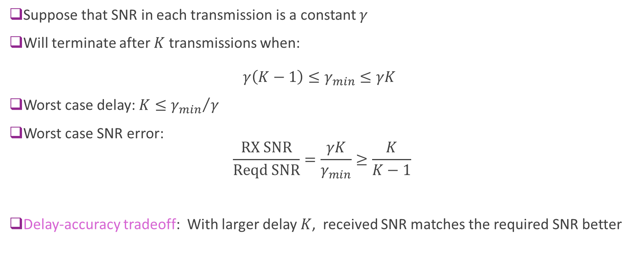


Delay-Accuracy Tradeoff
Suppose that SNR in each transmission is a constant $γ$
Will terminate after $K$ transmissions when: $γ\left(K−1\right)≤γ_{min}≤γK$
Worst case delay: $K≤{γ_{min}}/γ$
Worst case SNR error: $\frac{\text{RX} \text{SNR}}{\text{Reqd} \text{SNR}}=\frac{γK}{γ_{min}}≥\frac{K}{K−1}$
Delay-accuracy tradeoff: With larger delay $K$, received SNR matches the required SNR better
Accumulated SNR
$$3γ$$
$$γ_{min}$$
$$2γ$$
$$γ$$
$$0$$

Slide 51
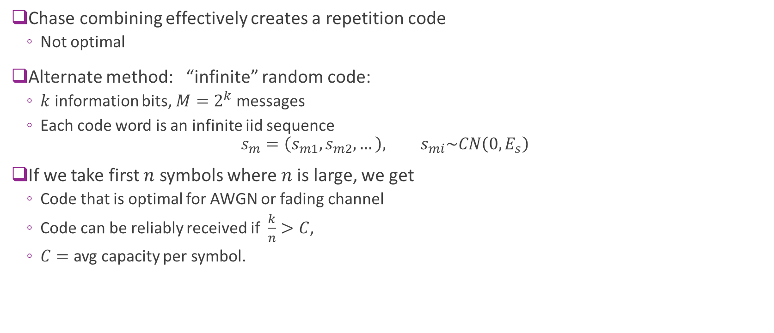
Rateless Gaussian Random Code
Chase combining effectively creates a repetition code
Not optimal
Alternate method: “infinite” random code:
$k$ information bits, $M=2^{k}$ messages
Each code word is an infinite iid sequence $s_{m}=\left(s_{m1},s_{m2},…\right), s_{mi}\sim CN\left(0,E_{s}\right)$
If we take first $n$ symbols where $n$is large, we get
Code that is optimal for AWGN or fading channel
Code can be reliably received if $\frac{k}{n}>C$,
$C=$ avg capacity per symbol.

Slide 52

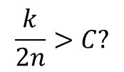
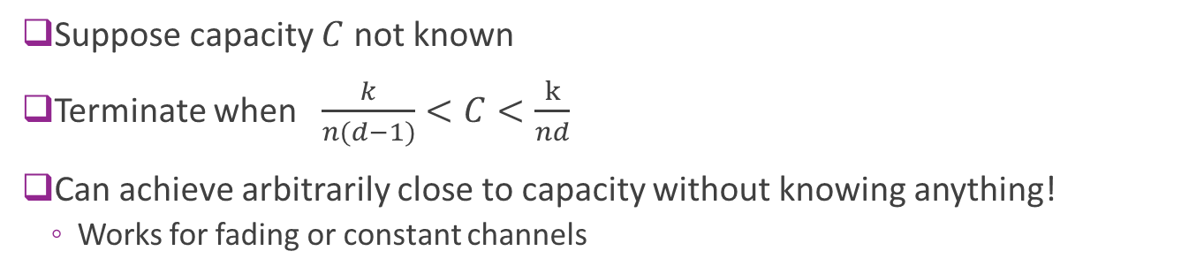
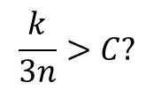
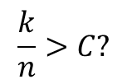
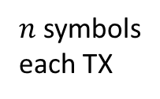
Using a Rateless Code
$k$ info bits
$n$ symbols each TX
$$\frac{k}{3n}>C?$$
$$\frac{k}{n}>C?$$
$$\frac{k}{2n}>C?$$
Suppose capacity $C$ not known
Terminate when $\frac{k}{n(d−1)}<C<\frac{k}{nd}$
Can achieve arbitrarily close to capacity without knowing anything!
Works for fading or constant channels

Slide 53
Outline
MCS Selection and ARQ in 802.11 Wireless LAN
MCS Selection, Scheduling and ARQ in 5G NR
CSI Feedback and Link Adaptation in 5G NR
Hybrid ARQ
HARQ with a Bitwise channel

Slide 54
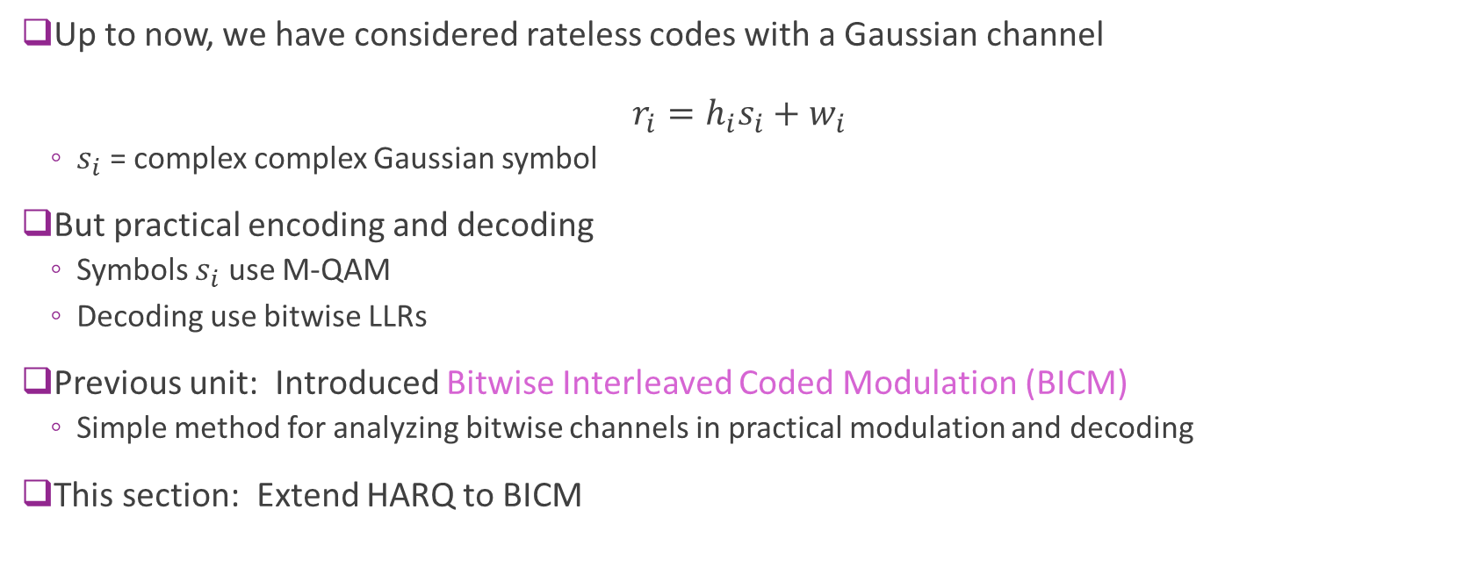
Practical Fading Channel Capacity
Up to now, we have considered rateless codes with a Gaussian channel $r_{i}=h_{i}s_{i}+w_{i}$
$s_{i}$ = complex complex Gaussian symbol
But practical encoding and decoding
Symbols $s_{i}$ use M-QAM
Decoding use bitwise LLRs
Previous unit: Introduced Bitwise Interleaved Coded Modulation (BICM)
Simple method for analyzing bitwise channels in practical modulation and decoding
This section: Extend HARQ to BICM

Slide 55
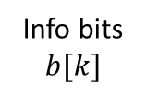
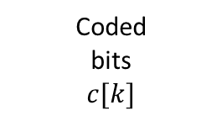
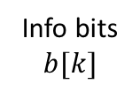
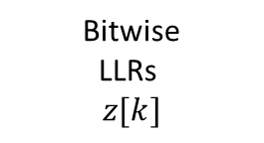
Bitwise Channel (Review from previous unit)
Info bits $$b[k]$$
Channel encoder
Inter-leaver
Symbol mapping
Equal-ization
De-inter-leaver
Channel decoder
Fading channel
Info bits $$b[k]$$
Coded bits $$c[k]$$
Bitwise LLRs $$z[k]$$
Channel encoder
Bitwise channel
Channel decoder
Noise and channel gain

Slide 56
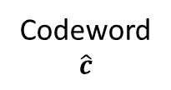
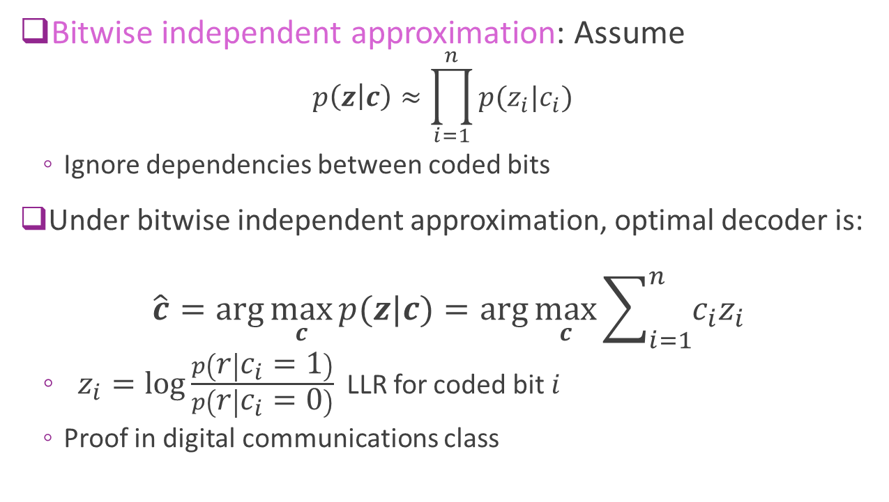


Review: LLR Decoding via Bitwise Approx
Bitwise independent approximation: Assume
$$p\left(z | c\right)≈\prod_{i=1}^{n}{p(z_{i}|c_{i})}$$
Ignore dependencies between coded bits
Under bitwise independent approximation, optimal decoder is: $\hat{c}=\arg{\max_{c}{p(z|c)}}=\arg{\max_{c}{\sum_{i=1}^{n}{c_{i}z_{i}}}}$
$z_{i}=\log{\frac{p\left(r | c_{i}=1\right)}{p\left(r | c_{i}=0\right)}}$ LLR for coded bit $i$
Proof in digital communications class
RX symbols $$r$$
Codeword $$\hat{c}$$
LLRs $$z$$
Demod
Channel decoder

Slide 57




BICM model with Fading
Memoryless channel:
Input is a coded bit $c_{k}$
Output is LLR estimate $z_{k}$
Transition $P(z_{k}|c_{k},h_{k})$
Depends on channel state $h_{k}$
Channel state is randomly varying over codeblock
Averaging over state $h_{k}$: $P\left(z_{k} | c_{k}\right)=∫P\left(z_{k} | c_{k},h_{k}\right)p\left(h_{k}\right)dh_{k}$
Can analyze fading as a stationary channel
Coded bits $${(c}_{1},…,c_{K})$$
Bitwise LLRs $$\left(z_{1},…,z_{K}\right)$$
Channel encoder
Bitwise channel
Channel decoder
Noise and channel gain $${(h}_{1},…,h_{K})$$

Slide 58

Combing Using LLRs
Assume the same coded bit $c_{i}$ is transmitted in $K$ channel uses: $r_{k}\sim P\left(r_{k} | c_{i}\right), i=1,…,K$
Assuming independence of noise in difference symbols: $z_{i}=\ln{\frac{P\left(r_{1} | c_{i}=1\right)⋯P\left(r_{K} | c_{i}=1\right)}{P\left(r_{1} | c_{i}=0\right)⋯P\left(r_{K} | c_{i}=0\right)} }=\ln{\frac{P\left(r_{1} | c_{i}=1\right)}{P\left(r_{1} | c_{i}=0\right)}}+⋯+\ln{\frac{P\left(r_{K} | c_{i}=1\right)}{P\left(r_{K} | c_{i}=0\right)}}$ $= z_{i1}+⋯+z_{iK}$
We can simply add the LLRs obtained from $K$ transmissions

Slide 59


Practical Incremental Redundancy
Generate a large “mother code” $c=(c_{1},…,c_{n})$
Typically rate 1/3 or 1/5
Initialize accumulated LLRs: ${\overline{z}}_{i}=0$
In each transmission, send a subset of coded bits: $c^{k}=\left\{ c_{i} \right| i∈I_{k} \}$
$I_{k}=$ indices transmitted in $k$transmission
In 3GPP, each transmission is called a redundancy version
Receiver gets LLRs: $z^{k}=\left\{ z_{i} \right| i∈I_{k} \}$
Accumulates the LLRs: ${\overline{z}}_{i}=0$ ${\overline{z}}_{i}={\overline{z}}_{i}+z_{i}, i∈I_{k}$
Decodes with accumulated LLRs: $\hat{c}=\arg{\max_{c}{\sum_{i=1}^{n}{c_{i}{\overline{z}}_{i}}}}$

Slide 60





Toy Example
Suppose mother code is 4-bits: $(c_{1},…,c_{4})$
Accumulated LLR buffer: $({\overline{z}}_{1},…,{\overline{z}}_{4})$
TX 1: Transmit $(c_{1},c_{2},c_{3})$
RX get LLRs $\left(0.7,1.2,−0.9\right)$
TX 2: Transmit $(c_{2},c_{3},c_{4})$
RX get LLRs $\left(0.5,−0.6,−1.4\right)$
Add to previous buffer
After each accumulation, decoder $\hat{c}=\arg{\max_{c}{\sum_{i=1}^{n}{c_{i}{\overline{z}}_{i}}}}$
LLR buffer
$${\overline{z}}_{1}$$
$${\overline{z}}_{2}$$
$${\overline{z}}_{3}$$
$${\overline{z}}_{4}$$
0
0
0
0
TX1
0.7
1.2
-0.9
0
TX2
0.7
1.7
-1.5
-1.4

Slide 61
IR Illustrated
Mother code
Decode 1:
Use part 1
Treat parts 2, 3 as erasures
Decode 2:
Use parts 1,2
Treat part 3 as erasure
TX
NAK
ACK
TX1
TX2
Decode w/ parts 1 and 2
Decode w/ part 1
RX
LLR buffer

Slide 62
Analysis
Exact analysis is complex
Depends on puncturing and precise fading pattern
Must use simulation
Accumulated information analysis
Assume codes operate at a fixed fraction from capacity
Many simulations show this model predicts actual performance on real codes well
Used widely in network simulations to avoid simulating the LDPC codes

Slide 63

Analysis via Accumulated Mutual Information
Suppose we send $k$ information bits
Each coded bit goes over bitwise channel $z_{i}\sim P(z_{i}|c_{i},h_{i})$
LLR depends on coded bit and channel state $h_{i}$
Capacity (information bits / coded bit) given $h_{i}$ is $I\left(c;z|h_{i}\right)=1−E\left[BCE\left(c,z\right)|h_{i}\right], BCE\left(c,z\right)=\log\left(1+e^{−z}\right)−cz$
After transmitting $N$ coded bits, we obtain accumulated mutual information: $M^{(N)}=\sum_{i=1}^{N}{M_{i}}, M_{i}=1−E\left[BCE\left(c,z\right)|h_{i} \right]$
For an ideal long block length code, the error probability is small when $M^{(N)}>K$
Practical code: Assume $M^{(N)}>M_{tgt}=βK$ for some $β>1$ for low error probability
Fraction $β=$ loss relative to Shannon capacity

Slide 64

Toy Example
Suppose we transmit $k=1000$ information bits with a rate 0.5 mother code
There are $n=2000$ coded bits
Assume practical code requires $β=1.2$ more information bits to pass
Need accumulated MI = $\left(1000\right)\left(1.2\right)=1200$ bits
Now suppose each transmission sends 200, 16-QAM symbols
Assume average MI per coded bit is 0.7 bits
Then, each transmissions has (200)(4) = 800 coded bits
So, we accumulate (800)(0.7) = 560 information bits per transmission
We will pass after 3 transmissions since 3(560)=1680 > 1200
At this point we have transmitted 3(800)=2400 bits over 3(200)=600 symbols
Hence, effective rate for the transmission is $\frac{1000}{600}≈1.67$ info bits per sym
$\frac{1000}{2400}≈0.41$ information bits / coded bit

Slide 65


5G NR HARQ Performance
Simulation with QPSK
With multiple transmissions:
Can obtain reasonable over wide range of SNRs
Staircase throughput curve
Selecting wrong MCS may not lead to poor rate:
Ex: At SNR=1 dB
Get ~0.95 bps/Hz with option 1 (QPSK, rate=0.95)
Get ~1 bps/Hz with option 1 (QPSK, rate=0.5)
Passes in 1 TX
2 TX
4 TX
3 TX
Hamidi-Sepeh et al, Analysis of 5G LDPC Codes Rate-matching Design, 2018

Slide 66





Rate Matching via Puncturing and Repetition
Many codes have limited rate options
Ex: Convolution codes, $\frac{1}{2},\frac{1}{3}$
Two options to get different rates
Puncturing
Take $(n,k)$ “base code” or “mother code”
Remove $m$ of the $n$ code bits
Effective rate = $\frac{k}{n−m}$
At decoder, set LLRs to zero for punctured bits
Repetition
Repeat $m$ of the $n$ code bits
Effective rate = $\frac{k}{n+m}$
At decoder, add LLRs for repeated bits
$k$ info bits
$n$ coded bits
Puncturing
Remove $m$ bits
Repetition
Repeat $m$ bits

Slide 67
Practical Considerations
Cellular standards use very powerful coding methods
Provides excellent performance
But presents several implementation challenges
Often need very large LLR buffer
Must be stored on chip
LLR memory often larger than decoder or even the entire modem!
Decoding delay:
Typical turnaround time is several slots (100s of us to milliseconds)
Much longer than WiFi (Recall SIFS time is 10 us)

Slide 68


Lab: Multi-Process NR HARQ Simulation

Slide 69





IR and Mutual Information Accumulation
Suppose that we modulate a packet that needs $γ_{min}$ SNR
Achieves a rate per symbol $R=α\log_{2}{(1+γ_{min})}$
That is, achieves Shannon capacity within a fraction $α$
We transmit $K$ times with $1/K$ symbols in each transmission
In each transmission, all symbols experiences some SNR $γ_{k}$
Packet will pass on transmission $K$when: $\frac{1}{K}(M_{1}+⋯+M_{K−1})≤\log_{2}\left(1+γ_{min}\right)≤\frac{1}{K}(M_{1}+⋯+M_{K})$
$M_{k}=\log_{2}{(1+γ_{k})}$= mutual information per symbol in transmission $k$
Accumulated SNR
$$M_{3}$$
$$M_{min}$$
$$M_{2}$$
$$M_{1}$$
$$0$$

Slide 70


Consequences of MI Accumulation
Approximately capacity achieving:
Suppose that increments are small
Then, $\log_{2}\left(1+γ_{min}\right)≈\frac{1}{K}(M_{1}+⋯+M_{K})$
Rate will be: $R_{IR}=R=α\log_{2}{(1+γ_{min})}≈\frac{α}{K}\sum_{k=1}^{K}{\log_{2}\left(1+γ_{k}\right)}$
Ergodic capacity, $C=\frac{1}{K}\sum_{k=1}^{K}{\log_{2}\left(1+γ_{k}\right)}$
Hence, $R_{IR}=αC$
Outperforms Chase combining
In identical situation, we saw $R_{Chase}=\frac{α}{K}\log_{2}{(1+}\sum_{k=1}^{K}{γ_{k}})$
By Jensen’s inequality: $R_{IR}≥R_{Chase}$
IR adds degrees of freedom. Chase adds power.
Accumulated SNR
$$M_{3}$$
$$M_{min}$$
$$M_{2}$$
$$M_{1}$$
$$0$$

