Slide 1


Slide 2
Unit Testing
With Dependency Injection and Moq

Slide 3





About Me
Graduated USF in 2010
Worked with Clark Associates since 2016

Slide 4
What is Dependency Injection (DI)?
Design Pattern in which one object supplies the dependencies of another object
Allows for decoupled logic between layers
Requires the use of an injector to resolve dependency types when constructing objects

Slide 5
Benefits of Dependency Injection
Single Responsibility Principle
Isolate components for unit tests
Substitute different implementations of dependencies without breaking anything

Slide 6
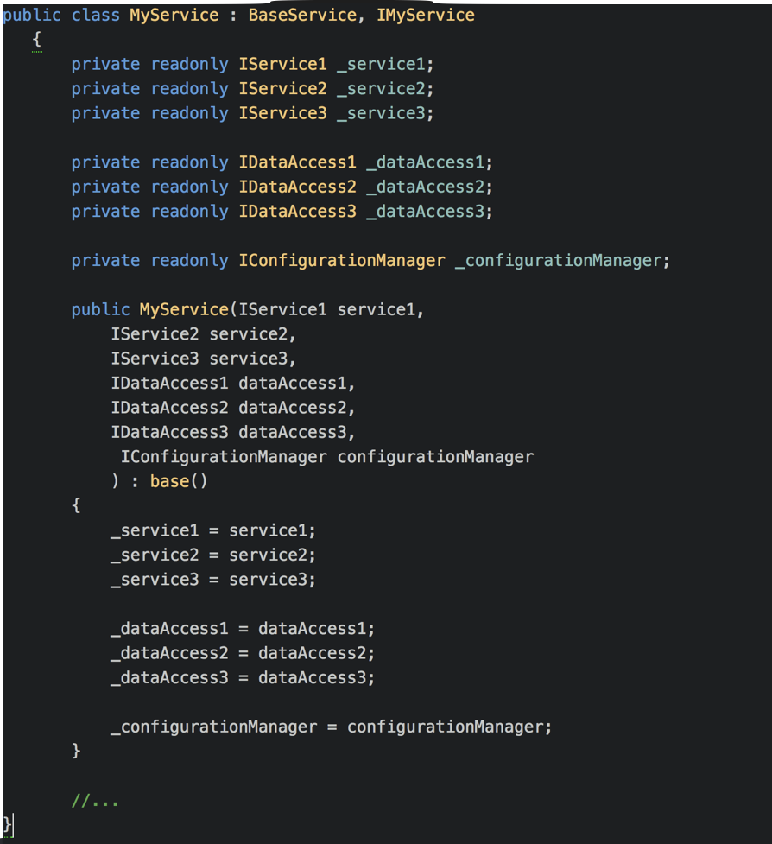

Slide 7
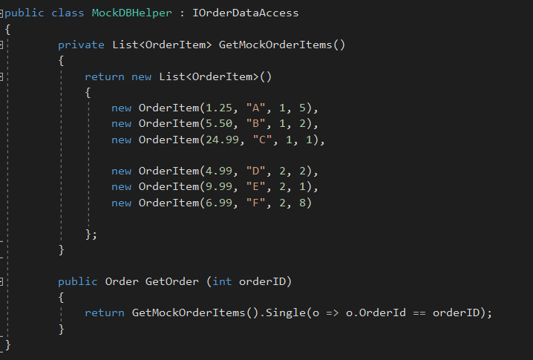

Slide 8
BUT HOW DO WE UNIT TEST WITH DI?
How do we mock a
dependency to assure correct functionality of the
System Under Test (SUT)?

Slide 9
BUT HOW DO WE UNIT TEST WITH DI?
How do we verify that
the internal workings
of the SUT are correct?

Slide 10
BUT HOW DO WE UNIT TEST WITH DI?
How do we ensure we
are covering all possible
execution paths in the code?

Slide 11
AutoMock = Autofac + Moq
Available for download via NuGet
Includes as dependencies:
Autofac: DI framework for .NET
Moq: Unit Testing framework for .NET

Slide 12
AutoMock = Autofac + Moq
Automock creates mocks/stubs on the fly for
any system under test that depends on a set
of dependencies through constructor based
dependency injection

Slide 13
What happens when we have a concrete dependency?
We still want to mock the functionality but AutoMock can’t force a mocked replacement since it’s concrete

Slide 14
ANSWER 1:
mock.Provide()
We can now create our own “fake” version and provide it to AutoMock

Slide 15
ANSWER 2:
Wrap your dependency in an interface and inject
We can now inject the dependency, return test data, and verify our calls

Slide 16
Best Practices
Use at least one
Verify call for each Setup

Slide 17
Best Practices
Remember to Verify with Times.Never as appropriate

Slide 18
Best Practices
Determine your need for
strict vs loose mocking behavior

Slide 19
BEST PRACTICES
Keep track of nested dependency chains to avoid circular references
This is a sign that code needs to be refactored or
isolated into a new shared dependency

Slide 20
Dependencies and Sources
xunit 2.3.0
autofac.extras.moq 4.2.0
autofac (included with autofac.extras.moq)
moq (included with autofac.extras.moq)
newtonsoft.json (internally for examples)
github.com/Moq/moq4/wiki/Quickstart
docs.autofac.org/en/latest/integration/moq.html
automock.codeplex.com/
www.experts-exchange.com/questions/28976449/Unit-testing-moq-best-practices.html
decayingcode.com/post/part-3-advanced-mocking-functionalities/
blackwasp.co.uk/MoqTimes.aspx
jasonpolites.github.io/tao-of-testing/ch3-1.1.html
c-sharpcorner.com/UploadFile/dacca2/unit-test-using-mock-object-in-dependency-injection/

Slide 21
Slides and code samples
available on GitHub
https://github.com/sdreier2/codecamp-unittests

Slide 22


