Slide 1

Software Based NTSC Signal Processing
Prateek Mohan Dayal
Dr. Debashis Ghosh

Slide 2
Organisation Of The Presentation
Problem Description
Discussion of Decoding Algorithms
Conclusions
Directions for Future Work

Slide 3
Problem Description
Demodulate NTSC Over The Air (OTA) broadcast Signal to get sound and video
Audio decoding completed last semester
Video decoding implemented this semster

Slide 4
Structure of the Samples
Complex Samples @ 8 Msamples/sec
16 bit real and 16 bit imaginary part
Video carrier at -1.75 MHz and Audio Carrier at 2.75 MHz
Instantaneous Phase and Envelope Information can be very simply calculated from these samples

Slide 5
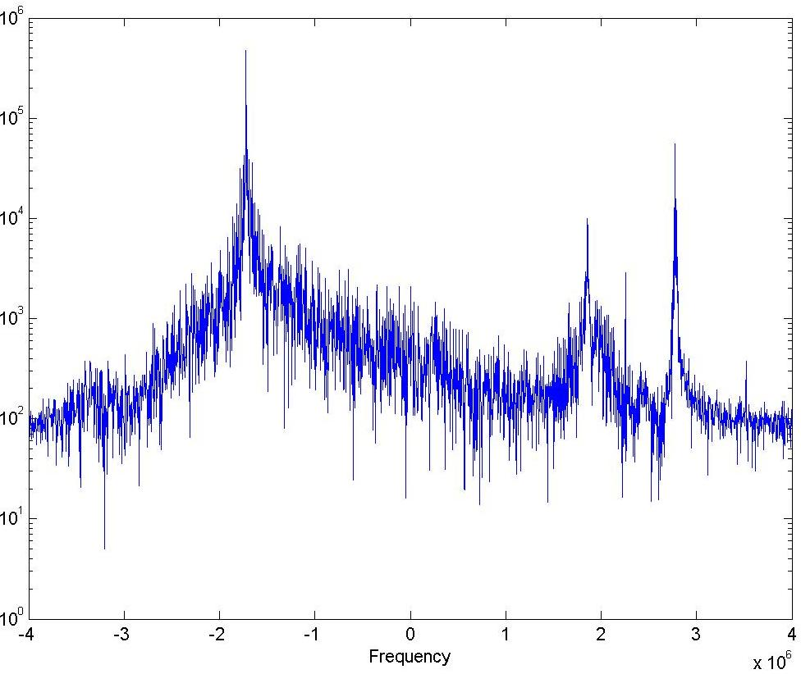
FFT of Samples

Slide 6
Video Decoding Algorithm
Interpolation
  Interpolation prevents alisaing when bringing the video down to 0 Hz
  We interpolate the samples to 24 Mhz
  The effectiveness of this step depends on the interpolating filter’s high freq. response

Slide 7
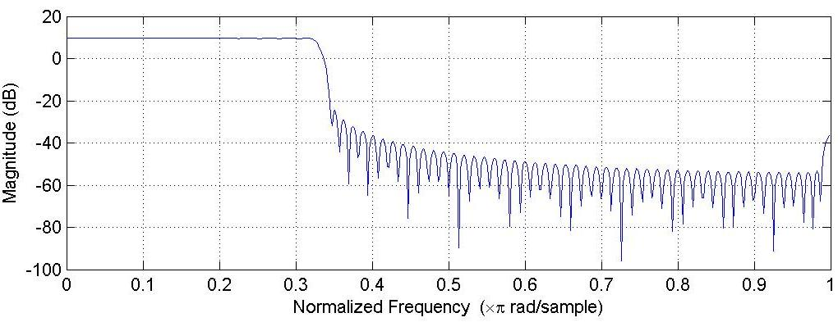
Interpolating Filter Response

Slide 8
Algorithm contd…
Supress the audio carrier
Shift the video carrier to baseband
Decimate a copy of these samples
  The decimated stream is used to extract timing information
  This reduces the computation for timing calculation
  Decimation by a factor of 3

Slide 9
Algorithm contd…
Sync Separation
  Using a comparison with blanking level
Sync Processing
  Using a cross correlation based approach
  The correlation peak locates the sync
  Vertical/Horizontal syncs are differentiated based on their duration
  Jitter can be calculated based on correlation output length

Slide 10
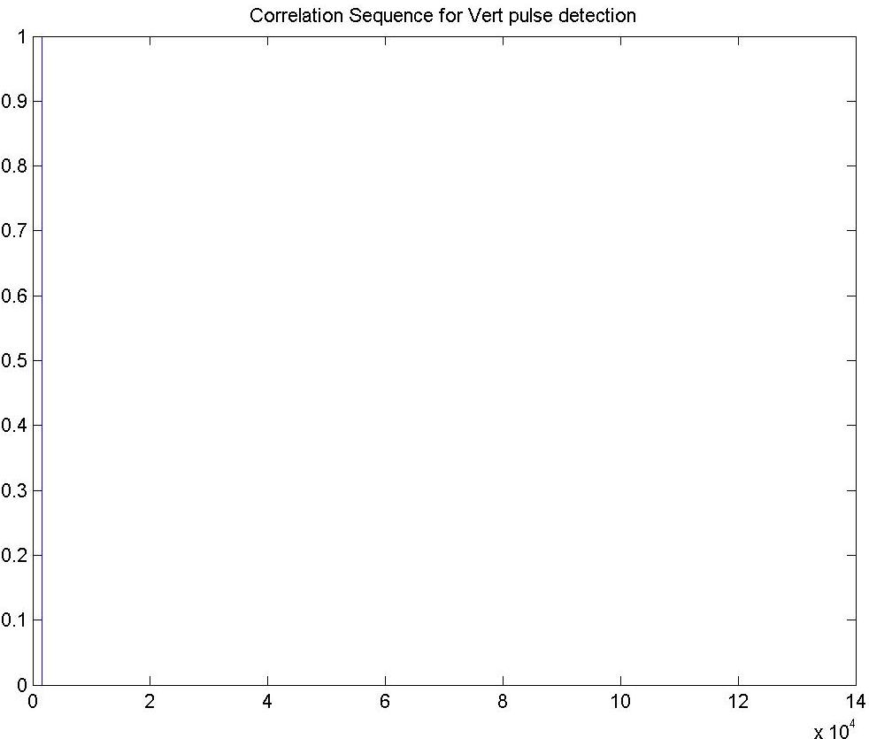
Vertical Sync Detection Sequence

Slide 11
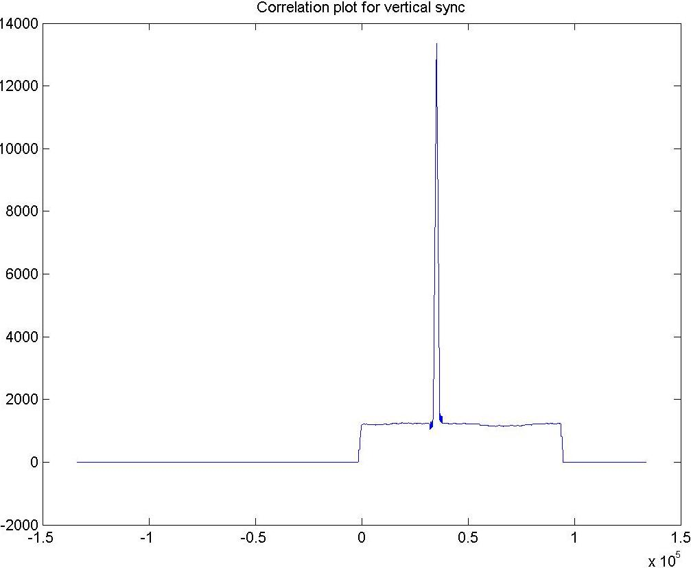
Vertical Sync Search Result

Slide 12
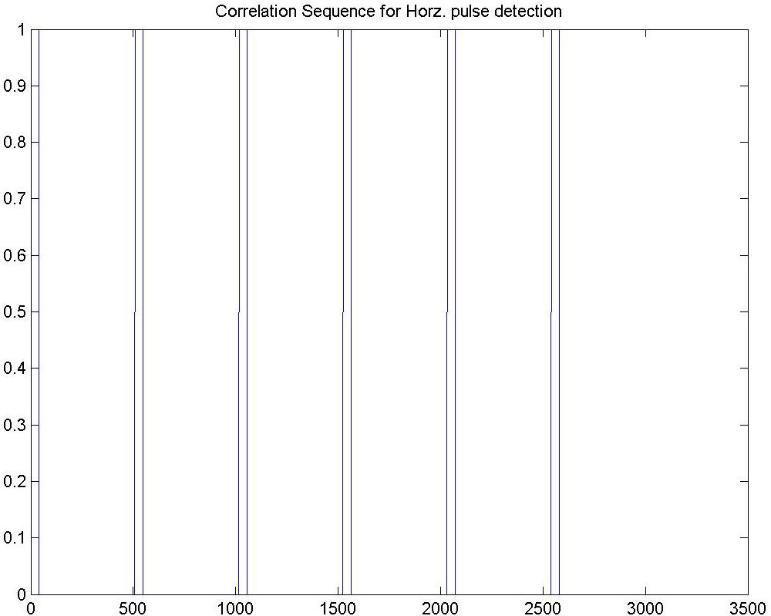
Horizontal Sync Detection Sequence

Slide 13
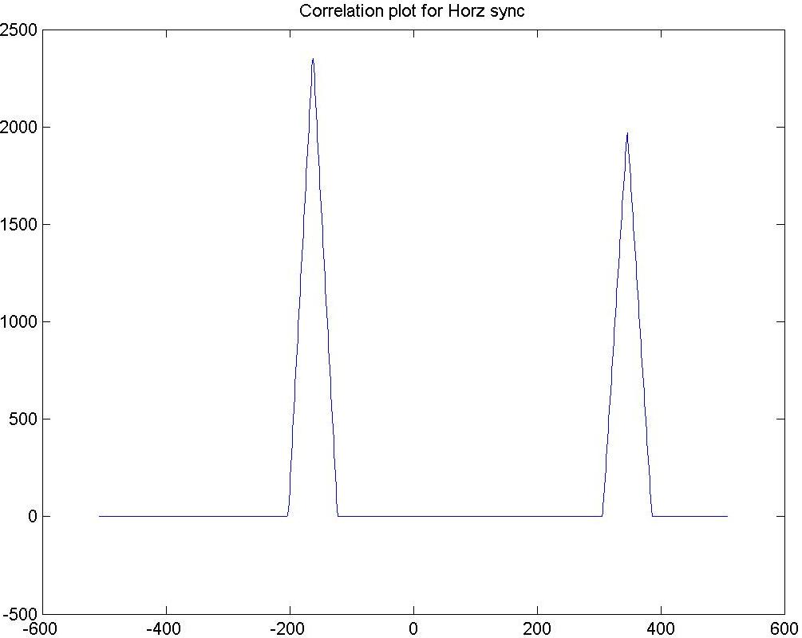
Horizontal Sync Search Result

Slide 14
Algorithm contd…
Even/Odd Field Detection
  Using the distance of the last horizontal pulse from the first pre-equalizing pulses
  Field is Even if this distance is H/2
  Field is Odd if this distance is H
Skip blanked lines
  First 21 lines for Odd Field
  First 18 lines for Even Field
  About 400 active lines of video

Slide 15
Algorithm contd…
Build Frame
  For every line
    Locate horizontal sync
    Calculate jitter
    Using the above information collect sample for each of the 200 active lines/field
Repeat the above for the other field
Build the de-interleaved frame

Slide 16
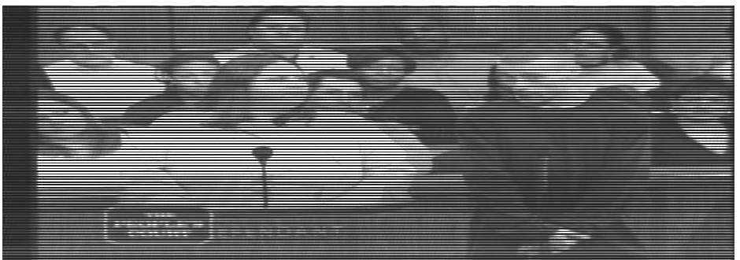
Odd Field
Brightness and contrast adjusted for better projection

Slide 17
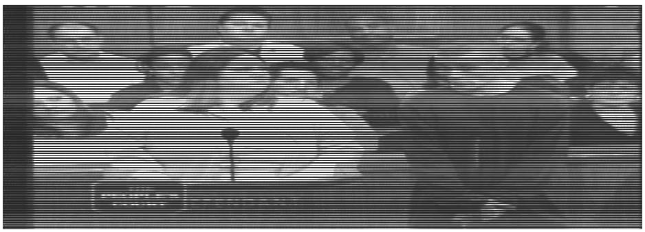
Even Field
Brightness and contrast adjusted for better projection

Slide 18
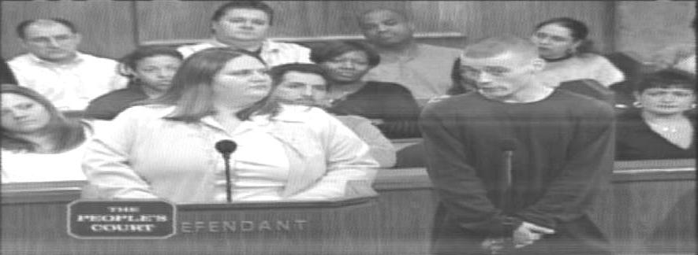
De-interleaved Frame
Brightness and contrast adjusted for better projection

Slide 19
Algorithm contd…
Comb Filtering
  Luminance comb filter suppresses odd harmonics of horizontal line frequency
  Chrominance comb filter supresseseven harmonics of horizontal line frequency
Several Varients
  2 line
  3 line
  2 line Adaptive

Slide 20
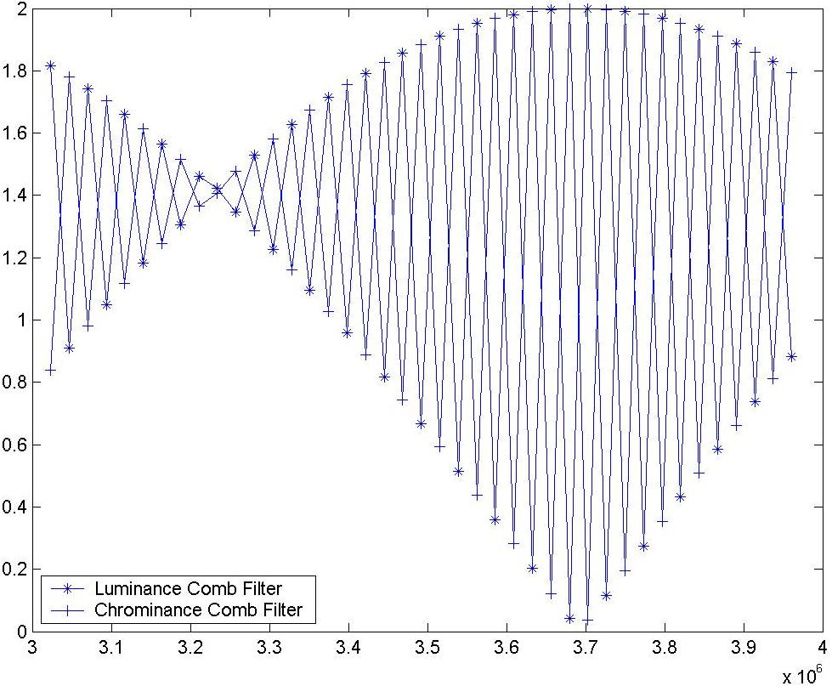
Comb Filter Action

Slide 21
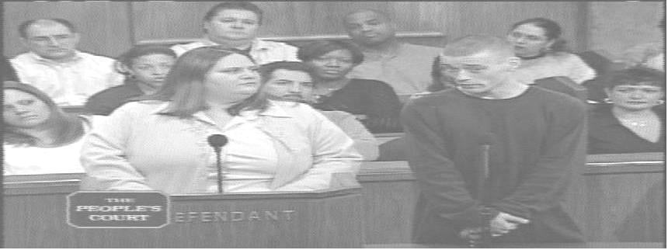
Unfiltered Image
Brightness and contrast adjusted for better projection

Slide 22
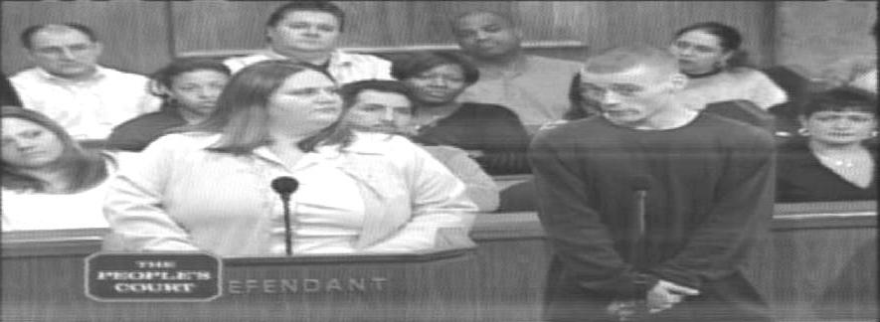
Luminance Image
Brightness and contrast adjusted for better projection

Slide 23
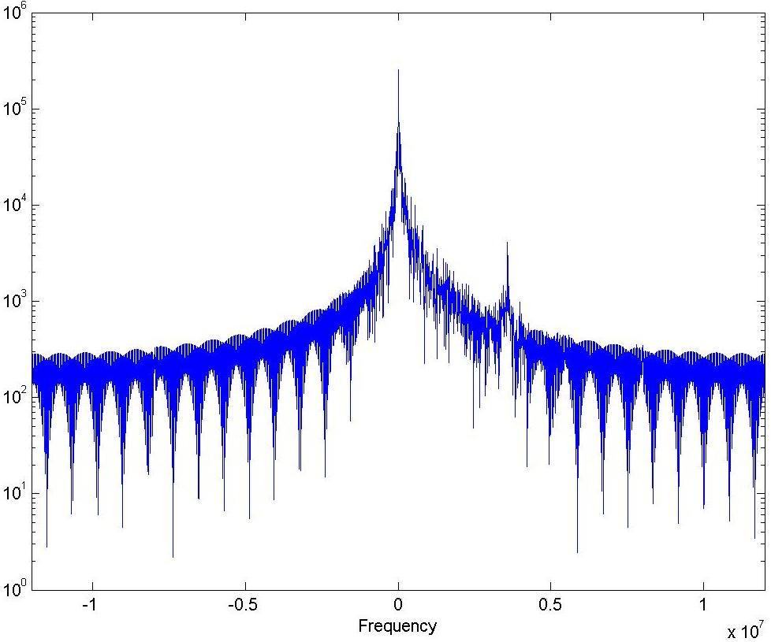
Luminance Samples’ FFT

Slide 24
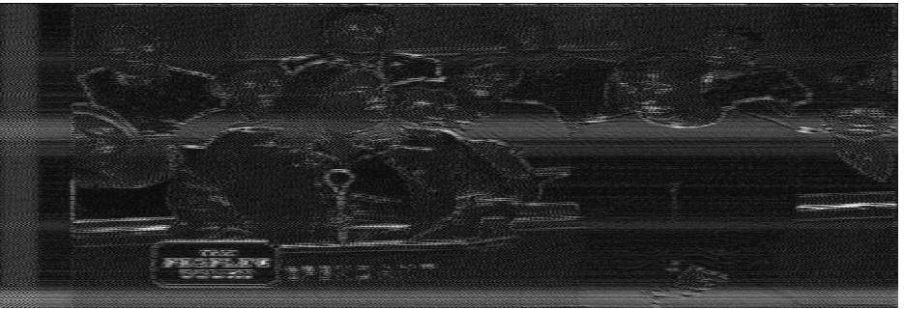
Chrominance Image
Brightness and contrast adjusted for better projection

Slide 25
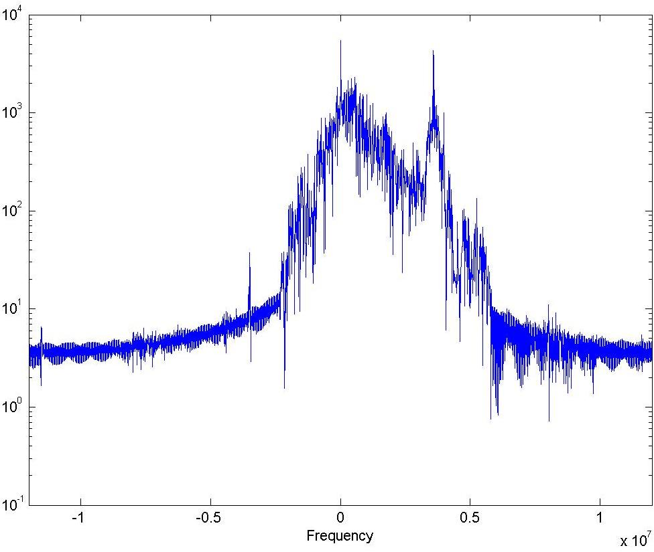
Chrominance Samples’ FFT

Slide 26
Algorithm contd…
I & Q components of color are DSBSC modulated
  Amplitude roughly corresponds to Saturation
  Phase roughly corresponds to Hue
To decode color, we need a phase reference
  Color burst provide a phase reference
  It is 8-11 cycles of unmodulated carrier on back porch
  Used as frequency and amplitude reference

Slide 27
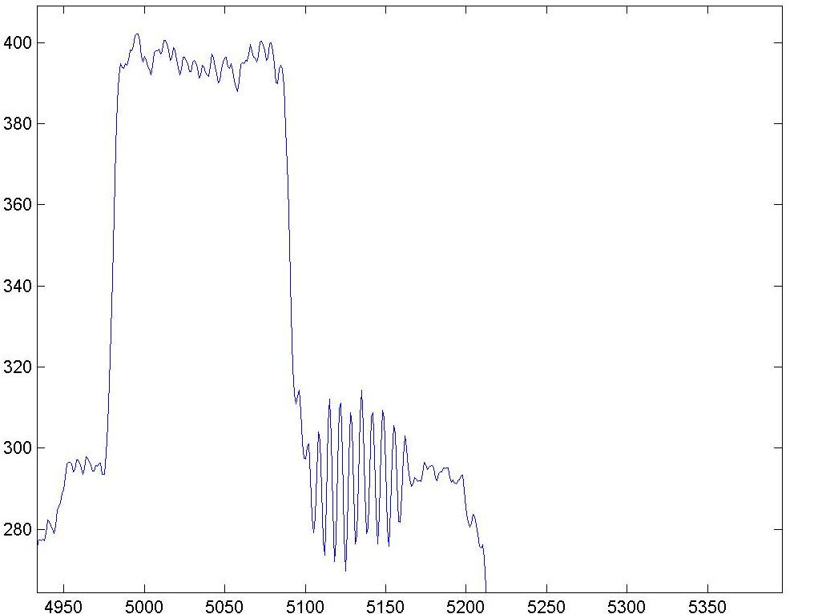
Color Burst

Slide 28
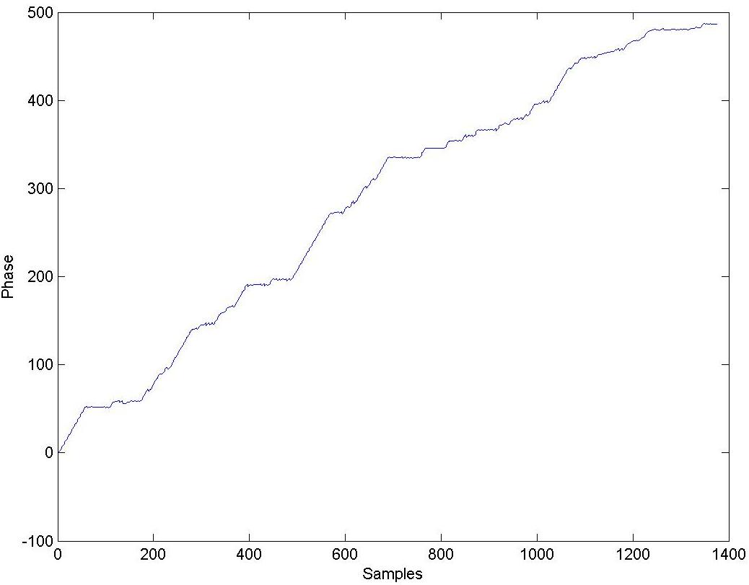
Phase Information

Slide 29
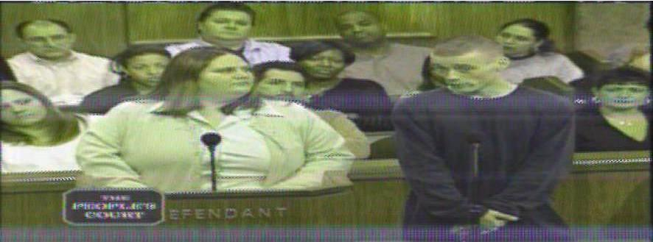
Color Image
Brightness and contrast adjusted for better projection
Color information not disturbed
Color Decoding Results based on preliminary work

Slide 30
Conclusions and Future Directions
Monochrome and preliminary color decoding results were presented
Performance improvements possible by implementing a carrier tracking module
Algorithms have to be tested and fine tuned with SMPTE bar

Slide 31
Thank You
Special Thanks to Eric Blossom and the entire GNU Radio community for their support and guidance
References in the Thesis
Available at www.geocities.com/pmd_iitgw/thesis_prateek_iitg.pdf

