Slide 1
Agile Software Development
MSc in Computer Science
Eamonn de Leastar
edeleastar@wit.ie

Slide 2
Programming Langages
Agile Software Development

Slide 3
Programming Languages
Context
Family Trees
Characteristics
Typing Spectrum
Static vs Dynamic Typing Example
Other considerations..

Slide 4
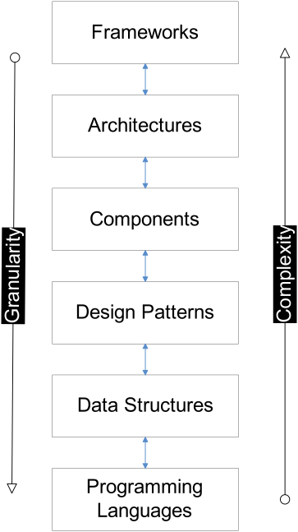
Context
Choice of programming language can have profound effect on accessibly of knowledge at higher layers

Slide 5
Family Trees

Slide 8
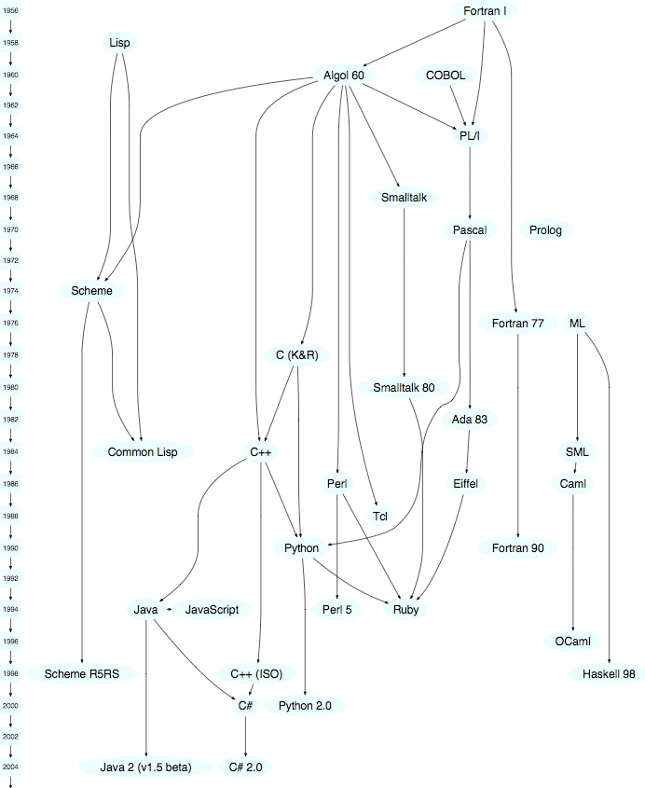
Family Tree (2)

Slide 9
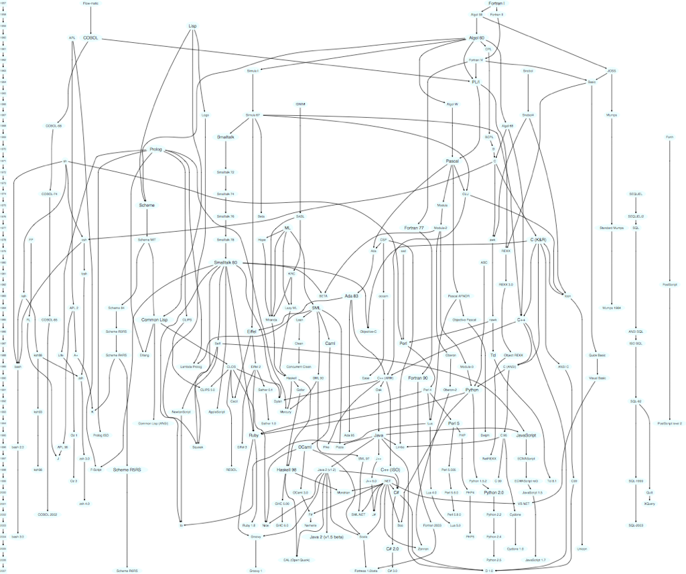
Family Tree (3)

Slide 10
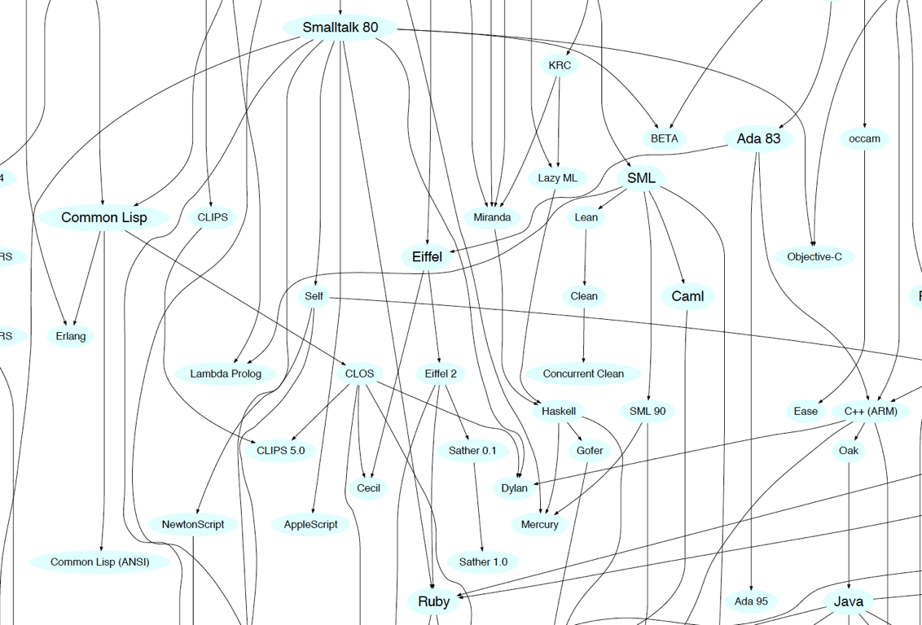
Smalltalk Cluster

Slide 11
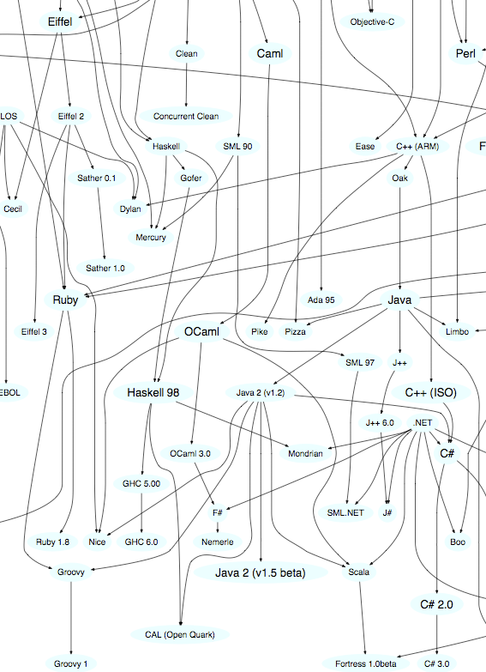
Ruby, Groovy, Java, Scala Cluster

Slide 12
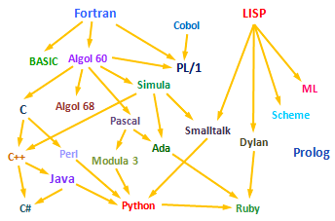
Objective-C
Scala
Groovy
Swift
Xtend
Go

Slide 13
Programming Languages as Reactions
(from Kevin Kelleher).
Algol: Assembly language is too low-level.
Pascal: Algol doesn't have enough data types.
Modula: Pascal is too wimpy for systems programming.
Simula: Algol isn't good enough at simulations.
Smalltalk: Not everything in Simula is an object.
Fortran: Assembly language is too low-level.
Cobol: Fortran is scary.
PL/1: Fortran doesn't have enough data types.
Ada: Every existing language is missing something.

Slide 14
...Continued
Basic: Fortran is scary.
APL: Fortran isn't good enough at manipulating arrays.
J: APL requires its own character set.
C: Assembly language is too low-level.
C++: C is too low-level.
Java: C++ is a kludge. And Microsoft is going to crush us.
C#: Java is controlled by Sun

Slide 15
...Continued
Lisp: Turing Machines are an awkward way to describe computation.
Scheme: MacLisp is a kludge.
T: Scheme has no libraries.
Common Lisp: There are too many dialects of Lisp.
Dylan: Scheme has no libraries, and Lisp syntax is scary.
Perl: Shell scripts/awk/sed are not enough like programming languages.
Python: Perl is a kludge.
Ruby: Perl is a kludge, and Lisp syntax is scary.
Groovy: Ruby isn't compatible with Java
Scala: Haskell is scary

Slide 16
Characteristics

Slide 17
Paul Grahams Wish List for a Programming Language
http://www.paulgraham.com/diff.html
Conditionals
A function type
Recursion
Dynamic typing
Garbage collection
Programs composed of expressions
A symbol type
A notation for code using symbols and trees
The whole language there all the time
Lisp programming Language has all of these features (since mid 1960’s)

Slide 18
Java?
Conditionals
A function type (but coming in Java 8)
Recursion
Dynamic typing
Garbage collection
Programs composed of expressions
A symbol type
A notation for code using symbols and trees
The whole language there all the time

Slide 19
Groovy/Ruby/Python/Scala/Xtend
(from Neal Ford)
Conditionals
A function type
Recursion
Dynamic typing (or Type Inference)
Garbage collection
Programs composed of expressions
A symbol type
A notation for code using symbols and trees
The whole language there all the time
+ Metaprogramming

Slide 20
Groovy/Ruby/Python/Scala
(from Neal Ford)
Conditionals
A function type
Recursion
Dynamic typing (or Type Inference)
Garbage collection
Programs composed of expressions
A symbol type
A notation for code using symbols and trees
The whole language there all the time
+ Metaprogramming

Slide 21
Typing

Slide 22
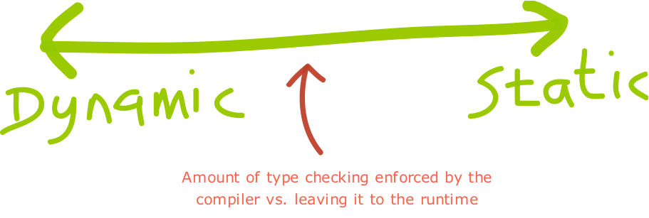

Slide 23
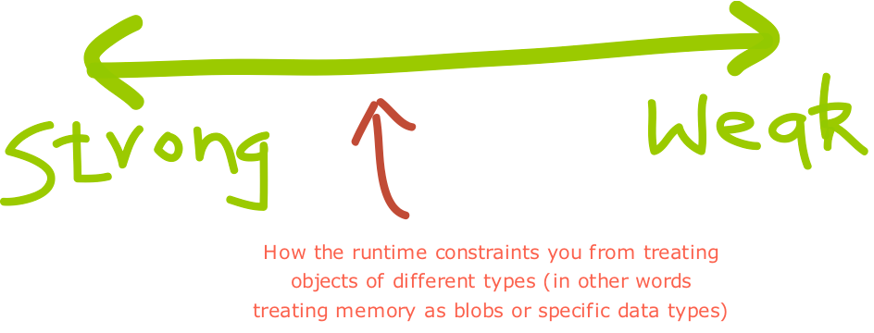
http://blogs.agilefaqs.com/2011/07/11/dynamic-typing-is-not-weak-typing/

Slide 24
Typing Spectrum
Dynamic
Python
Smalltalk
Javascript
Ruby
Groovy
PHP
C
C++
Java
Objective-C
C#
Static
Strong
Weak

Slide 25
Static to Dynamic

Slide 26
Java Example
import java.util.ArrayList;
import java.util.List;
class Erase
{
public static void main(String[] args)
{
List<String> names = new ArrayList<String>();
names.add("Ted");
names.add("Fred");
names.add("Jed");
names.add("Ned");
System.out.println(names);
Erase e = new Erase();
List<String> short_names = e.filterLongerThan(names, 3);
System.out.println(short_names.size());
for (String s : short_names)
{
System.out.println(s);
}
}
public List<String> filterLongerThan(List<String> strings, int length)
{
List<String> result = new ArrayList<String>();
for (String s : strings)
{
if (s.length() < length + 1)
{
result.add(s);
}
}
return result;
}
}
Java algorithm to filter a list of strings
Only printing those shorter than 3 (in this test case).

Slide 27
Groovy 1
import java.util.ArrayList;
import java.util.List;
class Erase
{
public static void main(String[] args)
{
List<String> names = new ArrayList<String>();
names.add("Ted");
names.add("Fred");
names.add("Jed");
names.add("Ned");
System.out.println(names);
Erase e = new Erase();
List<String> short_names = e.filterLongerThan(names, 3);
System.out.println(short_names.size());
for (String s : short_names)
{
System.out.println(s);
}
}
public List<String> filterLongerThan(List<String> strings, int length)
{
List<String> result = new ArrayList<String>();
for (String s : strings)
{
if (s.length() < length + 1)
{
result.add(s);
}
}
return result;
}
}
Also a valid Groovy program...

Slide 28
Groovy 1
import java.util.ArrayList;
import java.util.List;
class Erase
{
public static void main(String[] args)
{
List<String> names = new ArrayList<String>();
names.add("Ted");
names.add("Fred");
names.add("Jed");
names.add("Ned");
System.out.println(names);
Erase e = new Erase();
List<String> short_names = e.filterLongerThan(names, 3);
System.out.println(short_names.size());
for (String s : short_names)
{
System.out.println(s);
}
}
public List<String> filterLongerThan(List<String> strings, int length)
{
List<String> result = new ArrayList<String>();
for (String s : strings)
{
if (s.length() < length + 1)
{
result.add(s);
}
}
return result;
}
}
Do we need generics?
What about semicolons...
Should standard libraries be imported?

Slide 29
Groovy 2
class Erase
{
public static void main(String[] args)
{
List names = new ArrayList()
names.add("Ted")
names.add("Fred")
names.add("Jed")
names.add("Ned")
System.out.println(names)
Erase e = new Erase()
List short_names = e.filterLongerThan(names, 3)
System.out.println(short_names.size())
for (String s : short_names)
{
System.out.println(s)
}
}
public List filterLongerThan(Liststrings, length)
{
List result = new ArrayList();
for (String s : strings)
{
if (s.length() < length + 1)
{
result.add(s)
}
}
return result
}
}

Slide 30
Groovy 2
class Erase
{
public static void main(String[] args)
{
List names = new ArrayList()
names.add("Ted")
names.add("Fred")
names.add("Jed")
names.add("Ned")
System.out.println(names)
Erase e = new Erase()
List short_names = e.filterLongerThan(names, 3)
System.out.println(short_names.size())
for (String s : short_names)
{
System.out.println(s)
}
}
public List filterLongerThan(Liststrings, length)
{
List result = new ArrayList();
for (String s : strings)
{
if (s.length() < length + 1)
{
result.add(s)
}
}
return result
}
}
Do we need the static types?
Must we always have a main method and class definition?
Consistency (size or length)?

Slide 31
Groovy 3
def filterLongerThan(strings, length)
{
List result = new ArrayList();
for (String s : strings)
{
if (s.length() < length + 1)
{
result.add(s)
}
}
return result
}
List names = new ArrayList()
names.add("Ted")
names.add("Fred")
names.add("Jed")
names.add("Ned")
System.out.println(names)
List short_names = filterLongerThan(names, 3)
System.out.println(short_names.size())
for (String s : short_names)
{
System.out.println(s)
}

Slide 32
Groovy 3
def filterLongerThan(strings, length)
{
List result = new ArrayList();
for (String s : strings)
{
if (s.length() < length + 1)
{
result.add(s)
}
}
return result
}
List names = new ArrayList()
names.add("Ted")
names.add("Fred")
names.add("Jed")
names.add("Ned")
System.out.println(names)
List short_names = filterLongerThan(names, 3)
System.out.println(short_names.size())
for (String s : short_names)
{
System.out.println(s)
}
Should we have a special notation for lists?
And special facilities for list processing?

Slide 33
Groovy 4
def filterLongerThan(strings, length)
{
return strings.findAll {it.size() <= length}
}
names = ["Ted", "Fred", "Jed", "Ned"]
System.out.println(names)
List short_names = filterLongerThan(names, 3)
System.out.println(short_names.size())
short_names.each {System.out.println(it)}

Slide 34
Groovy 4
Method needed any longer?
Is there an easier way to use common methods (e.g. println)?
Are brackets always needed?
def filterLongerThan(strings, length)
{
return strings.findAll {it.size() <= length}
}
names = ["Ted", "Fred", "Jed", "Ned"]
System.out.println(names)
List short_names = filterLongerThan(names, 3)
System.out.println(short_names.size())
short_names.each {System.out.println(it)}

Slide 35
Groovy 5
names = ["Ted", "Fred", "Jed", "Ned"]
println names
short_names = names.findAll{it.size() <= 3}
println short_names.size()
short_names.each {println it}

Slide 36
Java vs Groovy?
import java.util.ArrayList;
import java.util.List;
class Erase
{
public static void main(String[] args)
{
List<String> names = new ArrayList<String>();
names.add("Ted");
names.add("Fred");
names.add("Jed");
names.add("Ned");
System.out.println(names);
Erase e = new Erase();
List<String> short_names = e.filterLongerThan(names, 3);
System.out.println(short_names.size());
for (String s : short_names)
{
System.out.println(s);
}
}
public List<String> filterLongerThan(List<String> strings, int length)
{
List<String> result = new ArrayList<String>();
for (String s : strings)
{
if (s.length() < length + 1)
{
result.add(s);
}
}
return result;
}
}
names = ["Ted", "Fred", "Jed", "Ned"]
println names
short_names = names.findAll{it.size() <= 3}
println short_names.size()
short_names.each {println it}

Slide 37
Static to Inferred

Slide 38
Another Approach to Types?
Type Inference : the compiler draws conclusions about the types of variables based on how programmers use those variables.
Yields programs that have some of the conciseness of Dynamically Typed Languages
But - decision made at compile time, not at run time
More information for static analysis - refactoring tools, complexity analysis. bug checking etc...
Haskell, Scala, Xtend
object InferenceTest1 extends Application
{
val x = 1 + 2 * 3 // the type of x is Int
val y = x.toString() // the type of y is String
def succ(x: Int) = x + 1 // method succ returns Int values
}

Slide 39
Typing Spectrum
Dynamic
Python
Smalltalk
Javascript
Ruby
Groovy
PHP
Xtend
Scala
Inferred
Go
Swift
C
C++
Java
Objective-C
C#
Static
Strong
Weak

Slide 40
Java Example -> XTend
import java.util.ArrayList;
import java.util.List;
class Erase
{
public static void main(String[] args)
{
List<String> names = new ArrayList<String>();
names.add("Ted");
names.add("Fred");
names.add("Jed");
names.add("Ned");
System.out.println(names);
Erase e = new Erase();
List<String> short_names = e.filterLongerThan(names, 3);
System.out.println(short_names.size());
for (String s : short_names)
{
System.out.println(s);
}
}
public List<String> filterLongerThan(List<String> strings, int length)
{
List<String> result = new ArrayList<String>();
for (String s : strings)
{
if (s.length() < length + 1)
{
result.add(s);
}
}
return result;
}
}
Unlike Groovy - this is NOT an XTend Program

Slide 41
def & var
import java.util.ArrayList;
import java.util.List;
class Erase
{
def static void main(String[] args)
{
var List<String> names = new ArrayList<String>();
names.add("Ted");
names.add("Fred");
names.add("Jed");
names.add("Ned");
System.out.println(names);
var Erase e = new Erase();
var List<String> short_names = e.filterLongerThan(names, 3);
System.out.println(short_names.size());
for (String s : short_names)
{
System.out.println(s);
}
}
def List<String> filterLongerThan(List<String> strings, int length)
{
var List<String> result = new ArrayList<String>();
for (String s : strings)
{
if (s.length() < length + 1)
{
result.add(s);
}
}
return result;
}
}
Are semicolons necessary?

Slide 42
No semicolons
import java.util.ArrayList;
import java.util.List;
class Erase
{
def static void main(String[] args)
{
var List<String> names = new ArrayList<String>()
names.add("Ted")
names.add("Fred")
names.add("Jed")
names.add("Ned")
System.out.println(names)
var Erase e = new Erase()
var List<String> short_names = e.filterLongerThan(names, 3)
System.out.println(short_names.size())
for (String s : short_names)
{
System.out.println(s)
}
}
def List<String> filterLongerThan(List<String> strings, int length)
{
var List<String> result = new ArrayList<String>()
for (String s : strings)
{
if (s.length() < length + 1)
{
result.add(s)
}
}
return result
}
}
Can some types be inferred?

Slide 43
Type inference
import java.util.ArrayList;
import java.util.List;
class Erase
{
def static void main(String[] args)
{
var names = new ArrayList<String>()
names.add("Ted")
names.add("Fred")
names.add("Jed")
names.add("Ned")
System.out.println(names)
var e = new Erase()
var short_names = e.filterLongerThan(names, 3)
System.out.println(short_names.size())
for (s : short_names)
{
System.out.println(s)
}
}
def filterLongerThan(List<String> strings, int length)
{
var result = new ArrayList<String>()
for (s : strings)
{
if (s.length() < length + 1)
{
result.add(s)
}
}
return result
}
}
What about Collection Literals?

Slide 44
Collection Literals
import java.util.ArrayList;
import java.util.List;
class Erase
{
def static void main(String[] args)
{
var names = #["Ted", "Fred", "Jed", "Ned"]
System.out.println(names)
var e = new Erase()
var short_names = e.filterLongerThan(names, 3)
System.out.println(short_names.size())
for (s : short_names)
{
System.out.println(s)
}
}
def filterLongerThan(List<String> strings, int length)
{
var result = new ArrayList<String>()
for (s : strings)
{
if (s.length() < length + 1)
{
result.add(s)
}
}
return result
}
}
Can Lambas simplify code?

Slide 45
Lambdas
import java.util.ArrayList;
import java.util.List;
class Erase
{
def static void main(String[] args)
{
var names = #["Ted", "Fred", "Jed", "Ned"]
System.out.println(names)
var e = new Erase()
var short_names = e.filterLongerThan(names, 3)
System.out.println(short_names.size())
short_names.forEach[System.out.println(it)]
}
def filterLongerThan(List<String> strings, int length)
{
val result = new ArrayList<String>()
strings.forEach[ if (it.length() < length + 1)
{
result.add(it)
}]
result
}
}
What are List Comprehensions?

Slide 46
Filters/List Comprehensions
import java.util.List;
class Erase
{
def static void main(String[] args)
{
var names = #["Ted", "Fred", "Jed", "Ned"]
System.out.println(names)
var e = new Erase()
var short_names = e.filterLongerThan(names, 3)
System.out.println(short_names.size())
short_names.forEach[System.out.println(it)]
}
def filterLongerThan(List<String> strings, int length)
{
val list = strings.filter[it.length() <= 3]
list
}
}
Do we need the class Erase at all?

Slide 47
Final Version
class Erase
{
def static void main(String[] args)
{
var names = #["Ted", "Fred", "Jed", "Ned"]
println(names)
var short_names = names.filter[it.length() <= 3]
println(short_names.size())
short_names.forEach[println(it)]
}
}

Slide 48
Java
import java.util.ArrayList;
import java.util.List;
class Erase
{
public static void main(String[] args)
{
List<String> names = new ArrayList<String>();
names.add("Ted");
names.add("Fred");
names.add("Jed");
names.add("Ned");
System.out.println(names);
Erase e = new Erase();
List<String> short_names = e.filterLongerThan(names, 3);
System.out.println(short_names.size());
for (String s : short_names)
{
System.out.println(s);
}
}
public List<String> filterLongerThan(List<String> strings, int length)
{
List<String> result = new ArrayList<String>();
for (String s : strings)
{
if (s.length() < length + 1)
{
result.add(s);
}
}
return result;
}
}
class Erase
{
def static void main(String[] args)
{
var names = #["Ted", "Fred", "Jed", "Ned"]
println(names)
var short_names = names.filter[it.length() <= 3]
println(short_names.size())
short_names.forEach[println(it)]
}
}
xtend
names = ["Ted", "Fred", "Jed", "Ned"]
println names
short_names = names.findAll{it.size() <= 3}
println short_names.size()
short_names.each {println it}
groovy
java

Slide 49
Java Example
import java.util.ArrayList;
import java.util.List;
class Erase
{
public static void main(String[] args)
{
List<String> names = new ArrayList<String>();
names.add("Ted");
names.add("Fred");
names.add("Jed");
names.add("Ned");
System.out.println(names);
Erase e = new Erase();
List<String> short_names = e.filterLongerThan(names, 3);
System.out.println(short_names.size());
for (String s : short_names)
{
System.out.println(s);
}
}
public List<String> filterLongerThan(List<String> strings, int length)
{
List<String> result = new ArrayList<String>();
for (String s : strings)
{
if (s.length() < length + 1)
{
result.add(s);
}
}
return result;
}
}
Java algorithm to filter a list of strings
Only printing those shorter than 3 (in this test case).

Slide 50
Swift
import Foundation
class Erase
{
func main()
{
var names:String[] = String[]()
names.append ("ted")
names.append ("fred")
names.append ("jed")
names.append ("ned")
println(names)
var short_names:String[] = filterLongerThan(names, length:3)
for name:String in short_names
{
println (name)
}
}
func filterLongerThan (strings : String[], length : Int) -> String[]
{
var result:String[] = String[]()
for s:String in strings
{
if countElements(s) < length + 1
{
result.append(s)
}
}
return result
}
}
var erase:Erase = Erase()
erase.main()

Slide 51
Swift
import Foundation
class Erase
{
func main()
{
var names = String[]()
names.append ("ted")
names.append ("fred")
names.append ("jed")
names.append ("ned")
println(names)
var short_names = filterLongerThan(names, length:3)
for name in short_names
{
println (name)
}
}
func filterLongerThan (strings : String[], length : Int) -> String[]
{
var result = String[]()
for s in strings
{
if countElements(s) < length + 1
{
result.append(s)
}
}
return result
}
}
var erase = Erase()
erase.main()
Type Inference

Slide 52
Swift
import Foundation
class Erase
{
func main()
{
var names = ["ted", "fred", "jed", "ned"]
var short_names = filterLongerThan(names, length:3)
for name in short_names
{
println (name)
}
}
func filterLongerThan (strings : String[], length : Int) -> String[]
{
var result = String[]()
for s in strings
{
if countElements(s) < length + 1
{
result.append(s)
}
}
return result
}
}
var erase = Erase()
erase.main()
Literals

Slide 53
Swift
Closures
import Foundation
class Erase
{
func main()
{
var names = ["ted", "fred", "jed", "ned"]
var short_names = names.filter { countElements($0) < 4 }
for name in short_names
{
println (name)
}
}
}
var erase = Erase()
erase.main()

Slide 54
Swift
Final version
import Foundation
var names = ["ted", "fred", "jed", "ned"]
println(names)
var short_names = names.filter { countElements($0) < 4 }
println(short_names)

Slide 55
import java.util.ArrayList;
import java.util.List;
class Erase
{
public static void main(String[] args)
{
List<String> names = new ArrayList<String>();
names.add("Ted");
names.add("Fred");
names.add("Jed");
names.add("Ned");
System.out.println(names);
Erase e = new Erase();
List<String> short_names = e.filterLongerThan(names, 3);
System.out.println(short_names.size());
for (String s : short_names)
{
System.out.println(s);
}
}
public List<String> filterLongerThan(List<String> strings, int length)
{
List<String> result = new ArrayList<String>();
for (String s : strings)
{
if (s.length() < length + 1)
{
result.add(s);
}
}
return result;
}
}
names = ["Ted", "Fred", "Jed", "Ned"]
println names
short_names = names.findAll{it.size() <= 3}
short_names.each {println it}
var names = #["Ted", "Fred", "Jed", "Ned"]
println(names)
var short_names = names.filter[it.length() <= 3]
short_names.forEach[println(it)]
var names = ["ted", "fred", "jed", "ned"]
println(names)
var short_names = names.filter { countElements($0) < 4 }
println(short_names)

