Slide 1
Agile Software Development
Eamonn de Leastar (edeleastar@wit.ie)

Slide 2
Collections

Slide 3
Overview
Collections Architecture
Definition
Architecture
Interfaces
Collection
List
Set
Map
Iterator
Implementations
ArrayList
HashMap
HashSet
Java 5 Generic Collections
Untyped vs Typed syntax
For-each loop

Slide 4
What are Collections?
Collections are Java objects used to store, retrieve, and manipulate other Java objects
Any Java object may be part of a collection, so collection can contain other collections
Collections do not store primitives
Java collection architecture includes:
Interfaces - abstract data types representing collections
Implementation - concrete implementation of collection interfaces
Algorithms - methods for manipulating collection objects (e.g. sorting, searching, shuffling, etc).

Slide 5
Overview
Collections Architecture
Definition
Architecture
Interfaces
Collection
List
Set
Map
Iterator
Implementations
ArrayList
HashMap
HashSet
Java 5 Generic Collections
Untyped vs Typed syntax
For-each loop

Slide 6
Collection Architecture - Benefits
Reusability | Promotes software reuse
Uniformity | Similar, consistent design adopted across the collections.
Faster development | As programmers don’t have to write their own data structures, they have more time to concentrate on writing programs.
Higher quality | High performance and quality implementations of useful data structures and algorithms. The various implementations of each interface are interchangeable, so programs can be easily tuned by switching collection implementations.
Interoperability | Collections generated by other (unrelated) APIs can be taken as input to or sent as output from our Java programs.
Less programming | Programmers don’t have to write classes to manage data structures.

Slide 7
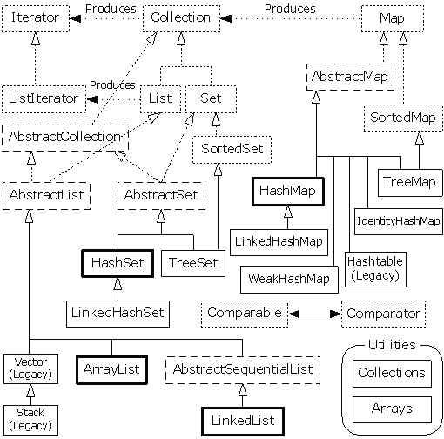
Collection Architecture
Legend
Interface
Abstract Class
Concrete Class

Slide 8
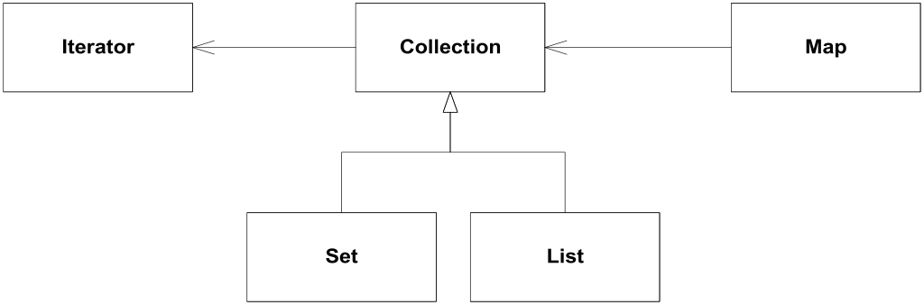
Interfaces
Collection “uses” Iterator
Map “uses” Collection
Set extends Collection (subtyping)‏
List extends Collection (subtyping)‏

Slide 9
Road Map
Collections Architecture
Definition
Architecture
Interfaces
Collection
List
Set
Map
Iterator
Implementations
ArrayList
HashMap
HashSet
Java 5 Generic Collections
Untyped vs Typed syntax
For-each loop

Slide 10
Collection Interface
Collection represents a group of objects
These collection objects are known as collection elements
There is no direct implementation of this interface in JDK
Concrete implementations are provided for subtypes
Collections in general can allow duplicate elements, and can be ordered
Unordered collections that allow duplicate elements should implement directly Collection interface

Slide 11
Adding Elements
In general two methods are defined for adding elements to the collection:
interface Collection
{
//…
/**
* Adds element to the receiver.
* Returns true if operation is successful, otherwise return s false.
*/
boolean add(Object element);
/**
* Adds each element from collection c to the receiver.
* Returns true if operation is successful, otherwise returns false.
*/
boolean addAll(Collection c);
}

Slide 12
Removing Elements
Similarly to adding protocol, there are two methods are defined for removing elements from the collection:
interface Collection
{
//…
/**
* Removes element from the receiver.
* Returns true if operation is successful, otherwise returns false.
*/
boolean remove(Object element);
/**
* Removes each element contained in collection c from the receiver.
* Returns true if operation is successful, otherwise returns false.
*/
boolean removeAll(Collection c);
}

Slide 13
Other Collection Methods
Includes methods for:
Checking how many elements are in the collection
Checking if an element is in the collection
Iterating through collection
boolean contains(Object element);
boolean containsAll(Collection c);
int size();
boolean isEmpty();
void clear();
boolean retainAll(Collection c);
Iterator iterator;

Slide 14
Iterator Interface
Defines a protocol for iterating through a collection:
public interface Iterator
{
/**
* Returns whether or not the underlying collection has next
* element for iterating.
*/
boolean hasNext();
/**
* Returns next element from the underlying collection.
*/
Object next();
/**
* Removes from the underlying collection the last element returned by next.
*/
void remove();
}

Slide 15
Set Interface
Set is a collection that cannot contain duplicate elements
This is supported by additional behavior in constructors and add(), hashCode(), and equals() methods
All constructors in a set must create a set that does not contain duplicate elements
The set does not maintain its elements in any particular order.
It is not permitted for a set to contain itself as an element
Take care if mutable objects (i.e. objects that have fields that can be changed) are used as set elements.
The behaviour of a set is not specified if the value of an object is changed in a manner that affects equals comparisons.

Slide 16
List Interface
List represents an ordered collection
Also known as sequence
Precise control over where in the list each element is inserted
Zero based indexed access
Lists may contain duplicate elements
Lists extend behavior of collections with operations for:
Positional Access
Search
List Iteration
Range-view (the sublist method performs arbitrary range operations on the list)

Slide 17
Map Interface
Map is an object that maps keys to values
Keys must be unique, i.e. map cannot contain duplicate keys
Each key in the map can map to most one value, i.e. one key cannot have multiple values
Map interface defines protocols for manipulating keys and values
Take care if mutable objects (i.e. objects that have fields that can be changed) are used as map keys.
The behaviour of a map is not specified if the value of an object is changed in a manner that affects equals comparisons while the object is a key in the map.

Slide 18
Collections
Collections Architecture
Definition
Architecture
Interfaces
Collection
List
Set
Map
Iterator
Implementations
ArrayList
HashMap
HashSet
Java 5 Generic Collections
Untyped vs Typed syntax
For-each loop

Slide 19
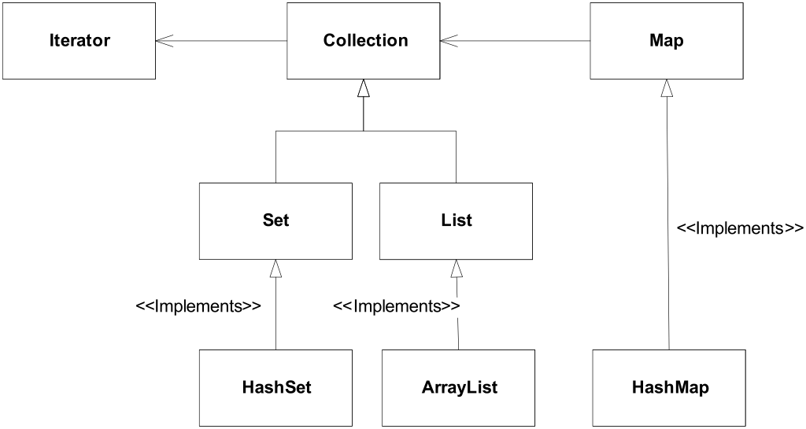
Most Commonly Used Collections
Three of the most commonly used collections:
HashSet
ArrayList
HashMap

Slide 20
ArrayList
Represents resizable-array implementation of the List interface
Permits all elements including null
Zero-based indexing
Permits duplicates
Unsorted
It is generally the best performing List interface implementation
Instances of this class have a capacity
It is size of the array used to store the elements in the list, and it’s always at least as large as the list size
It grows as elements are added to the list

Slide 21
ArrayList Examples
//declare list
ArrayList list = new ArrayList();
//add elements to the list
list.add("First element");
list.add("Second element");
//get the list size
int listSize = list.size();
//print the list size and the first element
System.out.println(listSize);
System.out.println(list.get(0));
//add first element in the list
list.add(0,"Added element");
//get the list iterator
Iterator iterator = list.iterator();
while (iterator.hasNext())
{
String element = (String)iterator.next();
System.out.println(element);
}
Console
2
First element
Console
Added element
First element
Second element

Slide 22
HashMap
Collection that contains pair of objects
Values are stored at keys
No duplicate keys allowed; when adding an identical key, the existing value is replaced with the new value.
It is a hash table based implementation of the Map interface
Permits null values and null keys
The order of the map is not guaranteed
Two parameters affect performance of a hash map:
Initial capacity, indicates capacity at the map creation time
Load factor, indicates how full the map should be before increasing its size
0.75 is the default

Slide 23
HashMap Example
//create a number dictionary
HashMap numberDictionary = new HashMap();
numberDictionary.put("1", "One");
numberDictionary.put("2", "Two");
numberDictionary.put("3", "Three");
numberDictionary.put("4", "Four");
numberDictionary.put("5", "Five");
//get an iterator of all the keys
Iterator keys = numberDictionary.keySet().iterator();
while (keys.hasNext())
{
String key = (String)keys.next();
String value = (String)numberDictionary.get(key);
System.out.println("Number: " + key + ", word: " + value);
}
Number: 5, word: Five
Number: 4, word: Four
Number: 3, word: Three
Number: 2, word: Two
Number: 1, word: One
Console

Slide 24
HashSet
Concrete implementation of the Set interface
Backed up by an instance of HashMap
Order is not guaranteed
Elements in the set cannot be duplicated; the add is ignored if a duplicate element is already stored.
Performance of the set is affected by size of the set and capacity of the map
It is important not to set the initial capacity too high, or the load factor too low if performance of iteration is important

Slide 25
HashSet Example
//create new set
HashSet set = new HashSet();
//add elements to the set
set.add("One");
set.add("Two");
set.add("Three");
//elements cannot be duplicated in the set
set.add("One");
//print the set
System.out.println(set);
Console
[One, Three, Two]
Notes:
.

Slide 26
Collections
Collections Architecture
Definition
Architecture
Interfaces
Collection
List
Set
Map
Iterator
Implementations
ArrayList
HashMap
HashSet
Java 5 Generic Collections
Untyped vs Typed syntax
For-each loop

Slide 27
Java 5 Generic Collection
Collections use polymorphism to store objects of any type.
A drawback is type loss on retrieval.
HashMap stores key/value pairs as java Objects.
get() method returns a matching Object for the given key.
HashMap numberDictionary = new HashMap();
numberDictionary.put("1", "One");
numberDictionary.put("2", "Two");
Object value = numberDictionary.get("1”);
String strValue = (String) value;
The key/values in this code are actually Strings
The return value must be type cast back to a String in order to accurately recover the stored object.

Slide 28
Untyped = Unsafe
Type casting is undesirable (due to possibility of run time errors).
Therefore, use of untyped (pre-Java 5) collections is considered ‘unsafe’.
Typed collections avoid type loss.
Runtime checks are simplified because the type is known.

Slide 29
Revised syntax
The type of object to be stored is indicated on declaration: private ArrayList<String> notes;
... and on creation: notes = new ArrayList<String>();
Collection types are parameterized.

Slide 30
Using a typed collection
ArrayList list = new ArrayList();
list.add("First element");
list.add("Second element");
String first = (String)list.get(0);
String second = (String)list.get(1);
untyped / unsafe
ArrayList<String> list = new ArrayList<String>();
list.add("First element");
list.add("Second element");
String first = list.get(0);
String second = list.get(1);
typed / safe

Slide 31
Using a Typed Iteration
ArrayList list = new ArrayList();
Iterator iterator = list.iterator();
while (iterator.hasNext()
{
String element = (String)iterator.next();
System.out.println(element);
}
untyped / unsafe
ArrayList<String> list = new ArrayList<String>();
Iterator<String> iterator = list.iterator();
while (iterator.hasNext())‏
{
String element = iterator.next();
System.out.println(element);
}
typed / safe

Slide 32
Typed HashMaps
HashMaps operate with (key,value) pairs.
A typed HashMap requires two type parameters: private HashMap<String, String> responses; ... responses = new HashMap<String, String> ();

Slide 33
HashMaps
HashMap numberDictionary = new HashMap();
numberDictionary.put("1", "One");
numberDictionary.put("2", "Two");
Object value = numberDictionary.get(“1”);
String strValue = (String) value;
untyped / unsafe
HashMap<String,String> numberDictionary =
new HashMap<String,String>();
numberDictionary.put("1", "One");
numberDictionary.put("2", "Two");
String value = numberDictionary.get(“1”);
typed / safe

Slide 34
Type Inference
Since Java 7, you can substitute the parameterized type of the constructor with an empty set of type parameters (<>) as long as the compiler can infer the type arguments from the context:
Map<String, String> myMap = new HashMap<>();
You must specify the diamond operator (<>):
// unchecked conversion warning
Map<String, List<String>> myMap = new HashMap();

Slide 35
For-each Loop
Iteration over collections is a common operation.
If a collections provides an Iterator, the enhanced for loop simplifies code.
ArrayList<String> list = new ArrayList<String>();
//…
Iterator <String> iterator = list.iterator();
while (iterator.hasNext())
{
String element = iterator.next();
System.out.println(element);
}
Standard while loop
ArrayList<String> list = new ArrayList<String>();
//…
for (String element : list)
{
System.out.println(element);
}
For-each loop

Slide 36
For-each Loop
The for-each loop is used solely for iteration.
It cannot be used for any other kind of operation, such as removing or editing an item in the collection or array.
To safely remove from a collection while iterating over it you should use an Iterator.

Slide 37
Summary of Collection Interfaces
The Java Collections Framework hierarchy consists of two distinct interface trees:
The first tree starts with the Collection interface, which provides for the basic functionality used by all collections, such as add and remove methods. We looked at the subinterfaces, Set and List.
Set: does not allow duplicate elements. Useful for storing collections such as a deck of cards or student records.
List: provides for an ordered collection, for situations in which you need precise control over where each element is inserted. You can retrieve elements from a List by their exact position.
The second tree starts with the Map interface, which maps keys and values.

Slide 38
Review
Collections Architecture
Definition
Architecture
Interfaces
Collection
List
Set
Map
Iterator
Implementations
ArrayList
HashMap
HashSet
Java 5 Generic Collections
Untyped vs Typed syntax
For-each loop

