Slide 1
Agile Software Development
Eamonn de Leastar (edeleastar@wit.ie)

Slide 2
Streams

Slide 3
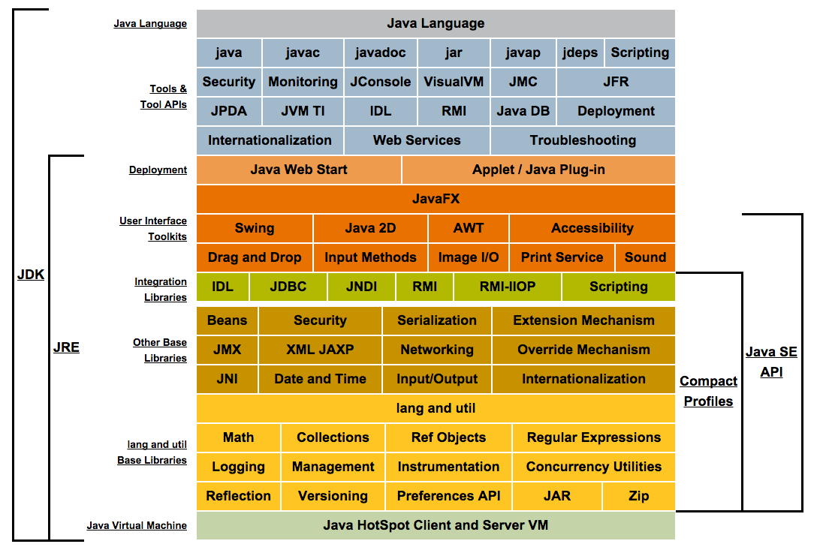
http://www.oracle.com/technetwork/java/javase/tech/index.html

Slide 4
Introduction
An I/O Stream represents an input source or an output destination.
A stream can represent
disk files
devices
other programs
Streams support
simple bytes
primitive data types
localized characters (サーバに関するお知らせ)
objects
Some streams simply pass on data, others manipulate and transform the data in useful ways.
4

Slide 5
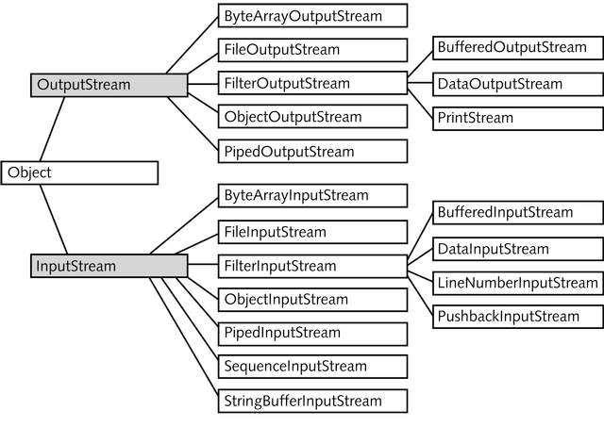
Byte-Oriented Streams
2

Slide 6
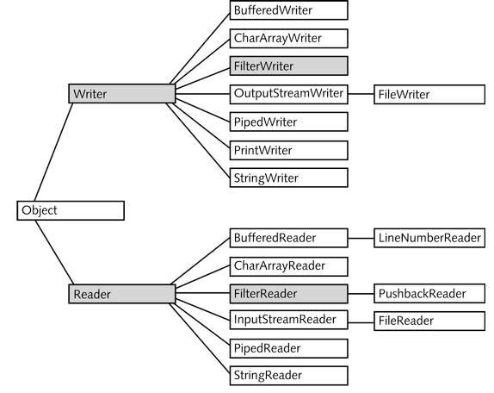
Text-Oriented Streams
3

Slide 7
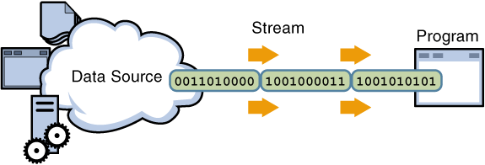
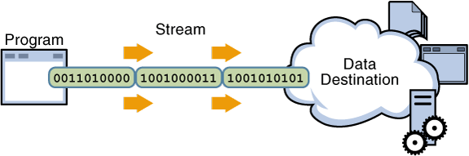
Input/Output Streams
A stream is a sequence of data.
A Java program uses an input stream to read data from a source, one item at a time:
disk files
program
device
socket
array
A Java program uses an output stream to write data to a destination, one item at time:
5

Slide 8
Byte Streams
Byte streams perform I/O of 8-bit bytes.
All byte stream classes are descended from InputStream & OutputStream.
To read/write from files, use FileInputStream and FileOutputStream.
Byte streams should only be used for the most primitive I/O.
However, all other stream types are built on byte streams.
6

Slide 9
CopyBytes (Byte Streams)
public class CopyBytes
{
public static void main(String[] args) throws IOException
{
FileInputStream in = null;
FileOutputStream out = null;
try{
in = new FileInputStream("input.txt");
out = new FileOutputStream("final.txt");
int c;
while ((c = in.read()) != -1){
out.write(c);
}
}
finally{
if (in != null){
in.close();
}
if (out != null){
out.close();
}
}
}
}
7

Slide 10
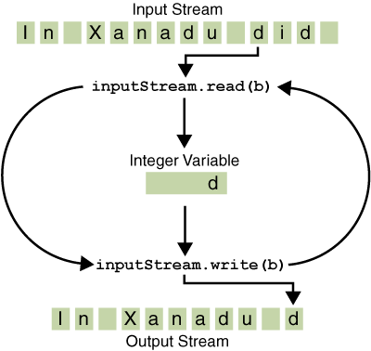
CopyBytes
An int return type allows read() to use -1 to indicate end of stream.
CopyBytes uses a finally block to guarantee that both streams will be closed even if an error occurs; this helps avoid resource leaks.
If CopyBytes was unable to open one or both files the associated file stream variable never changes from its initial null value; hence the test for null in the finally block.
8

Slide 11
Character Streams
Java stores character values using Unicode.
Character stream I/O automatically translates Unicode character values to and from the local character set.
In Western locales, the local character set is usually an 8-bit superset of ASCII.
I/O with character streams is no more complicated than I/O with byte streams.
9

Slide 12
CopyCharacters (Character Stream)
public class CopyCharacters
{
public static void main(String[] args) throws IOException
{
FileReader in = null;
FileWriter out = null;
try{
in = new FileReader("input.txt");
out = new FileWriter("final.txt");
int c;
while ((c = in.read()) != -1){
out.write(c);
}
}
finally{
if (in != null){
in.close();
}
if (out != null){
out.close();
}
}
}
}
10

Slide 13
CopyCharacters vs CopyBytes
CopyCharacters is very similar to CopyBytes.
CopyCharacters uses FileReader and FileWriter.
CopyBytes uses FileInputStream and FileOutputStream.
Both use an int variable to read to and write from.
CopyCharacters int variable holds a character value in its last 16 bits
CopyBytes int variable holds a byte value in its last 8 bits
Character streams are often "wrappers" for byte streams.
A byte stream to perform the physical I/O
The character stream handles translation between characters and bytes.
e.g. FileReader uses FileInputStream, while FileWriter uses FileOutputStream.
11

Slide 14
Buffered IO
So far we have used unbuffered I/O:
Each read or write request is handled directly by the underlying OS
Can be less efficient, since each such request often triggers disk or network access → relatively expensive!
To reduce this kind of overhead use buffered I/O streams.
Read data from a memory area known as a buffer
Native input API is called only when the buffer is empty
Buffered output streams write data to a buffer
Native output API is called only when the buffer is full
12

Slide 15
Line-Oriented I/O
Character I/O usually occurs in bigger units than single characters.
One common unit is the line:
a string of characters with a line terminator at the end.
A line terminator can be, depending on the OS:
a carriage-return and line-feed sequence ("\r\n")
a single carriage-return ("\r")
a single line-feed ("\n").
Supporting all possible line terminators, the BufferedReader readLine() method allows programs to read text files created on any of the widely used operating systems.
13

Slide 16
CopyLines
public class CopyLines
{
public static void main(String[] args) throws IOException
{
BufferedReader in = null;
PrintWriter out = null;
try
{
in = new BufferedReader(new FileReader("xanadu.txt"));
out = new PrintWriter(new FileWriter("characteroutput.txt"));
String l;
while ((l = in.readLine()) != null){
out.println(l);
}
}
finally{
if (in != null){
in.close();
}
if (out != null){
out.close();
}
}
}
}
14

Slide 17
BufferedWriter
An unbuffered stream can be converted into a buffered stream using the wrapper idiom.
The unbuffered stream object is passed to the constructor for a buffered stream class.
try
{
in = new BufferedReader(new FileReader("input.txt"));
out = new PrintWriter(
new BufferedWriter(
new FileWriter("characteroutput.txt")));
String l;
while ((l = in.readLine()) != null)
{
out.println(l);
}
}
15

Slide 18
Flushing Buffers
There are four buffered stream classes used to wrap unbuffered streams:
BufferedInputStream and BufferedOutputStream for byte streams
BufferedReader and BufferedWriter for character streams
It often makes sense to write out a buffer at critical points, without waiting for it to fill.
This is known as flushing the buffer.
16

Slide 19
Flushing Buffers
Some buffered output classes support autoflush, specified by an optional constructor argument.
When autoflush is enabled, certain key events cause the buffer to be flushed.
For example, an autoflush PrintWriter object flushes the buffer on every invocation of println or format.
To flush a stream manually, invoke its flush method.
The flush method is valid on any output stream, but has no effect unless the stream is buffered.
16

Slide 20
Scanning
Objects of type Scanner break input into tokens and translate individual tokens according to their data type.
By default, a Scanner uses white space to separate tokens.
To use a different token separator, invoke useDelimiter(), specifying a regular expression (i.e. a sequence of symbols and characters expressing a string/pattern).
Even though a scanner is not a stream, you need to close it to indicate that you're done with its underlying stream.
17

Slide 21
ScanFile
public class ScanFile
{
public static void main(String[] args) throws IOException
{
Scanner s = null;
try
{
s = new Scanner(new BufferedReader(
new FileReader("input.txt")));
while (s.hasNext())
{
System.out.println(s.next());
}
}
finally
{
if (s != null)
{
s.close();
}
}
}
}
18

Slide 22
Translating Individual Tokens
public class ScanSum
{
public static void main(String[] args) throws IOException
{
Scanner s = null;
double sum = 0;
try{
s = new Scanner(new BufferedReader(new FileReader("usnumbers.txt")));
while (s.hasNext()){
if (s.hasNextDouble()){
sum += s.nextDouble();
}
else{
s.next();
}
}
}
finally{
s.close();
}
System.out.println(sum);
}
}
19

Slide 23
Translating Individual Tokens
ScanSum reads a list of double values and adds them up.
The ScanFile example treats all input tokens as simple String values.
Scanner also supports tokens for all of the Java language's primitive types as well as BigInteger and BigDecimal.
20

Slide 24
Command Line I/O
A program is often run from the command line, and interacts with the user in the command line environment.
The Java platform supports this kind of interaction in two ways:
Standard Streams
Console
21

Slide 25
Standard Streams
A feature of many operating systems, they read input from the keyboard and write output to the display.
They also support I/O on files and between programs.
The Java platform supports three Standard Streams:
Standard Input, accessed through System.in;
Standard Output, accessed through System.out;
Standard Error, accessed through System.err.
These objects are defined automatically (do not need to be opened)
Standard Output and Standard Error are both for output
Having error output separately allows the user to divert regular output to a file and still be able to read error messages.
22

Slide 26
System.in, System.out, System.err
For historical reasons, the standard streams are byte streams (more logically character streams).
System.out and System.err are defined as PrintStream objects.
Although it is technically a byte stream, PrintStream utilises an internal character stream object to emulate many of the features of character streams.
By contrast, System.in is a byte stream with no character stream features.
To utilise Standard Input as a character stream, wrap System.in in InputStreamReader.
InputStreamReader cin = new InputStreamReader(System.in);
23

Slide 27
Console
New for Java 6 - a more advanced alternative to the Standard Streams
This is a single pre-defined object of type Console that has most of the features provided by the Standard Streams.
The Console object also provides input and output streams that are true character streams, through its reader and writer methods.
Before a program can use the Console, it must attempt to retrieve the Console object by invoking System.console().
If the Console object is available, this method returns it.
If it returns NULL, then Console operations are not permitted, either because the OS doesn't support them, or because the program was launched in a non-interactive environment.
24

Slide 28
Password Entry
The Console object supports secure password entry through its readPassword method.
This method helps secure password entry in two ways:
It suppresses echoing, so the password is not visible on the users screen.
readPassword returns a character array, not a String, so that the password can be overwritten, removing it from memory as soon as it is no longer needed.
25

Slide 29
Password (1)
public class Password
{
public static void main(String[] args) throws IOException
{
Console c = System.console();
if (c == null)
{
System.err.println("No console.");
System.exit(1);
}
String login = c.readLine("Enter your login: ");
char[] oldPassword = c.readPassword("Enter your old password: ");
//..
}
}
26

Slide 30
Password (2)
//..
if (verify(login, oldPassword))
{
boolean noMatch;
do
{
char[] newPassword1 = c.readPassword("Enter your new password: ");
char[] newPassword2 = c.readPassword("Enter new password again: ");
noMatch = !Arrays.equals(newPassword1, newPassword2);
if (noMatch)
{
c.format("Passwords don't match. Try again.%n");
}
else
{
change(login, newPassword1);
c.format("Password for %s changed.%n", login);
}
Arrays.fill(newPassword1, ' ');
Arrays.fill(newPassword2, ' ');
}
while (noMatch);
}
Arrays.fill(oldPassword, ' ');
}
27

Slide 31
format method
System.out.format("The value of " + "the float variable is " + "%f, while the value of the " + "integer variable is %d, " + "and the string is %s",
floatVar, intVar, stringVar);
Format specifiers begin with a percent sign (%) and end with a converter.

Slide 32
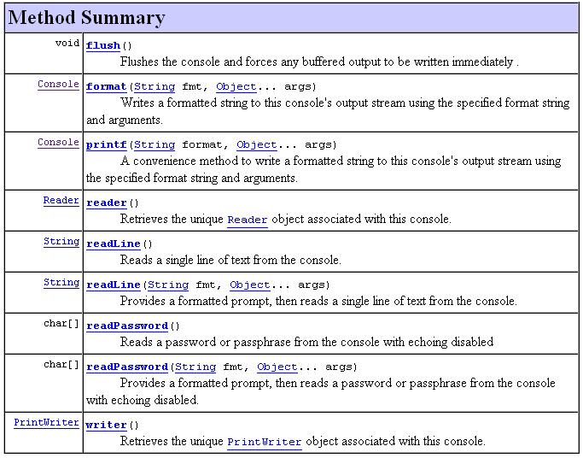
Console Methods
28

Slide 33
Data Streams
Data streams support binary I/O of primitive data type values (boolean, char, byte, short, int, long, float, and double) as well as String values.
All data streams implement either the DataInput interface or the DataOutput interface.
The most widely-used implementations of these interfaces are DataInputStream and DataOutputStream.
29

Slide 34
DataStream (1)
public class DataStream
{
static final String dataFile = "invoicedata";
static final double[] prices = { 19.99, 9.99, 15.99, 3.99, 4.99 };
static final int[] units = { 12, 8, 13, 29, 50 };
static final String[] descs = { "Java T-shirt", "Java Mug",
"Duke Juggling Dolls",
"Java Pin", "Java Key Chain"};
public static void main(String[] args) throws IOException
{
DataOutputStream out = new DataOutputStream(
new BufferedOutputStream(new FileOutputStream(dataFile)));
for (int i = 0; i < prices.length; i++)
{
out.writeDouble(prices[i]);
out.writeInt(units[i]);
out.writeUTF(descs[i]);
}
out.close();
//…continued
30

Slide 35
DataStream (2)
DataInputStream in = new DataInputStream(
new BufferedInputStream(
new FileInputStream(dataFile)));
double price;
int unit;
String desc;
double total = 0.0;
try
{
while (true)
{
price = in.readDouble();
unit = in.readInt();
desc = in.readUTF();
System.out.format("You ordered %d units of %s at $%.2f%n",
unit, desc, price);
total += unit * price;
}
}
catch (EOFException e)
{
System.out.println("End of file");
}
}
}
31

Slide 36
Data Streams Observations
The writeUTF method writes out String values in a modified form of UTF-8.
A variable-width character encoding that only needs a single byte for common Western characters.
Generally, we detect an end-of-file condition by catching EOFException, instead of testing for an invalid return value.
Each specialized write in DataStreams is exactly matched by the corresponding specialized read.
Floating point numbers not recommended for monetary values
In general, floating point is bad for precise values.
The correct type to use for currency values is java.math.BigDecimal.
Unfortunately, BigDecimal is an object type, so it won't work with data streams – need Object Streams.
32

Slide 37
Object Streams
Data streams support I/O of primitive data types, object streams support I/O of objects.
A class that can be serialized implements the marker interface Serializable.
The object stream classes are ObjectInputStream and ObjectOutputStream.
They implement ObjectInput and ObjectOutput, which are subtypes of DataInput and DataOutput.
Thus all the primitive data I/O methods covered in Data Streams are also implemented in object streams.
An object stream can contain a mixture of primitive and object values
If readObject() doesn't return the object type expected, attempting to cast it to the correct type may throw a ClassNotFoundException.
33

Slide 38
ObjectSteams
public class ObjectStreams
{
static final String dataFile = "invoicedata";
static final BigDecimal[] prices = {new BigDecimal("19.99"),
new BigDecimal("9.99"),
new BigDecimal("15.99"),
new BigDecimal("3.99"),
new BigDecimal("4.99") };
static final int[] units = { 12, 8, 13, 29, 50 };
static final String[] descs = { "Java T-shirt", "Java Mug",
"Duke Juggling Dolls",
"Java Pin", "Java Key Chain" };
public static void main(String[] args)
throws IOException, ClassNotFoundException
{
ObjectOutputStream out = null;
try
{
out = new ObjectOutputStream(
new BufferedOutputStream(new FileOutputStream(dataFile)));
out.writeObject(Calendar.getInstance());
for (int i = 0; i < prices.length; i++)
{
out.writeObject(prices[i]);
out.writeInt(units[i]);
out.writeUTF(descs[i]);
}
}
finally
{
out.close();
}
//…
}
34

Slide 39
ObjectStreams(2)
ObjectInputStream in = null;
try
{
in = new ObjectInputStream(
new BufferedInputStream(new FileInputStream(dataFile)));
Calendar date = null;
BigDecimal price;
int unit;
String desc;
BigDecimal total = new BigDecimal(0);
date = (Calendar) in.readObject();
System.out.format("On %tA, %<tB %<te, %<tY:%n", date);
try
{
while (true)
{
price = (BigDecimal) in.readObject();
unit = in.readInt();
desc = in.readUTF();
System.out.format("You ordered %d units of %s at $%.2f%n",unit, desc, price);
total = total.add(price.multiply(new BigDecimal(unit)));
}
}
catch (EOFException e)
{
}
System.out.format("For a TOTAL of: $%.2f%n", total);
}
finally
{
in.close();
}
35

Slide 40
readObject() and writeObject()
The writeObject and readObject methods contain some sophisticated object management logic.
This is particularly important for objects that contain references to other objects.
If readObject is to reconstitute an object from a stream, it has to be able to reconstitute all the objects the original object referred to.
These additional objects might have their own references, and so on.
In this situation, writeObject traverses the entire web of object references and writes all objects in that web onto the stream. Thus a single invocation of writeObject can cause a large number of objects to be written to the stream.
36

Slide 41
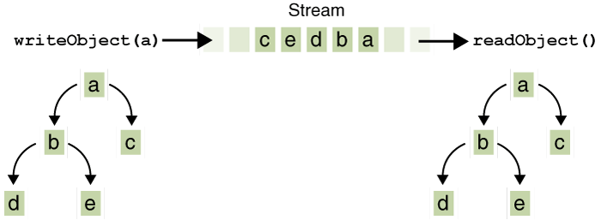
Suppose:
If writeObject is invoked to write a single object named a.
This object contains references to objects b and c,
while b contains references to d and e.
Invoking writeobject(a) writes a and all the objects necessary to reconstitute a
When a is read by readObject, the other four objects are read back as well, and all the original object references are preserved.
37

Slide 42
Streams in AgileLab05
public class Pim implements IPim
{
private AddressBookMap addressBook;
public Pim()
{
newPim();
}
public IAddressBook getAddressBook()
{
return addressBook;
}
public void newPim()
{
addressBook = new AddressBookMap();
}
//…
}
38

Slide 43
open
public boolean open(String filename)
{
boolean success = false;
try
{
File source = new File(filename);
ObjectInputStream is = new ObjectInputStream(new FileInputStream(source));
addressBook = (AddressBookMap) is.readObject();
is.close();
success = true;
}
catch (ClassNotFoundException e)
{
e.printStackTrace();
}
catch (IOException e)
{
e.printStackTrace();
}
return success;
}
39

Slide 44
save
public boolean save(String filename)
{
boolean success = false;
try
{
File destination = new File(filename);
ObjectOutputStream os
= new ObjectOutputStream(new FileOutputStream(destination));
os.writeObject(addressBook);
os.close();
success = true;
}
catch (IOException e)
{
e.printStackTrace();
}
return success;
}
40

Slide 45
Serializable Marker Interface
public class AddressBookMap implements IAddressBook, Serializable
{
private static final long serialVersionUID = 1L;
private Map<String, IContact> contacts;
//...
}
public class Contact implements IContact, Serializable
{
private static final long serialVersionUID = 1L;
//...
}
The serialVersionUID should be incremented if the class structure changes.
41

Slide 46
transient
If a field is to be excluded from the serialisation mechanism it can be marked “transient”.
writeObject() will ignore these fields and readObject() will not attempt to read them.
public class AddressBookMap implements IAddressBook, Serializable
{
private static final long serialVersionUID = 1L;
private Map<String, IContact> contacts;
private transient Map<String, IContact> removedContacts;
//...
}
42

Slide 47
Abstract the Mechanism
public interface ISerializationStrategy
{
void write(String filename, Object obj) throws Exception;
Object read(String filename) throws Exception;
}
Defining this interface will allow us to build different serialization strategies.
We can decide which to use at compile time, or at run time.
43

Slide 48
Binary Strategy
public class BinarySerializer implements ISerializationStrategy
{
public Object read(String filename) throws Exception
{
ObjectInputStream is = null;
Object obj = null;
try
{
is = new ObjectInputStream(new BufferedInputStream(
new FileInputStream(filename)));
obj = is.readObject();
}
finally
{
if (is != null)
{
is.close();
}
}
return obj;
}
//..
}
44

Slide 49
Binary Strategy (contd.)
public class BinarySerializer implements ISerializationStrategy
{
//..
public void write(String filename, Object obj) throws Exception
{
ObjectOutputStream os = null;
try
{
os = new ObjectOutputStream(new BufferedOutputStream(
new FileOutputStream(filename)));
os.writeObject(obj);
}
finally
{
if (os != null)
{
os.close();
}
}
}
}
45

Slide 50
XML Strategy
public class XMLSerializer implements ISerializationStrategy
{
public Object read(String filename) throws Exception
{
ObjectInputStream is = null;
Object obj = null;
try
{
XStream xstream = new XStream(new DomDriver());
is = xstream.createObjectInputStream(new FileReader(filename));
obj = is.readObject();
}
finally
{
if (is != null)
{
is.close();
}
}
return obj;
}
//...
}
46

Slide 51
XML Strategy (contd.)
public class XMLSerializer implements ISerializationStrategy
{
//...
public void write(String filename, Object obj) throws Exception
{
ObjectOutputStream os = null;
try
{
XStream xstream = new XStream(new DomDriver());
os = xstream.createObjectOutputStream(new FileWriter(filename));
os.writeObject(obj);
}
finally
{
if (os != null)
{
os.close();
}
}
}
}
47

