Slide 1
Agile Software Development
Eamonn de Leastar (edeleastar@wit.ie)

Slide 2
Introduction to Test Driven Development

Slide 3
Test Driven Development Introduction
“Good programmers write code, great programmers write tests”
Context & Motivation
What it is Unit Testing?
“Never, in the field of programming, have so many owed so much to so few”
- Martin Fowler on the developers behind JUnit

Slide 4
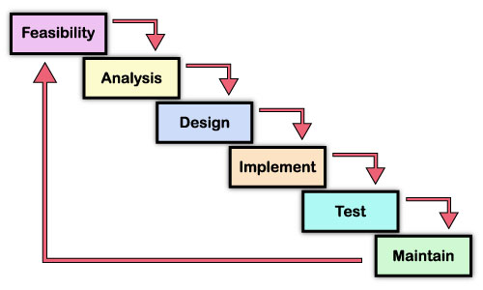
Waterfall development approach

Slide 5
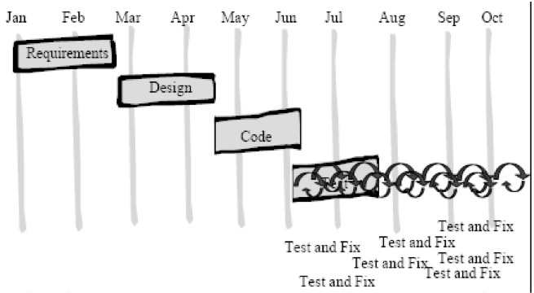
Waterfall development approach

Slide 6
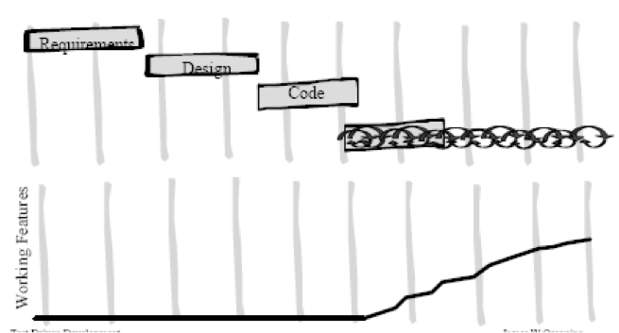
Waterfall - Working Features

Slide 7
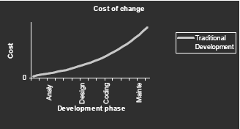
Waterfall - Cost of change

Slide 8
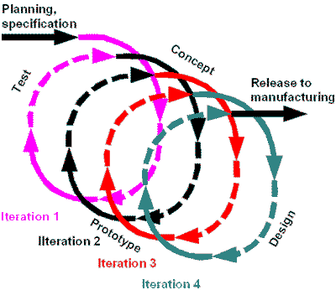
Iterative/Evolutionary approach

Slide 9
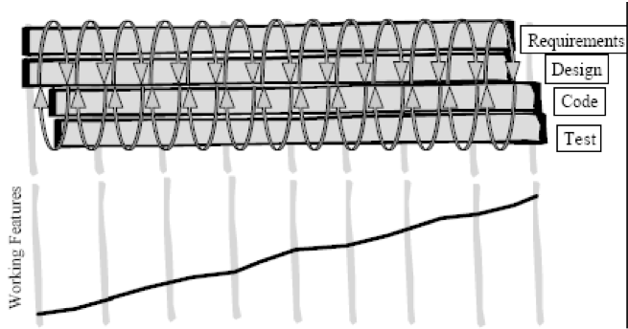
Iterative/Evolutionary - Working Features

Slide 10
Things have changed a little…
Computing power has increased astronomically
New tools have dramatically eased mundane developer tasks:
Automated test tools (e.g. JUnit)
System build tools (e.g. Maven)
Version control (e.g. Git repositories, Github hosting service)
Continuous integration (e.g. Jenkins)
Used properly, OO languages can make software much easier to change.
The cost curve is significantly flattened, i.e. costs don’t increase dramatically with time.
Up front modeling becomes a liability – some speculative work will certainly be wrong, especially in a business environment.

Slide 11
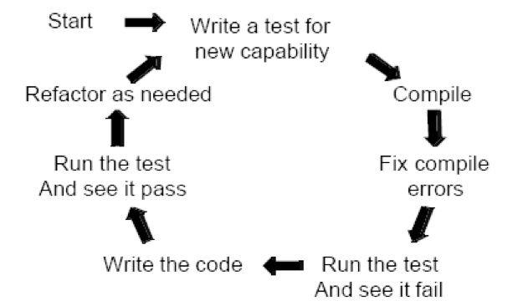
Test-driven development.

Slide 12
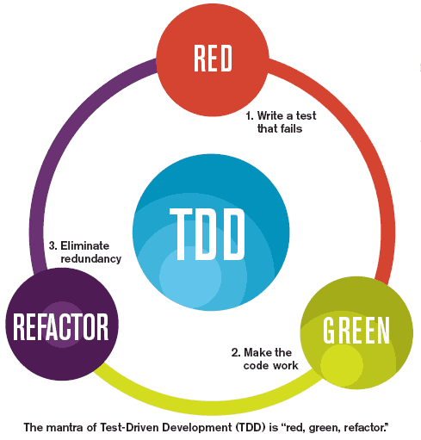

Slide 13
Principles of TDD.
Lots of small changes.
Use test-driven to get from A to B in very small verifiable steps.
You often end up in a better place.
Do the Simplest Thing
Assume simplicity.
Consider the simplest thing that could possibly work (to make the test pass).
Iterate to the needed solution.
When coding:
Build the simplest possible code that will pass the tests.
Refactor the code to have the simplest design possible.
Eliminate duplication.

Slide 14
Test driven development - General
An iterative technique to develop software.
Tests are written before the code itself.
As much (or more) about design as testing.
Encourages design from user’s point of view.
Encourages testing classes/units in isolation – Unit testing.
A test framework is used so that automated testing can be done after every small change to the code.
This may be as often as every 5 or 10 minutes.
Axiom:
‘Code that isn’t tested doesn’t work’
‘Code that isn’t regression tested suffers from code rot (breaks eventually)’

Slide 15
Test driven development – General (Contd.)
As much (or more) about documentation as testing.
The tests are the documentation of what the code does.
Must be learned and practiced.
Consequences:
Fewer bugs;
More maintainable code - loosely-coupled, highly-cohesive systems.
During development, the program always works—it may not do everything required, but what it does, it does right.
Breaks the cycle of more pressure == fewer tests (the fewer tests you write, the less productive you are and the less stable your code becomes).

Slide 16
What is regression testing?
New code and changes to old code can affect the rest of the code base.
‘Affect’ sometimes means ‘break’.
We need to rerun tests on the old code, to verify it still works – this is regression testing.
Regression testing is required for a stable, maintainable code base.
Unit tests retain their value over time and allows others to prove the software still works (as tested).

Slide 17
What is Unit Testing?
A unit test is a piece of code written by a developer that exercises a very small, specific area of functionality of the code being tested.
Usually a unit test exercises some particular method in a particular context
Unit tests are performed to prove that a piece of code does what the developer thinks it should do.
The question remains open as to whether that's the right thing to do according to the customer or end-user:
that is acceptance testing

Slide 18
What does Unit Testing Accomplish ?
Does the code do what was expected?
i.e. is the code fulfilling the intent of the developer?
Does the code do what was expected all the time?
exceptions get thrown, disks get full, network lines drop, buffers overflow - is the code still performing as expected?
Can the code be depended upon?
Need to know for certain both its strengths and its limitations.
Does the test document the developers intent?
An important side-effect of unit testing is that it helps communicate the code's intended use.

Slide 19
Why bother with Unit Testing?
Will make designs better
Drastically reduce the amount of time spent debugging

Slide 20
How is Unit Testing carried out?
Step 1: Decide how to test the method in question before writing the code itself
Step 2: Write the test code itself, either before or concurrently with the implementation code.
Step 3: Run the test itself, and probably all the other tests in that part of the system.
Key Feature of executing tests: need to be able to determine at a glance whether all tests are succeeding/failing.

Slide 21
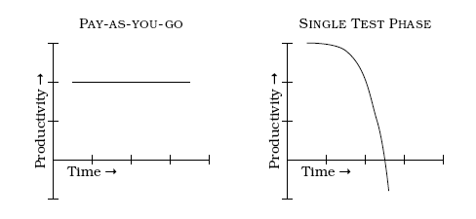
Excuses for not Testing (1)
It takes too much time to write the tests
The trade-off is not “test now” versus “test later”
It's linear work now versus exponential work and complexity trying to fix and rework at the end.

Slide 22
Excuses for not Testing (2)
“It takes too long to run the tests”
Separate out the longer-running tests from the short ones.
Only run the long tests once a day, or once every few days as appropriate, and run the shorter tests constantly.
“It's not developers job to test his/her code”
Integral part of developer job is to create working code.
“But it compiles!”
Compiler's blessing is a pretty shallow compliment.

