Slide 1


Agile Software Development
Produced
by
Eamonn de Leastar (edeleastar@wit.ie)
Department of Computing, Maths & Physics
Waterford Institute of Technology
http://www.wit.ie
http://elearning.wit.ie

Slide 2
Testing Pacemakerplay

Slide 3
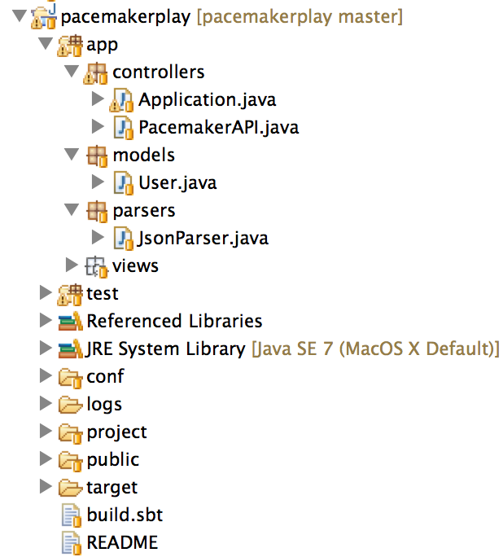
Two Projects
System Under Test (SUT)
Test Project

Slide 4
pacemakerplaytest
Test application runs as a separate process (may be on a different machine).
Tests written using standard JUnit conventions
Exercises pacemakerplay over http - as it is indented to be used.
Considerably expanded scope of the tests:
the model
the model’s Object Relational Mapping (ORM) to the database (+ evolutions?)
the ‘business logic’ in the server
the exposure of the API over Restful http
+ security? Performance? etc…

Slide 5
pacemakerplaytest - models
Model classes are ‘shadowed’ in test project
@Entity
@Table(name="my_user")
public class User extends Model
{
@Id
@GeneratedValue
public Long id;
public String firstname;
public String lastname;
public String email;
public String password;
public String nationality;
…
}
public class User
{
public Long id;
public String firstname;
public String lastname;
public String email;
public String password;
…
}
play
test

Slide 6
pacemakerplaytest - api
public class PacemakerAPI
{
public static List<User> getUsers () throws Exception
{
String response = Rest.get("/api/users");
List<User> userList = renderUsers(response);
return userList;
}
public static User createUser(String userJson) throws Exception
{
String response = Rest.post ("/api/users", userJson);
return renderUser(response);
}
public static User createUser(User user) throws Exception
{
return createUser(renderUser(user));
}
public static User getUser(Long id) throws Exception
{
String response = Rest.get ("/api/users/" + id);;
User user = renderUser(response);
return user;
}
public static void deleteUsers() throws Exception
{
Rest.delete("/api/users");
}
public static void deleteUser(Long userId) throws Exception
{
Rest.delete("/api/users/" + userId );
}
public static void updateUser(Long userId, String userJson) throws Exception
{
Rest.put("/api/users/" + userId, userJson);
}
public static void updateUser(Long userId, User user) throws Exception
{
Rest.put("/api/users/" + userId, renderUser(user));
}
}
Encapsulate the API into a single class
Class exposes Json and Model variants of API
Uses same JsonParser class as pacemaker play
Use Rest class to make blocking calls to server
Rely on Exceptions to convey errors

Slide 7
pacemakerplaytest - api
public class Rest
{
private static DefaultHttpClient httpClient = null;
private static final String URL = "http://localhost:9000";
private static DefaultHttpClient httpClient()
{
if (httpClient == null)
{
HttpParams httpParameters = new BasicHttpParams();
HttpConnectionParams.setConnectionTimeout(httpParameters, 10000);
HttpConnectionParams.setSoTimeout(httpParameters, 10000);
httpClient = new DefaultHttpClient(httpParameters);
}
return httpClient;
}
public static String get(String path) throws Exception
{
HttpGet getRequest = new HttpGet(URL + path);
getRequest.setHeader("accept", "application/json");
HttpResponse response = httpClient().execute(getRequest);
return new BasicResponseHandler().handleResponse(response);
}
public static String delete(String path) throws Exception
{
HttpDelete deleteRequest = new HttpDelete(URL + path);
HttpResponse response = httpClient().execute(deleteRequest);
return new BasicResponseHandler().handleResponse(response);
}
public static String post(String path, String json) throws Exception
{
HttpPost putRequest = new HttpPost(URL + path);
putRequest.setHeader("Content-type", "application/json");
putRequest.setHeader("accept", "application/json");
StringEntity s = new StringEntity(json);
s.setContentEncoding("UTF-8");
s.setContentType("application/json");
putRequest.setEntity(s);
HttpResponse response = httpClient().execute(putRequest);
return new BasicResponseHandler().handleResponse(response);
}
}
Make http requests, assuming Json payloads.
Block until response
Generate exceptions on failure
Uses apache httpcomponent library (compatible with android)

Slide 8
pacemakerplaytest - api
Filter Json output to specifically exclude ‘class’ metadata in serialised form
public class JsonParser
{
private static JSONSerializer userSerializer = new JSONSerializer().exclude("class");
public static User renderUser(String json)
{
return new JSONDeserializer<User>().deserialize(json, User.class);
}
public static String renderUser(Object obj)
{
return userSerializer.serialize(obj);
}
public static List<User> renderUsers(String json)
{
return new JSONDeserializer<ArrayList<User>>().use("values", User.class).deserialize(json);
}
}

Slide 9
pacemakerplaytest - test
Similar to pacemaker-1.0 tests
Extra fixture to test json serializer
public class Fixtures
{
static String userJson = "{\n"
+ "\"email\" : \"jim@simpson.com\" ,\n"
+ "\"firstName\": \"Jim\" ,\n"
+ "\"lastName\" : \"Simpson\" ,\n"
+ "\"password\" : \"secret\" \n"
+ "}";
static User users[] = {
new User ("homer", "simpson", "homer@simpson.com", "secret"),
new User ("lisa", "simpson", "lisa@simpson.com", "secret"),
new User ("maggie", "simpson", "maggie@simpson.com", "secret"),
new User ("bart", "simpson", "bart@simpson.com", "secret"),
new User ("marge", "simpson", "marge@simpson.com", "secret"),
};
}

Slide 10
pacemakerplaytest - test
public class UserTest
{
static User users[] =
{
new User ("homer", "simpson", "homer@simpson.com", "secret"),
new User ("lisa", "simpson", "lisa@simpson.com", "secret"),
new User ("maggie", "simpson", "maggie@simpson.com", "secret"),
new User ("bart", "simpson", "bart@simpson.com", "secret"),
new User ("marge", "simpson", "marge@simpson.com", "secret"),
};
User user;
@Before
public void setUp() throws Exception
{
user = new User ("mark", "simpson", "mark@simpson.com", "secret");
PacemakerAPI.deleteUsers();
}
@After
public void tearDown() throws Exception
{
PacemakerAPI.deleteUsers();
}
@Test
public void createUserJson() throws Exception
{
User user1 = PacemakerAPI.createUser(Fixtures.userJson);
User user2 = PacemakerAPI.getUser(user1.id);
assertEquals(user1, user2);
PacemakerAPI.deleteUser(user1.id);
}
@Test
public void createUserObj() throws Exception
{
User user2 = PacemakerAPI.createUser(user);
assertTrue(user.equals(user2));
PacemakerAPI.deleteUser(user2.id);
}

Slide 11
pacemakerplaytest - test
@Test
public void createUserObjs() throws Exception
{
for (User user : Fixtures.users)
{
User user2 = PacemakerAPI.createUser(user);
user.id = user2.id;
}
List <User> users = PacemakerAPI.getUsers();
assertEquals(users.size(), Fixtures.users.length);
for (User user : Fixtures.users)
{
PacemakerAPI.deleteUser(user.id);
}
List <User> users2 = PacemakerAPI.getUsers();
assertEquals(0, users2.size());
}
@Test
public void updateUser() throws Exception
{
User user2 = PacemakerAPI.createUser(user);
user2.email = "NEWNAME@simpson.com";
PacemakerAPI.updateUser(user2.id, user2);
User user3 = PacemakerAPI.getUser(user2.id);
assertEquals (user3.email, "NEWNAME@simpson.com");
assertEquals (user3.id, user2.id);
PacemakerAPI.deleteUser(user2.id);
}

Slide 12
pacemakerplaytest - test
@Test
public void updateNonExistantUser() throws Exception
{
try
{
Rest.put("/api/users/4000", Fixtures.userJson);
fail ("put error");
}
catch(HttpResponseException e)
{
assertTrue (404 == e.getStatusCode());
}
}
@Test
public void deleteeNonExistantUser() throws Exception
{
try
{
Rest.delete("/api/users/4000");
fail ("delete error");
}
catch(HttpResponseException e)
{
assertTrue (404 == e.getStatusCode());
}
}
}

Slide 13

Except where otherwise noted, this content is licensed under a Creative Commons Attribution-NonCommercial 3.0 License.
For more information, please see http://creativecommons.org/licenses/by-nc/3.0/

