Slide 1


Agile Software Development
Produced
by
Eamonn de Leastar (edeleastar@wit.ie)
Department of Computing, Maths & Physics
Waterford Institute of Technology
http://www.wit.ie
http://elearning.wit.ie

Slide 2

http://xunitpatterns.com/

Slide 3
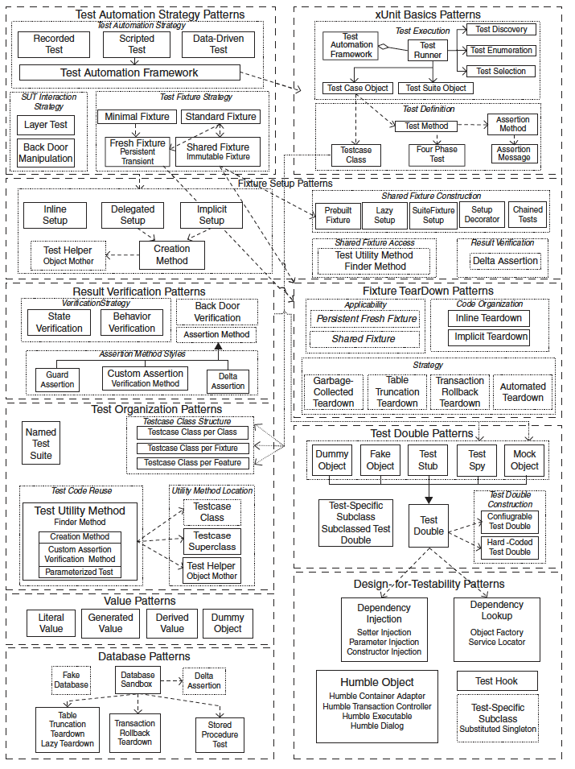
Unit Test Patterns
Comprehensive and exhaustive catalog of test Patterns covering:
Test Automation
xUnit Basics
Fixture Setup (& teardown)
Result Verification
Test Organisation
Test Doubles
Value
Database
Design-for-Testability

Slide 4
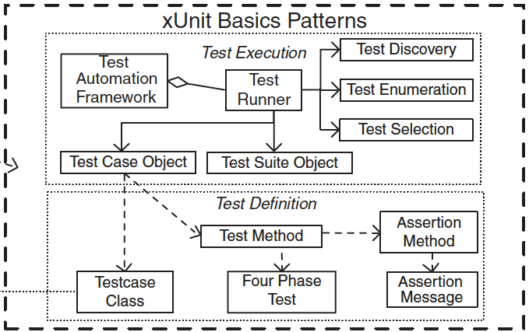
xUnit Basics
Features of the xUnit framework.
x indicates the programming language.
Largely implemented by JUnit - and automatically integrated into:
IDE (Eclipse)
Build System (maven)

Slide 5
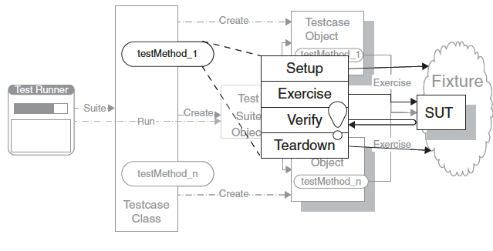
Four Phase Test
How do we structure our test logic to make what we are testing obvious?
We structure each test with four distinct parts executed in sequence.
SUT = System Under Test

Slide 6
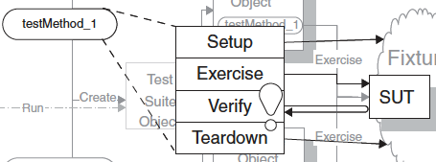
How it works
SETUP: In the first phase, we set up the test fixture (the “before” picture) that is required for the SUT to exhibit the expected behavior as well as anything you need to put in place to be able to observe the actual outcome.
EXERCISE: In the second phase, we interact with the SUT.
VERIFY: In the third phase, we do whatever is necessary to determine whether the expected outcome has been obtained.
TEARDOWN: In the fourth phase, we tear down the test fixture to put the world back into the state in which we found it.

Slide 7
Example
@Test
public void testXMLSerializer() throws Exception
{
String datastoreFile = "testdatastore.xml";
deleteFile (datastoreFile);
Serializer serializer = new XMLSerializer(new File (datastoreFile));
pacemaker = new PacemakerAPI(serializer);
populate(pacemaker);
pacemaker.store();
PacemakerAPI pacemaker2 = new PacemakerAPI(serializer);
pacemaker2.load();
assertEquals (pacemaker.getUsers().size(), pacemaker2.getUsers().size());
for (User user : pacemaker.getUsers())
{
Collection<User> users = pacemaker2.getUsers();
System.out.println("User to search for:");
System.out.println(user);
System.out.println("Collection");
System.out.println(users);
assertTrue (users.contains(user));
}
deleteFile (datastoreFile);
}

Slide 8
Example
@Test
public void testXMLSerializer() throws Exception
{
String datastoreFile = "testdatastore.xml";
deleteFile (datastoreFile);
Serializer serializer = new XMLSerializer(new File (datastoreFile));
pacemaker = new PacemakerAPI(serializer);
populate(pacemaker);
pacemaker.store();
PacemakerAPI pacemaker2 = new PacemakerAPI(serializer);
pacemaker2.load();
assertEquals (pacemaker.getUsers().size(), pacemaker2.getUsers().size());
for (User user : pacemaker.getUsers())
{
Collection<User> users = pacemaker2.getUsers();
System.out.println("User to search for:");
System.out.println(user);
System.out.println("Collection");
System.out.println(users);
assertTrue (users.contains(user));
}
deleteFile (datastoreFile);
}
Phase 1 (setup)
Phase 2(exercise)
Phase 3 (verify)
Phase 4 (teardown)

Slide 9
Example (xtend)
@Test def void testXMLSerializer()
{
pacemaker.store
val pacemaker2 = new PacemakerAPI(serializer)
pacemaker2.load
pacemaker.users.forEach [assertTrue(pacemaker2.users.contains(it))]
}
Phase 1 (setup)
Phase 2 (exercise)
Phase 3 (verify)
Phase 4 (in teardown)

Slide 10
Why we do this
The test reader must be able to quickly determine what behavior the test is verifying.
It can be very confusing when various behaviors of the SUT are being invoked—some to set up the pre-test state (fixture) of the SUT, others to exercise the SUT, and yet others to verify the post-test state of the SUT.
Clearly identifying the four phases makes the intent of the test much easier to see.
Avoid the temptation to test as much functionality as possible in a single Test Method because that can result in Obscure Tests.
It is preferable to have many small Single-Condition Test Methods.

