Slide 1


Agile Software Development
Produced
by
Eamonn de Leastar (edeleastar@wit.ie)
Department of Computing, Maths & Physics
Waterford Institute of Technology
http://www.wit.ie
http://elearning.wit.ie

Slide 2
Test Doubles - Topic List
Understanding Test Double Terms (by example).
Defining Test Doubles.
Pattern Variations of Test Doubles.
Test Stubs:
Hand-coded Test Stub.
Configurable Test Stub.
Mock Objects:
Defining Mock Objects.
Mock Object Test Structure.
Maven.
Expectations.
ClassImposteriser.
A note of caution on Test Doubles.

Slide 3
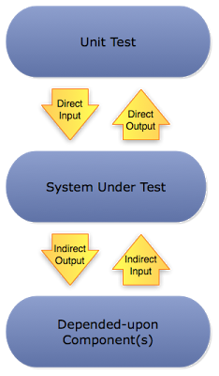
Understanding Test Double Terms – by example
Example 1:
We want to check that when an adder function is given a 2 and a 4 then it returns a 6.
In this case you’re controlling what the System Under Test (SUT) pulls in from its environment (the 2 and the 4) and also observing what it pushes out (the 6).
Example 2:
We want to test a method that talks to a remote service and verify that if it receives an error code (pulled from the environment) when trying to read from the network then it logs the appropriate error message to a logger (SUT pushes this out).
http://blog.thepete.net/blog/2011/01/04/working-with-indirect-input-and-output/

Slide 4
Understanding Test Double Terms – by example
Both examples illustrate the same fundamental practice of:
controlling input
observing output
but they are dealing with different kinds of input and output.
Example 1 (adder function):
controlling the Direct Input provided to the SUT.
observing the Direct Output from the SUT.
Example 2 (remote service):
controlling Indirect Input from a network service (DOC).
observing Indirect Output to a logging service (DOC).
http://blog.thepete.net/blog/2011/01/04/working-with-indirect-input-and-output/

Slide 5
Control and Observation Points
Control Point:
A control point is how the test asks the system under test (SUT) to do something for it. This could be for the purpose of:
setting up or tearing down the fixture or
it could be used during the exercise SUT phase of the test.
Observation Point:
A observation point is how the test inspects the post-exercise state of the system under test (SUT).
http://xunitpatterns.com/Test%20Double.html

Slide 6
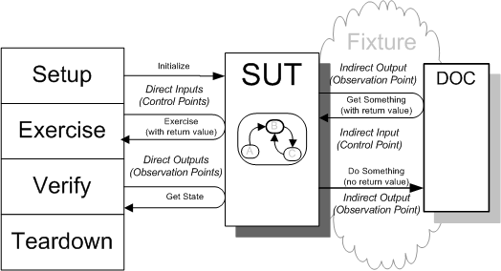
Understanding Testing Double Terms - Diagrams
SUT - System Under Test
DOC - Depended-On Component

Slide 7
Test Doubles - Topic List
Understanding Test Double Terms (by example).
Defining Test Doubles.
Pattern Variations of Test Doubles.
Test Stubs:
Hand-coded Test Stub.
Configurable Test Stub.
Mock Objects:
Defining Mock Objects.
Mock Object Test Structure.
Maven.
Expectations.
ClassImposteriser.
A note of caution on Test Doubles.

Slide 8
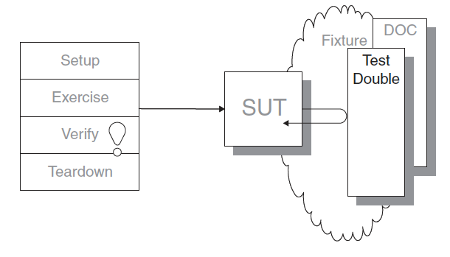
Test Double
How can we verify logic independently when code it depends on is unusable?
How can we avoid Slow Tests?
We replace a component on which the SUT depends with a “test-specific equivalent.”
SUT - System Under Test
DOC - Depended-On Component

Slide 9
What is a Test Double?
It can be hard to test the SUT because it depends on other components that cannot be used in the test environment e.g.:
components aren’t available, or
components will not return the results needed for the test, or
executing components would have undesirable side effects, etc.
When writing a test in which we cannot use the real Depended-on Component (DOC), we can replace it with a Test Double.
The Test Double doesn’t have to behave exactly like DOC, it merely has to provide the same API so that the SUT thinks it is the real one.
Called after “Stunt Double” in movie making - the stunt person takes the place of the real actor.

Slide 10
When to use Test Doubles
If we have:
an untested requirement because neither the SUT nor its DOCs provide an observation point for the SUT’s indirect output that we need to verify.
untested code and a DOC does not provide the control point to allow us to exercise the SUT with the necessary indirect inputs.
slow tests and we want to be able to run our tests more quickly and hence more often.

Slide 11
Test Doubles - Topic List
Understanding Test Double Terms (by example).
Defining Test Doubles.
Pattern Variations of Test Doubles.
Test Stubs:
Hand-coded Test Stub.
Configurable Test Stub.
Mock Objects:
Defining Mock Objects.
Mock Object Test Structure.
Maven.
Expectations.
ClassImposteriser.
A note of caution on Test Doubles.

Slide 12
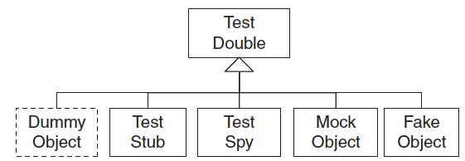
Pattern Variations of Test Double (1)
Dummy Object
Some method signatures of the SUT may require objects as parameters.
If neither the test nor the SUT cares about these objects, pass in a null object reference or an instance of the Object class.
A dummy object is passed around but never actually used; they typically just fill parameter lists.
Notes:
http://martinfowler.com/articles/mocksArentStubs.html

Slide 13
Pattern Variations of Test Double (2)
Test Stub
Replace a real DOC on which the SUT depends so that the test has a control point for the indirect inputs of the SUT.
Provides canned answers to calls made during the test, usually not responding at all to anything outside what's programmed in for the test.
Stubs use state verification.
Notes:
http://martinfowler.com/articles/mocksArentStubs.html

Slide 14
Pattern Variations of Test Double (3)
Test Spy
A more capable version of a Test Stub.
Implements an observation point that exposes the indirect outputs of the SUT so they can be verified.
Spy uses behaviour verification.

Slide 15
Pattern Variations of Test Double (4)
Mock Object:
An observation point to verify the indirect outputs of the SUT as it is exercised.
They are objects pre-programmed with expectations which form a specification of the calls they are expected to receive.
Mocks use behaviour verification.
Notes:
http://martinfowler.com/articles/mocksArentStubs.html

Slide 16
Pattern Variations of Test Double (5)
Fake Object:
Have real working implementations, but usually takes some shortcuts.
Replace the functionality of a real DOC in a test for reasons other than verification of indirect inputs and outputs of the SUT.
Perhaps real object too slow, has undesirable side effects etc...
Notes:
http://martinfowler.com/articles/mocksArentStubs.html

Slide 17
Test Doubles - Topic List
Understanding Test Double Terms (by example).
Defining Test Doubles.
Pattern Variations of Test Doubles.
Test Stubs:
Hand-coded Test Stub.
Configurable Test Stub.
Mock Objects:
Defining Mock Objects.
Mock Object Test Structure.
Maven.
Expectations.
ClassImposteriser.
A note of caution on Test Doubles.

Slide 18
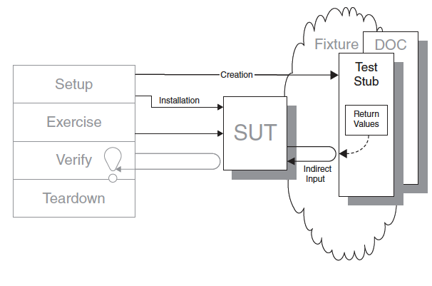
Test Stub
How can we verify logic independently when it depends on indirect inputs from other software components?
We replace a real object (DOC) with a test-specific object (Test Stub) that feeds the desired indirect inputs into the system under test (SUT).

Slide 19
Test Stub Motivation
public void testDisplayCurrentTime_AtMidnight()
{
// Instantiate SUT (fixture setup)
TimeDisplay sut = new TimeDisplay();
// Exercise SUT
String result = sut.getCurrentTimeAsHtmlFragment();
// Verify outcome
String expectedTimeString = "<span class=\"tinyBoldText\">Midnight</span>";
assertEquals("Midnight", expectedTimeString, result);
}
Verifies the basic functionality of a component that formats an HTML string containing the current time.
Depends on the real system clock so it rarely ever passes!

Slide 20
Test Doubles - Topic List
Understanding Test Double Terms (by example).
Defining Test Doubles.
Pattern Variations of Test Doubles.
Test Stubs:
Hand-coded Test Stub.
Configurable Test Stub.
Mock Objects:
Defining Mock Objects.
Mock Object Test Structure.
Maven.
Expectations.
ClassImposteriser.
A note of caution on Test Doubles.

Slide 21
Test Stub Hand-Code Example
public void testDisplayCurrentTime_AtMidnight()
{
// Fixture setup and Test Double configuration
TimeProvider tpStub = new TimeProviderTestStub(); //hand coded stub
tpStub.setHours(0);
tpStub.setMinutes(0);
// Instantiate SUT (fixture setup)
TimeDisplay sut = new TimeDisplay();
// Test Double installation
sut.setTimeProvider(tpStub);
// Exercise SUT
String result = sut.getCurrentTimeAsHtmlFragment();
// Verify outcome
String expectedTimeString = "<span class=\"tinyBoldText\">Midnight</span>";
assertEquals("Midnight", expectedTimeString, result);
}
TimeDisplay (SUT) depends on TimeProvider (DOC).
The DOC is replaced with a stub - TimeProviderTestStub which is hard coded to return 00:00 time.
This test stub is then used to inject indirect inputs into the SUT.

Slide 22
Hand-coded Test Stub
private Calendar myTime = new GregorianCalendar();
public TimeProviderTestStub(int hours, int minutes) { setTime(hours, minutes);
}
public void setTime(int hours, int minutes) {
setHours(hours);
setMinutes(minutes);
}
public void setHours(int hours) {
myTime.set(Calendar.HOUR_OF_DAY, hours);
}
public void setMinutes(int minutes) { myTime.set(Calendar.MINUTE, minutes); }
public Calendar getTime() {
return myTime;
}

Slide 23
Test Doubles - Topic List
Understanding Test Double Terms (by example).
Defining Test Doubles.
Pattern Variations of Test Doubles.
Test Stubs:
Hand-coded Test Stub.
Configurable Test Stub.
Mock Objects:
Defining Mock Objects.
Mock Object Test Structure.
Maven.
Expectations.
ClassImposteriser.
A note of caution on Test Doubles.

Slide 24
Test Stub Using JMock Library
public void testDisplayCurrentTime_AtMidnight_JM()
{
// Fixture setup
TimeDisplay sut = new TimeDisplay();
// Test Double configuration
Mock tpStub = mock(TimeProvider.class);
Calendar midnight = makeTime(0,0); //makeTime is a test utility method
tpStub.stubs().method("getTime").withNoArguments().will(returnValue(midnight));
// Test Double installation
sut.setTimeProvider((TimeProvider) tpStub);
// Exercise SUT
String result = sut.getCurrentTimeAsHtmlFragment();
// Verify outcome
String expectedTimeString ="<span class=\"tinyBoldText\">Midnight</span>";
assertEquals("Midnight", expectedTimeString, result);
}
JMock generates Mock Objects dynamically. There is no Test Stub implementation to examine for this test because the JMock framework implements the Test Stub using Reflection (inspects java classes at runtime).

Slide 25
Test Doubles - Topic List
Understanding Test Double Terms (by example).
Defining Test Doubles.
Pattern Variations of Test Doubles.
Test Stubs:
Hand-coded Test Stub.
Configurable Test Stub.
Mock Objects:
Defining Mock Objects.
Mock Object Test Structure.
Maven.
Expectations.
ClassImposteriser.
A note of caution on Test Doubles.

Slide 26
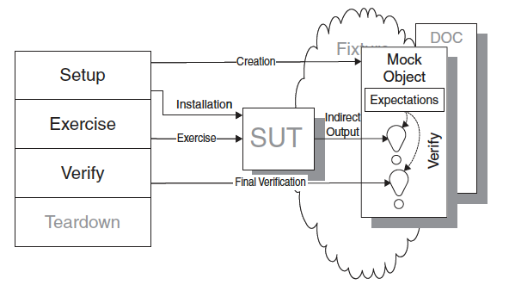
Mock Object
How do we implement Behavior Verification for indirect outputs of the SUT?
How can we verify logic independently when it depends on indirect inputs from other software components?
We replace an object on which the SUT depends on with a test specific object that verifies it is being used correctly by the SUT.

Slide 27
Mock Object - How it Works
Define a Mock Object that implements the same interface as an object on which the SUT depends.
During the test, configure the Mock Object with:
the values with which it should respond to the SUT and
the method calls (complete with expected arguments) it should expect from the SUT.
Before exercising the SUT, install the Mock Object so that the SUT uses it instead of the real implementation.
When called during SUT execution, the Mock Object compares the actual arguments received with the expected arguments using equality assertions and fails the test if they don’t match.

Slide 28
Test Doubles - Topic List
Understanding Test Double Terms (by example).
Defining Test Doubles.
Pattern Variations of Test Doubles.
Test Stubs:
Hand-coded Test Stub.
Configurable Test Stub.
Mock Objects:
Defining Mock Objects.
Mock Object Test Structure.
Maven.
Expectations.
ClassImposteriser.
A note of caution on Test Doubles.

Slide 29
Mock Object - Implementation
Tests written using Mock Objects look different from more traditional tests because all the expected behavior must be specified before the SUT is exercised.
This makes the tests harder to write and to understand.
The standard Four-Phase Test is altered somewhat when we use Mock Objects:
The fixture Setup phase of the test is broken down into a number of specific activities (next slide).
The result Verification phase more or less disappears, except for the possible presence of a call to the “final verification” method at the end of the test.
Setup
Exercise
Verify
Teardown

Slide 30
Mock Object - Test Structure
Fixture Setup:
Test constructs Mock Object.
Test configures Mock Object.
Test installs Mock Object into SUT.
Test sets expectations on mock object. i.e. what behavior it expects to be triggered by SUT
Exercise SUT:
SUT calls Mock Object; Mock Object does assertions.
Result Verification:
Test calls “final verification” method.
Fixture Teardown:
No impact.
Setup
Exercise
Verify
Teardown

Slide 31
Example - Motivation (from JMock Documentation)
public interface Subscriber
{
void receive(String message);
}
A Publisher sends messages to zero or one Subscriber.
We want to test the Publisher, which involves testing its interactions with its Subscribers.
We will test that a Publisher sends a message to a single registered Subscriber.
To test interactions between the Publisher and the Subscriber we will use a mock Subscriber object
public class Publisher
{
private Subscriber subscriber;
public void add(Subscriber subscriber)
{
this.subscriber = subscriber;
}
public void publish(String message)
{
if (subscriber != null)
subscriber.receive(message);
}
}

Slide 32
Configure Test Case
Having added the jMock jar files to your class path:
import the jMock classes
define our test fixture class and
create a "Mockery" that represents the context in which the Publisher exists.
The context mocks out the objects that the Publisher collaborates with (in this case a Subscriber) and checks that they are used correctly during the test.
import org.jmock.Expectations;
import org.jmock.Mockery;
import org.jmock.integration.junit4.JMock;
import org.jmock.integration.junit4.JUnit4Mockery;
import org.junit.Test;
import org.junit.runner.RunWith;
import sut.Publisher;
import sut.Subscriber;
@RunWith(JMock.class)
public class PublisherTest
{
Mockery context = new JUnit4Mockery();
...
}

Slide 33
Fixture Setup (1)
Write the method that will perform our test - first set up the context in which our test will execute:
Construct: create a Publisher to test.
Configure: create a mock Subscriber that should receive the message.
Install: register the Subscriber with the Publisher.
@Test
public void oneSubscriberReceivesAMessage()
{
Publisher publisher = new Publisher();
final Subscriber subscriber = context.mock(Subscriber.class);
publisher.add(subscriber);
....
}

Slide 34
Fixture Setup (2)
Define expectations on the mock Subscriber that specify the methods that we expect to be called upon it during the test run.
We expect the receive method to be called once with a single argument, the message that will be sent.
@Test
public void oneSubscriberReceivesAMessage()
{
...
context.checking(new Expectations()
{{
oneOf(subscriber).receive(message);
}});
...
}

Slide 35
Exercise SUT
@Test
public void oneSubscriberReceivesAMessage()
{
...
publisher.publish(message);
...
}
We then execute the code that we want to test.

Slide 36
Result Verification
After the code under test has finished our test must verify that the mock Subscriber was called as expected.
If the expected calls were not made, the test will fail. The MockObjectTestCase does this automatically.
You don't have to explicitly verify the mock objects in your tests.
@Test
public void oneSubscriberReceivesAMessage()
{
//Fixture Setup
Publisher publisher = new Publisher();
final Subscriber subscriber = context.mock(Subscriber.class);
publisher.add(subscriber);
final String message = "message";
//Expectations Set
context.checking(new Expectations()
{{
oneOf (subscriber).receive(message);
}});
//Exercise SUT
publisher.publish(message);
//Verify
//context.assertIsSatisfied();
}

Slide 37
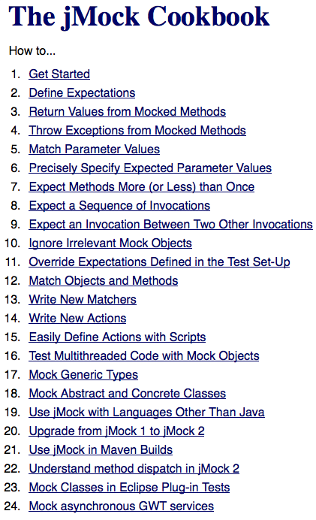
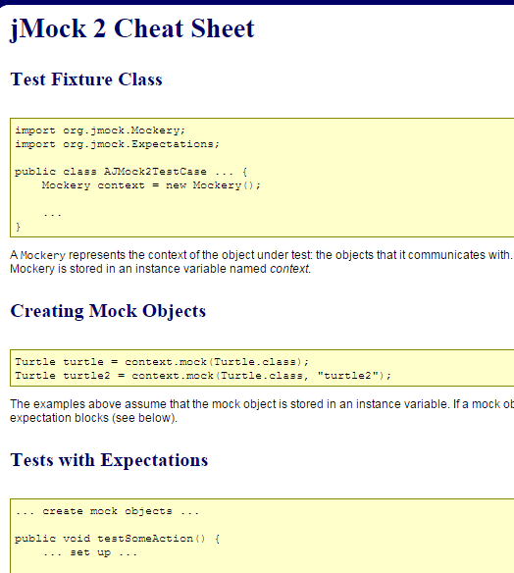
http://www.jmock.org/cheat-sheet.html
Good article on Mocks and Stubs:
http://martinfowler.com/articles/mocksArentStubs.html
http://www.jmock.org/cookbook.html

Slide 38
Test Doubles - Topic List
Understanding Test Double Terms (by example).
Defining Test Doubles.
Pattern Variations of Test Doubles.
Test Stubs:
Hand-coded Test Stub.
Configurable Test Stub.
Mock Objects:
Defining Mock Objects.
Mock Object Test Structure.
Maven.
Expectations.
ClassImposteriser.
A note of caution on Test Doubles.

Slide 39
Using jMock from Maven Builds
The jMock 2 jars are accessible via Maven 2 by declaring the following dependencies in your POM.
All the required dependencies on jMock will be included automatically.
<dependency>
<groupId>org.jmock</groupId>
<artifactId>jmock-junit4</artifactId>
<version>2.5.1</version>
</dependency>

Slide 40
Test Doubles - Topic List
Understanding Test Double Terms (by example).
Defining Test Doubles.
Pattern Variations of Test Doubles.
Test Stubs:
Hand-coded Test Stub.
Configurable Test Stub.
Mock Objects:
Defining Mock Objects.
Mock Object Test Structure.
Maven.
Expectations.
ClassImposteriser.
A note of caution on Test Doubles.

Slide 41
A note on Expectations
Expectations are defined within a "Double-Brace Block“.
It defines the expectations in the context of the test's Mockery.
An expectations block can contain any number of expectations.
Each expectation has the following structure:
Except for the invocation count and the mock object, all clauses are optional.
invocation-count (mock-object).method(argument-constraints);
inSequence(sequence-name);
when(state-machine.is(state-name));
will(action);
then(state-machine.is(new-state-name));

Slide 42
Returning Values
Return values from mocked methods by using the returnValue action within the "will" clause of an expectation.
The returnIterator action returns an iterator over a collection.
A convenient overload of the returnIterator method lets you specify the elements inline:
oneOf (calculator).add(1, 1); will(returnValue(2));
oneOf (calculator).add(2, 2); will(returnValue(5));
final List<Employee> employees = new ArrayList<Employee>();
employees.add(alice);
employees.add(bob);
context.checking(new Expectations()
{{
oneOf (department).employees(); will(returnIterator(employees));
}});
context.checking(new Expectations()
{{
oneOf (department).employees(); will(returnIterator(alice, bob));
}});

Slide 43
Exceptions
Use the throwException action to throw an exception from a mocked method.
allowing (bank).withdraw(with(any(Money.class)));
will(throwException(new WithdrawalLimitReachedException());

Slide 44
Expecting Methods More (or Less) than Once
oneOf The invocation is expected once and once only.
exactly(n).of The invocation is expected exactly n times. Note: oneOf is a convenient shorthand for exactly(1).
atLeast(n).of The invocation is expected at least n times.
atMost(n).of The invocation is expected at most n times.
between(min, max).of The invocation is expected at least min times and at most max times.
allowing The invocation is allowed any number of times but does not have to happen.
ignoring The same as allowing. Allowing or ignoring should be chosen to make the test code clearly express intent.
never The invocation is not expected at all. This is used to make tests more explicit and so easier to understand.

Slide 45
Test Doubles - Topic List
Understanding Test Double Terms (by example).
Defining Test Doubles.
Pattern Variations of Test Doubles.
Test Stubs:
Hand-coded Test Stub.
Configurable Test Stub.
Mock Objects:
Defining Mock Objects.
Mock Object Test Structure.
Maven.
Expectations.
ClassImposteriser.
A note of caution on Test Doubles.

Slide 46
Mocking Classes with jMock and the ClassImposteriser
The default configuration of the jMock framework can only mock interfaces, not classes.
However, the ClassImposteriser extension class uses the CGLIB 2.1 and Objenesis libraries to create mock objects of classes as well as interfaces.
This is useful when working with legacy code to tease apart dependencies between tightly coupled classes.
import org.jmock.Mockery;
import org.jmock.Expectations;
import org.jmock.integration.junit4.JUnit4Mockery;
import org.jmock.lib.legacy.ClassImposteriser;
@RunWith(JMock.class)
public class ConcreteClassTest
{
private Mockery context = new JUnit4Mockery()
{{
setImposteriser(ClassImposteriser.INSTANCE);
}};
@Test
void someTest()
{
Graphics g = context.mock(java.awt.Graphics.class);
// expectations and tests
}
}

Slide 47
Test Doubles - Topic List
Understanding Test Double Terms (by example).
Defining Test Doubles.
Pattern Variations of Test Doubles.
Test Stubs:
Hand-coded Test Stub.
Configurable Test Stub.
Mock Objects:
Defining Mock Objects.
Mock Object Test Structure.
Maven.
Expectations.
ClassImposteriser.
A note of caution on Test Doubles.

Slide 48
A word of caution on Test Doubles
Exercise caution when using Test Doubles: → you are testing the SUT in a different configuration from that which will be used in production.
→Have at least one test that verifies it works without a Test Double.
be careful you don’t replace the parts of the SUT that you are trying to verify as this can result in tests that test the wrong software!
excessive use of Test Doubles can result in Fragile Tests as a result of Overspecified Software (i.e. a test says too much about how the software should be structured or behave).

