Slide 1


Agile Software Development
Produced
by
Eamonn de Leastar (edeleastar@wit.ie)
Department of Computing, Maths & Physics
Waterford Institute of Technology
http://www.wit.ie
http://elearning.wit.ie

Slide 2
Mocking Opportunities in Pacemaker

Slide 3
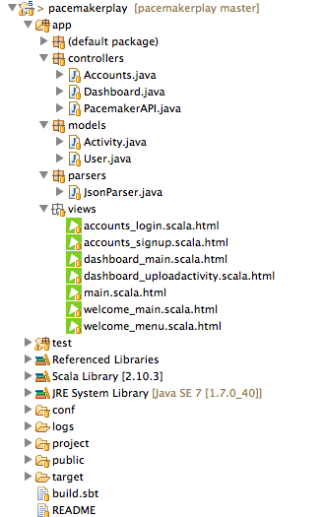
Pacemaker 2.0
REST Web Service
Standard Web UI

Slide 4
Assignment Rubric for Assignment 2 (top marks deployment + any 2 others)
Standard | Deployment | Features | UX | DX
Baseline | REST (Local) | activities (see runkeeper) | Console | Rest Tests
Good | REST (Deployed) | reports (see runkeeper) | Console - asciiart | Models
Excellent | REST (Secured e.g. OAuth) | friends (see runkeeper) | Simple Web | Test Doubles (Factor out pacemaker into 2 services)
Outstanding | REST (2 x cloud) | dashboard (see runkeeper) | Rich Client / Mobile App | API Documentation

Slide 5
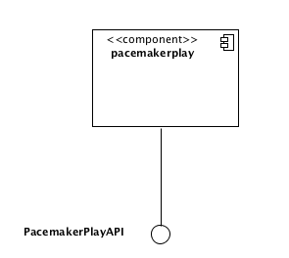
pacemakerplay service
Provides an API for managing:
users
activities
routes (within activities)
# API
GET /api/users controllers.PacemakerAPI.users()
DELETE /api/users controllers.PacemakerAPI.deleteAllUsers()
POST /api/users controllers.PacemakerAPI.createUser()
GET /api/users/:id controllers.PacemakerAPI.user(id: Long)
DELETE /api/users/:id controllers.PacemakerAPI.deleteUser(id: Long)
PUT /api/users/:id controllers.PacemakerAPI.updateUser(id: Long)
GET /api/users/:userId/activities controllers.PacemakerAPI.activities(userId: Long)
POST /api/users/:userId/activities controllers.PacemakerAPI.createActivity(userId: Long)
GET /api/users/:userId/activities/:activityId controllers.PacemakerAPI.activity(userId: Long, activityId:Long)
DELETE /api/users/:userId/activities/:activityId controllers.PacemakerAPI.deleteActivity(userId: Long, activityId:Long)
PUT /api/users/:userId/activities/:activityId controllers.PacemakerAPI.updateActivity(userId: Long, activityId:Long)

Slide 6
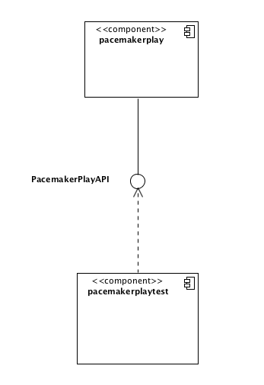
pacemakerplaytest
Exercise the API over HTTP
Full set of tests to verify key features

Slide 7
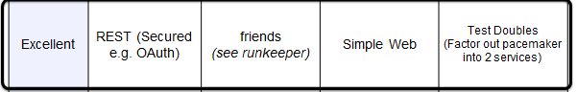
New Feature - ‘Social’
Follow friends
View Friends activities
‘Feeds’, etc…
Consider modelling this as a separate service
With its own API for managing
social graph
updates
follow/unfollow etc…

Slide 8
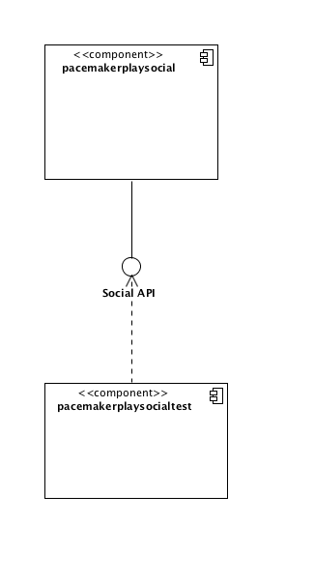
pacemakerplaysocial
Uncouple the social aspects from the core activity service.
Allows the social service to be constructed and optimised independently:
NoSQL database more appropriate.
Interfaces to Twitter, FaceBook, etc…

Slide 9
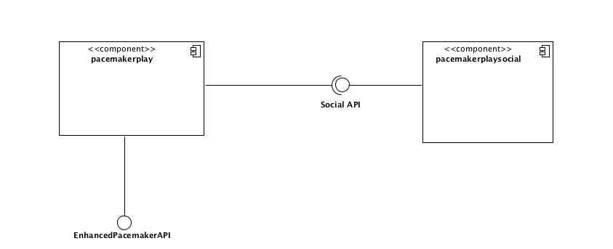
pacemakerplay → pacemakerplaysocial
‘Enhanced’ API uses Social features, provided by pacemakerplaysocial service

Slide 10
The Role of Mock Objects
Postpone the Construction of the pacemakerplaysocial component.
Model the API first as a REST API.
Mock out its implementation.
Then:
Write Tests against the Mocked out API.
Enhance pacemaker play API to incorporate social features.

Slide 11
pacemakerplay → pacemakerplaysocial
Mocked Implementation
Use REST Mocking Services to deliver realistic test data to pacemakerplay.

Slide 12
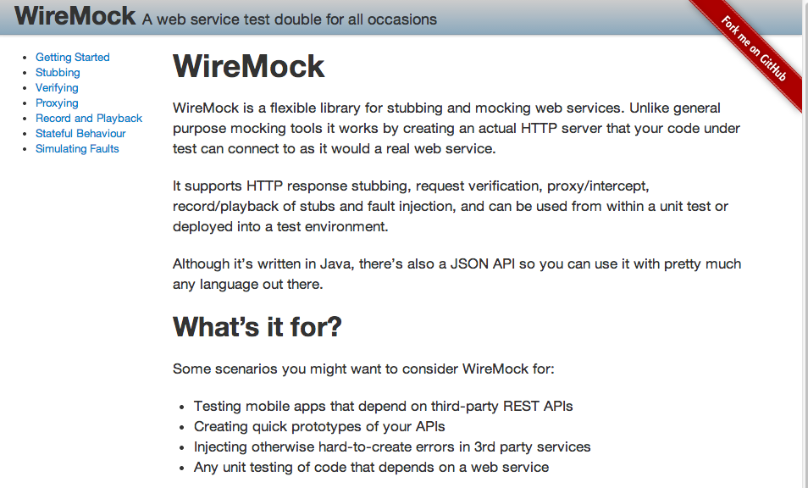

Slide 13
WireMock Video
Gives a very good introduction to WireMock with examples of how to use it:
https://skillsmatter.com/skillscasts/6853-scalable-management-of-test-data-making-tests-readable#video

Slide 14
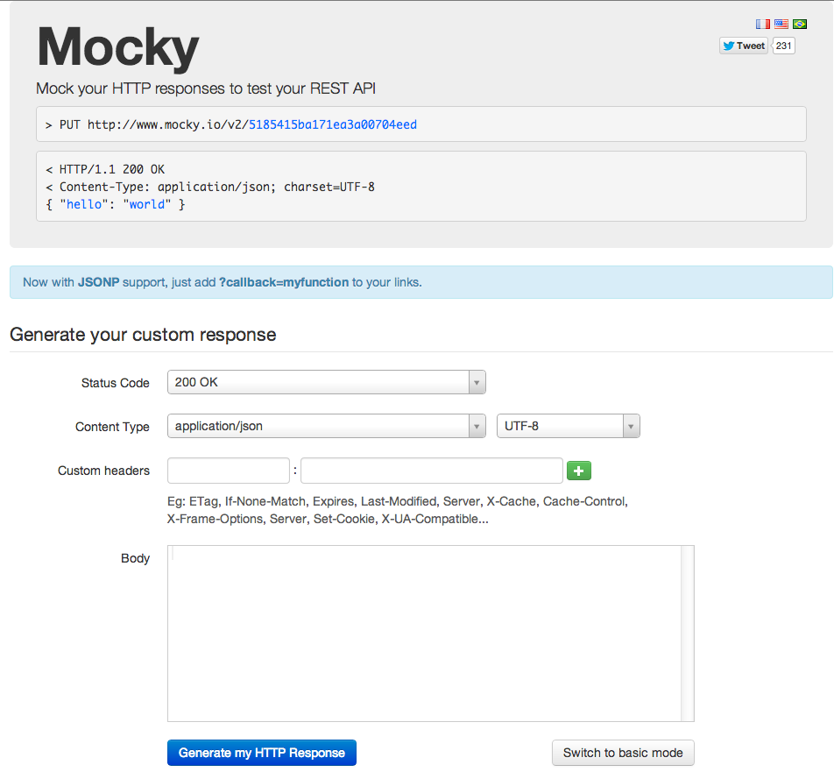
http://www.mocky.io/

Slide 15
Mocky
Mocky is a service that allows web developers to mock their HTTP responses in order to test the functionality of a REST API.
Available as:
A Web Console – www.mocky.io.
Downloadable software – for installation on your own server.

Slide 16
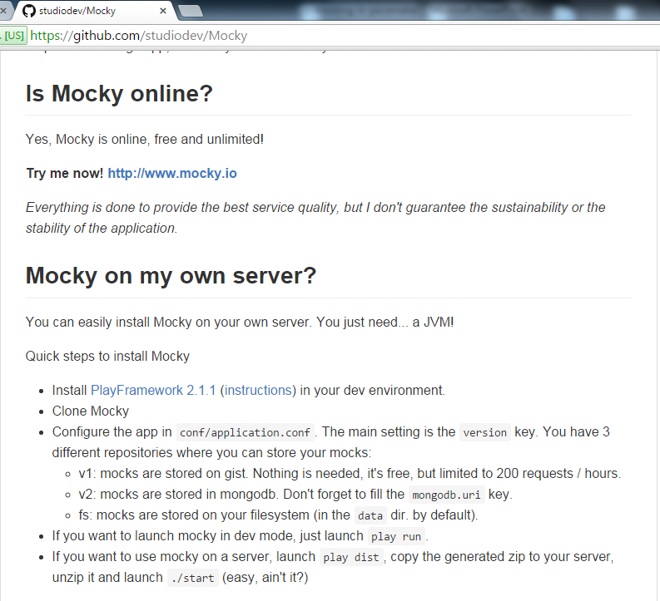

Slide 17
Key Text on Employing Test Doubles Effectively
Implementing TDD effectively: getting started, and maintaining your momentum throughout the project.
Creating cleaner, more expressive, more sustainable code.
Using tests to stay relentlessly focused on sustaining quality.
Understanding how TDD, Mock Objects, and Object-Oriented Design come together in the context of a real software development project.
Using Mock Objects to guide object-oriented designs.
Succeeding where TDD is difficult: managing complex test data, and testing persistence and concurrency.

Slide 18


TDD - Key Texts

Slide 19

Except where otherwise noted, this content is licensed under a Creative Commons Attribution-NonCommercial 3.0 License.
For more information, please see http://creativecommons.org/licenses/by-nc/3.0/

