Slide 1
Agile Software Development
Eamonn de Leastar (edeleastar@wit.ie)

Slide 2
First Tests

Slide 3
Assertions
To check if code is behaving as you expect, use an assertion, a simple method call that verifies that something is true.
E.g the method assertTrue checks that the given boolean condition is true
public void assertTrue(boolean condition)
{
if (!condition)
{
abort();
}
}

Slide 4
Using Asserts
You could use this assert to check all sorts of things, including whether numbers are equal to each other.
To check that two integers are equal, a method that takes two integer parameters might be more useful.
We can now write the first test a little more expressively:
int a = 2;
//...
assertTrue (a == 2);
public void assertEquals (int a, int b)
{
assertTrue(a == b);
}
int a = 2;
assertEquals (2, a);

Slide 5
Planning Tests
Method to test: A static method designed to find the largest number in a list of numbers.
The following tests would seem to make sense:
[7, 8, 9] -> 9
[8, 9, 7] -> 9
[9, 7, 8] -> 9
(supplied test data ->expected result)
public static int largest (int[] list)
{
...
}

Slide 6
More Test Data + First Implementation
Already have this data:
[7, 8, 9] -> 9
[8, 9, 7] -> 9
[9, 7, 8] -> 9
What about this set:
[7, 9, 8, 9] -> 9
[1] -> 1
[-9, -8, -7] -> -7
public static int largest (int[] list)
{
int index, max = Integer.MAX_VALUE;
for (index = 0; index < list.length - 1; index++)
{
if (list[index] > max)
{
max = list[index];
}
}
return max;
}

Slide 7
Writing the Test
import junit.framework.TestCase;
public class TestLargest extends TestCase
{
public TestLargest (String name)
{
super(name);
}
public void testOrder ()
{
int[] arr = new int[3];
arr[0] = 8;
arr[1] = 9;
arr[2] = 7;
assertEquals(9, Largest.largest(arr));
}
}
This is a TestCase called TestLargest.
It has one Unit Test - to verify the behaviour of the largest method.

Slide 8
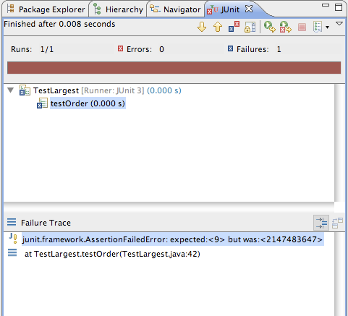
Running the Test
Why did it return such a huge number instead of our 9
Where could that very large number have come from?

Slide 9
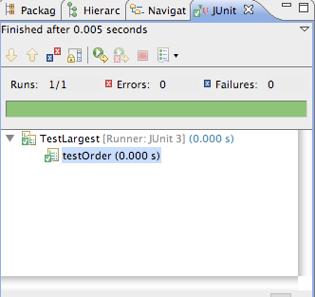
Bug
First line should initialize max to zero, not MAX_VALUE.
public static int largest (int[] list)
{
//int index, max = Integer.MAX_VALUE;
int index, max = 0;
for (index = 0; index < list.length - 1; index++)
{
if (list[index] > max)
{
max = list[index];
}
}
return max;
}

Slide 10
Further Tests
What happens when the largest number appears in different places in the list - first or last, and somewhere in the middle?
Bugs most often show up at the “edges”.
In this case, edges occur when the largest number is at the start or end of the array that we pass in.
Aggregate into a single unit test:
public void testOrder ()
{
assertEquals(9, Largest.largest(new int[] { 9, 8, 7 }));
assertEquals(9, Largest.largest(new int[] { 8, 9, 7 }));
assertEquals(9, Largest.largest(new int[] { 7, 8, 9 }));
}

Slide 11
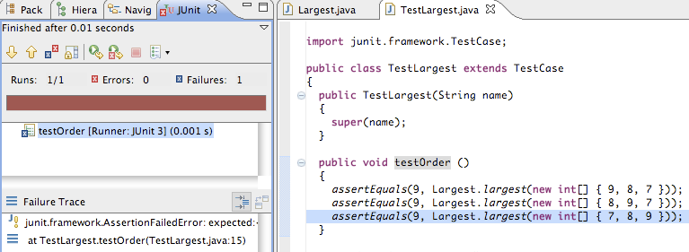
Failure + Fix
public static int largest (int[] list)
{
int index, max = 0;
//for (index = 0; index < list.length - 1; index++)
for (index = 0; index < list.length; index++)
{
if (list[index] > max)
{
max = list[index];
}
}
return max;
}

Slide 12
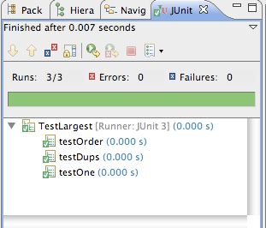
Further Boundary Conditions
public void testDups ()
{
assertEquals(9, Largest.largest(new int[] { 9, 7, 9, 8 }));
}
public void testOne ()
{
assertEquals(1, Largest.largest(new int[] { 1 }));
}
Now exercising multiple tests

Slide 13
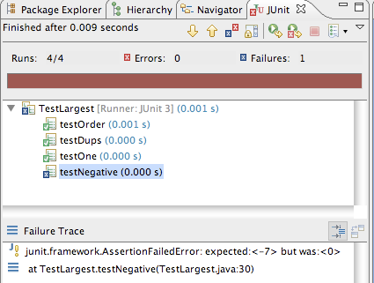
Failure on testNegative
public void testNegative ()
{
int[] negList = new int[] { -9, -8, -7 };
assertEquals(-7, Largest.largest(negList));
}

Slide 14
fix testNegative
public static int largest (int[] list)
{
//int index, max = 0;
int index, max = Integer.MIN_VALUE;
for (index = 0; index < list.length; index++)
{
if (list[index] > max)
{
max = list[index];
}
}
return max;
}
Choosing 0 to initialize max was a bad idea;
Should have been MIN VALUE, so as to be less than all negative numbers as well.

Slide 15
Expected Errors?
public static int largest (int[] list)
{
int index, max = Integer.MIN_VALUE;
if (list.length == 0)
{
throw new RuntimeException("Empty list");
}
for (index = 0; index < list.length; index++)
{
if (list[index] > max)
{
max = list[index];
}
}
return max;
}
If the array is empty, this is considered an error, and an exception should be thrown.
public void testEmpty ()
{
try
{
Largest.largest(new int[] {});
fail("Should have thrown an exception");
}
catch (RuntimeException e)
{
assertTrue(true);
}
}

