Slide 1


Agile Software Development
Produced
by
Eamonn de Leastar (edeleastar@wit.ie)
Department of Computing, Maths & Physics
Waterford Institute of Technology
http://www.wit.ie
http://elearning.wit.ie

Slide 2
Database / Schema Evolution

Slide 3
Database Evolution
Database evolution (sometimes called schema evolution) refers to the problem of evolving a database schema to adapt it to a change in the modeled reality.
The problem is not limited to the modification of the schema, also affecting the data stored under the given schema
“The problem has been recognized as a very pressing one by the database community for more than 12 years … support for Schema Evolution, is a difficult problem involving complex mapping among schema versions, the tool support has been so far very limited. The recent theoretical advances on mapping composition and mapping invertibility, which represent the core problems underlying the schema evolution remains almost inaccessible to the large public”
http://en.wikipedia.org/wiki/Schema_evolution

Slide 4
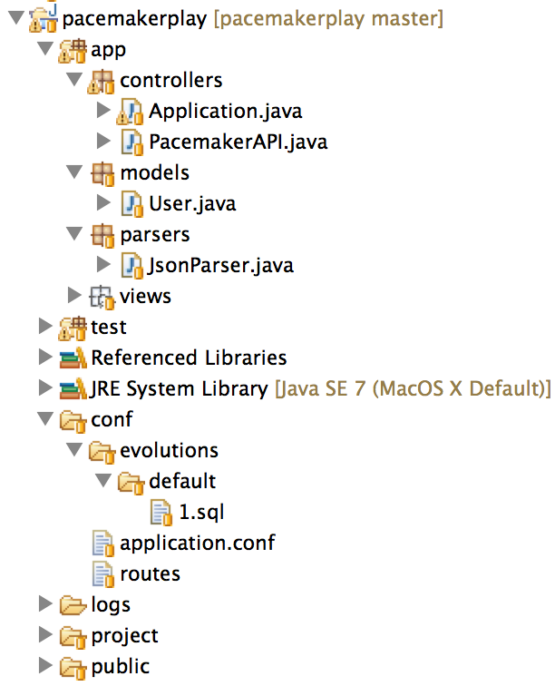
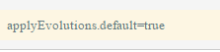
Database Evolution in Play (1)
In the application.conf file, add the line:

Slide 5
Database Evolution in Play (2)
Play monitors model classes and generates a new SQL script if it detects a change in the model from the pre-existing script.
This script can also be manually updated and maintained.

Slide 6
Evolution Script (1)
# --- Created by Ebean DDL
# --- !Ups
create table my_user (
id bigint not null,
firstname varchar(255),
lastname varchar(255),
email varchar(255),
password varchar(255),
constraint pk_my_user primary key (id))
;
create sequence my_user_seq;
# --- !Downs
drop table if exists my_user cascade;
drop sequence if exists my_user_seq;
@SuppressWarnings("serial")
@Entity
@Table(name="my_user")
public class User extends Model
{
@Id
@GeneratedValue
public Long id;
public String firstname;
public String lastname;
public String email;
public String password;
…

Slide 7
Evolution Script (2)
# --- Created by Ebean DDL
# --- !Ups
create table my_user (
id bigint not null,
firstname varchar(255),
lastname varchar(255),
email varchar(255),
password varchar(255),
nationality varchar(255),
constraint pk_my_user primary key (id))
;
create sequence my_user_seq;
# --- !Downs
drop table if exists my_user cascade;
drop sequence if exists my_user_seq;
@SuppressWarnings("serial")
@Entity
@Table(name="my_user")
public class User extends Model
{
@Id
@GeneratedValue
public Long id;
public String firstname;
public String lastname;
public String email;
public String password;
public String nationality;
…

Slide 8
More interesting model
@Entity
@Table(name="my_user")
public class User extends Model
{
@Id
@GeneratedValue
public Long id;
public String firstname;
public String lastname;
public String email;
public String password;
@OneToMany(cascade=CascadeType.ALL)
public List<Activity> activities = new ArrayList<Activity>();
//…
}
@Entity
public class Activity extends Model
{
@Id
@GeneratedValue
public Long id;
public String type;
public String location;
public double distance;
//…
}
CascadeType.ALL: persistence will propagate (cascade) all EntityManager operations (PERSIST, REMOVE, REFRESH, MERGE, DETACH) to the relating entities.
Notes:
http://stackoverflow.com/questions/13027214/jpa-manytoone-with-cascadetype-all

Slide 9
application.conf
Database URL different for local/Heroku database
Database Driver also different!
This implies the syntax of the evolution script may differ depending on which driver is loaded.
#db.default.driver=org.postgresql.Driver
#db.default.url=${DATABASE_URL}
db.default.driver=org.h2.Driver
db.default.url="jdbc:h2:mem:play"
db.default.user=sa
db.default.password=""

Slide 10
Different Evolutions!
create table activity (
id bigint not null,
user_id bigint not null,
type varchar(255),
location varchar(255),
distance double,
constraint pk_activity primary key (id))
;
create table my_user (
id bigint not null,
firstname varchar(255),
lastname varchar(255),
email varchar(255),
password varchar(255),
constraint pk_my_user primary key (id))
;
create sequence activity_seq;
create sequence my_user_seq;
alter table activity add constraint fk_activity_my_user_1 foreign key (user_id) references my_user (id) on delete restrict on update restrict;
create index ix_activity_my_user_1 on activity (user_id);
SET REFERENTIAL_INTEGRITY FALSE;
drop table if exists activity;
drop table if exists my_user;
SET REFERENTIAL_INTEGRITY TRUE;
drop sequence if exists activity_seq;
drop sequence if exists my_user_seq;
create table activity (
id bigint not null,
user_id bigint not null,
type varchar(255),
location varchar(255),
distance float,
constraint pk_activity primary key (id))
;
create table my_user (
id bigint not null,
firstname varchar(255),
lastname varchar(255),
email varchar(255),
password varchar(255),
constraint pk_my_user primary key (id))
;
create sequence activity_seq;
create sequence my_user_seq;
alter table activity add constraint fk_activity_my_user_1 foreign key (user_id) references my_user (id);
create index ix_activity_my_user_1 on activity (user_id);
drop table if exists activity cascade;
drop table if exists my_user cascade;
drop sequence if exists activity_seq;
drop sequence if exists my_user_seq;
Postgres
MySql

Slide 11
Switching Drivers
This will not run locally.
${DATABASE_URL} is only valid inside the Heroku environment:
i.e. it indicates the database connection string is to come from the environment variable on Heroku.
→ Evolution will not be generated unless:
Use Postgres database locally
Connect to Postgres in Heroku
db.default.driver=org.postgresql.Driver
db.default.url=${DATABASE_URL}
#db.default.driver=org.h2.Driver
#db.default.url=“jdbc:h2:mem:play"
#db.default.user=sa
#db.default.password=“"

Slide 12
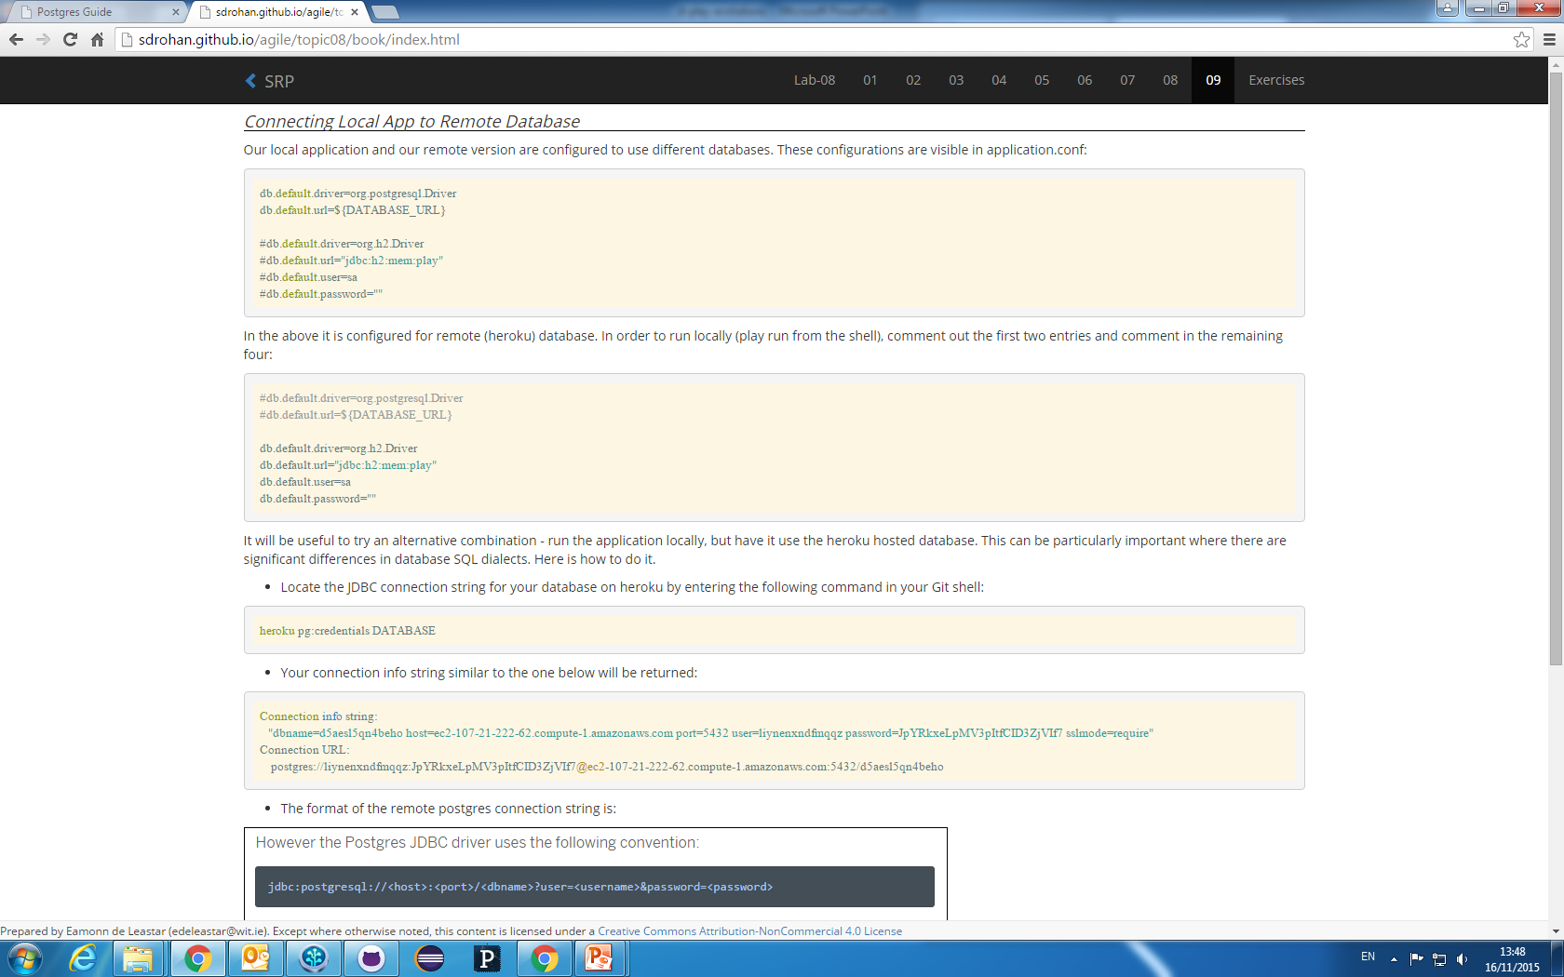
Connecting Local App to Postgres on Heroku (1)
Locate the JDBC connection string for your database on Heroku by entering the following command in your Git shell:
Your connection info string similar to the one below will be returned:

Slide 13
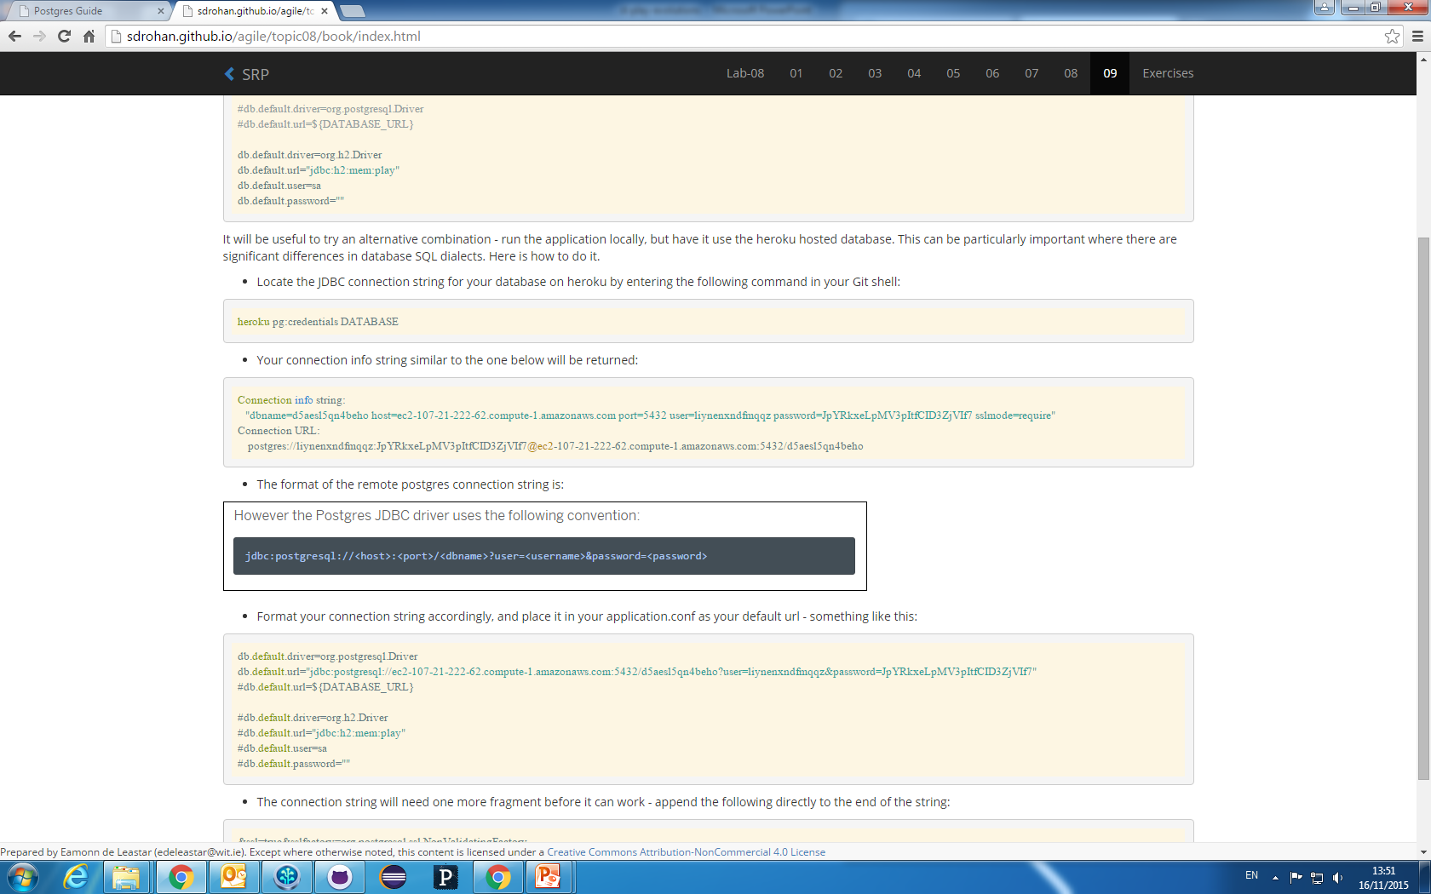
Connecting Local App to Postgres on Heroku (2)
Format your connection string accordingly, and place it in your application.conf as your default url:

Slide 14
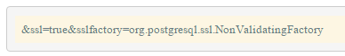
Connecting Local App to Postgres on Heroku (3)
The connection string will need one more fragment before it can work - append the following directly to the end of the string:
Restart the local app, it should be using the Postgres database on Heroku.

Slide 15
Approach: Evolve Locally - Deploy Remotely
Evolve the database locally.
Commit the generated SQL script to Git.
Push to Heroku.
This will trigger a remote evolution.

Slide 16

Except where otherwise noted, this content is licensed under a Creative Commons Attribution-NonCommercial 3.0 License.
For more information, please see http://creativecommons.org/licenses/by-nc/3.0/

