Slide 1
Agile Software Development
Eamonn de Leastar (edeleastar@wit.ie)

Slide 2
Maven
Objectives:
Provide a standard development infrastructure across projects.
Make the development process transparent.
Decrease training for new developers.
Bring together tools in a uniform way.
Prevent inconsistent setups.
Divert energy to application development activities.
Maven is a process of applying patterns to a build infrastructure in order to provide a coherent view of software projects.

Slide 3
Maven Principles
Convention over configuration
Reuse of build logic
Declarative execution
Coherent organization of dependencies

Slide 4
Convention over configuration
Provide sensible default strategies for the most common build tasks
The primary conventions to promote a familiar development environment are:
Standard directory layout for projects
Standardised set of build phases – lifecycle phases
A single Maven project produces a single output/artifact
Standard naming conventions
Conventions are Maven’s understanding of how a project is typically built. This built-in project knowledge simplifies and facilitates project builds.
Leverages its built-in project knowledge to help users understand a complex project's structure and potential variations in the build process.

Slide 5
Maven Principles
Convention over configuration
Reuse of build logic
Declarative execution
Coherent organization of dependencies

Slide 6
Reuse of build logic
Maven encapsulates build logic into modules called plugins.
A plugin’s components, called mojos, perform build tasks.
MOJO - Maven plain Old Java Objects
Maven acts as a framework which coordinates the execution of plugins in a well defined way.
Some plugins are standard, others are downloaded on demand.

Slide 7
Maven Principles
Convention over configuration
Reuse of build logic
Declarative execution
Coherent organization of dependencies

Slide 8
Declarative Execution
Ant’s typical target names are standardised into a set of well-defined and well-known build lifecycle phases.
A lifecycle phase invokes the relevant plugins (the mojos) to do the work.
The phase to plugin bindings are hardwired (for standard plugins).
User configures a plugin declaratively in the POM (Project Object Model) file.
Configuration only necessary for non-standard cases.

Slide 9

Declarative Execution
Maven
generate- sources
mojo
compile
mojo
test
mojo
plugins
package
integration- test
user
mojo
install
e.g. mvn install
mojo
deploy
bindings
Well-known phases
Notes:
- MOJO = Maven POJO = goals. For example when you call « mvn [plugin prefix]:[goal name] » it is mapped to a mojo at execution time.
- There are more phases than those represented:
<phases>
<phase>validate</phase>
<phase>initialize</phase>
<phase>generate-sources</phase>
<phase>process-sources</phase>
<phase>generate-resources</phase>
<phase>process-resources</phase>
<phase>compile</phase>
<phase>process-classes</phase>
<phase>generate-test-sources</phase>
<phase>process-test-sources</phase>
<phase>generate-test-resources</phase>
<phase>process-test-resources</phase>
<phase>test-compile</phase>
<phase>test</phase>
<phase>package</phase>
<phase>integration-test</phase>
<phase>verify</phase>
<phase>install</phase>
<phase>deploy</phase>
</phases>

Slide 10
Declarative Execution
When user invokes a lifecycle phase, all its predecessors are also executed, if necessary, e.g. mvn package.
You can also invoke plugins directly.
Format: mvn plugin-name:goal
e.g. mvn jetty:run

Slide 11
Declarative Execution
The POM file (pom.xml) is Maven's description of a single project.
It drives Maven’s execution for a project:
e.g configuring a plugin for a particular phase.
Contains metadata about the project
Location of directories, Developers/Contributors, Extra plugins required, Special plugin configuration, Jars required (3rd party and in-house), Repositories to search for plugins/jars, etc.
A project’s POM inherits from the Super POM.
All standard project information (e.g. directory structure) is held in the Super POM (principle).

Slide 12
Minimalist POM
<project>
<modelVersion>4.0.0</modelVersion>
<groupId>com.mycompany.app</groupId>
<artifactId>my-app</artifactId>
<packaging>jar</packaging>
<version>1.0</version>
<dependencies>
<dependency>
<groupId>com.thoughtworks.xstream</groupId>
<artifactId>xstream</artifactId>
<version>1.3.1</version>
</dependency>
</dependencies>
</project>

Slide 13
Maven Principles
Convention over configuration
Reuse of build logic
Declarative execution
Coherent organization of dependencies

Slide 14
Coherent organization of dependencies
Three related concepts: Artifact; Dependencies; Repositories
<project>
………
<dependencies>
<dependency>
<groupId>com.thoughtworks.xstream</groupId>
<artifactId>xstream</artifactId>
<version>1.3.1</version>
</dependency>
</dependencies>
</project>
This project has a dependency
on version 1.3.1 of the artifact
with id xstream, produced by the
com.thoughtworks.xstream group.

Slide 15
Coherent organization of dependencies
All artifacts/dependencies are stored in repositories
Local and remote repositories
The local repository is searched first, then remote ones
Dependencies are automatically downloaded (from remote repositories) and installed (in local repository) for future use
Maven knows about some remote repositories, e.g.
http://ibiblio.org/maven2
Other remote repositories can be listed in the project POM or in Maven’s configuration file (setting.xml)

Slide 16
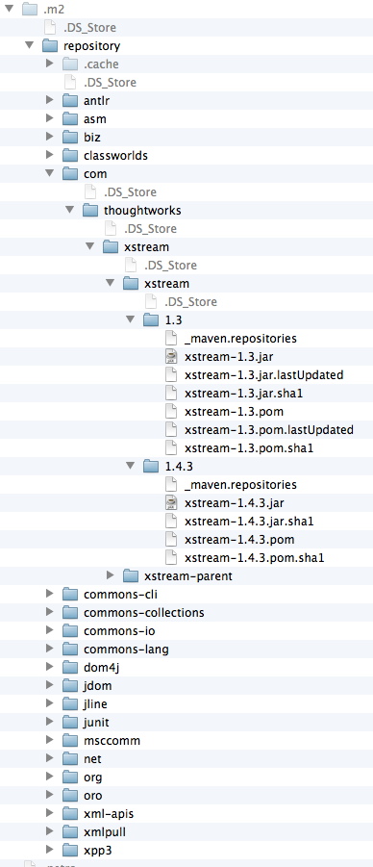
Local repositories
After installing and running Maven for the first time a local repository is automatically created and populated with some standard artifacts.
Default Local repository location: Home/.m2/repository
Plugins are also stored in repositories.
In theory a repository is an abstract storage mechanism, but in practice it is a directory structure in your file system

Slide 17
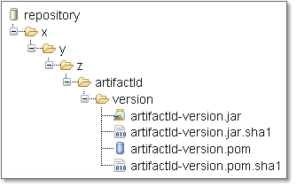
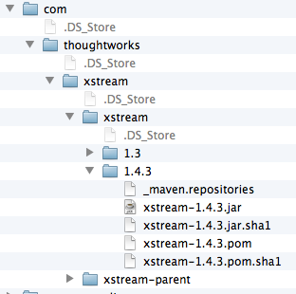
Repository structure
Repository structure centered around dependency coordinates schema.
Maven uses artifact’s id, group id. and version to navigate to the correct folder.
If the groupId is a fully qualified domain name such as x.y.z then it is fully expanded.

Slide 18
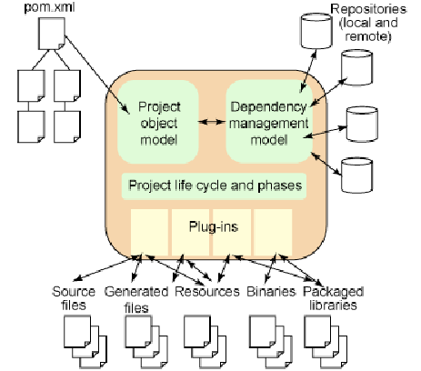
The full picture

Slide 19
Archetypes
An archetype is a template project structure.
Many archetype options:
maven-archetype-webapp – Web application (WAR) project template
maven-archetype-j2ee-simple – J2EE project (EAR) with directories and subprojects for the EJBs, servlets, etc.
maven-archetype-quickstart (default) – simple Java project (JAR)
Create a new project folder structure with the archetype plugin, invoking the create goal
mvn archetype:create
-DgroupId=[your project's group id]
-DartifactId=[your project's artifact id]
-DarchetypeArtifactId=[artifact type]

Slide 20

Quickstart archetype
Folder structure for ‘quickstart’ archetype.
The base directory name is taken from artifactid.
A minimal POM is included in base directory.

