Slide 1
Agile Software Development
Eamonn de Leastar (edeleastar@wit.ie)

Slide 2
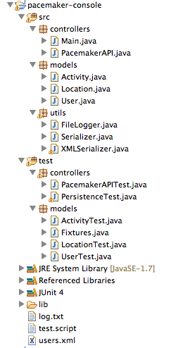
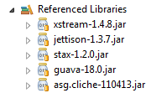
pacemaker-console
Take the pacemaker-console (java) project.
Note the external dependencies:
xstream-1.4.8.jar
guava-18.0.jar
asg.cliche-11-413.jar

Slide 3
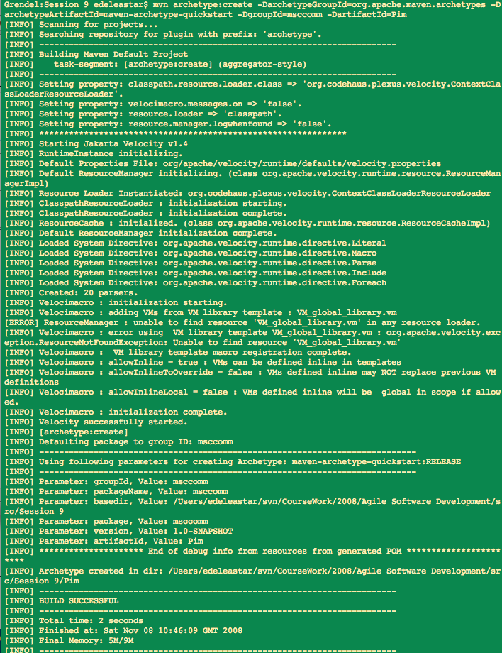
Project
Creation Archetype
From the command line, execute maven command to create a project skeleton structure:
mvn archetype:generate -DarchetypeGroupId=org.apache.maven.archetypes
-DarchetypeArtifactId=maven-archetype-quickstart
-DgroupId=pacemaker
-DartifactId=pacemaker-console-maven

Slide 4
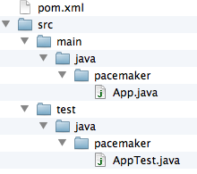
Generated Directory Structure
The generated directory structure contains two dummy java files that can be discarded
It also generates a POM, which is the basis for the project dependency structure.
<project xmlns="http://maven.apache.org/POM/4.0.0" xmlns:xsi="http://www.w3.org/2001/XMLSchema-instance"
xsi:schemaLocation="http://maven.apache.org/POM/4.0.0 http://maven.apache.org/xsd/maven-4.0.0.xsd">
<modelVersion>4.0.0</modelVersion>
<groupId>pacemaker</groupId>
<artifactId>pacemaker-console-maven</artifactId>
<version>1.0-SNAPSHOT</version>
<packaging>jar</packaging>
<name>pacemaker-console-maven</name>
<url>http://maven.apache.org</url>
<properties>
<project.build.sourceEncoding>UTF-8</project.build.sourceEncoding>
</properties>
<dependencies>
<dependency>
<groupId>junit</groupId>
<artifactId>junit</artifactId>
<version>3.8.1</version>
<scope>test</scope>
</dependency>
</dependencies>
</project>

Slide 5
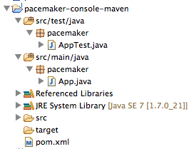
Generate ‘Eclipse’ project
Generates the ‘.project’ and ‘.classpath’ Eclipse uses to specify project name, structure and dependencies.
The project can then be ‘imported’ into eclipse.
mvn eclipse:eclipse

Slide 6
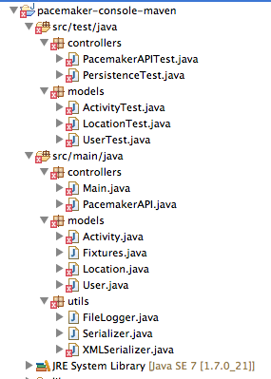
Manipulate the project in eclipse...
Copy Paste sources from original project into maven generated project.
Reference errors - project is missing ‘Referenced Libraries’

Slide 7
Default POM
<project xmlns="http://maven.apache.org/POM/4.0.0" xmlns:xsi="http://www.w3.org/2001/XMLSchema-instance"
xsi:schemaLocation="http://maven.apache.org/POM/4.0.0 http://maven.apache.org/xsd/maven-4.0.0.xsd">
<modelVersion>4.0.0</modelVersion>
<groupId>pacemaker</groupId>
<artifactId>pacemaker-console-maven</artifactId>
<version>1.0-SNAPSHOT</version>
<packaging>jar</packaging>
<name>pacemaker-console-maven</name>
<url>http://maven.apache.org</url>
<properties>
<project.build.sourceEncoding>UTF-8</project.build.sourceEncoding>
</properties>
<dependencies>
<dependency>
<groupId>junit</groupId>
<artifactId>junit</artifactId>
<version>3.8.1</version>
<scope>test</scope>
</dependency>
</dependencies>
</project>

Slide 8
url + version
<version>1.0</version>
<url>http://www.wit.ie</url>
<project...>
<modelVersion>4.0.0</modelVersion>
<groupId>pacemaker</groupId>
<artifactId>pacemaker-console-maven</artifactId>
<version>1.0</version>
<packaging>jar</packaging>
<name>pacemaker-console-maven</name>
<url>http://www.wit.ie</url>
<properties>
<project.build.sourceEncoding>UTF-8</project.build.sourceEncoding>
</properties>
<dependencies>
<dependency>
<groupId>junit</groupId>
<artifactId>junit</artifactId>
<version>3.8.1</version>
<scope>test</scope>
</dependency>
</dependencies>
</project>

Slide 9
Java 8 Support + ‘rev’ Junit to 4.11
<properties>
<project.build.sourceEncoding>UTF-8</project.build.sourceEncoding>
<maven.compiler.source>1.8</maven.compiler.source>
<maven.compiler.target>1.8</maven.compiler.target>
</properties>
<dependency>
<groupId>junit</groupId>
<artifactId>junit</artifactId>
<version>4.11</version>
<scope>test</scope>
</dependency>

Slide 10
<project ...>
<groupId>pacemaker</groupId>
<artifactId>pacemaker-console-maven</artifactId>
<version>1.0</version>
<packaging>jar</packaging>
<name>pacemaker-console-maven</name>
<url>http://www.wit.ie</url>
<properties>
<project.build.sourceEncoding>UTF-8</project.build.sourceEncoding>
<maven.compiler.source>1.8</maven.compiler.source>
<maven.compiler.target>1.8</maven.compiler.target>
</properties>
<dependencies>
<dependency>
<groupId>junit</groupId>
<artifactId>junit</artifactId>
<version>4.11</version>
<scope>test</scope>
</dependency>
</dependencies>
</project>
Java 8 Support +
‘rev’ Junit to 4.11

Slide 11
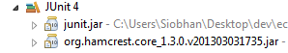
Dependencies
JUnit installed.
Need to incorporate:
guava
xstream
and also
asg.cliche
what about
hamcrest-core?
Well supported, maintained components:
xstream, guava
abandoned, legacy?
asg.cliche
Downstream dependency of junit
hamcrest-core

Slide 12
Dependency entries
<dependencies>
<dependency>
<groupId>junit</groupId>
<artifactId>junit</artifactId>
<version>4.11</version>
<scope>test</scope>
</dependency>
<dependency>
<groupId>com.google.guava</groupId>
<artifactId>guava</artifactId>
<version>18.0</version>
</dependency>
<dependency>
<groupId>com.thoughtworks.xstream</groupId>
<artifactId>xstream</artifactId>
<version>1.4.8</version>
</dependency>
<dependency>
<groupId>asg-cliche</groupId>
<artifactId>asg-cliche</artifactId>
<version>1.0</version>
</dependency>
</dependencies>
Junit
guava
xstream
asg.cliche
JUnit ‘depends on’ hamcrest’, and including JUnit will automatically incorporate hamcrest into build

Slide 13
Complete POM
<project ...>
<groupId>pacemaker</groupId>
<artifactId>pacemaker-console-maven</artifactId>
<version>1.0</version>
<packaging>jar</packaging>
<name>pacemaker-console-maven</name>
<url>http://www.wit.ie</url>
<properties>
<project.build.sourceEncoding>UTF-8</project.build.sourceEncoding>
<maven.compiler.source>1.8</maven.compiler.source>
<maven.compiler.target>1.8</maven.compiler.target>
</properties>
<dependencies>
<dependency>
<groupId>junit</groupId>
<artifactId>junit</artifactId>
<version>4.11</version>
<scope>test</scope>
</dependency>
<dependency>
<groupId>com.google.guava</groupId>
<artifactId>guava</artifactId>
<version>18.0</version>
</dependency>
<dependency>
<groupId>com.thoughtworks.xstream</groupId>
<artifactId>xstream</artifactId>
<version>1.4.8</version>
</dependency>
<dependency>
<groupId>asg-cliche</groupId>
<artifactId>asg-cliche</artifactId>
<version>1.0</version>
</dependency>
</dependencies>
</project>
Project identifiers
Project version
Language version
Dependencies

Slide 14
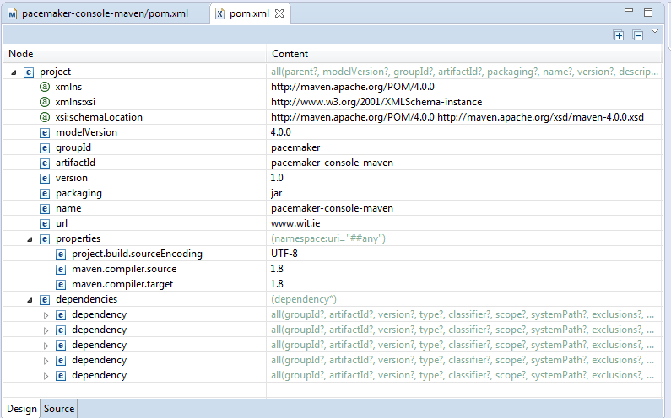
Design View (Eclipse XML Editor)

Slide 15
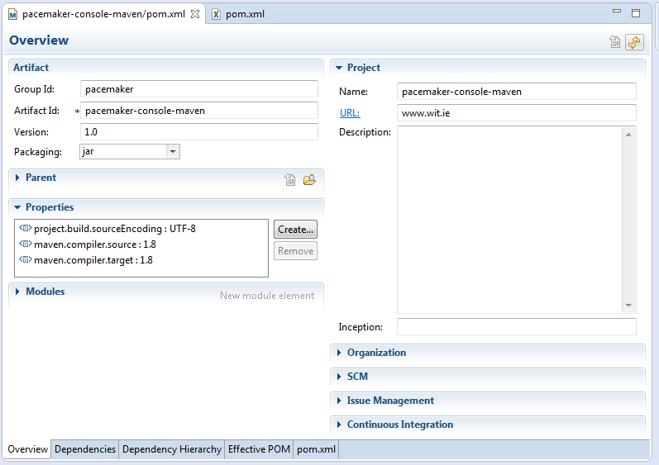
Eclipse Maven Support (via Maven plugin)

Slide 16
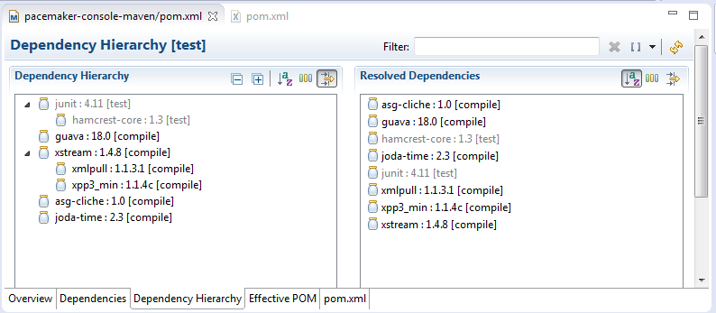
Dependency Hierarchy
Shows ‘implicit’ dependencies:
Hamcrest (for JUnit),
xmlpull, xpp3_min (parsing engine)

Slide 17
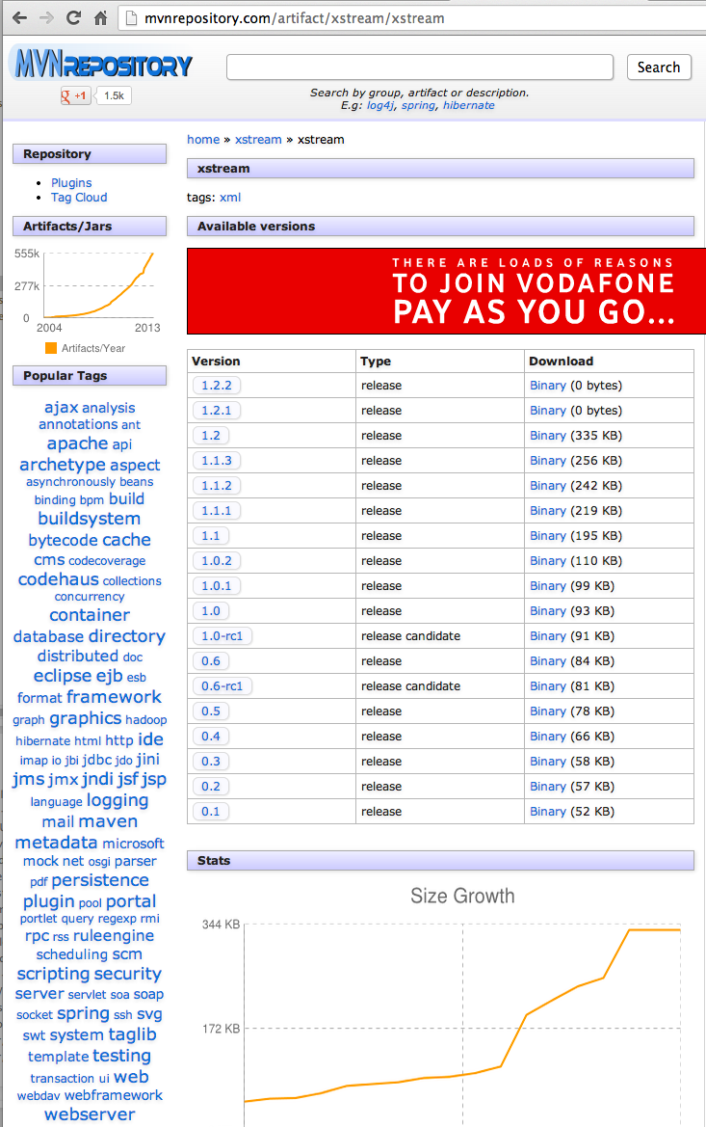
Supported Libraries
junit, guava and xstream are all under active development.
Latest versions are deposited in public maven repositories.

Slide 18
Unsupported Libraries
asg-cliche is not under active development, and is not in any public maven repo.
To keep our build consistent, we install asg-cliche in our local repo:
Our maven build will find it locally, and resolve to that version without searching further.
mvn install:install-file
-Dfile=asg-cliche-1.0.jar
-DgroupId=asg-cliche
-DartifactId=asg-cliche
-Dversion=1.0
-Dpackaging=jar

Slide 19
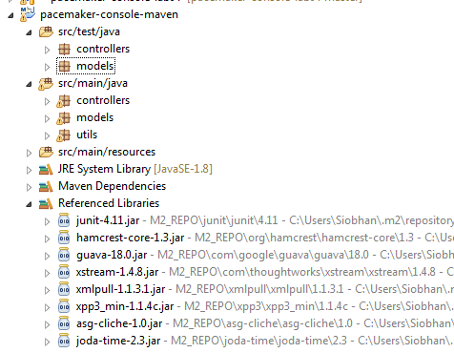
Regenerate Eclipse Version
On command line, instruct maven to refresh the eclipse project
mvn eclipse:eclipse
This will now include dependancies, including inferred upstream dependencies

Slide 20
Maven Lifecycles
Maven is based around the central concept of a build lifecycle - a clearly defined process for building and distributing a particular artifact.
Only necessary to learn a small set of commands to build any Maven project, and the POM will ensure correct execution.
There are three built-in build lifecycles:
default: handles your project deployment.
clean: handles project re-initialization/clean up.
site: handles the creation of the project's documentation.

Slide 21
Maven Default Lifecycle
Each of these build lifecycles is defined by a different list of build phases, wherein a build phase represents a stage in the lifecycle.
For example, the default lifecycle has the following build phases (for a complete list of the build phases, refer to the Lifecycle Reference):
validate
compile
test
package
integration-test
verify
install
deploy

Slide 22
pacemaker
<project ...>
<groupId>pacemaker</groupId>
<artifactId>pacemaker-console-maven</artifactId>
<version>1.0</version>
<packaging>jar</packaging>
<name>pacemaker-console-maven</name>
<url>http://www.wit.ie</url>
<properties>
<project.build.sourceEncoding>UTF-8</project.build.sourceEncoding>
<maven.compiler.source>1.7</maven.compiler.source>
<maven.compiler.target>1.7</maven.compiler.target>
</properties>
<dependencies>
<dependency>
<groupId>junit</groupId>
<artifactId>junit</artifactId>
<version>4.11</version>
<scope>test</scope>
</dependency>
<dependency>
<groupId>com.google.guava</groupId>
<artifactId>guava</artifactId>
<version>15.0</version>
</dependency>
<dependency>
<groupId>com.thoughtworks.xstream</groupId>
<artifactId>xstream</artifactId>
<version>1.4.4</version>
</dependency>
<dependency>
<groupId>asg-cliche</groupId>
<artifactId>asg-cliche</artifactId>
<version>1.0</version>
</dependency>
</dependencies>
</project>
The build phases we will look at:
Validate
Compile
Test
Package
Install

Slide 23
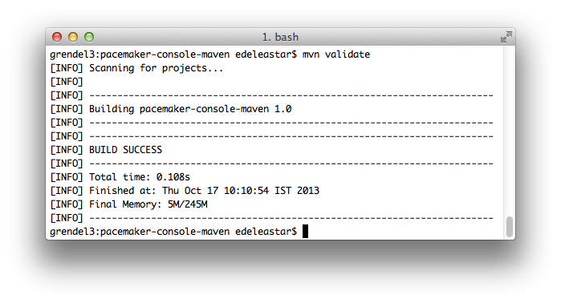
Build phase: validate
Validate the project is correct and all necessary information is available

Slide 24
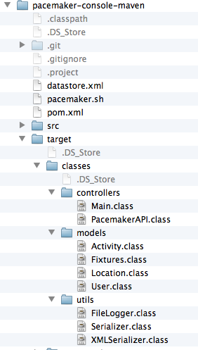
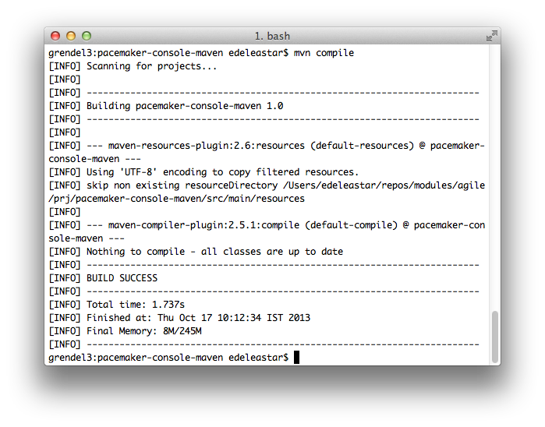
Build phase: compile
compile the source code of the project

Slide 25
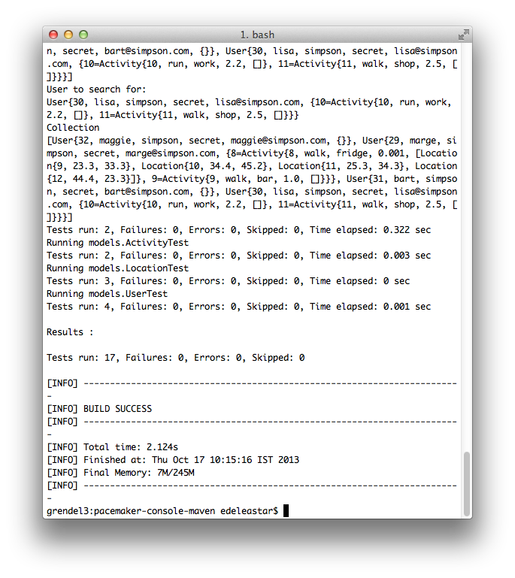
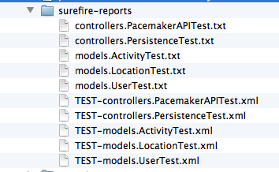
Build phase: test
test the compiled source code using a suitable unit testing framework. These tests should not require the code be packaged or deployed.
Maven Surefire Report Plugin (reports the results of the unit tests)

Slide 26
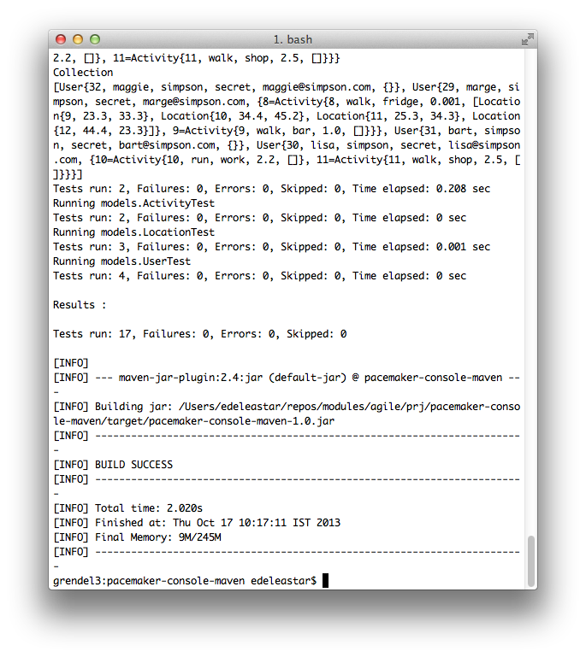
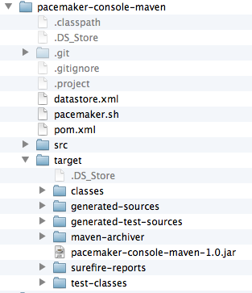
Build phase: package
take the compiled code and package it in its distributable format, such as a JAR.

Slide 27
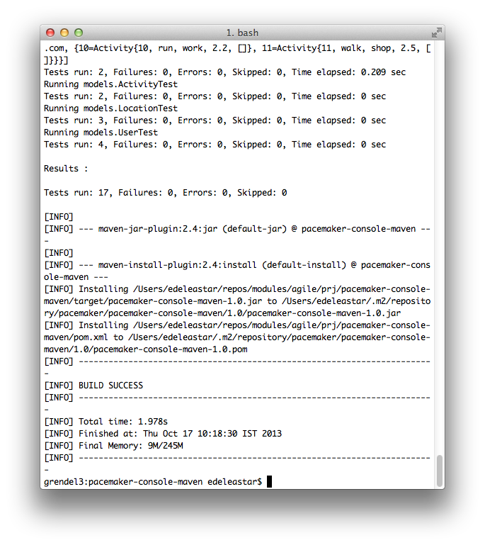
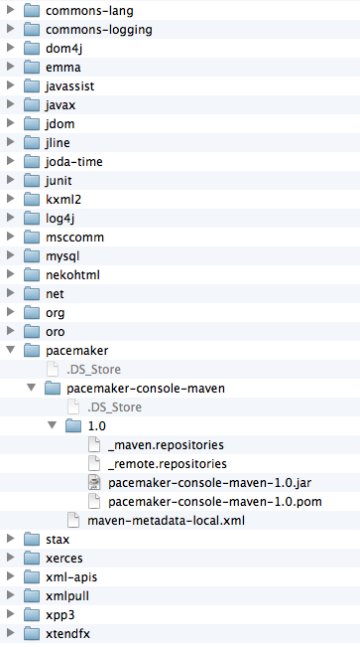
Build phase: install
install the package into the local repository, for use as a dependency in other projects locally.

Slide 28
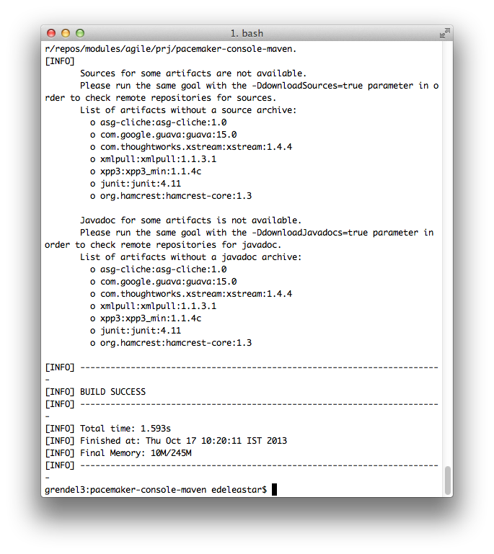
Maven & Eclipse
The projects is now built entirely by the maven build system. However, we can continue to use Eclipse for day to day development.
To do this, we generate an eclipse project from the maven project structure. Do this by issuing the following maven command:
mvn eclipse:eclipse

Slide 29
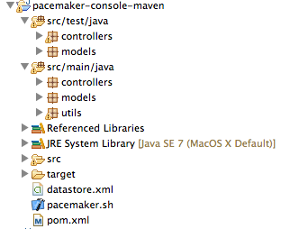
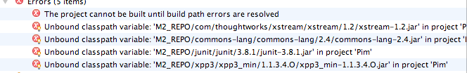
Eclipse Project Structure
This will have produced the required .classpath and .project files in the project directory.
You can now import this project into eclipse using the normal import →existing project into workspace.
Although will import successfully, it will not build

Slide 30
Eclipse .classpath and .project files
<classpath>
<classpathentry kind="src" path="src/test/java" output="target/test-classes" including="**/*.java"/>
<classpathentry kind="src" path="src/main/java" including="**/*.java"/>
<classpathentry kind="output" path="target/classes"/>
<classpathentry kind="var" path="M2_REPO/asg-cliche/asg-cliche/1.0/asg-cliche-1.0.jar"/>
<classpathentry kind="var" path="M2_REPO/com/google/guava/guava/18.0/guava-18.0.jar"/>
<classpathentry kind="var" path="M2_REPO/org/hamcrest/hamcrest-core/1.3/hamcrest-core-1.3.jar"/>
<classpathentry kind="var" path="M2_REPO/junit/junit/4.11/junit-4.11.jar"/>
<classpathentry kind="var" path="M2_REPO/xmlpull/xmlpull/1.1.3.1/xmlpull-1.1.3.1.jar"/>
<classpathentry kind="var" path="M2_REPO/xpp3/xpp3_min/1.1.4c/xpp3_min-1.1.4c.jar"/>
<classpathentry kind="var" path="M2_REPO/com/thoughtworks/xstream/xstream/1.4.8/xstream-1.4.8.jar"/>
<classpathentry kind="con" path="org.eclipse.jdt.launching.JRE_CONTAINER"/>
</classpath>
<projectDescription>
<name>pacemaker-console-maven</name>
<projects/>
<buildSpec>
<buildCommand>
<name>org.eclipse.jdt.core.javabuilder</name>
</buildCommand>
</buildSpec>
<natures>
<nature>org.eclipse.jdt.core.javanature</nature>
</natures>
</projectDescription>

Slide 31
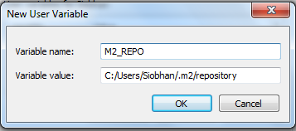
Eclipse Variable Definition

Slide 32
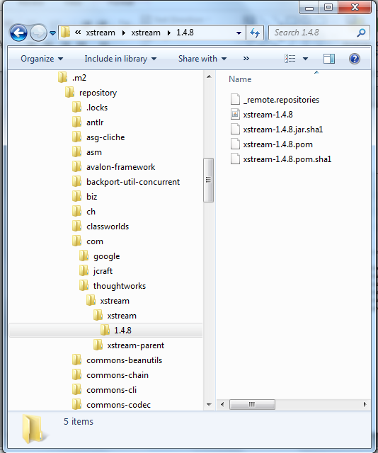
Dependencies also in Repositories
<dependencies>
<dependency>
<groupId>junit</groupId>
<artifactId>junit</artifactId>
<version>4.11</version>
<scope>test</scope>
</dependency>
<dependency>
<groupId>com.google.guava</groupId>
<artifactId>guava</artifactId>
<version>18.0</version>
</dependency>
<dependency>
<groupId>com.thoughtworks.xstream</groupId>
<artifactId>xstream</artifactId>
<version>1.4.8</version>
</dependency>
<dependency>
<groupId>asg-cliche</groupId>
<artifactId>asg-cliche</artifactId>
<version>1.0</version>
</dependency>
</dependencies>

Slide 33
Launch Script – Unix / Linux / OS X
Maven Repository
Classpath for pacemaker
Launch Command
M2_REPO=/Users/edeleastar/.m2/repository
export CLASSPATH=%CLASSPATH%:\
${M2_REPO}/pacemaker/pacemaker-console-maven/1.0/pacemaker-console-maven-1.0.jar:\
${M2_REPO}/com/thoughtworks/xstream/xstream/1.4.8/xstream-1.4.8.jar:\
${M2_REPO}/com/google/guava/guava/18.0/guava.18.0.jar:\
${M2_REPO}/asg-cliche/asg-cliche/1.0/asg-cliche-1.0.jar
java controllers.Main

Slide 34
Launch Script – Windows (.bat file)
Maven Repository
Classpath for pacemaker
Launch Command
echo off
set M2_REPO=C:/Users/Siobhan/.m2/repository
set CLASSPATH=.;%CLASSPATH%;
%M2_REPO%/pacemaker/pacemaker-console-maven/1.0/pacemaker-console-maven-1.0.jar;
%M2_REPO%/com/thoughtworks/xstream/xstream/1.4.8/xstream-1.4.8.jar;
%M2_REPO%/com/google/guava/guava/18.0/guava.18.0.jar;
%M2_REPO%/asg-cliche/asg-cliche/1.0/asg-cliche-1.0.jar;"
java controllers.Main

Slide 35
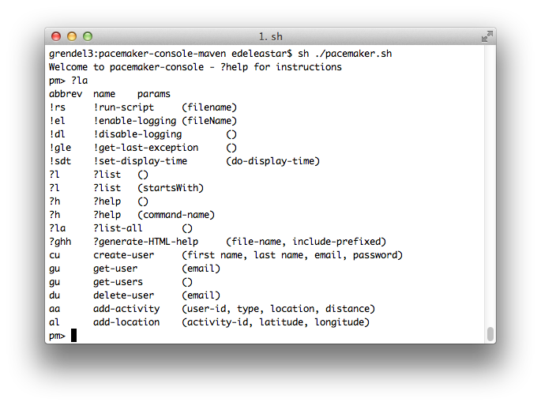

Slide 36
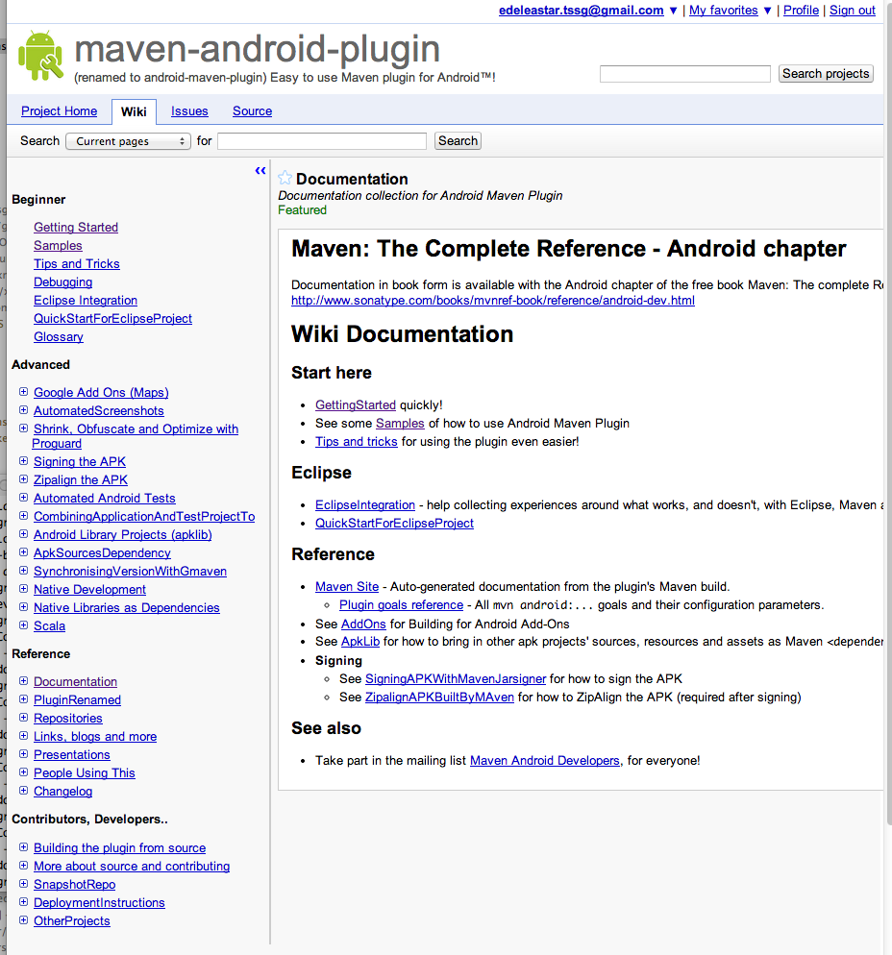
Comment by XXXX, May 2, 2013
I found the Maven android plugin on several plugin collection page, so I thought this will be a resource I should use, but I gave up, because I didn't even found out what is this in a few minutes. You should really write at least one paragraph about this project for the newbies like me. I am not too lazy to put time in learning, but I will not spend time for something which has no real documentation, and I will presume there is none, if I didn't found out what is this on the project homepage.

