Slide 1
Agile Software Development
Eamonn de Leastar (edeleastar@wit.ie)

Slide 2
Assignment Solution
UML + Code

Slide 3
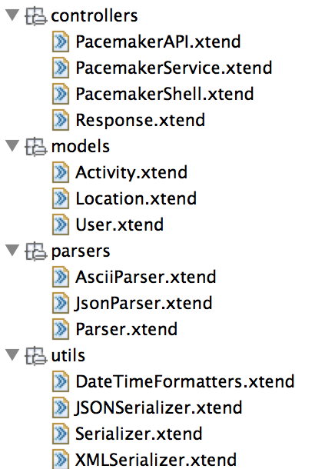
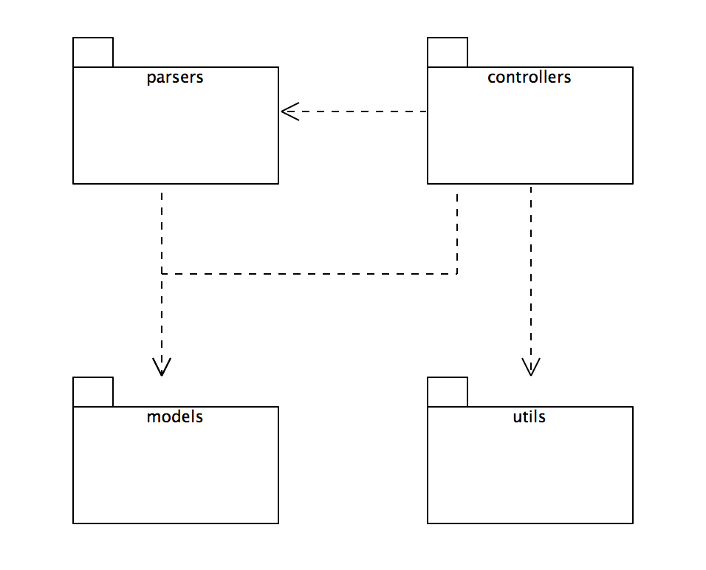
pacemaker-console-xtend
uml package diagram
Legend: uses

Slide 4
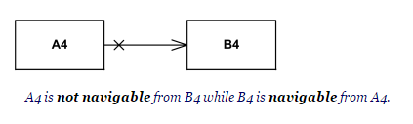
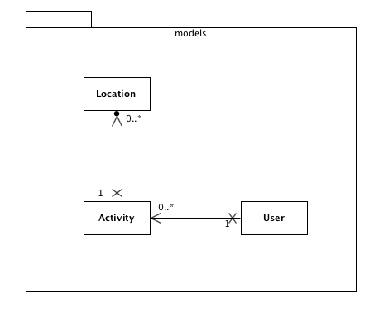
Legend

Slide 5
models
@Data class User
{
Long id
String firstname
String lastname
String email
String password
@Accessors Map<Long, Activity> activities = new HashMap
}
@Data class Activity
{
Long id
String type
String location
double distance
DateTime starttime
Duration duration
@Accessors List<Location> route = new ArrayList
}
@Data class Location
{
float latitude
float longitude
}

Slide 6
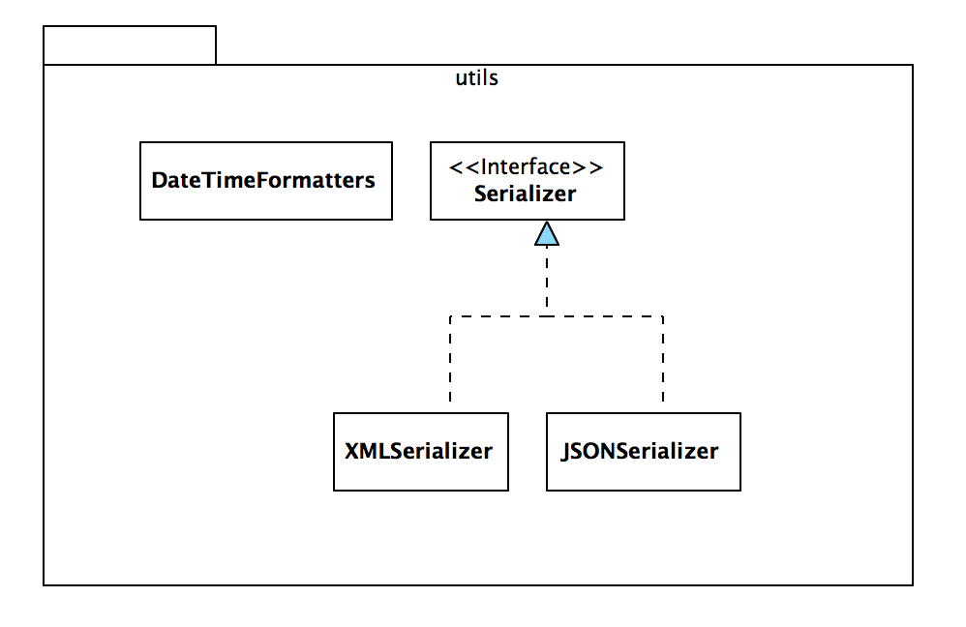

Slide 7
utils
interface Serializer
{
def void push(Object o)
def Object pop()
def void write()
def void read()
}

Slide 8
class XMLSerializer implements Serializer
{
var Deque<Object> stack = new ArrayDeque
val File file;
new (String filename)
{
this.file = new File(filename + '.xml');
}
override void push(Object o)
{
stack.push(o)
}
override Object pop()
{
return stack.pop();
}
override void write()
{
var ObjectOutputStream os = null
try{
val xstream = new XStream(new DomDriver())
os = xstream.createObjectOutputStream
(new FileWriter(file))
os.writeObject(stack)
}
finally{
if (os != null){
os.close
}
}
}
}
@SuppressWarnings("unchecked")
override void read() {
var ObjectInputStream is = null
try{
val xstream = new XStream(new DomDriver())
is = xstream.createObjectInputStream(
new FileReader(file))
stack = is.readObject as Deque<Object>
}
finally{
if (is != null)
{
is.close();
}
}
}

Slide 9
class JSONSerializer implements Serializer
{
// ...
@SuppressWarnings("unchecked")
override void read() {
var ObjectInputStream is = null
try{
val xstream = new XStream(new JettisonMappedXmlDriver())
is = xstream.createObjectInputStream(new FileReader(file))
stack = is.readObject as Deque<Object>
}
finally{
if (is != null)
{
is.close();
}
}
}
override void write() {
var ObjectOutputStream os = null
try{
val xstream = new XStream(new JettisonMappedXmlDriver())
os = xstream.createObjectOutputStream(new FileWriter(file))
os.writeObject(stack)
}
finally{
if (os != null)
{
os.close
}
}
}
}

Slide 10
class DateTimeFormatters
{
static val periodFormatter = new PeriodFormatterBuilder().printZeroAlways()
.appendHours()
.appendSeparator(":")
.appendMinutes()
.appendSeparator(":")
.appendSeconds()
.toFormatter();
static val dateFormatter = DateTimeFormat.forPattern("dd:MM:yyyy HH:mm:ss");
def static parseDateTime (String dateTime){
new DateTime(dateFormatter.parseDateTime(dateTime))
}
def static parseDateTime (DateTime dateTime){
dateFormatter.print(dateTime)
}
def static parseDuration (String duration){
periodFormatter.parsePeriod(duration).toStandardDuration
}
def static parseDuration (Duration duration){
periodFormatter.print(duration.toPeriod)
}
}

Slide 11
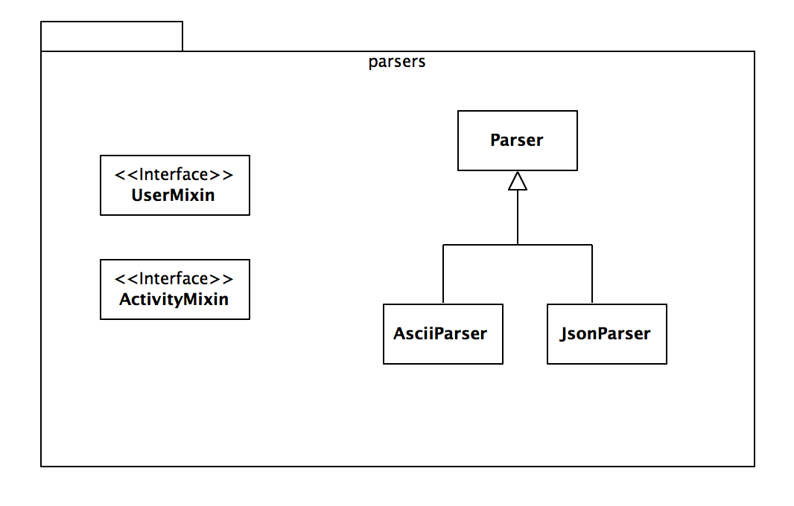

Slide 12
class Parser
{
def String renderUser(User user)
{
user.toString
}
def String renderUsers(Collection<User> users)
{
users.toString
}
def String renderActivities(Collection<Activity> activities)
{
activities.toString
}
}

Slide 13
class AsciiParser extends Parser
{
override renderUser(User user)
{
val List<User> userList = new ArrayList()
userList.add(user)
renderUsers(userList)
}
override renderActivities(Collection<Activity> activities)
{
if (!activities.empty)
{
val List<Activity> activityList = new ArrayList(activities)
var activitiesTable = new CollectionASCIITableAware<Activity>
(activityList, "id", "type", "location", "distance", "starttime", "duration", "route")
ASCIITable.getInstance().getTable(activitiesTable)
}
}
override renderUsers(Collection<User> users)
{
if (!users.empty)
{
val List<User> userList = new ArrayList(users)
var asciiTableAware = new CollectionASCIITableAware<User>
(userList, "id", "firstname", "lastname", "email", "password")
ASCIITable.getInstance().getTable(asciiTableAware);
}
}
}

Slide 14
interface UserMixin{
@JsonIgnore def String getActivities()
@JsonIgnore def Long getId()
}
class JsonParser extends Parser{
val mapper = new ObjectMapper()
new(){
mapper.addMixInAnnotations(typeof(User), typeof(UserMixin))
mapper.addMixInAnnotations(typeof(Activity), typeof(ActivityMixin))
}
override renderUser(User user){
mapper.writerWithDefaultPrettyPrinter.writeValueAsString(user)
}
override renderActivities(Collection<Activity> activities){
if (activities.size > 0){
mapper.writerWithDefaultPrettyPrinter.writeValueAsString(activities)
}
}
override renderUsers(Collection<User> users){
mapper.writerWithDefaultPrettyPrinter.writeValueAsString(users)
}
}
interface ActivityMixin{
@JsonIgnore def Long getId()
}
Notes:
@JsonIgnore is a member-level or method-level annotation, which expects that the properties to be excluded are marked one by one. To completely exclude a member from the process of serialization and de-serialization it’s possibile to annotate the actual property or its setter or its getter. (This behavior is in force since version 1.9 of Jackson).
https://fasterxml.github.io/jackson-databind/javadoc/2.0.0/com/fasterxml/jackson/databind/ObjectMapper.html#addMixInAnnotations(java.lang.Class, java.lang.Class)

Slide 15
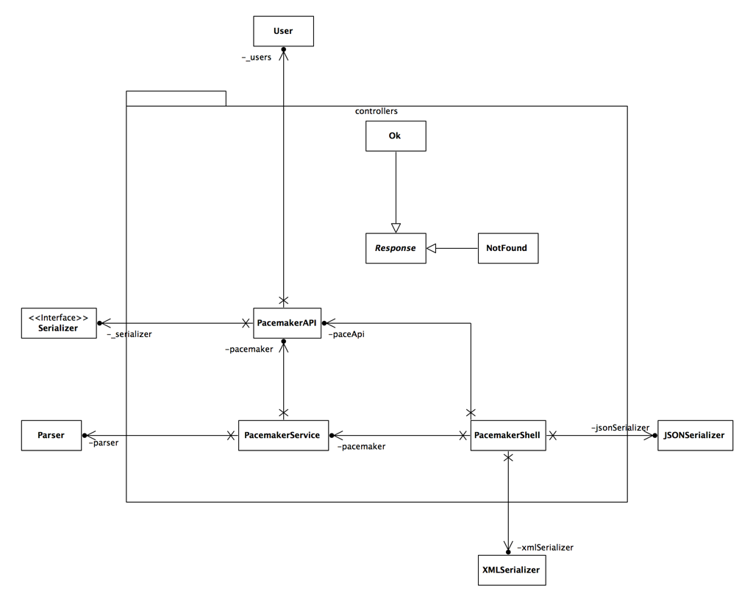

Slide 16
abstract class Response {
var String response
new(String response){
this.response = response
}
override toString(){
response
}
}
class Ok extends Response{
new (String response){
super("ok\n" + response)
}
}
class NotFound extends Response{
new (String response) {
super("not found\n")
}
}

Slide 18
class PacemakerAPI
{
static long userIndex = 0;
static long activityIndex = 0;
var Map<Long, User> userMap = new HashMap
var Map<String, User> userEmailMap = new HashMap
var Map<Long, Activity> activityMap = new HashMap
@Property Collection<User> users = userMap.values
@Property Serializer serializer
new()
{
userIndex = 0
activityIndex = 0
}
def void load() throws Exception
{
serializer.read();
activityIndex = serializer.pop() as Long
userIndex = serializer.pop() as Long
activityMap = serializer.pop() as Map<Long, Activity>
userEmailMap = serializer.pop() as Map<String, User>
userMap = serializer.pop() as Map<Long, User>
users = userMap.values
}
def void store()
{
serializer.push(userMap)
serializer.push(userEmailMap)
serializer.push(activityMap)
serializer.push(userIndex)
serializer.push(activityIndex)
serializer.write()
}

Slide 19
def Long createUser (String firstName, String lastName, String email, String password)
{
userIndex = userIndex + 1
var user = new User (userIndex, firstName, lastName, email, password)
userMap.put(userIndex, user);
userEmailMap.put(user.email, user)
userIndex
}
def getUser (Long id)
{
userMap.get(id)
}
def getUser (String email)
{
userEmailMap.get(email)
}
def deleteUser (Long id)
{
userEmailMap.remove(userMap.get(id))
userMap.remove(id)
}
def deleteUser (String email)
{
val user = userEmailMap.remove(getUser(email))
userMap.remove(user.id)
}

Slide 20
def Activity createActivity(Long id, String type, String location, double distance,
String dateStr, String durationStr)
{
var Activity activity = null;
var user = Optional.fromNullable(userMap.get(id))
if (user.isPresent())
{
activityIndex = activityIndex + 1
activity = new Activity (activityIndex, type, location, distance,
parseDateTime(dateStr), parseDuration(durationStr))
user.get.activities.put(activity.id, activity);
activityMap.put(activity.id, activity);
}
return activity;
}
def getActivity (Long id)
{
activityMap.get(id)
}
def void addLocation (Long id, float latitude, float longitude)
{
val activity = Optional.fromNullable(activityMap.get(id))
if (activity.isPresent())
{
activity.get.route.add(new Location(latitude, longitude));
}
}

Slide 22
class PacemakerService{
var PacemakerAPI pacemaker
var Parser parser
new(PacemakerAPI pacemaker, Parser parser){
this.pacemaker = pacemaker
this.parser = parser
}
def createUser(String firstname, String lastname, String email, String password) {
val id = pacemaker.createUser(firstname, lastname, email, password)
new Ok(parser.renderUser(pacemaker.getUser(id)))
}
def getUser(Long id) {
val user = pacemaker.getUser(id)
if (null != user) new Ok(parser.renderUser(user)) else new NotFound("")
}
def getUser(String email) {
val user = pacemaker.getUser(email)
if (null != user) getUser(user.id) else new NotFound("")
}
def getUsers(){
new Ok(parser.renderUsers(pacemaker.users))
}
def deleteUser(Long id){
val user = pacemaker.getUser(id)
pacemaker.deleteUser(user?.id)
if (null != user) new Ok("") else new NotFound("")
}

Slide 23
def createActivity(Long id, String type, String location, double distance, String dateStr, String durationStr)
{
if (null != pacemaker.getUser(id))
{
pacemaker.createActivity(id, type, location, distance, dateStr, durationStr)
new Ok("")
}
else new NotFound("")
}
def getActivities(Long id)
{
val user = pacemaker.getUser(id)
if (null != user) new Ok(parser.renderActivities(user.activities.values)) else new NotFound("")
}
def addLocation (Long id, float latitude, float longitude)
{
val activity = pacemaker.getActivity(id)
if (null != activity)
{
pacemaker.addLocation(id, latitude, longitude)
new Ok("")
}
else new NotFound("")
}

Slide 24
def listActivities (Long id, String sortBy)
{
val activities = pacemaker.getUser(id).activities.values
val report = switch (sortBy)
{
case "type" : activities.sortBy[type]
case "location" : activities.sortBy[location]
case "distance" : activities.sortBy[distance]
case "date" : activities.sortBy[starttime]
case "duration" : activities.sortBy[duration]
}
return new Ok(parser.renderActivities(report))
}

Slide 26
class PacemakerShell
{
var PacemakerAPI paceApi
var PacemakerService pacemaker
val datastore = "testdatastore";
val xmlSerializer = new XMLSerializer(datastore);
val jsonSerializer = new JSONSerializer(datastore);
new()
{
paceApi = new PacemakerAPI;
paceApi.serializer = xmlSerializer
pacemaker = new PacemakerService (paceApi, new AsciiParser as Parser)
}
@Command(description="List all users details")
def void listUsers ()
{
println(pacemaker.getUsers)
}
@Command(description="Create a new User")
def void createUser (@Param(name="first name") String firstname, @Param(name="last name") String lastname,
@Param(name="email") String email, @Param(name="password") String password)
{
println (pacemaker.createUser(firstname, lastname, email, password))
}
@Command(description="List a users details")
def void listUser (@Param(name="email") String email)
{
println (pacemaker.getUser(email))
}
@Command(description="List a users details")
def void listUser (@Param(name="id") Long id)
{
println (pacemaker.getUser(id))
}`

Slide 27
@Command(description="List a users activities")
def void listActivities (@Param(name="user id") Long id)
{
println (pacemaker.getActivities(id))
}
@Command(description="Delete a User")
def void deleteUser (@Param(name="id") Long id)
{
println (pacemaker.deleteUser(id))
}
@Command(description="Add an activity")
def void addActivity (@Param(name="user-id") Long id, @Param(name="type") String type,
@Param(name="location") String location, @Param(name="distance") double distance,
@Param(name="datetime") String dateStr, @Param(name="duration") String durationStr
)
{
try
{
println (pacemaker.createActivity(id, type, location, distance, dateStr, durationStr))
}
catch (IllegalArgumentException e)
{
println ("Date or Duration format error: " + e.message)
}
}
@Command(description="Add Location to an activity")
def void addLocation (@Param(name="activity-id") Long id,
@Param(name="latitude") float latitude, @Param(name="longitude") float longitude)
{
println (pacemaker.addLocation(id, latitude, longitude))
}

Slide 28
@Command(description="List Activities")
def void listActivities (@Param(name="userid") Long id,
@Param(name="sortBy: type, location, distance, date, duration") String sortBy)
{
val options = #{"type", "location", "distance", "date", "duration"}
if (options.contains(sortBy))
{
println (pacemaker.listActivities(id, sortBy))
}
else
println ("usage : la " + options.toString)
}

Slide 29
@Command(description="Set file format")
def void changeFileFormat (@Param(name="file format: xml, json") String fileFormat)
{
switch (fileFormat)
{
case 'xml' : paceApi.serializer = xmlSerializer
case 'json' : paceApi.serializer = jsonSerializer
}
}
@Command(description="Load activities persistent store")
def void load ()
{
paceApi.load
}
@Command(description="Store activities persistent store")
def void store ()
{
paceApi.store
}
def static void main(String[] args) throws Exception
{
val main = new PacemakerShell()
val shell = ShellFactory.createConsoleShell("pm", "Welcome to pacemaker-console - ?help for instructions", main)
shell.commandLoop
main.paceApi.store
}

