Slide 1
Agile Software Development
Eamonn de Leastar (edeleastar@wit.ie)

Slide 2
Assignment Solution
Structure 101 Analysis

Slide 3
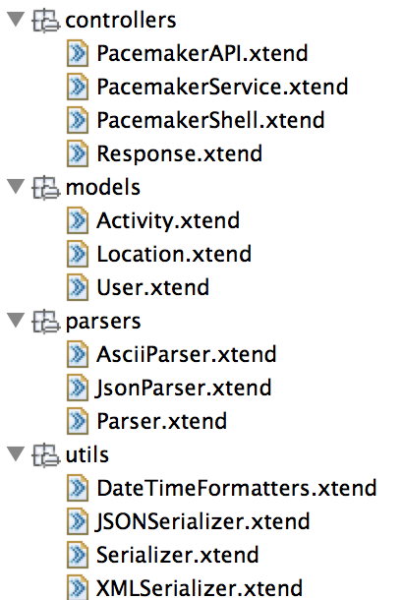
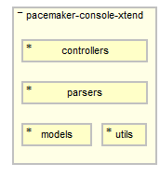
pacemaker-console-xtend
Physical Organisation
The assignment solution has:
a number of source files.
interdependencies between these files.

Slide 4
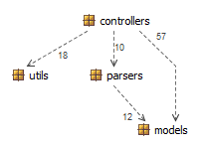
Containment model (dependency graph)
Use containers (packages) to manage complexity.
Containment creates dependencies between containers.
How we organise our containers is key to controlling dependencies between the containers.
Notes:
Maybe talk about ccd (cumulative component dependency): https://vimeo.com/81446002

Slide 5
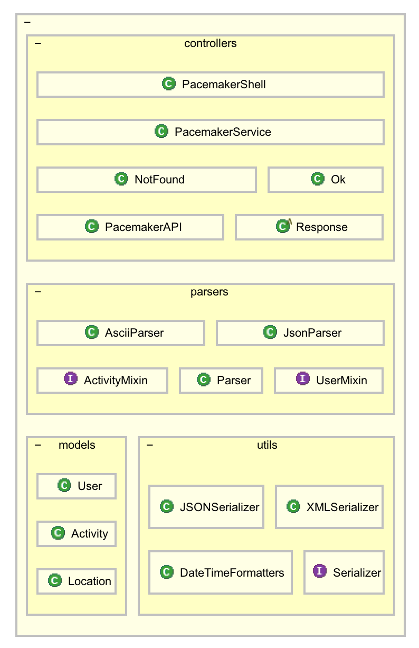
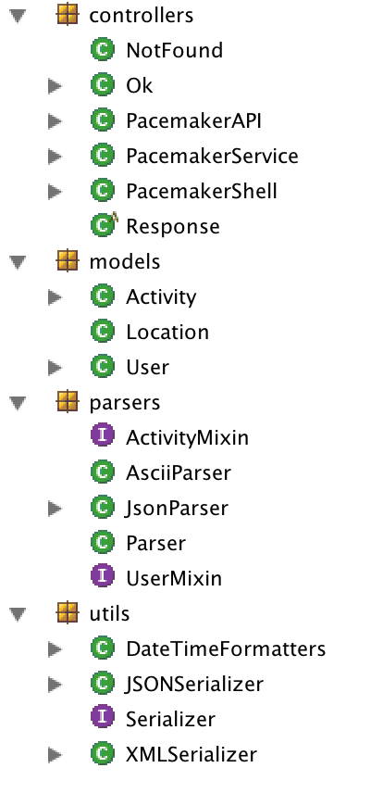

Slide 6
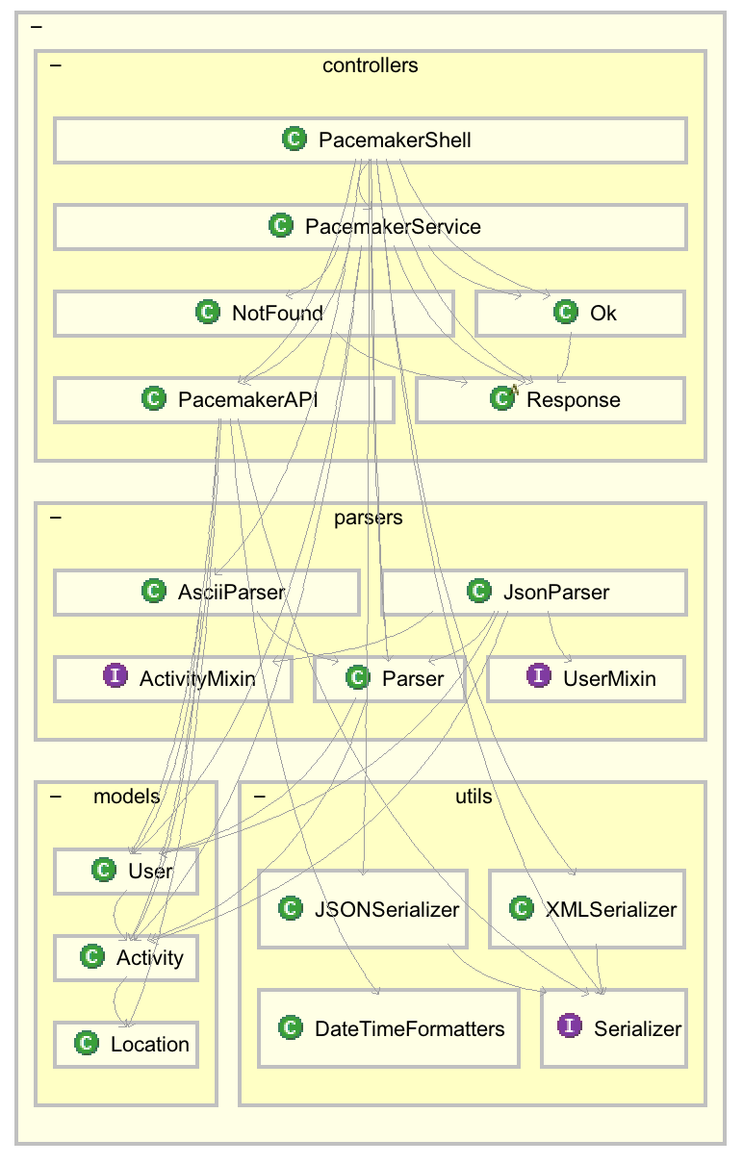
Dependencies
When dependencies all point in the same direction (e.g. downwards), the cumulative dependency is smallest.
When you have cyclical dependencies (i.e. dependencies pointing upwards) the cumulative dependency becomes large and you have what is called a Design Tangle.

Slide 7
Measuring complexity in a code base.
Excess complexity is measured in terms of 2 metrics:
Fat is a measure of the compositional (breakout) complexity at every level e.g. number of edges in a dependency graph. Default threshold in Structure101 is 15 (methods), 120 (design, package, class level).
Design Tangles are cyclic dependencies between packages, measured at the breakout of high-level packages ("design level"). Default threshold in Structure101 is 0% - always undesirable!
Fat value: 4
https://structure101.com/help/java/structure101/Content/xs/measuring-complexity.html

Slide 8
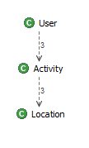
Dependency graph (models)
Fat value: 2 (edges)

Slide 9
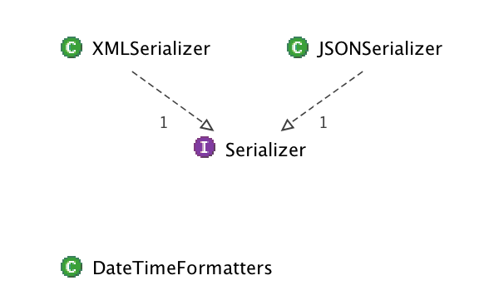
Dependency graph (utils)
Fat value: 2 (edges)

Slide 10
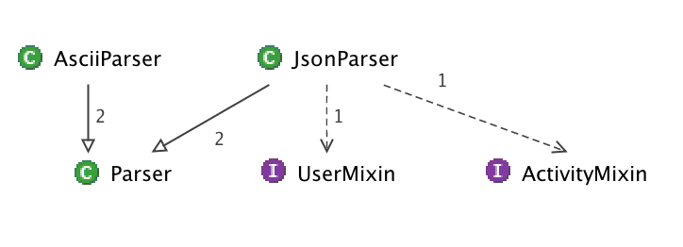
Dependency graph (parsers)
Fat value: 4 (edges)

Slide 11
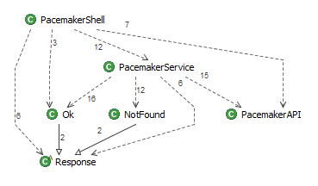
Dependency graph (controllers)
Fat value: 10 (edges)

Slide 12
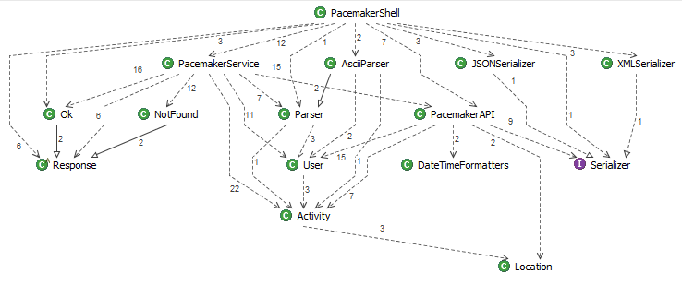
Dependency graph (no externals)

Slide 13
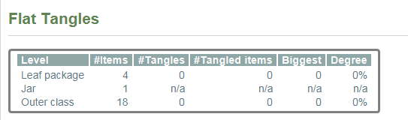
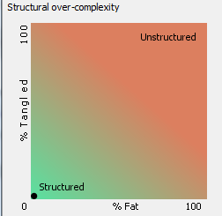
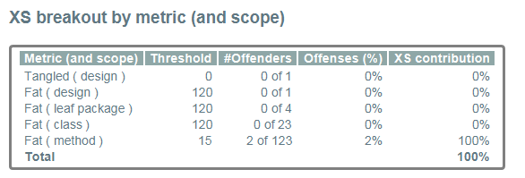
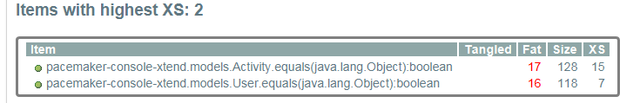
Summary of pacemaker-console-xtend
Notes:
Leaf package refers to packages that contain only classes.
Design refers to packages that contain other packages.

Slide 14
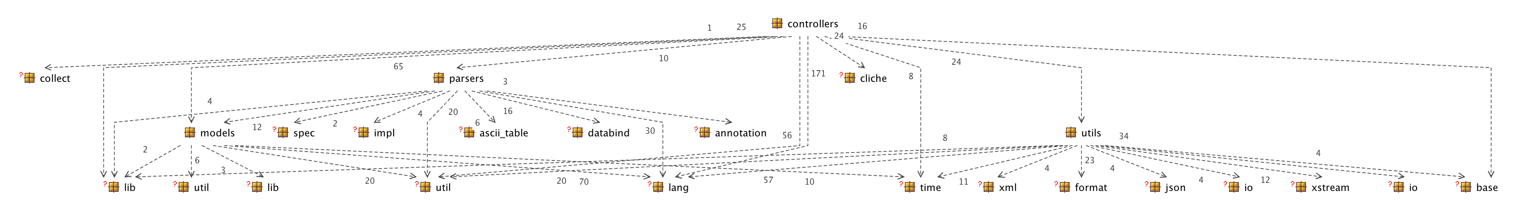
Dependency graph (with externals)

Slide 15
