Slide 1


Agile Software Development
Produced
by
Eamonn de Leastar (edeleastar@wit.ie)
Department of Computing, Maths & Physics
Waterford Institute of Technology
http://www.wit.ie
http://elearning.wit.ie

Slide 2
SOLID Principles
S The Single Responsibility Principle (SRP)
A class should have one, and only one, reason to change.
O The Open Closed Principle (OCP)
You should be able to extend a classes behavior, without modifying it.
L The Liskov Substitution Principle (LSP)
Derived classes must be substitutable for their base classes.
I The Interface Segregation Principle (ISP)
Make fine grained interfaces that are client specific.
D The Dependency Inversion Principle (DSP)
Depend on abstractions, not on concretions.

Slide 3
SOLID Principles – Scope for module
S The Single Responsibility Principle (SRP – this week)
A class should have one, and only one, reason to change.
O The Open Closed Principle (OCP – week 10)
You should be able to extend a classes behavior, without modifying it.
L The Liskov Substitution Principle (LSP – week 12)
Derived classes must be substitutable for their base classes.
I The Interface Segregation Principle (ISP)
Make fine grained interfaces that are client specific.
D The Dependency Inversion Principle (DSP)
Depend on abstractions, not on concretions.

Slide 4

Source
Sample Contents:
Agile principles, and the fourteen practices of Extreme Programming
Spiking, splitting, velocity, and planning iterations and releases
Test-driven development, test-first design, and acceptance testing
Refactoring with unit testing
Pair programming
Agile design and design smells
The five types of UML diagrams and how to use them effectively.
Object-oriented package design and design patterns.
How to put all of it together for a real-world project

Slide 5
SOLID Principles in Poster form…
http://blogs.msdn.com/b/cdndevs/archive/2009/07/15/the-solid-principles-explained-with-motivational-posters.aspx
SOLID Motivational Posters, by Derick Bailey, is licensed under a Creative Commons Attribution-Share Alike 3.0 United States License.

Slide 6
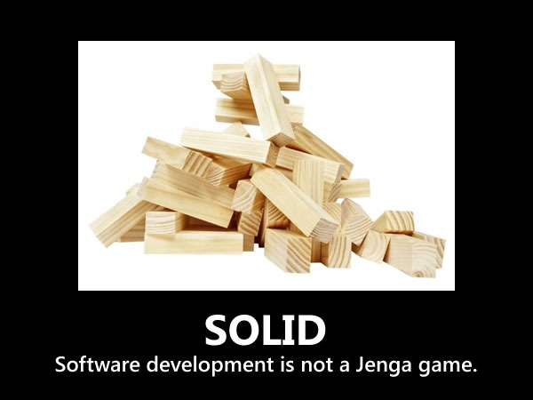

Slide 7
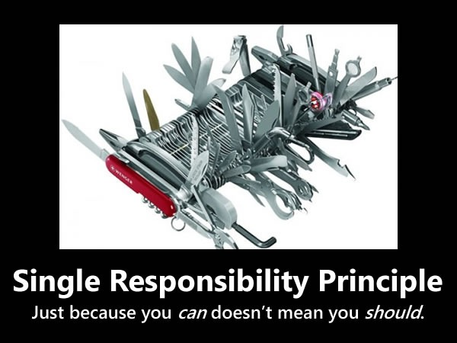

Slide 8
“S” in SOLID - Single Responsibility Principle
Every object should have a single responsibility and that all of its services should be aligned with that responsibility.
“Responsibility” is defined as “a reason to change”, and Wikipedia does a pretty good job of explaining it:
As an example, consider a module that compiles and prints a report. Such a module can be changed for two reasons. First, the content of the report can change. Second, the format of the report can change. These two things change for very different causes; one substantive, and one cosmetic. The single responsibility principle says that these two aspects of the problem are really two separate responsibilities, and should therefore be in separate classes or modules. It would be a bad design to couple two things that change for different reasons at different times.
Notes:
http://blogs.msdn.com/b/cdndevs/archive/2009/07/15/the-solid-principles-explained-with-motivational-posters.aspx

Slide 9
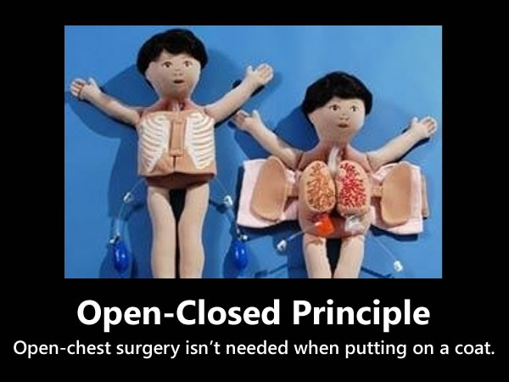

Slide 10
“O” in SOLID - Open-Closed Principle
Software entities – such as classes, modules, functions and so on – should be open for extension but closed for modification.
The idea is that it’s often better to make changes to things like classes by adding to or building on top of them (using mechanisms like subclassing or polymorphism) rather than modifying their code.
Notes:
http://blogs.msdn.com/b/cdndevs/archive/2009/07/15/the-solid-principles-explained-with-motivational-posters.aspx

Slide 11
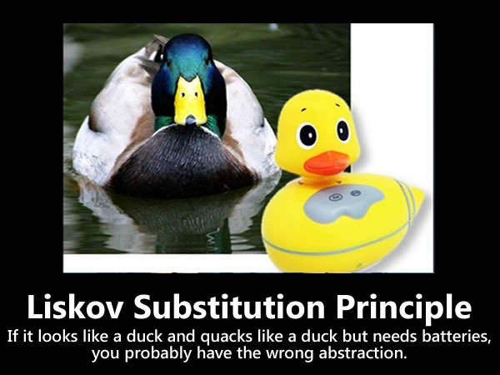

Slide 12
“L” in SOLID - Liskov Substitution Principle
Subclases should be substitutable for the classes from which they were derived.
For example, if MySubclass is a subclass of MyClass, you should be able to replace MyClass with MySubclass without bunging up the program.
Notes:
http://blogs.msdn.com/b/cdndevs/archive/2009/07/15/the-solid-principles-explained-with-motivational-posters.aspx

Slide 13
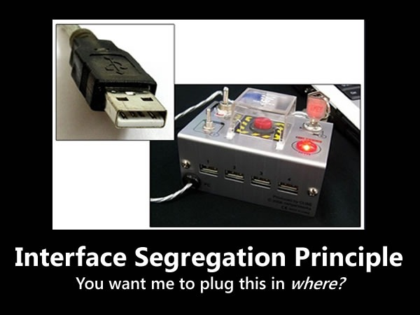

Slide 14
“I” in SOLID - Interface Segregation Principle
Many client specific interfaces are better than one general purpose interface.
Make fine grained interfaces that are client specific.
outside the scope of this module

Slide 15
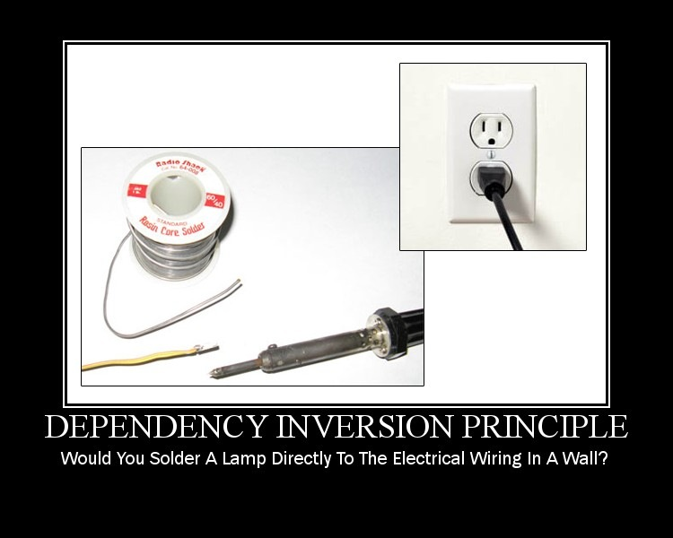

Slide 16
“D” in SOLID - Dependency Inversion Principle
High-level modules shouldn’t depend on low-level modules, but both should depend on shared abstractions.
In addition, abstractions should not depend on details – instead, details should depend on abstractions.
Depend on abstractions, not on concretions.
outside the scope of this module
In your own time, see the Manager example here.

Slide 17
SRP – Single Responsibility Principle

Slide 18
SRP: The Single Responsibility Principle
THERE SHOULD NEVER BE MORE THAN ONE REASON FOR A CLASS TO CHANGE.
Each responsibility is an axis of change.
When the requirements change, that change will be manifested through a change in responsibility amongst the classes.
If a class assumes more than one responsibility, then there will be more than one reason for it to change.
Changes to one responsibility may impair or inhibit the class’ ability to meet the others.

Slide 19
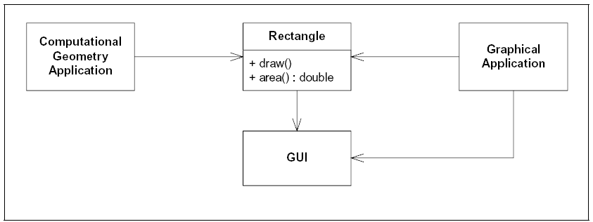
Example
The Rectangle class has two methods:
one draws the rectangle on the screen
the other computes the area of the rectangle.
Two applications use this class:
one application uses Rectangle to help it with the mathematics of geometric shapes.
the other uses the class to render a Rectangle on a window.

Slide 20
SRP Violation
Rectangle has two responsibilities:
provide a mathematical model of the geometry of a rectangle.
render the rectangle on a graphical user interface.
Violation of SRP:
the GUI must be included in the in the computational geometry application.
the class files for the GUI have to be deployed to the target platform.
if a change to the Graphical Application causes the Rectangle to change for some reason, that change may force us to rebuild, retest, and redeploy the Computational Geometry Application.

Slide 21
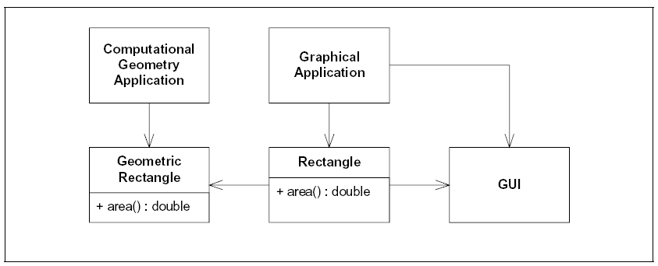
SRP Fix
Separate the two responsibilities into two separate classes
Moves the computational portions of Rectangle into the GeometricRectangle class.
Now changes made to the way rectangles are rendered cannot affect the ComputationalGeometry Application.

Slide 22
What is a Responsibility?
“A reason for change.”
If you can think of more than one motive for changing a class, then that class has more than one responsibility.
interface Modem
{
void dial(String pno);
void hangup();
void send(char c);
char recv();
}

Slide 23
Modem Responsibilities
interface Modem
{
void dial(String pno);
void hangup();
void send(char c);
char recv();
}
Two responsibilities:
connection management (dial and hangup functions)
data communication (send and recv functions)
They have little in common
may change for different reason
will be called from different parts of the applications
They will change for different reasons.

Slide 24
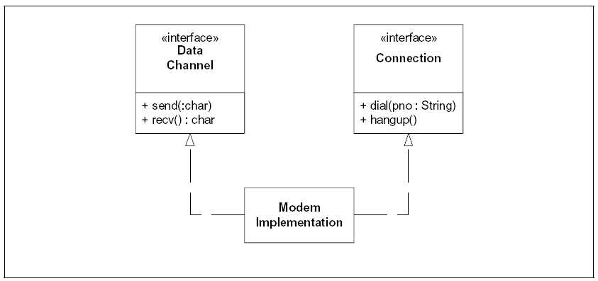
Separation of Responsibilities
Separate the two responsibilities into two separate interfaces.
However, we may couple the two responsibilities into a single Modem Implementation class.
This is not necessarily desirable, but it may be necessary. (for implementation purposes)

Slide 25

SRP Violation?
Coupling persistence services (store) with business rules (calculatePay) violates SRP

Slide 26
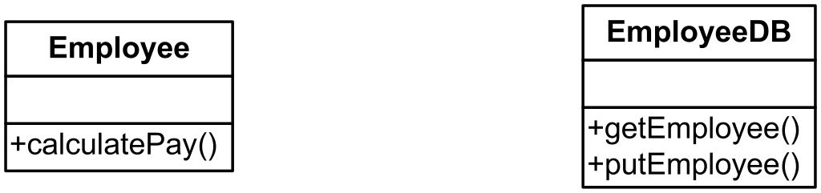
Separate Concerns

Slide 27
Example - Personal Information Manager
Design an Application to manage a contact list.
It should support:
Console based UI
Load/save to/from a file on disk
Simple reports and search functions

Slide 28
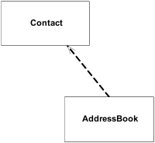
AddressBook
Propose two classes:
Contact - to represent each contact
AddressBook - to incorporate
serialization
reporting
UI
etc…
Violates SRP as AddressBook has multiple reasons to change
Data structure change (e.g. HashMap to TreeMap)
Serialization mechanism (e.g. binary to XML)
Alternative reports (e.g. different formats and content)
Command line syntax changes

Slide 29
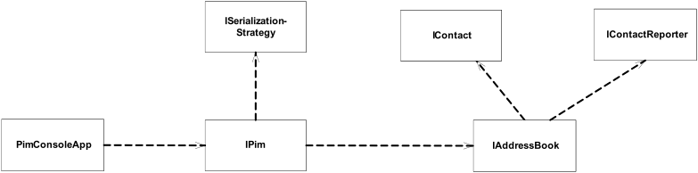
Refactor Addressbook
AddressBook responsible for contact data structure
ContactReporter responsible for format and content of reports
SerializationStrategy responsible for persistence
Pim responsible for binding address book to serialization mechanism – and for exposing coherent top level functionality
PimConsoleApp responsible binding an running application to an IPim.

Slide 30


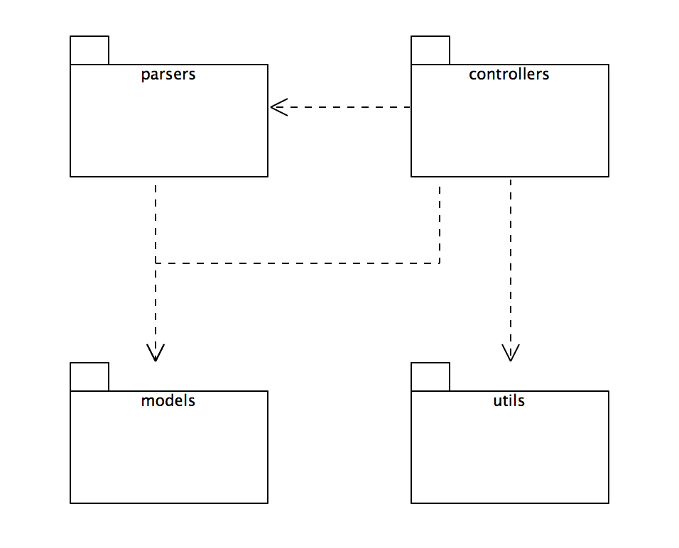

Pacemaker - package responsibilities
transform the model into various formats
Application services + user interface
information model for the app
general purpose application independent utilities

Slide 31
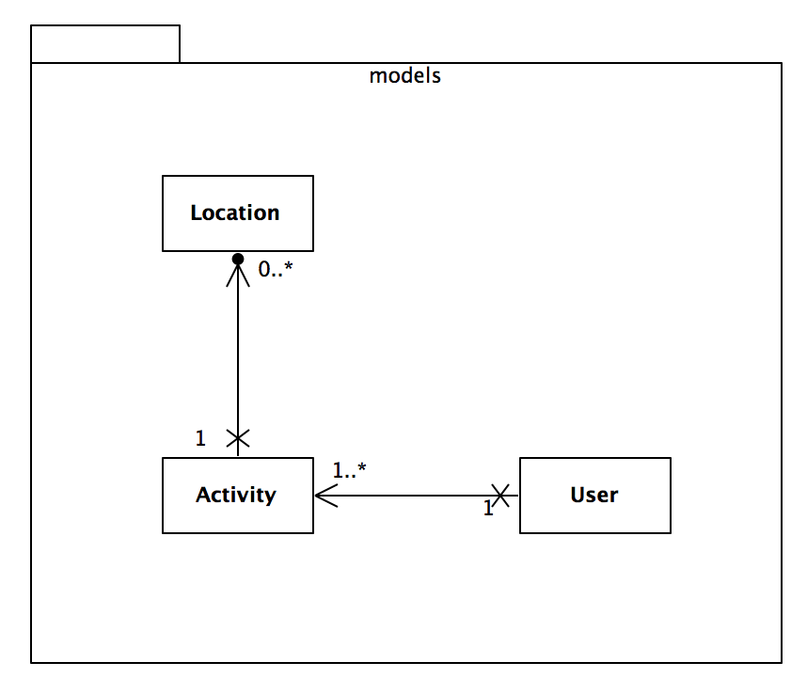



Pacemaker – model responsibilities
Represent individual locations
Represent individual Activities
Represent individual Users

Slide 32

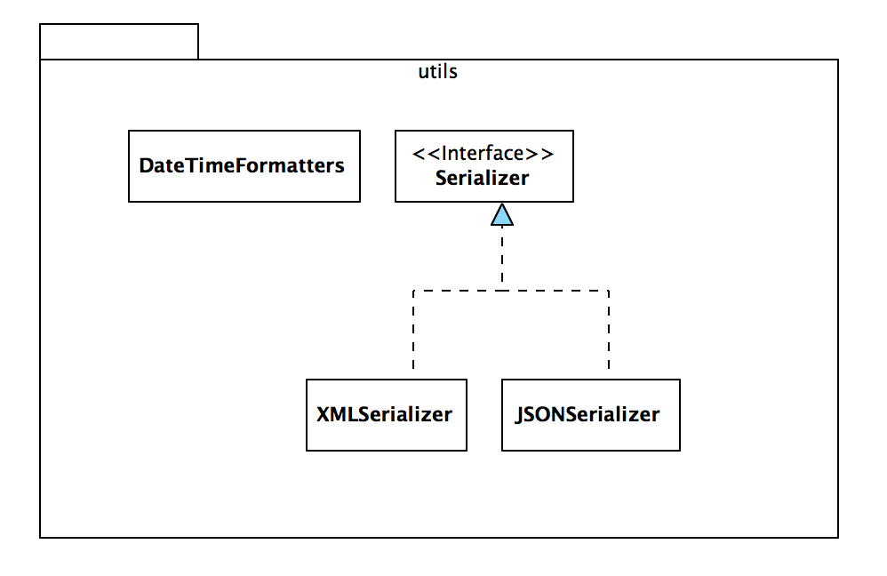

Pacemaker – utils responsibilities
Centralise data/time formatting for application
Encapsulate data structure serialisation
Specialise serialisation for XML
Specialise serialisation for JSON

Slide 33
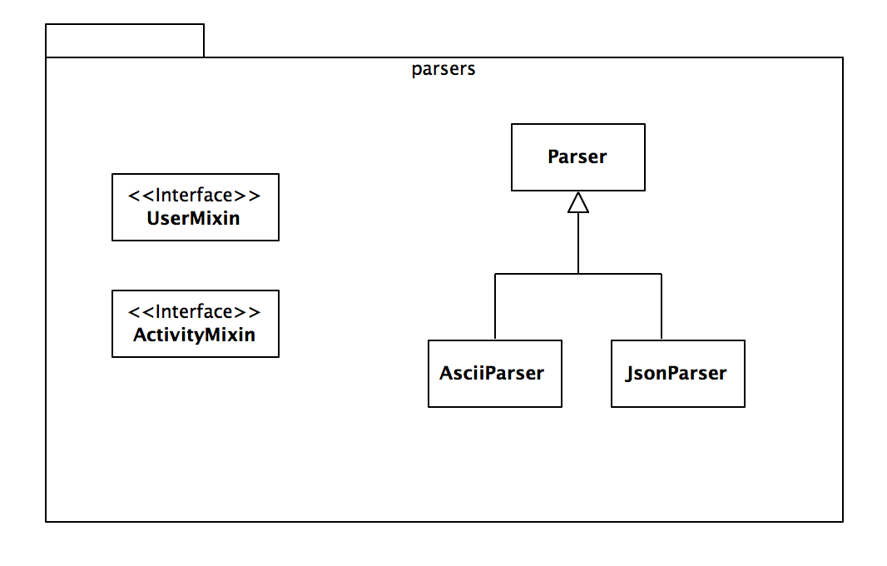



Pacemaker – parsers responsibilities
Encapsulate parsing (transformation) requirements for app
Specialise parsing for JSON (using jackson)
Specialise parsing for Ascii (using btc-ascii component)

Slide 34
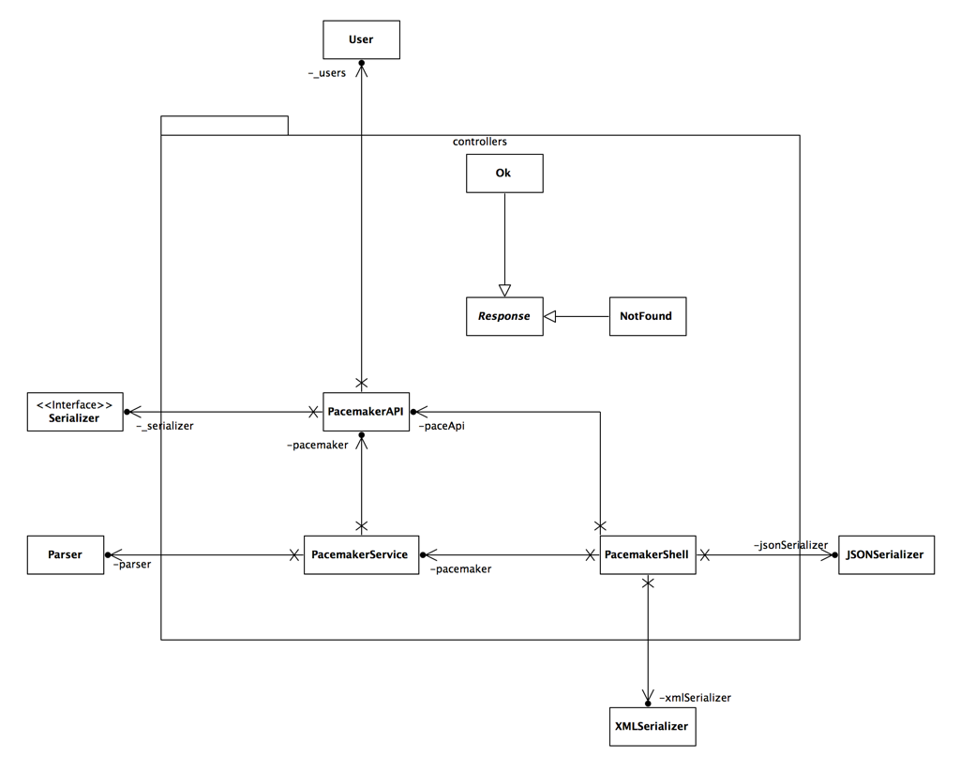

Slide 35

Pacemaker – Response responsibilities
Represent responses from an application to requests from clients (use HTTP terminology)

Slide 36

Pacemaker – PacemakerAPI responsibilities
Implement the core application features as represented by the Model.

Slide 37

Pacemaker – PacemakerService responsibilities
Expose the core application features to clients

Slide 38

Pacemaker – PacemakerShell responsibilities
Deliver a console user experience

Slide 39



Pacemaker – controllers responsibilities
Represent responses from an application to requests from clients(information modelled for the app on HTTP)
Implement the core application features as represented by the Model.
Expose the core application features to clients
Deliver a console user experience

Slide 40
SRP Summary
Changes in requirements are manifested as changes in class responsibilities.
Therefore a ‘cohesive’ responsibility is a single axis of change – requirement changes often are restricted to a few cohesive responsibilities (in a reasonably designed system).
Thus, to avoid coupling responsibilities that change for different reasons, a class should have only one responsibility, one reason to change.
Violation of SRP causes spurious dependencies between modules that are hard to anticipate, in other words fragility.

Slide 42

Except where otherwise noted, this content is licensed under a Creative Commons Attribution-NonCommercial 3.0 License.
For more information, please see http://creativecommons.org/licenses/by-nc/3.0/

