Slide 1


Agile Software Development
Produced
by
Eamonn de Leastar (edeleastar@wit.ie)
Department of Computing, Maths & Physics
Waterford Institute of Technology
http://www.wit.ie
http://elearning.wit.ie

Slide 2
pacemakerplay v2

Slide 3
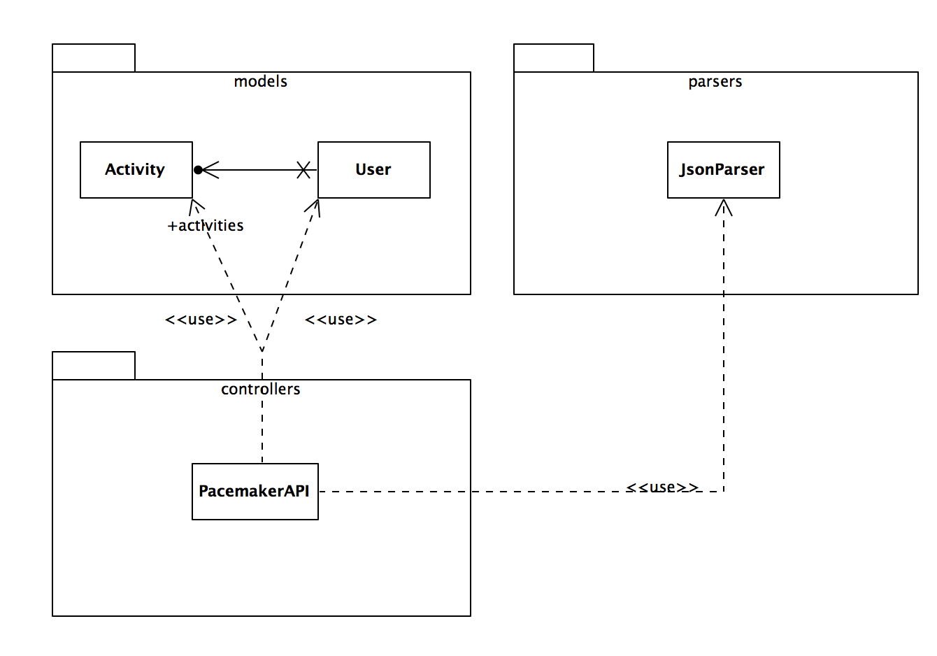
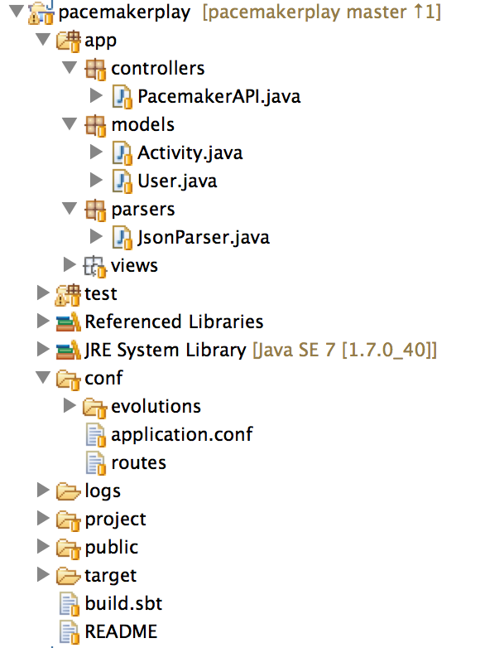
Model - Class/Package Diagram

Slide 4
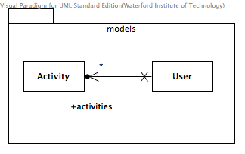
Model
@Entity
public class User extends Model
{
@Id
@GeneratedValue
public Long id;
public String firstname;
public String lastname;
public String email;
public String password;
@OneToMany(cascade=CascadeType.ALL)
public List<Activity> activities = new ArrayList<Activity>();
//…
}
@Entity
public class Activity extends Model
{
@Id
@GeneratedValue
public Long id;
public String type;
public String location;
public double distance;
//…
}

Slide 5
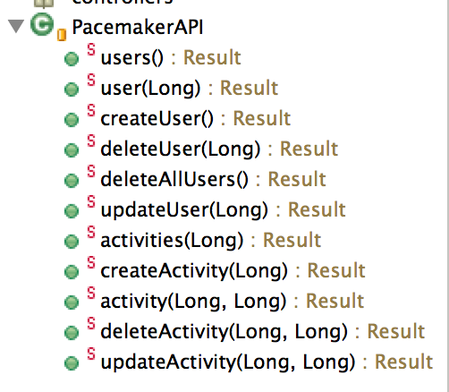
Routes + PacemakerAPI
GET /api/users controllers.PacemakerAPI.users()
DELETE /api/users controllers.PacemakerAPI.deleteAllUsers()
POST /api/users controllers.PacemakerAPI.createUser()
GET /api/users/:id controllers.PacemakerAPI.user(id: Long)
DELETE /api/users/:id controllers.PacemakerAPI.deleteUser(id: Long)
PUT /api/users/:id controllers.PacemakerAPI.updateUser(id: Long)
GET /api/users/:userId/activities controllers.PacemakerAPI.activities(userId: Long)
POST /api/users/:userId/activities controllers.PacemakerAPI.createActivity(userId: Long)
GET /api/users/:userId/activities/:activityId controllers.PacemakerAPI.activity(userId: Long, activityId:Long)
DELETE /api/users/:userId/activities/:activityId controllers.PacemakerAPI.deleteActivity(userId: Long, activityId:Long)
PUT /api/users/:userId/activities/:activityId controllers.PacemakerAPI.updateActivity(userId: Long, activityId:Long)
Each route maps to a PacemakerAPI method.
Support standard Create/Read/Update/Delete (CRUD) operations.

Slide 6
API Namespace
Retrieve / Delete all users
Create a User
Retrieve / Delete / Update a specific user
GET /api/users
DELETE /api/users
POST /api/users
GET /api/users/:id
DELETE /api/users/:id
PUT /api/users/:id
Retrieve all activities for a user
Create an activity for a user
Retrieve / Delete / Update a specific activity
GET /api/users/:userId/activities
POST /api/users/:userId/activities
GET /api/users/:userId/activities/:activityId
DELETE /api/users/:userId/activities/:activityId
PUT /api/users/:userId/activities/:activityId

Slide 7
A note on play.db.ebean.Model
Play 2.0 comes with Ebean.
With Ebean, you can use standard JPA annotations e.g. @Entity, @Table, @Id, etc.
With Ebean, it is very easy to perform CRUD operations on the entity using these methods:
void save(); void insert(); void delete(); void update();

Slide 8
Actions in Play
Most of the requests received by a Play application are handled by an Action.
An action is basically a Java method that processes the request parameters, and produces a result to be sent to the client.
An action returns a play.mvc.Result value, representing the HTTP response to send to the web client.
play.mvc.Results
static Results.Status | badRequest() Generates a 400 BAD_REQUEST simple result.
static Results.Status | notFound() Generates a 404 NOT_FOUND simple result.
static Results.Status | ok() Generates a 200 OK simple result.
static Results.Status | ok(java.lang.String content) Generates a 200 OK simple result.
Source: https://www.playframework.com/documentation/2.0/JavaActions

Slide 9
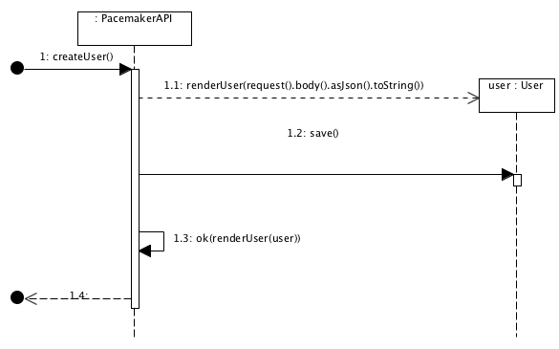
createUser - Sequence Diagram
public static Result createUser()
{
User user = renderUser(request().body().asJson().toString());
user.save();
return ok(renderUser(user));
}

Slide 10
A note on renderUser in JsonParser.java
In routes.conf, the create user entry is: POST /api/users controllers.PacemakerAPI.createUser()
When your Content-Type header is application/json, request().body().asJson().toString() retrieves the entire request body sent in a POST request to the play server.
PacemakerAPI.java
public static Result createUser(){
User user = renderUser(request().body().asJson().toString());
user.save();
return ok(renderUser(user));
}
JsonParser.java
public static String renderUser(Object obj)
{
return userSerializer.serialize(obj);
}

Slide 11
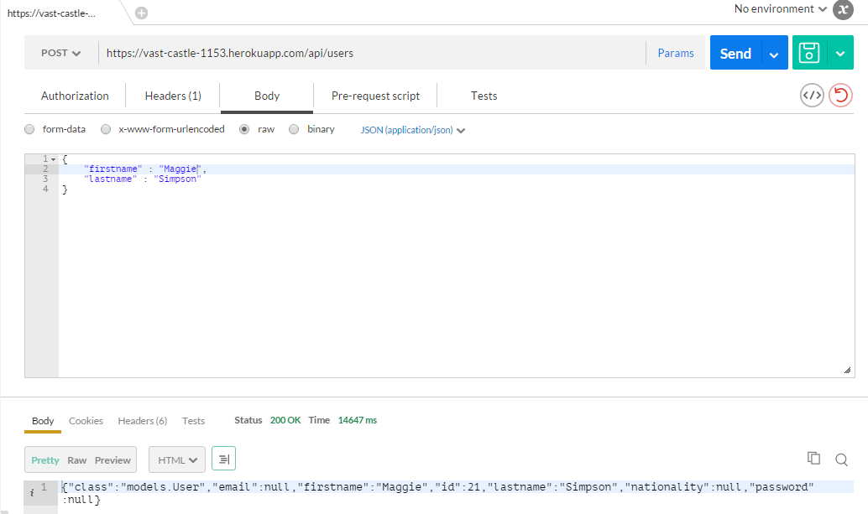
Testing create user with POSTMAN

Slide 12
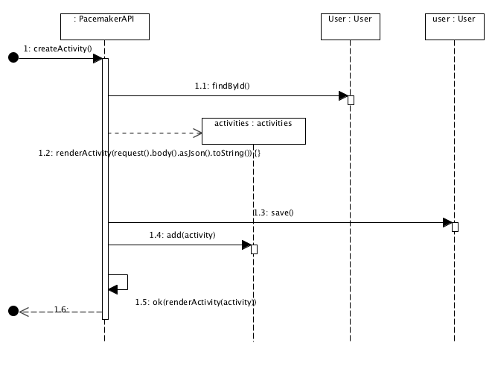
createActivity Sequence Diagram
public static Result createActivity (Long userId)
{
User user = User.findById(userId);
Activity activity = renderActivity(request().body().asJson().toString());
user.activities.add(activity);
user.save();
return ok(renderActivity(activity));
}

Slide 13
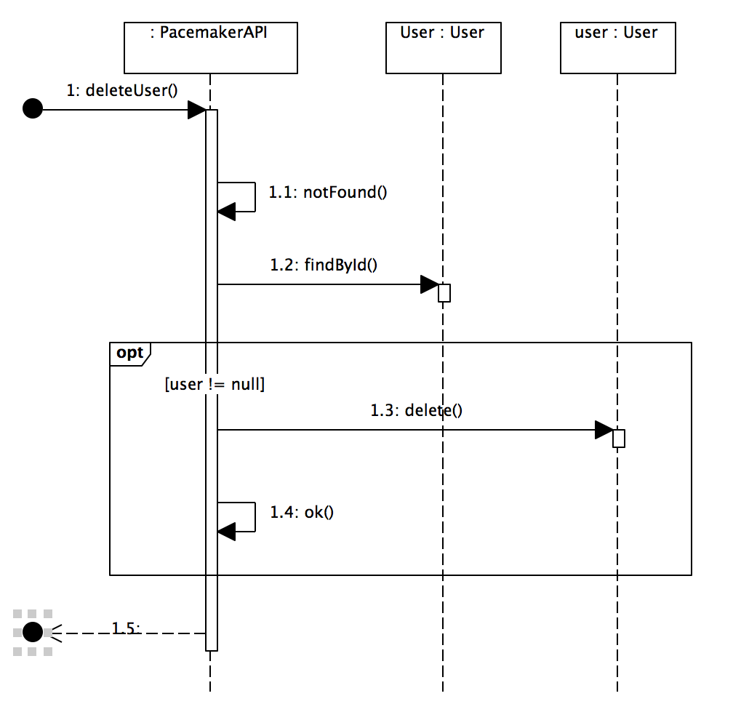
deleteUser - Sequence Diagram
public static Result deleteUser(Long id)
{
Result result = notFound();
User user = User.findById(id);
if (user != null)
{
user.delete();
result = ok();
}
return result;
}

Slide 14
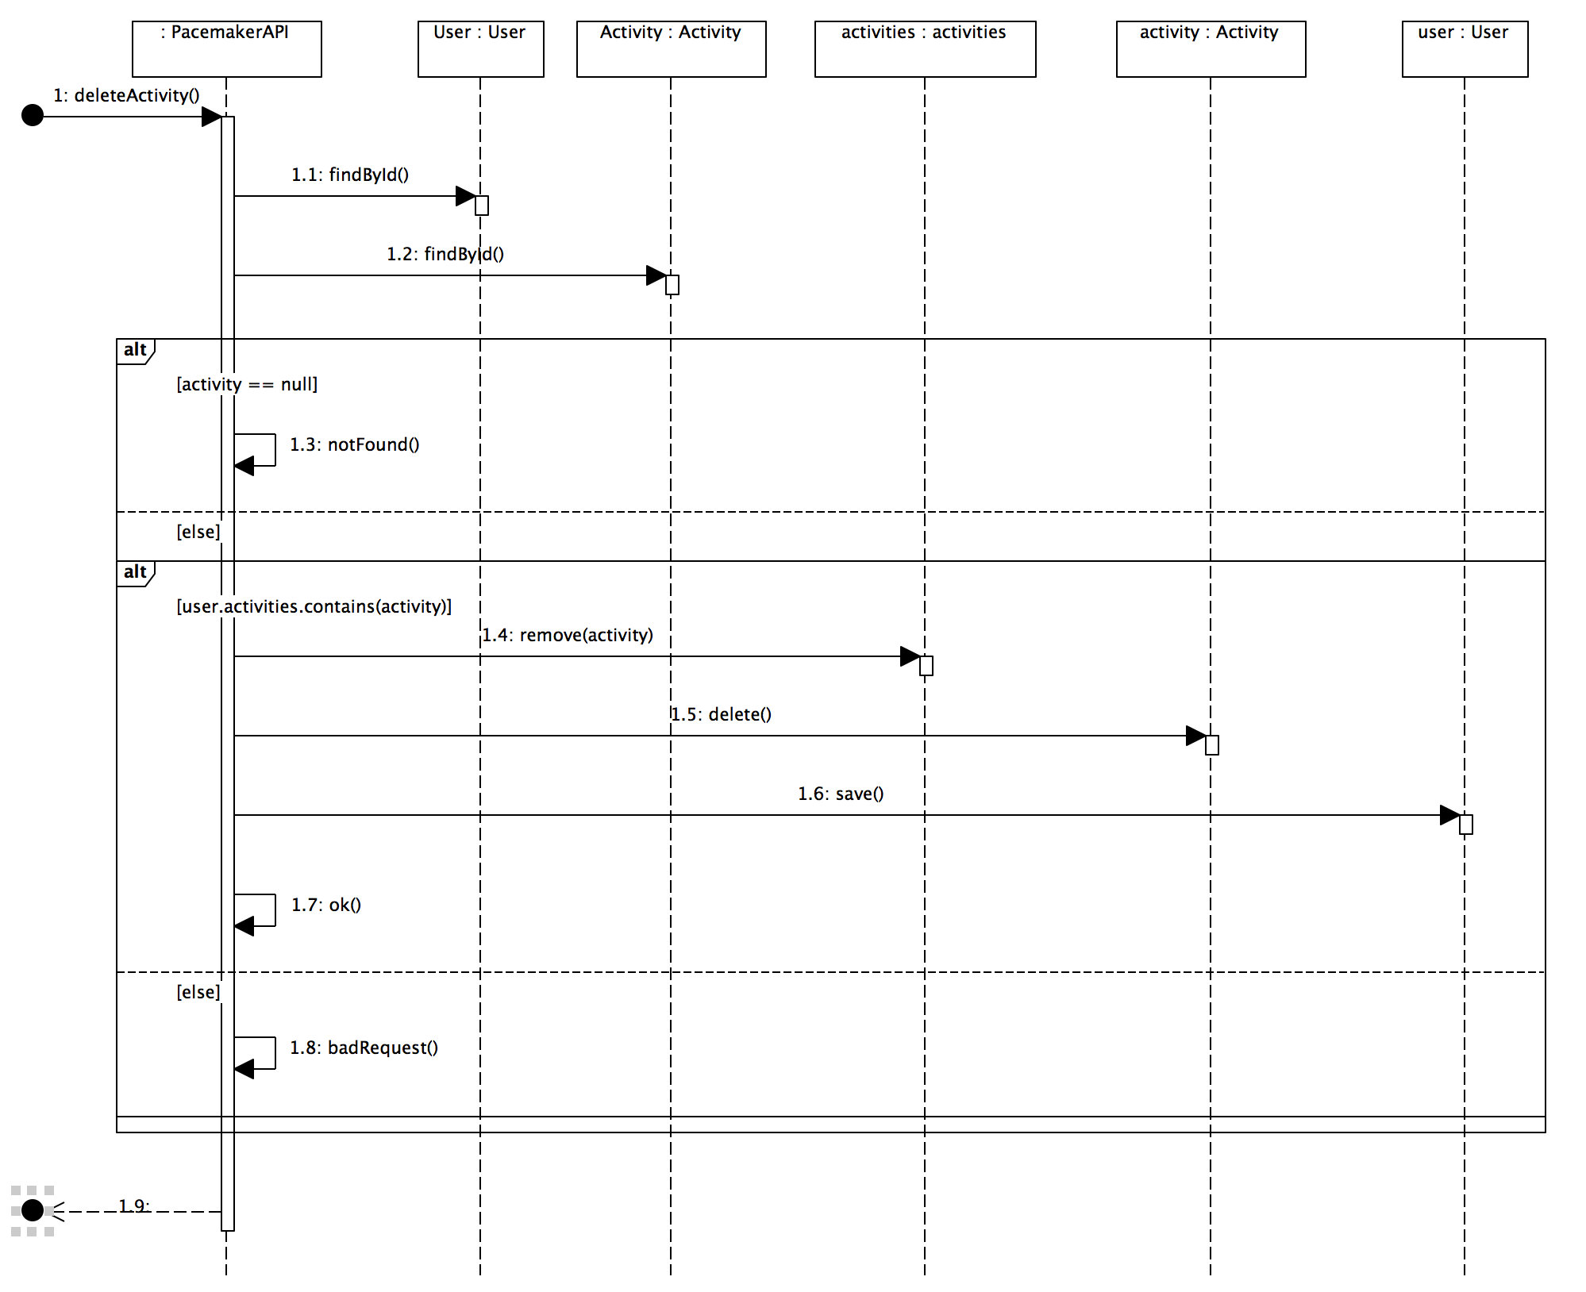
deleteActivity – Sequence Diagram
public static Result deleteActivity (Long userId, Long activityId)
{
User user = User.findById(userId);
Activity activity = Activity.findById(activityId);
if (activity == null) {
return notFound();
}
else{
if (user.activities.contains(activity)){
user.activities.remove(activity);
activity.delete();
user.save();
return ok();
}
else{
return badRequest();
}
}
}

Slide 15
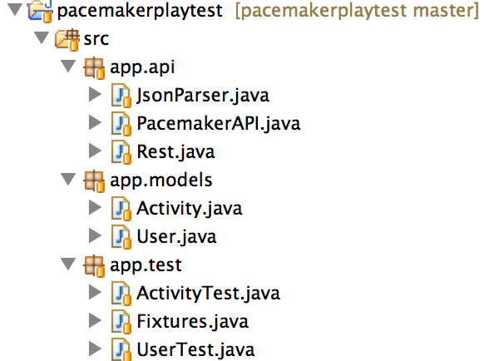
Pacemakerplaytest

Slide 16
Fixtures
public class Fixtures
{
static String userJson = "{\n"
+ "\"email\" : \"jim@simpson.com\" ,\n"
+ "\"firstName\": \"Jim\" ,\n"
+ "\"lastName\" : \"Simpson\" ,\n"
+ "\"password\" : \"secret\" \n"
+ "}";
static String activityJson = "{\n"
+ "\"type\" : \"run\" ,\n"
+ "\"location\" : \"Dunmore\" ,\n"
+ "\"distance\" : 3 \n"
+ "}";
static User users[] = {
new User ("homer", "simpson", "homer@simpson.com", "secret"),
new User ("lisa", "simpson", "lisa@simpson.com", "secret"),
new User ("maggie", "simpson", "maggie@simpson.com", "secret"),
new User ("bart", "simpson", "bart@simpson.com", "secret"),
new User ("marge", "simpson", "marge@simpson.com", "secret"),
};

Slide 17
ActivityTest (1)
public class ActivityTest
{
private User user;
private Activity activity;
@Before
public void setUp() throws Exception
{
activity = new Activity ("run", "tramore", 3);
user = PacemakerAPI.createUser(Fixtures.userJson);
}
@After
public void tearDown() throws Exception
{
Rest.delete("/api/users");
}
@Test
public void createActivityJson() throws Exception
{
Activity activity = PacemakerAPI.createActivity(user.id, Fixtures.activityJson);
Activity getResponse = PacemakerAPI.getActivity(user.id, activity.id);
assertTrue(activity.equals(getResponse));
PacemakerAPI.deleteActivity(user.id, activity.id);
}
@Test
public void createActivityObj() throws Exception
{
Activity createResponse = PacemakerAPI.createActivity(user.id, activity);
assertEquals(activity, createResponse);
Activity getResponse = PacemakerAPI.getActivity(user.id, createResponse.id);
assertEquals(activity, getResponse);
PacemakerAPI.deleteActivity(user.id, createResponse.id);
}

Slide 18
ActivityTest (2)
@Test
public void updateActivity() throws Exception
{
Activity createResponse = PacemakerAPI.createActivity(user.id, activity);
assertEquals(activity, createResponse);
activity.distance = 12;
activity.location = "connemara";
Activity updateResponse = PacemakerAPI.updateActivity(user.id, createResponse.id, activity);
assertEquals(activity, updateResponse);
PacemakerAPI.deleteActivity(user.id, createResponse.id);
}
@Test
public void getActivities() throws Exception
{
Activity createResponse = PacemakerAPI.createActivity(user.id, activity);
List<Activity> activities = PacemakerAPI.getActivities(user.id);
assertEquals(1, activities.size());
assertEquals(activity, activities.get(0));
PacemakerAPI.deleteActivity(user.id, createResponse.id);
}
@Test
public void getMultipleActivities() throws Exception
{
Activity createResponse = PacemakerAPI.createActivity(user.id, activity);
Activity activity2 = new Activity ("ride", "tramore", 3);
Activity createResponse2 = PacemakerAPI.createActivity(user.id, activity2);
List<Activity> activities = PacemakerAPI.getActivities(user.id);
assertEquals(2, activities.size());
assertEquals(activity, activities.get(0));
assertEquals(activity2, activities.get(1));
PacemakerAPI.deleteActivity(user.id, createResponse.id);
PacemakerAPI.deleteActivity(user.id, createResponse2.id);
}

Slide 19

Except where otherwise noted, this content is licensed under a Creative Commons Attribution-NonCommercial 3.0 License.
For more information, please see http://creativecommons.org/licenses/by-nc/3.0/

