Slide 1
Agile Software Development
Eamonn de Leastar
edeleastar@wit.ie

Slide 2
The Liskov Substitution Principle

Slide 3
SOLID Principles
S The Single Responsibility Principle (SRP)
A class should have one, and only one, reason to change.
O The Open Closed Principle (OCP)
You should be able to extend a classes behaviour, without modifying it.
L The Liskov Substitution Principle (LSP)
Derived classes must be substitutable for their base classes.
I The Interface Segregation Principle (ISP)
Make fine grained interfaces that are client specific.
D The Dependency Inversion Principle (DSP)
Depend on abstractions, not on concretions.

Slide 4
SOLID Principles – Scope for module
S The Single Responsibility Principle (SRP – week 8)
A class should have one, and only one, reason to change.
O The Open Closed Principle (OCP – week 10)
You should be able to extend a classes behaviour, without modifying it.
L The Liskov Substitution Principle (LSP – this week)
Derived classes must be substitutable for their base classes.
I The Interface Segregation Principle (ISP)
Make fine grained interfaces that are client specific.
D The Dependency Inversion Principle (DSP)
Depend on abstractions, not on concretions.

Slide 5
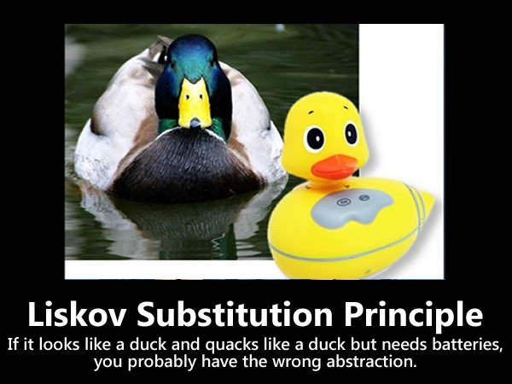

Slide 6
LSP
Methods that use references to base class types must be able to use objects or derived types without knowing it.
What is wanted here is something like the following substitution property:
If for each object o₁ of type S there is an object o₂ of type T such that for all programs P defined in terms of T, the behaviour of P is unchanged when o₁ is substituted for o₂ then S is a subtype of T.
Barbara Liskov, “Data Abstraction and Hierarchy,” SIGPLAN Notices, 23,5 (May, 1988).
T
O₂: T
extends
S
O₁: S

Slide 7

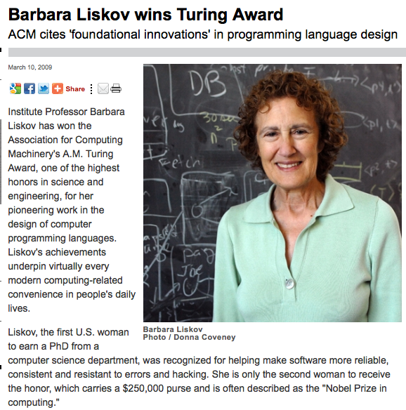
Barbara Liskov

Slide 8
Simple Violation of LSP
drawShapes() references a base type shape.
It violates LSP because it must know of every derived type of Shape.
void drawShapes (Shape shape)
{
if (shape instanceof Square)
{
drawSquare ((Square)shape);
}
else if (shape instance of Circle)
{
drawCircle ((Circle) shape);
}
}
It must be modified whenever new derivatives of Shape are presented.

Slide 9
Adhering to LSP
class Shape
{
void draw()
{//…}
}
class Circle extends Shape
{
private double itsRadius;
private Point itsCenter;
public void draw()
{ //… }
}
class Square extends Shape
{
private double itsSide;
private Point itsTopLeft;
public void draw()
{ //… }
}
void drawShape (Shape s)
{
s.draw();
}
drawShape now adheres to LSP.+

Slide 10
Rectangle
class Rectangle
{
private int width;
private int height;
public void setWidth (int width)
{...}
public void setHeight (int height)
{...}
public int getWidth ()
{...}
public int getHeight ()
{...}
}
Rectangle class is released for general use.

Slide 11
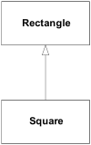
Square
A Square class is required.
Square is introduced as a subclass of Rectangle.
At one level, this use of inheritance can be considered appropriate:
A Square is a rectangle whose width and height are equal.
However, both width & height not needed (just one).
Potential inefficiency if many rectangles created (e.g. CAD application)

Slide 12
Rectangle Width & Height
Both setWidth() and setHeight() should not vary independently.
Client could easily call one and not the other – thus compromising the Rectangle.
Potential solution is to implement setWidth() and setHeight() in Square class.
These methods then make sure width & height are adjusted.
class Square extends Rectangle
{
public void setWidth (int width)
{
super.setWidth(width);
super.setHeight(width);
}
public void setHeight (int height)
{
super.setWidth(height);
super.setHeight(height);
}
}

Slide 13
Polymorphism
void f (Rectangle r)
{
r.setWidth(5);
}
Polymorphism ensures that:
If the f() method is passed a Rectangle, then its width will be adjusted.
If passed a Square, then both height and width will be changed
Assume model is consistent & correct.
However….

Slide 14
More Subtle Problem
void g (Rectangle r)
{
r.setWidth(5);
r.setHeight(4);
assert (r.getWidth() * r.getHeight()) == 20;
}
If r is a Rectangle instance
g() methods works as expected
If r is a Square
g() assertion is triggered
g() assumes that width and height of a Rectangle can be varied independently
Substitution of a Square violates this assumption.
Square violates LSP.

Slide 15
Validating the Model
A model, viewed in isolation, cannot be meaningfully validated.
The validity of a model can only be expressed in terms of its clients:
Examining the final version of the Square and Rectangle classes in isolation, we found that they were self consistent and valid.
When we examined from the viewpoint of g() (which made reasonable assumptions) the model broke down.
Thus, when considering whether a design is appropriate or not, it must be examined in terms of the reasonable assumptions that will be made by the users of that design.

Slide 16
Behavioural Problems
A square might be a rectangle, but a Square object is not a Rectangle object.
the behaviour of a Square object is not consistent with the behaviour of a Rectangle object.
The LSP makes clear that inheritance relationship pertains to behaviour.
Not intrinsic private behaviour, but extrinsic public behaviour; behaviour that clients depend upon.
g() depended on the fact that Rectangles behave such that their height and width vary independently of one another.
That independence of the two variables is an extrinsic public behaviour that other methods are also likely to depend upon.

Slide 17
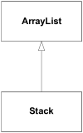
Fragile Base Class Problem
class Stack extends ArrayList
{
private int stack_pointer = 0;
public void push( Object article )
{
add( stack_pointer++, article );
}
public Object pop()
{
return remove( --stack_pointer );
}
public void push_many( Object[] articles )
{
for( int i = 0; i < articles.length; ++i )
push( articles[i] );
}
}

Slide 18
Clearing the Stack
Stack a_stack = new Stack();
a_stack.push("1");
a_stack.push("2");
a_stack.clear();
This code and uses the ArrayList's clear() method to pop everything off the stack
The code successfully executes, but since the base class doesn't know anything about the stack pointer, the Stack object is now in an undefined state.
The next call to push() puts the new item at index 2 (the stack_pointer's current value), so the stack effectively has three elements on it—the bottom two are garbage.

Slide 19

Use Composition instead of Inheritance

Slide 20
Composed Solution
class Stack
{
private int stack_pointer = 0;
private ArrayList the_data = new ArrayList();
public void push( Object article )
{
the_data.add( stack_pointer++, article );
}
public Object pop()
{
return the_data.remove( --stack_pointer );
}
public void push_many( Object[] articles )
{
for( int i = 0; i < o.length; ++i )
push( articles[i] );
}
}

Slide 21
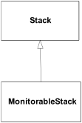
Monitorable Stack
class Monitorable_stack extends Stack
{
private int high_water_mark = 0;
private int current_size;
public void push( Object article )
{
if( ++current_size > high_water_mark )
high_water_mark = current_size;
super.push(article);
}
public Object pop()
{
--current_size;
return super.pop();
}
public int maximum_size_so_far()
{
return high_water_mark;
}
}
Tracks the maximum stack size over a certain time period.

Slide 22
push_many Implementation
void f(Stack s)
{
//...
s.push_many (someObjectArray);
//...
}
Which class implements push_many()method?
If f()is passed a MonitorableStack, does a call to push_many()update high_water_mark?
Polymorphism ensures that MonitrableStack’s push() method is called, and high_water_mark is appropriately updated.
This is because Stack.push_many()calls the push()method, which is overridden by MonitorableStack.

Slide 23
Revised Stack
A profiler is run against an implementation using Stack.
It notices the Stack isn't as fast as it could be and is heavily used.
Stack is rewritten so it doesn't use an ArrayList and consequently it gains a performance boost…

Slide 24
Revised Stack using Arrays
class Stack
{
private int stack_pointer = -1;
private Object[] stack = new Object[1000];
public void push( Object article )
{
assert stack_pointer < stack.length;
stack[ ++stack_pointer ] = article;
}
public Object pop()
{
assert stack_pointer >= 0;
return stack[ stack_pointer-- ];
}
public void push_many( Object[] articles )
{
assert (stack_pointer + articles.length) < stack.length;
System.arraycopy(articles, 0, stack, stack_pointer+1,
articles.length);
stack_pointer += articles.length;
}
}

Slide 25
Problems?
void f(Stack s)
{
//...
s.push_many (someObjectArray);
//...
}
If s is a MonitorableStack, is high_water_mark updated?
No – because the new Stack base class push_many() implementation does not call push()at all
LSP Violation: i.e. function f()will not appropriately operate a Stack derived object.

Slide 26
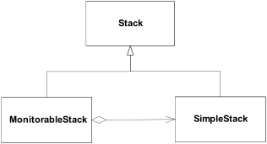
Solution
interface Stack
{
void push( Object o );
Object pop();
void push_many( Object[] source );
}

Slide 27
Simple_Stack
class Simple_Stack implements Stack
{
private int stack_pointer = -1;
private Object[] stack = new Object[1000];
public void push( Object article )
{
assert stack_pointer < stack.length;
stack[ ++stack_pointer ] = article;
}
public Object pop()
{
assert stack_pointer >= 0;
return stack[ stack_pointer-- ];
}
public void push_many( Object[] articles )
{
assert (stack_pointer + articles.length) < stack.length;
System.arraycopy(articles, 0, stack, stack_pointer+1,
articles.length);
stack_pointer += articles.length;
}
}

Slide 28
class Monitorable_Stack implements Stack
{
private int high_water_mark = 0;
private int current_size;
Simple_stack stack = new Simple_stack();
public void push( Object o )
{
if( ++current_size > high_water_mark )
high_water_mark = current_size;
stack.push(o);
}
public Object pop()
{
--current_size;
return stack.pop();
}
public void push_many( Object[] source )
{
if( current_size + source.length > high_water_mark )
high_water_mark = current_size + source.length;
stack.push_many( source );
}
public int maximum_size()
{
return high_water_mark;
}
}

Slide 29
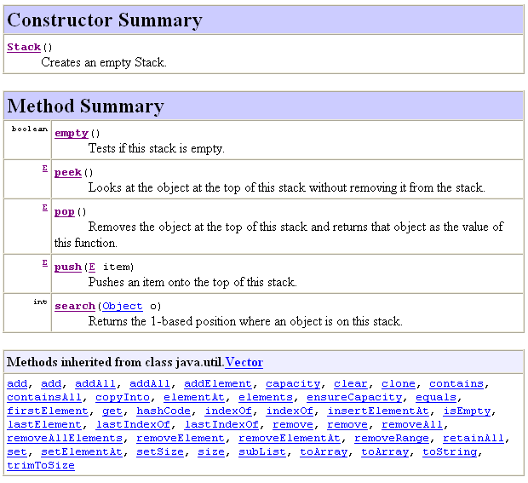
Consult Stack API

Slide 30
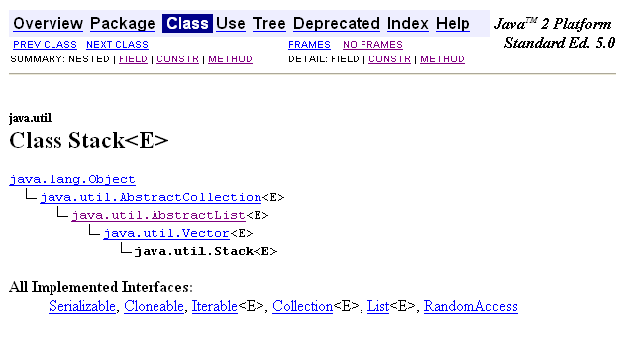
Stack is Derived from Vector

Slide 31
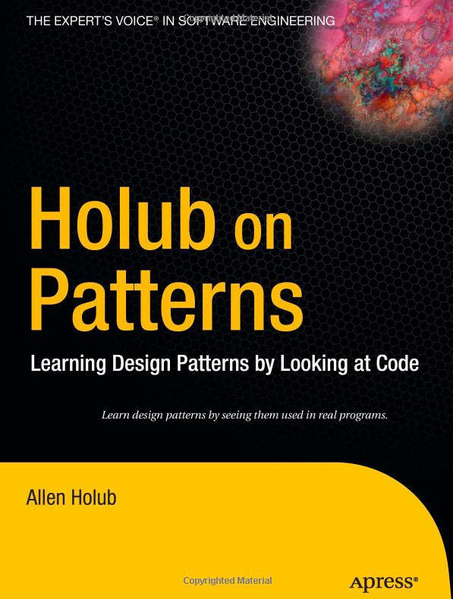
Holub’s Advice
In general, it's best to avoid concrete base classes and extends relationships in favour of interfaces and implements relationships.
Rule of thumb : 80 percent of code at minimum should be written entirely in terms of interfaces.
e.g. never use references to a HashMap, use references to the Map
The more abstraction you add, the greater the flexibility.
In today's business environment, where requirements regularly change as the program develops, this flexibility is essential.

