Slide 1


Agile Software Development
Produced
by
Eamonn de Leastar (edeleastar@wit.ie)
Department of Computing, Maths & Physics
Waterford Institute of Technology
http://www.wit.ie
http://elearning.wit.ie

Slide 2
Play 2

Slide 3
Web Applications - Request/Response
Http Request
Client
Server
Http Response
Request - http request emitted by browser as a result to url in address bar, link, button or form submission on page.
Response - web page returned from service to be presented in browser.

Slide 4
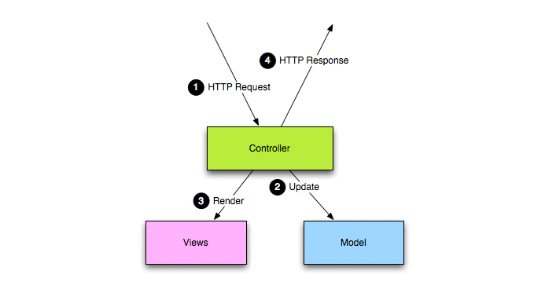
Web Applications - MVC
Model View Controller is a generally accepted pattern or separation of concerns within the server.
Model: Core application domain model + database persistence.
View: User Experience.
Controller: Directly handle all requests, mediate with Model, build and assemble the response using the views.

Slide 5
Request/Response Lifecycle
PLAY FRAMEWORK
Browser
Routing
Controller
Views
Browser
Match url to class/method
Handle and process parameters
Define how the page will look; use templates if necessary
REQUEST
Creation of a dynamic content
Rendering
4

Slide 6
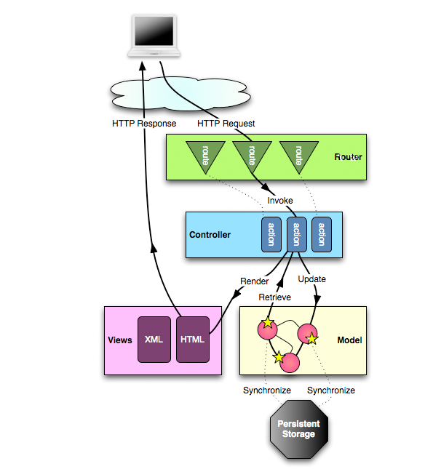
MVC in Play
Router: examine incoming requests and match to corresponding Controller/Action.
Action: a method in the controller.

Slide 7
Routes File Example (Pacemaker)
# UI
GET / controllers.Accounts.index()
GET /signup controllers.Accounts.signup()
GET /login controllers.Accounts.login()
GET /logout controllers.Accounts.logout()
POST /register controllers.Accounts.register()
POST /authenticate controllers.Accounts.authenticate()
GET /dashboard controllers.Dashboard.index()
GET /upload controllers.Dashboard.uploadActivityForm()
POST /submitactivity controllers.Dashboard.submitActivity()
# API
GET /api/users controllers.PacemakerAPI.users()
DELETE /api/users controllers.PacemakerAPI.deleteAllUsers()
POST /api/users controllers.PacemakerAPI.createUser()
GET /api/users/:id controllers.PacemakerAPI.user(id: Long)
DELETE /api/users/:id controllers.PacemakerAPI.deleteUser(id: Long)
PUT /api/users/:id controllers.PacemakerAPI.updateUser(id: Long)
GET /api/users/:userId/activities controllers.PacemakerAPI.activities(userId: Long)
POST /api/users/:userId/activities controllers.PacemakerAPI.createActivity(userId: Long)
GET /api/users/:userId/activities/:activityId controllers.PacemakerAPI.activity(userId: Long, activityId:Long)
DELETE /api/users/:userId/activities/:activityId controllers.PacemakerAPI.deleteActivity(userId: Long, activityId:Long)
PUT /api/users/:userId/activities/:activityId controllers.PacemakerAPI.updateActivity(userId: Long, activityId:Long)
# Map static resources from the /public folder to the /assets URL path
GET /assets/*file controllers.Assets.at(path="/public", file)

Slide 8
Routes - UI
# UI
GET / controllers.Accounts.index()
GET /signup controllers.Accounts.signup()
GET /login controllers.Accounts.login()
GET /logout controllers.Accounts.logout()
POST /register controllers.Accounts.register()
POST /authenticate controllers.Accounts.authenticate()
GET /dashboard controllers.Dashboard.index()
GET /upload controllers.Dashboard.uploadActivityForm()
POST /submitactivity controllers.Dashboard.submitActivity()
Routes to deliver UI.
Each of these routes appears in views folder.
Each of these actions generates and returns a complete HTML page.

Slide 9
Routes - API
# API
GET /api/users controllers.PacemakerAPI.users()
DELETE /api/users controllers.PacemakerAPI.deleteAllUsers()
POST /api/users controllers.PacemakerAPI.createUser()
GET /api/users/:id controllers.PacemakerAPI.user(id: Long)
DELETE /api/users/:id controllers.PacemakerAPI.deleteUser(id: Long)
PUT /api/users/:id controllers.PacemakerAPI.updateUser(id: Long)
GET /api/users/:userId/activities controllers.PacemakerAPI.activities(userId: Long)
POST /api/users/:userId/activities controllers.PacemakerAPI.createActivity(userId: Long)
GET /api/users/:userId/activities/:activityId controllers.PacemakerAPI.activity(userId: Long, activityId:Long)
DELETE /api/users/:userId/activities/:activityId controllers.PacemakerAPI.deleteActivity(userId: Long, activityId:Long)
PUT /api/users/:userId/activities/:activityId controllers.PacemakerAPI.updateActivity(userId: Long, activityId:Long)
Routes to deliver API.
Each of these routes is an API Request.
Each of these actions generates and returns a JSON payload.

Slide 10
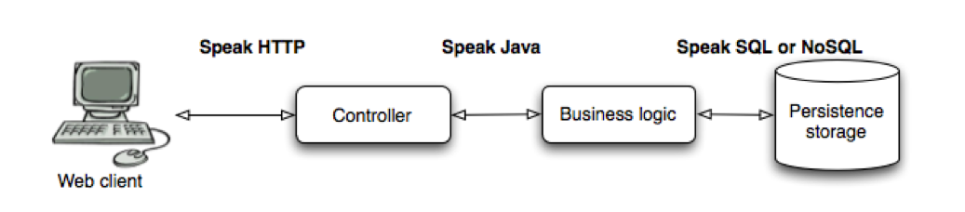
Role of Controller

Slide 11
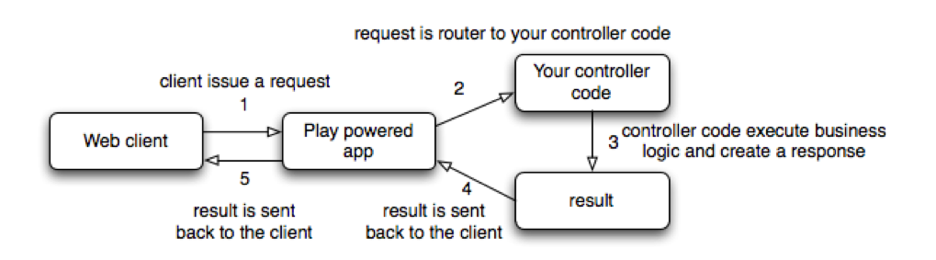
Controller Lifecycle

Slide 12
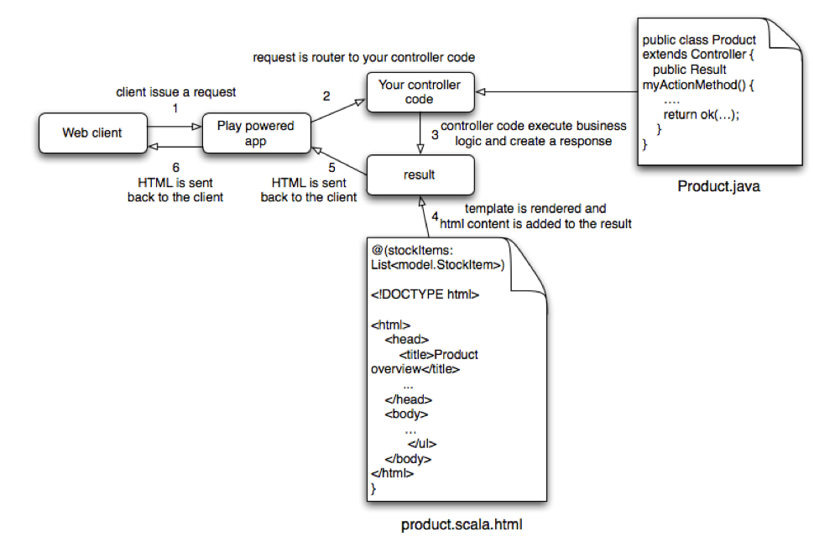
Controller Lifecycle (detail)

Slide 13
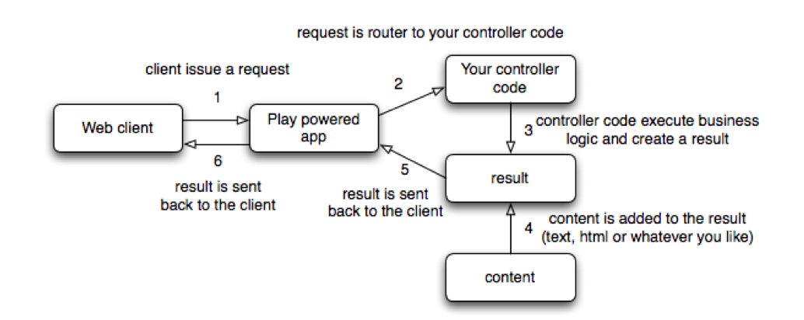
Controller Lifecycle with Content

Slide 14
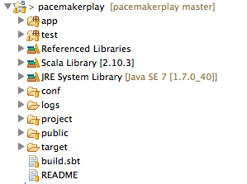
Play Project Anatomy
app
conf
public
build.sbt

Slide 15
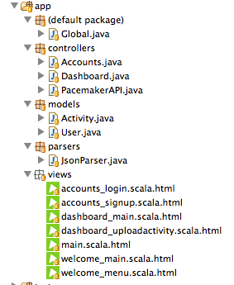
app folder
controllers
models
views

Slide 16
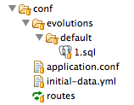
conf folder

Slide 17
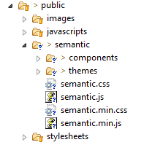
public folder

Slide 18
build.sbt
name := "pacemakerplay"
version := "1.0-SNAPSHOT"
libraryDependencies ++= Seq(
javaJdbc,
javaEbean,
cache,
"net.sf.flexjson" % "flexjson" % "3.1",
"postgresql" % "postgresql" % "9.1-901-1.jdbc4"
)
play.Project.playJavaSettings

Slide 19
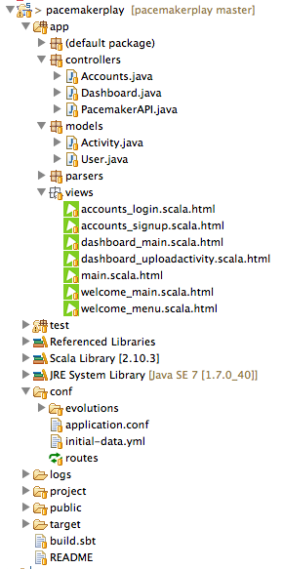
pacemakerplay

Slide 20

Except where otherwise noted, this content is licensed under a Creative Commons Attribution-NonCommercial 3.0 License.
For more information, please see http://creativecommons.org/licenses/by-nc/3.0/

