Slide 1


Agile Software Development
Produced
by
Produced
by
Eamonn de Leastar (edeleastar@wit.ie)
Department of Computing, Maths & Physics
Waterford Institute of Technology
Department of Computing, Maths & Physics
Waterford Institute of Technology
http://www.wit.ie
http://www.wit.ie
http://elearning.wit.ie
http://elearning.wit.ie

Slide 2
Semantic HTML + UI

Slide 3
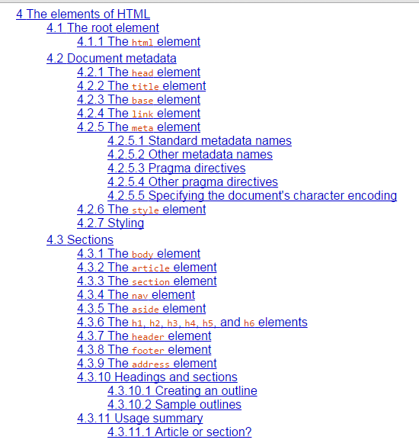
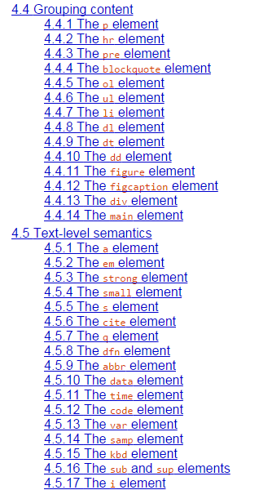
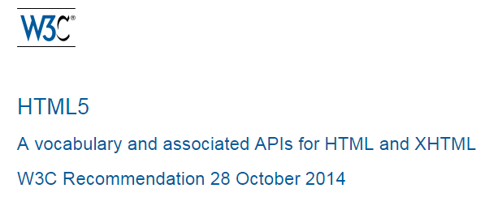
HTML5
A subset of Section 4 of the HTML5 spec…

Slide 4
metadata
sections
grouping
links
embedding
forms
tabular data
<html> <head>
<body><section><article><nav><aside><header><footer><h1><h2><h3>
<p><ul> <ol> <li> <div>
<a>
<img>
<form>
<table>
attribute
element
<article class="ten wide column">
<h1 class="ui header"> Sign up for Pacemaker </h1>
<p> No Bitcoins accepted! </p>
</article>
+ attribute syntax:

Slide 5
The Need for Semantic Elements
Give content on the page meaning and structure.
Semantics portray the value of content on a page, and are not just its style.
Semantic markup can be interpreted by tools for the visually impaired.
Search Engines can use semantic markup to better categorise and classify content.
Semantic markup can make site maintenance easier as new developers can quickly grasp the site structure.
Updating / Restyling may be streamlined by using semantic elements.

Slide 6
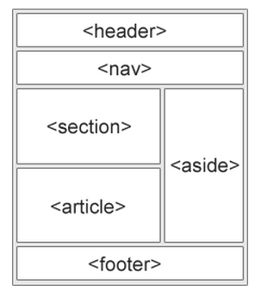
The HTML5 Semantic Elements
<header>
<nav>
<section>
<article>
<aside>
<figcaption>
<figure>
<footer>

Slide 7
<nav>
<nav>
<h1>Navigation</h1>
<ul>
<li><a href="articles.html">Index of all articles</a></li>
<li><a href="today.html">Things sheeple need to wake up for today</a></li>
<li><a href="successes.html">Sheeple we have managed to wake</a></li>
</ul>
</nav>
"The nav element represents a section of a page that links to other pages or to parts within the page: a section with navigation links.”

Slide 8
<article>
<article itemscope itemtype="http://schema.org/BlogPosting">
<header>
<h1 itemprop="headline">The Very First Rule of Life</h1>
<p><time itemprop="datePublished" datetime="2009-10-09">3 days ago</time></p>
<link itemprop="url" href="?comments=0">
</header>
<p>If there's a microphone anywhere near you, assume it's hot and
sending whatever you're saying to the world. Seriously.</p>
<p>...</p>
<footer>
<a itemprop="discussionUrl" href="?comments=1">Show comments...</a>
</footer>
</article>
"The article element represents a complete, or self-contained, composition in a document, page, application, or site and that is, in principle, independently distributable or reusable, e.g. in syndication. This could be a forum post, a magazine or newspaper article, a blog entry, a user-submitted comment, an interactive widget or gadget, or any other independent item of content.

Slide 9
A brief note on MicroData and Items
Sometimes, it is desirable to annotate HTML content with specific machine-readable labels.
Microdata allows nested groups of name-value pairs to be added to documents, in parallel with the existing content.
The microdata model consists of a group of name-value pairs. The groups are called items. Each name-value pair is a property.
itemscope | boolean attribute that creates a new item for the element.
itemtype | Gives the item a URL type (used in conjunction with itemscope).
itemprop | Used on one of the item’s descendant's to add a property to the item.
http://www.w3.org/TR/microdata/#the-microdata-model

Slide 10
<section>
"The section element represents a generic section of a document or application.
A section, in this context, is a thematic grouping of content.
The theme of each section should be identified, typically by including a heading (h1-h6 element) as a child of the section element.”
<article>
<header>
<h2>Apples</h2>
<p>Tasty, delicious fruit!</p>
</header>
<p>The apple is the pomaceous fruit of the apple tree.</p>
<section>
<h3>Red Delicious</h3>
<p>These bright red apples are the most common found in many
supermarkets.</p>
</section>
<section>
<h3>Granny Smith</h3>
<p>These juicy, green apples make a great filling for apple
pies.</p>
</section>
</article>

Slide 11
<aside>
"The aside element represents a section of a page that consists of content that is tangentially related to the content around the aside element, and which could be considered separate from that content. Such sections are often represented as sidebars in printed typography.”
<aside>
<h1>Switzerland</h1>
<p>Switzerland, a land-locked country in the middle of
geographic Europe, has not joined the geopolitical
European Union, though it is a signatory to a
number of European treaties.</p>
</aside>

Slide 12
<header> & <footer>
"The header element represents introductory content for its nearest ancestor sectioning content or sectioning root element. A header typically contains a group of introductory or navigational aids.”
<header>
<p>Welcome to...</p>
<h1>Voidwars!</h1>
</header>
<footer>
<a href="../">Back to index…</a>
</footer>
"The footer element represents a footer for its nearest ancestor sectioning content or sectioning root element. A footer typically contains information about its section such as who wrote it, links to related documents, copyright data, and the like.”

Slide 13
<figure> & <figcaption>
The <figcaption> tag defines a caption for a <figure> element.
The <figcaption> element can be placed as the first or last child of the <figure> element.
<figure> <img src="img_pulpit.jpg" alt="The Pulpit Rock" width="304" height="228"> <figcaption>Fig1. - A view of the pulpit rock in Norway.</figcaption> </figure>
http://www.w3schools.com/tags/tag_figcaption.asp

Slide 14
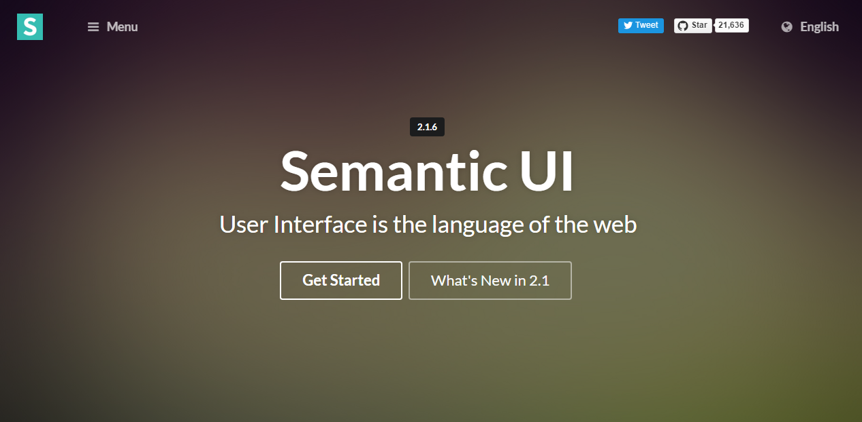
Semantic UI
http://semantic-ui.com/

Slide 15
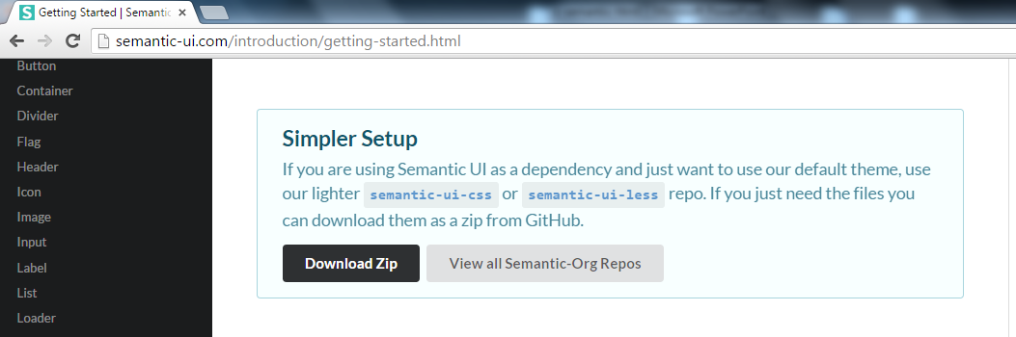
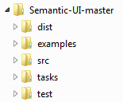
Installing Semantic UI as a project dependency
Download and expand the zip file.
You should have this file structure →

Slide 16
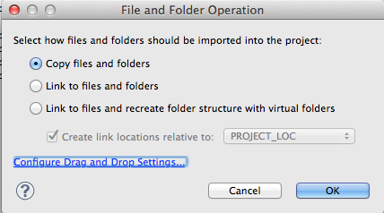
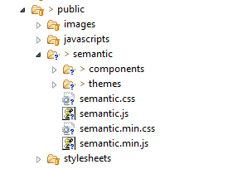
Installing Semantic UI as a project dependency
Open your eclipse project and drag the dist folder and drop it into the public folder.
When prompted, select the copy files and folders option:
Once the folder is copied over rename it from dist to semantic. Your public folder structure should now look similar to this:

Slide 17
Terminology – Definitions and Components
A definition is a set of CSS and Javascript which describe a component's essential qualities.
A component is a general term used to refer to any user interface element packaged for distribution.
Semantic UI classifies components into five different definition types depending on its qualities:
Element
Collection
Views
Modules
Behavior
http://semantic-ui.com/introduction/glossary.html

Slide 18
Terminology – Global & Five Component Types
Globals | Globals are styles that are applied across a site. These include things like sitewide font, link and sizing defaults.
Element | UI elements are page elements with a single function. They can exist alone or in a plural form with elements sharing qualities e.g.: A group of buttons may use ui red buttons as a grouping with individual ui button children.
Collection | Collections are heterogeneous groups of components which are usually found together. They describe a list of "usual suspects" which appear in a certain context.
Views | A view is a convention for presenting specific types of content that is usually consistent across a website. These include things like comments, activity feeds, etc.
Modules | Modules are components that include both a definition of how they appear and how they behave. These include components like dropdowns, popups, etc.
Behaviors | Behaviors are standalone Javascript components that describe how page elements should act, but not how they should appear. Behaviors include things like form validation, state management, and API request routing.
http://semantic-ui.com/introduction/glossary.html

Slide 19
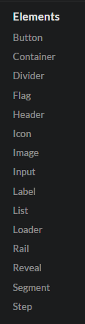
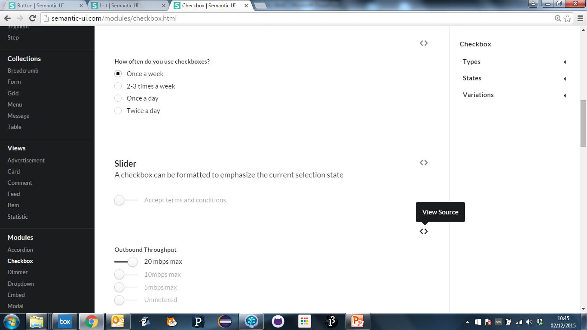
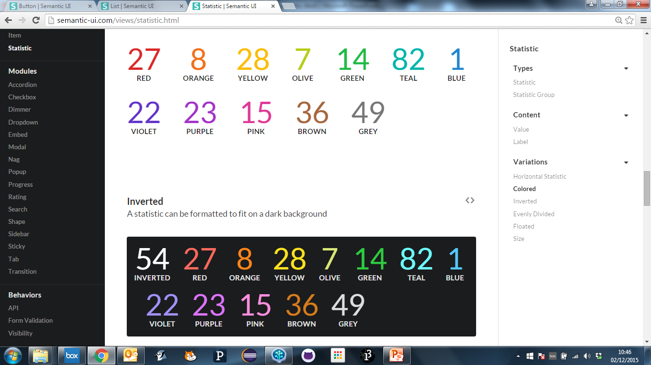
Component Types Catalogue

Slide 20
Terminology - Definition Sections
All UI components of a single type are defined similarly
Types | Types are mutually exclusive versions of an element that modify the element's standard appearance.
Variations | Variations modify qualities of an element like size, or color. Variations are mutually inclusive, and can be used together to modify an element.
Content | Content are parts which only have meaning in the context of a component. Content use names which describe the type of expected content like header, description, menu, or item.
States | States are modifications to an element that help indicate a change inaffordances. Common states include loading, disabled, hovered and active.
Behaviors | Behaviors are actions that a component can perform. Behaviors are represented by simple phrases like "set value" or "increment", that can be invoked in Javascript..

Slide 21
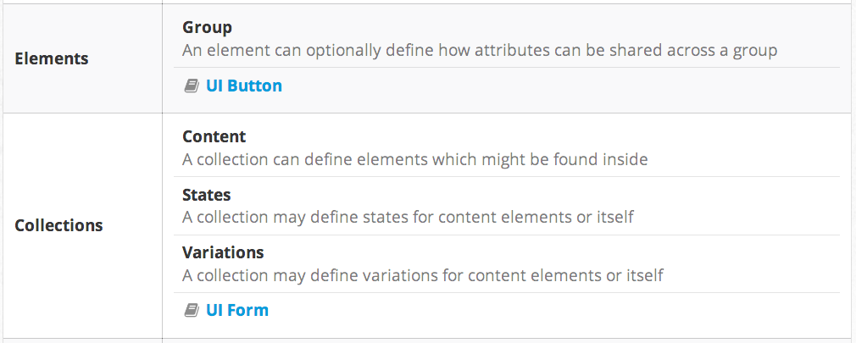
Components (Elements & Collections)

Slide 22
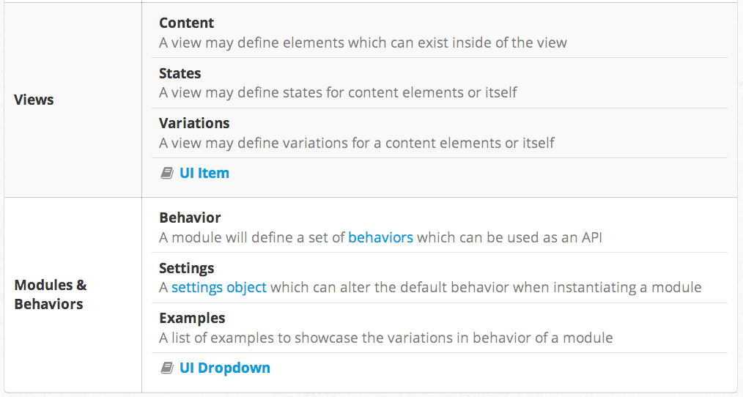
Components (Views, Modules & Behaviours)

Slide 23
Component Types Catalogue

Slide 24
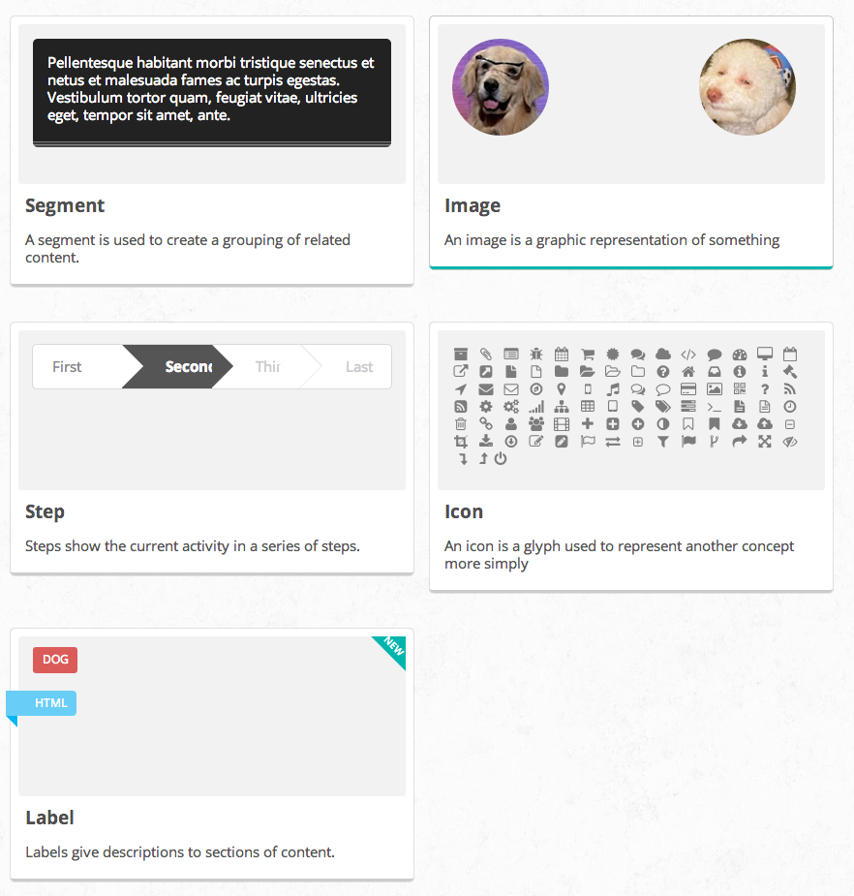
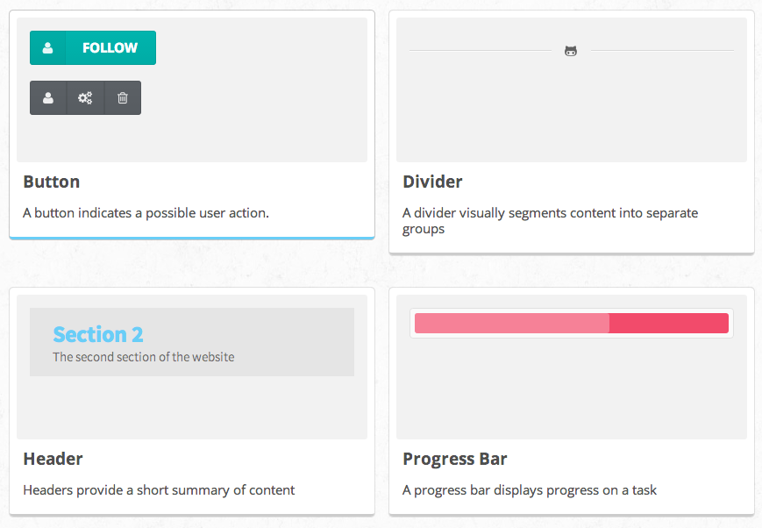
Elements

Slide 25
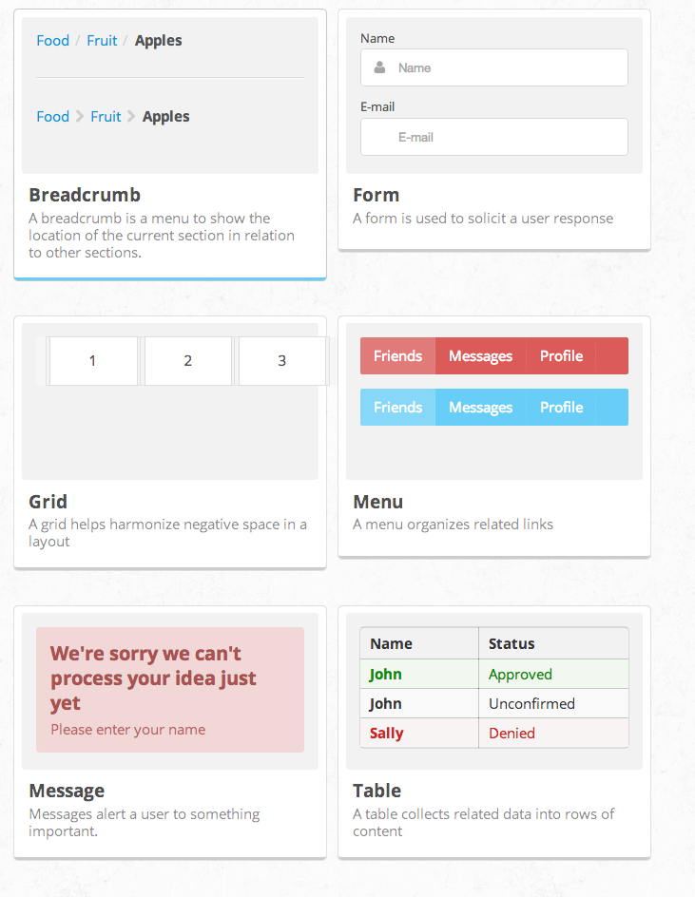
Collections

Slide 26
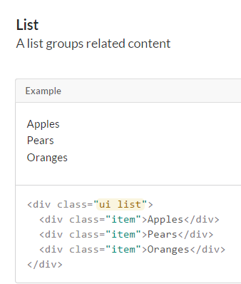
ui – Special Class
ui is a special class name used to distinguish parts of components from components e.g.
a list will receive the class ui list because it has a corresponding definition, however a list item, will receive just the class item.
The ui class name helps encapsulate CSS rules by making sure all 'parts of a component' are defined in context to a 'whole' component.
It also helps make scanning unknown code simpler. If you see ui you know you are looking at a component.

Slide 27
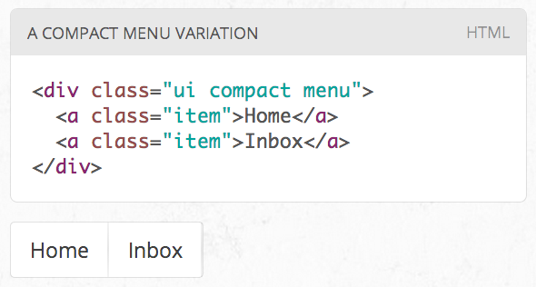
Changing an Element
Class names in Semantic always use single english words.
If a class name is an adjective it is either a type of element or variation of an element.
CSS definitions always define adjectives in the context of a noun. In this way class names cannot pollute the namespace.

Slide 28
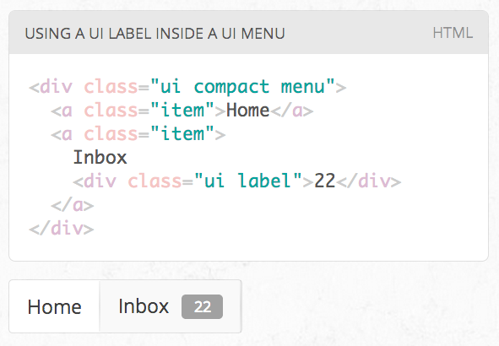
Combining an Element
All UI definitions in semantic are stand-alone, and do not require other components to function.
However, components can choose to have optional couplings with other components.
For example you might want to include a badge inside a menu. A label inside of a menu will automatically function as a badge

Slide 29
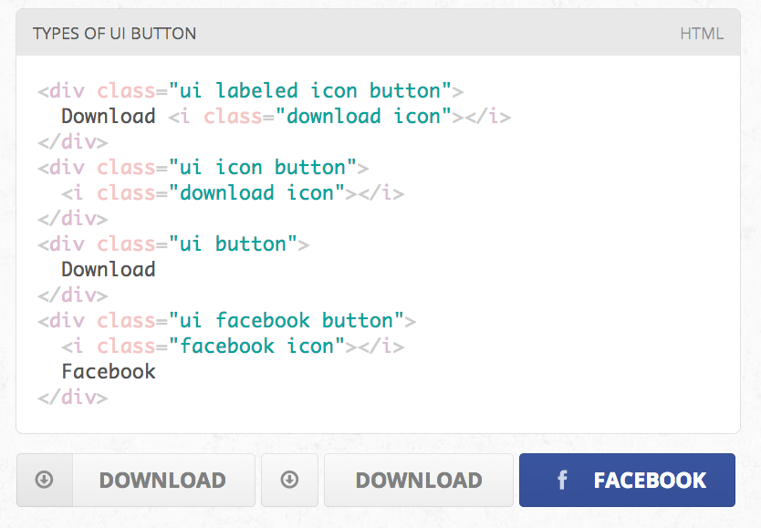
Types / Variations
A ui definition in Semantic usually contains a list of mutually exclusive variations on an element design.
A type is designated by an additional class name on a UI element

Slide 30
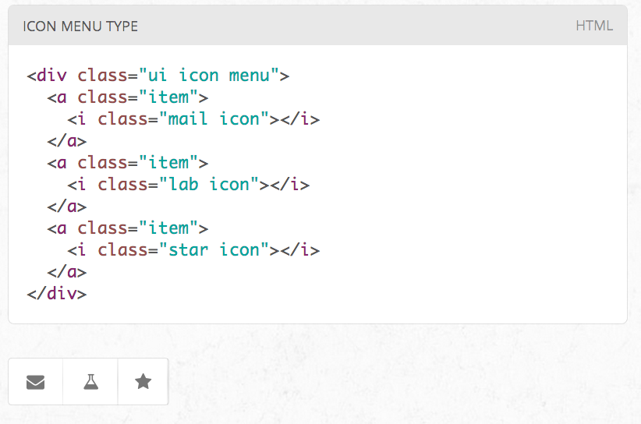
Types / Content
Types may require different html structures to work correctly.
For example, an icon menu might expect different content like icons glyphs instead of text to be formatted correctly

Slide 31
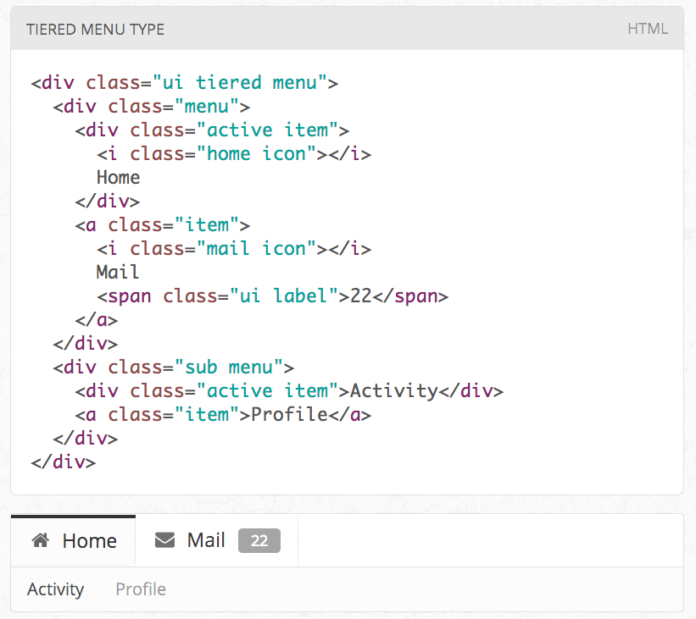
Types / HTML Differences
Types may also each require slightly different html.
For example, a tiered menu needs html specified for a sub menu to display itself correctly

Slide 32
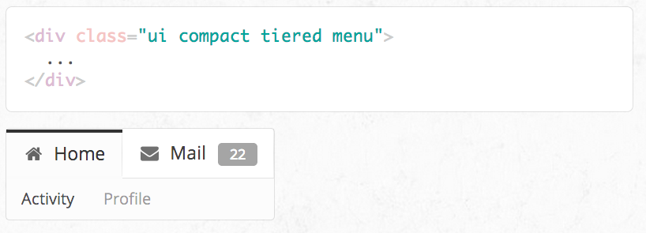
Variations
A variation alters the design of an element but is not mutually exclusive.
Variations can be stacked together, or be used along with altering an element's type.
For example, having wide menus that take up the full width of its parent may sometimes be overwhelming. You can use the compact variation of a menu to alter its format to only take up the necessary space.

Slide 33
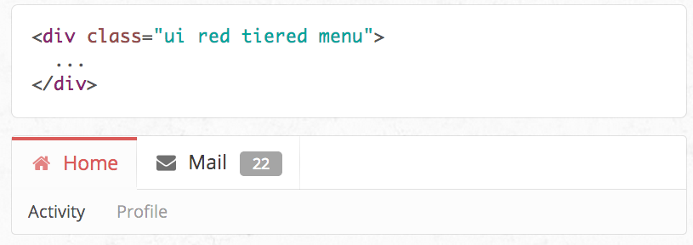
Intersecting Variations
The definition for the variation red contains css specifically for describing the intersection of both red and inverted.

Slide 34

Except where otherwise noted, this content is licensed under a Creative Commons Attribution-NonCommercial 3.0 License.
For more information, please see http://creativecommons.org/licenses/by-nc/3.0/

