Slide 1
Agile Software Development
Eamonn de Leastar (edeleastar@wit.ie)

Slide 2
Assignment 2

Slide 3
Pacemaker 2.0
Enhance the pacemaker application along 4 axis
  Deployment
  Features
  User eXperience (UX)
  Developer eXperience (DX)
Top marks may be achieved by addressing (1) and any two of 2-4

Slide 4
Pacemaker Deployment
Version 1.0
  The application is a standalone console process.
  All IO is via standard in/out.
Version 2.0
  Deploy the app to a service environment e.g. Heroku, Amazon.
  Expose the app via an API e.g. convert to Play → RESTful API
  The API supports some protocol e.g. REST.

Slide 5
Pacemaker Deployment - Remaining Agile Labs
Deploy Version 1.0
as REST Service
(i.e. Play Framework, version 2.2.6 ).
Initiated in week 8 labs.

Slide 6
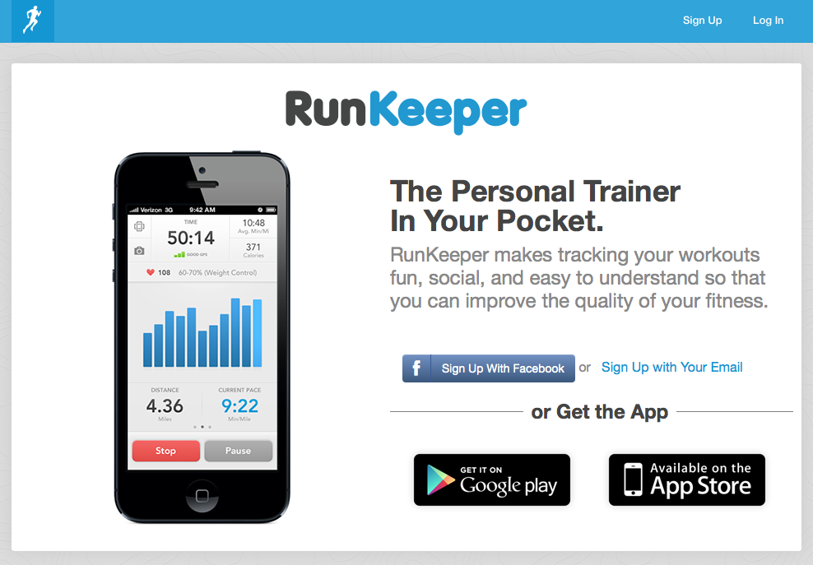
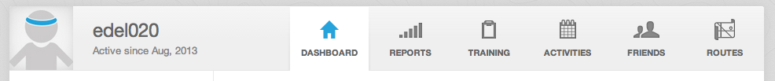
Features - Explore RunKeeper

Slide 7
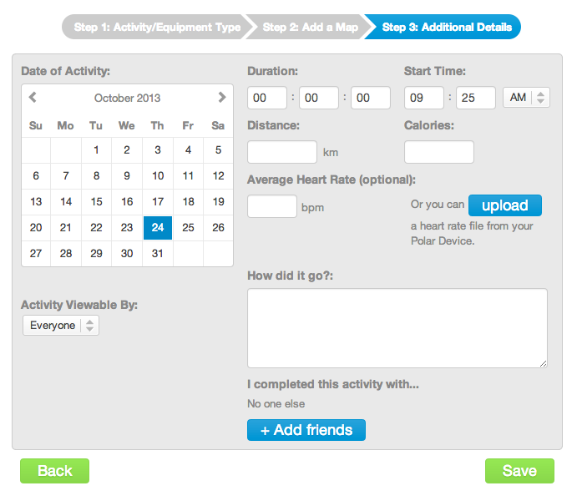

Slide 8
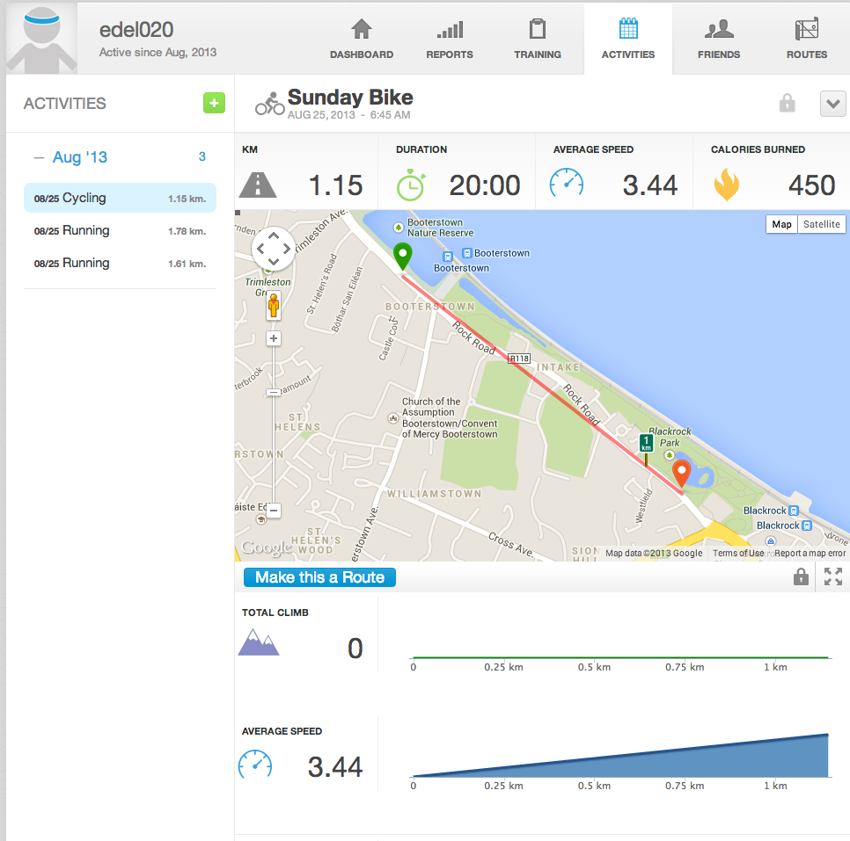

Slide 9
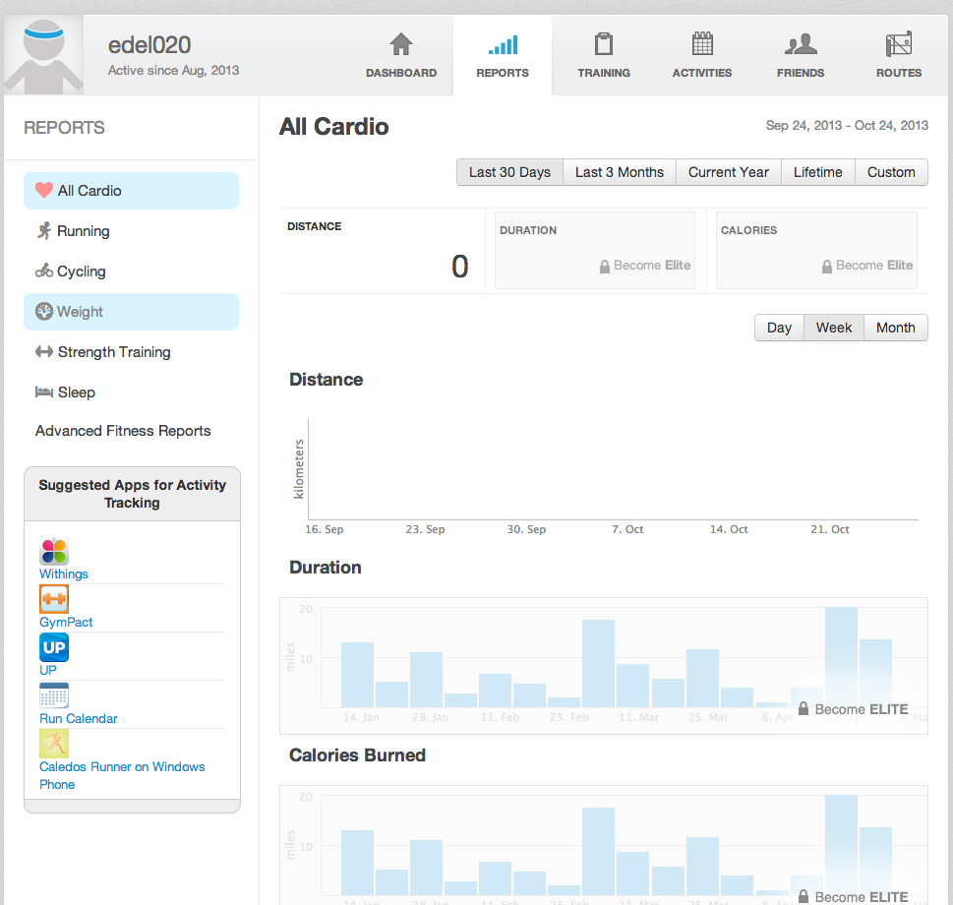

Slide 10
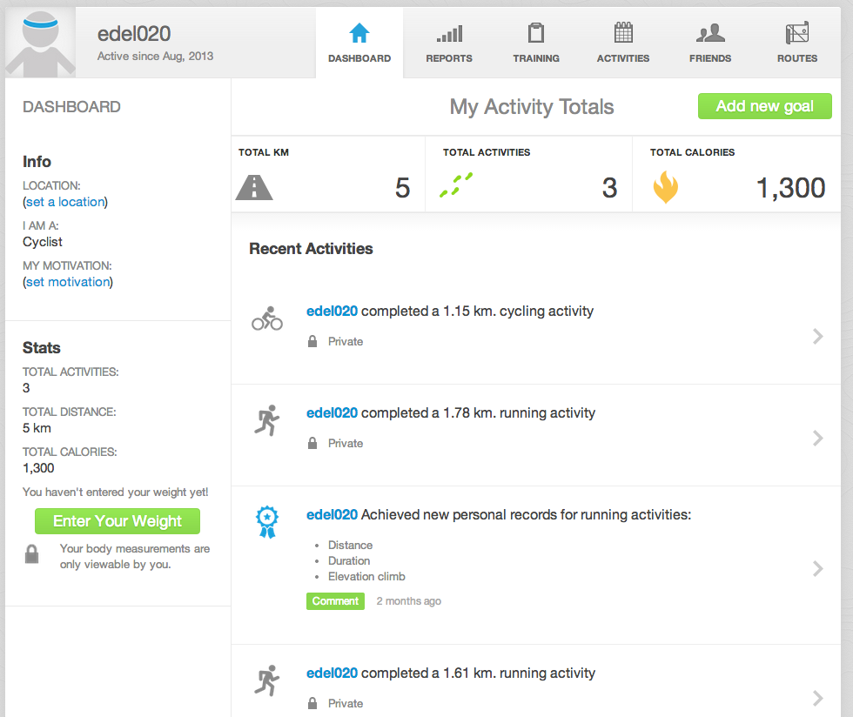

Slide 11
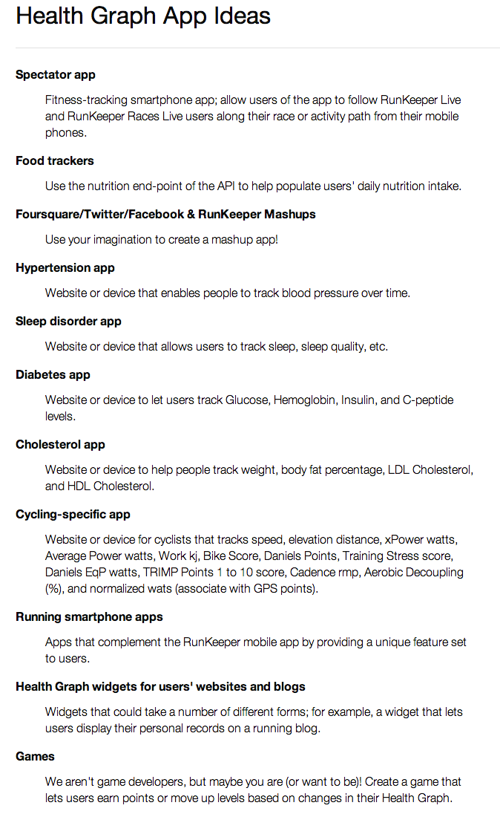
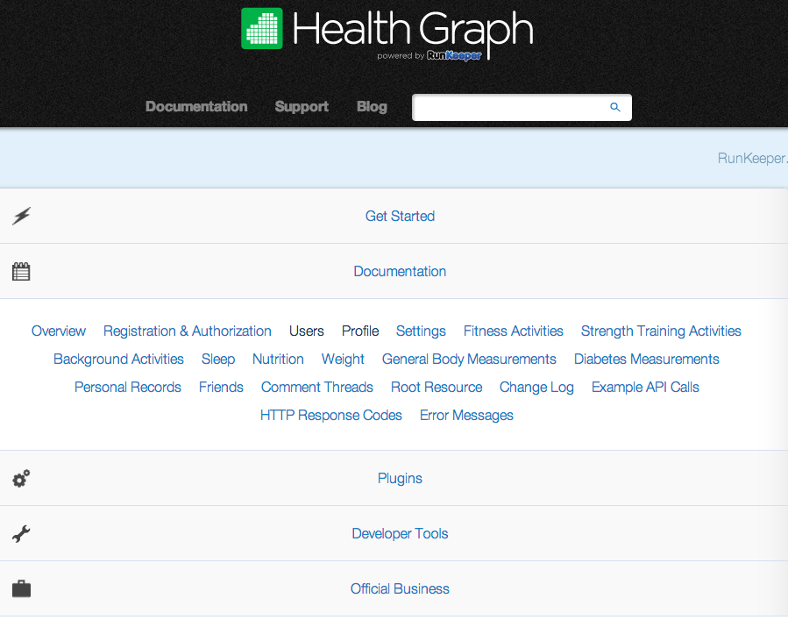
http://developer.runkeeper.com/

Slide 12
Features - Remaining Labs
No new features over 1.0!

Slide 13
User Experience (UX)
Console (as in pacemaker 1.0).
Simple Website.
Rich Client-side App (e.g. using Angular, Ember, Backbone, etc.)
Smartphone App.

Slide 14
UX - Remaining Labs
Simple Web Interface using the Play Framework (week 8 labs).
Console Interface (week 10 labs).

Slide 15
Developer Experience (DX)
Documentation
  Documented API (e.g. Javadoc, Swagger – takes REST API and produces documentation)
  Models (i.e. UML diagrams).
TDD
  TDD for REST APIs (week 10)
  Mock Objects (week 11)
  BDD

Slide 16
DX - Remaining Labs
Models - Visual Paradigm + Structure 101 Analysis
TDD for REST APIs - Test API using Play
Test Doubles

Slide 17
Assignment Rubric for Assignment 2 (top marks deployment + any 2 others)
Standard | Deployment | Features | UX | DX
Baseline | REST (Local) | activities (see runkeeper) | Console | Rest Tests
Good | REST (Deployed) | reports (see runkeeper) | Console - asciiart | Models
Excellent | REST (Secured e.g. OAuth) | friends (see runkeeper) | Simple Web | Test Doubles
Outstanding | REST (2 x cloud) | dashboard (see runkeeper) | Rich Client / Mobile App | API Documentation

Slide 18
Deadlines
Submit assignment, via Moodle, on Tuesday 22nd December at 5pm SHARP.
Tentatively, presentations will take place on Monday 4th January 2016.
A presentation schedule will be circulated as soon as possible.

