Slide 1

Event Handling
Mouse Events
Produced
by:
Department of Computing and Mathematics

Slide 2
What is an event?
“An action such as a key being pressed,
the mouse moving, or
a new piece of data becoming available to read.
An event interrupts the normal
flow of a program to
run the code within an event block”
(Reas & Fry, 2014)

Slide 3
Mouse Events
Mouse Variables | Description
mousePressed | true if any mouse button is pressed, false otherwise. Note: this variable reverts to false as soon as the button is released.
mouseButton | Can have the value LEFT, RIGHT and CENTER, depending on the mouse button most recently pressed. Note: this variable retains its value until a different mouse button is pressed.

Slide 4
Mouse Events
Mouse and keyboard events only work when a program has draw().
Without draw(), the code is only run once and then stops listening for events.
Source: https://processing.org/reference/

Slide 5
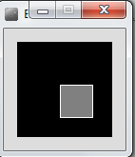
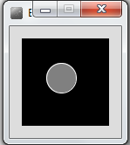
Processing Example 5.1
Functionality:
If the mouse is pressed, draw a gray square with a white outline.
Otherwise draw a gray circle with a white outline.

Slide 6
Processing Example 5.1 - Code
void setup() {
size(100,100);
}
void draw() {
background(0);
stroke(255);
fill(128);
if (mousePressed){
rect(45,45,34,34);
}
else{
ellipse(45,45,34,34);
}
}
Source: Reas & Fry (2014)

Slide 7
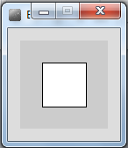
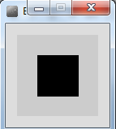
Processing Example 5.2
Functionality:
If the mouse is pressed, set the fill to white and draw a square.
Otherwise set the fill to black and draw a square.

Slide 8
Processing Example 5.2
void setup() {
size(100,100);
}
void draw() {
background(204);
if (mousePressed == true)
{
fill(255); // white
} else {
fill(0); // black
}
rect(25, 25, 50, 50);
}
Source: Reas & Fry (2014)

Slide 9
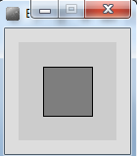
Processing Example 5.3
Functionality:
If the LEFT button on the mouse is pressed, set the fill to black and draw a square. As soon as the LEFT button is released, gray fill the square.
If the RIGHT button on the mouse is pressed, set the fill to white and draw a square. As soon as the RIGHT button is released, gray fill the square.
If no mouse button is pressed, set the fill to gray and draw a square.

Slide 10
Processing Example 5.3
void setup() {
size(100,100);
}
void draw() {
if (mousePressed){
if (mouseButton == LEFT)
fill(0); // black
else if (mouseButton == RIGHT)
fill(255); // white
}
else {
fill(126); // gray
}
rect(25, 25, 50, 50);
}
Source: Reas & Fry (2014)

Slide 11
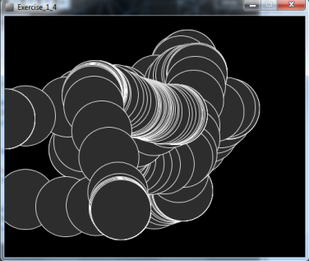
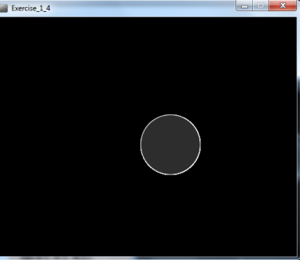
Processing Example 5.4
Functionality:
Draw a circle on the mouse (x,y) coordinates.
Each time you move the mouse, draw a new circle.
All the circles remain in the sketch until you press a mouse button.
When you press a mouse button, the sketch is cleared and a single circle is drawn at the mouse (x,y) coordinates.

Slide 12
Processing Example 5.4
void setup() {
size(500,400);
background(0);
}
void draw() {
if (mousePressed) {
background(0);
}
stroke(255);
fill(45,45,45);
ellipse(mouseX, mouseY, 100, 100);
}
https://processing.org/tutorials/interactivity/

Slide 13
Processing Example 5.4
void setup() {
size(500,400);
background(0);
stroke(255);
fill(45,45,45);
}
We moved the stroke and fill function calls to the setup() function.
Q: Does this change the functionality of our sketch?
void draw() {
if (mousePressed) {
background(0);
}
ellipse(mouseX, mouseY, 100, 100);
}
https://processing.org/tutorials/interactivity/

Slide 14

Questions?

Slide 15
References
Reas, C. & Fry, B. (2014) Processing – A Programming Handbook for Visual Designers and Artists, 2nd Edition, MIT Press, London.

Slide 16
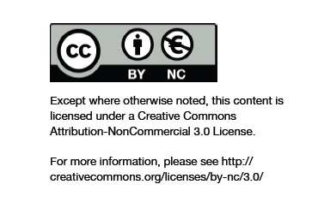
Department of Computing and Mathematics
http://www.wit.ie/

