Slide 1

Iteration
For Loops, variable scope, compound statements
Produced
by:
Department of Computing and Mathematics

Slide 2
Topics list
Variable Scope
Repetition in Programming (for loops).
Compound Assignment Statements

Slide 3
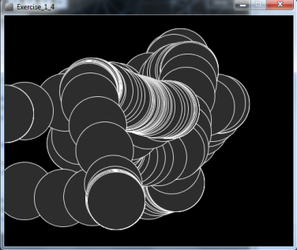
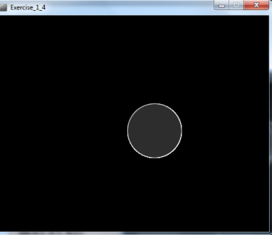
Recap: Processing Example 5.4
void setup() {
size(500,400);
background(0);
stroke(255);
fill(45,45,45);
}
void draw() {
if (mousePressed) {
background(0);
}
ellipse(mouseX, mouseY, 100, 100);
}
https://processing.org/tutorials/interactivity/

Slide 4
Processing Example 6.1
void setup() {
size(500,400);
background(0);
stroke(255);
fill(45,45,45);
}
void draw() {
int diameter = 100;
if (mousePressed) {
background(0);
}
ellipse(mouseX, mouseY, diameter, diameter);
}
https://processing.org/tutorials/interactivity/

Slide 5
Local Scope – diameter variable
The diameter variable is declared in the draw() function i.e. it is a local variable.
It is only “alive” while the draw() function is running.
Each time the draw() function:
finishes running, the diameter variable is destroyed.
is called, a new diameter variable is re-created.
void draw() {
int diameter = 100;
if (mousePressed) {
background(0);
}
ellipse(mouseX, mouseY, diameter, diameter);
}

Slide 6
Local variables – scope rules!
The scope of a local variable is the block it is declared in. A block is delimited by the curly braces {}.
The lifetime of a local variable is the time of execution of the block it is declared in.
Trying to access a local variable outside its scope will trigger a syntax error e.g.:
void draw()
{
if (mousePressed)
{
int diameter = 100;
background(0);
}
ellipse(mouseX, mouseY, diameter, diameter);
}
Syntax Error

Slide 7
Processing Example 6.2
void setup() {
size(500,400);
background(0);
stroke(255);
fill(45,45,45);
}
We now want to reduce the diameter size by 10 each time the mouse is pressed. Is this correct?
void draw() {
int diameter = 100;
if (mousePressed) {
diameter = diameter – 10;
background(0);
}
ellipse(mouseX, mouseY, diameter, diameter);
}
https://processing.org/tutorials/interactivity/

Slide 8
Processing Example 6.2
void setup() {
size(500,400);
background(0);
stroke(255);
fill(45,45,45);
}
We have a bug in our logic.
As the diameter variable is re-created each time draw() is called, its value will be reset to 100 and will loose our decrement of 10.
void draw() {
int diameter = 100;
if (mousePressed) {
diameter = diameter – 10;
background(0);
}
ellipse(mouseX, mouseY, diameter, diameter);
}
https://processing.org/tutorials/interactivity/

Slide 9
Global variables – scope rules!
The scope of the diameter variable is too narrow; as soon as draw() finishes running, the local variable is destroyed and we loose all data.
We need a diameter variable that lives for the lifetime is sketch i.e. a global variable.

Slide 10
Processing Example 6.3
We still have a bug in our logic.
The diameter variable is decreased each time we press the mouse. Correct!
However, what happens when we reach zero?
int diameter = 100;
void setup() {
size(500,400);
background(0);
stroke(255);
fill(45,45,45);
}
void draw() {
if (mousePressed) {
diameter = diameter - 10;
background(0);
}
ellipse(mouseX, mouseY, diameter, diameter);
}

Slide 11
Processing Example 6.3
In the ellipse function, the width and height are absolute values (negative sign is dropped).
To handle this logic bug, we need to stop reducing by 10 when we reach a certain value, say 20.
int diameter = 100;
void setup() {
size(500,400);
background(0);
stroke(255);
fill(45,45,45);
}
void draw() {
if ((mousePressed) && (diameter > 20)){
diameter = diameter - 10;
background(0);
}
ellipse(mouseX, mouseY, diameter, diameter);
}

Slide 12
Processing Example 6.3
Did you notice that it seems the reduction is larger than 10 when we press the mouse?
Why? The default frame rate is 60 refreshes of the screen per second i.e. draw() is called 60 times per second.
You can change the frame rate by calling the frameRate() function.
int diameter = 100;
void setup() {
size(500,400);
background(0);
stroke(255);
fill(45,45,45);
frameRate(20);
}
void draw() {
if ((mousePressed) && (diameter > 20)){
diameter = diameter - 10;
background(0);
}
ellipse(mouseX, mouseY, diameter, diameter);
}

Slide 13
Topics list
Variable Scope
Repetition in Programming (for loops).
Compound Assignment Statements

Slide 14
Recap: Boolean conditions
A boolean condition is an expression that evaluates to either true or false e.g.
mouseX < 50
Boolean conditions can be used to control:
Selection i.e. if statements and
Iteration i.e. loops (we will look at these now).

Slide 15
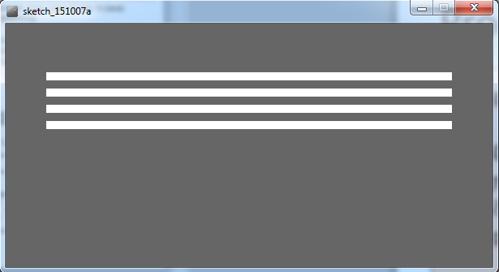
Repetition in Programming
Computers are very good at repetition.
Draw a rectangle 4 times that has a gap of 10 pixels between each one:
Without loop:
rect(50, 60, 500, 10);
rect(50, 80, 500, 10);
rect(50, 100, 500, 10);
rect(50, 120, 500, 10);

Slide 16
Repetition in Programming
Draw a rectangle 4 times that has a gap of 10 pixels between each one:
With a loop:
do this 4 times (adding 20 onto the yCoordinate variable each time).
rect(50, yCoordinate, 500, 10);

Slide 17
Loops in Programming
There are three types of loop in (Java) programming:
For loops (we will cover these).
While loops
Do While loops

Slide 18
For loop pseudo-code
General form of a for loop
for(initialization; boolean condition; post-body action)
{
statements to be repeated
}

Slide 19
Processing Example 6.4
int yCoordinate = 60;
size(600, 300);
background(102);
fill(255);
noStroke();
for(int i = 0; i < 4; i++)
{
rect(50, yCoordinate, 500, 10);
yCoordinate = yCoordinate + 20;
}

Slide 20
For loop syntax
for(int i = 0; i < 4; i++)
for(initialization; boolean condition; post-body action)
{
statements to be repeated
}

Slide 21
For loop syntax
for(int i = 0; i < 4; i++)
Initialization | int i = 0 | Initialise a loop control variable (LCV) e.g. i. It can include a variable declaration.
Boolean condition | i < 4 | Is a valid boolean condition that typically tests the loop control variable (LCV).
Post-body action | i++ | A change to the loop control variable (LCV). Contains an assignment statement.

Slide 22

for Loop Flowchart
boolean
condition?
true
statement(s)
update
for(int i = 0; i < 4; i++)
{
rect(50, yCoordinate, 500, 10);
yCoordinate = yCoordinate + 20;
}
false

Slide 23
Returning to: Processing Example 6.4
int yCoordinate = 60;
size(600, 300);
background(102);
fill(255);
noStroke();
for(int i = 0; i < 4; i++)
{
rect(50, yCoordinate, 500, 10);
yCoordinate = yCoordinate + 20;
}
Do we need the yCoordinate variable? Can you think of a different approach using a for loop?

Slide 24
Updated: Processing Example 6.4
size(600, 300);
background(102);
fill(255);
noStroke();
for(int i = 60; i <= 120; i = i + 20)
{
rect(50, i, 500, 10);
}

Slide 25
For loop: all parts are optional
for ( ; ; )
{
// statements here
}
This is an infinite loop…

Slide 26
For loops can be nested
The value of i is: 0 and j is: 0
The value of i is: 0 and j is: 1
The value of i is: 0 and j is: 2
The value of i is: 0 and j is: 3
The value of i is: 1 and j is: 0
The value of i is: 1 and j is: 1
The value of i is: 1 and j is: 2
The value of i is: 1 and j is: 3
The value of i is: 2 and j is: 0
The value of i is: 2 and j is: 1
The value of i is: 2 and j is: 2
The value of i is: 2 and j is: 3
The value of i is: 3 and j is: 0
The value of i is: 3 and j is: 1
The value of i is: 3 and j is: 2
The value of i is: 3 and j is: 3
for (int i=0; i < 4; i++)
for (int j=0; j < 4; j++)
println("The value of i is: " + i + " and j is: " + j);

Slide 27
Topics list
Variable Scope
Repetition in Programming (for loops).
Compound Assignment Statements

Slide 28
A note on i++
The post-body action in this for loop is i++.
This is called a compound assignment statement.
It is a shortcut for i = i + 1.
for(int i = 0; i < 4; i++)
{
rect(50, yCoordinate, 500, 10);
yCoordinate = yCoordinate + 20;
}

Slide 29
Compound Assignment Statements
 | Full statement | Shortcut
Mathematical shortcuts | x = x + a; | x += a;
 | x = x - a; | x -= a;
 | x = x * a; | x *= a;
 | x = x / a; | x /=a;
Increment shortcut | x = x + 1; | x++;
Decrement shortcut | x = x - 1; | x--;
Notes:
Objects First with Java
© David J. Barnes and Michael Kölling
29

Slide 30

Questions?

Slide 31
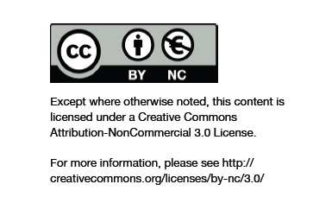
Department of Computing and Mathematics
http://www.wit.ie/

