Slide 1

Introduction to Processing
Creating static drawings
Produced
by:
Department of Computing and Mathematics

Slide 2
Topics list
What is Processing?
Coordinate System in Computing.
Functions in Processing.
Basic Shapes.
Syntax Errors.
Logic Errors.

Slide 3
What is Processing?
“Processing is a programming language,
development environment,
and online community.”
Source: https://processing.org/
This example was developed using Processing: http://balldroppings.com/js/

Slide 4
What is Processing?
Processing…
…can be used to develop static or interactive online material and data visualisations.
…is often used by visual artists.
…produces visual and interactive representations of programming code.

Slide 5
What is Processing?
Three different programming languages can be used with Processing:
Java: we will use this language.
JavaScript.
Python.

Slide 6
Topics list
What is Processing?
Coordinate System in Computing.
Functions in Processing.
Basic Shapes.
Syntax Errors.
Logic Errors.

Slide 7
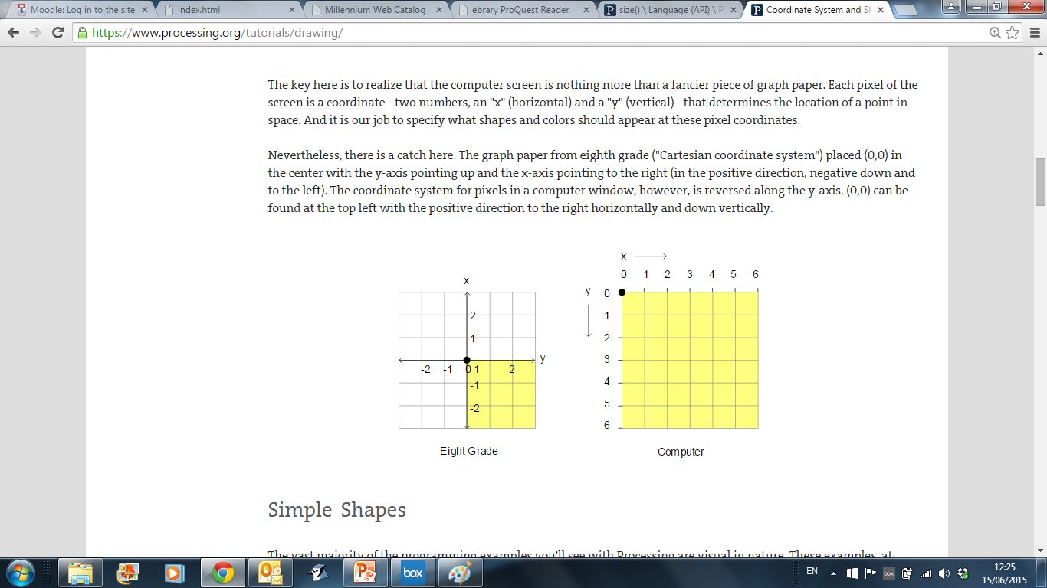
Coordinate System in Computing
In Geometry,
we use this type of
coordinate system:
point (0,0) is in the centre.
In Computing, we use this type of coordinate system to represent the screen:
point (0,0) is in the top left hand corner. Each number is a pixel.
https://processing.org/

Slide 8
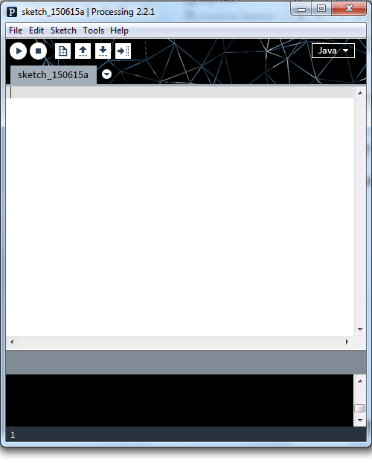
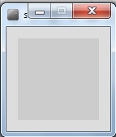
Coordinate System in Computing
Run button
So how does this relate to Processing?
When you open Processing and click on the run button, a display window pops up.
Display window

Slide 9
Coordinate System in Computing
The display window is where your code is run/ displayed.
It follows the rules of the Computing coordinate system i.e. the top left hand corner is (0,0).
A point (10,20) is 10 pixels to the right of (0,0) and 20 pixels below (0,0).
(0,0)
Display window

Slide 10
Topics list
What is Processing?
Coordinate System in Computing.
Functions in Processing.
Basic Shapes.
Syntax Errors.
Logic Errors.

Slide 11
Functions in Processing
Processing comes with several pre-written functions that we can use.
A function comprises a set of instructions that performs some task.
When you call the function, it performs the task.
We will now look at functions that draw the following shapes:
Rectangle, square, line, oval and circle.

Slide 12
Topics list
What is Processing?
Coordinate System in Computing.
Functions in Processing.
Basic Shapes.
Formatting the display window.
Syntax Errors.
Logic Errors.

Slide 13
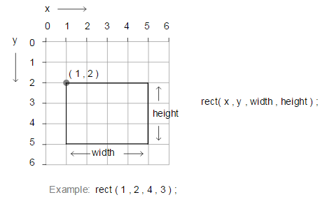
rect()
https://processing.org/

Slide 14
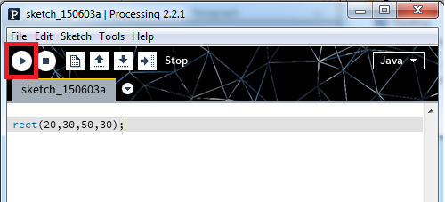
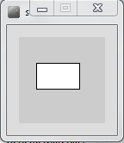
rect() – drawing a rectangle

Slide 15
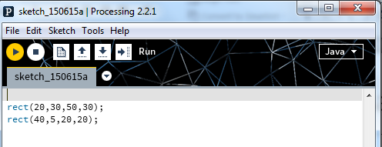
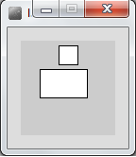
rect() – drawing a square
Note how each line of code has a semi-colon (;) at the end of it. This is called a statement terminator and must be included.

Slide 16
rect() – syntax
rect(x, y, w, h)
x = x-coordinate of the upper left corner of the rectangle
y = y-coordinate of the upper left corner of the rectangle
w = width of the rectangle
h = height of the rectangle
The rect function above defines four parameters i.e. x, y, w, h.
When you call rect, you are expected to pass four numbers to it. These actual numbers are called arguments.
rect uses these four numbers to render the rectangle on the display window.
To draw a square, the width and height must be the same value.

Slide 17
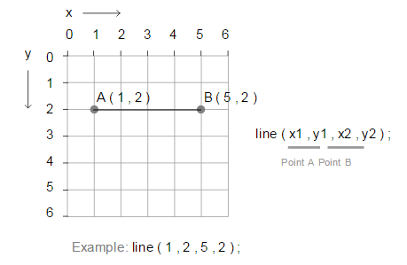
line()
https://processing.org/

Slide 18
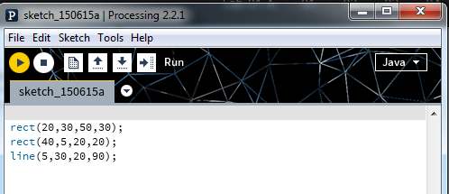
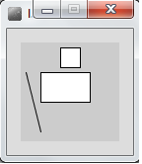
line () – drawing a line

Slide 19
line() – syntax
line(x1, y1, x2, y2)
x1 = x-coordinate of first point
y1 = y-coordinate of first point
x2 = x-coordinate of second point
y2 = y-coordinate of second point

Slide 20
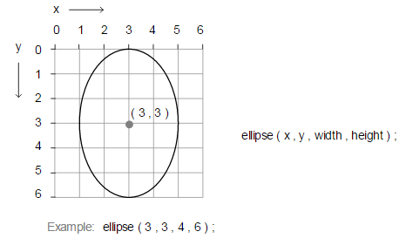
ellipse()
https://processing.org/

Slide 21
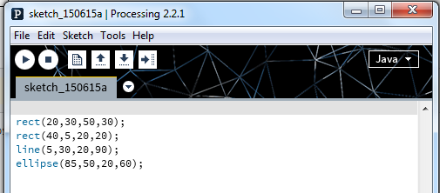
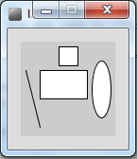
ellipse()

Slide 22
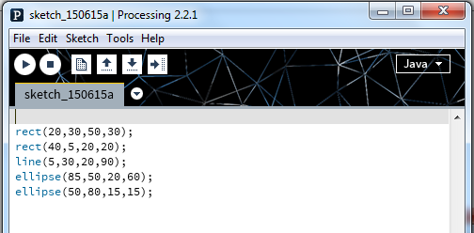
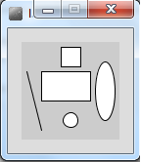
ellipse()

Slide 23
ellipse() – syntax
ellipse(x, y, w, h)
x = x-coordinate of the centre of the ellipse
y = y-coordinate of the centre of the ellipse
w = width of the ellipse
h = height of the ellipse
To draw a circle, the width and height must be the same value.

Slide 24
Topics list
What is Processing?
Coordinate System in Computing.
Functions in Processing.
Basic Shapes.
Syntax Errors.
Logic Errors.

Slide 25
Syntax and Syntax Errors
You will have seen the term Syntax mentioned above.
Syntax are the rules you must follow when writing well-formed statements in a programming language.
When you don’t follow the rules, Processing will not run your code; instead you will get an error.
Some syntax error examples are on the upcoming slides.

Slide 26
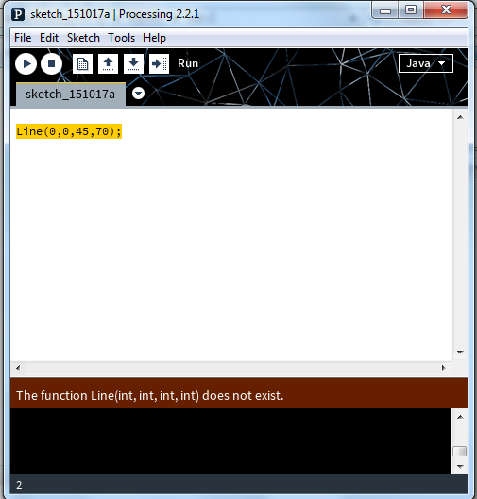
Syntax Errors
The spelling of the line function must be identical to the spelling below (case sensitive!).
line(x1, y1, x2, y2)
x1 = x-coordinate of first point
y1 = y-coordinate of first point
x2 = x-coordinate of second point
y2 = y-coordinate of second point

Slide 27
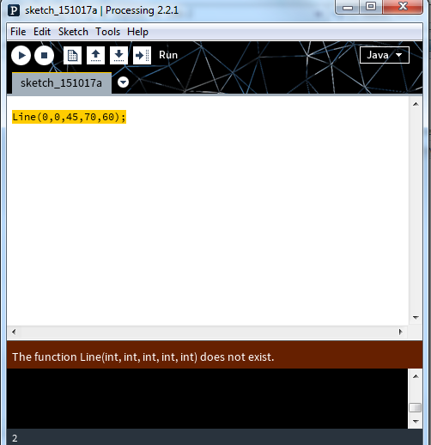
Syntax Errors
The line function has too many arguments passed to it
line(x1, y1, x2, y2)
x1 = x-coordinate of first point
y1 = y-coordinate of first point
x2 = x-coordinate of second point
y2 = y-coordinate of second point

Slide 28
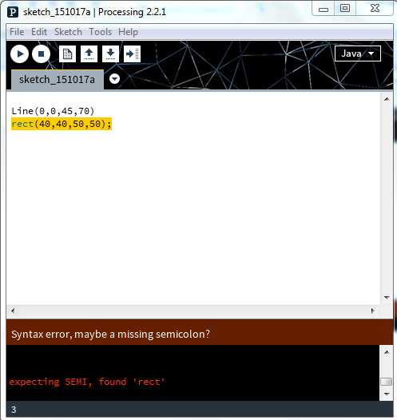
Syntax Errors
The semi-colon (;) is missing at the end of the statement.
Java needs a statement terminator for each line!

Slide 29
Topics list
What is Processing?
Coordinate System in Computing.
Functions in Processing.
Basic Shapes.
Syntax Errors.
Logic Errors.

Slide 30
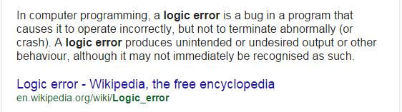
Logic Errors

Slide 31
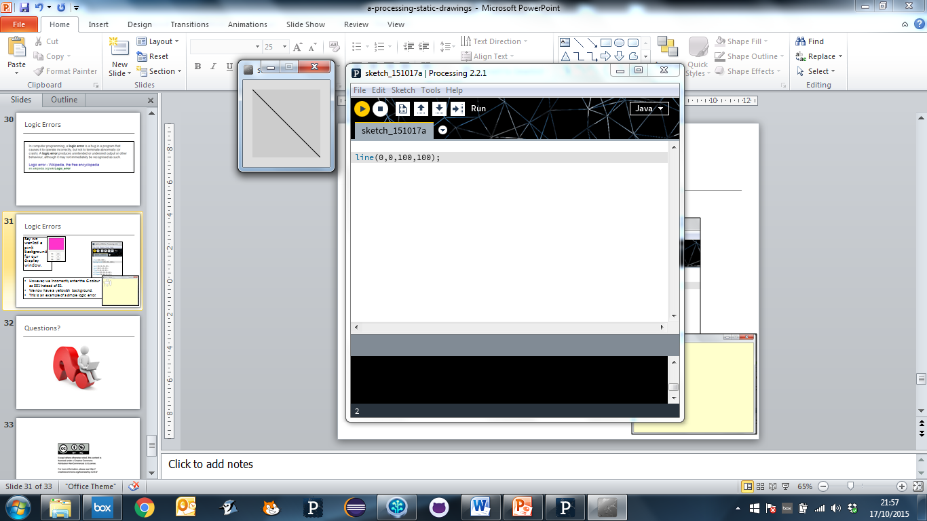
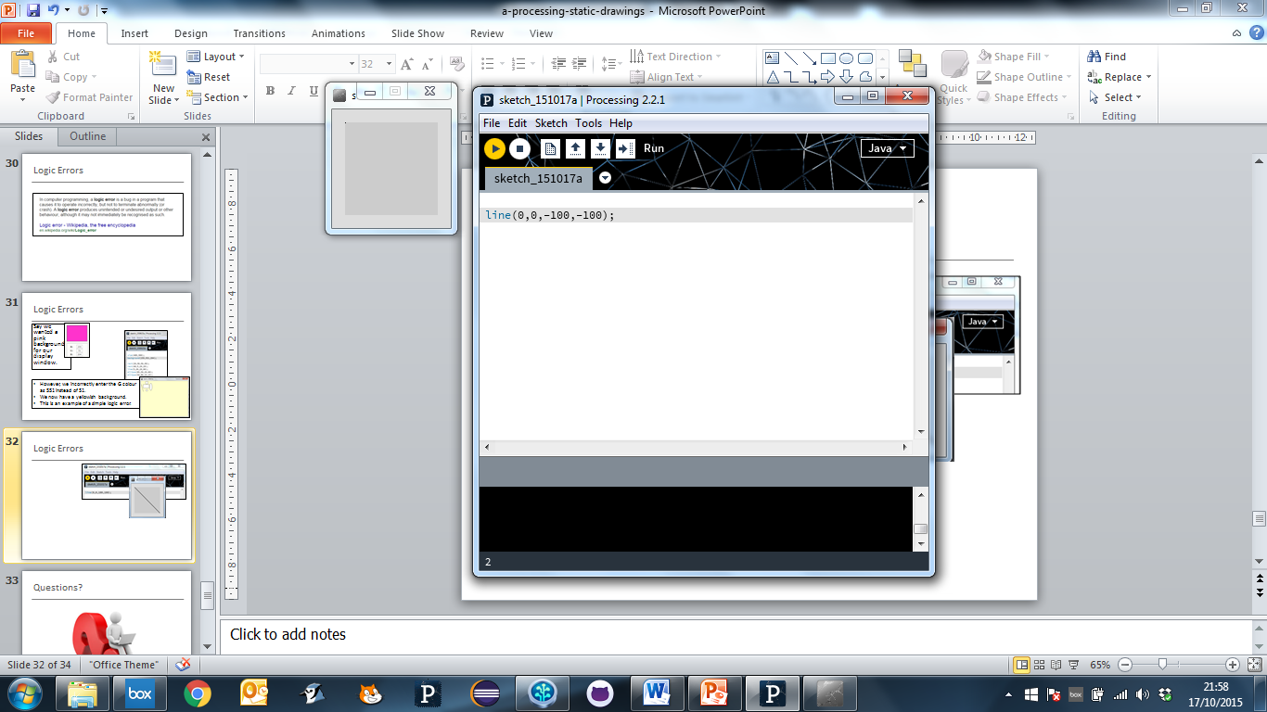
Logic Errors
But we accidentally entered negative numbers for our point b co-ordinates...no line is drawn. This is an example of a simple logic error.
Say we wanted to draw a diagonal line on our display window.

Slide 32

Questions?

Slide 33
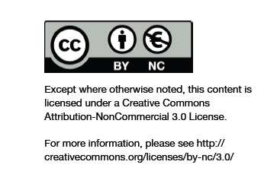
Department of Computing and Mathematics
http://www.wit.ie/

