Slide 1

Animating your Drawings
Basics of Animation
Produced
by:
Department of Computing and Mathematics

Slide 2
Topics list
The setup() function.
The draw() function.
System Variables in Processing.

Slide 3
void setup()
setup() is called once when the program starts and should not be called again.
setup() can set the screen size and background colour.
There can only be one setup() function for each sketch.
https://processing.org/reference/setup_.html

Slide 4
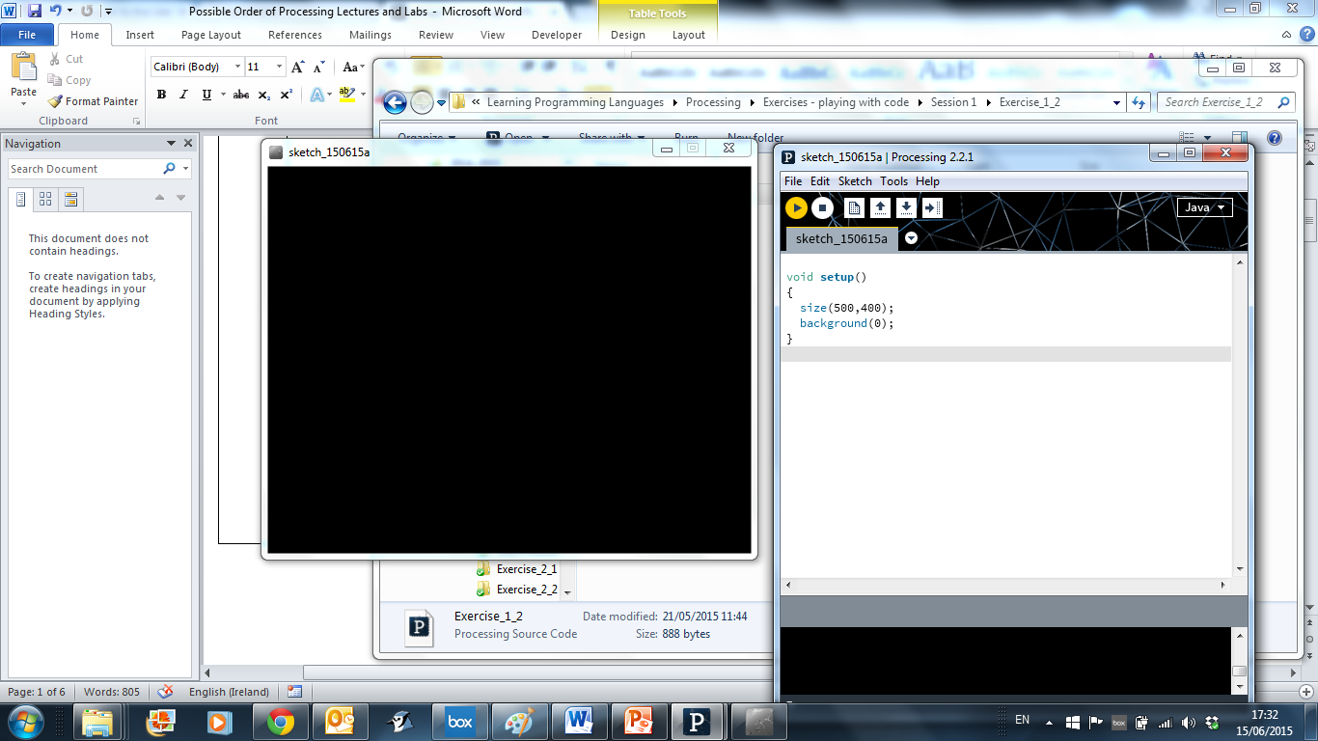
void setup()
Notes:
void setup()
{
size(500,400);
background(0);
}

Slide 5
Topics list
The setup() function.
The draw() function.
System Variables in Processing.

Slide 6
void draw()
You should never call the draw() function.
Processing automatically calls the draw() function straight after the setup() call.
draw() continuously executes the code contained inside it.
There can only be one draw() function for each sketch.
https://processing.org/reference/draw_.html

Slide 7
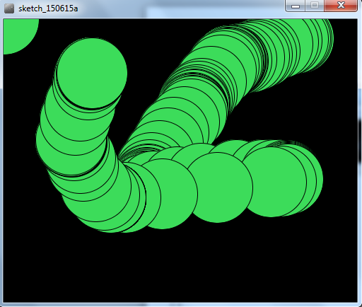
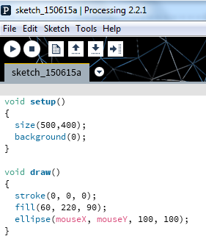
void draw()
mouseX = x co-ordinate of mouse pointer
mouseY = y co-ordinate of mouse pointer
Q: Why many circles?
A: background(0) is in the setup function.
Notes:
void setup()
{
size(500,400);
background(0);
}
void draw()
{
stroke(0, 0, 0);
fill(60, 220, 90);
ellipse(mouseX, mouseY, 100, 100);
}

Slide 8
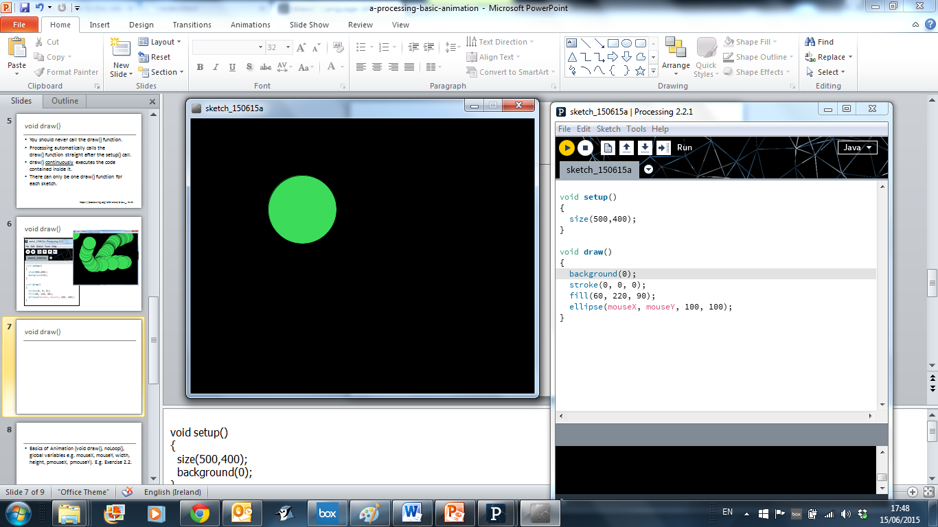
void draw()
mouseX = x co-ordinate of mouse pointer
mouseY = y co-ordinate of mouse pointer
Q. Why only one circle?
A. background(0) is in the draw function.
Notes:
void setup()
{
size(500,400);
background(0);
}
void draw()
{
stroke(0, 0, 0);
fill(60, 220, 90);
ellipse(mouseX, mouseY, 100, 100);
}

Slide 9
Topics list
The setup() function.
The draw() function.
System Variables in Processing.

Slide 10
System Variables in Processing
Some examples of system variables in Processing:
mouseX (x co-ordinate of the mouse pointer on the display window)
mouseY (y co-ordinate of the mouse pointer on the display window)
width (width of the display window)
height (height of the display window)
We don’t have to define/create these; we just use them.
Notes:
void setup()
{
size(500,400);
background(0);
}
void draw()
{
stroke(0, 0, 0);
fill(60, 220, 90);
ellipse(mouseX, mouseY, 100, 100);
}

Slide 11
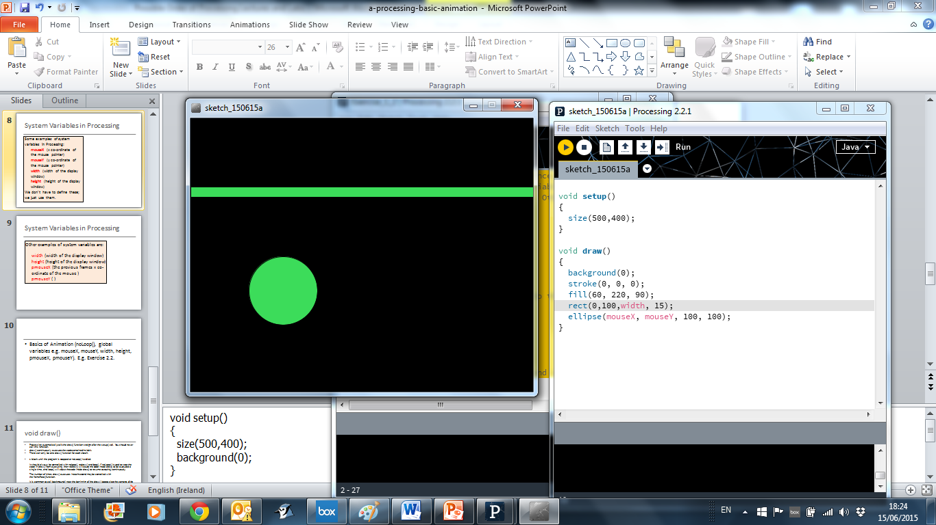
System Variables in Processing
Notes:
void setup()
{
size(500,400);
}
void draw()
{
background(0);
stroke(0, 0, 0);
fill(60, 220, 90);
rect(0,100,width, 15);
ellipse(mouseX, mouseY, 100, 100);
}

Slide 12
System Variables in Processing
Q: What would happen to our animation if we swapped the mouseX and mouseY global variables in the ellipse function with each other?
Notes:
void setup()
{
size(500,400);
}
void draw()
{
background(0);
stroke(0, 0, 0);
fill(60, 220, 90);
rect(0,100,width, 15);
ellipse(mouseY, mouseX, 100, 100);
}

Slide 13

Questions?

Slide 14
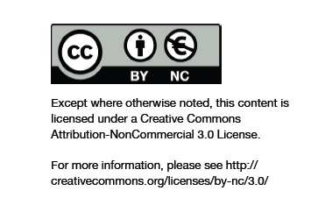
Department of Computing and Mathematics
http://www.wit.ie/

