Slide 1

Conditional Statements
If Statement and Boolean Expressions
Produced
by:
Department of Computing and Mathematics

Slide 2
Topics list
Conditional Statements
Boolean conditions and Relational Operators
Logical Operators

Slide 3
Conditional Statement Syntax (1)
boolean condition to be tested
‘if’ keyword
actions if condition is true
if(perform some test)
{
Do these statements if the test gave a true result
}

Slide 4
Conditional Statement Syntax (2)
boolean condition to be tested
‘if’ keyword
actions if condition is true
if(perform some test) {
Do these statements if the test gave a true result
}
else {
Do these statements if the test gave a false result
}
actions if condition is false
‘else’ keyword

Slide 5
Conditional Statement Syntax (3)
if(condition1…perform some test)
{
Do these statements if condition1 gave a true result
}
else if(condition2…perform some test)
{
Do these statements if condition1 gave a false result and condition2 gave a true result
}
else
{
Do these statements if both condition1 and
condition2 gave a false result
}

Slide 6
Topics list
Conditional Statements
Boolean conditions and Relational Operators
Logical Operators

Slide 7
Boolean conditions
A boolean condition is an expression that evaluates to either true or false e.g.
mouseX < 50
An if statement evaluates a boolean condition and its result will determine which portion of the if statement is executed.

Slide 8
Boolean conditions
// Do these statements before.
if (boolean condition)
{
// Perform this clause if the condition //is true.
}
// Do these statements after.

Slide 9
Java Relational Operators
Operator | Use | Returns true if
> | op1 > op2 | op1 is greater than op2
>= | op1 >= op2 | op1 is greater than or equal to op2
< | op1 < op2 | op1 is less than to op2
<= | op1 <= op2 | op1 is less than or equal to op2
== | op1 == op2 | op1 and op2 are equal
!= | op1 != op2 | op1 and op2 are not equal
Source: http://www.freejavaguide.com/relational_operators.htm

Slide 10
Some notes on the if statement
An if statement IS a statement; it is only executed once.
When your if statement only has one statement inside it, you do not need to use the curly braces.
For example, both of these are the same:
if (mouseX < 50)
{
rect(0, 0, 50, 100);
}
if (mouseX < 50)
rect(0, 0, 50, 100);

Slide 11
Some notes on the if statement
The semi-colon (;) is a statement terminator.
One is circled in the code example below:
Your if statement does not need a statement terminator.
if (mouseX < 50)
{
rect(0, 0, 50, 100) ;
}

Slide 12
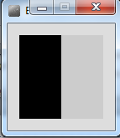
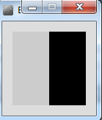
Conditional Example 4.1
void setup() {
size(100, 100);
noStroke();
fill(0);
}
void draw() {
background(204);
if (mouseX < 50)
{
rect(0, 0, 50, 100);
}
else
{
rect(50, 0, 50, 100);
}
}
Source: Reas & Fry (2014)

Slide 13
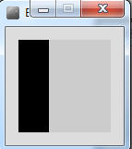
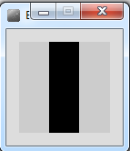
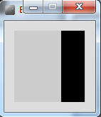
Conditional Example 4.2
void setup() {
size(100, 100);
noStroke();
fill(0);
}
void draw() {
background(204);
if (mouseX < 33) {
rect(0, 0, 33, 100);
}
else if (mouseX < 66) {
rect(33, 0, 33, 100);
}
else {
rect(66, 0, 33, 100);
}
}
Source: Reas & Fry (2014)

Slide 14
Topics list
Conditional Statements
Boolean conditions and Relational Operators
Logical Operators

Slide 15
Logical operators
Logic operators operate on boolean values.
They produce a new boolean value as a result.
The ones that we will use are:
&& (and)
|| (or)
! (not)

Slide 16
Logical operators
a && b (and)
This evaluates to true if both a and b are true.
It is false in all other cases.
a || b (or)
This evaluates to true if either a or b or both are true, and false if they are both false.
!a (not)
This evaluates to true of a is false, and false if a is true.

Slide 17
Logical operators - quiz
int a = 5;
int b = 10;
int c = 7;
What is the result of each of these boolean expressions:
(a > b) && (a < c)
(a < b) || (c < a)
!(b < a) && (c > b)

Slide 18
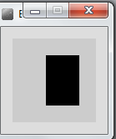
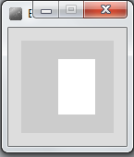
Conditional Example 4.3
void setup() {
size(100, 100);
noStroke();
fill(0);
}
void draw() {
background(204);
if ((mouseX > 40) && (mouseX < 80) &&
(mouseY > 20) && (mouseY < 80)) {
fill(255);
} else {
fill(0);
}
rect(40, 20, 40, 60);
}
Source: Reas & Fry (2014)

Slide 19
Conditional Example 4.4
void setup() {
size(100, 100);
noStroke();
fill(0);
}
void draw() {
background(204);
if ((mouseX <= 50) && (mouseY <= 50)) {
rect(0, 0, 50, 50); // upper-left
} else if ((mouseX <= 50) && (mouseY > 50)) {
rect(0, 50, 50, 50); // lower-left
} else if ((mouseX > 50) && (mouseY <= 50)) {
rect(50, 0, 50, 50); // upper-right
} else {
rect(50, 50, 50, 50); // lower-right
}
}
Source: Reas & Fry (2014)

Slide 20

Questions?

Slide 21
References
Reas, C. & Fry, B. (2014) Processing – A Programming Handbook for Visual Designers and Artists, 2nd Edition, MIT Press, London.

Slide 22
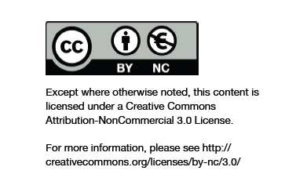
Department of Computing and Mathematics
http://www.wit.ie/

