Slide 1

Event Handling
Mouse Events and Arithmetic Operators
Produced
by:
Department of Computing and Mathematics

Slide 2
Topics list
Mouse Events
Recap: Arithmetic Operators
Order of Evaluation

Slide 3
What is an event?
“An action such as a key being pressed,
the mouse moving, or
a new piece of data becoming available to read.
An event interrupts the normal
flow of a program to
run the code within an event block”
(Reas & Fry, 2014)

Slide 4
Mouse Events
Mouse Variables | Description
mousePressed | true if any mouse button is pressed, false otherwise. Note: this variable reverts to false as soon as the button is released.
mouseButton | Can have the value LEFT, RIGHT and CENTER, depending on the mouse button most recently pressed. Note: this variable retains its value until a different mouse button is pressed.

Slide 5
Mouse Events
Mouse and keyboard events only work when a program has draw().
Without draw(), the code is only run once and then stops listening for events.
Source: https://processing.org/reference/

Slide 6
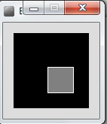
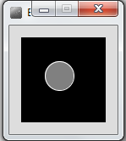
Processing Example 5.1
Functionality:
If the mouse is pressed, draw a gray square with a white outline.
Otherwise draw a gray circle with a white outline.

Slide 7
Processing Example 5.1 - Code
void setup() {
size(100,100);
}
void draw() {
background(0);
stroke(255);
fill(128);
if (mousePressed){
rect(45,45,34,34);
}
else{
ellipse(45,45,34,34);
}
}
Source: Reas & Fry (2014)

Slide 8
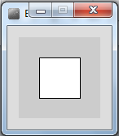
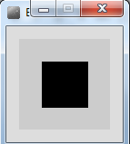
Processing Example 5.2
Functionality:
If the mouse is pressed, set the fill to white and draw a square.
Otherwise set the fill to black and draw a square.

Slide 9
Processing Example 5.2
void setup() {
size(100,100);
}
void draw() {
background(204);
if (mousePressed == true)
{
fill(255); // white
} else {
fill(0); // black
}
rect(25, 25, 50, 50);
}
Source: Reas & Fry (2014)

Slide 10
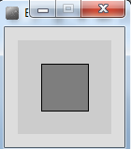
Processing Example 5.3
Functionality:
If the LEFT button on the mouse is pressed, set the fill to black and draw a square. As soon as the LEFT button is released, gray fill the square.
If the RIGHT button on the mouse is pressed, set the fill to white and draw a square. As soon as the RIGHT button is released, gray fill the square.
If no mouse button is pressed, set the fill to gray and draw a square.

Slide 11
Processing Example 5.3
void setup() {
size(100,100);
}
void draw() {
if (mousePressed){
if (mouseButton == LEFT)
fill(0); // black
else if (mouseButton == RIGHT)
fill(255); // white
}
else {
fill(126); // gray
}
rect(25, 25, 50, 50);
}
Source: Reas & Fry (2014)

Slide 12
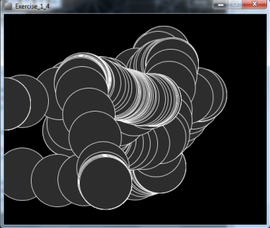
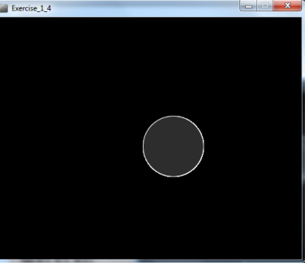
Processing Example 5.4
Functionality:
Draw a circle on the mouse (x,y) coordinates.
Each time you move the mouse, draw a new circle.
All the circles remain in the sketch until you press a mouse button.
When you press a mouse button, the sketch is cleared and a single circle is drawn at the mouse (x,y) coordinates.

Slide 13
Processing Example 5.4
void setup() {
size(500,400);
background(0);
}
void draw() {
if (mousePressed) {
background(0);
}
stroke(255);
fill(45,45,45);
ellipse(mouseX, mouseY, 100, 100);
}
https://processing.org/tutorials/interactivity/

Slide 14
Processing Example 5.4
void setup() {
size(500,400);
background(0);
stroke(255);
fill(45,45,45);
}
We moved the stroke and fill function calls to the setup() function.
Q: Does this change the functionality of our sketch?
void draw() {
if (mousePressed) {
background(0);
}
ellipse(mouseX, mouseY, 100, 100);
}
https://processing.org/tutorials/interactivity/

Slide 15
Topics list
Mouse Events
Recap: Arithmetic Operators
Order of Evaluation

Slide 16
Recap: Arithmetic Operators
Arithmetic Operator | Explanation | Example(s)
+ | Addition | 6 + 2 amountOwed + 10
- | Subtraction | 6 – 2 amountOwed – 10
* | Multiplication | 6 * 2 amountOwed * 10
/ | Division | 6 / 2 amountOwed / 10

Slide 17
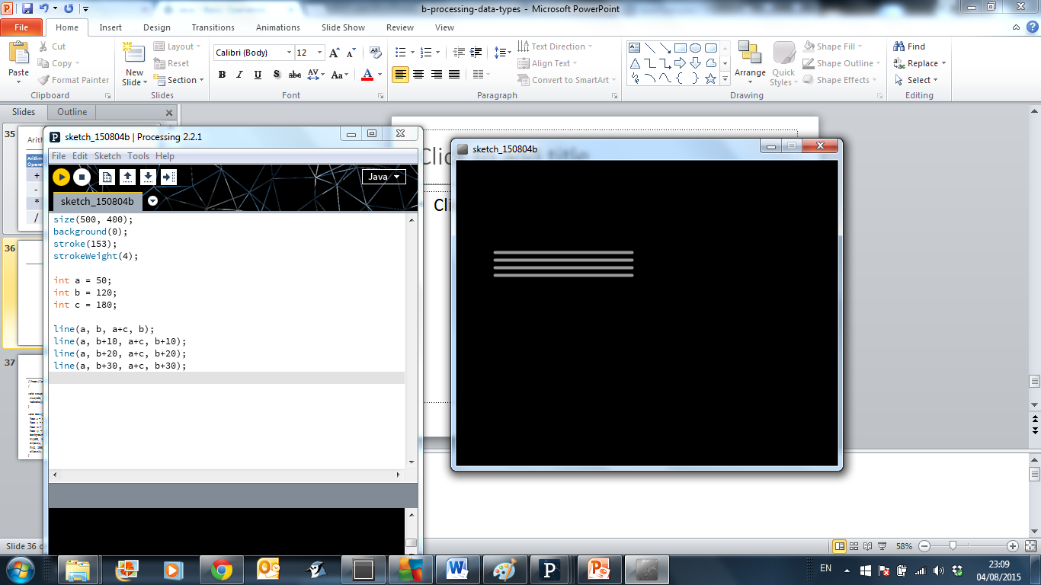
Recap: Arithmetic operators: Example 3.6
Based on the Processing Example: Basics → Data → Variables
Notes:
size(500, 400);
background(0);
stroke(153);
strokeWeight(4);
int a = 50;
int b = 120;
int c = 180;
line(a, b, a+c, b);
line(a, b+10, a+c, b+10);
line(a, b+20, a+c, b+20);
line(a, b+30, a+c, b+30);

Slide 18
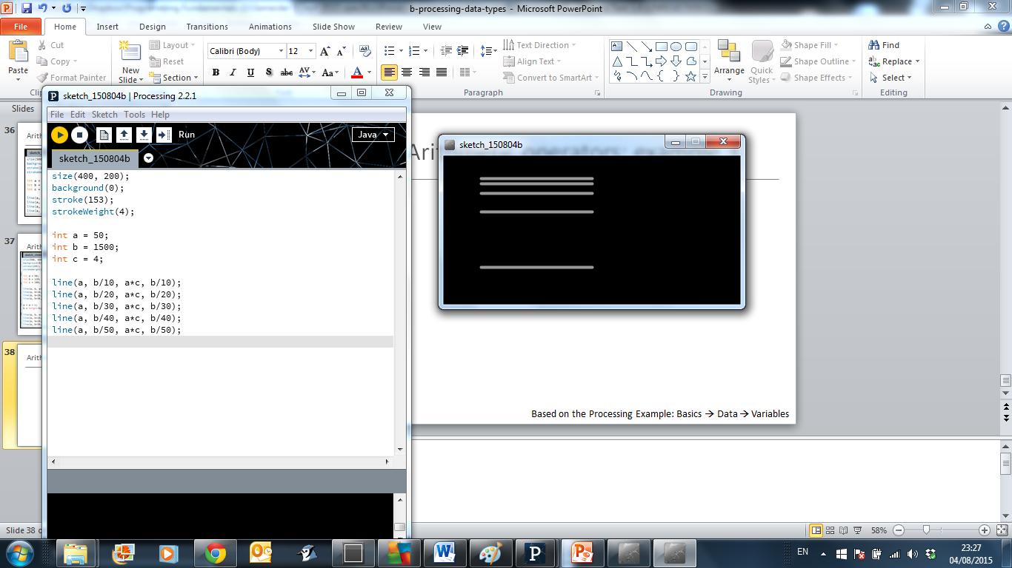
Recap: Arithmetic operators: Example 3.8
Based on the Processing Example: Basics → Data → Variables
Notes:
size(400, 200);
background(0);
stroke(153);
strokeWeight(4);
int a = 50;
int b = 1500;
int c = 4;
line(a, b/10, a*c, b/10);
line(a, b/20, a*c, b/20);
line(a, b/30, a*c, b/30);
line(a, b/40, a*c, b/40);
line(a, b/50, a*c, b/50);

Slide 19
Arithmetic Operators
If you want to keep track of how many times something happens, you are keeping a running total e.g.
The number of times you drew a line on the computer screen.
As each line is drawn, you add one to your counter variable.

Slide 20
Arithmetic Operators
int counter = 0;
void draw()
{
line (mouseX, mouseY, 50,50);
counter = counter + 1;
println (counter);
}

Slide 21
Arithmetic Operators
These examples are straightforward uses of the arithmetic operators.
However, we typically want to do more complex calculations involving many arithmetic operators.
To do this, we need to understand the Order of Evaluation.

Slide 22
Topics list
Mouse Events
Recap: Arithmetic Operators
Order of Evaluation

Slide 23
Order of Evaluation
Brackets ()
Multiplication (*)
Division (/)
Addition (+)
Subtraction (-)
BoMDAS
Beware My Dear Aunt Sally

Slide 24
Order of Evaluation - Quiz
What are the results of these calculations?
Q1: 3+6*5-2
Q2: 3+6*(5-2)
Q3: (3+6)*5-2
Notes:
A1: 31
A2: 21
A3: 43

Slide 25

Questions?

Slide 26
References
Reas, C. & Fry, B. (2014) Processing – A Programming Handbook for Visual Designers and Artists, 2nd Edition, MIT Press, London.

Slide 27
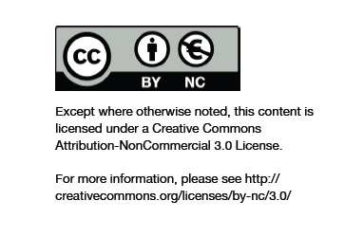
Department of Computing and Mathematics
http://www.wit.ie/

