Slide 1
Building a Raspberry Pi Cluster
Rick Wagner, SDSC

Slide 2
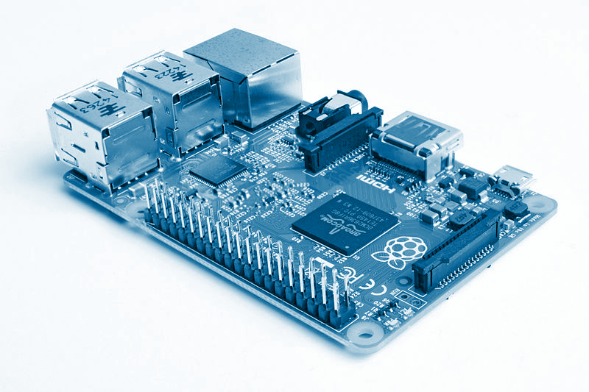
Outline
Ask questions!
Part I
Why clusters & parallel computing?
Raspberry Pi
Part II
Building the cluster
Part III
Running parallel applications
Writing parallel applications
Discussion
CC BY-SA 4.0 https://commons.wikimedia.org/wiki/User:Multicherry

Slide 3
Part I:
Introduction

Slide 4
Why Parallel Computing?

Slide 5
Types of Parallel Applications

Slide 6
Distributed Computing

Slide 7
Making Computers Work Together

Slide 8
Linux Clusters

Slide 9
Part II:
Build a Cluster

Slide 10
Anatomy of a Raspberry Pi Cluster
(TODO): Summary & diagram of cluster components and roles

Slide 11
What We’re Going To Do
Gather materials
Almost fully assemble the cluster
Configure first node
Configure other nodes

Slide 12
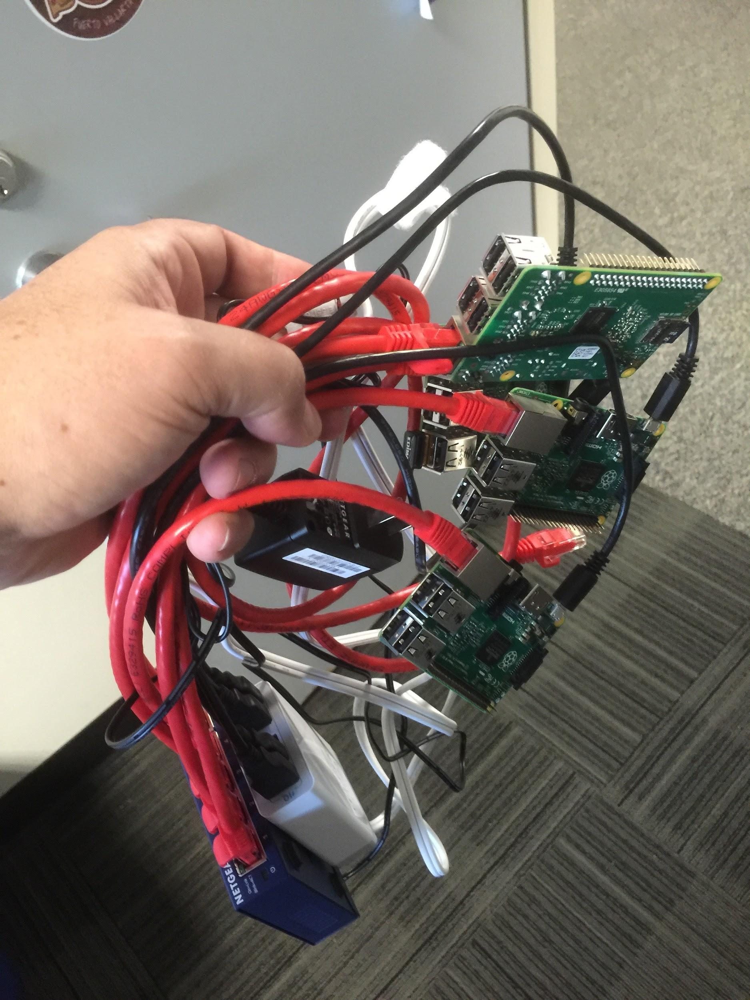
Materials Needed (Per Group)
Raspberry Pi’s (4)
4+ port USB Power Hub
4+ port Ethernet Port Switch
USB Keyboard
USB Mouse
1-4 LCD Monitors
Wireless Adapter
4 microSD Cards

Slide 13
Assemble!

Slide 14
Configure pinode-0

Slide 15
Configure pinode-1 and Repeat

Slide 16
Part III:
Parallel Programming

Slide 17
Running A Parallel Application
Run images.py on single machine
Change the image
run it on all four machines
larger image, scale up windows
Sketch out basics of tiled displays (geometry)

Slide 18
Writing A Parallel Application
Change the picture
Move sections around
Transform image (rotate, transparency, etc.)

Slide 19
Discussion

