Slide 1

A quick view of R,
and parallel R options

Slide 2
Outline
A Glimpse of R
R strengths (and one weakness)
A few examples of data operations with R
R and Scaling
Parallel options for R
Other options and future options

Slide 3
The What and Why of R
A statistical computing environment
Grew out of S-plus language
Full set of Statistical/Mathematical functions
Programming Language for complete data manipulation
usual data types (integer, float, logical, vector, etc..)
special data types (data frame, model results, …)
logical control statements (if-else, for loop, while, etc..)
I/O functions (read, write, save, etc..)

Slide 4
The What and Why of R
Free, Open Source
Lots of resources
Extended with user written packages
R development core team determines base package
> 5,800 additional packages available (as of 6/2014)
Requires users to install packages not in base R
https://cran.r-project.org/

Slide 5
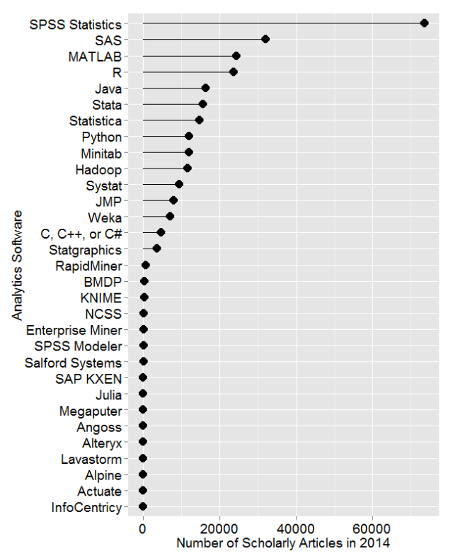
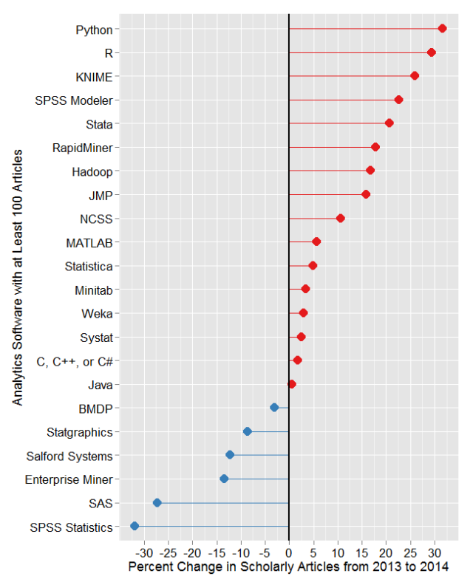
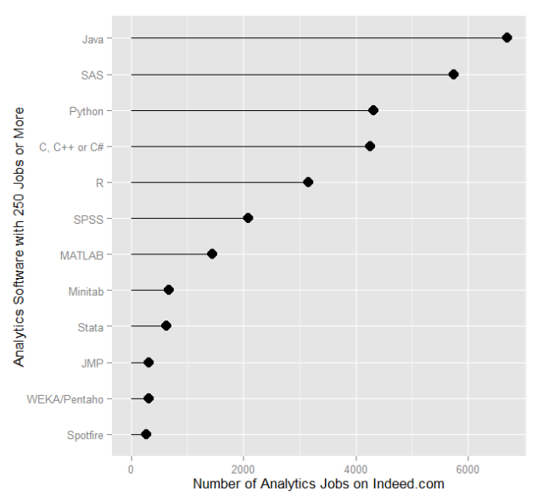
What and Why of R
Widely used in academic and increasingly in industry
(http://r4stats.com/articles/popularity/)

Slide 6
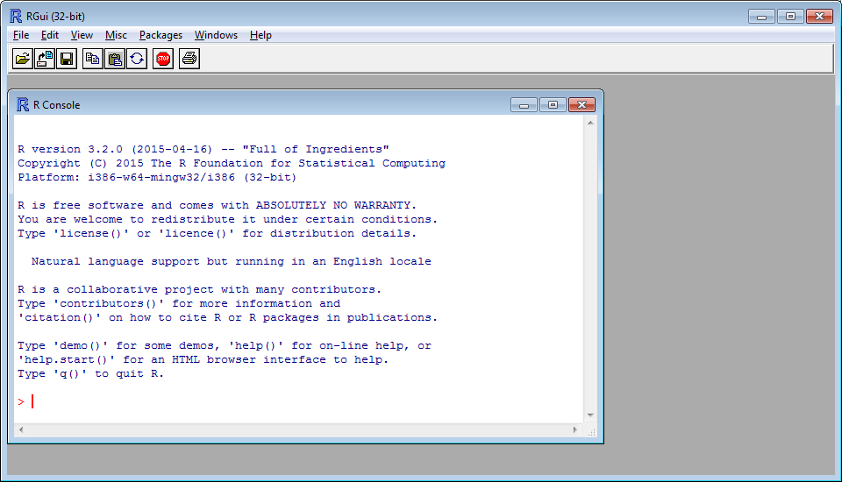
R: Interactive with Statistical Computing
Commands entered in ‘console’ window at ‘>’ prompt
Command outputs appear in console
Figures created in new windows

Slide 7
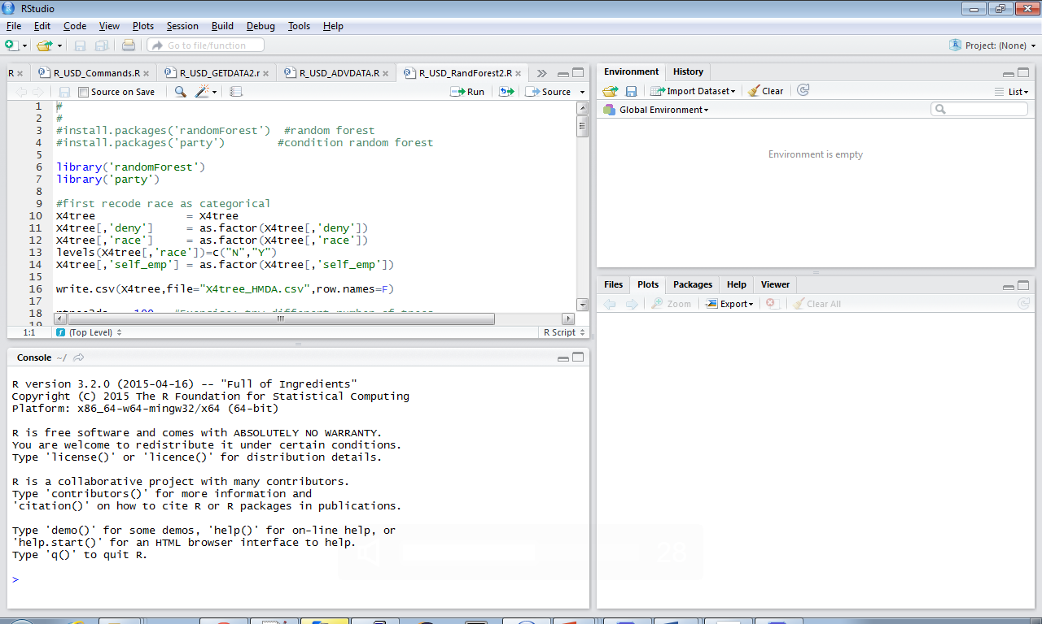
A typical R development workflow
R studio: An Integrated development environment for R on your local machine
Environment Information on variables and command history
Menu tab
Edit window to
Build scripts
Plots, help,
R console

Slide 8
R commands in brief
x = c(0,8,1,5,6) #combine the values into a vector
typeof(x) # all data have a defined type in memory
class(x) # and a abstract data type for calculations
x[1] # access the vector elements using square brackets
N=length(x) # let's use a built-in R function to get the length
x[3:N] # access subset of elements with : ,as in from 3 to N
x[seq(3,N,1)] # access a subset using a sequence function from 3-to-N by 1
y = x + rnorm(N) # add in some random normally distributed noise
which(y>6) # just get the indices that satisfy the condition

Slide 9
R commands in brief
A = c(4,5,6) # make a new vector
B=matrix(seq(1:15),5,3) # make a 5x3 matrix out of sequence
BtimeA = B %*% t(A) # matrix multiplication, A transposed
help(rnorm) # will show you parameters and related functions
plot(x,y) # scatter plot y vs x
# install package not in base R
install.packages(‘someRpackage_name’)
library(‘someRpackage_name’) # to invoke package for your session
At Unix prompt on Comet:
module load R
R (for interactive) or Rscript script-name (for batch)

Slide 10
R commands in brief
A typical R code workflow:
#READ DATA
X = read.csv('hmda_aer.csv', header=T, stringsAsFactors=T)
#SUBSET DATA
indices_2keep = which(X[,'s13'] %in% c(3,4,5)))
X = X[unique(indices_2keep),]
#CREATE/TRANSFORM VARIABLES
pi_rat = as.numeric(X[,'s46']/100) # debt2income ratio
race = as.numeric(X[,'s13'] %in% c(3,4)) # race category
deny = as.numeric(X[,'s7']==3) # dependent variable
#RUN MODEL and SHOW RESULTS
lm_result = lm(deny~race+pi_rat) # lm is ‘linearmodel’
summary(lm_result)

Slide 11
R strengths
Some examples what R is especially good for:
Sampling/bootstrap methods,
Data Wrangling,
Particular Statistical procedures that you won’t find implemented anywhere else, e.g.
Multiple Imputation methods,
Instrument Variable (2 stage) Regression
Can run interactive (for development) or as a script (for production)

Slide 12
R’s biggest weakness
R is an interpreted language. Contrast to C/C++, Fortran, Python (using numba) and other compiled languages. Loops can be particularly slow. Fortunately, there’s a workaround
# Instead of this (loop body interpreted n times)
for (i in m:n) {
vec1[i] <- vec2[i] + vec3[i]
}
# try this (loop replaced with vector statement, interpreted once)
vec1[m:n] <- vec2[m:n] + vec3[m:n]

Slide 13
R and missing data
Several imputation packages available, such as ‘mice’ and ‘amelia’
Produces multiple data sets
Iterates over missing data estimates and linear model estimates
Mice uses Gibbs sampling
Amelia uses Expectation Maximization
Beware of correlation in variables
Matrices not invertible

Slide 14
R and missing data
Sample R code using Amelia:
Data: UN conflict data in pairs of countries
300K rows ~ 1 hour on Gordon compute node (not run on the user’s PC)
1K-100K entries missing per col for about 20 of 50 cols
Note: mice package is probably more well known, and has similar options, but MCMC is slower than EM
time variable
crosssection
# run the imputation
library(‘amelia’)
a.out <- amelia(data, ts = "year", cs = "dyadid",
idvars = c("dyadidyr", "cntryera", "statea", "stateb"),
intercs=FALSE, p2s = 2, m=10, parallel = "multicore”)
ignore ‘id’ variables
interactions
parallel options

Slide 15
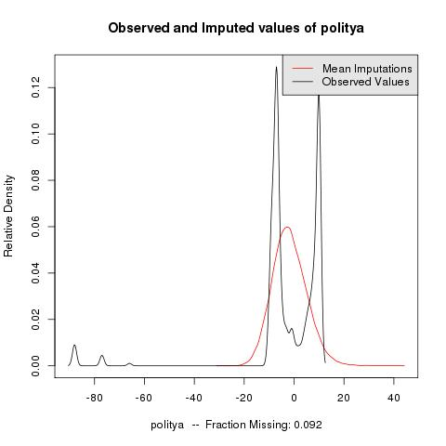
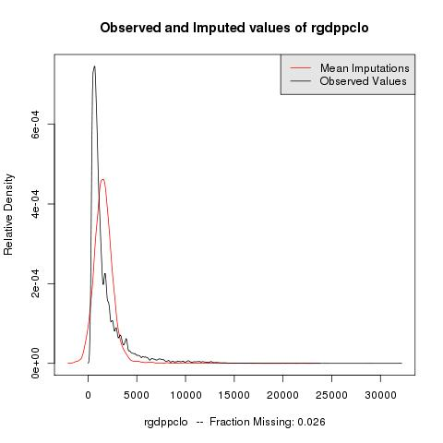
R and missing data
#QA on missing data by comparing density of imputated & original data
compare.density(a.out, var=“politya")
compare.density(a.out,var='rgdpcontg')

Slide 16
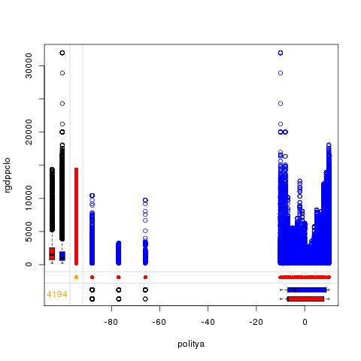
R and missing data
# Useful library for printing margin plots, to compare histograms # conditional on missing/non-missing data
library('VIM')
marginplot(gart2use[,c('politya', 'rgdppclo')],
col=c('blue','red','orange')
dist of rgdpcontg when
politya missing
politya present
What would you want to see here?

Slide 17
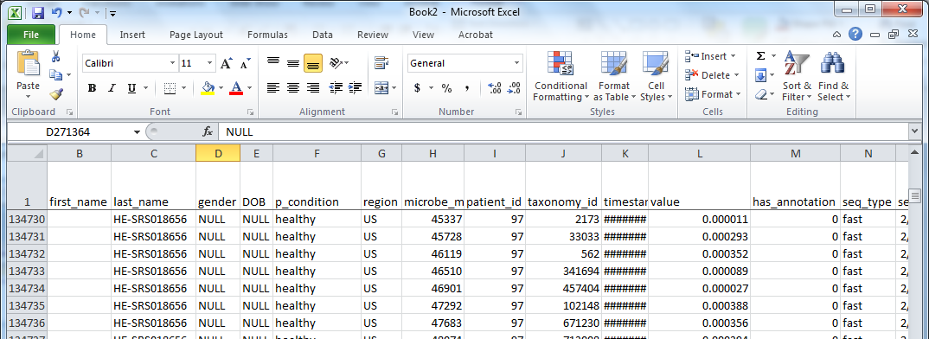
Data Wrangling example
tables joined
PatientID | Age
HE.1 | 50
HE.2 | 25
HE.3 | …
Patient ID | Microbe | Value | …
HE.1 | Ecoli | 0.1
HE.1 | Bacteriia 1 | 0.01
HE.1 | Bacteria 2 | 0.001
…
Issue:
~3000 rows for each subject (1 row for each measurement). But needed 1 row per subject.

Slide 18
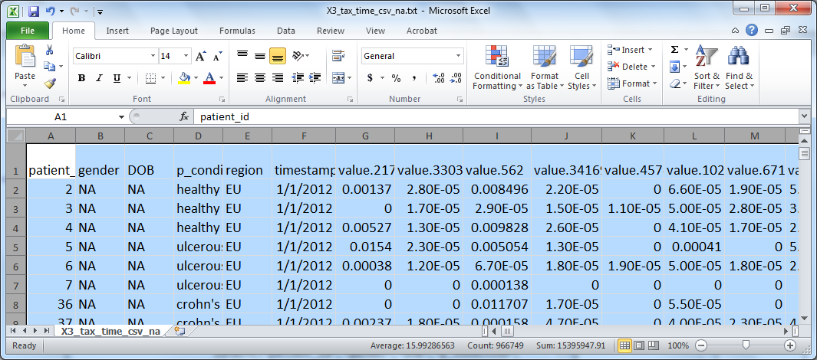
Data Wrangling example
Reshape command to get a ‘wide’ format with repeated measurements
in separate columns of the same record
Xa = read.csv('patmeasjoinall_0219.csv',header=T,sep='\t')
Xatest = reshape(Xa, direction = "wide",
idvar=c("patient_id","gender","DOB","p_condition","region"),
v.names="value", timevar="taxonomy_id", sep=".")
write.csv(Xatest,file="Xa_reshaped");
Row values are now columns

Slide 19
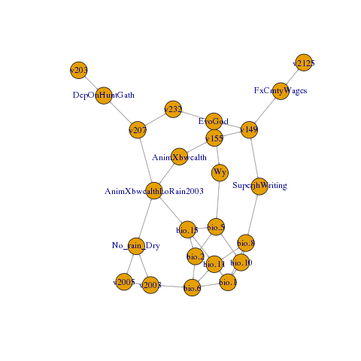
R Analysis options
Depend. var
Two-stage least squares to handle spatially correlated errors (OLS, logit, multinomial logit)
Bootstrap sampling of Bayesian network (package bnlearn) to confirm OLS effects, or suggest other moderating/mediating effects

Slide 20
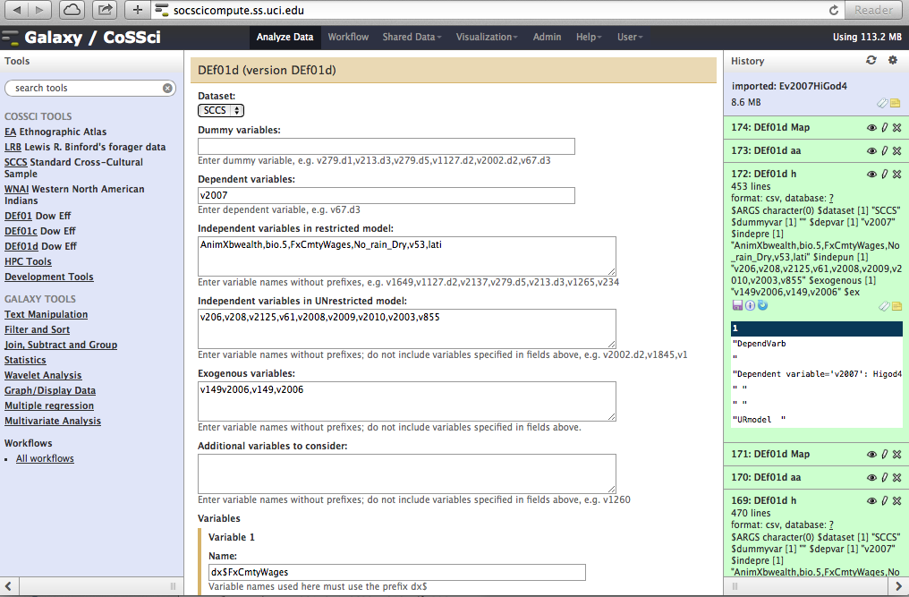
Complex Social Science Gateway a tool for cross-cultural analysis in R
Select dataset,
Select variables
Submit analysis
http://socscicompute.ss.uci.edu/

Slide 21
Scaling, practically
Scaling (with or without more data):
more complex analysis (i.e. optimizations)
more sampling (i.e. more trees in Random Forest)
Sometimes easy to parallelize (like with sampling),
Sometimes too much communication between parts (matrix inversion)

Slide 22
Basic Distributed Computing
1 compute node
many cores
memory
network
fastest
fast
…
core
core
core
faster
local SSD
File system

Slide 23
Basic Distributed Computing
many nodes
…
Keep in mind:
trade offs between gains from distributed computing vs loss from increased communication
network
…
…
…
File system

Slide 24
Scaling In a nutshell
R takes advantage of math libraries for vector operations
R packages provide multicore, multinode (snow), or map/reduce (RHadoop) options
However, model implementations not necessarily built to use parallel back ends
Some models more amenable to parallel versions

Slide 25
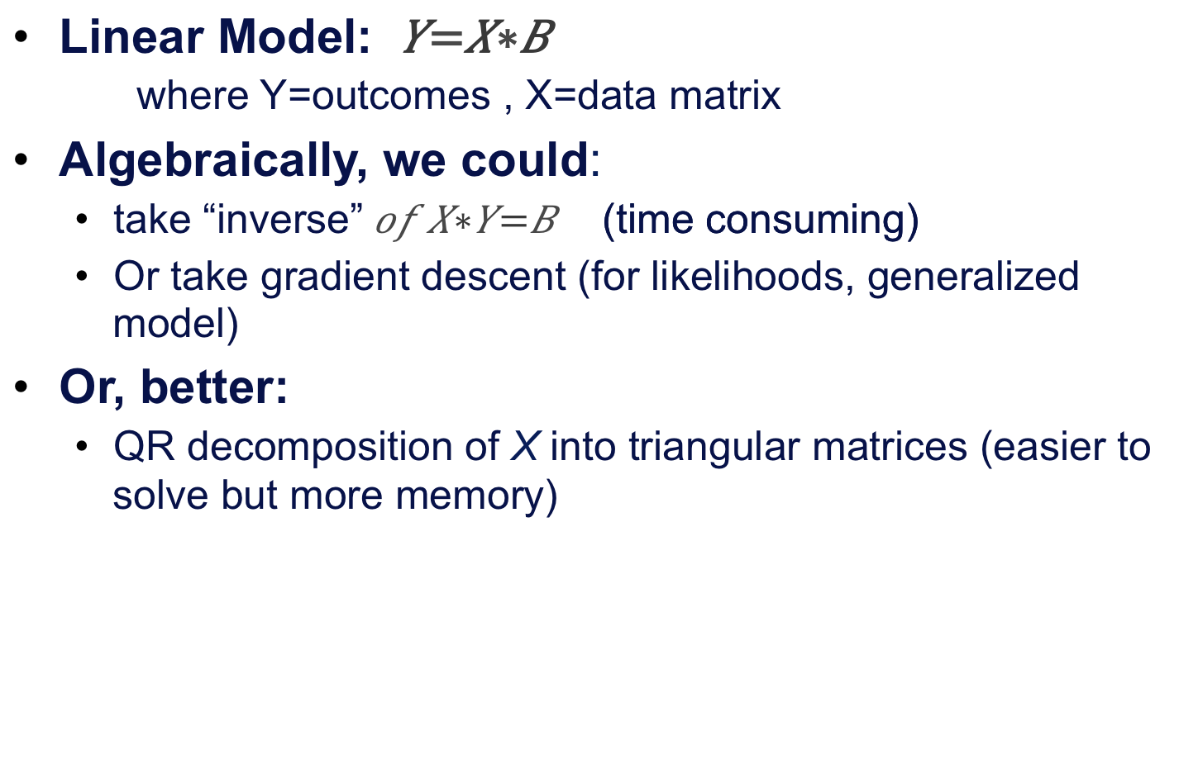
Consider Regression Computations
Linear Model: $Y=X∗B$
where Y=outcomes , X=data matrix
Algebraically, we could:
take “inverse”$of X∗Y=B$ (time consuming)
Or take gradient descent (for likelihoods, generalized model)
Or, better:
QR decomposition of X into triangular matrices (easier to solve but more memory)

Slide 26
Consider Regression models in R
Related Models and Functions :
lm() #Linear Model
glm() #Generalized Linear Model
(logistic regression, etc)
aov() #Analysis of Variance
( returns ANOVA table of F-scores)
All these work on system of equations

Slide 27
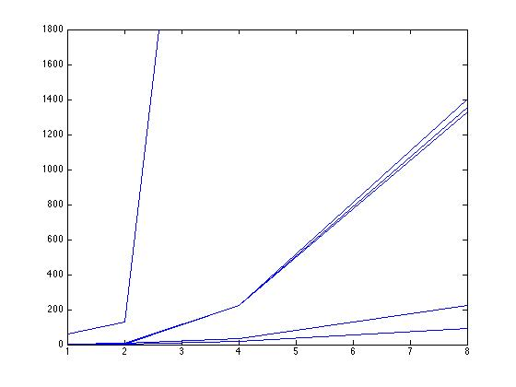
Solving Linear Systems Performance with R, 1 compute node
glm(Y~X,family=gaussian) #gaussn regrssn (like lm)
glm(Y~X,family=binomial) # logistic regrssn (Y=0 or 1)
Matrix inverse solutions
30min
GLM: logistic
GLM: Gaussian
LM()
inverse
Gradient descent
Wall
Time
(secs)
QR solutions
Solve(a,b)
QR
1K
2K
4K
8K
Data Matrix Size (i.e. square, rowsXcol)

Slide 28
R multicore – linking to MKL
Intel Math Kernel Libraries (MKL) provides fast operations for vector operations
Uses threads across cpu cores to pass data & commands

Slide 29
R multicore
Run loop iterations on separate cores
%dopar% puts loops across cores,
(loops are independent)
%do% runs it serially
install.packages(doMC)
library(doMC)
registerDoMC(cores=24)
getDoParWorkers()
results = foreach(i=1:24,.combine=rbind) %dopar%
{ … your code here
return( a variable or object )
})
allocate workers
returned items ‘combined’ into list
by default
specify to combine results into array with row bind

Slide 30
R multicore – one caveat
Multicore does not mean multithreaded! R is a single threaded language and will most likely remain so.
The %dopar% in the previous example may superficially remind you of OpenMP, but you’re actually creating new processes, each with their own copies of the necessary data structures.

Slide 31
R multinode: parallel backend
Run loop iterations on separate nodes
install.packages(‘doSNOW’)
library(‘doSNOW’)
…
cl <- makeCluster( mpi.universe.size()-1, type='MPI' )
clusterExport(cl,c('data'))
registerDoSNOW(cl)
results = foreach(i=1:47,.combine=rbind) %dopar%
{ … your code here
return( a variable or object )
})
stopCluster(cl)
mpi.exit()
allocate cluster as
parallel backend
%dopar% puts loops across cores and
nodes

Slide 32
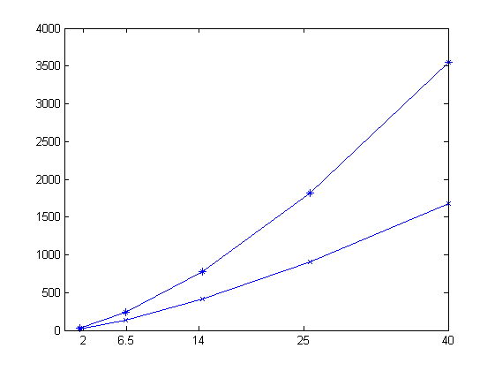
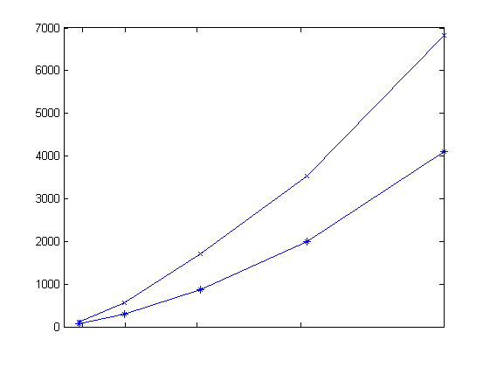
Multiple compute nodes not always helpful (benchmarked on Gordon)
Matrix Multiplication
Matrix Inversion
4 nodes
1 node
time
time(s)
4 nodes
2 nodes
N=10K 20K 30K 40K 50K
Gb=2 6.5 14 25 40
N=10K 20K 30K 40K 50K
Gb=2 6.5 14 25 40
Square Matrix size
multinodes: more nodes → less time for multiplication, more nodes → more time for inversion

Slide 33
Another Parallel option:
Serially packing R jobs onto cores
batch script starts a job and calls MPI run utility
MPI utility executes a Perl script on each core
Perl script executes R with argument=cpu-id
R uses cpu-id to process some particular input

Slide 34
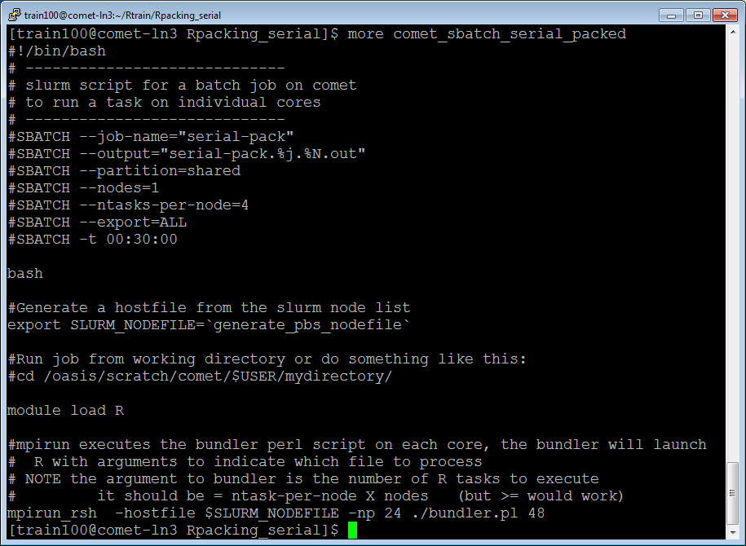

Slide 35
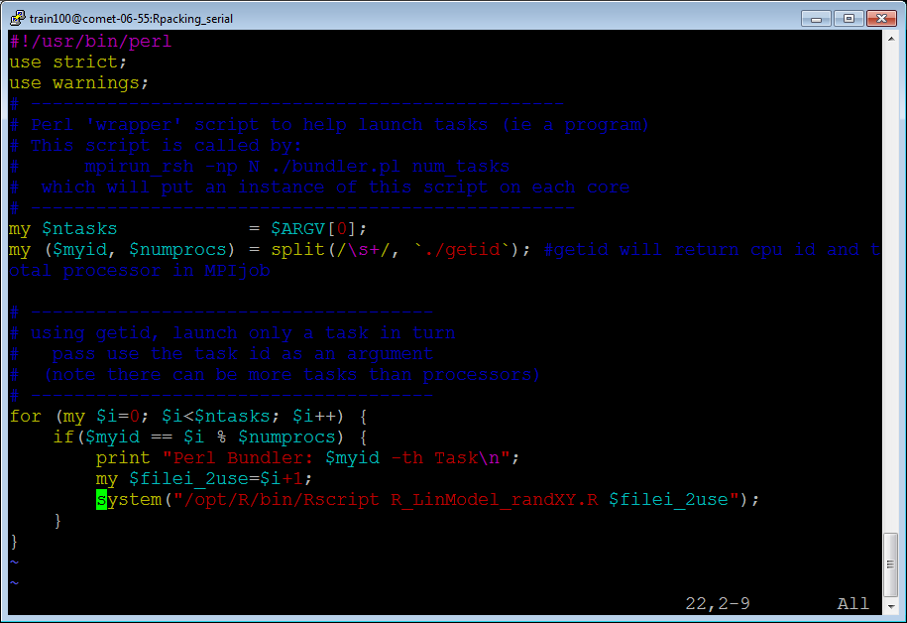

Slide 36
Packing Serial with large Random Forest job
Option 1: Run separate trees on separate cores
%dopar% puts loops across cores,
(loops are independent)
%do% runs it serially
install.packages(doMC)
registerDoMC(cores=15)
getDoParWorkers()
library("randomForest");
results = foreach(i=1:15,.combine=rbind) %dopar%
{RF1 <-randomForest(formula,data=X,na.action=na.omit,
importance=TRUE,
ntree=100000,
do.trace=1,
nodesize=1)
classRF1$importance
})
allocate workers
returned items ‘combined’ into list
Sampling on large data
could be huge

Slide 37
Packing Serial with large Random Forest job
Option 2: split sampling to make it perfectly parallel
i.e. run R script on separate cores and average results
And, for very large number of parameters, run each tree on subset of variables
i.e. take samples of columns, run lots of trees
Can speed up processing without losing interesting variable combinations

Slide 38
Packing Serial with large Random Forest job
A GWAS study, RandomForest Sampling in stages:
Take 1000 samples out of ~80K variables (SNPs )
Run 50 trees on each sample => 50K total trees
Run 1 instance of R on each core => on 4 compute nodes (64 cores) < 16hours (on Gordon)
Runs better than using foreach with randomForest()
b/c less total memory across nodes

Slide 39
Matlab quickview
Distributed Toolbox:
allocate distributed matrices using ‘spmd’ code
MPI or threads under the hood
You decide data/task set up
LAB 1
X local part
CLIENT
X matrix
.
.
.
Separate nodes
or threads
LAB N
X local part

Slide 40
SPMD Matlab – general scheme
%Matlab code using SPMD toolbox, where X is a matrix
…
spmd
fprintf('in 1st spmd %i \n',labindex);
Xsd=codistributed(X, codistributor('1d', 1)); %distrib rows
XsdLoc=getLocalPart(Xsd);
end
% …. Other code…
spmd
local-result ~ calculations on XsdLoc
end;
gather local-result
% … rest of code….
Distribute Matrix X
and process local part
It stays distributed
in memory for further
processing within SPMD block

Slide 41
Other R packages:
pdbR - higher level over R-MPI, distributed matrix support and other
HiPLAR – GPU and multicore for linear algebra
Rgputools – GPU support
R openMP , better data management than dopar, parallel (mclapply)
Ff, bigmemory; Revolution Scale R (commercial) – map data to files

Slide 42
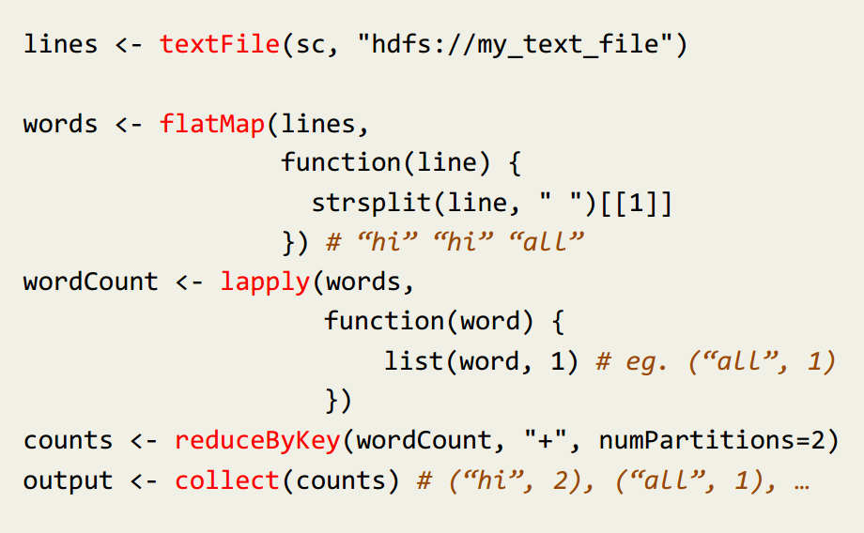
R spark coming
lapply = ‘apply function to list’
it is used like map

Slide 43
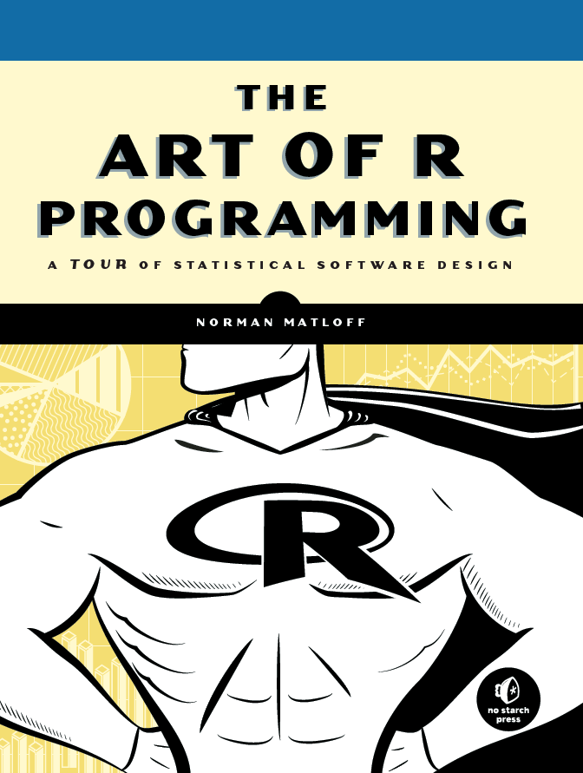
IMHO, the indispensible R resource

