Slide 1

Using Comet File Systems
Manu Shantharam
mshantharam@sdsc.edu
SDSC Summer Institute 2017

Slide 2
Why File Systems
Out-of-core calculations generating 1000s of temporary files – genome sequencing
Large shared file dumps due to checkpointing – weather forecasting codes
Large number of files per process

Slide 3
A Cautionary Tale
http://www.youtube.com/watch?v=gDfLXAtRJfY&feature=youtu.be

Slide 4
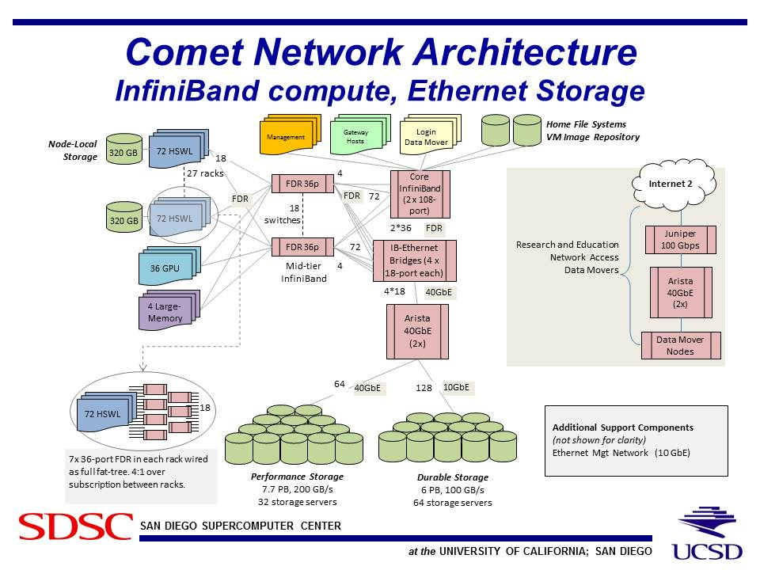
Comet File System Overview

Slide 5
Why Various Filesystems
Performance
Shared access across nodes
Backup / long-term
Quota

Slide 6
Comet File Systems
Path | Purpose | User Access Limits | Lifetime
$HOME | NFS storage; Source code, important files | 100 GB | Backed-up
/oasis/scratch/comet/$USER/temp_project | Global/Parallel Lustre FS; temp storage for distributed access | 500 GB | No backup
/oasis/projects/nsf | Global/Parallel Lustre FS; project storage | ~2.5 PB total | Backed-up
/scratch/$USER/$SLURM_JOB_ID | Local SSD on batch job node fast per-node access | 210 GB per compute node, 286GB on GPU, Large memory nodes | Purged after job ends

Slide 7
Order of Magnitude Guide
Storage | file/directory | file sizes | BW
Local HDD | 1000s | GB | 100 MB/s
Local SSD | 1000s | GB | 500 MB/s
RAM FS | 10000s | GB | GB/s
NFS | 100s | GB | 100 MB/s
Lustre/GPFS | 100s | TB | 100 GB/s
Local file systems are good for small and temporary files (low latency, modest bandwidth)
Network file systems very convenient for sharing data between systems (high latency, high bandwidth)

Slide 8
Application Focus
Storage choices should be driven by application need, not just what’s available.
But, applications need to adapt as they scale.
Writing a few small files to an
NFS server is fine… writing 1000’s simultaneously will wipe out the server.
If you use binary files,
don’t invent your own format. Consider HDF5.

Slide 9
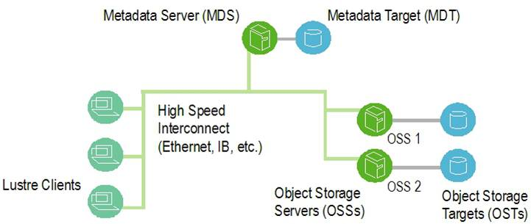
Lustre File System
Ref: Cornell Virtual Workshop

Slide 10
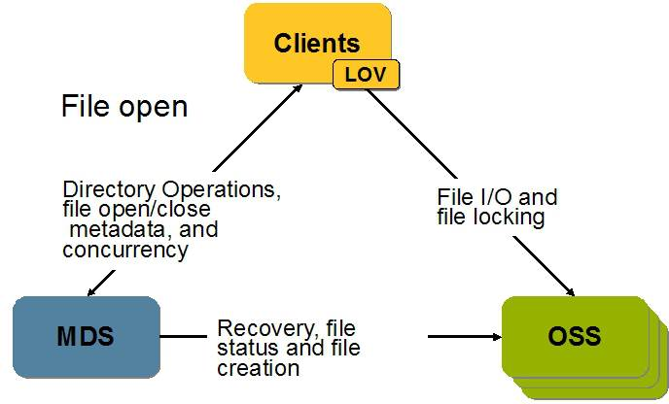
LFS Interactions
Ref: Cornell Virtual Workshop

Slide 11
A Typical LFS
Client
Client
Client
Client
Client
Client
Client
…
…
MDS0
MDS1
MDSN
OSS0
OSS1
OSSN
MDT0
MDT1
MDTN
OST0
OST1
OSTN
Temp scratch
2 MDTs, 16 OSSs, 96 OSTs
Project scratch
2 MDTs, 16 OSSs, 96 OSTs
Metadata:
SSDs & RAM
Object Storage:
Lots of drives

Slide 12
File View
Logical view of a file with N+2 segments
1 | 2 | 3 | 4 | 5 | … | N+2
sz
Stripe count = N
Stripe size = sz
Physical view of the file across OSTs
….
OST 1
OST 2
OST 3
OST N
Why is striping useful?
a way to store a large file
file can be accessed in parallel, increasing the bandwidth

Slide 13
LFS Commands
lfs help – lists all options
lfs osts – lists all the OSTs
lfs mdts – lists all the MDTs
lfs getstripe – retrieves the striping information of a file / directory
lfs setstripe – sets striping information of a file / directory

Slide 14
LFS Commands: getstripe
-bash-4.1$ lfs getstripe testout
testout
lmm_stripe_count: 1
lmm_stripe_size: 1048576
lmm_pattern: 1
lmm_layout_gen: 0
lmm_stripe_offset: 43
obdidx objid objid group
43 8979631 0x8904af 0
-bash-4.1$ lfs getstripe --stripe-count testout
1
-bash-4.1$ lfs getstripe --stripe-size testout
1048576
-

Slide 15
LFS Commands: setstripe
lfs setstripe -c 16 testout
-bash-4.1$ lfs getstripe testout
testout
lmm_stripe_count: 16
lmm_stripe_size: 1048576
lmm_pattern: 1
lmm_layout_gen: 0
lmm_stripe_offset: 89
obdidx objid objid group
89 9202813 0x8c6c7d 0
45 9819070 0x95d3be 0
...............................

Slide 16
LFS Commands: setstripe
bash-4.1$ lfs setstripe -c -1 test1
bash-4.1$ lfs getstripe test1
test1
lmm_stripe_count: 96
lmm_stripe_size: 1048576
lmm_pattern: 1
lmm_layout_gen: 0
lmm_stripe_offset: 65
obdidx objid objid group
65 9738084 0x949764 0
41 9153699 0x8baca3 0
...............................

Slide 17
LFS Commands: setstripe
-bash-4.1$ mkdir dir
-bash-4.1$ lfs setstripe -c 4 dir
-bash-4.1$ vi dir/test
-bash-4.1$ lfs getstripe dir/test
dir/test
lmm_stripe_count: 4
lmm_stripe_size: 1048576
lmm_pattern: 1
lmm_layout_gen: 0
lmm_stripe_offset: 43
obdidx objid objid group
43 8979901 0x8905bd 0
25 10609192 0xa1e228 0

Slide 18
LFS Usage Guidelines
Avoid certain operations
ls –l, ls with color, frequent file opens/closes
find, du, wildcards (ls *.out)
Why??
Try /bin/ls -U instead of ls -l
Select appropriate stripe count / size
Best case selection is complicated
Do not store too many files in one directory

Slide 19
LFS Performance Using IOR Benchmark
IOR (Interleaved Or Random) developed at LLNL to benchmark/test parallel filesystems.
Current version is very versatile (beyond what the name suggests).
Test aggregate I/O rates using several I/O options including POSIX, MPIIO, HDF5, and NCMPI.
Control several aspects of I/O to help mimic real applications:
Overall I/O Size
Transfer size
File access mode – single or file/task ….

Slide 20
IOR Options
IOR -h gives you all the options. Some important ones are:
-F : write one file per task
(without -F a single file is written)
-b : blockSize – contiguous bytes to write per task
-t : size of transfer in bytes (e.g. 8, 4k, 2m, 1g)
-w : Only write a file (default is to write and read)
-r : Only read an existing file
-i : number of iterations
-B : uses O_DIRECT for POSIX, bypassing I/O buffers
Command: mpirun -n 16 ./IOR.mpiio -a MPIIO -b 1g -w -k -t 1m -i 1 –o testfile

Slide 21
Case Study: WRF
Weather Research & Forecasting (WRF) Model: collaboration between NCAR, NCEP, NRL and many other institutions
Used for atmospheric research
Different types of I/O within WRF
Reading from a large input file, writing forecast history files periodically, writing restart files periodically
Various ways to perform I/O:
NetCDF file from task 0, PNetCDF, I/O Quilting – processors dedicated for output

Slide 22
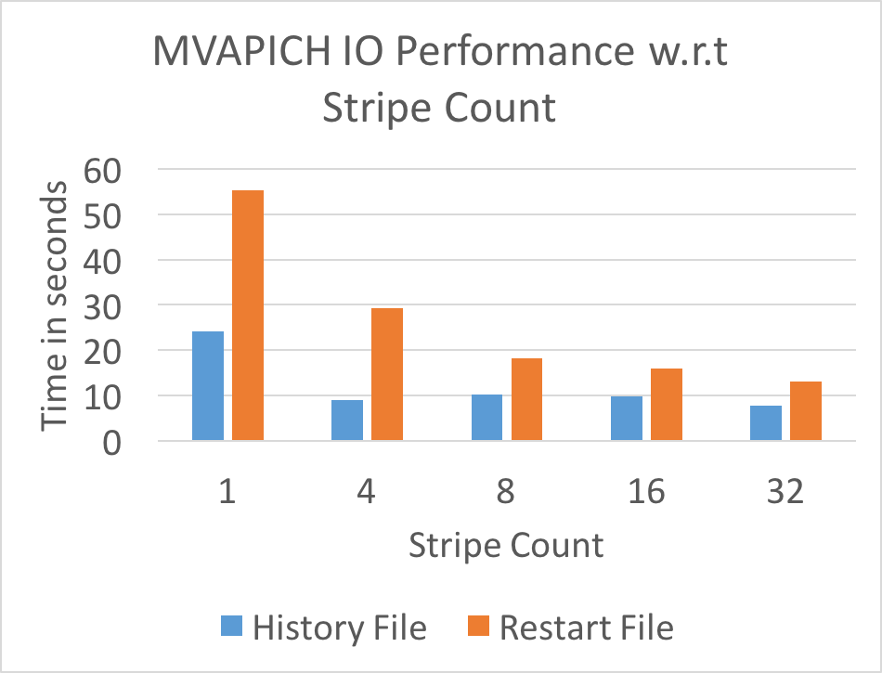
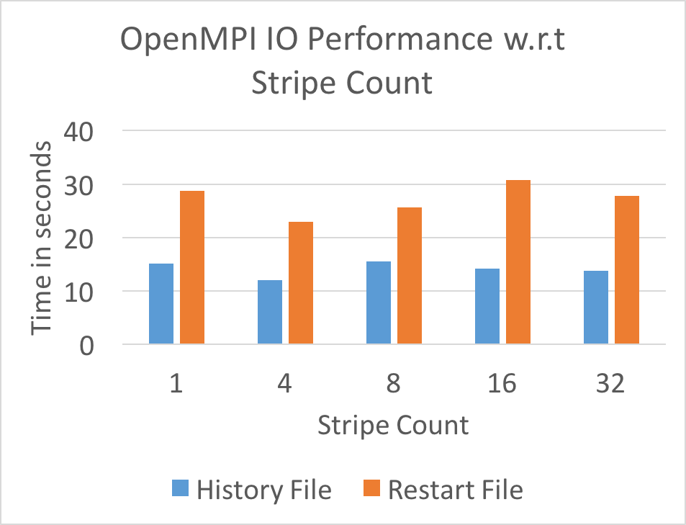
I/O Performance vs Lustre Stripe Count (240 cores)
Stripe count matters, need to carefully tune the libraries

Slide 23
Choosing
My application needs to:
Write a checkpoint dump from memory from a large parallel simulation.
I should consider:
A parallel file system and a binary file format like HDF5.

Slide 24
Choosing
My application needs to:
write and read 1000s of small files local to each process, store all the files across all the processes
I should consider:
a combination of local SSDs and Lustre!

Slide 25
Choosing
My application needs to:
Randomly access many small files, or read and write small blocks from large files.
I should consider:
RAM FS, or local scratch space.

