Slide 1
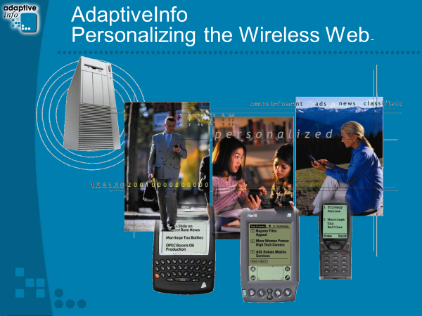
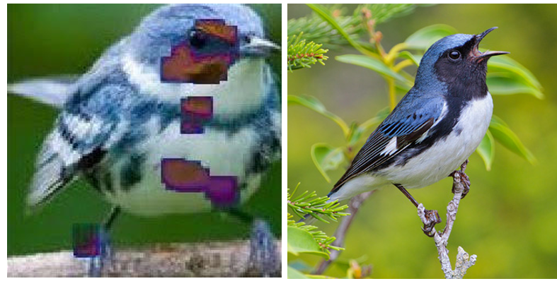
Michael Pazzani
University of California, Riverside
Machine Learning
  UCI Repository: Medium Data
  Explanation-based Learning
  Naïve Bayes
  Personalization
  Recommendation Systems
  Text Classification
  Contrast Sets
  Medical Informatics
  Deep Learning
  Explainable AI (XAI)
s=-180+10runs+5hit+0.9obp+15hrs+14rbi-0.8ave-18dbl-39trpl
s=-207+15runs+0.8hit+11hr+11rbi+0.33ave+5dbl

Slide 2
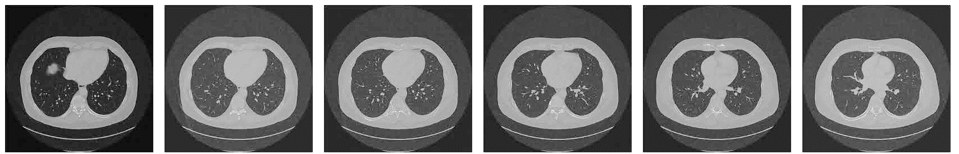
Michael Pazzani
University of California, Riverside
1. Deep Learning on Big Data: 3D Radiology, fMRI
Data Size
Is ImageNet or AlexNet the right starting point?
XAI
Scaling Contrast Sets to Gene Discover
Find x₁ & … x_{n}
P(c | x₁ & … & x_{n}) > P(c)

