Slide 1

--everything-is-local
--Balkrishna Pandey
2/14/2013

Slide 2
Chapters
Introduction
  About Version Control
  GIT Short History
  Companies & Projects Using Git
  Why Git?
  GIT in a nutshell
  Installing Git

Slide 3
Chapters
GIT Workshop
  Getting a Git Repository
  First-Time Git Setup
  Adding Changes
  Committing
  Viewing Your Staged and Unstaged Changes
  Removing Files
  Moving Files
  log
  Working with Remotes
  Tagging
  Ignoring Files
  Getting Help

Slide 4
Introduction

Slide 5
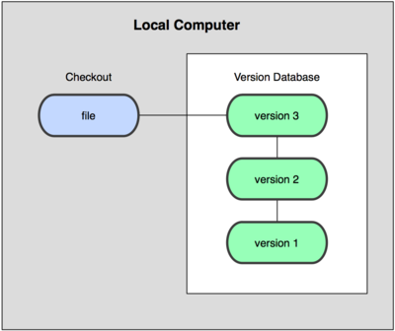
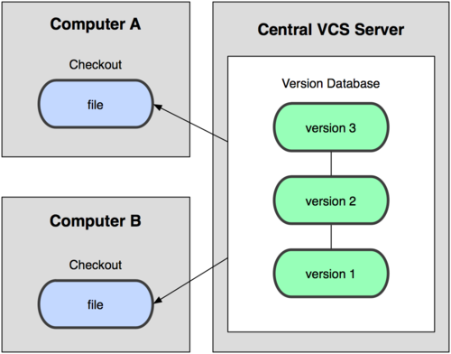
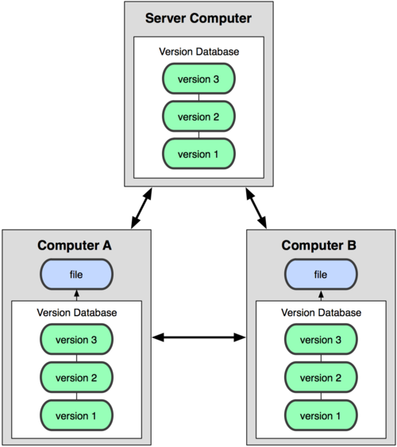
About Version Control
Figure 1-1. Local version control
Figure 1-2. Centralized version control
Figure 1-3. Distributed version control

Slide 6
GIT Short History
Original author(s) : Linus Torvalds (Linux kernel)
Initial release: 7 April 2005
Stable release: 1.8.1.3(8 February 2013)
Written in : C, Bourne Shell, Tcl, Perl
(Note: In 2005, the relationship between the community that developed the Linux kernel and the commercial company that developed BitKeeper broke down, and the tool’s free-of-charge status was revoked. This prompted the Linux development community (and in particular Linus Torvalds, the creator of Linux) to develop their own tool based on some of the lessons they learned while using BitKeeper. )
(Source: http://en.wikipedia.org/wiki/Git_%28software%29)

Slide 7
Companies & Projects Using Git
Google Facebook
Microsoft Twitter
LinkedIn Android
NetFlix Perl
PostgreSQL Rails
Gnome Eclipse
Linux Kernel Kde
And others many
(Source: http://git-scm.com/)

Slide 8
Why Git?
Everything is Local.
Git Has Integrity (Use SHA-1 hash as a checksum. This is a 40-character string composed of hexadecimal characters (0–9 and a–f) and calculated based on the contents of a file or directory structure in Git.)
SHA-1 hash: 24b9da6552252987aa493b52f8696cd6d3b00373
Strong support for non-linear development (thousands of parallel branches).
Easy Branch
Space (Tags, Branches)

Slide 9

GIT in a nutshell
You modify files in your working directory.
You stage the files, adding snapshots of them to your staging area.
You do a commit, which takes the files as they are in the staging area and stores that snapshot permanently to your Git directory.
Figure 1-4. Working directory, staging area, and git directory.

Slide 10
Installing Git
Installing on Linux (Debian-based distribution )
  apt-get install git
Installing on Linux (Fedora-based distribution )
  yum install git-core
Installing on Windows
  http://git-scm.com/

Slide 11
GIT Workshop

Slide 12
GIT Workshop (Getting a Git Repository)
Two main approaches
  Initializing a Repository in an Existing Directory
    $ git init
  Cloning an Existing Repository
    $ git clone git@git.deerwalk.com:/var/cache/git/test001

Slide 13
GIT Workshop (First-Time Git Setup)
/etc/gitconfig file: Contains values for every user on the system and all their repositories. If you pass the option --system to git config, it reads and writes from this file specifically.
~/.gitconfig file: Specific to your user. You can make Git read and write to this file specifically by passing the --global option.
Config file in the git directory (that is, .git/config) of whatever repository you’re currently using: Specific to that single repository. Each level overrides values in the previous level, so values in .git/config trump those in /etc/gitconfig.
Example
git config --global user.name "John Doe"
git config --global user.email johndoe@example.com

Slide 14
GIT Workshop (First-Time Git Setup)
Create an empty directory “testGit”
    mkdir testGit
To initialize a Git repository type
    git init
    Initialized empty Git repository in d:/Products/git/testGit/.git/
(Note: Our “testGit” directory now has an empty repository in /.git/. The repository is a hidden directory where Git operates.)
Checking the Status of Your Files
    $ git status
    # On branch master
    nothing to commit (working directory clean)

Slide 15
GIT Workshop(Adding Changes)
Adding
Create a file called readme.txt in the testGit repository. Now you should run git status command again to see how the repository status has changed.
    $ git status
# On branch master
#
# Initial commit
#
# Untracked files:
# (use "git add <file>..." to include in what will be committed)
#
# readme.txt
nothing added to commit but untracked files present (use "git add" to track)

Slide 16
GIT Workshop (Adding Changes)
Adding Changes
To tell Git to start tracking changes made to readme.txt, we first need to add it to the staging area by using git add.
  $ git add readme.txt
  # On branch master
  #
  # Initial commit
  #
  # Changes to be committed:
  # (use "git rm --cached <file>..." to unstage)
  #
  # new file: readme.txt

Slide 17
GIT Workshop (Committing)
Committing
To store our staged changes we run the commit command with a message describing what we've changed.
  $ git commit -m “readme.txt file containing general info”
  [master (root-commit) 0554cbd] readme.txt file containing general info
  1 file changed, 1 insertion(+)
  create mode 100644 readme.txt

Slide 18
GIT Workshop (Adding All Changes)
  Adding All Changes
  You also can use wildcards if you want to add many files of the same type. Create two files hello.txt and big_hello.txt
  $ git add '*.txt’
you've added all the text files to the staging area. Feel free to run git status to see what you're about to commit.
If it looks good, go ahead and run:
$ git commit -m “Added big_hello.txt for BIG HELLO and hello.txt for small hello”

Slide 19
GIT Workshop (Staged and Unstaged Changes)
  Viewing Your Staged and Unstaged Changes
  git diff gives the answer of questions, what have you changed but not yet staged? And what have you staged that you are about to commit?
  To see what you’ve changed but not yet staged, type git diff with no other arguments:
  $git diff
  If you want to see what you’ve staged that will go into your next commit, you can use
  $git diff --cached
  $git diff --staged (Git versions 1.6.1 and later)

Slide 20
GIT Workshop (Removing Files)
  Removing Files
  To remove a file from Git, you have to remove it from your tracked files (more accurately, remove it from your staging area) and then commit. The git rm command does that,
  $ git rm hello.txt
  rm ‘hello.txt’
  $ git status
  # On branch master
  # Changes to be committed:
  # (use "git reset HEAD <file>..." to unstage)
  # deleted: hello.txt
  The next time you commit, the file will be gone and no longer tracked.

Slide 21
GIT Workshop (Removing Files)
Removing Changes
  To remove changes from Staging area we can use git rm.
  $ git rm --cached readme.txt
  rm ‘readme.txt’
Removing modified file
  Force the removal with the -f option.
  $ git rm -f hello.txt

Slide 22
GIT Workshop (Moving Files)
Moving Files
  If you want to rename a file in Git, you can run something like
  $ git mv readme.txt README
  Now check git status
  $ git status
  # On branch master
  # Changes to be committed:
  # (use "git reset HEAD <file>..." to unstage)
  #
  # renamed: readme.txt -> README
  #

Slide 23
GIT Workshop (log)
Viewing the Commit History
  The most basic and powerful tool to do this is the git log command.
  Examples:
  $git log (lists the commits made in that repository in reverse chronological order.)
  $ git log -2 (Limit output to 2)
  $git log -p -2 (-p shows the diff introduced in each commit)
  $git log --pretty=oneline (prints each commit on a single line, other option are short, full, and fuller )

Slide 24
GIT Workshop (log)
  $ git log --since="yesterday“
  $ git log --since="1 week ago" --until=“today“
  $ git log --since=“02/16/2013”
  $ git log --since=2.weeks
  $git log --author=Bal
  $git log --grep=hello
Note: (YYYY.MM.DD, MM/DD/YYYY, DD.MM.YYYY, RFC 2822 and ISO 8601 are all valid)

Slide 25
GIT Workshop (Working with Remotes)
Showing Your Remotes
git remote command lists the short names of each remote handle you’ve specified.
  $ git remote
  origin
  You can also specify -v, which shows you the URL that Git has stored for the short name to be expanded to:
  $ git remote -v
  origin git@build.deerwalk.com:/var/cache/git/testGit.git (fetch)
  origin git@build.deerwalk.com:/var/cache/git/testGit.git (push)

Slide 26
GIT Workshop (Working with Remotes)
Adding Remote Repositories
  To add a new remote Git repository as a shortname you can reference easily, run git remote add [shortname] [url]
  $ git remote add selenium git@build.deerwalk.com:/var/cache/git/selenium.git
  $git remote -v
  origin git@build.deerwalk.com:/var/cache/git/testGit.git (fetch)
  origin git@build.deerwalk.com:/var/cache/git/testGit.git (push)
  selenium git@build.deerwalk.com:/var/cache/git/selenium.git (fetch)
  selenium git@build.deerwalk.com:/var/cache/git/selenium.git (push)

Slide 27
GIT Workshop (Working with Remotes)
Fetching and Pulling from Your Remotes
  $ git fetch [remote-name]
  (Note: The fetch command pulls the data to your local repository — it doesn’t automatically merge it with any of your work or modify what you’re currently working on. You have to merge it manually into your work when you’re ready.)
  $ git pull origin master
  (note: git pull command to automatically fetch and then merge a remote branch into your current branch. )

Slide 28
GIT Workshop (Working with Remotes)
Pushing to Your Remotes
  $ git push origin master
  Removing and Renaming Remotes
  $ git remote rename selenium remote_sel
  $ git remote rm remote_sel

Slide 29
GIT Workshop (Tagging)
Listing Your Tags
  $ git tag
  R_0.1
  R_0.2
  $ git tag 'v1.4.2.*'
  v1.4.2.1
  v1.4.2.2
  v1.4.2.3
  v1.4.2.4

Slide 30
GIT Workshop (Tagging)
Creating Tags
  Git uses two main types of tags: lightweight and annotated. A lightweight tag is very much like a branch that doesn’t change — it’s just a pointer to a specific commit. Annotated tags, however, are stored as full objects in the Git database.
  Annotated Tags
  $ git tag -a R_0.1 -m ‘Version Release R_0.1‘
  $git tag
  $ git show R_0.1

Slide 31
GIT Workshop (Tagging)
Lightweight Tags
  To create a lightweight tag, don’t supply the -a or -m option:
  $ git tag R_0.3
  Tagging Later
  $ git tag -a R_0.4 -m 'version 0.4' 9fceb02
  $git tag
  $git show R_0.4

Slide 32
GIT Workshop (Tagging)
Sharing Tags
  By default, the git push command doesn’t transfer tags to remote servers. You will have to explicitly push tags to a shared server using git push origin [tagname].
  $ git push origin R_0.1
  If you have a lot of tags that you want to push up at once, you can also use the --tags option to the git push command.
  $ git push origin --tags

Slide 33
GIT Workshop (Some More)
  Ignoring Files
  (Note: Often, you’ll have a class of files that you don’t want Git to automatically add or even show you as being untracked. These are generally automatically generated files such as log files or files produced by your build system. In such cases, you can create a file listing patterns to match them named .gitignore.)
  Some Examples:
Compiled source | Packages | Logs and databases | OS generated files
*.com *.class *.dll *.exe *.o *.so | *.7z *.dmg *.gz *.iso *.jar *.rar *.tar *.zip | *.log *.sql *.sqlite | .DS_Store .DS_Store? ._* .Spotlight-V100 .Trashes Icon? ehthumbs.db Thumbs.db

Slide 34
GIT Workshop(Some more)
Getting Help
  git help <verb>
  git <verb> --help
  man git-<verb>
For example, you can get the man page help for the config command by running
  git help config

Slide 35
References
http://git-scm.com/
http://git-scm.com/book
https://help.github.com/articles/ignoring-files

Slide 36
Queries ??

Slide 37
Thank You !!

