Slide 1
PRODUCT STRATEGY — MYNTRA GROWTH
Closing the Wishlist Confidence Gap
Improving Myntra's wishlist-to-purchase conversion by resolving in-app decision doubt — without discounts, coupons, or cashback.
FOCUS
LEVER
CONSTRAINT
Ethnic / occasion / fashion-forward wishlist items
In-app decision confidence, not price
No monetary incentives
Product Manager, Growth Team
1

Slide 2
BUSINESS METRIC
WPCR is stuck at decision confidence, not at “they never open the app”
North Star — WPCR: % of users who purchase ≥ 1 wishlisted item within 30 days of adding it.
1
2
3
4
Re-engagement
Decision Confidence
Cart Conversion
Checkout
→
→
→
% of wishlisted items
revisited in 30 days
% of revisited items
where doubt is resolved
% of resolved items
added to cart
% of cart items
purchased
PRIMARY PRODUCT OUTCOME
In scope: bookmarkers → intenders · ethnic > basics · confidence-blocked · once-a-month + 2–4×/month Out of scope: rarely shoppers · price-only waiters (no monetary levers available)
Product Manager, Growth Team
2

Slide 3
AI DISCOVERY ENGINE
Quality is loudest, fit is real, price is out of scope
Play Store + App Store + YouTube reviews → LLM-tagged by theme → mention share (n = 550). Reviews under-index silent wishlist freeze — this sets direction, not the full picture.
SCOPE READ-OUT
Quality / authenticity
47.8%
IN
Fit / size
13.0%
IN
Comparison
11.8%
IN
External research
10.5%
IN
Found alternative
5.2%
IN
Occasion mismatch
2.6%
IN
Price / deal-waiting
13.9%
OUT
Combined in-scope confidence themes dominate; price is the largest single out-of-scope theme and is excluded from this solution.
AI Discovery Engine: [LINK: AI Discovery Engine — Streamlit Tab 1]
Product Manager, Growth Team
3

Slide 4
PRIMARY RESEARCH — PILOT SURVEY
Pilot (n=10): monthly+ shoppers in “Probably” leave the app — 7/10 blockers are confidence
Caveat: n=10, not statistically powered; screener leaky (frequency/wishlist-size blank for 7/10). We pursue the 7/10 confidence cluster, not the 3/10 price cluster.
MAIN BLOCKER (of 10)
OUTSIDE-APP BEHAVIOUR — 10/10 did at least one
Compare prices — 6 · Visit store — 6
Instagram — 3 · Friends — 3 · YouTube/Google — 3
WHAT WOULD UNSTICK THEM
7/10 wanted similar-buyer reviews/photos
COPING TODAY
Order two sizes, keep the one that fits
Order per size chart, then exchange
Leave it in the wishlist until payday
Confidence cluster (comparison + quality + occasion + fit) = 7/10
Named items: 4/10 ethnic/occasion (Rakhi dress, wedding dress, kurta set, kurta) Intent: Probably 6/10 · Yes, definitely 3/10 · Not sure 1/10
Survey: [LINK: Google Form viewform]
Product Manager, Growth Team
4

Slide 5
PROBLEM DEFINITION
No in-app way to resolve fit, quality, or comparison on ethnic saved items
SEGMENT
24–30, Tier 1–2, shop fashion at least once a month, 5+ wishlist items, several dormant 2+ weeks, “Probably” intent, ethnic/occasion or fashion-forward
PRODUCT OUTCOME
Decision Confidence Rate (funnel stage 2)
ROOT CAUSE
No in-app mechanism to resolve fit, quality (fabric/threadwork vs. photo), or comparison doubt at reconsideration — users leave the app and the loop rarely completes
WORKAROUNDS TODAY
Order multiple sizes and return, ask friends, visit stores, search reviews off-app, leave items in an ever-growing wishlist
USER VALUE
Less anxiety, fewer returns, faster yes/no on occasion purchases
BUSINESS VALUE
Higher-AOV ethnic slice converts existing saved demand without discounting; avoids inflating returns
WPCR
Stage-2
Outcome
AI Discovery
(quality+fit in;
price out)
Primary Research
(7/10 confidence;
6/10 Probably)
In-App
Confidence Gap
→
→
→
→
Product Manager, Growth Team
5

Slide 6
SOLUTION RATIONALE
Why ethnic-wear confidence, not basics and not discounts (once-a-month included)
Ethnic/occasion/fashion-forward has higher AOV than basics and higher hesitation — same lift moves more GMV
Confidence themes (quality, fit, comparison, occasion) outweigh price in both AI discovery and primary research once price is excluded
One product, one mechanism (in-app decision confidence) serves both frequency segments — not two different builds
PRIMARY DESIGN CASE
2–4×/month intenders
Already open the app often — their gap is confidence, not return frequency.
ALSO IN SCOPE
Once-a-month intenders
EXPLICITLY NOT SOLVING
Same dormant-wishlist + confidence pattern. Fewer sessions in a 30-day window means revisit matters too — a segment-width note, not a reason to build re-engagement as the hero.
Acquisition · “add more to wishlist” · reminder/push spam · price or discount levers
Product Manager, Growth Team
6

Slide 7
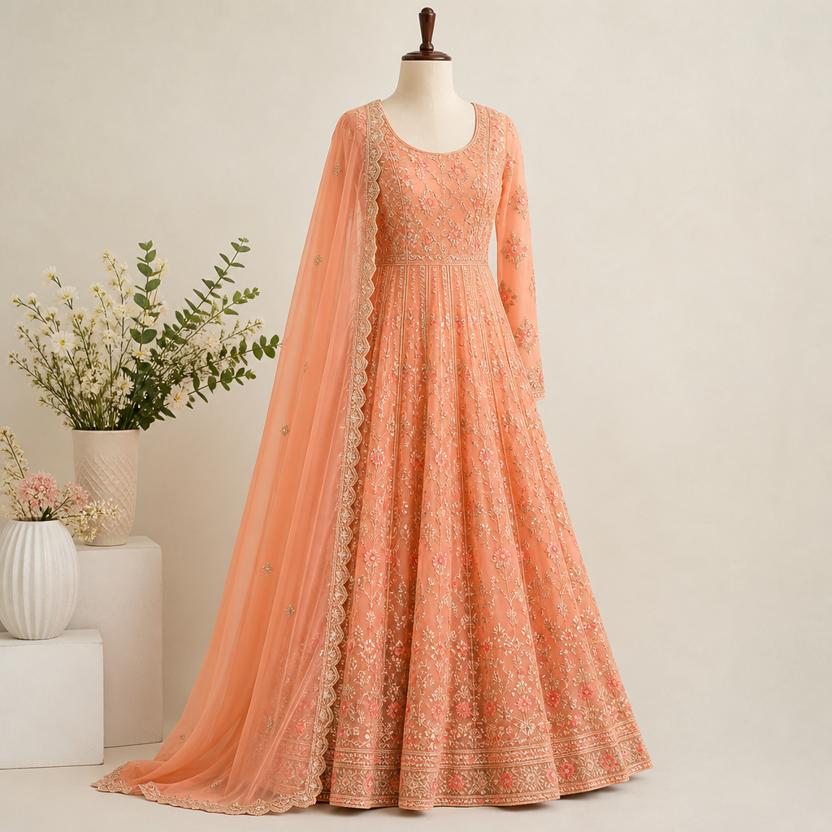
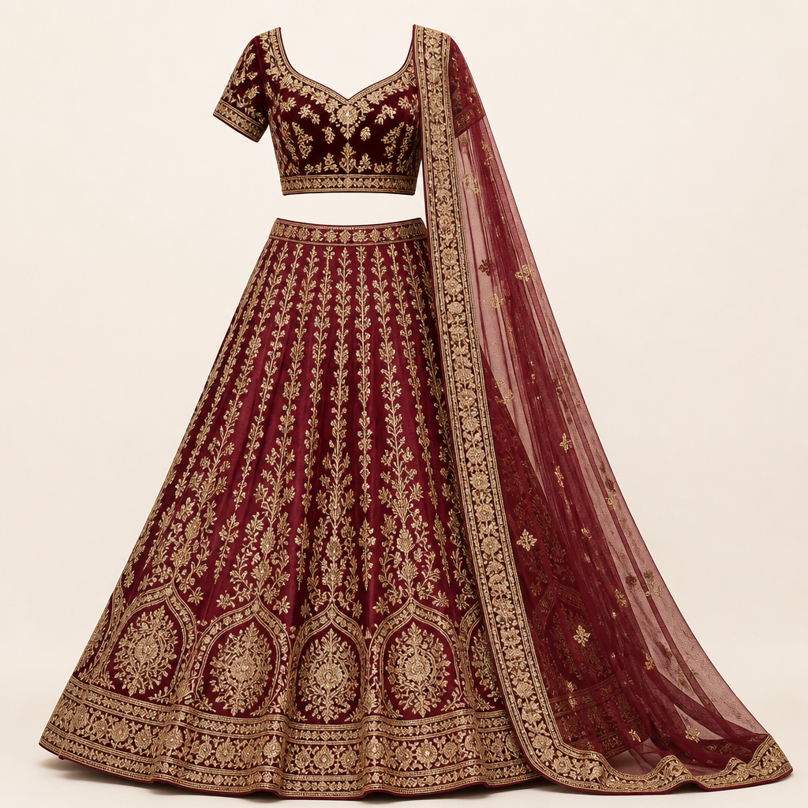
MVP — FUNCTIONAL PROTOTYPE
The MVP lives on the wishlist: check fit before Move to Bag
Same surface users already open — one extra action at the moment of hesitation, no new destination and no discount.
Wishlist
7 items
CHECK FIT — OPENS ON THAT SAVED ITEM
WHAT IT DOES
Libas · Embroidered Anarkali Suit
1
Confidence score with provenance
♥
♥
Saved 3 weeks · intent: Probably
Counted from that item's reviews and return reasons
Fit confidence 67 — labelled, not a black box
2
Ask on the saved item
From this item's 15 reviews: 3 read true-to-size, 3 say size up, 3 praise the threadwork, 2 flag average lining.
Fit, fabric or threadwork versus the photo, occasion
Fit confidence 67
Need more reviews
3
Personalised fit
Libas
Kalini
“Will the work look cheap in person? Should I size up for daytime Rakhi?”
Cross-references the shopper's past orders where available
Embroidered Anarkali Suit
Embroidered Lehenga Set
4
Compare, capped at 3
Rs. 2499
Rs. 4499
The answer quotes those reviews back with counts, and says what the reviews do not cover — instead of inventing a percentage.
Only similar items already on the wishlist
MOVE TO BAG
MOVE TO BAG
CHECK FIT
CHECK FIT
COLD START, HANDLED HONESTLY
Scroll for 5 more saved items
All 15 reviews shown
Compare max 3 saved
The Kalini lehenga has 3 reviews, so its card reads “Need more reviews” and falls back to brand size chart and Q&A.
Prototype, not the live Myntra app
Moves stage 2 (decision confidence): Move to Bag stays the shopper's decision, and nothing in the flow offers a discount.
Deployed MVP: [LINK: Deployed MVP — Streamlit Tab 2]
Product Manager, Growth Team
7

Slide 8
SUCCESS METRICS
WPCR + resolution rate + return/wishlist-add guardrails
NORTH STAR
WPCR — 30-day wishlist-to-purchase conversion
PRIMARY PRODUCT METRIC
LEADING INDICATOR
Decision Confidence Rate
Assistant Engagement Rate
% of assistant interactions ending in add-to-cart, a “this helped” signal, or a clear decide-no
% of wishlist visits where the tool is opened
GUARDRAILS
Return rate
Wishlist-add rate
Fit/quality support contacts
Must not increase
Must not decrease
Expected to decrease
Context-only note: for once-a-month shoppers, also watch revisit rate as background context — not the MVP's job.
Product Manager, Growth Team
8

Slide 9
RISKS & MITIGATION
De-risk cold start, hallucination, trust, hiding, compare-overload
Cold start
New/low-review ethnic items lack data
Fallback to brand-level size charts and community Q&A
AI hallucination
Wrong fit/quality claims erode trust
Ground answers strictly in real review/return text; show provenance; use confidence caveats, not absolute claims
AI-only distrust
Users don't trust a single AI summary
Show real user reviews alongside the AI summary, never AI-only
Low discoverability
Feature goes unused if buried
Embed directly inside the wishlist card, not a separate section
Compare-overload
Too many options re-creates decision fatigue
Hard cap at 2–3 saved similar items
Constraint carried through every mitigation: never a discount, coupon, or cashback tool.
Product Manager, Growth Team
9

Slide 10
RECAP
Recap + artefact links
Resolve fit, quality (photo vs. real fabric/threadwork), and comparison doubt at hesitation on high-AOV ethnic/forward saved items, for shoppers who buy at least monthly — lifting decision-confidence rate and WPCR without touching price.
AI DISCOVERY ENGINE
[LINK: AI Discovery Engine — Streamlit Tab 1]
DEPLOYED MVP
[LINK: Deployed MVP — Tab 2]
PRIMARY RESEARCH
[LINK: Google Form viewform]
Product Manager, Growth Team
10

