Slide 1
PRODUCT STRATEGY — GOOGLE PHOTOS · CORE EXPERIENCE
TOPIC SEARCH RETURNS ONE PILE — PHOTOS, PAPERS, SCREENSHOTS
People search a life topic they still remember. Photos answers with one undifferentiated grid. The intended item can sit in the set while they evaluate the wrong kind.
Raise successful evaluation of topic-search results by separating personal photos, documents, and screenshots — not by asking for a better keyword.
FOCUS
LEVER
OUT
Coarse life-topic search
Type mix / visual evaluation
Query rewrite, delete, father-only People
Live app https://REPLACE_ME.streamlit.app/ · Notes survey/interview_notes.md
Product Manager, Core Experience
1

Slide 2
THE LEAK IS EVALUATION — THE ITEM MAY ALREADY BE IN THE SET
North star: share of topic-search sessions where the user can confirm the intended kind of item.
Recall
Query
Interpret
RELEVANCE
EVALUATE
Refine
Recall — they have a topic: college, a trip, “that certificate.”
Query formulation — they can type the topic. Not the hero failure.
Relevance — search mixes camera photos, screenshots, and documents that share the topic word. TARGET.
Evaluate — certificates look like “college”; they cannot pick the memory. TARGET.
Refine — they scroll, open Files, or leave. Intelligence belongs in typing the grid, not rewriting the box.
IN: large libraries, topic search. OUT: crash, storage, People-tab only, auto-delete.
Product Manager, Core Experience
2

Slide 3
THE ENGINE COMPARES FUNNEL FAILURES — IT DOES NOT SCORE SENTIMENT
PIPELINE
CLICK PATH
Play · App Store · Reddit · YouTube
→ filter: retrieval + topic / mixed-kind talk (drop crash/storage-only)
→ tag: funnel stage, memory type, anchors, workaround, severity
→ matrix for the deck
→ live Q&A over tagged items (TF-IDF + counts)
Worked question: “when do certificates show up in photo search?”
1. Open live app → Discovery.
2. Theme chip or type a PM question.
3. Read findings tied to tagged fields.
4. Compare funnel × memory-type table.
Gold n = 156.
Sources: {'app_store': 24, 'google_support_community': 1, 'play_store': 98, 'reddit': 8, 'youtube': 25}
query formulation leads failure-stage mentions (87.2%). Functional/utility vs episodic compared in the matrix.
Product Manager, Core Experience
3

Slide 4
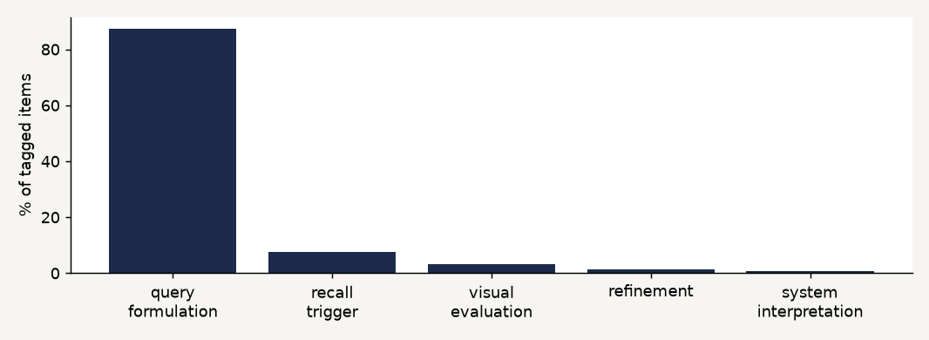
CORPUS RANKS STAGES — INTERVIEWS LOCK THE TYPE-MIX JOB
query formulation leads failure-stage mentions (87.2%). Functional/utility vs episodic compared in the matrix.
Memory types
unclear: 52.6%
functional_utility: 30.8%
people_anchored: 10.9%
temporal_only: 4.5%
emotional_episodic: 1.3%
Hero IN: type-blind topic grids.
Caveat: reviews under-index silent scroll. Interviews are a second layer — not averaged. No invented lift %.
Product Manager, Core Experience
4

Slide 5
RITU AND SWATI LOCK THE JOB — RAHUL AND AKSHAY ARE NAMED OUT
Ritu — IN
Swati — IN
Named OUT
Searched college photos. The same grid returned certificates. She could not evaluate which tiles were memories.
Wants personal photos, documents, and screenshots sequenced or separated — not one mixed dump.
Rahul: father-only People search (not generic search; do not demo a deceased parent). Akshay: auto-delete unused photos — cleanup, off metric.
Method: 30–40 min critical-incident reconstruction. First names only. Directional n. Full notes in the repo. Two evidence layers — corpus % is not interview n.
Product Manager, Core Experience
5

Slide 6
RESEARCH CONFIRMS TYPE-BLIND GRIDS — AND KILLS THE WRONG FIXES
CONFIRMED
KILLED
• They can name the topic.
• Photos mixes memories with papers and screenshots.
• The right tile can be present and still unusable.
• They want kinds sequenced or separated.
• Workarounds: scroll, Files, leave.
• Killed as hero: query formulation / smarter keywords.
• Killed: date picker as clarifying UI.
• Killed: Rahul — People-tab / father-only.
• Killed: Akshay — auto-delete unused photos.
• Corpus % ≠ interview n. Never merged. No fake lift.
Product Manager, Core Experience
6

Slide 7
ONE GRID CANNOT CARRY THREE KINDS OF “COLLEGE”
SEGMENT
SCENARIO
OUTCOME
Large, multi-year libraries. Topic search, not filename search.
“College photos” returns memories + certificates + screenshots together.
Visual evaluation + type-relevant ranking.
ROOT CAUSE
WORKAROUNDS
WHY IT MATTERS
Topic words are shared across kinds. The product does not type the grid.
Scroll past papers, open Files, ask someone.
Topic search stays the default. Photos remains the archive, not chat apps.
Metric → funnel (relevance + evaluate) → Ritu/Swati → this problem. Not “search is hard.”
Product Manager, Core Experience
7

Slide 8
ASK KIND ONCE — THEN SHOW A TYPED GRID. NOT A CHATBOT.
MVP LOOP
PART 6
1. Dump a coarse topic (college photos).
2. If results mix kinds, ask: memory vs saved to use later (document/screenshot).
3. Cap at two turns (optional document vs screenshot).
4. Show a typed thumbnail grid: personal / document / screenshot.
5. None of these → different kind.
College mixed-results card is the hero task. Demo library only.
n=3 prompt cards (college memories, college certificate, saved screenshot).
Found in top 5: 3 miss: 0
Log: original query, clarifying turns, success/fail.
No lift % invented.
Not built: Google login, date picker, open chat, auto-delete, father-only filter.
Product Manager, Core Experience
8

Slide 9
MEASURE WHETHER THEY CAN EVALUATE KIND — NOT QUERY REWRITE
North star — Topic-search evaluation success: in-scope sessions that end in a confirmed find of the intended kind.
Leading — Type-mix ask rate: share of sessions whose first grid mixed personal / document / screenshot.
Leading — Success after kind answer: memory vs saved-for-later actually changes the usable set.
Diagnostic — Wrong-kind selects (certificate when they wanted photos).
Diagnostic — Question rated helpful vs annoying (Part 6 free text).
Guardrail — Precise keyword search must not regress; no auto-delete; demo library only (privacy).
Product Manager, Core Experience
9

Slide 10
A TYPED DEMO GRID CAN LOOK SOLVED AND STILL FAIL IN PHOTOS
Demo cheating — small set. Mitigation: keep utility library + college memories and certificates that share topic words; report miss rate.
Date-shaped questions sneak back — wrong lock. Mitigation: scripted type-mix questions only; no date picker.
Looks like ChatGPT-on-search — Creativity collapse. Mitigation: two-turn cap, no open chat, typed grid is the UI.
Scope creep to People or delete — Rahul/Akshay. Mitigation: named OUT in docs and deck.
Privacy — testers will not use a real account. Mitigation: bundled demo library; production stays inside Photos.
Product Manager, Core Experience
10

