Slide 1
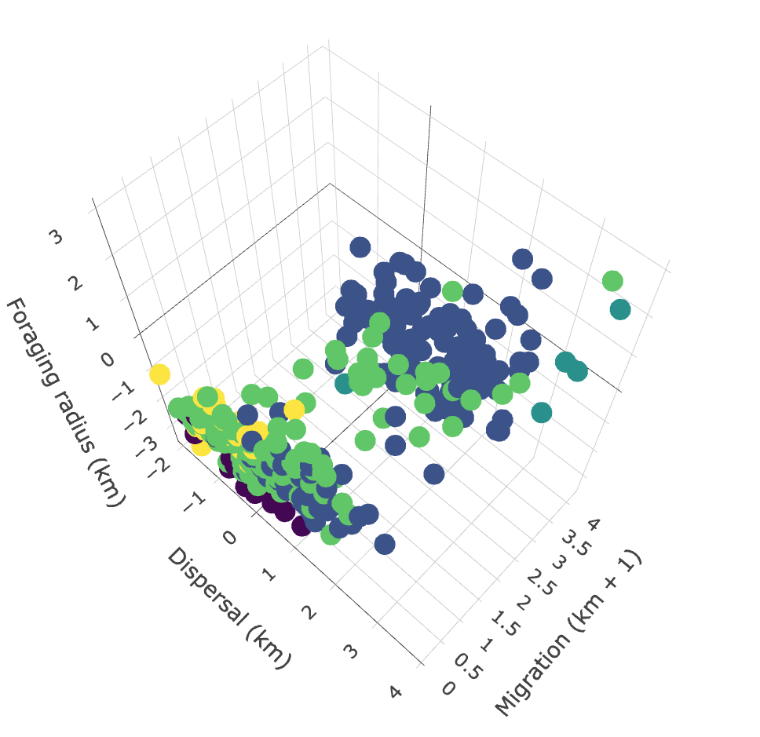
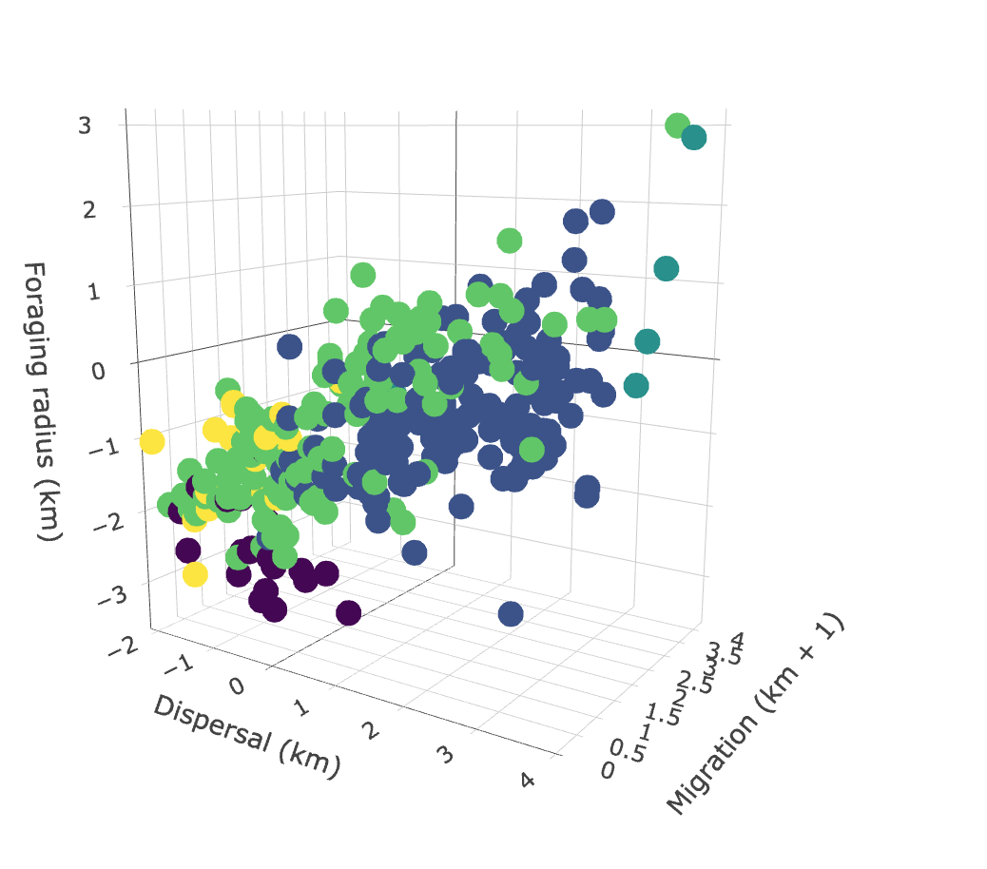
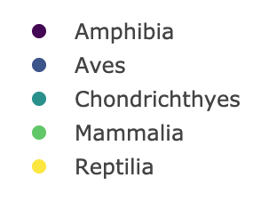
a
b
c
 | Foraging | Dispersal | Migration
Mass | 0.978 | 0.651 | 0.03
Foraging | - | 0.651 | 0.561
Dispersal | - | - | 0.769

