Slide 1
OBD Bluetooth Interface and Android App
Team Members:
Patrick Landis (pal25) - Hardware
Schuyler Thompson (sdt16) – Software
Adviser:
Swarup Bhunia, PhD.
Page 1/4

Slide 2
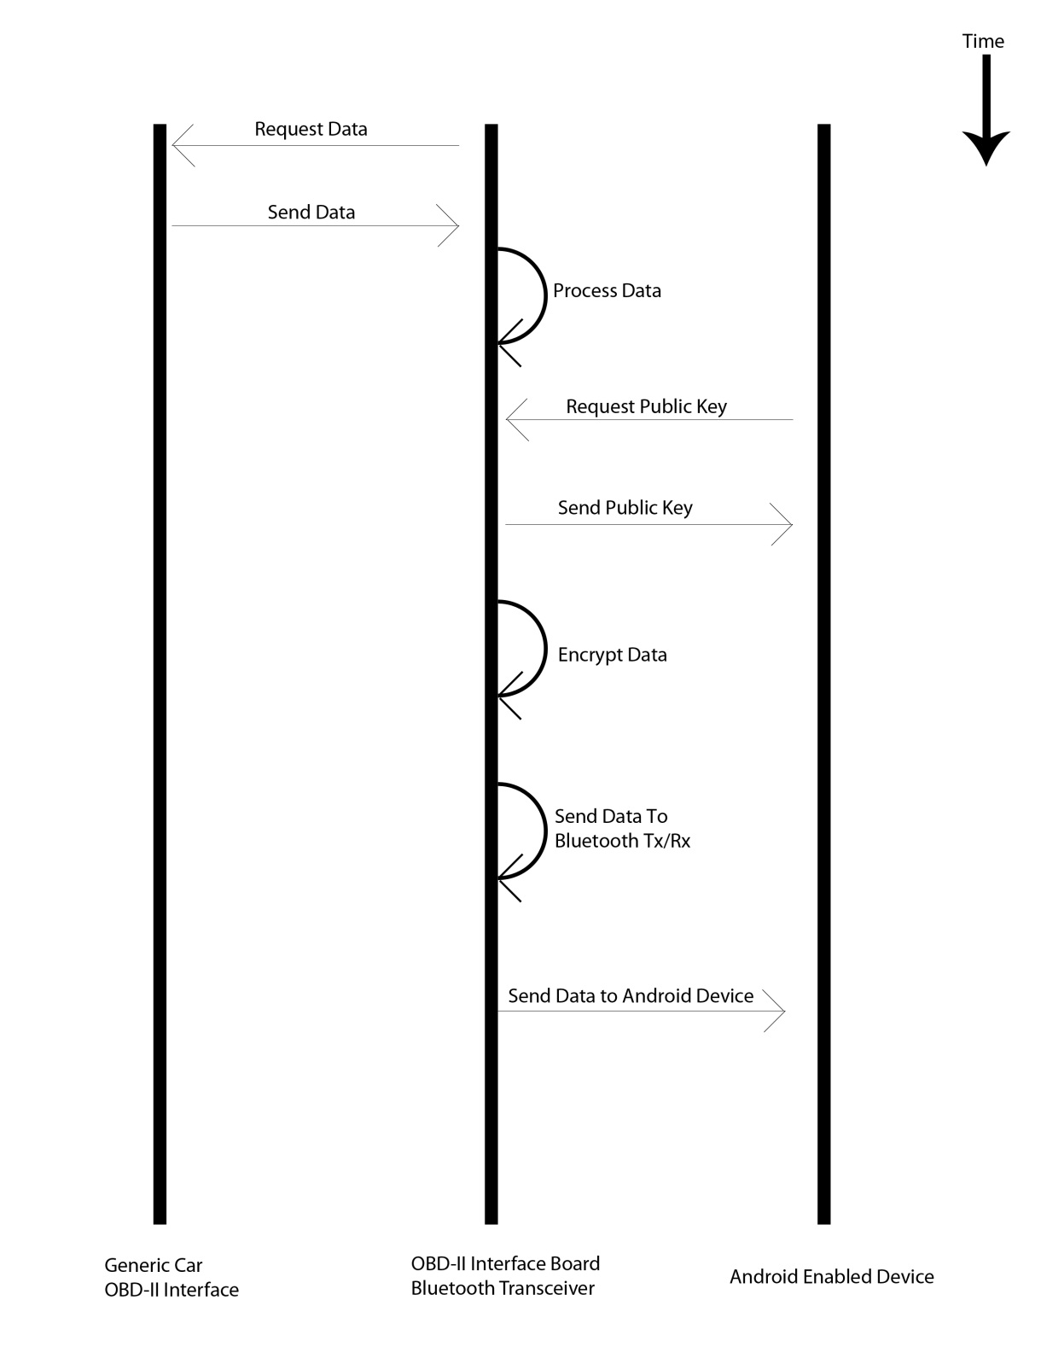
Overview
2/4
Just as a reminder…

Slide 3
Validation
3/4
Bench-top testing for circuit components, initially
Migrate to in-car testing after bench-top testing
Tests need to cover regulators, signals, and general functionality
Outlined explicitly in the project specification document
Test code (for app and MCU) with unit tests and/or integrating tests when appropriate
Outlined explicitly in the project specification document

Slide 4
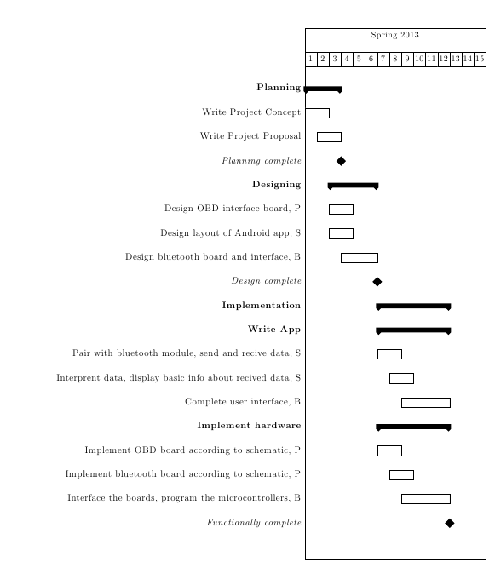
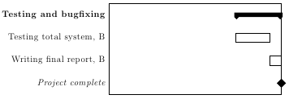
Management (High Level Tasks)
4/4

Slide 5
Fin

Slide 6
Project Overview
2/6
Project involves reading OBD-II messages from vehicles
Once data is read, send it to a MCU which controls a Bluetooth TxRx.
Transmit data *securely* over Bluetooth to Android supported devices.
Profit!

Slide 7
OBD-II Interface
4/6
Will need to read OBD-II messages
Will need to be powered off of cars OBD-II port
Send data to MCU upon request
Undecided on protocol… UART? SPI?
Will need to support a few message protocols
SAE J1850, SAE J2411, SAE J2284, ISO 15765-2, ISO 914102, ISO 14230-4

Slide 8
Android Application
5/6
The app will be able to display all of the basic messages from the diagnostic part of OBD.
This includes the fault codes, monitor readiness, and whether the malfunction indicator light (MIL) is on or off.

Slide 9
Android App (cont.)
The app will contain the database of all of the standard fault codes and their meanings for easy lookup.
The monitor readiness is indicating whether the all of the monitors used by the OBD system are ready to make a reading. They are reset when the OBD system is reset, and if the monitors are set to not ready, the car will fail any emissions check performed by a DMV.

Slide 10
Bluetooth TxRx
6/6
Will need to take care of securing wireless communications
Shared key will be stored on the MCU
Will need to be powered off cars OBD-II interface
Will need to communicate with MCU
Will need to be able to pass messages to/from Android devices

