Slide 1
Project Oral Status Report II Bluetooth OBD Interface
Schuyler Thompson (sdt16)
Patrick Landis (pal25)

Slide 2
Project Description
OBD-II interface
Send data over bluetooth
Read data in Android App

Slide 3
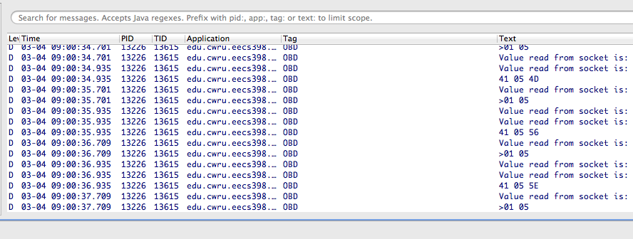
App progress

Slide 4
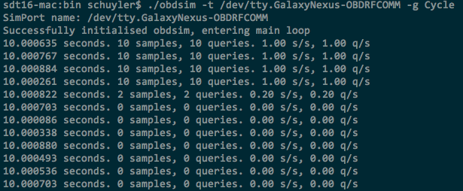
App Progress

Slide 5
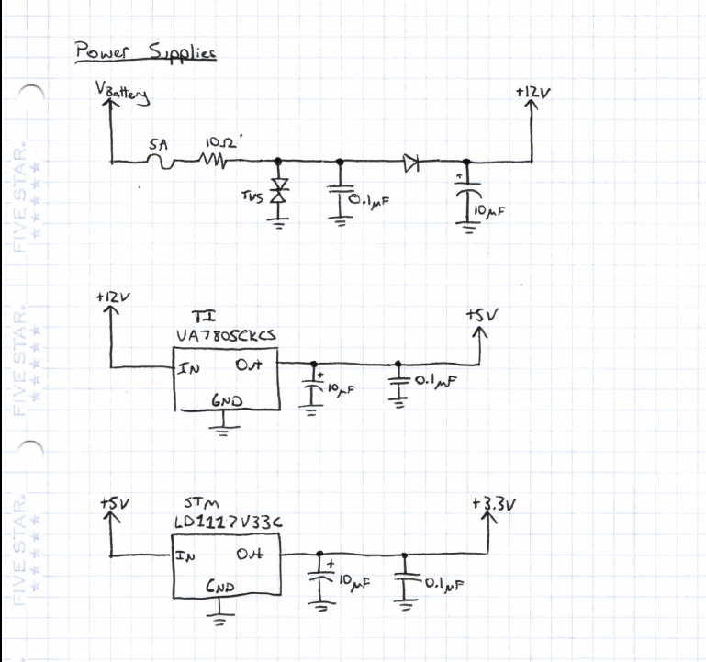
Circuit Diagrams

Slide 6
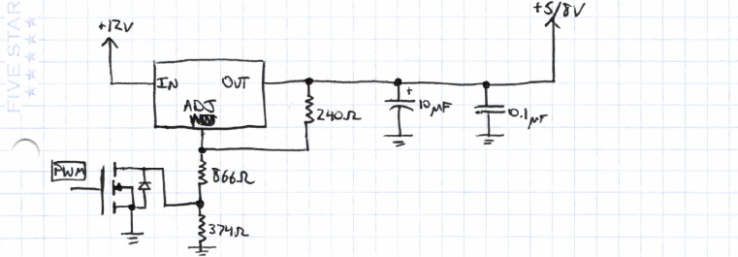
Circuit Diagrams

Slide 7
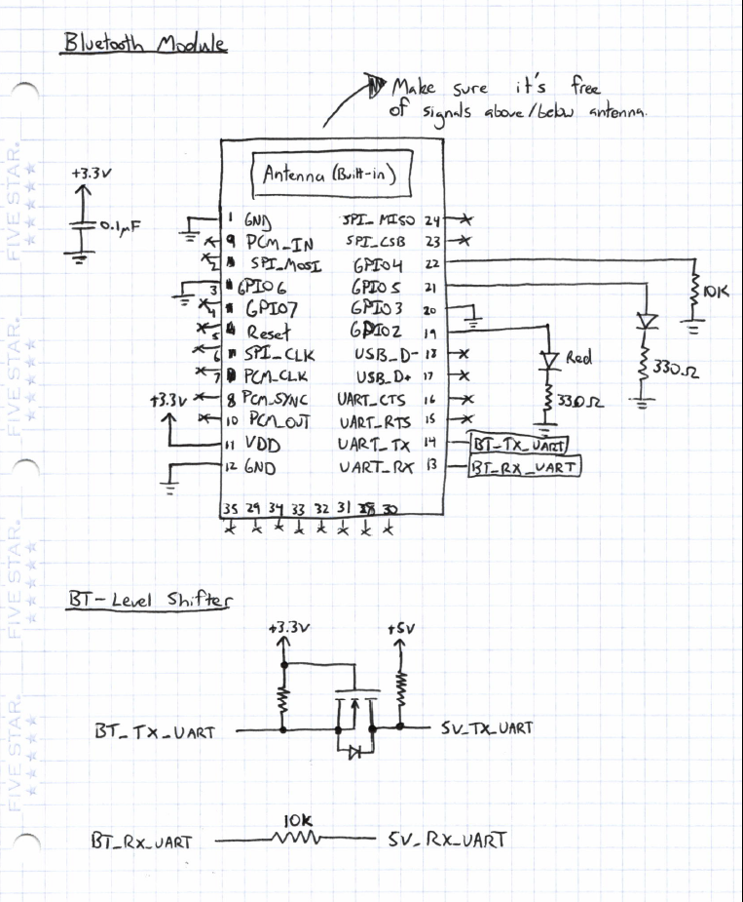
Circuit Diagrams

Slide 8
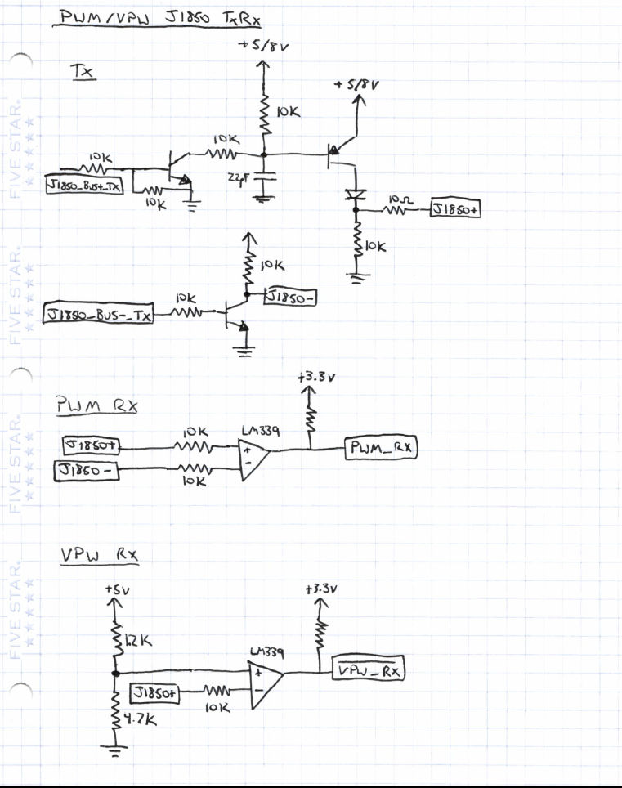
Circuit Diagrams

Slide 9
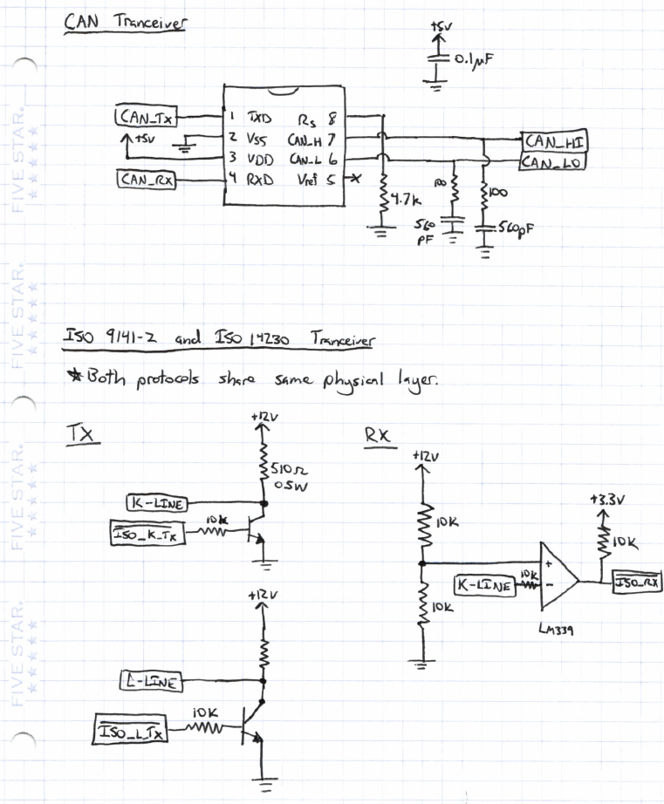
Circuit Diagrams

Slide 10
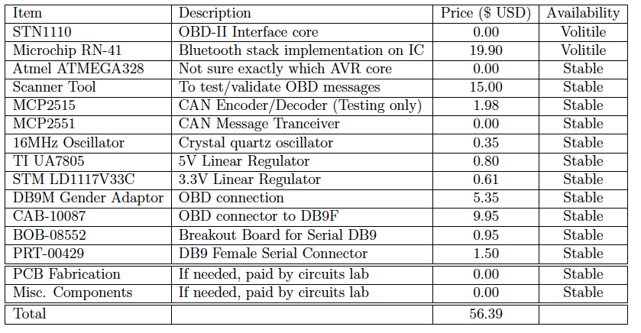
Updated Budget

Slide 11
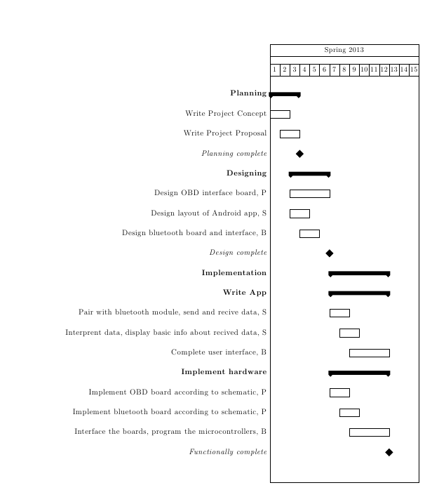
Project Schedule

