Slide 1
Public Opinions on Russia-Ukraine War
A Sentiment Analysis on Tweet and Reddit Posts
Group 14

Slide 2
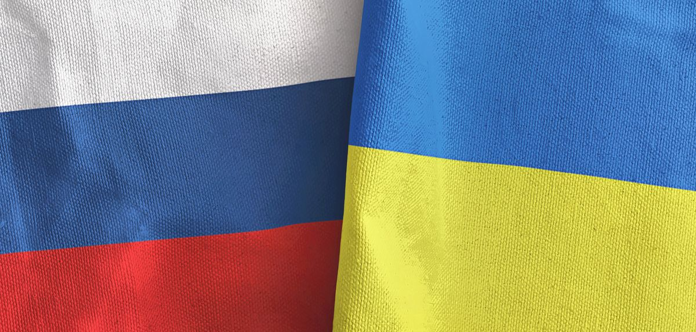
Introduction
In Feb. 2022, Russia Launched full-scale invasion of Ukraine.
Both governments have their own stories
Purpose of project:
Capture public opinions
Recommendations to improve Ukraine’s image
Free Ukraine from Western Influence
Invasion is unjustified and violates human rights
University of Oxford

Slide 3


Data Sources
Tweets
from Apr. to Nov. 2022
Around 11000 entries
Reddit Comments
872 entries
Notes:
To analyze the public opinion on the war, we gathered data from two social medias. First, we extracted around 11 thousands entries about the war from Twitter, which covers the tweets from April to November of 2022. Second, we obtained 872 comments under Ukraine conflicts tag from Reddit.

Slide 4
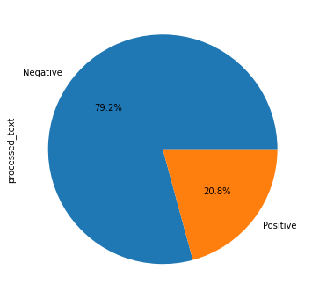
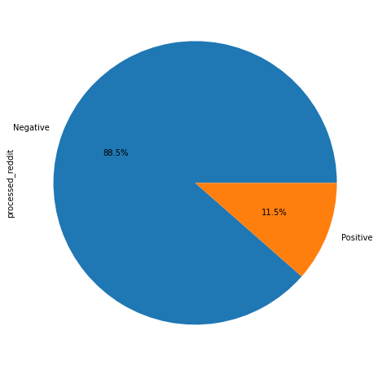
Sentiment Classification
Notes:
These data are analyzed with a pretrained classifier to discuss the people’s emotions and opinions. As shown in the pie charts, the preliminary analysis results from the two datasets showcases that the percentage of positives opinion is significantly smaller than the percentage of negative opinion. This demonstrates how the general public tends to view war negatively.

Slide 5
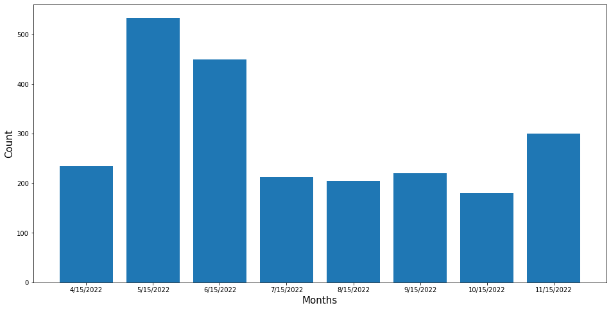
Time Variation of Sentiments
Count of positive opinions is decreasing……
Notes:
Given 8 months Twitter data, timeline analysis is performed to illustrate the changes in emotion as the war progresses. As this bar chart shows, the positive posts are decreasing as time continues, which means people are becoming more negative towards the war.

Slide 6
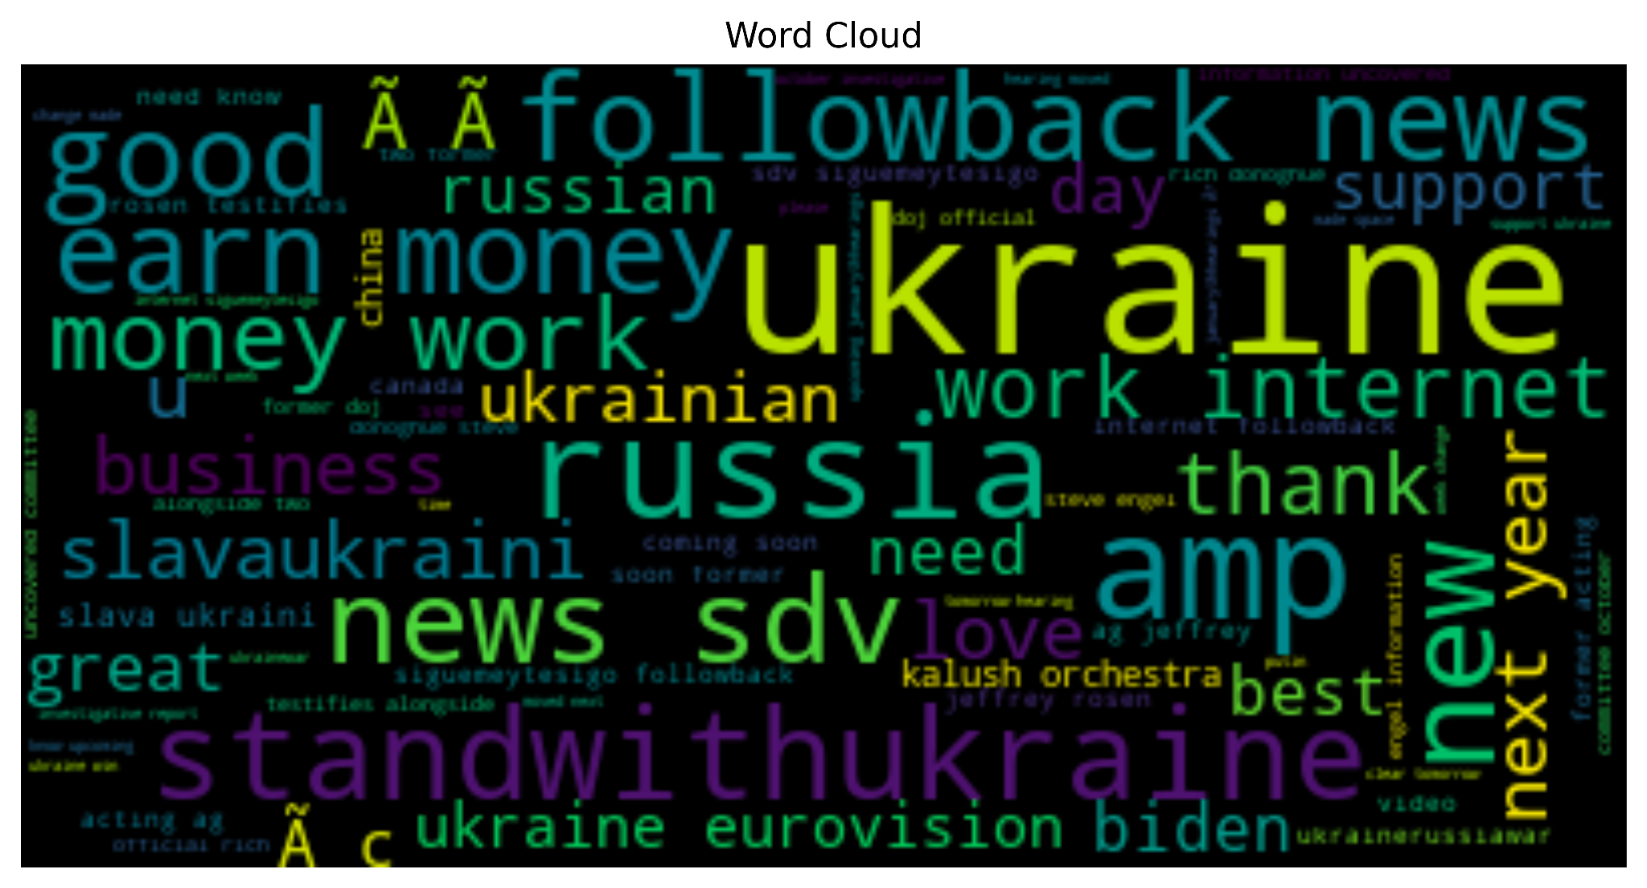
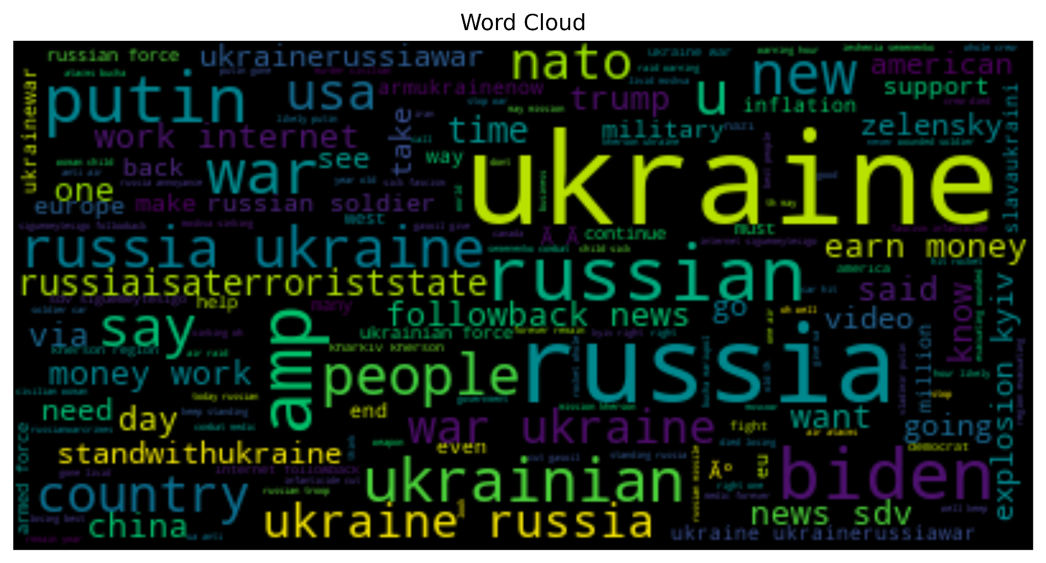
Word Clouds
Word Cloud for Positive Opinion
Word Cloud for Negative Opinion
Notes:
For the Twitter data, we generated 2 word clouds that are showing positive opinions and negative opinions.

Slide 7
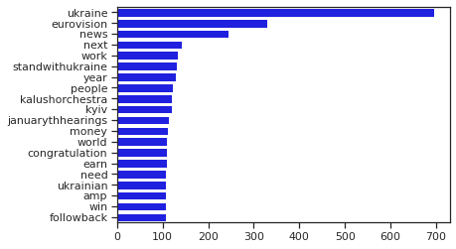
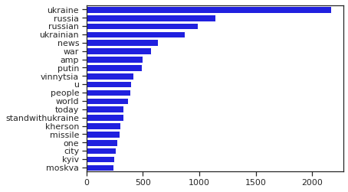
Frequent Words from Tweets
Positive (Earlier)
Negative (Earlier)
Notes:
Using the twitter data, our team also created these bar charts to demonstrate the frequent words from the tweet that were classified as positive sentiment or negative sentiment. The two charts here show the results from the first 4 months since the start of the war. For obvious reasons words related to Ukraine such as “ukraine” or “ukrainian” showed up on both positive and negative sentiments as it is the focus of the war. One particular thing to notice is that Russian related words such as “Russia”, “Russian” and “Putin” are more associated with negative sentiments.

Slide 8
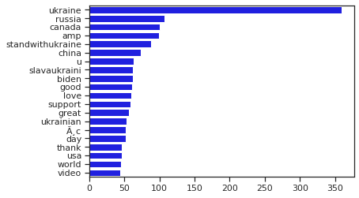
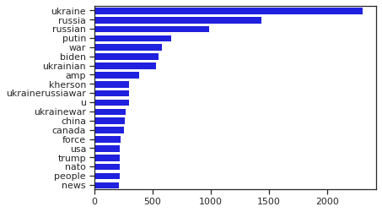
Frequent Words from Tweets
Positive (Later)
Negative (Later)
Notes:
The two charts here show the results from the last 4 months since the start of the war. One particular thing to notice is that Russian related words such as “Russia”, “Russian” and “Putin” are more associated with negative sentiments. Additionally, some words related to American politics such as “biden”, “democrats”, and “trump” are also found in the data with high frequencies.

Slide 9
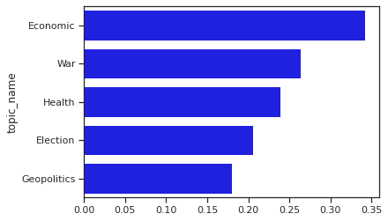
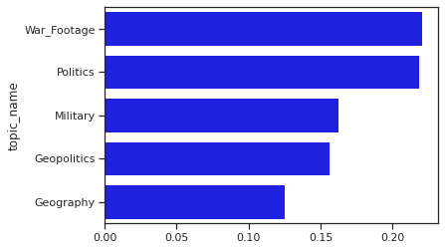
Sentiment
-Driving Topics
Notes:
From the analysis we summarized the main topics which are driving the sentiments. The most dominant one on the twitter data was economic factors. From our analysis it would seem that initially people around world cared more about the economic impact of the war instead of the well-being of the Ukrainian people. As the war progresses and more war related footages start surfacing online, people’s discussions are shifted more towards the actual war and the damage it has done to the people. More importantly, in both datasets, politics remains one of the most dominant factors for the online discussions.

Slide 10
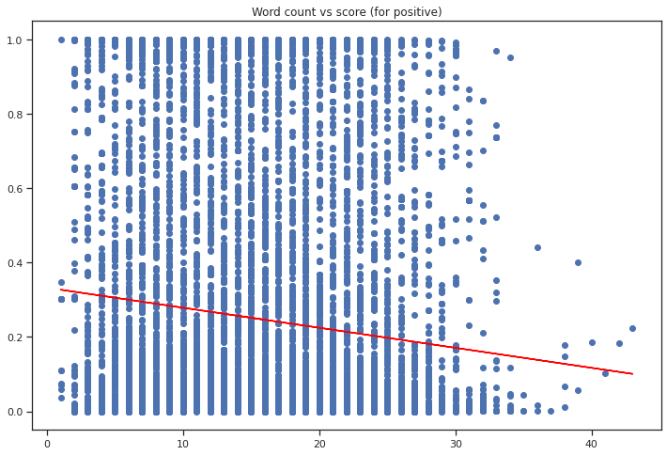
Word Counts vs.
Sentiment
Notes:
Additionally, we also created a model to see whether the length of the posts affected the sentiments. The result here shows that shorter posts are correlated towards a more positive sentiment.

Slide 11
Findings
The public shows more negative opinions on the war.
The negativity grows with time.
Ukraine is strongly related to non-neutral sentiment.
Russia is relatively closer to negative sentiment.
At earlier stage, public opinions on Putin was strongly negative but has become mixed later.
Shorter texts drive more positive sentiment.

Slide 12
Suggestions
In public speaking/writing, use Ukraine-related positive terms to provoke a positive public feeling
E.g., ‘stand with Ukraine’, ’support’, ’Eurovision’,’ slava ukrani’
Focus the efforts in the most sentiment-driving topics for efficiency
E.g., Health, War Footage, Economics
Investigate how Putin’s image has improved over time and deploy some counters
E.g., exposure and criticism of his propaganda
Short sentences for positive sentiment and longer sentences for a negative sentiment.

Slide 13
The End
Thank you for listening!
Questions?

